Slide 1


iagnosis-driven SL iolation D tection
2021
D
O
V
E
Yiran Lei, Yu Zhou, Yunsenxiao Lin, Mingwei Xu, Yangyang Wang
Tsinghua University
Notes:
Hello everyone! I am Yiran Lei from Tsinghua University.
Today, I am about to introduce my research work, DOVE: Diagnosis-driven SLO Violation Detection, to you.

Slide 2

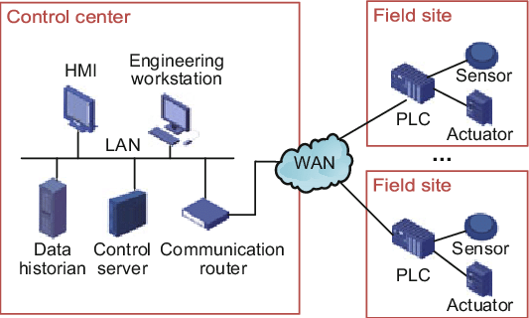
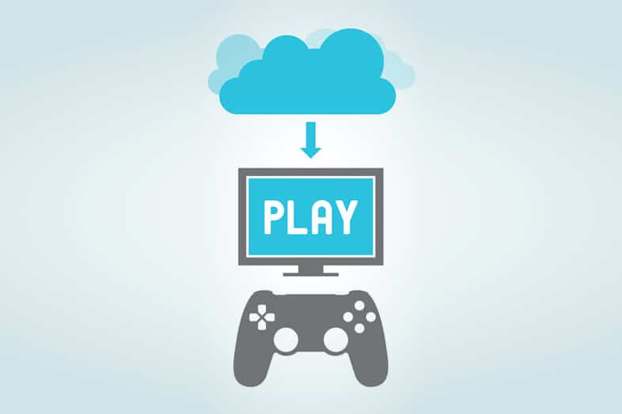
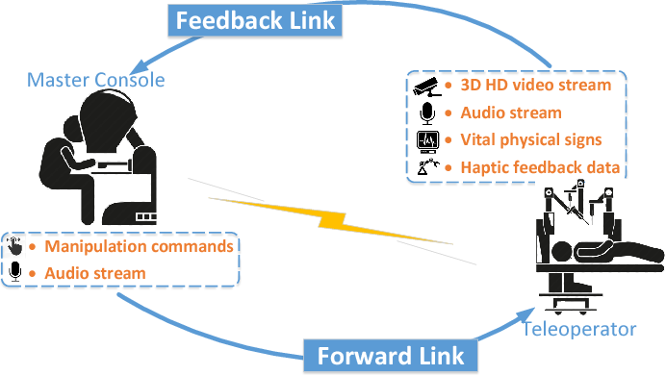

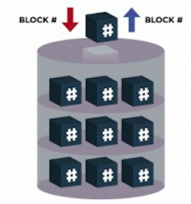

SLO Maintenance is Important
Algorithmic Stock Trading
Cloud Gaming
Industrial Control System
✓ constantly low latency
✓ constantly low latency and packet loss
Telesurgery
Video Conference
Block Storage Service
VR Video Streaming
✓ constantly low latency and packet loss, and high throughput
✓ high throughput and low packet loss
Notes:
As network develops, internet applications are having more and more strict service-level-objectives (or SLO for short) over reachability, packet loss, latency, and bandwidth. Today, SLO maintenance is gaining increasing importance.
Let me show you a few examples here.
Algorithmic Stock Trading and Clouding Gaming require constantly low latency to make full use of every financial opportunities in the market and have good playing experiences respectively.
Along with latency requirement, Industrial Control System has more requirements on packet loss to never lose controls.
Telesurgery and Video Conferencing have further throughput requirements to offer clear videos and audios.
Block Storage Service and VR Video Streaming require high throughput and low packet loss to ensure high performance and good watching experiences.

Slide 3
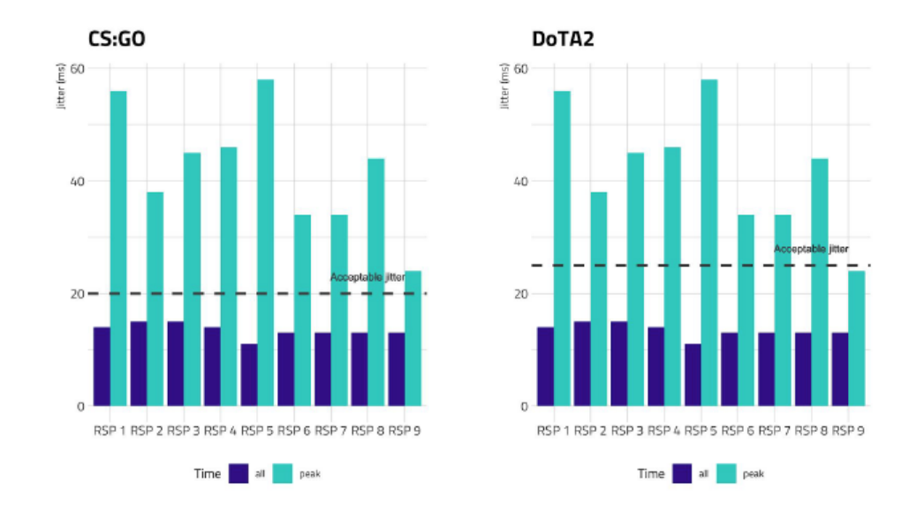
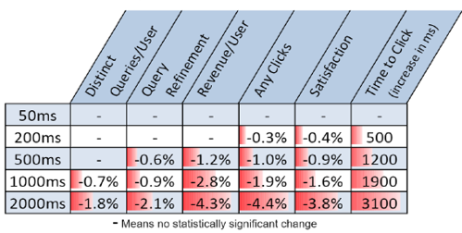
SLO Violation is Common and Destructive
Latency SLO violation causes monetary damages from Google and Bing
Latency SLO violation is common at busy time when playing games from Australian ISPs
Amazon lost $66,240/ minute on 2013.8.19 due to a blackout
40-80 machines suffer from packet loss in DCN per year
Katz-Bassett discovered reachability problems involving about 10,000 distinct prefixes during 3 weeks
Tens of Internet outages from https://www.thousandeyes.com/outages/ in last 24 hours
Notes:
However, at the same time, SLO violation is common and destructive. SLO violations may degrade user experiences, cause monetary damage, pose security or function issues.
For example,
Google and Bing’s report indicates that extra web visiting delay directly leads to revenue reduction.
A survey shows the Internet services from nine Australian ISPs have severe latency jitters at busy time, which is unacceptable for many games.
Amazon lost a lot of money out of a blackout accident.
Another survey shows that in many data center networks, there are around 40 to 80 machines suffering from severe packet loss every year.
Even at the moment, there are many IP prefixes having reachability problems.

Slide 4


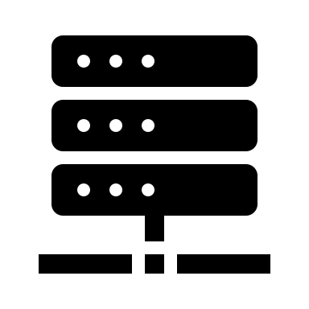
Fast Mitigation upon SLO Violation
detection
diagnosis
troubleshooting
flow A
flow B
delay of flow A exceeds 120ms
delay SLO is violated
traffic of flow B bursts
flow A’s SLO violation is due to flow B’s burst
a server is sending large flow B
the server is misconfigured
fix and mitigate violation
discover SLO violation:
measure performance
compare with objectives
analyze causality of SLO violation:
find flow-level causes
repair hardware and software
…
Notes:
In order to reduce the damage brought by SLO violation, there are urgent needs to fast mitigate the network problems.
Fast mitigation requires three steps.
The first step is detection. Detection measures network performance at real time and compares the real performance with the expectations, i.e., objectives. When the network fails to meet the objectives, it should report to and notify the network operators.
The second step is diagnosis. Diagnosis analyzes the causality of the SLO violations. In many cases, flow-level causal information is extremely helpful.
The last step is troubleshooting. With flow-level causal information, network operators can do corresponding actions, e.g., reset firewalls, and reboot hardware, to mitigate the problems.
The detection and diagnosis are the key steps of all. Fine-grained and accurate detection gives network operators clear visibility into network performance. When bad things happen, detection makes operators know about them immediately. Diagnosis finds out the responsible culprit flows. When bad things happen, diagnosis makes operators know who-to-blame to solve the problems.

Slide 5
Problems of Existing Solutions
Detection Tools
Existing Solutions | Property |  |  |  |  | SLO Type
 | granularity | lags | overhead | control plane involvement | end-host involvement | packet loss | percentile delay | max delay
ping | coarse | low | low | ✕ | ✓ | ✓ | ✓ | ✓
Netflow | coarse | high | low | ✕ | ✕ | ✕ | ✕ | ✕
SNMP | coarse | high | low | ✕ | ✕ | ✕ | ✕ | ✕
NetSight | fine | low | high | ✓ | ✕ | ✓ | ✓ | ✓
SwitchPointer | fine | low | low | ✕ | ✓ | ✕ | ✕ | ✕
TPP | fine | low | high | ✕ | ✓ | ✓ | ✓ | ✓
LossRadar | fine | high | low | ✓ | ✕ | ✓ | ✕ | ✕
INTSight | fine | low | low | ✓ | ✕ | ✕ | ✕ | ✓
??? | fine | low | low | ✕ | ✕ | ✓ | ✓ | ✓
Notes:
Unfortunately, existing detection and diagnosis solutions have several drawbacks. Let’s first take a look at detection tools.
Traditional active and passive tools, e.g., ping, Netflow, SNMP, work at coarse timescale, which is at second even minute level. It can not detect microbursts and provide fine-grained information.
Packet mirroring techniques, e.g, NetSight, send packet information from the switches to the control plane. It collects exhaustive information and can verify SLO on the control plane. However, the traffic overhead of NetSight is large and it faces scalability issues.
End-host involved techniques, e.g., SwitchPointer, TPP, need to modify the network stacks of the end hosts, which is impractical in real network settings.
LossRadar and INTSight can only test certain types of SLO. And they rely on control plane’s computation capability to function, which introduces extra lags.
Therefore, we need a new detection tool, which detects at fine-grained timescale, gets rid of the control plane and end-host to reduce lags, generates small traffic overhead, and monitors multiple SLOs.

Slide 6
Problems of Existing Solutions
NetSight
but too much overhead !!!
Diagnosis Tools
Dapper
DTaP
Provenance
Zeno
✓
exhaustive flow-level queue information at arbitrary time
Causality of SLO Violation
✕
NetFlow
SwitchPointer
LossRadar
…
how existing diagnosis tools work
SLO violation of flow E is mainly due to flow B
flow A B C D E
switch queue
Notes:
Existing diagnosis tools, e.g., Dapper, DTaP and Provenance, can link events to its direct causes.
In the network settings, in most cases, high queue occupancy is the direct causes of SLO violations. Exhaustive flow-level queue information at arbitrary time is needed to let the tools work. NetSight can provide such information but it generates too much overhead. Other detection tools cannot provide such fine-grained queue information. Therefore, we are facing a dilemma where there is no feasible diagnosis solutions to explain SLO violations.

Slide 7
DOVE: Diagnosis-driven SLO Violation Detection
Detection |  |  |  |  |  |  |  | Diagnosis
Property |  |  |  |  | SLO Type |  |  | ✓
granularity | lags | overhead | control plane involvement | end-host involvement | packet loss | percentile delay | max delay
fine | low | low | ✕ | ✕ | ✓ | ✓ | ✓
Notes:
Therefore, we bring you DOVE to
1) measure multiple service-level-objectives at fine-grained timescale with low lags and overhead.
2) collect causal information and diagnose the SLO violations.

Slide 8
Specific Flows
resource constraints of the data plane
detection does not rely on the control plane
accurate SLO verification
high diagnosis accuracy:
gather more causal information
detection
diagnosis
selected flows
watched flows
partial set of flows instead of the complete set of flows
﻿empirical and set by network operators
a wider set of flows, even the complete set of flows
ONLY data plane resources & logics
data plane logics & resources
sketches
Sonata
…
Notes:
Let’s look at some core concepts of DOVE. Different from generalized processors such as CPU, the computation resources of the programmable data plane are extremely constrained.
Detection requires high SLO verification accuracy without introducing the computation ability of the control plane.
Hence for detection, DOVE only monitors partial set of flows, i.e., VIP flows and measures their SLOs. Detection is completely based on data plane resources and logics.
We call the set of flows the selected flows.
Diagnosis requires gathering more causal information to have more accurate violation explanations, which means watching more flows to find out potential bad ones. Hence for diagnosis, DOVE gathers causal information from a wider set of flows called the watched flows.
The watched flows can use sketches to monitor the complete set of flows or use Sonata for periodic updates.
The watched flows and selected flows are not necessarily the same. They are empirical and set by network operators.

Slide 9
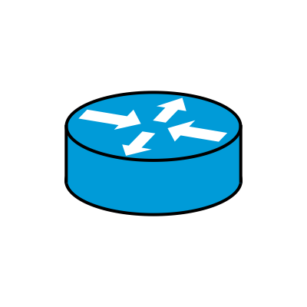




Epoch and Segmentation
continuous time
adjacent epochs (hundreds of microseconds)
$$e_{1}$$
$$e_{2}$$
$$e_{3}$$
…
$$e_{N}$$
t
flow path
segments
upstream switch
down/up-stream switch
downstream switch
P4 Switch Architecture
Ingress MAC Ports
Ingress Match-Action Pipeline
Queuing & Buffer
Egress Match-Action Pipeline
Egress MAC ports
…
Ingress Match-Action Pipeline
…
…
Ingress Match-Action Pipeline
…
segment1
segment2
upstream and downstream switches $≠$ neighbor switches
partial and incremental deployment
Ingress Pipeline
segment
Ingress Pipeline
DOVE measures SLOs on each segment during each epoch
Notes:
Next, we look at epoch and segmentation.
DOVE splits continuous time into a series of adjacent epochs. The length of epoch is identical and configurable.
DOVE splits flow path into segments. The life cycle of a packet going through a programmable switch includes ingress mac ports, ingress match-action pipeline, queuing, egress match-action pipeline and egress mac ports. A segment is from the ingress match-action pipeline of the upstream switch to the ingress match-action pipeline of the downstream switch.
A physical switch can be a downstream and upstream switch at the same time for adjacent segments. Upstream and downstream switches do not have to be neighbor switches, which makes DOVE support partial and incremental deployment.
Note that for every selected flow, DOVE measures its SLO on each segment during each epoch.

Slide 10


DOVE’s Architecture
SLO violation of flow A is due to flow C
causality
DOVE-enabled switch
Analyzer
SLO Violation Analyzer
Control Plane
Data Plane
SLO Violation Detector
Suspicious Flow Behavior Monitor
link
DOVE-enabled switch s1
s2
s3
selected flows
watched flows
packet
alert
event
packet with DOVE telemetry header
configuration
The packet loss SLO of flow A on segment 12 during epoch 3 is violated
Flow C is a heavy hitter during epoch 3 at switch s2
DOVE uses telemetry headers to pass information and carry control signals
Epoch length is 200us
SLO: packet loss of flow A on segment 12 should not exceed 5%
Notes:
Let’s look at DOVE’s architecture and how it works.
DOVE consists of three components. On the data plane, SLO Violation Detector verifies the SLOs of the selected flows. It generates alerts and reports them to the control plane at the end of current epoch if SLOs are violated. Suspicious Flow Behavior Monitor checks the flow behaviors to find bad flows out of the watched flows. It generates events and reports them to the control plane if any suspicious flows are found.
On the control plane, SLO Violation Analyzer passively collects all the alerts and events. It uses events to explain the causes of SLO violations.
In the network view, the first DOVE-enabled switch inserts telemetry headers into the packets of the selected flows. When these packets leave the network, the exit switch removes the headers. The analyzer also distributes epoch-wise and segment-wise SLO values within the configuration files to the switches. The SLO values are installed as thresholds. Switches collect and compute real network performance and compare it with the thresholds to decide whether to generate alerts or events.

Slide 11









SLO Violation Detector
Measure Real Performance
Satisfy SLO?
no
Report Alert
yes
Packet Loss
Coloring Algorithm: the number of lost packet
completely on the data plane
① upstream switch dyes packets red or green
carries the value of
carries the value of
④ upstream switch clears control bit for the first half of epoch and sets the bit for the second
$$e_{1}$$
$$e_{2}$$
$$e_{3}$$
② switch’s red/green counter records
carries control bit = 0
$$t∈[0, e/2):$$
upstream ++ when switch sends
$$t∈[e/2, e):$$
carries control bit = 1
upstream ++ when switch sends
resets
resets
downstream ++ when switch receives
⑤ downstream switch stores upstream counter value and calculates packet loss upon first set control bit
downstream ++ when switch receives
stores the value of
stores the value of
③ upstream switch copies the counter value of previous epoch into the DOVE telemetry header
control bit = 1:
PL = - resets
PL = - resets
Notes:
Let’s look into SLO Violation Detector to see its mechanism to verify SLOs.
First, DOVE measures packet loss using Coloring Algorithm, which completely runs on the data plane
Upstream switch dyes packets red or green in turns. The packets of the same epoch are dyed the same color. This is done by setting the color bit in the telemetry header.
Switch’s red or green counter increments when it sends or receives a packet in the corresponding color.
Upstream switch copies the counter value of the previous epoch into the telemetry header. Red packets carry the number of green packets while green packets carry the number of red packets.
Upstream switch clears the control bit for the first half of the epoch and sets the bit for the second. At the beginning of the second half, upstream switch resets the counter of previous epoch to prepare for the next epoch.
For the first half the epoch, downstream switch stores the number of sent packets carried in headers. When first seeing the set control bit, it calculates packet loss by subtracting the number of received packets from the stored number. Then it resets downstream counter of the previous epoch.
Coloring Algorithm is resilient to packets’ out-of-order and loss, because it waits for half of the epoch to get the number of sent packets.

Slide 12
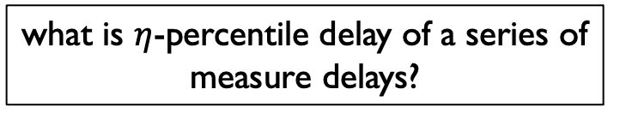
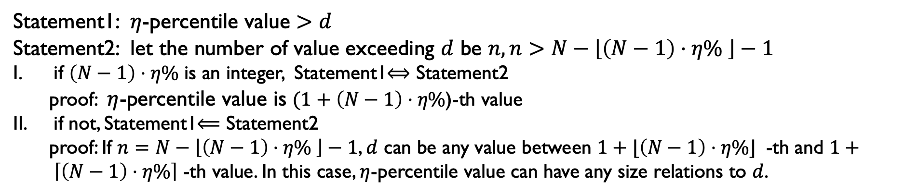
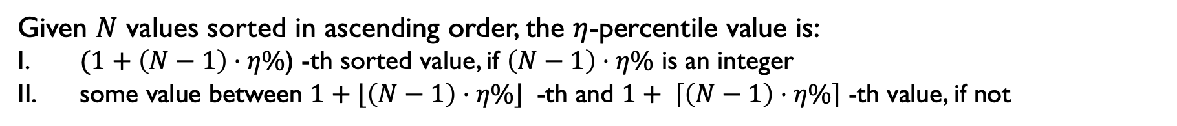
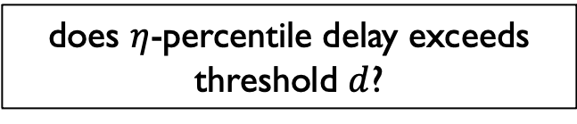
SLO Violation Detector
Percentile Delay
approximation algorithm
on the data plane
difficult
measure flow-level percentile delay
verify SLO of percentile delay
feasible
what is $η$-percentile delay of a series of measure delays?
does $η$-percentile delay exceeds threshold $d$?
Given $N$ values sorted in ascending order, the $η$-percentile value is:
$(1+\left(N−1\right)⋅η\%$) -th sorted value, if ﻿$\left(N−1\right)⋅η\%$ is an integer
some value between $1+⌊\left(N−1\right)⋅η\%⌋$ -th and $1+ \left\lceil \left(N−1\right)⋅η\%\right\rceil$ -th value, if not
Statement1: $η$-percentile value $>d$
Statement2: let the number of value exceeding $d$ be $n, n>N−\left\lfloor \left(N−1\right)⋅η\% \right\rfloor −1$
if ﻿$\left(N−1\right)⋅η\%$ is an integer, Statement1$⟺$ Statement2
proof: $η$-percentile value is $(1+\left(N−1\right)⋅η\%$)-th value
if not, Statement1$⟸$ Statement2
proof: If $n=N−\left\lfloor \left(N−1\right)⋅η\% \right\rfloor −1$, $d$ can be any value between $1+⌊\left(N−1\right)⋅η\%⌋$ -th and $1+ \left\lceil \left(N−1\right)⋅η\%\right\rceil$ -th value. In this case, $η$-percentile value can have any size relations to $d$.
Notes:
Next, DOVE measures percentile delay using an approximation algorithm.
It is difficult to measure flow-level percentile delay on the data plane. However, instead of answering what is the eta-percentile delay, we only need to answer a yes/no question: does eta-percentile delay exceeds a certain threshold?
Let’s see how to answer this question.
[Given N values sorted in ascending order, the eta-percentile value is:
(one plus left bracket N minus one right bracket times eta percent)-th value, if (eta percent times bracket N minus 1) is an integer
Some value between (one plus left floor N minus one times eta percent right floor)-th and (one plus left cell N minus one times eta percent right cell)-th value, if that number is not integer
Bearing this in mind, let’s see two statements:]
Statement1: eta percentile value is larger than d
Statement2: let the number of value exceeding d be n, n is larger than (N minus left floor N minus one times eta percent) right floor minus one.
Statement 1 and 2 are equivalent if (N minus one times eta percent) is an integer
They are not equivalent, if that number is not integer. In this case, if statement 1 is true, statement 2 can be false, whose n is (N minus left floor N minus one times eta percent right floor minus one). However, considering it is rare that n happens to be that number, we can treat two statements equivalent.

Slide 13
SLO Violation Detector
Percentile Delay
Statement1: $η$-percentile value $>d$
Statement2: let the number of value exceeding $d$ be $n, n>N−\left\lfloor \left(N−1\right)⋅η\% \right\rfloor −1$
Statement1$\underset{⇔}{approximation}$ Statement2:
calculate $N−\left\lfloor \left(N−1\right)⋅η\% \right\rfloor$ from control plane and populate it as a threshold to the data plane
Max Delay
compares the new measured delay with history delays and stores the bigger one
Suspicious Flow Behavior Monitor
Suspicious Behavior?
yes
Monitor Flow Behavior
Report Event
no
Unlike SLO measuring, the monitor checks flow behaviors on each DOVE switch during each epoch
Notes:
Here is the interesting part: we can then simply count the number of delays exceeding d, and compare the number with a threshold installed from the control plane.
At last, SLO Violation Detector measures maximum delay of the current epoch.
Next, we look into Suspicious Flow Behavior Monitor to see how it gathers causal information. Unlike SLO measuring, the monitor checks flow behaviors on each DOVE switch (instead of on each segment) during each epoch.

Slide 14
Suspicious Flow Behavior Monitor
what contributes to SLO violations ?
high queue occupancy
high delay
inter- and intra-switch loop
…
the most common one
SLO Violation Causes
queue-related cause
queue overflow
link corruption and failure
high packet loss
software bugs
flows contributing much to queue occupancy
…
Heavy Hitter:
monitor flows with large traffic
Heavy Changer:
monitor flows whose traffic increases rapidly
monitor newly-established flows
Notes:
Let’s first ask what contributes to SLO violations?
The causes are various. High queue occupancy, inter and intra switch loop, etc can lead to high delay. Queue overflow, link corruption and failure, and software bugs can cause high packet loss. Among all the causes, the most common one is the queue-related cause, ﻿ because the hardware, software, and configurations are relatively fixed compared with dynamic network conditions.
Therefore, the monitor finds out the flows contributing much to the queue occupancy as the potential causes. The monitor finds:
heavy hitters, which are flows with large traffic.
heavy changers, which are newly-established flows, or whose traffic increases rapidly. ﻿Although the absolute flow rate may not be large, several heavy changers may break the balance and cause congestions at switches.

Slide 15
SLO Violation Analyzer
principle:
location adjacency: flows sharing same queues
epoch adjacency: flows having close epochs
correlate the alert to:
high queue occupancy at upstream switch:
events from alert’s upstream switch
events sharing same egress port with the alert
events happen just before alerts
any heavy hitters or heavy changers
high queue occupancy at the previous switch
of the downstream switch:
events from alert’s downstream switch
events sharing same ingress port with the alert
events happen just before alerts
any heavy hitters and heavy changers
alert
flow ID
upstream switch id
egress port
downstream switch id
ingress port
if violate max delay SLO
if violate percentile delay SLO
if violate packet loss SLO
epoch
event
flow ID
switch id
ingress port
egress port
if heavy hitter
if heavy changer
epoch
Notes:
The last component is SLO Violation Analyzer. Having collected alerts and events, the analyzer has to link certain events to the alert.
There are two principles about the correlation.
Location adjacency. Heavy hitters and changers need to share the same queues with the selected flows whose SLOs are violated.
Epoch adjacency. The epochs of heavy hitters and changers should be close to those of the selected flows.
Based on the principle, alert can be correlated to:
high queue occupancy at the upstream switch. The events are from alert’s upstream switch sharing the same egress port with the alert. And the events’epochs are just before that of the alert.
high queue occupancy at the previous switch of the downstream switch. The events are from alert’s downstream switch sharing the same ingress port with the alert. And the events’epochs are just before that of the alert.

Slide 16
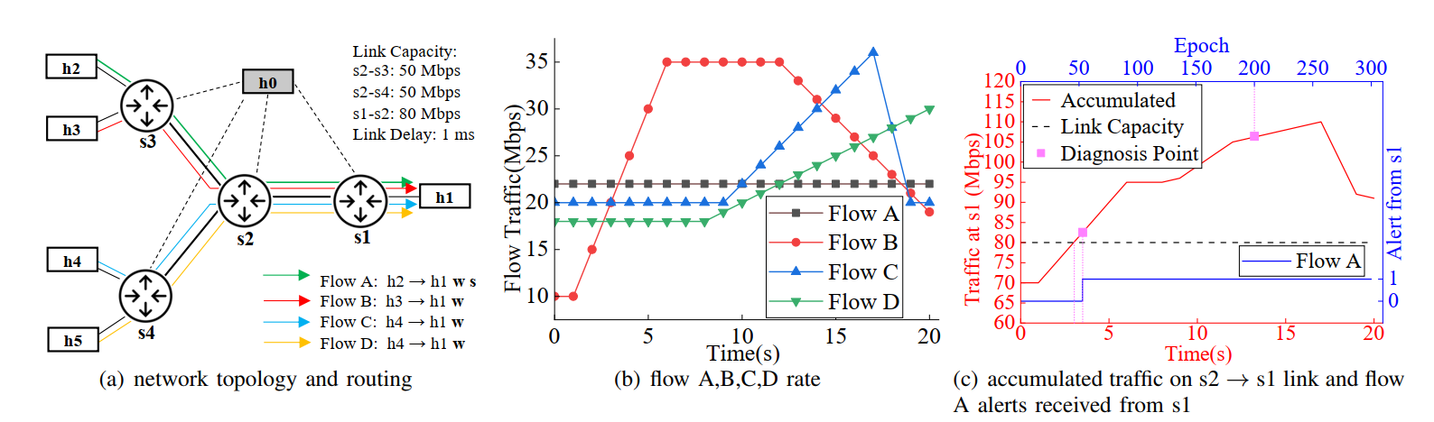
Evaluation
Case Study - DOVE’s effectiveness
settings and collected alerts:
diagnosis point 1 - 3.43s
diagnosis point 2 - 13.1s
selected flow A suffers performance degradation from flow B,C,D competition on link s2-s1
Notes:
We implement DOVE on p4 software switch( Behavior Model Version Two) and Barefoot Tofino, testify its effectiveness, accuracy and overhead, and compare DOVE with state-of-the-art works.
We show DOVE’s effectiveness with a use case.
﻿We set up a simulation using Mininet with the topology shown in Figure (a). There are 4 switches, all of which are
DOVE-enabled. Flow A is the only selected flow whose SLO should be maintained. ﻿The rates of flow A, B, C, D are shown in (b). ﻿Figure (c) shows the accumulated flow rate (the left axis) with the running time (the bottom axis) on segment s2 to s1. ﻿ It also shows whether an alert is received(1 for received) in each epoch (the top axis).
we choose two alerts shown as diagnosis points on Figure (c) to verify the effectiveness.

Slide 17
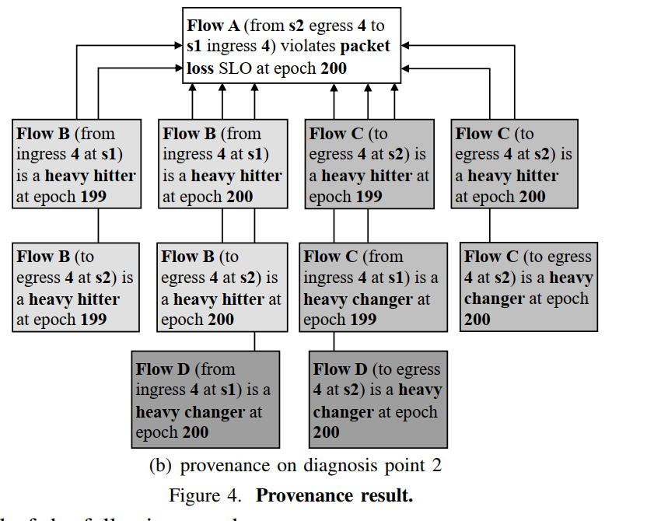
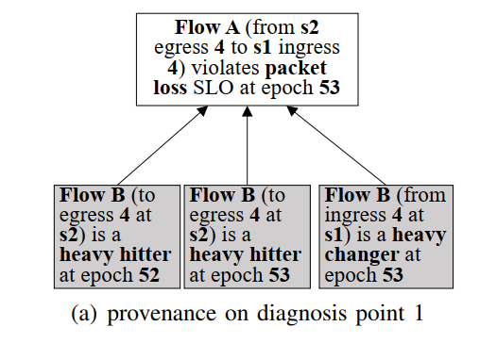
Evaluation
Case Study: DOVE’s effectiveness
diagnosis results:
diagnosis point 1:
only flow B is the culprit flow
diagnosis point 2:
flow B, C, D are all the culprit flows
Notes:
T﻿he analysis results are shown in DAG.
The first alert is mainly caused by flow B.
The Second alert is due to flow B, C, D.
Note that this corresponds to the real traffic change.

Slide 18
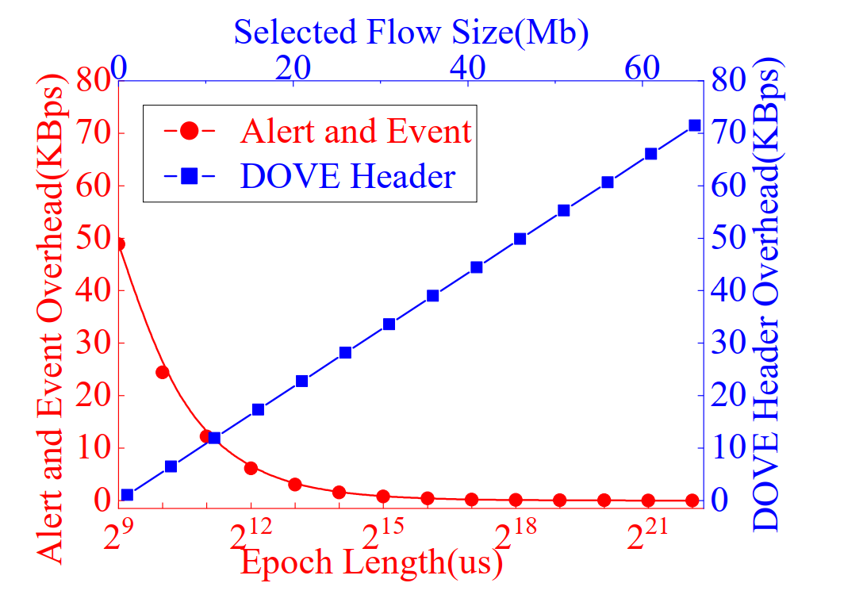
Evaluation
DOVE’s overhead: alert, event, telemetry header
there is a tradeoff between SLO measure accuracy (epoch length) and overhead
telemetry header overhead is proportional to the size of selected flows
Notes:
﻿We evaluate DOVE’s bandwidth overhead. The bandwidth overhead of DOVE consists of two parts,which are 1) telemetry header, and 2) alerts and events.
There is a tradeoff between SLO measuring accuracy (epoch length) and overhead. A finer epoch length has deeper visibility into network status at the cost of generating more traffic overhead.
﻿The header overhead is proportional to the size of the selected flows

Slide 19
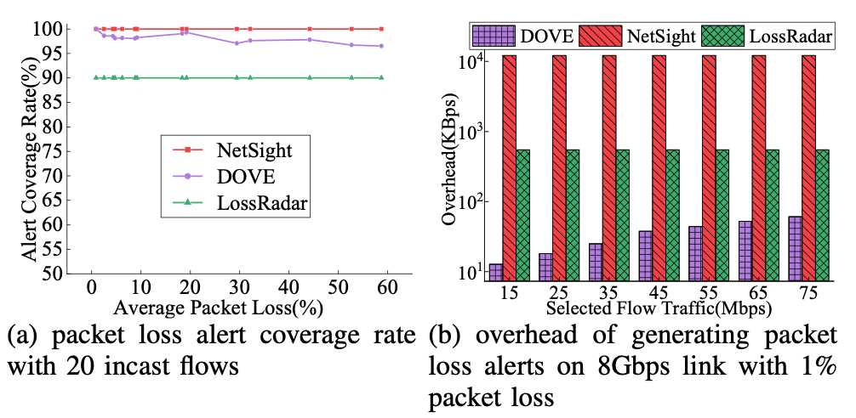
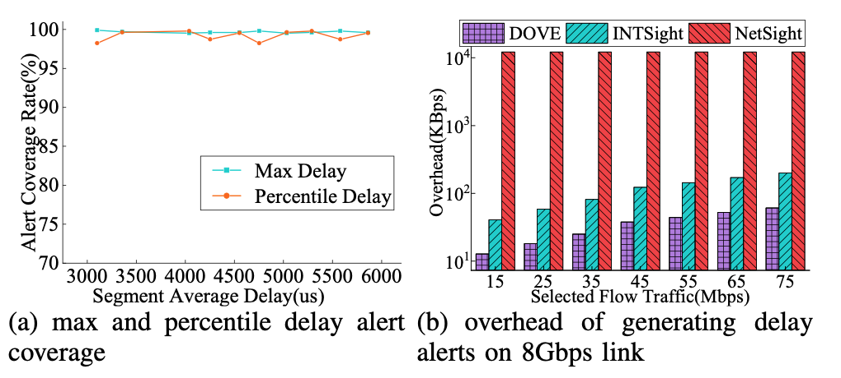
Evaluation
DOVE’s packet loss: accuracy and overhead
DOVE’s delay: accuracy and overhead
packet loss:
good coverage rate (>97%)
generates much less traffic overhead compared with NetSight and LossRadar
heavy packet loss makes Coloring Algorithm less effective
delay:
generate less traffic overhead than INTSight (simpler telemetry header)
Notes:
We evaluate DOVE’s packet loss and delay coverage rate, compare DOVE with state-of-the-art works.
For packet loss, DOVE achieves good coverage rate. It is worth noting that heavy packet loss makes Coloring Algorithm less effective, which reduces coverage rate. ﻿This is because all of the packets which belong to the second half of the epoch are lost. Without the set control bits, downstream switches are not triggered to calculate packet loss.
DOVE generates much less traffic overhead than NetSight and LossRadar.
As for delay measuring, DOVE generates less traffic overhead than INTSight and NetSight.

Slide 20
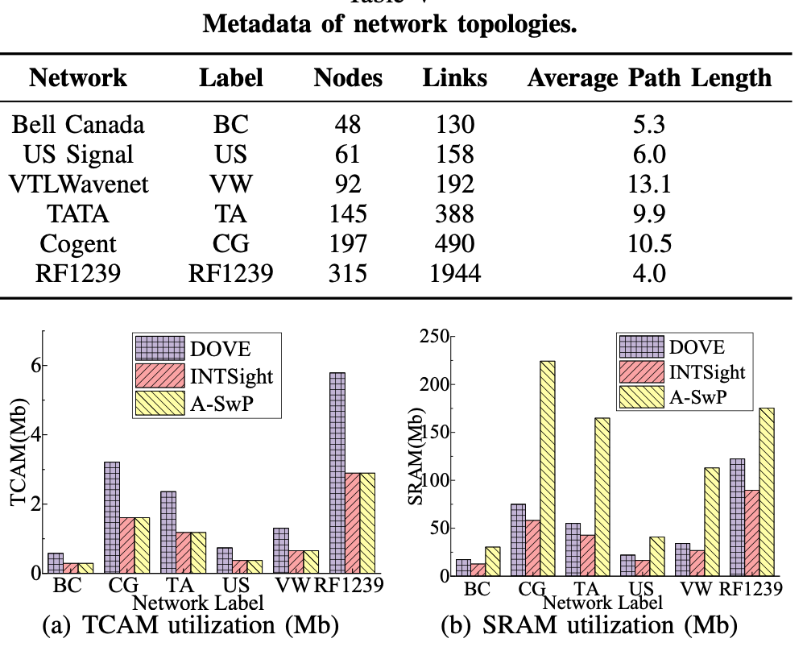
Evaluation
DOVE’s resource utilization over large networks
512 selected flows and 512 watched flows for each pair of nodes
DOVE TCAM = 2x INTSight TCAM
DOVE monitors two sets of flows as INTSight only monitors one
DOVE SRAM > INTSight SRAM
DOVE requires many registers to store intermediate values
The required resources can fit into programmable switches such as Tofino.
Notes:
We evaluate DOVE’s data plane resource utilization in several real network topologies shown in the table.
﻿For each pair of source and destination nodes, there are 512 selected flows and 512 watched flows.
﻿The TCAM usage of DOVE is twice as much as that of INTSight. This is because DOVE has two lookup tables for selected flows and watched flows respectively. ﻿DOVE’s SRAM usage is more than INTSight since packet loss measuring in DOVE requires many registers used as triggers and counters.
﻿DOVE’s TCAM and SRAM requirements are within the resources of Tofino, which makes DOVE deployable in real network settings.

Slide 21
iagnosis-driven SL iolation D tection
D
O
V
E
THANKS
leiyr20[AT]mails[DOT]tsinghua[DOT]edu[DOT]cn
Notes:
That’s the end of it. Thank you for listening!

