Slide 1



Performance Diagnosis via Queue Measurement in the Data Plane
PrintQueue
PrintQueue
Yiran Lei, Liangcheng Yu, Vincent Liu, Mingwei Xu
Notes:
Hello everyone!
I am Yiran Lei from Tsinghua University. I am a Master student and I apply for my Ph.D this Fall.
Today I will introduce our work: PrintQueue – a system to track the provenance of queuing delay
This work is in collaboration with Liangcheng Yu, Vincent Liu from University of Pennsylvania, and my advisor Mingwei Xu from Tsinghua University.
[P]

Slide 2
Why performance issue?
Performance issue debugging: hard
DoS attack
TCP incast
ECMP misconf
Packets reaching destinations: late
Packet-level causes of queuing delay: critical
What makes me waiting?
Notes:
It is difficult to debug network performance issues.
Because the issues come from many sources.
For example, Denial-of-service attack, TCP incast, ECMP misconfiguration.
However, from the perspective of packet, many performance issues boil down to packets reaching their destinations late.
So it is critical to analyze the causes of queuing delay in switches.
For example, knowing which other flows keep our the victim packet waiting will help diagnose and mitigate the performance issues.

Slide 3
Provenance of queuing delay
Observation:
queuing
current state
historical effect
A congestion regime: direct indirect original
Notes:
In other words, we need to track the provenance of queuing delay.
Our observation is that queuing is the result of both the current state and historical effect of the network,
To explain this, we describe a congestion regime and find all the responsible packets that contribute to a victim’s queuing.
We classify the responsible packets into three types: direct, indirect, and original culprits.
The first type reflects the current state of the network.
And the last two capture the historical effect.
Together they explain exactly why a victim packet experience the queuing that it did.
Next, we introduce each type of culprit.

Slide 4
Direct culprits
victim
FIFO
enqueue
queuing
dequeue
Why victim waits?
Notes:
We start with direct culprits
Suppose there is a victim packet experiencing high delay
The victim enqueues, stays in the queue for some time, and finally dequeues.
The victim waits because the switch chooses to transmit other packets instead of the victim.
So any packets that are dequeued in this period are the direct culprits for victim’s waiting.
What’s more, if the direct culprits are transmitted earlier the victim may experience less queuing time。

Slide 5
Indirect culprits
Why direct culprits are delayed?
start of queue buildup
queue depth > 0
victim enqueues
If fewer
Notes:
So we ask a question why direct culprits are delayed?
In fact, they are delayed by packets earlier than the victim’s enqueue time. We trace these packets back to the beginning of queue buildup.
Any packets that are dequeued in this period decide the number of direct culprits for the victim.
Like the blue one in the figure.
We call them indirect culprits for the victim. If there are fewer of them, the queue depth may be shorter, even zero, at victim’s enqueue moment.

Slide 6
Original culprits
A subset of indirect culprits: more blame
burst
TCP flow
…
victim
Why queue depth > 0 ?
Notes:
Finally, out of the indirect culprits, we note that a subset of packets have slightly more blame.
Consider the following scene.
The arrival of a UDP burst increases the queue depth.
A TCP flow that shares the same queue keeps sending packets.
The UDP burst leaves the queue after a short time and the queue starts to drain slowly.
Then comes our victim. It looks for the cause of high queue occupancy.
In this case, indirect culprits include TCP flow and the burst. But the volume of TCP flow is much larger than the burst. So indirect culprits will mistakenly treat the TCP flow as the cause.
Therefore, we need to highlight the packets that brought the queue to its current level, that is the burst in our example.
We call them original culprits.
Now, we need to track each type of culprits as the causes of the queuing delay. But it is challenging to do so.

Slide 7
Gap of existing works
Heavy hitter detection: fixed time intervals
Packet mirroring: large overhead
result
read & reset
arbitrary timespans: over/under-estimate
Notes:
Existing solutions fail to accurately track culprits with low overhead.
A well-known class of techniques related to our problem is heavy hitter detection method.
It records packet number of each flow and returns largest one.
The method reads the data structure and resets it in fixed time intervals.
The result is in terms of the entire time period.
However, the culprits of queuing delay can start and end at any moment.
We need to retrieve packets from arbitrary timespans instead of fixed time periods.
So the method will over or under-estimate the packet number.
Another class of techniques is packet mirroring method. It can record each packet’s queuing information and do offline analysis. But it has too large overhead.

Slide 8

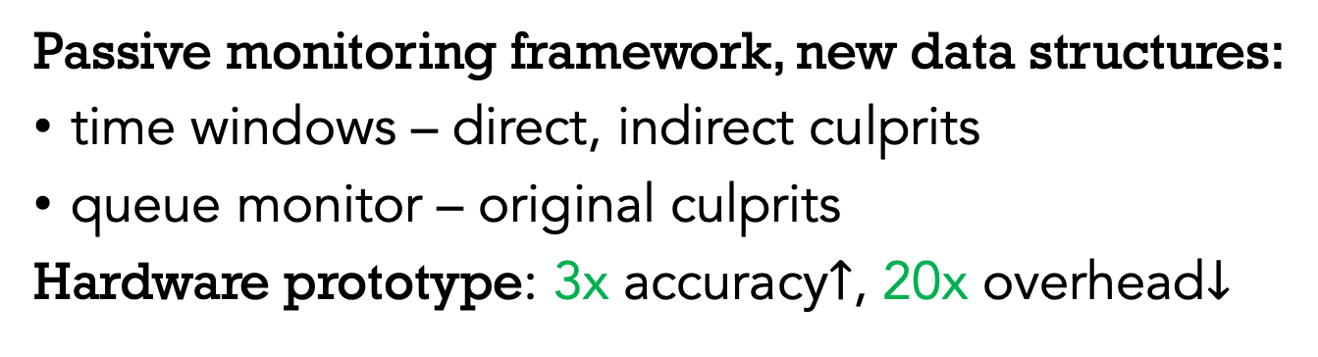
Overview
Passive monitoring framework, new data structures:
time windows – direct, indirect culprits
queue monitor – original culprits
Hardware prototype: 3x accuracy$↑$, 20x overhead$↓$
Data-plane query
Ingress logic
Queuing
Time windows
Queue monitor
Data
Periodic collection
Control
Analysis program
Records
Asynchronous query
Notes:
To address these gaps, we present PrintQueue, a passive monitoring framework for tracking all types of culprits. We propose novel data structures called time windows and queue monitor. We implement a prototype in a Tofino switch. Our evaluation shows PrintQueues achieves better performance compared with existing works.
Our system consists of two parts.
In the data plane, we implement the tracking data structures in the egress processing pipeline. The data structures store relevant packet information in the data-plane registers.
In the control plane, the analysis program periodically collect the register values and store them in the disk.
To query the culprits of a victim, users can use the historical records to do asynchronous queries. Also, packets can directly trigger a query in the data plane to have a more accurate and timely result.
Next, we introduce each part of the system.

Slide 9
Time windows
Queue monitor
Query execution
Notes:
First, we introduce the data structure called time windows. They are designed for tracking direct and indirect culprits.

Slide 10
Time windows
Strawman
A |  | B | C
cells
1:1
A
B
C
small time periods
Hierarchical variant: fit into data-plane stages
full $→$ overwrite, pass
A |  | B | C
stage 2
stage 1
D
E
F
A
B
C
A
B
C
D
E
F
update in cycles
Notes:
The key is to know what packets are dequeued during certain time periods. So we should record packets along their dequeue timestamps.
We first offer a strawman approach.
We split timeline into small time periods that have identical length.
We need a table consisting of many cells.
Each cell corresponds to a small time period.
To retrieve packets from an arbitrary timespan, we just need to look up the corresponding cells.
Next, we adapt the strawman approach to the data plane architecture.
The data plane consists of multiple stages. So we implement the table in each stage to form a hierarchical variant.
As shown in the figure, when the first table is full, we overwrite it from the beginning. And pass the old record to the second table.
Like the strawman approach, to retrieve packets from arbitrary timespan, we just need to look up the right cells.
Also, we note that each table updates itself in cycles. In the figure, the black and blue time periods are different cycles for the first table.

Slide 11

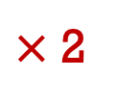
Time windows
Save space by slightly sacrificing accuracy:
compress multiple cells into one
B or D?
A | B | C | C
C
D
A
A
B
C
D
A
B
D
A
D
A
B
C
C
D
A
B
D
C
D
A
A
How to compress:
latest record $∈$ cells that stored packets in the previous cycle
Proportional property:
compressed packet number : original number = constant
Example:
A | B | C | D
2 | 0 | 1 | 1
+
A | B | C | D
1 | 1 | 1 | 1
$×$ 2
=
A | B | C | D
4 | 2 | 3 | 3
Notes:
Next, we made a trade-off between accuracy and space.
The objective here is to save space by slightly sacrificing accuracy.
What we do is to compress multiple cells into one when we are passing old records.
Here, we call the table the time window.
As shown in the figure, we compress two cells into one and pass only one record.
We do save the space, as we use two tables to store three cycles of packets.
It is important to know when compressing multiple cells together, which one’s record is passed and stored in the next table?
As shown in the figure, we must choose one from flow B and D’s packets and drop the other.
In fact, we choose the latest record from the cells that stored packets in the previous cycle.
In our example, every cell stored a packet in the previous cycle. So we will always choose the latter record. And that is flow D’s packet.
By applying this rule, we have a proportional property that is used to recover from the compression.
We find that the ratio between compressed packet number and real packet number is a constant. We can calculate that ratio under different settings.
In the example, the ratio is 0.5. we just need to multiply the packet number in the second table by two.
As you see, for the entire period, the recovered result exactly reveals real per-flow packet number.

Slide 12
Time windows
Queue monitor
Query execution
Notes:
Next, we introduce the queue monitor for original culprits.

Slide 13

Queue monitor
Stack
Strawman: sequence number
stack top pointer
stale
stack bottom
A,1
B,2
A,3
A,4
A,5
A,6
C,9
C,8
C,7
overwrite $→$ error
Queue monitor: separate in/de-crease
preserved
stale
increase
 | A,1 | B,2 |  |  |  | A,6
 |  |  | C,9 | C,8 | C,7
A,3
A,4
A,5
decrease
Notes:
To track original culprits, the key is know what packets in history brought the queue to the current level.
The first thing we think of is a stack. Stack will store the oldest information for longest time.
We want to use this feature. But unfortunately, we cannot implement a full stack in a resource-constrained data plane.
We come up with a strawman approach to simulate a stack. The data structure has the same depth as the queue and takes the latest queue depth as the stack top pointer.
When a packet changes the queue depth, the packet is inserted in the corresponding entry along with an increasing sequence number.
As shown in the figure, flow A and B’s packets gradually fill the stack.
If the queue depth stops changing from the moment, the stack will keep remembering flow A and B’s fault.
If the queue depth decreases, the old records are overwritten by the new one.
The sequence number helps us filter out the stale records.
However, overwriting old records may cause error. In our example, flow A contributes the most to the queue increase.
But the information is lost when we write flow C’s packets in the same entries.
Therefore, we fix this by letting each entry store two pieces of information. As shown in the figure, the upper half stores packets when queue depth increases while the lower half stores decreases.
And flow A’s packets are well preserved.

Slide 14
Time windows
Queue monitor
Query execution
Notes:
Finally, we introduce how to trigger a query to get a result from our system.

Slide 15
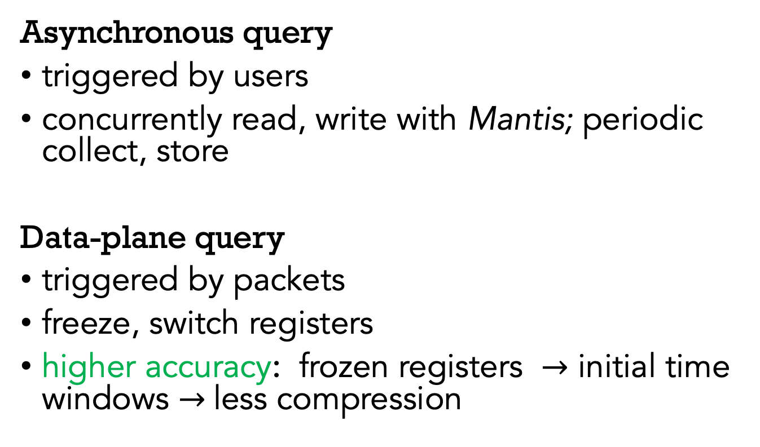
Query execution
Asynchronous query
triggered by users
concurrently read, write with Mantis; periodic collect, store
Data-plane query
triggered by packets
freeze, switch registers
higher accuracy: frozen registers $→$ initial time windows $→$less compression
Notes:
PrintQueue supports two types of query that are asynchronous query and data-plane query.
We borrow a technique from a recent work, Mantis, to concurrently read and write data-plane registers. The control plane periodically collect the registers and store the values in the control plane disk. The records cover the whole timeline. So users can trigger offline queries and retrieve packets from arbitrary timespans.
Besides, queries can be directly triggered by packets in the data plane.
The triggering packets can be a high-priority packet requesting for diagnosis.
Upon seeing a special packet, the data plane freezes the current registers and switches to backup ones. And the result is retrieved from the frozen registers immediately.
Data-plane queries have higher accuracy, because when it freezes registers, the culprit packets stay in the initial time windows. This means the culprits are slightly compressed or not compressed at all, thus leading to higher accuracy

Slide 16

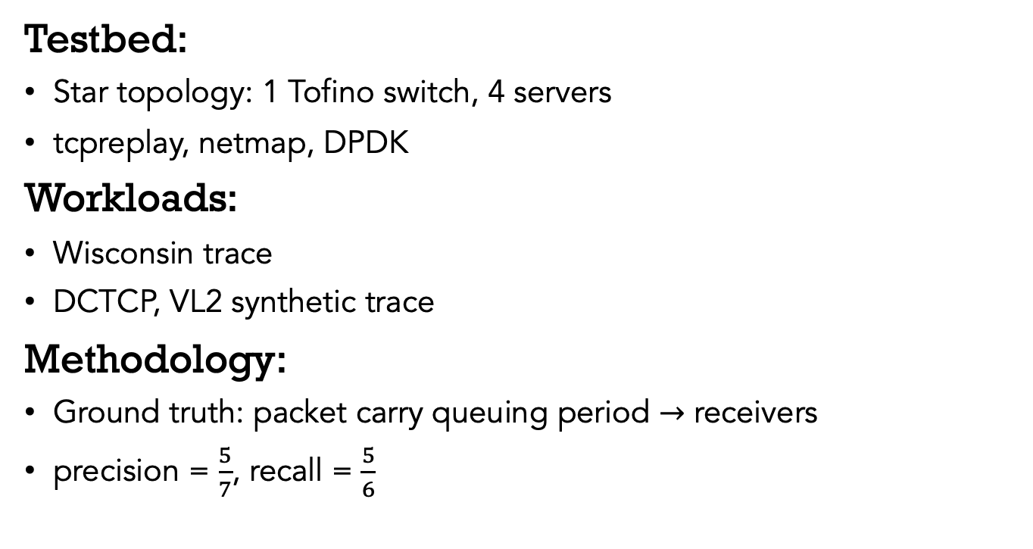
Evaluation
github.com/A-Dying-Pig/PrintQueue
~5000 loc
Testbed:
Star topology: 1 Tofino switch, 4 servers
tcpreplay, netmap, DPDK
Workloads:
Wisconsin trace
DCTCP, VL2 synthetic trace
Methodology:
Ground truth: packet carry queuing period $→$ receivers
precision = $\frac{5}{7}$, recall = $\frac{5}{6}$
ground truth
query result
A
1
A | B
2 | 3
C
2
Notes:
We implement PrintQueue in a Tofino switch with approximately five thousands line of code. We open source our project in Github.
The testbed is a Tofino switch connecting four servers. We use the tcpreplay to send traffic, netmap driver to accelerate sending, and DPDK to receive packets.
The workloads include three traces: real trace from Wisconsin, synthetic traces of DCTCP and VL2.
To get the ground truth of a query, we let each packet carry its queueing period after it is dequeued in the switch. We store each packet with its queuing period at receiver servers.
Later, we get the ground truth culprits at the receivers.
With the result from time windows, we do precision and recall to evaluate accuracy.
Let’s see some evaluation results.

Slide 17
PrintQueue achieves high accuracy
Wisconsin
DCTCP
VL2
0 0.5 1
0 0.5 1
0 0.5 1
PrintQueue
HashPipe
FlowRadar
 | Precision | Recall
Asynchronous query
Data-plane query
Notes:
PrintQueue achieves high accuracy.
The leftist column shows the result under Wisconsin trace.
The blue bar represents the precision for asynchronous query, while the light blue bar represents data-plane query.
The green bar represents the recall for asynchronous query, while the light green bar represents data-plane query.
The black and grey bar represent precision and recall respectively.
As you can see, PrintQueue outperforms the existing heavy hitter detection method, HashPipe and FlowRadar.
As expected, the accuracy for data-plane query is approaching 100%.
We can find similar results under all three traces.

Slide 18
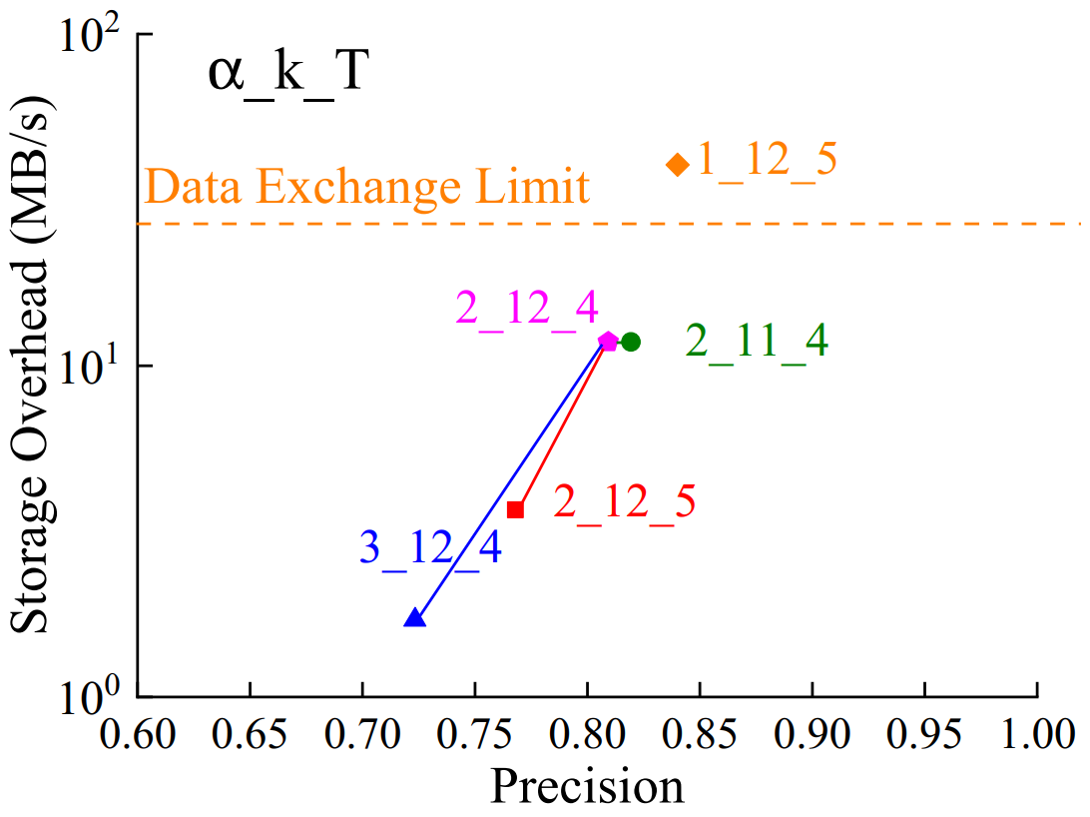

PrintQueue incurs low overhead
parameters - $α, k, T$
bottleneck
Simultaneous activation in 10 ports.
Notes:
At the same time, PrintQueue incurs low overhead.
As shown in the figure, the storage overhead and precision are related to a list of the parameters.
Alpha controls how many cells are compressed into one across time windows, k decides the number of cells in a table, and T is the number of windows.
As expected, a larger alpha and T reduce accuracy and overhead at the same time.
And k does not have obvious influences, but it does affect the SRAM usage in the data plane.
One thing we want to mention is that there is the data exchange limit of the local interface between the data plane and control plane.
The interfaces fails to read the data-plane registers in a timely manner if we choose parameters above the line.
So we have to sacrifice some accuracy for feasibility in some cases.
What's more, PrintQueue can be activated in 10 ports simultaneously in our testbed.

Slide 19
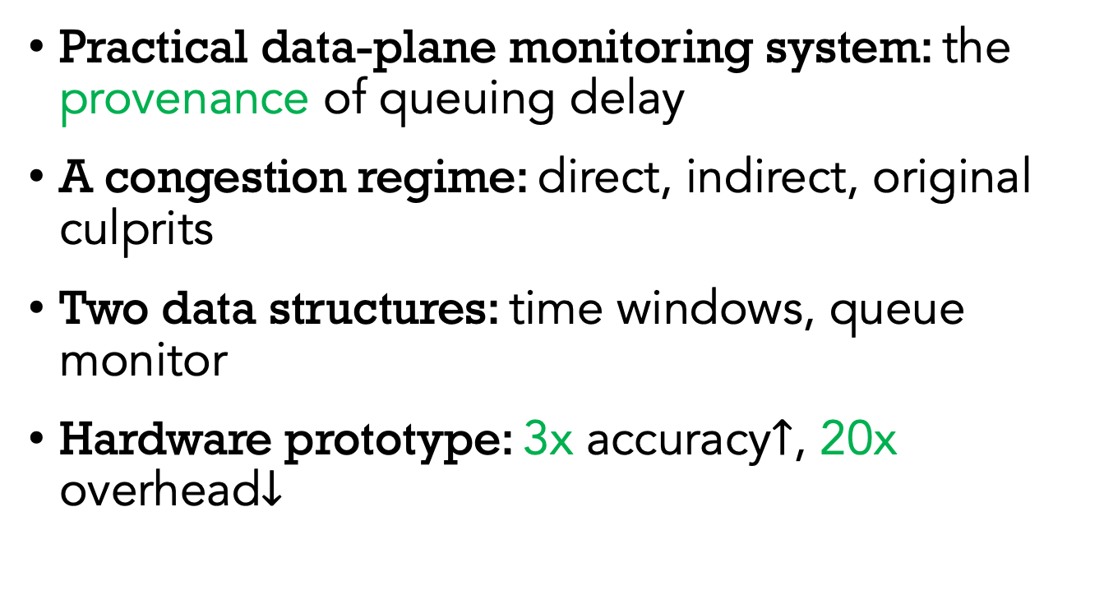
Summary
PrintQueue
Practical data-plane monitoring system: the provenance of queuing delay
A congestion regime: direct, indirect, original culprits
Two data structures: time windows, queue monitor
Hardware prototype: 3x accuracy$↑$, 20x overhead$↓$
github.com/A-Dying-Pig/PrintQueue
yiranlei.yiranlei@gmail.com
Notes:
In summary
PrintQueue is
Specifically, describe
classify
Design
Implement

