Slide 1





SwitchNIC: A Hybrid Architecture for Network Functions with Fast and Consistent Shared States
Yiran Lei, Francisco Pereira, Arvind Krishnamurthy, Justine Sherry
Notes:
Hello everyone, my name is Francisco Pereira. I’m a PhD student from University of Lisbon, and I’ll be presenting our work on SwitchNIC: a hybrid architecture for network functions with fast and consistent shares states.
Unfortunately, the lead author behind this work, Yiran Lei, is unable to join us, so I will be presenting in his stead.

Slide 2

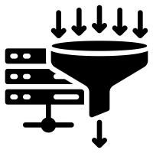


Stateful network functions are commonly deployed
Performance impact
Security impact
Load Balancer
Rate Limiter
Packet Inspector
Firewall
Enhancing stateful NFs’ performance and efficiency is crucial
Notes:
Stateful network functions are commonly deployed in today’s data centers.
These are small programs that analyze, filter, route traffic before it reaches the destinations.
They implement a wide range of functionality. Some of them have a direct impact on the performance of the applications running in the data center, for example Load Balancers and Rate Limiters. Others concern themselves more with security, like Packet Inspectors and Firewalls.
And enhancing both their performance and efficiency is crucial to ensure that they continue to do their jobs in networks with increasingly higher bandwidth demand

Slide 3



State of the art in NF implementation
E.g. NetCache [SOSP’17], Gallium [SIGCOMM’20], TEA [SIGCOMM’20], Pigasus [OSDI’20]
High-performance hardware
Flexible software
Programmable switch
FPGA-based SmartNIC
Server CPU
For rare complex operations or added memory needs
For common simple operations
Notes:
With these performance and efficiency concerns in mind, the current state of the art in NF implementation takes advantage of high performant network hardware accelerators like programmable switches and FPGA SmartNICs.
However, because these typically are very constrained in terms of both resources and computation they can perform, they are paired with commodity servers capable of running any piece of software.
And this is a match made in heaven, because we can have the high performance hardware with limited computations perform common simple operations, and complement that with much slower and less efficient commodity servers to run rare complex operations or to complement additional memory needs.
However, to fully take advantage of this distributed system, state must be shared between these two platforms.

Slide 4
Consistency is important, but hard
Notes:
And that sharing comes with an old and hard problem: consistency. Ensuring consistency is hard because:
Consistency protocols are hard by themselves, but also
While designing the protocol, we need to consider each platform’s strengths, weaknesses, and idiosyncrasies
Let me show you an example of this.

Slide 5
How existing work handles the states?
Example: key-value store for food preference
Programmable switch
Server
Name | Preference
Alice
Bob | 🥬
Name | Preference
Alice
Bob | 🥬
Charlie | 🍒
David | 🥦
🍎
🍎
Notes:
Mention that actually we use the KVS store just as a motivating example (for simplicity), but there's a wide range of application where this also applies (for example TCP reassembler, Deep Packet Inspection).

Slide 6
How existing work handles the states?
No state sharing
Read+write on both platforms
E.g. Gallium [SIGCOMM’20]
Shared, but read-only switch state
Write packets go to server
E.g. NetCache [SOSP’17], TEA [SIGCOMM’20]
Programmable switch
Server
Programmable switch
Server
Name | Preference
Alice | 🍎
Bob | 🥬
Name | Preference
Charlie | 🍒
David | 🥦
Name | Preference
Alice | 🍎
Bob | 🥬
Name | Preference
Alice | 🍎
Bob | 🥬
Charlie | 🍒
David | 🥦
No complex operations for states on switch
Even trivial updates must go to the server
Notes:
For Gallium, the states on switch can not be moved, so those states won’t be able to support any complex operations, e.g., a database query; if all the states can trigger complex operations, this means all the states must stay at server, leading to poor performance
We use the KVS store just as a motivating example (for simplicity), but there's a wide range of application where this also applies (for example TCP reassembler, Deep Packet Inspection).

Slide 7
What we really want is for both platforms to write shared state
For common simple operations
For occasional complex operations
Programmable switch
Server
Name | Preference
Alice
Bob | 🥬
Name | Preference
Alice
Bob | 🥬
Charlie | 🍒
David | 🥦
Packet 1
🍎
🍎
Packet 2
Alice | 🍉
Alice | ?
🍉
Notes:
Want we actually wanted was for both platforms to share and be able to perform write operations whenever needed, so that common simple operations are handled at switch and occasional complex operations can be handled at server
Consider a key-value-store-like application that keeps information about the user’s food preferences
This application is distributed across the fast programmable switch on the left, and the slower but more computationally capable server on the right
Right now, we store the information that Alice likes apples, but Alice would like to change that
Because updating the table is a relatively simple operation, Alice's update goes directly to the switch, which replaces the apple with a watermelon
Later, Alice queries the application, requiring a complex query for a database, a more complex operation that is sent to the server. (this rarely happens, compared to the simple case)

Slide 8
What we really want is for both platforms to write shared state
For common simple operations
For occasional complex operations
Inconsistency: What is Alice’s preference
Programmable switch
Server
Name | Preference
Alice | 🍉
Bob | 🥬
Name | Preference
Alice
Bob | 🥬
Charlie | 🍒
David | 🥦
🍎
Notes:
But now state is incoherent between the switch and the server!
Who own the data? How do we migrate between the platforms?

Slide 9
Assumption: both income and outgoing traffic of a flow to a server must go through the same switch
Interposer
Incoming traffic
Outgoing traffic
Tracks state locations
Triggers synchronization when needed
State piggybacks on the packets that use it
Notes:
To solve this problem, we work under a single assumption: that both income and outgoing traffic of a flow to a server must go through the same switch.
That is, the switch is the consistent interposer of the flow packets that come and go to the server.
Our insight is that exactly because of this interposition, the switch can:
Track valid state locations to trigger synchronization when needed
Trigger synchronization with the server whenever needed
And use those same packets to piggyback data that’s meant to be migrated to the server
And actually, many applications that rely on programmable switches are already designed this assumption

Slide 10
Sounds easy enough, what’s the problem?
Realizing this requires:
Strong Consistency Protocol
Latency and lossy communication channel
Fully Mutable Data Plane State Table
Limited programmability of the switch
Caching Algorithm
Based on both Recency and Frequency
Notes:
So, this sounds easy enough. The switch sees all traffic and knows everything. What’s the problem?
Well, this is actually easier said than done. Realizing this requires:
A strong consistency protocol between the switch and the server, one that takes into consideration the latency between the two platforms and the fact that packets can be lost between them.
And actually to realize the strong consistency protocol, and to allow the switch to perform the simple operations quickly, we also need a fully mutable state table on the switch, without depending on the controller to perform write operations. This is a well known challenge due to the limited programmability on the switch.
And finally, we need a caching algorithm to know when the state should be migrated to the server, and when it should be migrated back to the switch. This algorithm should have both recency and frequency in mind if it wants to be high performant.

Slide 11
We propose SwitchNIC
Tightly integrated heterogeneous architecture
Fast-path programmable switch + flexible slow-path ARM cores
In this talk:
Strong Consistency Protocol
Fully Mutable Data Plane State Table
Caching Algorithm
Notes:
With this in mind, we propose SwitchNIC, a tightly integrated heterogeneous architecture that combines a highly efficient fast-path on a programmable switch with flexible co-located ARM cores to support high performance stateful NFs. And this does this while ensuring strong consistency.
In the interest of time, I will only address the strong consistency protocol in this talk. If you want to learn more about the fully mutable data plane state table and the caching algorithm, I invite you to read our paper.
Additionally, there also a lot of complexity in designing the protocol to be amenable to the programmable switch. I'm not going to address this challenge in this talk.

Slide 12
Strong Consistency Protocol
Managing mutable, shared states in a loss-free network:
Direct updates at switch
Migrate to server
Migrate back to switch
Notes:
Here is an intuitive overview of SwitchNIC’s strong consistency protocol:
First, and most commonly, perform simple updates at the switch.
If need be, migrate the state to the server to perform complex operations
Finally, migrate the state back to the switch when no more complex operations are require
Let me show you how this works with our key value store example.

Slide 13
#1: Direct updates at switch
Switch has valid state for Alice
① Programmable switch
②Server
Name | Preference
Alice | 🍎
Bob | 🥬
Charlie | 🍒
David | 🥦
Name | Preference
Alice
Bob | 🥬
Packet 1
Alice | 🍉
🍎
Packet 1
Alice | 🍉
🍉

Slide 14
#1: Direct updates at switch
Direct update at switch and exit
Bypass
① Programmable switch
②Server
Name | Preference
Alice | 🍎
Bob | 🥬
Charlie | 🍒
David | 🥦
Stale
Name | Preference
Alice | 🍉
Bob | 🥬
Packet 1
Alice | 🍉
Notes:
Notice that the server contains stale information now, but that is fine!
The switch is the authoritative state coordination entity that oversees all traffic. So the switch knows it has the most recent data, and that the server is stale.

Slide 15
#2: Migrate to server
Clear Bob’s state due to a popularity change or a complex operation
① Programmable switch
②Server
Name | Preference
Alice | 🍎
Bob
Charlie | 🍒
David | 🥦
Name | Preference
Alice | 🍉
Bob | 🫐
Valid
Packet 3
Packet 3
🥬
Bob
Bob | 🫐
Packet 3
Packet 3
Bob
Bob | 🫐
🫐
🫐
State travels with packet
Notes:
However, sometimes we might need to resort to the server to perform some complex operation, or clear bob's state because it is no longer a popular key and should be replaced by one that is more popular
(Migrations also happen for write packets, we just need to carry both the read state and the write state to the server)

Slide 16
#2: Migrate to server
Clean Bob’s state due to a popularity change or a complex operation
① Programmable switch
②Server
Name | Preference
Alice | 🍎
Bob | 🫐
Charlie | 🍒
David | 🥦
Name | Preference
Alice | 🍉
Packet 3
Packet 3
Bob | 🫐
Bob | 🫐
Bob
🫐
Good to clear
Packet 3
Bob | 🫐

Slide 17
#3: Migrate back to switch
Offload popular David’s state to switch
① Programmable switch
②Server
Switch does not have David’s state
Name | Preference
Alice | 🍎
Bob | 🫐
Charlie | 🍒
David
Name | Preference
Alice | 🍉
Packet 4
Packet 4
David | 🍟
David | 🍟
🥦
Packet 4
Packet 4
David | 🍟
David | 🍟
🍟

Slide 18
#3: Migrate back to switch
Offload popular David’s state to switch
① Programmable switch
②Server
Now switch has valid David’s state
Name | Preference
Alice | 🍎
Bob | 🫐
Charlie | 🍒
David | 🍟
Name | Preference
Alice | 🍉
Packet 4
Packet 4
David | 🍟
David | 🍟
State travels with packet
Packet 4
David | 🍟
David
🍟

Slide 19
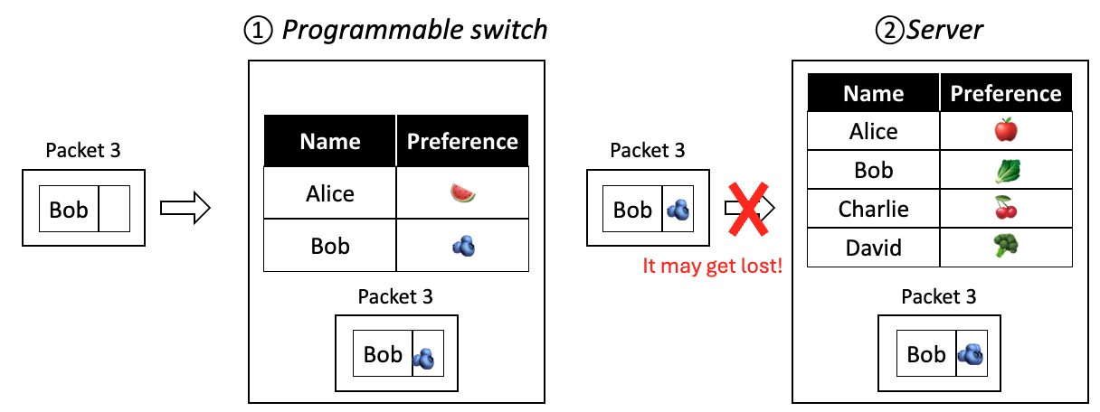
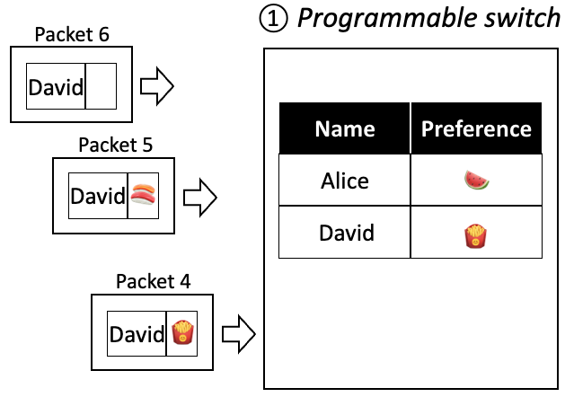
Problems in a real network
Read paper!
Packet loss
Idea: continuous write-backs until ACKs are received
Packet train
Idea: track migration, and discard ongoing migration from server
Notes:
So, as you’ve probably guessed, we are stepping over some details here. Actual real networks are messier, and our consistency protocol needs to deal with issues coming from real networks.
For example, packets may be lost between the switch and the server. The key idea to solve this for the switch to keep track the migration was successful by expecting acknowledgments from the server, and simply to continue to write-back the migration until it is successful.
One other problem that might come is a train of packets from the same flow, in this case the same person. If we don’t deal with this, this can lead to inconsistent states if it happens during a migration. The key idea is for the switch to track the migration and abort ongoing migrations if new packets from the same flow arrive to the switch.
More details about these problems and how we solved them are in the paper, which we invite you to go check out.

Slide 20
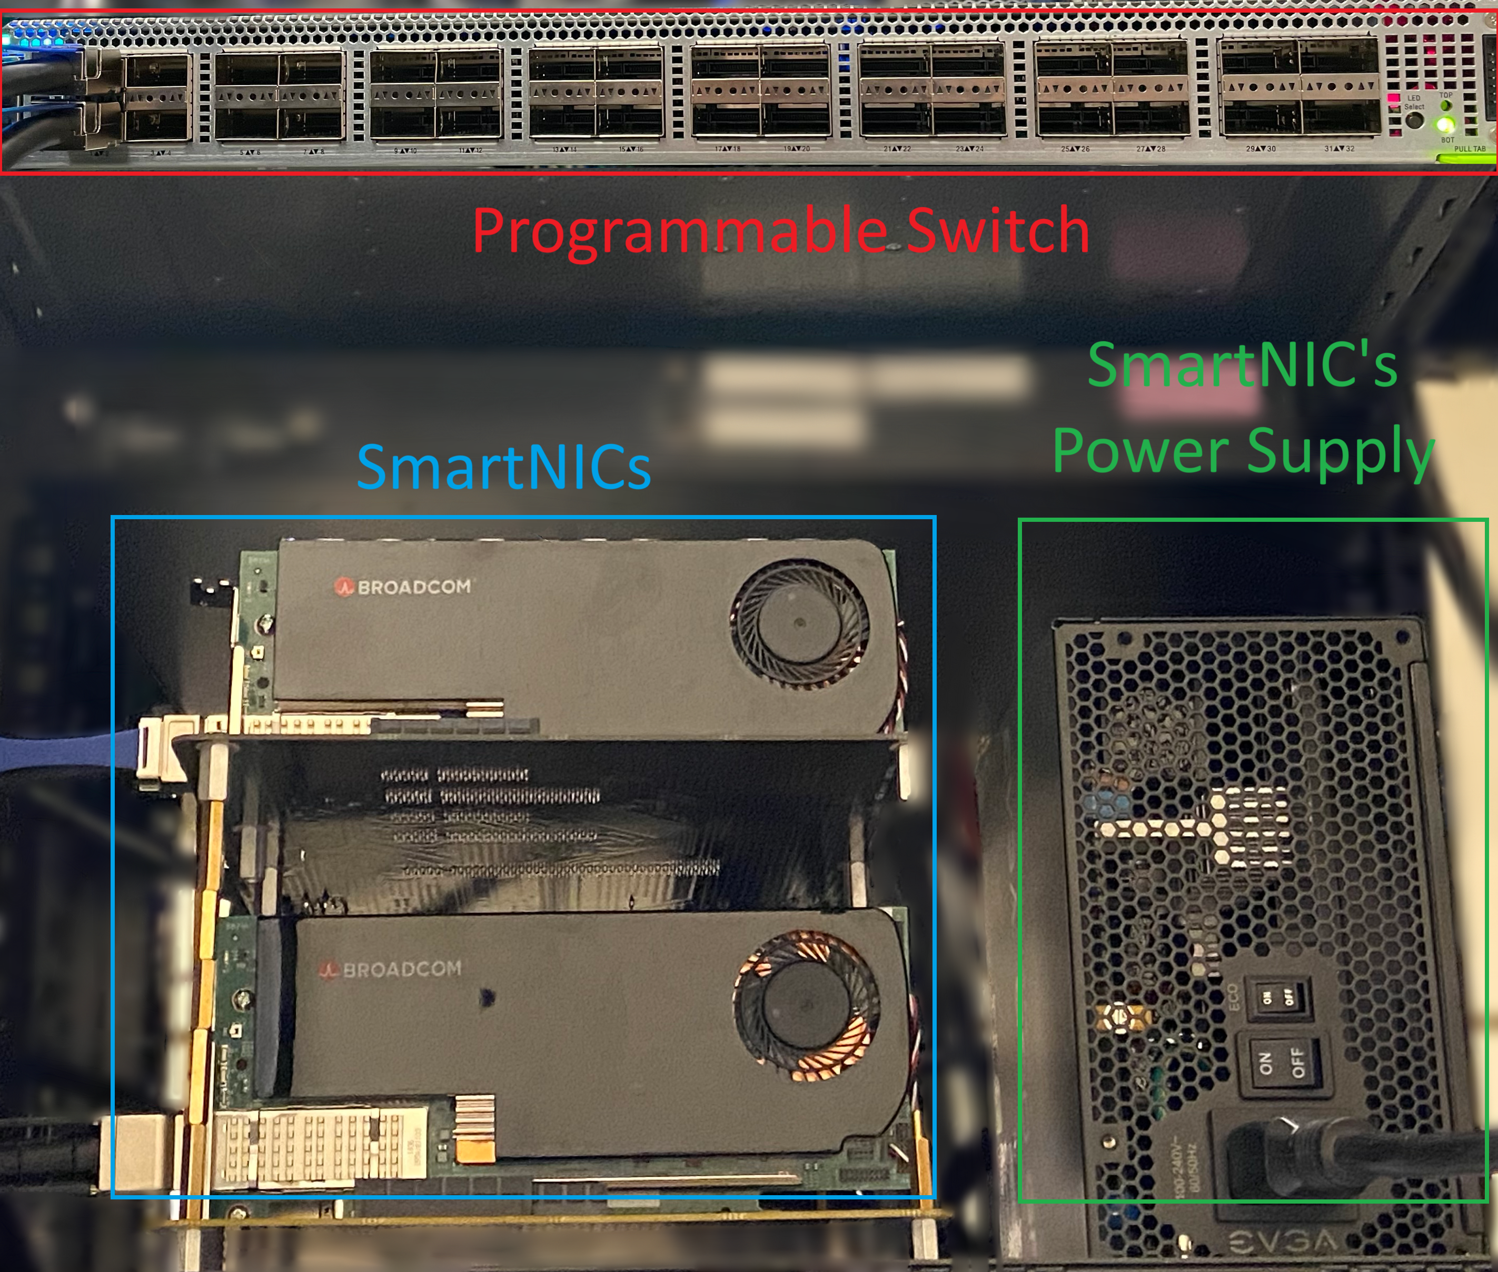
Testbed & Workload
ARM-based SmartNIC instead of servers
Reduce latency
Improve energy-efficiency
Typical data center traffic pattern
Skewed flow size
100k concurrent flows
100k new flows/min,
0.1% complex operation
SmartNIC has 8-core ARM A72 CPU @ 3.0GHz

Slide 21
SwitchNIC achieves 1.5x better energy efficiency
Notes:
Here we show how SwitchNICs fairs in terms of efficiency, that is throughput over power consumption.
On the x-axis we have all the network functions that we evaluated: a firewall, a load balancer, a key value store, a packet reassemble, and a deep packet inspector.
On the y-axis we have efficiency in Gbps/Watt, or throughput per power consumption. Higher is better, that is, the more efficient the better.
Each column represents a specific system. We have:
Our system SwitchNIC in purple,
The server, in black, where we used a server to run the entire NF.
The Cache, in green, where we used both a programmable switch and a server to run the NF, with the caveat that operation on the switch are read-only as they do not have our consistency protocol
And finally, the SmartNIC in pink. Similarly to the server, here we used a flexible ARM-core SmartNIC to run the entire NF.
Notice that the Cache system does not support the packet reassemble and the inspector, as the operations on the switch are read only.
The main take-away from this graph is that SwitchNIC achieves at least 50% better energy efficiency than the alternatives.
For the Server and SmartNIC cases this is easy to explain: the use of the extremely high performant programmable switch brings significant performance advantages when compared to running on a server or a smartnic only.
Regarding the previous “cache”-style hybrid design, SwitchNIC outperforms them in two key ways:
1. Supports more complex NFs – It can handle stateful functions like packet inspection and reassembly, while prior systems mainly target simple NFs due to lack of consistent shared states.
2. Outperforms in terms of raw throughput because more traffic can be offloaded to the switch under high traffic churns.
This is because SwitchNIC stores the entire flow-state table in the data plane to enable fast state insertions, deletions, and updates —unlike earlier designs that rely on the much slower switch control plane.

Slide 22
SwitchNIC achieves 1.6x better processing latency
Notes:
In this last experiment, we analyze processing latency.
This is measured from the time the packet enters the switch to the time it leaves the switch.
We have the same x-axis with the NFs, and the same systems under evaluation.
On the y-axis, we now have latency in microseconds. Here, lower is better, meaning lower latency.
The main takeaway here is that SwitchNIC achieves at least 60% better processing latency than the other systems. This is mainly for two reasons:
1. Most packets require simple operations, so most traffic is directly returned by the switch
2. It achieves a higher cache hit ratio under dynamic traffic conditions than prior caching systems

Slide 23

Summary
Shared-state consistency in hybrid hardware/software NFs
Simple
When the hardware lies on the data path to the software
SwitchNIC
1.5x better energy efficiency, 1.6x better latency
Contact: yiranlei@cs.cmu.edu
SwitchNIC is open source
Notes:
So, the main takeaway from this talk is that maintaining shared/state consistency in hybrid hardware/software NFs is simple when the hardware lies on the data path to the software.
With this, we presented SwitchNIC, a tightly integrated heterogeneous architecture capable of ensuring strong consistency under high performance.
SwitchNIC achieves 1.5x better energy efficiency, 1.6x better latency

Slide 24
Backup slides

Slide 25
#3: Migrate back to switch
Offload popular David’s state to switch
What if a packet train?
Idea: cancel migration
① Programmable switch
②Server
Packet 6
David
Name | Preference
Alice | 🍎
Bob | 🫐
Charlie | 🍒
David
Name | Preference
Alice | 🍉
Packet 5
Get stale 🍟 from switch
Get valid 🍣 from server
David | 🍣
David
🍟
🥦
Stale
Valid
Packet 4
David | 🍟
🍟
🍣

Slide 26
#3: Migrate back to switch
Offload popular David’s state to switch
What if a packet train?
Idea: cancel migration
① Programmable switch
②Server
Packet 6
David
Name | Preference
Alice | 🍎
Bob | 🫐
Charlie | 🍒
David
Name | Preference
Alice | 🍉
Packet 5
David | 🍣
David
🍟
🥦
Packet 4
Valid
David | 🍟
🍟
🍣

