Slide 1
AI Based Demand Side Management in Smart Home Environment Final Year Project-EEe499
By Supervisor
Abdullah Faisal Dr. M. Saeed Uz Zaman
Co-Supervisor
Dr. M. Abu Bakar

Slide 2
Contents
Introduction
Literature Review
Methodology
Workflow
Models of Electrical Components
Constraints of Components
Cost Function
Grey Wolf Algorithm
Results

Slide 3
Introduction
In this project, a smart home consisting of smart electrical sources (fuel cell, BESS, Utility electricity and renewables) and smart electrical loads(EV charging and other smart loads) is considered as an optimization problem.
With number of variables increased, the traditional mathematical optimization techniques become extremely complex to implement, so we are using Grey Wolf Optimization algorithm, which is a nature inspired metaheuristic optimization AI algorithm.

Slide 4
Literature Review
Smart Home Energy Management Systems (SHEMS) are increasingly used to reduce electricity cost and improve energy efficiency through optimal scheduling of household resources (Khan et al., 2020).
Recent studies integrated renewable energy sources such as solar PV and wind along with Battery Energy Storage Systems (BESS) and Fuel Cells (FC) for residential applications (Mumtaz et al., 2018).
Electric Vehicle (EV) charging coordination and scheduling of non-critical household loads have also been investigated to reduce peak demand and operating cost (Mohsenian-Rad et al., 2010).
Traditional optimization techniques such as Linear Programming and Dynamic Programming face difficulties in solving nonlinear constrained energy management problems (Siano, 2014).

Slide 5
Workflow
Start
Fetch Predicted Data
Start
Initialize Wolves Population
Define Comps. specs. and constraints
Calculate Obj. Function
Define Obj. Fun. with Power Balance constraints
Specify α, B and δ
Optimization Process
Update the Population
Select Optimal Solution
Counter = Max_Gen
NO
Schedule the Devices
YES
End
End

Slide 6
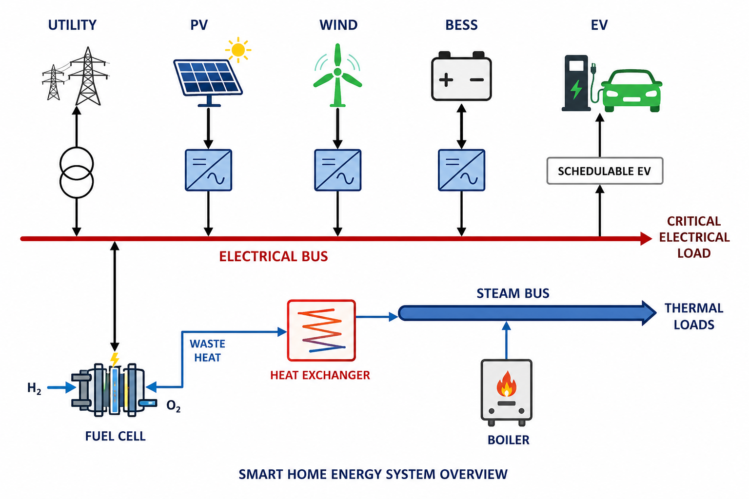
Components Overview

Slide 7
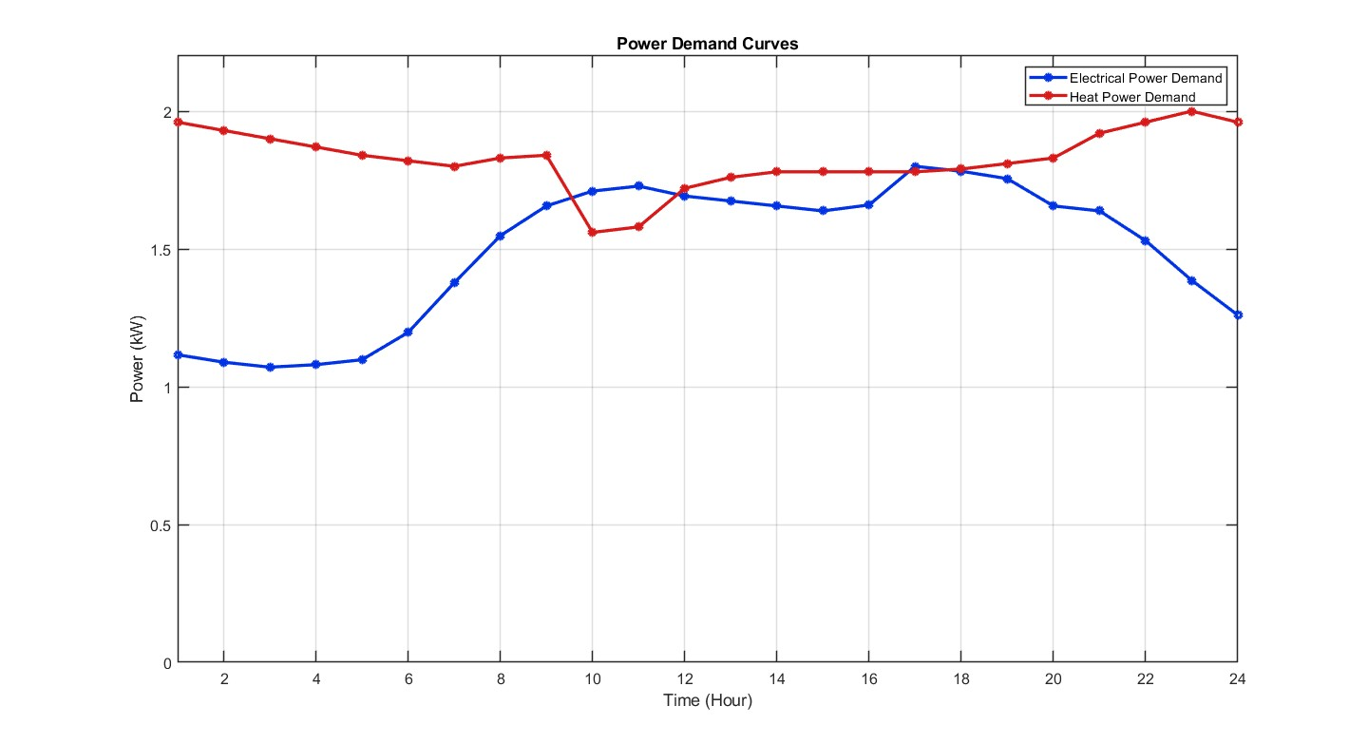
Electrical and Thermal Loads

Slide 8
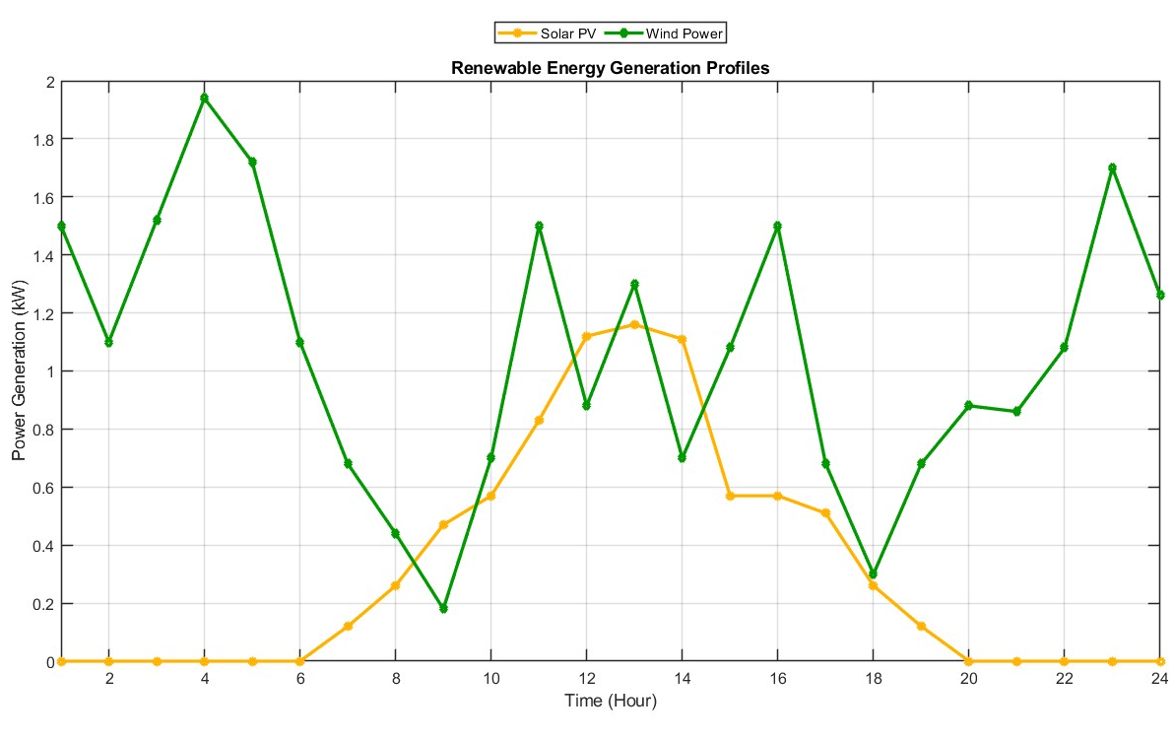
Renewables Generation

Slide 9
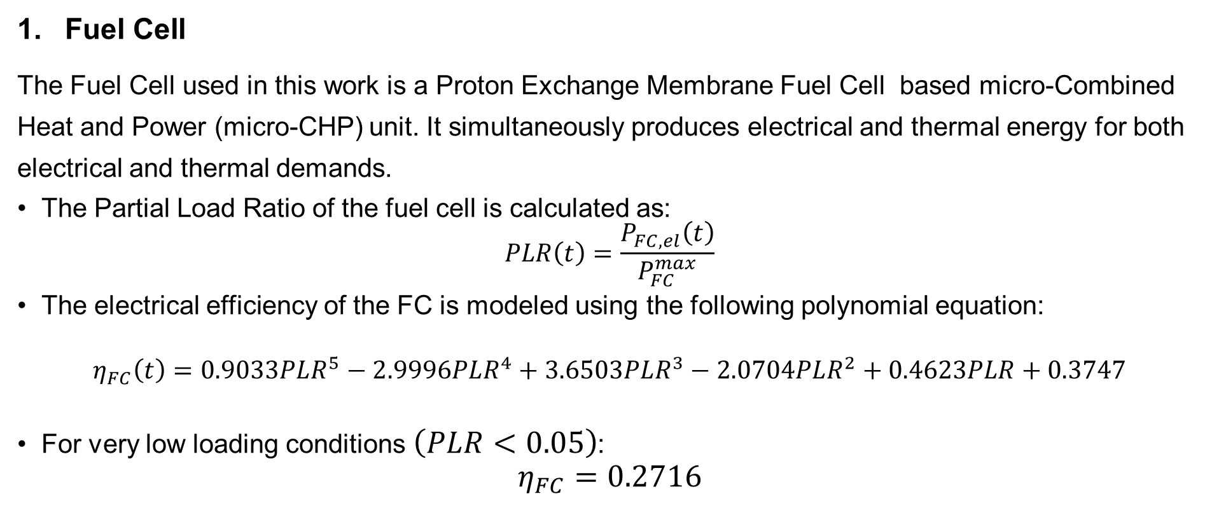
Modeling the Components
Fuel Cell
The Fuel Cell used in this work is a Proton Exchange Membrane Fuel Cell based micro-Combined Heat and Power (micro-CHP) unit. It simultaneously produces electrical and thermal energy for both electrical and thermal demands.
The Partial Load Ratio of the fuel cell is calculated as:
$$PLR\left(t\right)=\frac{P_{FC,el}\left(t\right)}{P_{FC}^{max}}$$
The electrical efficiency of the FC is modeled using the following polynomial equation:
$$η_{FC}\left(t\right)=0.9033PLR^{5}−2.9996PLR^{4}+3.6503PLR^{3}−2.0704PLR^{2}+0.4623PLR+0.3747$$
For very low loading conditions $\left(PLR<0.05\right)$:
$$η_{FC}=0.2716$$

Slide 10
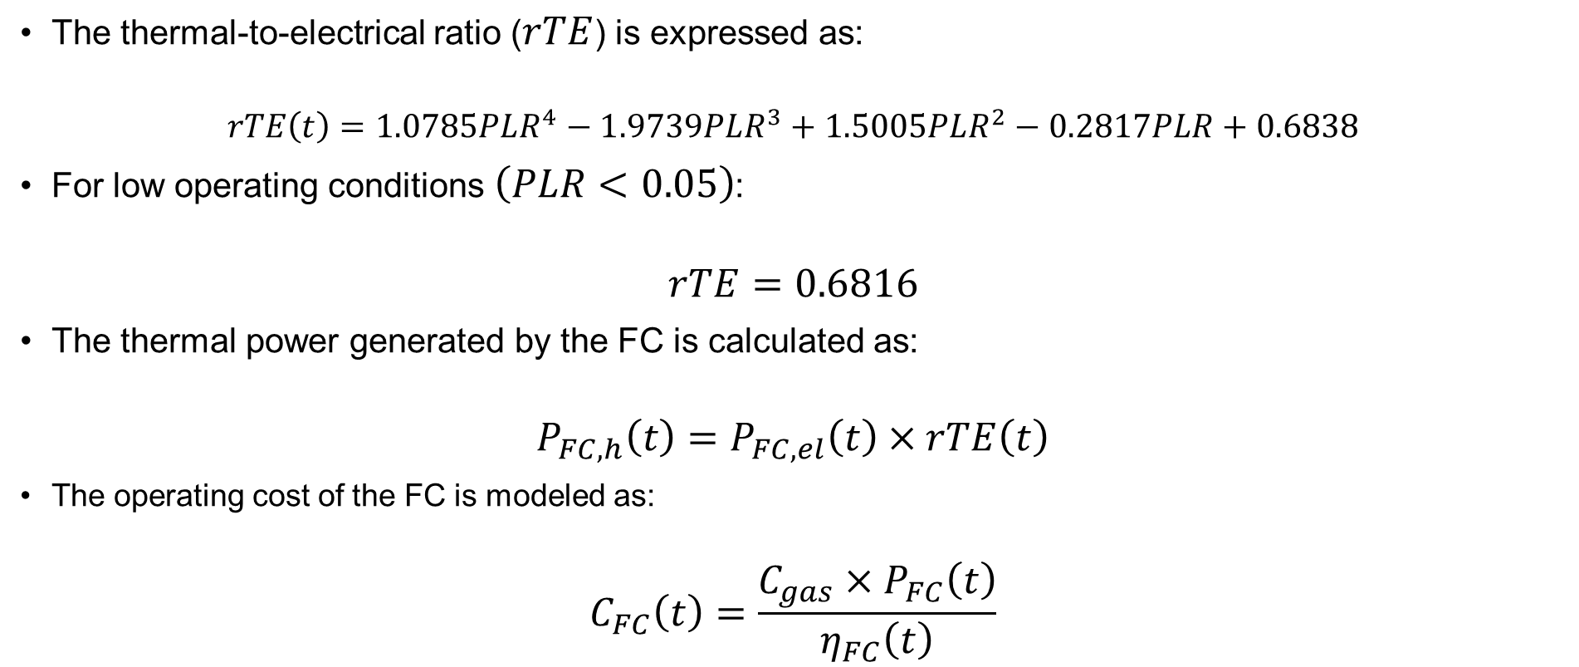
Modeling the Components
The thermal-to-electrical ratio ($rTE$) is expressed as:
$$rTE\left(t\right)=1.0785PLR^{4}−1.9739PLR^{3}+1.5005PLR^{2}−0.2817PLR+0.6838$$
For low operating conditions $\left(PLR<0.05\right)$:
$$rTE=0.6816$$
The thermal power generated by the FC is calculated as:
$$P_{FC,h}\left(t\right)=P_{FC,el}\left(t\right)×rTE\left(t\right)$$
The operating cost of the FC is modeled as:
$$C_{FC}\left(t\right)=\frac{C_{gas}×P_{FC}\left(t\right)}{η_{FC}\left(t\right)}$$

Slide 11
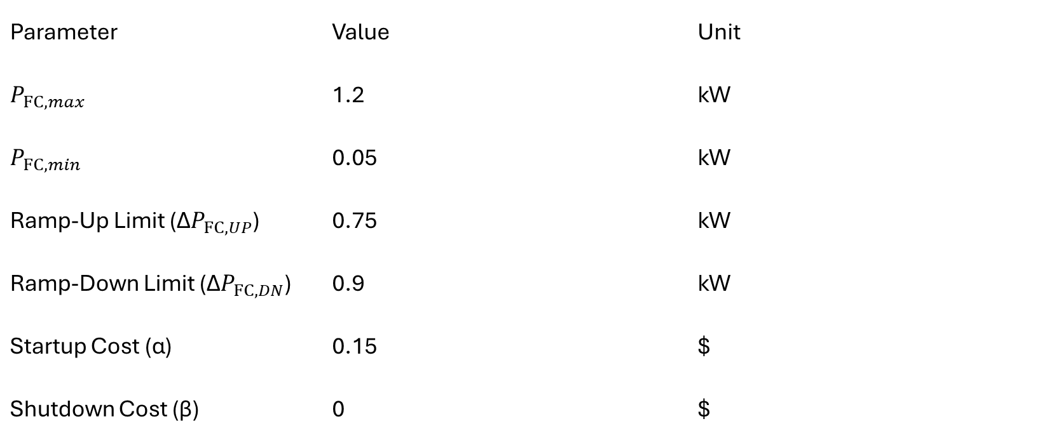
Modeling the Components
Fuel Cell Parameters
Parameter | Value | Unit
$$P_{FC,max}$$ | 1.2 | kW
$$P_{FC,min}$$ | 0.05 | kW
Ramp-Up Limit (Δ$P_{FC,UP}$) | 0.75 | kW
Ramp-Down Limit (Δ$P_{FC,DN}$) | 0.9 | kW
Startup Cost (α) | 0.15 | $
Shutdown Cost (β) | 0 | $

Slide 12
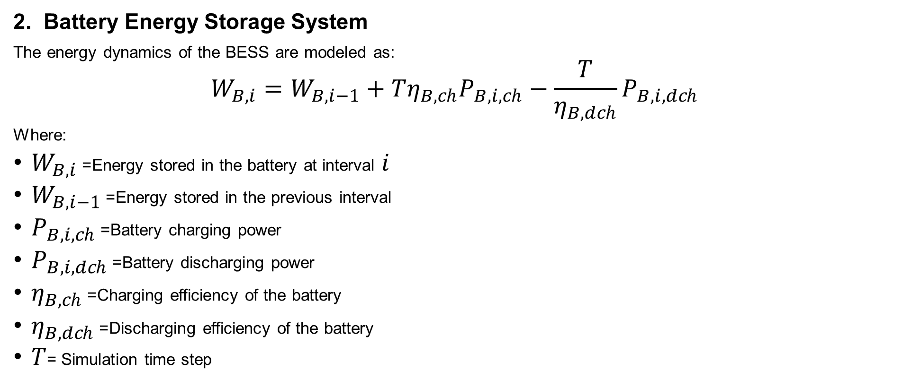
Modeling the Components
2. Battery Energy Storage System
The energy dynamics of the BESS are modeled as:
$$W_{B,i}=W_{B,i−1}+Tη_{B,ch}P_{B,i,ch}−\frac{T}{η_{B,dch}}P_{B,i,dch}$$
Where:
$W_{B,i}$= Energy stored in the battery at interval $i$
$W_{B,i−1}$= Energy stored in the previous interval
$P_{B,i,ch}$= Battery charging power
$P_{B,i,dch}$= Battery discharging power
$η_{B,ch}$= Charging efficiency of the battery
$η_{B,dch}$= Discharging efficiency of the battery
$T$= Simulation time step

Slide 13
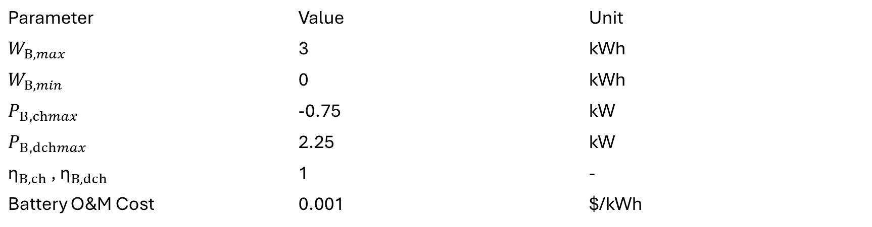
Modeling the Components
BESS Parameters
Parameter | Value | Unit
$$W_{B,max}$$ | 3 | kWh
$$W_{B,min}$$ | 0 | kWh
$$P_{B,chmax}$$ | -0.75 | kW
$$P_{B,dchmax}$$ | 2.25 | kW
${\text{η}}_{B,ch}$ , ${\text{η}}_{B,dch}$ | 1 | -
Battery O&M Cost | 0.001 | $/kWh

Slide 14

Modeling the Components
3. Electric Vehicle
The SOC of the EV at plug-in time is calculated as:
$$SOC_{EV,pi}=\left\{\begin{matrix}SOC_{EV,po}−\frac{d}{η_{EV} C_{EV}}, & \text{if} SOC_{EV,po}−\frac{d}{η_{EV} C_{EV}}≥SOC_{EV,min} \\ SOC_{EV,min}, & \text{Otherwise}\end{matrix}\right.$$
Where:
$SOC_{EV,pi}$= EV SOC at plug-in time
$SOC_{EV,po}$= EV SOC at plug-out time
$SOC_{EV,min}$= Minimum allowable EV SOC
$d$= Trip distance (miles)
$η_{EV}$= EV driving efficiency
$C_{EV}$= EV battery capacity (kWh)
This constraint prevents excessive battery depletion and preserves battery health.

Slide 15
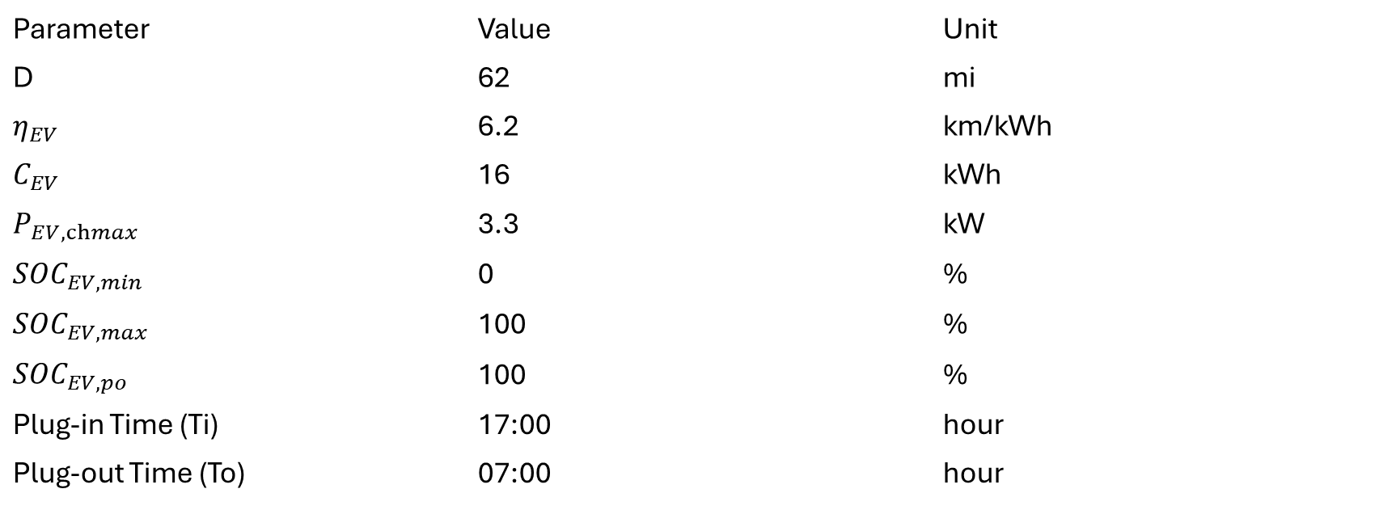
Modeling the Components
EV Parameters
Parameter | Value | Unit
D | 62 | mi
$$η_{EV}$$ | 6.2 | km/kWh
$$C_{EV}$$ | 16 | kWh
$$P_{EV,chmax}$$ | 3.3 | kW
$$SOC_{EV,min}$$ | 0 | %
$$SOC_{EV,max}$$ | 100 | %
$$SOC_{EV,po}$$ | 100 | %
Plug-in Time (Ti) | 17:00 | hour
Plug-out Time (To) | 07:00 | hour

Slide 16
Modeling the Components
Non-Critical Load
These appliances are considered non-critical because their operation can be shifted within a permissible time window without affecting user comfort significantly.
The optimizer schedules these loads during economically favorable hours to reduce overall operating cost and peak demand.
Appliance | Power Rating (kW) | Time Duration(Hours) | Flexible Operating Time
Electric Iron | 1.0 | 1 | 18:00 – 23:00
Washing Machine | 0.8 | 2 | 08:00 – 19:00
Water Pump | 1.2 | 1 | 06:00 – 10:00`

Slide 17
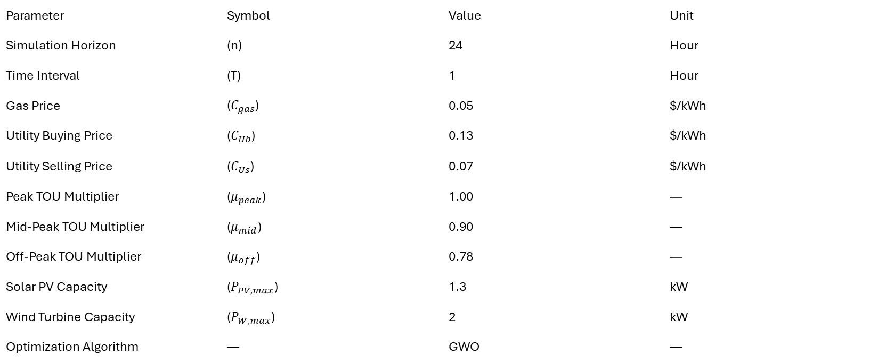
Modeling the Components
Other Parameters
Parameter | Symbol | Value | Unit
Simulation Horizon | (n) | 24 | Hour
Time Interval | (T) | 1 | Hour
Gas Price | ($C_{gas}$) | 0.05 | $/kWh
Utility Buying Price | ($C_{Ub}$) | 0.13 | $/kWh
Utility Selling Price | ($C_{Us}$) | 0.07 | $/kWh
Peak TOU Multiplier | ($μ_{peak}$) | 1.00 | —
Mid-Peak TOU Multiplier | ($μ_{mid}$) | 0.90 | —
Off-Peak TOU Multiplier | ($μ_{off}$) | 0.78 | —
Solar PV Capacity | ($P_{PV, max}$) | 1.3 | kW
Wind Turbine Capacity | ($P_{W, max}$) | 2 | kW
Optimization Algorithm | — | GWO | —

Slide 18

Cost Function(Objective Function)
The Objective Function for the Optimizer is:
min∑​($C_{FC,i}$+ $C_{BL,i}$​+ $C_{U,i}$​+ $C_{B,i}$​)
$C_{FC,i}=\left\{\begin{matrix}T⋅C_{gas}\left(\frac{P_{FC,i}}{η_{FC,i}}\right)+α, & P_{FC,i−1}=0, P_{FC,i}>0 \\ β, & P_{FC,i−1}>0, P_{FC,i}=0 \\ T⋅C_{gas}\left(\frac{P_{FC,i}}{η_{FC,i}}\right), & \text{Otherwise}\end{matrix}\right.$
$C_{BL,i}=T⋅C_{gas}⋅H_{BL,i}$
$C_{U,i}=\left\{\begin{matrix}T⋅T_{b}⋅C_{Ub}⋅P_{U,i}, & P_{U,i}≥0 \\ T⋅T_{s}⋅C_{Us}⋅P_{U,i}, & P_{U,i}<0\end{matrix}\right.$
$C_{B,i}=\left\{\begin{matrix}C_{BOM}⋅P_{B,i}⋅T, & P_{B,i}≥0 \\ −C_{BOM}⋅P_{B,i}⋅T, & P_{B,i}<0\end{matrix}\right.$

Slide 19
Grey Wolf Algorithm
Inspiration from Nature
The Grey Wolf Optimizer (GWO) is a metaheuristic optimization algorithm inspired by the hunting behavior and leadership hierarchy of grey wolves.
Hierarchy of Wolves
Alpha (α) → Best solution
Beta (β) → Second best solution
Delta (δ) → Third best solution
Omega (ω) → Remaining search agents
The wolves cooperate and follow the top three leaders to search for the global optimum solution.

Slide 20
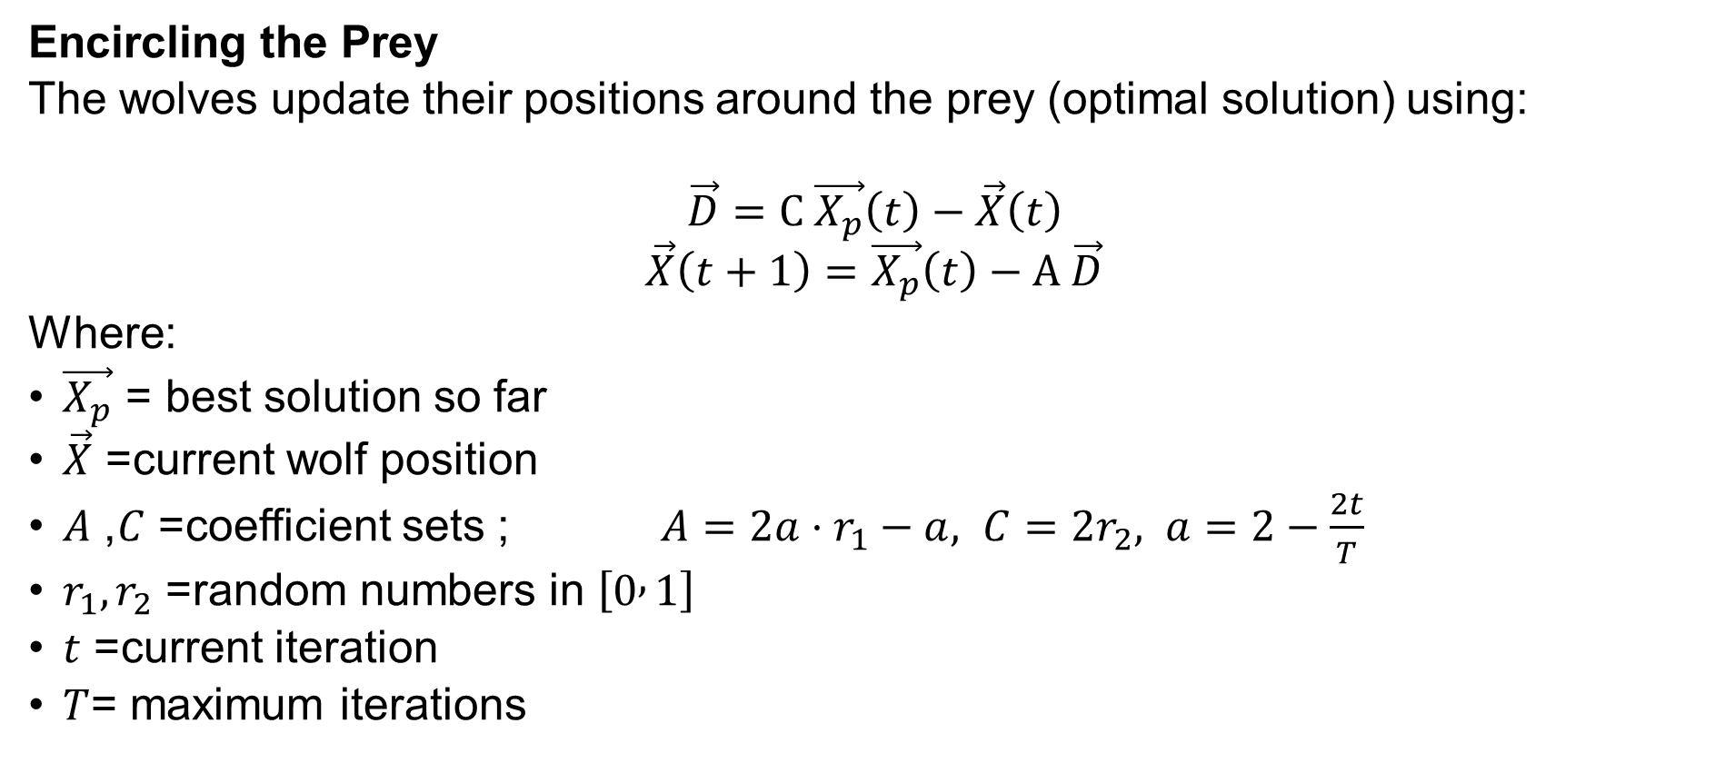
Grey Wolf Algorithm
Encircling the Prey
The wolves update their positions around the prey (optimal solution) using:
$$\vec{D}=C \vec{X_{p}}\left(t\right)−\vec{X}\left(t\right)$$
$$\vec{X}\left(t+1\right)=\vec{X_{p}}\left(t\right)−A \vec{D}$$
Where:
$\vec{X_{p}}$= best solution so far
$\vec{X}$= current wolf position
$A$, $C$= coefficient sets ; $A=2a⋅r_{1}−a, C=2r_{2}, a=2−\frac{2t}{T}$
$r_{1},r_{2}$= random numbers in $\left[0 , 1\right]$
$t$= current iteration
$T$= maximum iterations

Slide 21
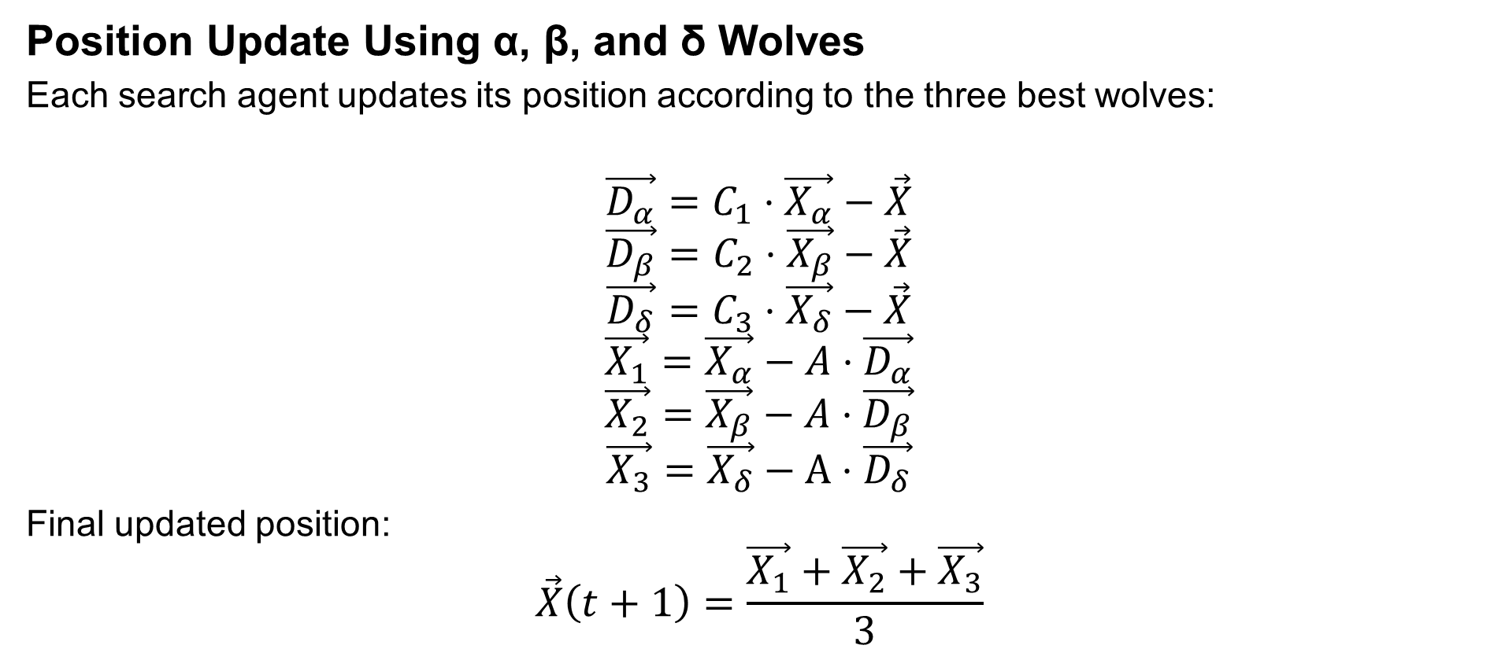
Grey Wolf Algorithm
Position Update Using α, β, and δ Wolves
Each search agent updates its position according to the three best wolves:
$$\vec{D_{α}}=C_{1}⋅\vec{X_{α}}−\vec{X}$$
$$\vec{D_{β}}=C_{2}⋅\vec{X_{β}}−\vec{X}$$
$$\vec{D_{δ}}=C_{3}⋅\vec{X_{δ}}−\vec{X}$$
$$\vec{X_{1}}=\vec{X_{α}}−A⋅\vec{D_{α}}$$
$$\vec{X_{2}}=\vec{X_{β}}−A⋅\vec{D_{β}}$$
$$\vec{X_{3}}=\vec{X_{δ}}−A⋅\vec{D_{δ}}$$
Final updated position:
$$\vec{X}\left(t+1\right)=\frac{\vec{X_{1}}+\vec{X_{2}}+\vec{X_{3}}}{3}$$

Slide 22
Test Cases
Case | RES | BESS | FC | Non-Critical Load Scheduling | Net Metering | EV | EV Scheduling
Case 1 | ✗ | ✗ | ✗ | ✗ | ✗ | ✗ | ✗
Case 2 | ✓ | ✗ | ✗ | ✗ | ✗ | ✗ | ✗
Case 3 | ✓ | ✓ | ✗ | ✗ | ✗ | ✗ | ✗
Case 4 | ✓ | ✓ | ✓ | ✗ | ✗ | ✗ | ✗
Case 5 | ✓ | ✓ | ✓ | ✓ | ✗ | ✗ | ✗
Case 6 | ✓ | ✓ | ✓ | ✓ | ✓ | ✗ | ✗
Case 7 | ✓ | ✓ | ✓ | ✓ | ✓ | ✓ | ✗
Case 8 | ✓ | ✓ | ✓ | ✓ | ✓ | ✓ | ✓
Net Cost Case I = 6.41$

Slide 23
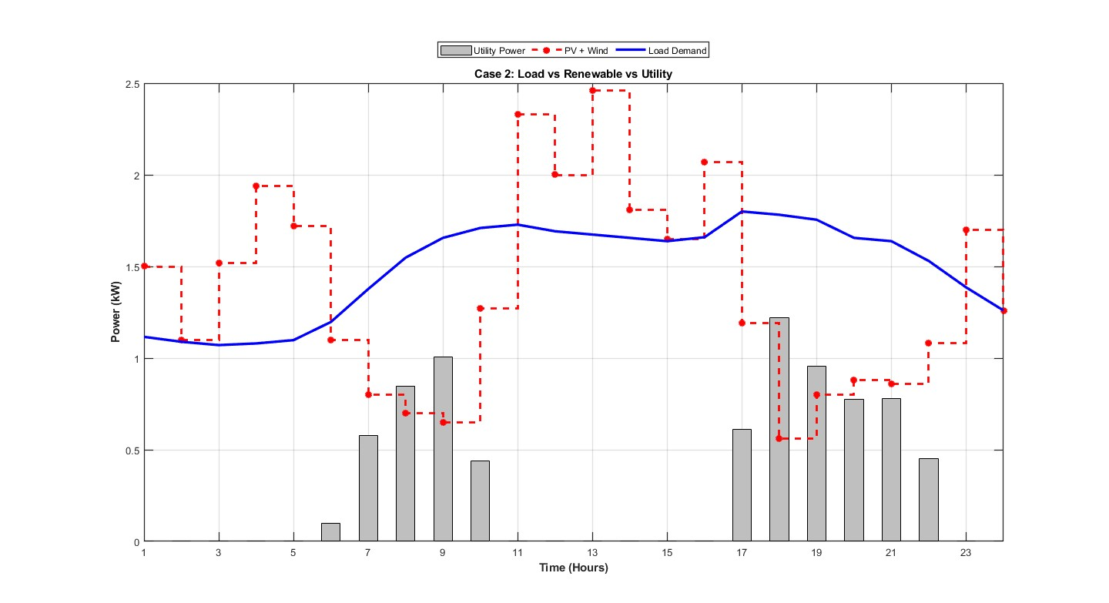
Test Case 2(Renewables Added)
Net Cost = 3.16$

Slide 24
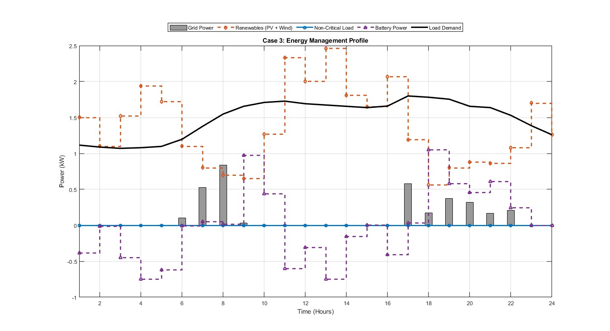
Test Case 3(BESS Added)
Net Cost = 2.85$

Slide 25
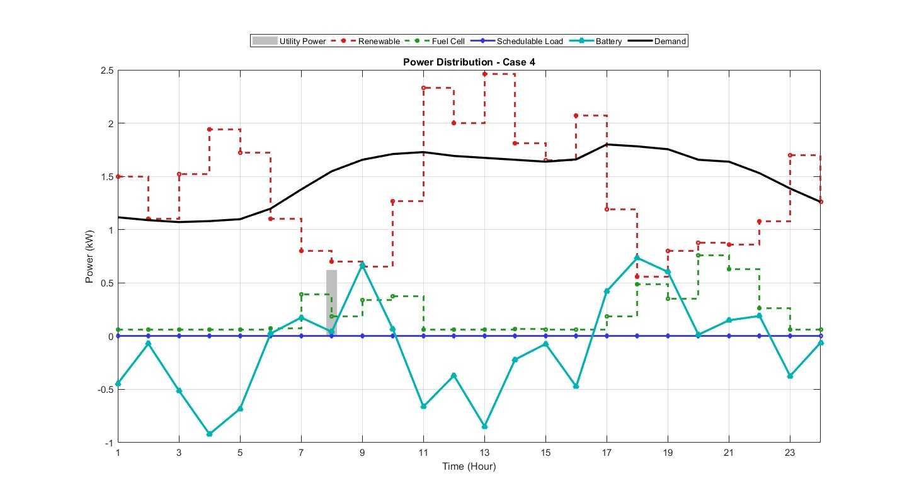
Test Case 4(FC Added)
Net Cost = 2.81$

Slide 26
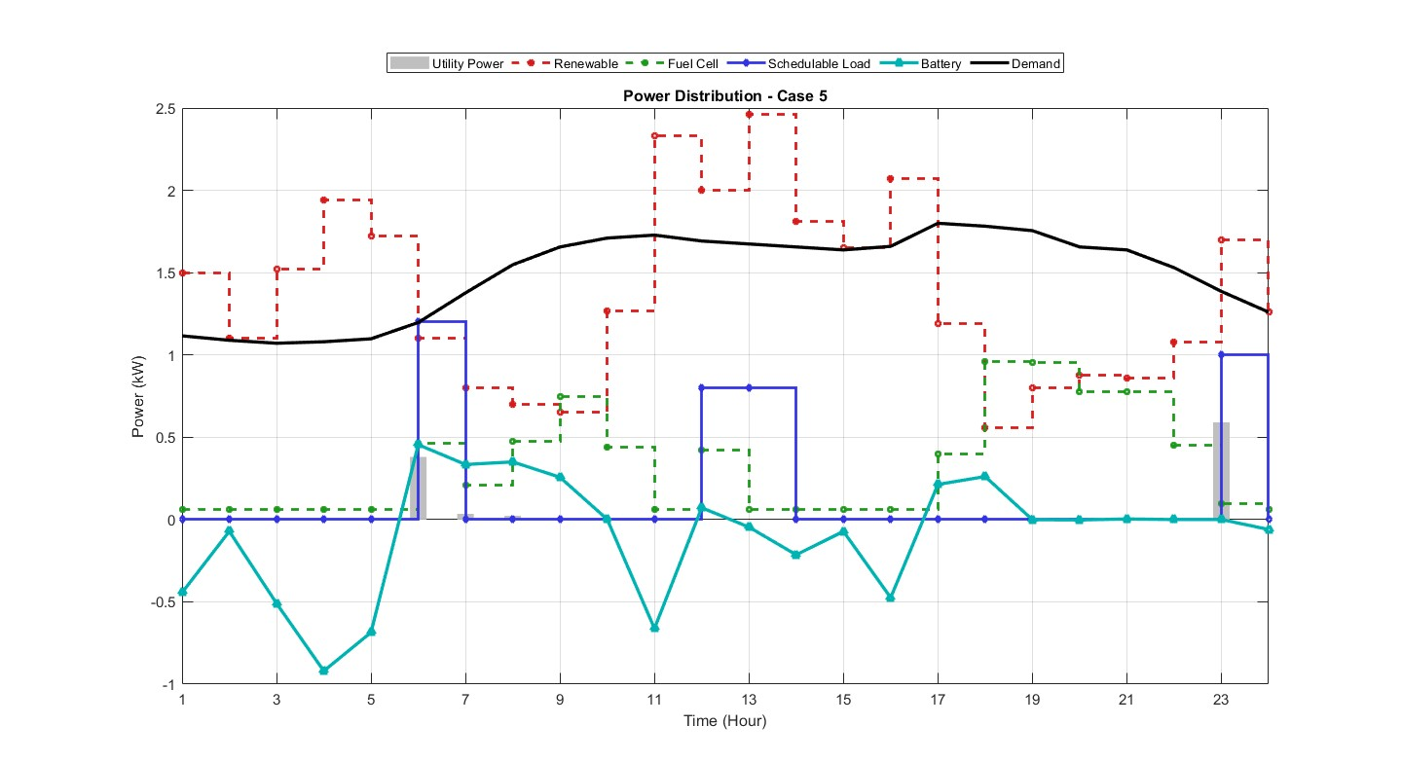
Test Case 5(Non-Critical Load Added)
Net Cost = 3.14$

Slide 27
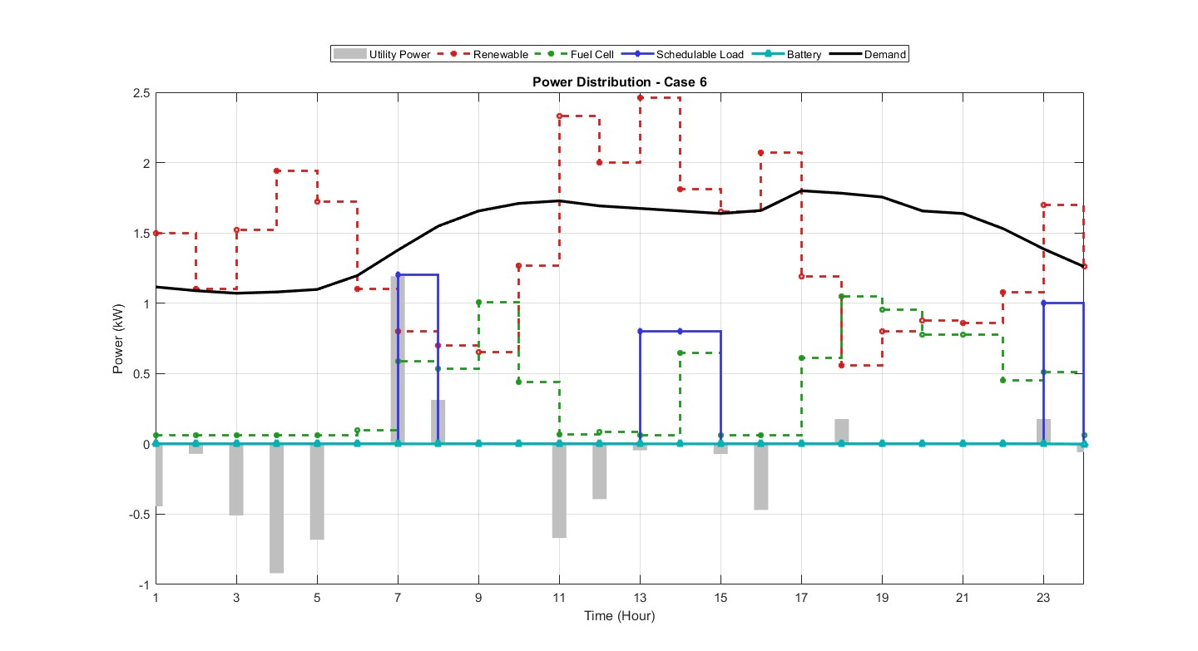
Test Case 6(Net Metering Allowed)
Net Cost = 3.01$

Slide 28
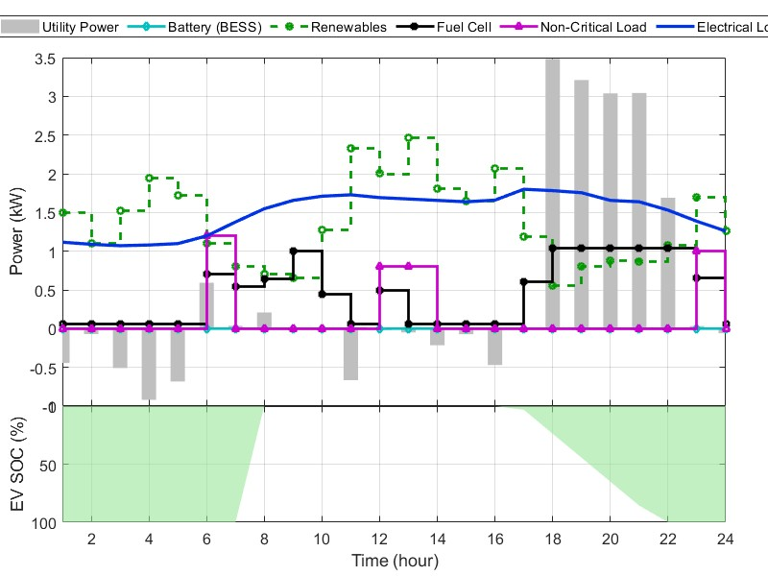
Test Case 7(EV Added Non-Schedulable)
Net Cost = 5.01$

Slide 29
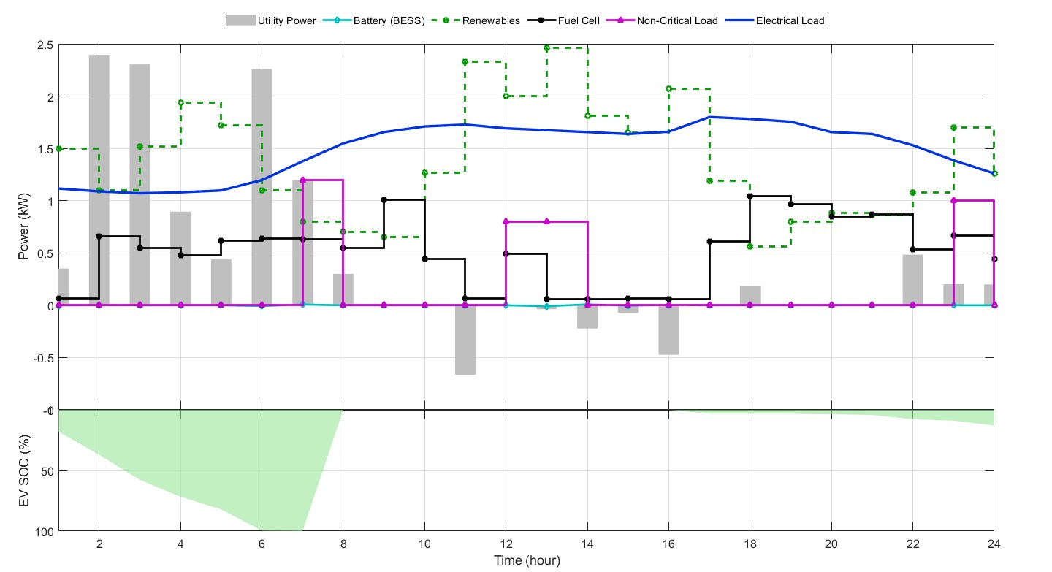
Test Case 8(EV added Schedulable)
Net Cost = 4.42$

Slide 30
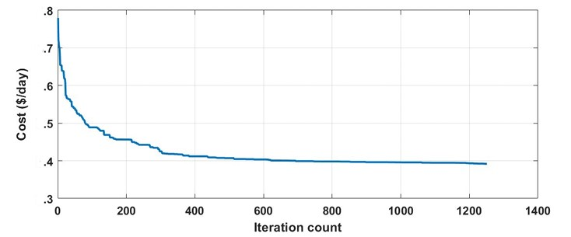
GWO Convergence (Case VIII)
4
4
4
4
4
4
Net Cost = 4.42$ Wolves = 500

Slide 31
The End…

