Slide 1
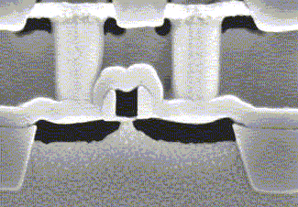
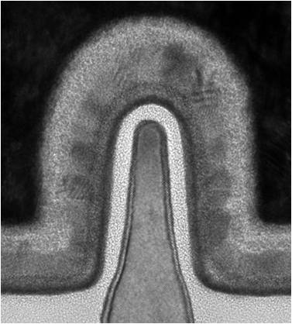
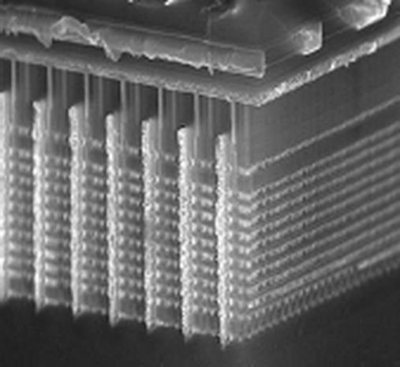
ECE4332 Carry-Skip Adder
Mac Cartier and Ashley Ferraro

Slide 2
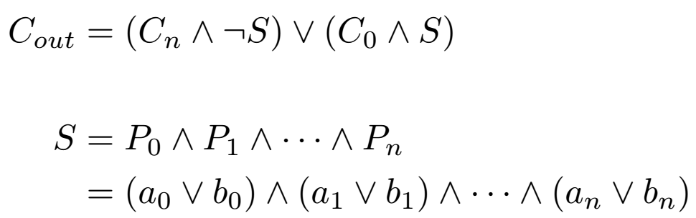
Carry-Skip Architecture
Standard ripple-carry architecture with the addition of a MUX allowing the carry in signal to skip to carry out rather than propagating through all the adders.
If the propagate signal is 1 for all of the summand bits, then the carry in is output. Else, the n-th carry out is output.

Slide 3
Block-Carry-Skip
The 16-bit adder is comprised of four 4-bit carry-skip adder blocks chained together.
The critical-path delay on a single block is no different from that of a carry-ripple adder. The improvement occurs when CSA blocks are chained together.
Worst case delay is propagation delay, 8 carry delays, 3 skip delays, and a sum delay. This is better than the 16 carry delays and a sum delay of a carry-ripple adder.
Delay reduction increases with number of bits.

Slide 4
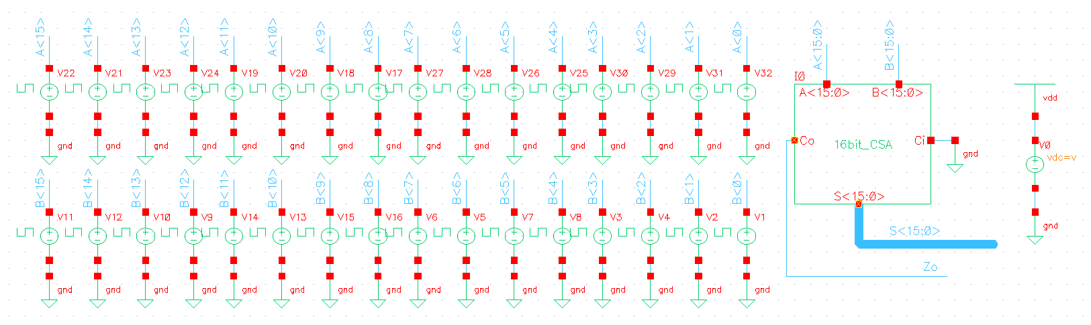
Testbench

Slide 5
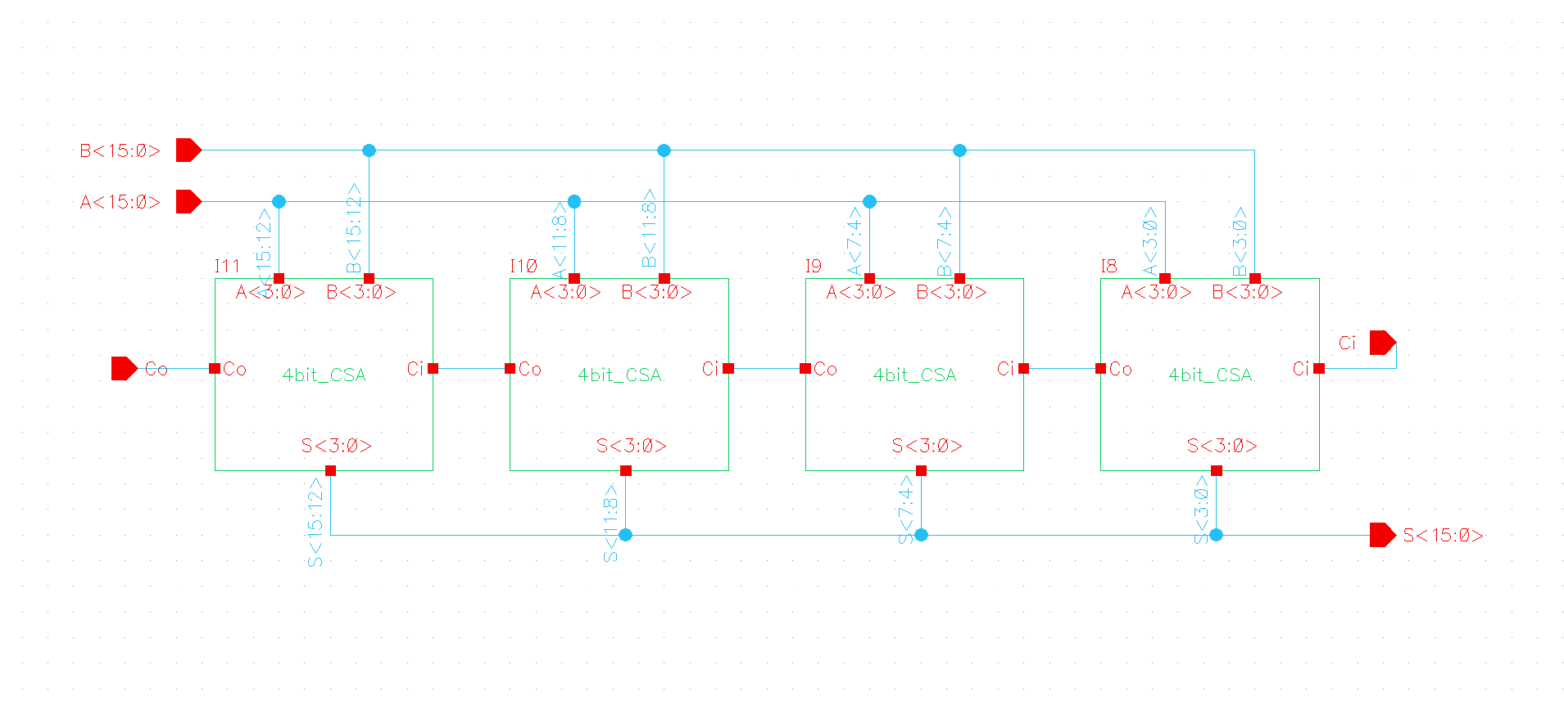
16-bit CSA

Slide 6
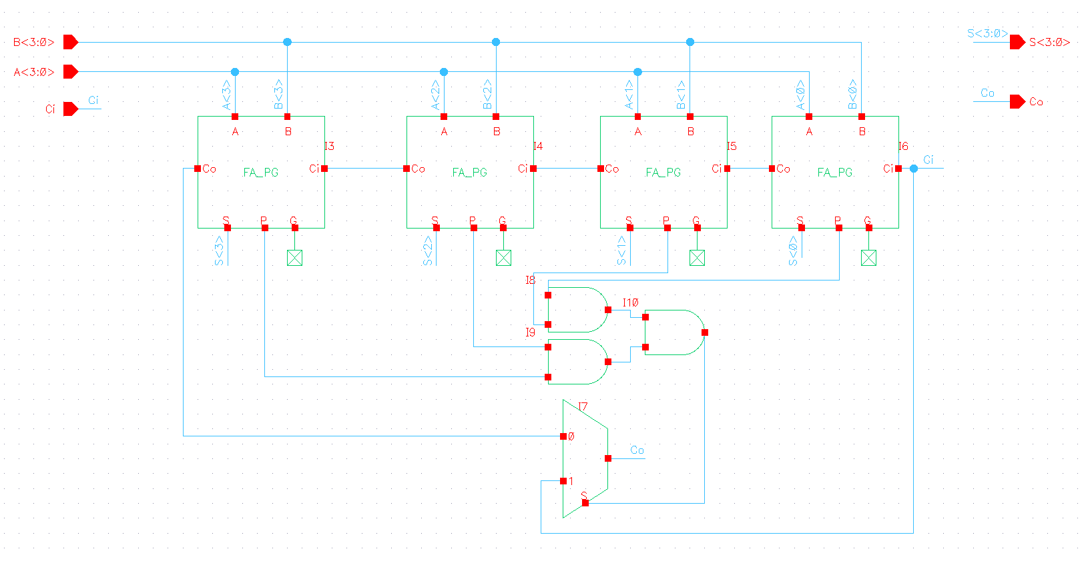
4-bit CSA

Slide 7
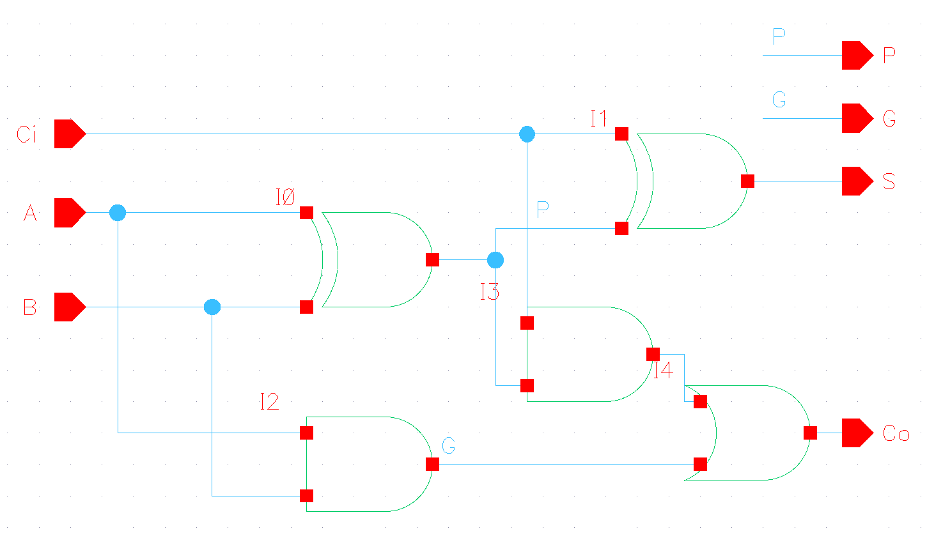
Full Adder

Slide 8
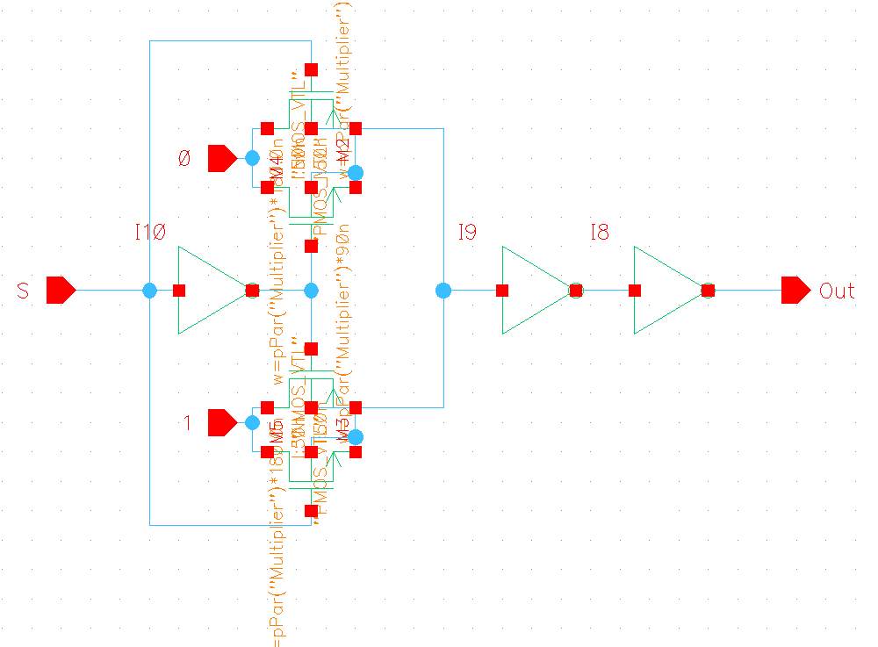
2:1 MUX

Slide 9
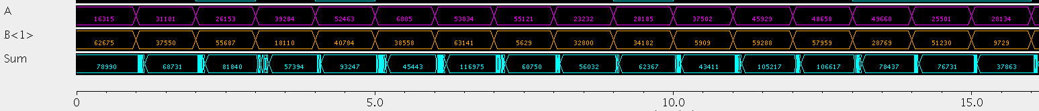
Functional Verification

Slide 10
Power Consumption
VDD (mV) | Average current (μA) | Average power (μW)
600 | 82.1 | 49.26
700 | 104.7 | 73.29
800 | 146.5 | 117.2
900 | 200 | 180
1000 | 264.1 | 264.1
1100 | 347.5 | 382.25
1200 | 456.7 | 548.04

Slide 11
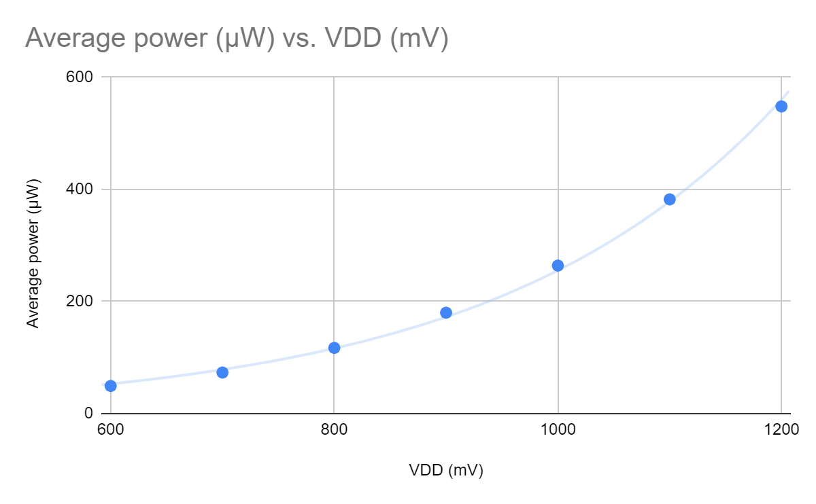

Slide 12
Critical Path Delay
VDD (mV) | Critical delay (ns)
600 | 0.44
700 | 0.366
800 | 0.291
900 | 0.26
1000 | 0.24
1100 | 0.22
1200 | 0.212

Slide 13
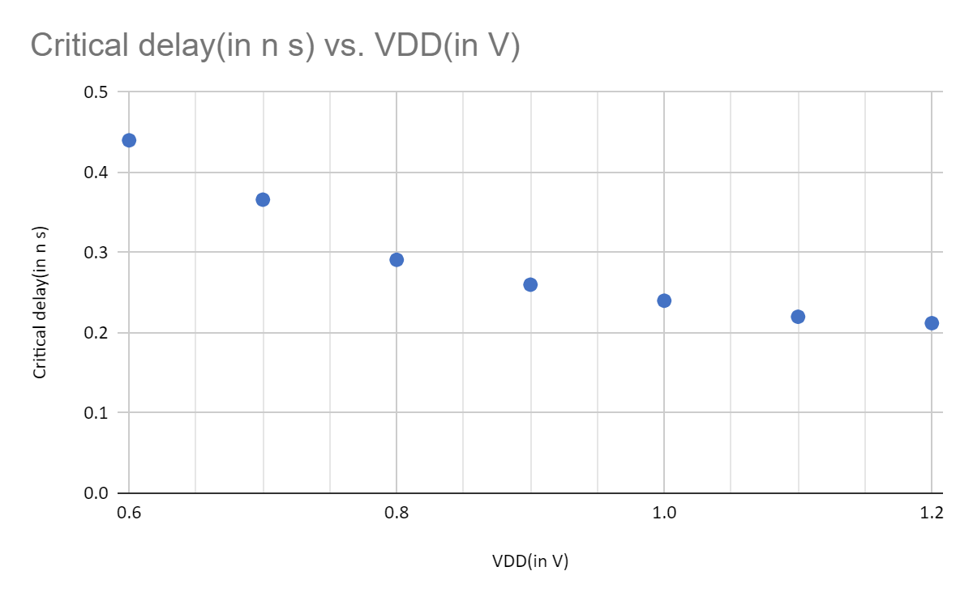

Slide 14
Power Delay Product
VDD (mV) | PDP (nJ)
600 | 14.53
700 | 17.08
800 | 23.16
900 | 32.44
1000 | 43.21
1100 | 57.7
1200 | 84.62

Slide 15
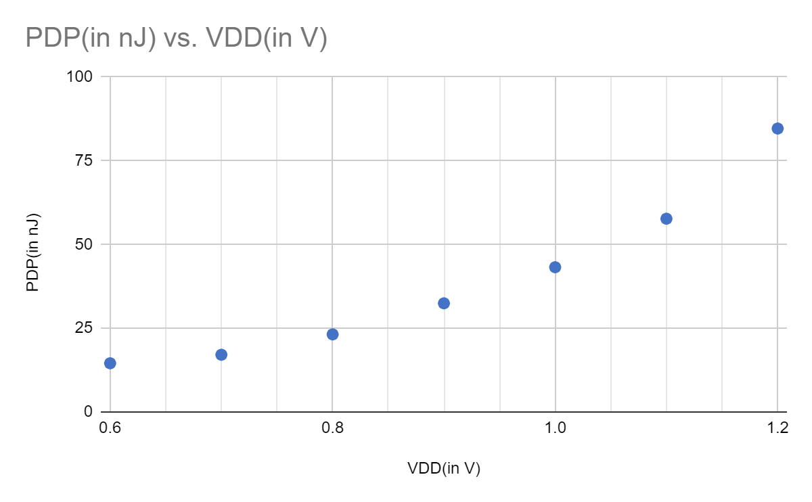

Slide 16
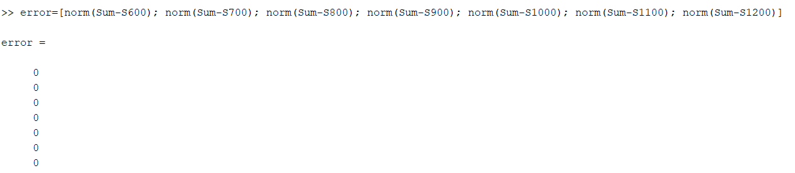
Accuracy
Our design had no errors at any of the VDD values. This was verified in MATLAB by finding the Euclidean norm of the differences of the sum vector and a reference sum vector.

Slide 17
Data Processing
All sum signals were sampled and exported to a csv file which was imported into MATLAB and processed with a script.
The script imports the voltages as vectors, quantizes the voltages to 0 or 1, and iterates through the columns to extract a decimal value.

Slide 18
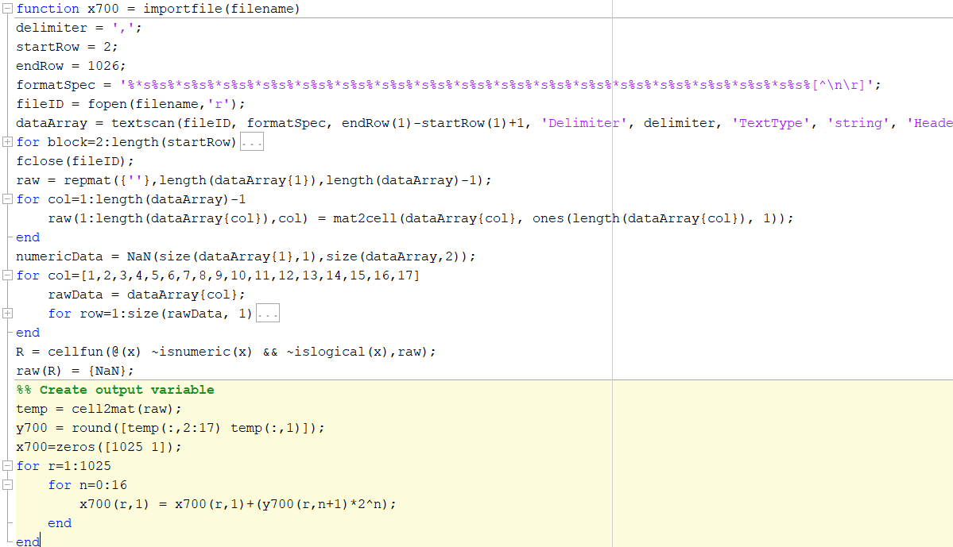

Slide 19
Challenges
At certain transition cases there are some transient spikes propagating through carry chains to the sums. It doesn't significantly affect functionality, so the issue was not pursued for more than a few hours. If we had more time, we would try to fix this issue.
We faced voltage sag at the MUX inputs which we rectified by buffering the output of the carries.

Slide 20
Future Work
A multilevel carry-skip architecture could improve on the speed of our design.
In the future we would fix the transition transient ringing issue
Optimization of transistor widths to reduce delay

Slide 21
Conclusion
The carry-skip architecture provides 100% accuracy while improving upon the ripple-carry architecture without significantly complicating the circuit or adding many additional transistors.
Using the PDP as a figure of merit, running the circuit at 600mV is ideal since it has the lowest PDP of any VDD option and it has perfect accuracy. This option doubles delay for a 20x reduction in power usage compared to VDD=1200mV. If delay were the figure of merit and power were inconsequential, then 1200mV would be the recommended VDD.

Slide 22
Results
VDD (mV) | Average power (μW) | Critical delay (ns) | PDP (nJ)
600 | 49.26 | 0.44 | 14.53
700 | 73.29 | 0.366 | 17.08
800 | 117.2 | 0.291 | 23.16
900 | 180.0 | 0.26 | 32.44
1000 | 264.1 | 0.24 | 43.21
1100 | 382.3 | 0.22 | 57.70
1200 | 548.0 | 0.212 | 84.62

