Slide 1
Human Factors of Distributed Software Engineering
Austin FitzGerald
INDSTENG 3430
12/09/2020
Notes:
Hello, I’m Austin FitzGerald and I am presenting an overview of the human factors of distributed software engineering. I’ll mention distributed software engineering a couple times throughout the next few slides but I won’t be able to truly state its definition until I cover a few other important topics first. For now, imagine that if you were a software engineer working in a distributed setting, you are working remotely – maybe from home.

Slide 2
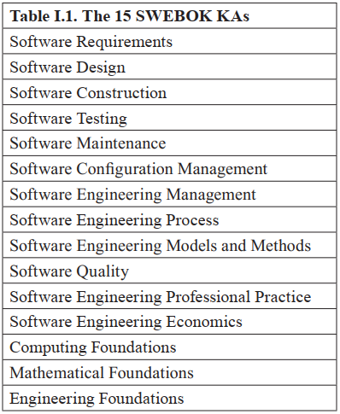
Software Engineering
There is no streamlined approach, as each project brings new interdisciplinary activities.
It is not just coding.
Human factors are impactful throughout the discipline.
Figure 1. The 15 SWEBOK Knowledge Areas. (Bourque et al., 2014)
Notes:
ISO/IEC/IEEE Systems and Software Engineering Vocabulary defines software engineering as “the application of a systematic, disciplined, quantifiable approach to the development, operation, and maintenance of software; that is, the application of engineering to software”. Figure 1 displays a list of Knowledge Areas created by the many writers and editors of The Guide to the Software Engineering Body of Knowledge, a book dedicated to characterizing the contents of software engineering in order to promote a consistent worldwide view and provide foundation for curriculum development. A misunderstanding in popular culture is that software engineering mostly involves coding, but in actuality each of these Knowledge Areas heavily relies on human-to-human interaction. Consideration of human-computer-interaction, across both digital and physical interfaces, is vital for successful software. Yet from a management perspective, any user-centered design is first dependent on successful application of software engineering processes.

Slide 3
Software is a byproduct of human activities that incorporates our problem- solving capabilities, cognitive aspects, and social interaction.
(Capretz, 2014)
Existing research revolves around analysis of socio-technical interaction, not physical states and traits.
Notes:
As one experienced author stated, “Software is a byproduct of human activities that incorporates our problem-solving capabilities, cognitive aspects, and social interaction”. In the study of human factors in software engineering, topics are less about the “factors of humans” involving physical states, and more about socio-technical interaction. While, from my review, authors rarely cite any formal definition for their use of the term “human factors”, it is obvious that most existing literature generally serves to understand and improve engineering process outcomes and human wellbeing. I will explain more near the end of this presentation, but longstanding overrepresentation of technological concepts has inhibited the ability for institutions to truly consider human factors in software engineering. Still, researchers like Lenberg or Feldt have chosen to move forward by using theories, concepts, and knowledge developed within social sciences. Others such as Bird, Edwards, or Nguyen have presented empirical studies that utilize unique procedures to measure the impacts of socio-technical differences on software quality.

Slide 4
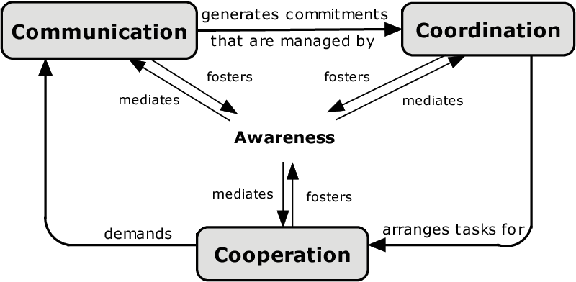
The 3C Collaboration Model
Communication: Exchange of information.
Coordination: Organization of people and tasks.
Cooperation: People working using shared resources.
Awareness: Understanding of total environment.
Trust: Expectations of people and groups for each other.
Figure 2. A diagram of the 3C Collaboration Model. (Fuks et al., 2007)
Notes:
In the literature which I reviewed, the most widely used terms used to describe human factors in general daily processes for software engineers are awareness, trust, communication, coordination, and cooperation. Nearly all papers which I reviewed used these terms without citing any definitions, but overall their use was fairly consistent with that of those who did. The 3C Collaboration Model is a framework for assessing overall collaboration in a system while separately analyzing each dimension, it was not created specifically for use in software engineering, but researchers have found it to be applicable. With respect to software engineering, Steinmacher defines each of the 3 C’s as follows. “During communication, people negotiate and make decisions, generating commitments. Coordination organizes and manages tasks and people. Cooperation is the execution of tasks by group members by means of a joint operation in a shared space manipulating shared artifacts”. Now, the descriptions of awareness and trust are each a bit longer, so for the purpose of this presentation I won’t go into much detail. Omoronyia et al. as well as Trainer & Redmiles separately describe how awareness is contextualized over time such that deeper levels of a person’s understanding of their work environment and coworkers is formed. This contextual awareness is helpful in exploring another group member’s situations, and therefore leads to more accurate trust. Developing and maintaining awareness and trust is critical for establishing effective communication, coordination, and collaboration, but difficult in distributed software engineering according to Dullemond et al. and Jolak et al..

Slide 5
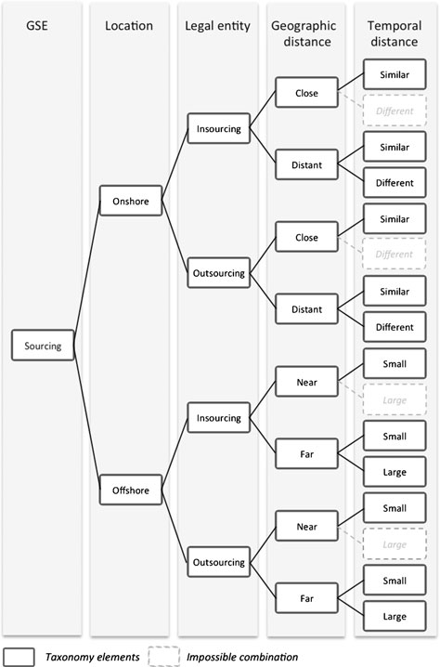
Distributed Software Engineering (DSE)
Individual, team, or organizational differences in:
Geographic location.
Organizational structure.
Temporal distance.
Cultural perspective.
Figure 3. DSE Taxonomy.
(Šmite et al., 2012)
Notes:
One interesting change to software engineering processes which causes noticeable impacts on awareness, trust, and the 3 C’s is distributed software engineering (DSE). Sometimes referred to as global software engineering, DSE is a growing organizational placement strategy that is sadly somewhat hard to define. There is no unified terminology or taxonomy of DSE. Still, I found one paper which systematically reviewed existing research and defined generally accepted knowledge. Šmite et al defines distributed software engineering as a facet of geographic location and relationships involving both inter- and intra-organizational structures. Basically, the difference from classical software engineering is that some individuals, teams, or organizations are working together while in different places. Working in DSE does not only involve working remotely, as I previously alluded to. You could work in one office with the same team every day, but if you have to coordinate work with anyone who is of measurable geographic distance, then you are working in a distributed environment. There are multiple authors who also use culture as a distinct element of DSE, stating that factors such as language and workplace norms are not exclusively related to geographic distance. Nonetheless, the taxonomy shown in Figure 3 may help everyone picture the vast number of scenarios which may arise in DSE, and the difficulties in the 3 C’s that are plausible.

Slide 6

Impacts of DSE on Communication
 |  | Does DSE cause significant negative impact on communication?
 |  | Yes | No
Does technology significantly mitigate social issues in communication? | Yes | (Andres, 2002; Henshel et al., 2015; Herbsleb et al., 2000; Jiménez et al., 2009; Jolak et al., 2018; Pierce and St.Amant, 2011; Stray & Moe, 2020) | (Al-Ani & Edwards, 2008; Bird et al., 2009; Edwards & Sridhar, 2003, Jabangwe et al., 2014; Nguyen et al., 2008)
 | No | (Olson & Olson, 2000) | (Reed & Knight, 2010)
Notes:
According to Bird et al., communication is the single most referenced factor related to challenges in DSE. Most of the literature that I reviewed observed negative impacts on communication due to decreased awareness and trust. Nearly all observed positive influence of rich communication tools in mitigating those social challenges. Olson & Olson concluded that there would never be technology which could properly mitigate cultural issues, but over the past 20 years multiple authors, like Nguyen et al., have taken the opportunity to directly refute their claim. Conversely, Reed & Knight failed to conclude concerns of inadequate communication in DSE but did nothing more than ponder about any technological benefits. Of those others who found no significant negative impact, Jabangwe et al. found that limiting geographic distance to nearshoring was more impactful than the technology used to communicate, suggesting social issues were more important. Bird, et al. attributed consistent use of tools and frequent contact as ways which they mitigated negative impacts on communication, but alluded to difficulties in doing so with large temporal distance. Interestingly, Al-Ani & Edwards found that classic co-located teams were just as likely to rely on the same types of media as distributed teams. They also found that defining explicit communication models was positively impactful. Greater awareness and trust in team members has been shown to mitigate geographic, temporal, and cultural differences that negatively impact communication according to Bird et al., and Omoronyia et al.. Likewise, having negative trust in managers has been observed to decrease the effectiveness of communication in DSE according to Casey. One paper in particular, Lous et al. caught my attention as being unique. It makes the claim that DSE can positively impact communication in some workplaces, as the ability to choose less-rich media allows for more efficient communication depending on the topic, suggesting that some meetings really do belong to be emails.

Slide 7
Mitigation of Issues
Affecting Coordination
Early definition of expectations for coordination, scheduling, and stakeholder roles (Herbsleb, 2007; Stray & Moe, 2020).
Constant activities to encourage trust such as formal or informal knowledge sharing sessions (Casey, 2010; Misra et al., 2013).
Long-term awareness of surroundings mitigates doubts in coordination (Espinosa et al., 2007; Jabangwe et al., 2014; Lous et al., 2018).
Notes:
As compared to communication, both coordination and cooperation are less popular in the literature that I reviewed. The two terms are referenced often enough, but most papers hold the same general conclusions as communication. Failures due to social issues with communication largely result in failures of technical organization in coordination. Nonetheless, Herbsleb states that the key phenomenon of DSE is coordination over distance. There can be any number of individuals or teams that are owners of certain parts of a software project. For software parts to eventually compose an entire product, individuals and teams must share schedules, allocate responsibilities, and maintain dependencies of tasks onto individuals and teams. This is especially difficult in DSE according to Espinosa et al.. Herbsleb describes how software architects, who begin to work in the earliest stages of development, have a major role in shaping the mechanisms for coordination. So, it is vital to define involved parties, their rules, expectations for scheduling, and other mechanisms early on according to Casey, Herbsleb, as well as Stray & Moe. In practice, coordination is largely dependent on the engineering approach used, for example an approach called Agile is designed with specific human roles, timelines, and meetings archetypes (Cockburn & Highsmith, 2001). As an interpersonal factor, the development of contextual awareness is vital for effective coordination. That is, it is important that people should rarely be made to switch teams, as coordination becomes more effective as individuals are more aware of their total surroundings according to Espinosa et al. and Lous et al..

Slide 8
Mitigation of Issues
Affecting Cooperation
Consistency in use of cooperation tools may be more important than the tools themselves (Bird et al., 2009; Prikladnicki et al., 2003; Rajpal, 2018; Stray & Moe, 2020)
Cooperation tools are chosen due to collective group awareness of perceived best practices (Lous et al., 2018).
Implementation of small-scale engineering cooperation methodologies like pair programming (Jalali and Wohlin, 2010; Rajpal, 2018).
Implementation of large-scale methodologies such as Agile or eXtreme Programming (Cockburn & Highsmith, 2001; Jalali and Wohlin, 2010; Mishra & Mishra, 2009).
Notes:
According to Jiménez et al., cooperation relies on the technical skills of a group much more than communication and coordination do. So, while it levies the tasks organized via coordination and is greatly impacted by the transfer of information via communication, there are less social issues directly involved with cooperation. Still, as you may have already guessed, some researchers have argued that geographic and temporal distance negatively impact cooperation as well, like Casey and Misra et al.. The use of tools to mitigate these concerns is shown in a different light for cooperation, as many authors argue that consistency is more important than the tools themselves. The consistent use of tools works to increase workspace awareness, which directly improves productivity and trust, which in turn positively impacts contextual awareness. The researchers largely attribute problem solving skills as reason for the lack of vital choice of tools itself; that said, no researchers specifically chose tools that they thought wouldn’t work. Also, as Lous et al. wrote of their observation that continuous improvement of processes and tools is dictated by the ways which groups want to cooperate; this calls back to contextual awareness. Lastly, multiple studies have shown success in DSE after careful and collaborative implementation of organizational methodologies.

Slide 9
State of Research in DSE
Very limited number of empirical studies involving software quality in DSE (Jabangwe et al., 2014; Jimenez et al., 2009; Misra & Fernández-Sanz, 2011).
Contradictory findings on the effects of DSE, possibly due to invalid research methodology (Nguyen et al., 2016).
Over representation of technology in academia.
  Lack of research in SE involving organizational, social, or psychological factors (Amrit et al., 2014 ; Lenberg et al., 2014; Feldt et al, 2008; Pirzadeh, 2010).
  Human factors in SE is treated as common sense in college classes, there is not enough focus on the soft skills involved in software engineering (Capretz, 2014).
Lack of unified and generally accepted terminology and taxonomy describing DSE (Gumm, 2006; Šmite et al., 2012)
Notes:
My original purpose in this literature review was to find the factors involved in distributed software engineering which had direct impacts on software quality. Most research concluded that socio-technical concerns related to trust and awareness have some significantly negative impact on communication, coordination, or cooperation. Yet, as far as my literature review is concerned, there are very few studies which leverage human factors in DSE to determine differences in software quality. There is even doubt in the accuracy of research involving DSE and software quality due to, as Nguyen et al. describes, unnoticed bias in research methodology. Overall, a central issue is just a lack of organized knowledge on human factors in software engineering. International standards don’t specifically define much of anything to do with DSE or human factors except for user-centered design, so accreditation criteria doesn’t include anything, and therefore college professors don’t either.

Slide 10
References 1
Al-Ani, B., & Edwards, H. K. (2008). A Comparative Empirical Study of Communication in Distributed and Collocated Development Teams. 2008 IEEE International Conference on Global Software Engineering, 35–44. https://doi.org/10.1109/ICGSE.2008.9
Amrit, C., Daneva, M., & Damian, D. (2014). Human factors in software development: On its underlying theories and the value of learning from related disciplines. A guest editorial introduction to the special issue. Information and Software Technology, 56(12), 1537–1542. https://doi.org/10.1016/j.infsof.2014.07.006
Andres, H. (2002). A comparison of face-to-face and virtual software development teams. Team Performance Management, 8, 39–48. https://doi.org/10.1108/13527590210425077
Bird, C., Nagappan, N., Devanbu, P., Gall, H., & Murphy, B. (2009). Does distributed development affect software quality? An empirical case study of Windows Vista. 2009 IEEE 31st International Conference on Software Engineering, 518–528. https://doi.org/10.1109/ICSE.2009.5070550
Bourque, P., Fairley, R. E., & IEEE Computer Society. (2014). Guide to the software engineering body of knowledge.
Capretz, L. F. (2014). Bringing the Human Factor to Software Engineering. IEEE Software, 31(2), 104–104. https://doi.org/10.1109/MS.2014.30
Casey, V. (2010). Developing Trust In Virtual Software Development Teams. Journal of Theoretical and Applied Electronic Commerce Research, 5(2), 41–58. https://doi.org/10.4067/S0718-18762010000200004
Cockburn, A., & Highsmith, J. (2001). Agile software development, the people factor. Computer, 34(11), 131–133. https://doi.org/10.1109/2.963450
Conchuir, E. O., Holmstrom, H., Agerfalk, P. J., & Fitzgerald, B. (2006). Exploring the Assumed Benefits of Global Software Development. 2006 IEEE International Conference on Global Software Engineering (ICGSE’06), 159–168. https://doi.org/10.1109/ICGSE.2006.261229
Dullemond, K., Gameren, B. van, & Solingen, R. van. (2012). Supporting distributed software engineering in a fully distributed organization. 2012 5th International Workshop on Co-Operative and Human Aspects of Software Engineering (CHASE), 30–36. https://doi.org/10.1109/CHASE.2012.6223017
Edwards, H. K., & Sridhar, V. (2003). Analysis of the effectiveness of global virtual teams in software engineering projects. 36th Annual Hawaii International Conference on System Sciences, 2003. Proceedings of The, 9 pp.-. https://doi.org/10.1109/HICSS.2003.1173664
Espinosa, J., Slaughter, S., Kraut, R., & Herbsleb, J. (2007). Team Knowledge and Coordination in Geographically Distributed Software Development. J. of Management Information Systems, 24, 135–169. https://doi.org/10.2753/MIS0742-1222240104
Feldt, R., Torkar, R., Angelis, L., & Samuelsson, M. (2008). Towards individualized software engineering: Empirical studies should collect psychometrics. Proceedings of the 2008 International Workshop on Cooperative and Human Aspects of Software Engineering - CHASE ’08, 49–52. https://doi.org/10.1145/1370114.1370127
Fuks, H., Raposo, A., Gerosa, M. A., Pimental, M., & Lucena, C. (2007). The 3C collaboration model (pp. 637–644). https://doi.org/10.4018/978-1-59904-000-4.ch097
Gumm, D. C. (2006). Distribution Dimensions in Software Development Projects: A Taxonomy. IEEE Software, 23(5), 45–51. https://doi.org/10.1109/MS.2006.122
Henshel, D., Cains, M. G., Hoffman, B., & Kelley, T. (2015). Trust as a Human Factor in Holistic Cyber Security Risk Assessment. Procedia Manufacturing, 3, 1117–1124. https://doi.org/10.1016/j.promfg.2015.07.186
Herbsleb, J. D. (2007). Global Software Engineering: The Future of Socio-technical Coordination. Future of Software Engineering (FOSE ’07), 188–198. https://doi.org/10.1109/FOSE.2007.11
Herbsleb, J. D., Mockus, A., Finholt, T. A., & Grinter, R. E. (2000). Distance, dependencies, and delay in a global collaboration. Proceedings of the 2000 ACM Conference on Computer Supported Cooperative Work - CSCW ’00, 319–328. https://doi.org/10.1145/358916.359003
International Organization for Standardization. (2010). Ergonomics of human-system interaction—Part 210: Human-centred design for interactive systems (ISO Standard No. 9241-210:2010). https://www.iso.org/standard/52075.html
Jabangwe, R., Börstler, J., & Petersen, K. (2015). Handover of managerial responsibilities in global software development: A case study of source code evolution and quality. Software Quality Journal, 23(4), 539–566. https://doi.org/10.1007/s11219-014-9247-1
Jalali, S., & Wohlin, C. (2010). Agile Practices in Global Software Engineering—A Systematic Map. 2010 5th IEEE International Conference on Global Software Engineering, 45–54. https://doi.org/10.1109/ICGSE.2010.14

Slide 11
References 2
Jolak, R., Wortmann, A., Chaudron, M., & Rumpe, B. (2018). Does Distance Still Matter? Revisiting Collaborative Distributed Software Design. IEEE Software, 35(6), 40–47. https://doi.org/10.1109/MS.2018.290100920
Lenberg, P., Feldt, R., & Wallgren, L. G. (2015). Human Factors Related Challenges in Software Engineering – An Industrial Perspective. 2015 IEEE/ACM 8th International Workshop on Cooperative and Human Aspects of Software Engineering, 43–49. https://doi.org/10.1109/CHASE.2015.13
Lenberg, Per, Feldt, R., & Wallgren, L.-G. (2014). Towards a behavioral software engineering. Proceedings of the 7th International Workshop on Cooperative and Human Aspects of Software Engineering, 48–55. https://doi.org/10.1145/2593702.2593711
Lous, P., Tell, P., Michelsen, C. B., Dittrich, Y., Kuhrmann, M., & Ebdrup, A. (2018). Virtual by Design: How a Work Environment can Support Agile Distributed Software Development. 2018 IEEE/ACM 13th International Conference on Global Software Engineering (ICGSE), 97–106.
Mishra, D., & Mishra, A. (2009). Effective communication, collaboration, and coordination in eXtreme Programming: Human-centric perspective in a small organization. Human Factors and Ergonomics in Manufacturing, 19(5), 438–456. https://doi.org/10.1002/hfm.20164
Misra, S., Colomo-Palacios, R., Pusatlı, T., & Soto-Acosta, P. (2013). A discussion on the role of people in global software development. Tehnicki Vjesnik, 20, 525–531.
Misra, S., & Fernández-Sanz, L. (2011). Quality Issues in Global Software Development. ICSEA 2011: The Sixth International Conference on Software Engineering Advances, 325–330.
Nguyen, T. H. D., Adams, B., & Hassan, A. E. (2016). Does Geographical Distance Effect Distributed Development Teams: How Aggregation Bias in Software Artifacts Causes Contradictory Findings. 2016 IEEE 27th International Symposium on Software Reliability Engineering (ISSRE), 412–423. https://doi.org/10.1109/ISSRE.2016.36
Nguyen, T., Wolf, T., & Damian, D. (2008). Global Software Development and Delay: Does Distance Still Matter? 2008 IEEE International Conference on Global Software Engineering, 45–54. https://doi.org/10.1109/ICGSE.2008.39
Olson, G. M., & Olson, J. S. (2000). Distance Matters. Human–Computer Interaction, 15(2–3), 139–178. https://doi.org/10.1207/S15327051HCI1523_4
Omoronyia, I., Ferguson, J., Roper, M., & Wood, M. (2010). A review of awareness in distributed collaborative software engineering. Software: Practice and Experience, 40(12), 1107–1133. https://doi.org/10.1002/spe.1005
Pierce, R., & St.Amant, K. (2011). Working from home in a globally distributed environment. SIGDOC’11 - Proceedings of the 29th ACM International Conference on Design of Communication. https://doi.org/10.1145/2038476.2038519
Pirzadeh, L. (2010). Human Factors in Software Development: A Systematic Literature Review [Master’s thesis, Chalmers University of Technology]. https://hdl.handle.net/20.500.12380/126748
Prikladnicki, R., Audy, J. L. N., & Evaristo, R. (2003). Global software development in practice lessons learned. Software Process: Improvement and Practice, 8(4), 267–281. https://doi.org/10.1002/spip.188
Rajpal, M. (2018). Effective Distributed Pair Programming. 2018 IEEE/ACM 13th International Conference on Global Software Engineering (ICGSE), 6–10. https://dl.acm.org/doi/10.1145/3196369.3196388
Reed, A. H., & Knight, L. V. (2010). Effect of a virtual project team environment on communication-related project risk. International Journal of Project Management, 28(5), 422–427. https://doi.org/10.1016/j.ijproman.2009.08.002
Šmite, D., Wohlin, C., Galviņa, Z., & Prikladnicki, R. (2014). An empirically based terminology and taxonomy for global software engineering. Empirical Software Engineering, 19(1), 105–153. https://doi.org/10.1007/s10664-012-9217-9
Steinmacher, I., Chaves, A. P., & Gerosa, M. A. (2013). Awareness Support in Distributed Software Development: A Systematic Review and Mapping of the Literature. Computer Supported Cooperative Work (CSCW), 22(2–3), 113–158. https://doi.org/10.1007/s10606-012-9164-4
Stray, V., & Moe, N. B. (2020). Understanding coordination in global software engineering: A mixed-methods study on the use of meetings and Slack. Journal of Systems and Software, 170, 110717. https://doi.org/10.1016/j.jss.2020.110717
Trainer, E. H., & Redmiles, D. F. (2018). Bridging the gap between awareness and trust in globally distributed software teams. Journal of Systems and Software, 144, 328–341. https://doi.org/10.1016/j.jss.2018.06.028

