Slide 1

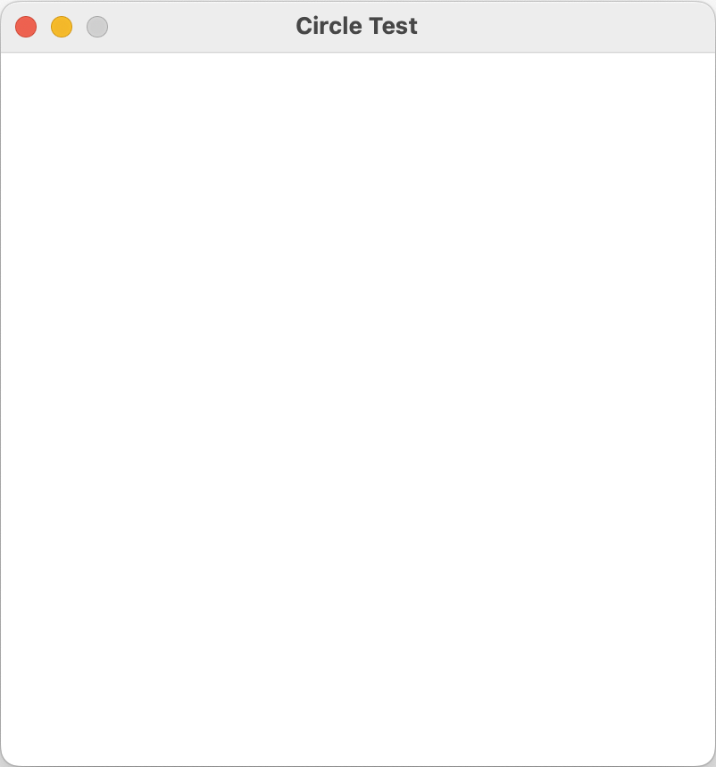
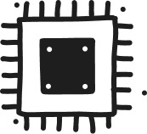
Memory
The Stack
using static SplashKitSDK.SplashKit;
OpenWindow("Circle Test", 400, 400);
ClearScreen(ColorYellow());
while ( !QuitRequested())
{
FillCircle(RandomColor(), Rnd(ScreenWidth()), Rnd(ScreenHeight()), Rnd(50));
RefreshScreen();
ProcessEvents();
}
Creates a new window on the stack and displays it to the user
Program
Counter
3
1,2
CPU

Slide 2
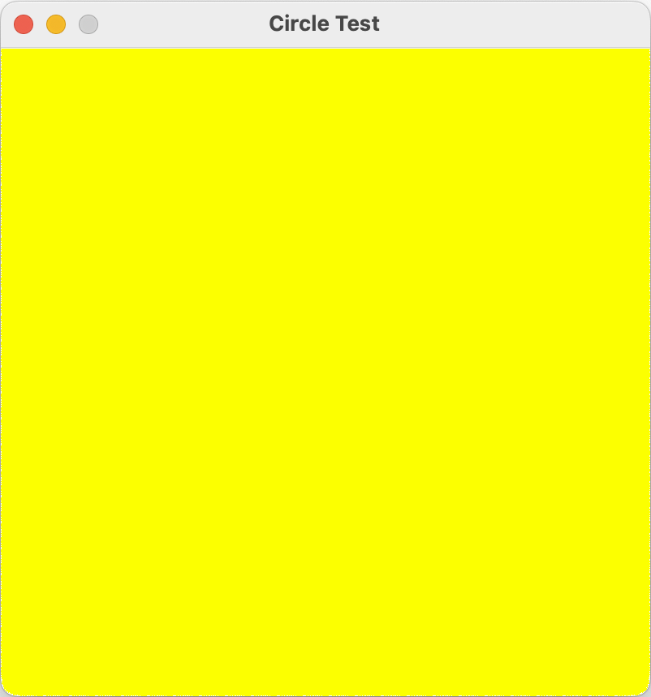
Memory
The Stack
using static SplashKitSDK.SplashKit;
OpenWindow("Circle Test", 400, 400);
ClearScreen(ColorYellow());
while ( !QuitRequested())
{
FillCircle(RandomColor(), Rnd(ScreenWidth()), Rnd(ScreenHeight()), Rnd(50));
RefreshScreen();
ProcessEvents();
}
Program
Counter
4
3
CPU

Slide 3
Memory
The Stack
using static SplashKitSDK.SplashKit;
OpenWindow("Circle Test", 400, 400);
ClearScreen(ColorYellow());
while ( !QuitRequested())
{
FillCircle(RandomColor(), Rnd(ScreenWidth()), Rnd(ScreenHeight()), Rnd(50));
RefreshScreen();
ProcessEvents();
}
Program
Counter
5,6
4
CPU

Slide 4
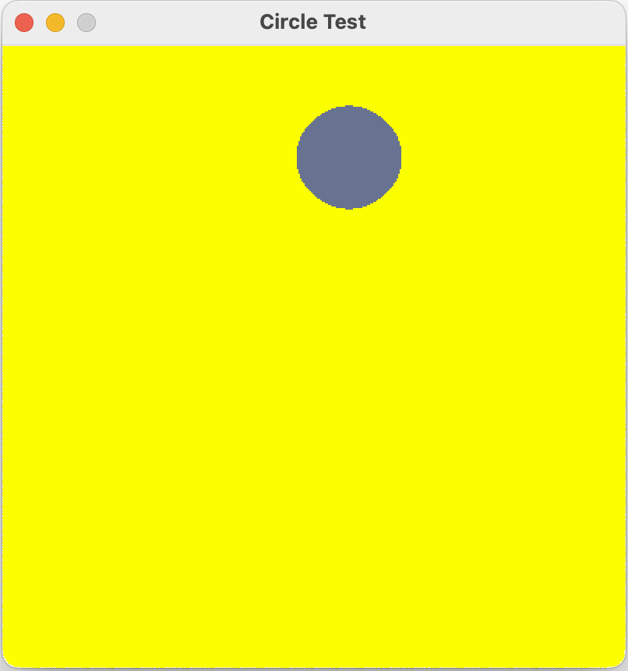
Memory
The Stack
using static SplashKitSDK.SplashKit;
OpenWindow("Circle Test", 400, 400);
ClearScreen(ColorYellow());
while ( !QuitRequested())
{
FillCircle(RandomColor(), Rnd(ScreenWidth()), Rnd(ScreenHeight()), Rnd(50));
RefreshScreen();
ProcessEvents();
}
Program
Counter
7
5,6
CPU

Slide 5
Memory
The Stack
using static SplashKitSDK.SplashKit;
OpenWindow("Circle Test", 400, 400);
ClearScreen(ColorYellow());
while ( !QuitRequested())
{
FillCircle(RandomColor(), Rnd(ScreenWidth()), Rnd(ScreenHeight()), Rnd(50));
RefreshScreen();
ProcessEvents();
}
Program
Counter
8
7
CPU

Slide 6
Memory
The Stack
using static SplashKitSDK.SplashKit;
OpenWindow("Circle Test", 400, 400);
ClearScreen(ColorWhite());
while ( !QuitRequested())
{
FillCircle(RandomColor(), Rnd(ScreenWidth()), Rnd(ScreenHeight()), Rnd(50));
RefreshScreen();
ProcessEvents();
}
Program
Counter
4
8
CPU

Slide 7
Memory
The Stack
using static SplashKitSDK.SplashKit;
OpenWindow("Circle Test", 400, 400);
ClearScreen(ColorWhite());
while ( !QuitRequested())
{
FillCircle(RandomColor(), Rnd(ScreenWidth()), Rnd(ScreenHeight()), Rnd(50));
RefreshScreen();
ProcessEvents();
}
Program
Counter
5,6
4
CPU

Slide 8
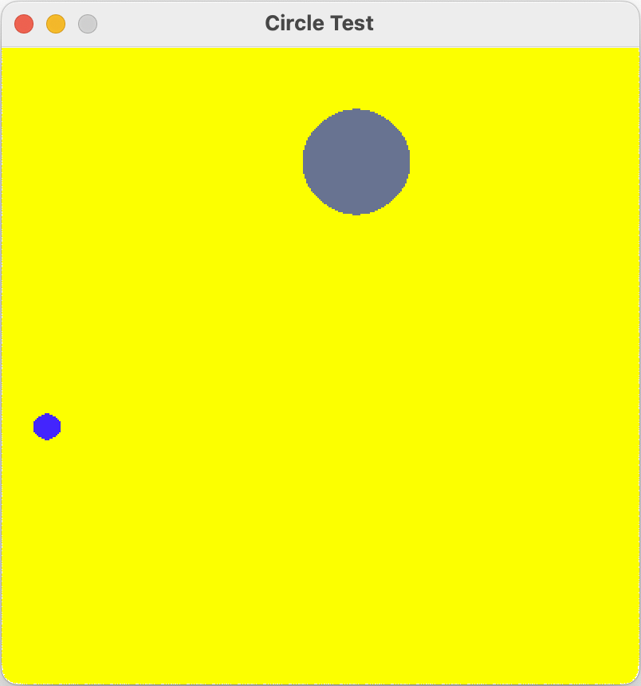
Memory
The Stack
using static SplashKitSDK.SplashKit;
OpenWindow("Circle Test", 400, 400);
ClearScreen(ColorWhite());
while ( !QuitRequested())
{
FillCircle(RandomColor(), Rnd(ScreenWidth()), Rnd(ScreenHeight()), Rnd(50));
RefreshScreen();
ProcessEvents();
}
Program
Counter
7
6
CPU

Slide 9
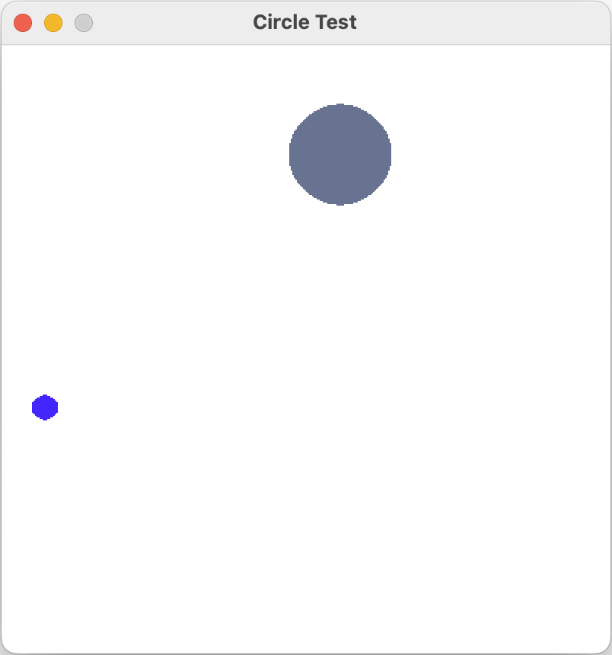
Memory
The Stack
using static SplashKitSDK.SplashKit;
OpenWindow("Circle Test", 400, 400);
ClearScreen(ColorWhite());
while ( !QuitRequested())
{
FillCircle(RandomColor(), Rnd(ScreenWidth()), Rnd(ScreenHeight()), Rnd(50));
RefreshScreen();
ProcessEvents();
}
Program
Counter
8
7
CPU

Slide 10
Memory
The Stack
using static SplashKitSDK.SplashKit;
OpenWindow("Circle Test", 400, 400);
ClearScreen(ColorWhite());
while ( !QuitRequested())
{
FillCircle(RandomColor(), Rnd(ScreenWidth()), Rnd(ScreenHeight()), Rnd(50));
RefreshScreen();
ProcessEvents();
}
Program
Counter
4
8
CPU

Slide 11
Memory
The Stack
using static SplashKitSDK.SplashKit;
OpenWindow("Circle Test", 400, 400);
ClearScreen(ColorWhite());
while ( !QuitRequested())
{
FillCircle(RandomColor(), Rnd(ScreenWidth()), Rnd(ScreenHeight()), Rnd(50));
RefreshScreen();
ProcessEvents();
}
Program
Counter
5,6
4
CPU

Slide 12
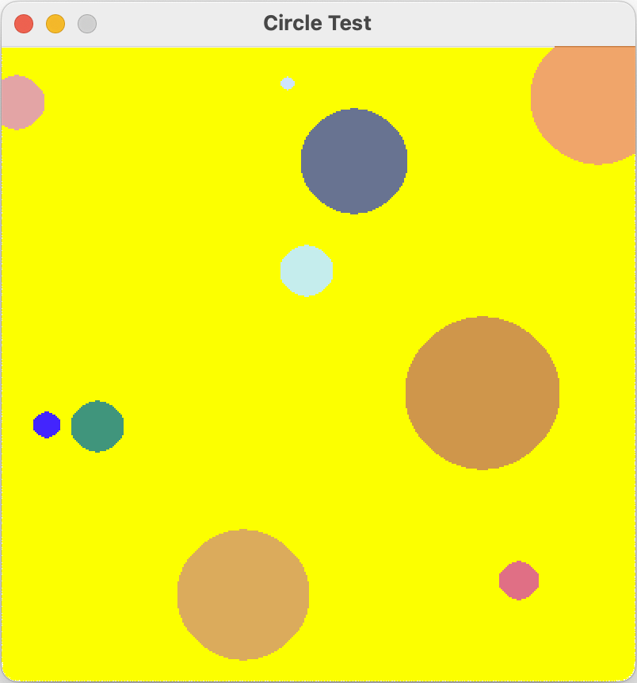
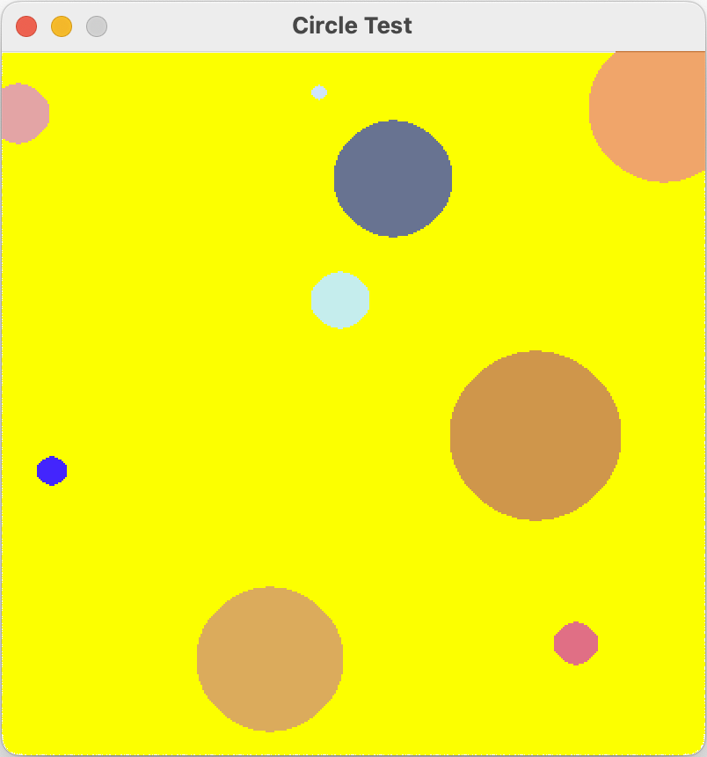
Memory
The Stack
using static SplashKitSDK.SplashKit;
OpenWindow("Circle Test", 400, 400);
ClearScreen(ColorWhite());
while ( !QuitRequested())
{
FillCircle(RandomColor(), Rnd(ScreenWidth()), Rnd(ScreenHeight()), Rnd(50));
RefreshScreen();
ProcessEvents();
}
Let’s skip ahead … to the 10th iteration of the loop
Add 10th circle
Program
Counter
7
9 circles in window
5,6
CPU

Slide 13
Memory
The Stack
using static SplashKitSDK.SplashKit;
OpenWindow("Circle Test", 400, 400);
ClearScreen(ColorWhite());
while ( !QuitRequested())
{
FillCircle(RandomColor(), Rnd(ScreenWidth()), Rnd(ScreenHeight()), Rnd(50));
RefreshScreen();
ProcessEvents();
}
Program
Counter
8
10 circles in window
7
CPU

Slide 14


Memory
The Stack
using static SplashKitSDK.SplashKit;
OpenWindow("Circle Test", 400, 400);
ClearScreen(ColorWhite());
while ( !QuitRequested())
{
FillCircle(RandomColor(), Rnd(ScreenWidth()), Rnd(ScreenHeight()), Rnd(50));
RefreshScreen();
ProcessEvents();
}
The user clicks the quit button
Program
Counter
4
8
CPU

Slide 15
Memory
The Stack
using static SplashKitSDK.SplashKit;
OpenWindow("Circle Test", 400, 400);
ClearScreen(ColorWhite());
while ( !QuitRequested())
{
FillCircle(RandomColor(), Rnd(ScreenWidth()), Rnd(ScreenHeight()), Rnd(50));
RefreshScreen();
ProcessEvents();
}
Program
Counter
9
4
CPU

Slide 16
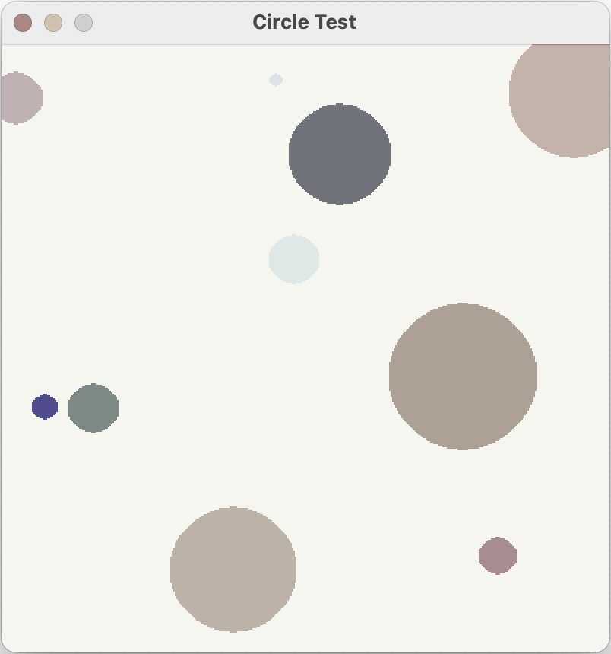
Memory
The Stack
using static SplashKitSDK.SplashKit;
OpenWindow("Circle Test", 400, 400);
ClearScreen(ColorWhite());
while ( !QuitRequested())
{
FillCircle(RandomColor(), Rnd(ScreenWidth()), Rnd(ScreenHeight()), Rnd(50));
RefreshScreen();
ProcessEvents();
}
Free memory
Program
Counter
END
Close window
9
CPU

