Slide 1




ADHD DIAGNOSIS
Mohammad Amin Nosrati
Amir Hossein Mansouri

Slide 2
PROJECT INTRODUCTION

Slide 3
Extracting frequent brain connectivity patterns in ADHD
What is the problem ?
ADHD is a common neurodevelopmental disorder.
Symptoms include inattention, hyperactivity, and impulsivity.
The need for accurate classification to aid in treatment and management.

Slide 4
What is the data mining question posed to solve the problem ?
Can we classify individuals with ADHD based on brain connectivity patterns?
How was data collected?
ADHD-200 Competition
Collaborative data collection effort for ADHD research.
Multi-Lab Data Collection
Data gathered from 9 different laboratories.
fMRI Data
Collected functional MRI scans from participants.

Slide 5
Extracting frequent brain connectivity patterns in ADHD
How the problem was solved ?
Calculated the correlation between each pair of points using four different similarity measures, Pearson R, Cosine Sim., Wavelet Dist, Euclidean distance.
Due to high dimensionality, we reformulated the problem into a graph, computer vision task and explored various methods of feature selection with ML models.

Slide 6
Results Overview
Model | #Input Features | Accuracy | Weighted Avg. F1-Score
VarianceThreshold-0.103+StandardScaler+SVC-Linear | 29 | 0.62 | 0.53
VarianceThreshold-0.103+StandardScaler+SVC-Poly | 29 | 0.62 | 0.53
VarianceThreshold-0.103+StandardScaler+SVC-RBF | 29 | 0.63 | 0.58
VarianceThreshold-0.103+StandardScaler+SVC-Sigmoid | 29 | 0.56 | 0.56
VarianceThreshold-0.103+StandardScaler+AdaBoost-1000 | 29 | 0.59 | 0.58
VarianceThreshold-0.103+StandardScaler+GaussianNB | 29 | 0.63 | 0.62
SequentialFeatureSelector | - | - | -
KBest-Mutualinformation+StandardScaler+SVC-Linear | 30 | 0.61 | 0.56
KBest-Mutualinformation+StandardScaler+SVC-Poly | 30 | 0.62 | 0.63
KBest-Mutualinformation+StandardScaler+SVC-RBF | 30 | 0.62 | 0.58
KBest-Mutualinformation+StandardScaler+SVC-Sigmoid | 30 | 0.63 | 0.59
Sim>0.9+StandardScaler+AdaBoost-50 | 30 | 0.64 | 0.63
Sim>0.9+StandardScaler+AdaBoost-1000 | 30 | 0.61 | 0.61
Sim<0.3+StandardScaler+AdaBoost-50 | 30 | 0.59 | 0.58
Sim<0.3+StandardScaler+AdaBoost-1000 | 30 | 0.56 | 0.55

Slide 7
Results Overview
Data | Model Name | Accuracy
Pearson r-test | GNN | 77.08
Pearson r-test | GCNN | 57.03
Pearsonr-test | Graph Traditional SVM | 69.75
Pearsonr-test | Mlp | 65.55
Pearsonr-test | Random Forest | 58.33
Pearsonr-test | Yolov | 80.7

Slide 8
Evaluation Method
Direct assessment of feature quality is not possible.
Therefore, we train a model to evaluate their quality.

Slide 9
EDA

Slide 10
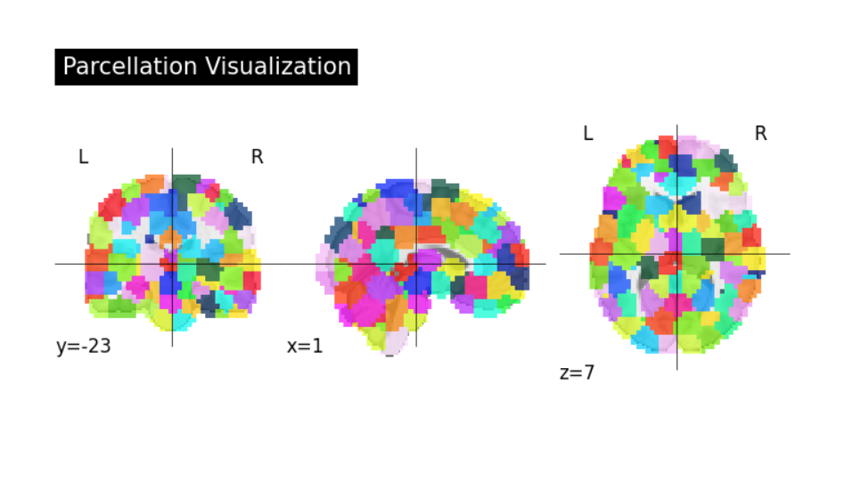

Slide 11
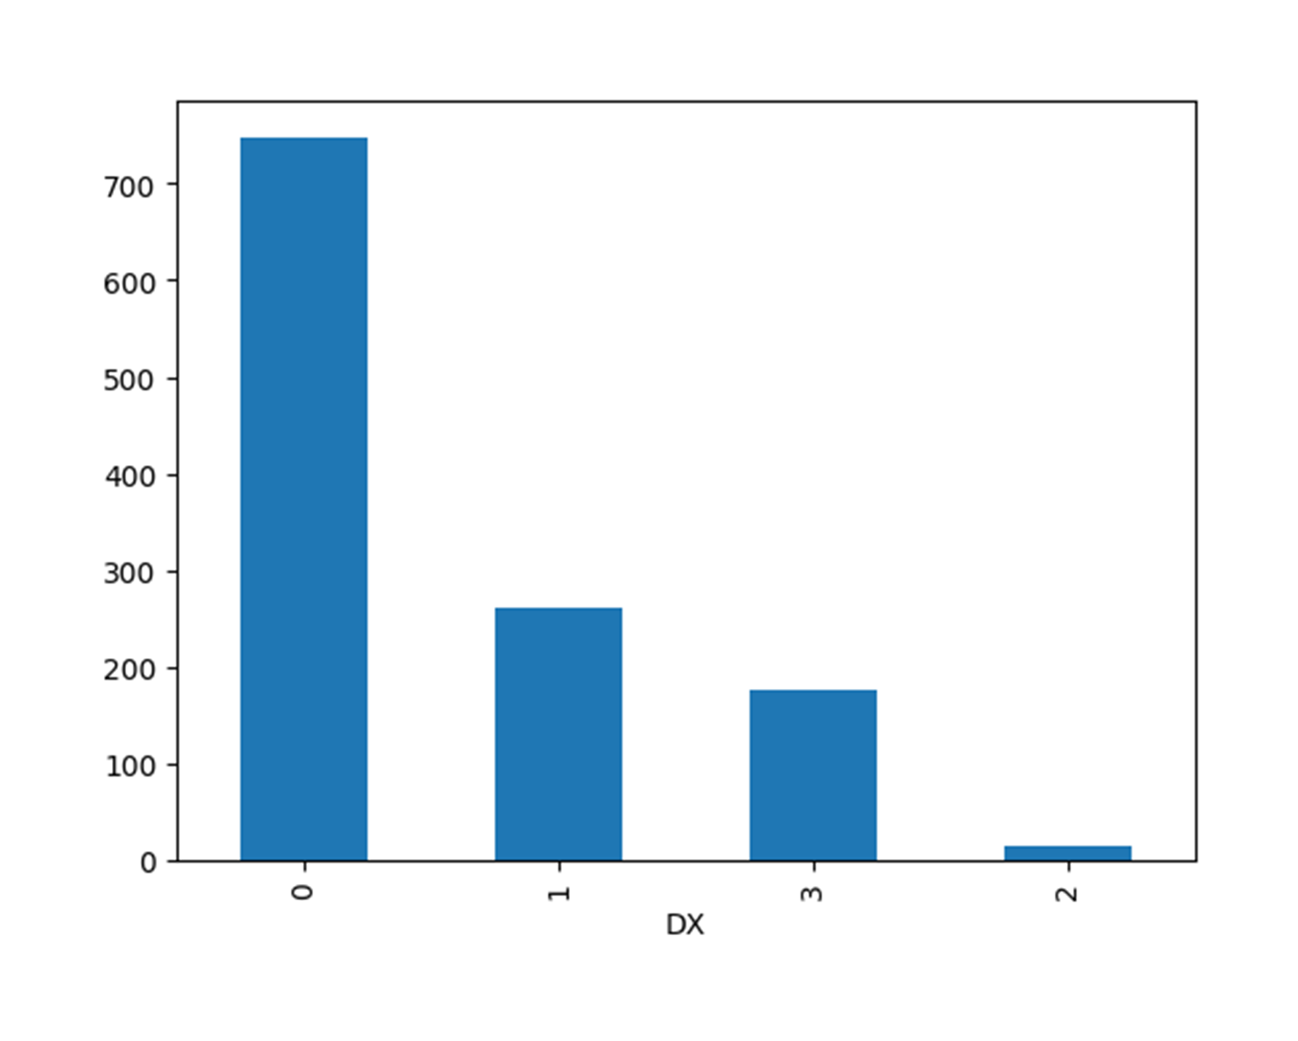
4-class Label Distribution

Slide 12
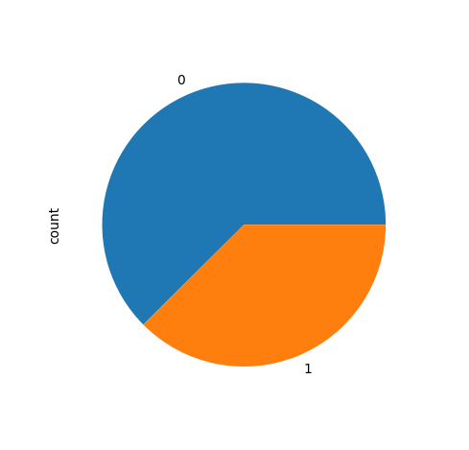
Binary Label Distribution

Slide 13
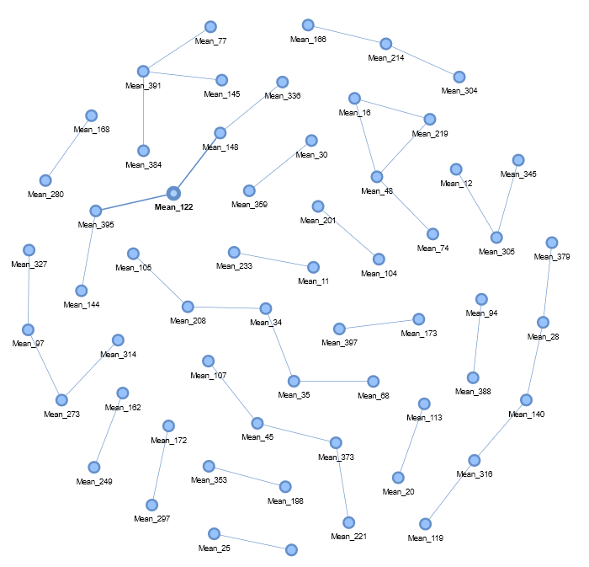
Correleations with significant difference in mean of correlation in each class.

Slide 14
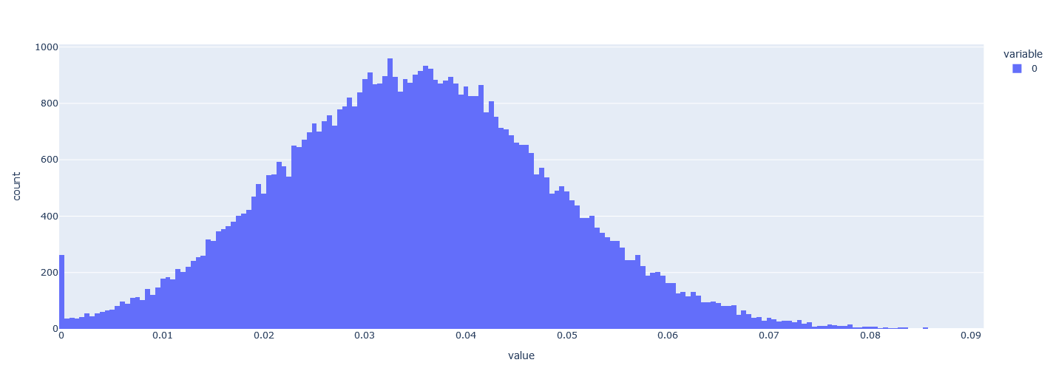
Histogram of mutual information between Target class and Each pearson correlation

Slide 15
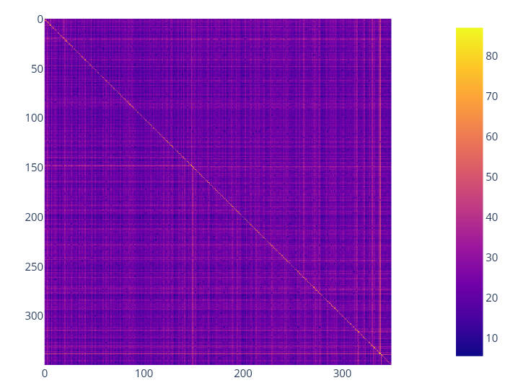
Mean Pearson R Correlation Matrix for people with ADHD

Slide 16
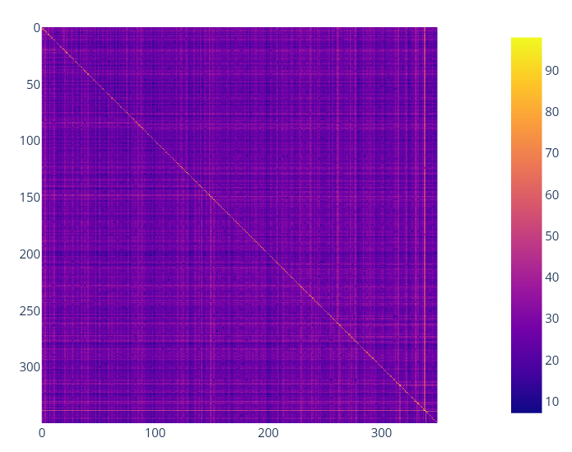
Mean Pearson R Correlation Matrix for people without ADHD

Slide 17
Model Development

Slide 18
ML Models

Slide 19
Extracting frequent brain connectivity patterns in ADHD
SVM models excel in handling high-dimensional data, offer versatility with various kernel functions to manage both linear and non-linear relationships, making them robust to overfitting.
Support Vector Machine
Extracting frequent brain connectivity patterns in ADHD
Random Forest
Random Forest is an ensemble learning method that constructs multiple decision trees on various subsets of the dataset and combines the predictions of each tree to improve accuracy and control overfitting.
Multilayer Perceptron
Neural Networks are a set of algorithms modeled after the human brain, used to recognize patterns. They are ability to capture complex nonlinear relationships in the data.

Slide 20
YOLO v8
As a transformer-based model, YOLOv benefits from self-attention mechanisms that enable it to capture intricate patterns and contextual information within the data, improving its classification performance.

Slide 21
Clustering Coefficient
Measures the degree to which nodes in a graph cluster together.
Helps identify closely-knit communities.
Laplacian Matrix
Constructed to analyze the structural properties of the graph.
Used in spectral clustering to partition the graph into meaningful subgroups.
.
Traditional Graph Methods
Central Measures
Evaluates the importance of individual nodes within the graph.
Used to identify key brain regions involved in ADHD.
GraphLet
Represents small subgraphs within the larger graph.
Used to capture local connectivity patterns and structural motifs.

Slide 22
Graph Neural Networks (GNN)
GNN Utilization
Applied Graph Neural Networks to model complex relationships in high-dimensional ADHD data.
Leveraged the ability of GNNs to learn from graph-structured data for improved classification accuracy.
Advantages of GNN
Captures intricate dependencies between nodes.
Enhanced performance over traditional methods in capturing brain connectivity patterns.

Slide 23
Results

Slide 24
Comparison of ML Models Using Cross-Validation
Model | #Input Features | Accuracy | Weighted Avg. F1-Score
VarianceThreshold-0.103+StandardScaler+SVC-Linear | 29 | 0.62 | 0.53
VarianceThreshold-0.103+StandardScaler+SVC-Poly | 29 | 0.62 | 0.53
VarianceThreshold-0.103+StandardScaler+SVC-RBF | 29 | 0.63 | 0.58
VarianceThreshold-0.103+StandardScaler+SVC-Sigmoid | 29 | 0.56 | 0.56
VarianceThreshold-0.103+StandardScaler+AdaBoost-1000 | 29 | 0.59 | 0.58
VarianceThreshold-0.103+StandardScaler+GaussianNB | 29 | 0.63 | 0.62
SequentialFeatureSelector | - | - | -
KBest-Mutualinformation+StandardScaler+SVC-Linear | 30 | 0.61 | 0.56
KBest-Mutualinformation+StandardScaler+SVC-Poly | 30 | 0.62 | 0.63
KBest-Mutualinformation+StandardScaler+SVC-RBF | 30 | 0.62 | 0.58
KBest-Mutualinformation+StandardScaler+SVC-Sigmoid | 30 | 0.63 | 0.59
Sim>0.9+StandardScaler+AdaBoost-50 | 30 | 0.64 | 0.63
Sim>0.9+StandardScaler+AdaBoost-1000 | 30 | 0.61 | 0.61
Sim<0.3+StandardScaler+AdaBoost-50 | 30 | 0.59 | 0.58
Sim<0.3+StandardScaler+AdaBoost-1000 | 30 | 0.56 | 0.55

Slide 25
Results Overview
Data | Model Name | Accuracy
Pearson r-test | GNN | 77.08
Pearson r-test | GCNN | 57.03
Pearsonr-test | Graph Traditional SVM | 69.75
Pearsonr-test | Mlp | 65.55
Pearsonr-test | Random Forest | 58.33
Pearsonr-test | Yolov | 80.7

Slide 26
List of Discovered Facts
For traditional methods, SVM with an RBF kernel is agnostic and PAC-learnable.
.
GCNNs may not work effectively if there is a significant reduction in the number of edges, as this can impair the message passing capability essential for learning the properties of the graph.
.

Slide 27
References
https://onlinelibrary.wiley.com/doi/10.1002/hbm.21333
https://github.com/ccraddock/cluster_roi
https://ccraddock.github.io/cluster_roi/atlases.html
https://www.nitrc.org/projects/cluster_roi/
http://neurobureau.projects.nitrc.org/ADHD200/Introduction.html

Slide 28
Future Works

