Slide 1

lifeMEDeasy
AUTOMATING HEALTHCARE

Slide 2

OUR novel IDEA
Our Mission is to automate Healthcare and make health facilities available to everyone regardless of their limitations. We seek to automate Healthcare Appointments, make available Disease Severity Prediction on Symptoms provided through Healthcare Chat-bots and AI Technology and Online Ambulance Booking Services and Medical document storage via an all in1 full fledged Web-Portal

Slide 3
THE MARKET
ONLINE APPOINTMENT SEGMENTATION
12%
15%
10%
05%
11.5%
Mumbai
Pune
Delhi
Kolkata
Bangalore
 | Mumbai | Pune | Delhi | Kolkata | Bangalore
HOSPITALS WITH ONLINE PRESENCE | 987 | 629 | 745 | 162 | 1103
HOSPITALS WITH ONLINE BOOKING FACILITIES | 122 | 97 | 71 | 08 | 127

Slide 4
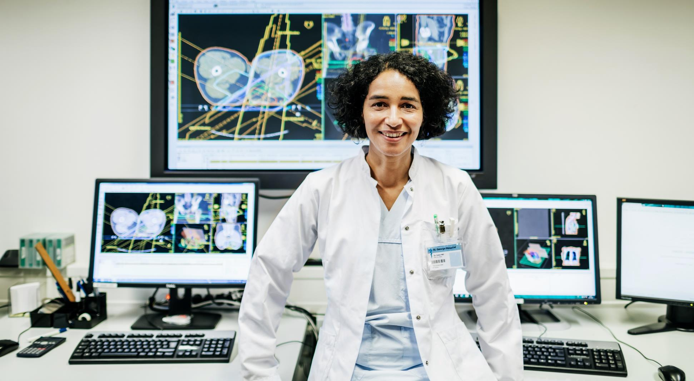

OUR FEATURES
Online Hospital / Clinics Appointment Facility
Users can now book healthcare appointments online without in-visit practices, thus automating this age-old practice

Slide 5

OUR FEATURES
Medical Document Storage
Lets Patients Store their Medical Documents and makes it easy for Medical Practitioners to access the documents with utmost Privacy guaranteed
This module would enable online storage of patient's documents, this will help preserve them and avoid the hassle of carrying them for every consultation.

Slide 6

OUR FEATURES
AI Chat-bot for Disease and Severity Prediction
Our Artificial Intelligence enabled Chat-bot can help users predict the disease they might be suffering from alongside its severity
This module would provide an automated, AI enabled chat-bot which would provide inputs on the medical condition of the user, in case medical help is not accessible

Slide 7

OUR FEATURES
It would aid people in urgent need of medical help, the web app would provide the facility to book ambulances for essential help in emergency situations.
Ambulance Booking Services
Ambulances can now be booked Online in times of Distress!

Slide 8
THE TEAM
Avinash Ranjan
Harshita Kanal
Manish Gotame
Soham Patil

Slide 9

Thank you

