Slide 1
Black Forest Burn Scar
Asa Hayes 31 Jan, 2019

Slide 2
Image Details
ASTER Satellite Sensor
13 Bands over 3 subsensors, total spectral range: 0.52-11.65 μm
Spatial Resolution: 15/60/90m,
One of 5 main sensors on board the Terra Satellite
Image URL: https://eoimages.gsfc.nasa.gov/images/imagerecords/81000/81473/blackforestfire_ast_2013172_lrg.jpg
Note Image on slide cropped from full image to show specific area.
Characteristics of presented image
Bands used: 3B/N (0.78-0.86 μm)
Image rendered in false-color
Geography of the image
Image shows Black Forest area near Monument, CO
Image shows burn scar (grey-black area, center) from 2013 fire, compared to unburnt surrounding vegetation (red-pink-white)

Slide 3
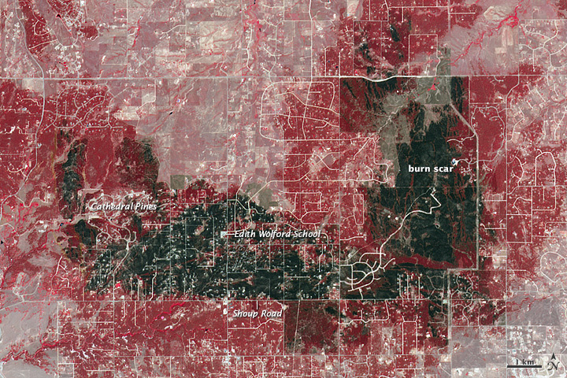

Slide 4
Significance of the image
Physical geography:
Black Forest is relatively isolated, could have been much larger area like Waldo Canyon Fire the previous year.
Due to elevation, recent water conditions, and high flammability of a pine forest, fire was quickly able to grow out of control.
Wind coming East from mountains was also a major factor, in both intensifying fire and shaping its spread. As it came up from the valley, the wind created updrafts which worsened the fire.
Human geography
Due to both road structure and previous fire mitigation, the fire didn’t consume all of the Black Forest area. Note the clear borders on the South and East edges of the burn scar.
Many people’s homes were consumed by the fire, and the smoke had detrimental effects on people and wildlife for miles around.
I lived just west of the cropped image’s border, and saw images like this in the news, which is what lead to me becoming interested in GIST to begin with, so this image is also personally significant.

Slide 5
Sources
Image and Addt’l. Info: https://earthobservatory.nasa.gov/images/81473/aftermath-of-colorados-most-destructive-wildfire
ASTER Specifications:
https://www.satimagingcorp.com/satellite-sensors/other-satellite-sensors/aster/

