Slide 1
A GROUP RESEARCH PRESENTATION
Meta-Learning for Algorithm Selection
Choosing the best machine learning method automatically, using only the features of a dataset
Presented by: Asamu Caleb Ayomide · Presentation & Peer-Review Coordinator
On behalf of the full research group · Department of Information Systems
Notes:
Hello everyone. Welcome to our presentation. Our project is called Meta-Learning for Algorithm Selection. In simple words, we are teaching a computer program to look at a dataset and predict, before even testing every method, which machine learning method will work best on it. My name is Asamu Caleb Ayomide, and I am presenting this work on behalf of our full research group. Let's get started.

Slide 2
The Research Question
Which machine learning algorithms work best across many different datasets — and which measurable properties of a dataset can predict that success in advance?
1
No single winner
2
A costly problem
3
Our idea
No one machine learning method performs best on every dataset. The best choice depends on the data itself.
Testing every method by hand, on every new dataset, takes a lot of time and computing power.
Teach a second, lighter model to predict the right method in advance, using simple facts about the dataset.
Meta-Learning for Algorithm Selection · 02
Notes:
Here is the exact question our research group set out to answer: Which machine learning algorithms work best across many different datasets, and which measurable properties of a dataset can predict that success in advance? Three quick points explain why this matters. First, there is no single winner — no one machine learning method performs best on every dataset. Second, testing every method by hand is slow and expensive. Third, our idea is to train a second, lighter model that can predict the right method in advance, just by looking at simple facts about the dataset.

Slide 3
Why This Problem Matters
Algorithm Selection
Our Contribution
In everyday machine learning work, a person usually has to guess, or try out, several algorithms before finding the one that fits their data best. This step is called Algorithm Selection. It is known in research as Meta-Learning, which simply means "learning how to learn."
A fully data-driven, reproducible study — every claim is backed by a table, a figure, or code output.
Twenty real, varied datasets from a trusted public source.
Five well-known algorithms, compared fairly using the same testing method.
A meta-learner that predicts the best algorithm from dataset features alone.
Formal statistical proof, not just a guess, that the differences we find are real.
If we can predict the right algorithm ahead of time, we save time, save computing cost, and get better results faster.
Meta-Learning for Algorithm Selection · 03
Notes:
So why does this matter? In everyday machine learning work, a person usually has to guess or try out several algorithms before finding the one that fits their data best. This step is called Algorithm Selection, and in research it is known as Meta-Learning, which simply means learning how to learn. If we can predict the right algorithm ahead of time, we save time, save computing cost, and get better results faster. Our group's contribution is a fully data-driven study: twenty real datasets, five well-known algorithms compared fairly, a meta-learner that predicts the best algorithm from dataset features alone, and formal statistical proof that our findings are real and not just chance.

Slide 4
Step 1: The Data
Binary Classification
1
Sorting data into one of two groups — for example, "yes" or "no."
~20
Multiclass Classification
real-world datasets
2
Sorting data into three or more named groups.
Taken from the Penn Machine Learning Benchmark (PMLB), a well-known, trusted public collection of datasets used for testing machine learning methods.
Regression
3
Predicting a number instead of a category — for example, a price or a score.
Meta-Learning for Algorithm Selection · 04
Notes:
The first step of the project is the data. Our team gathered close to twenty real-world datasets from the Penn Machine Learning Benchmark, usually shortened to PMLB. This is a well-known, trusted public collection of datasets that researchers use to test machine learning methods fairly. The datasets cover three kinds of problems: Binary Classification, where data is sorted into one of two groups; Multiclass Classification, where data is sorted into three or more named groups; and Regression, where the goal is to predict a number instead of a category, such as a price or a score. This variety is important — it means our findings are not limited to just one type of problem.

Slide 5
Step 2: Five Algorithms, Tested Fairly
Every dataset was tested on all five algorithms below, using 5-fold stratified cross-validation — a method that splits the data into five equal parts and rotates them, so every algorithm is tested fairly and consistently.
1
2
3
4
5
Random Forest
Gradient Boosting
Support Vector Machine (SVM)
k-Nearest Neighbors (KNN)
Neural Network
A large group of decision trees that vote together on the answer.
Many small, simple models built one after another, each fixing the last one's mistakes.
Finds the clearest dividing line, or boundary, between different groups of data.
Looks at the closest, most similar examples in the data to make its decision.
A layered model loosely inspired by the brain, which learns patterns through many small adjustments.
Meta-Learning for Algorithm Selection · 05
Notes:
Every one of the twenty datasets was tested on five different algorithms, so we could fairly compare them. We used a method called 5-fold stratified cross-validation. In simple words, this splits the data into five equal parts and rotates them, testing each algorithm several times so the result is fair and reliable, not just lucky. The five algorithms are: Random Forest, a large group of decision trees that vote together on the answer; Gradient Boosting, many small models built one after another, each fixing the last one's mistakes; Support Vector Machine, often shortened to SVM, which finds the clearest dividing line between groups of data; k-Nearest Neighbors, often shortened to KNN, which looks at the closest, most similar examples to make its decision; and finally, Neural Network, a layered model loosely inspired by the brain.

Slide 6
Step 3: The Core Idea — The Meta-Learner
This is the heart of our project.
1
2
3
Dataset Features
The Meta-Learner
Instant Prediction
We measure simple, describable facts about each dataset — for example, its size, its number of columns, and how balanced its groups are. These facts are called Meta-Features.
A model trained on those Meta-Features, together with the results from Step 2, learns the pattern: "datasets that look like this tend to work best with that algorithm."
For a brand-new dataset, the Meta-Learner can now suggest the best algorithm immediately — without testing all five algorithms by hand.
→
→
Meta-Learning for Algorithm Selection · 06
Notes:
Now, here is the heart of the whole project — the meta-learner. This part answers our research question directly. Step one: we measure simple, describable facts about each dataset — for example, its size, its number of columns, and how balanced its groups are. These facts are called Meta-Features. Step two: we train a separate model, the Meta-Learner, using those Meta-Features together with the results from testing the five algorithms. It learns the pattern that datasets which look a certain way tend to work best with a certain algorithm. Step three: for a brand-new dataset we have never seen before, the Meta-Learner can now suggest the best algorithm immediately, without testing all five algorithms by hand. That is the practical value of this research.

Slide 7
Step 4: Proving the Results Are Real
A good result must be more than a lucky guess. Our group used formal statistical tests to check that the differences between algorithms are real and not caused by chance.
Friedman Test
Nemenyi Test
Wilcoxon Signed-Rank Test
Checks whether there is any real difference at all among the five algorithms, across all twenty datasets, at the same time.
A careful follow-up test that finds exactly which specific pairs of algorithms are different from each other.
Compares two algorithms directly, one pair at a time, to confirm a difference in a very precise way.
Meta-Learning for Algorithm Selection · 07
Notes:
A good result must be more than a lucky guess, so our group used formal statistical tests to prove our findings are trustworthy. First, the Friedman Test checks whether there is any real difference at all among the five algorithms, across all twenty datasets, at the same time. Second, the Nemenyi Test is a careful follow-up that finds exactly which specific pairs of algorithms are different from one another. Third, the Wilcoxon Signed-Rank Test compares two algorithms directly, one pair at a time, to confirm a difference in a very precise way. Together, these three tests give our conclusions real scientific weight.

Slide 8
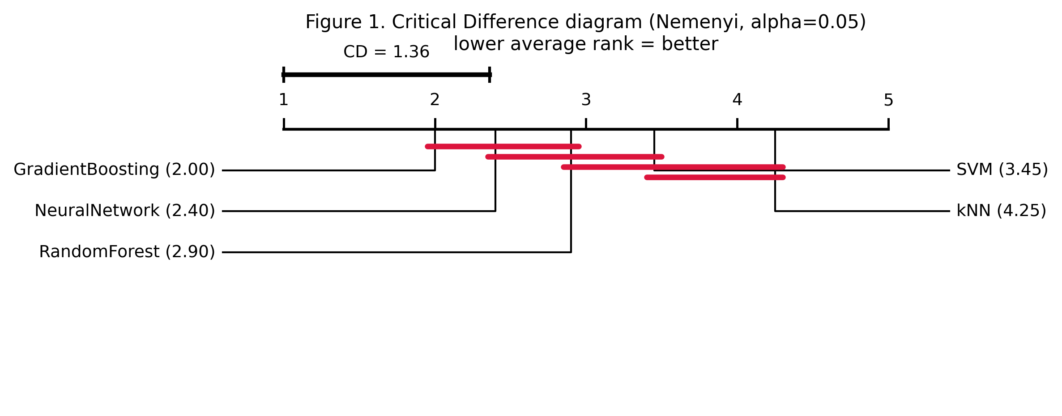
Step 5: What We Found — Ranking the Algorithms
How to read this chart
Each algorithm gets an average rank across all twenty datasets — a lower rank means better overall performance.
Algorithms joined by a line are statistically too close to call — the data cannot confidently separate them.
Algorithms standing apart, with no connecting line, are confidently better or worse than the rest.
Our result: Gradient Boosting had the best (lowest) average rank, 2.0, and was the top algorithm on 9 of the 20 datasets.
Source (GitHub): meta-learning-algorithm-selection/figures/figure1_critical_difference.png
Meta-Learning for Algorithm Selection · 08
Notes:
This chart is our main results figure, called a Critical Difference Diagram, taken directly from our repository file figures/figure1_critical_difference.png. Here is how to read it. Each algorithm gets an average rank across all twenty datasets, and a lower rank means better overall performance. Algorithms that are joined by a line on the chart are statistically too close to call — meaning our data cannot confidently say one is better than the other. Algorithms standing apart, with no connecting line, are confidently better or worse than the rest. Our result: Gradient Boosting had the best, meaning lowest, average rank of 2.0, and was the top-performing algorithm on nine of our twenty datasets — more than any other algorithm.

Slide 9
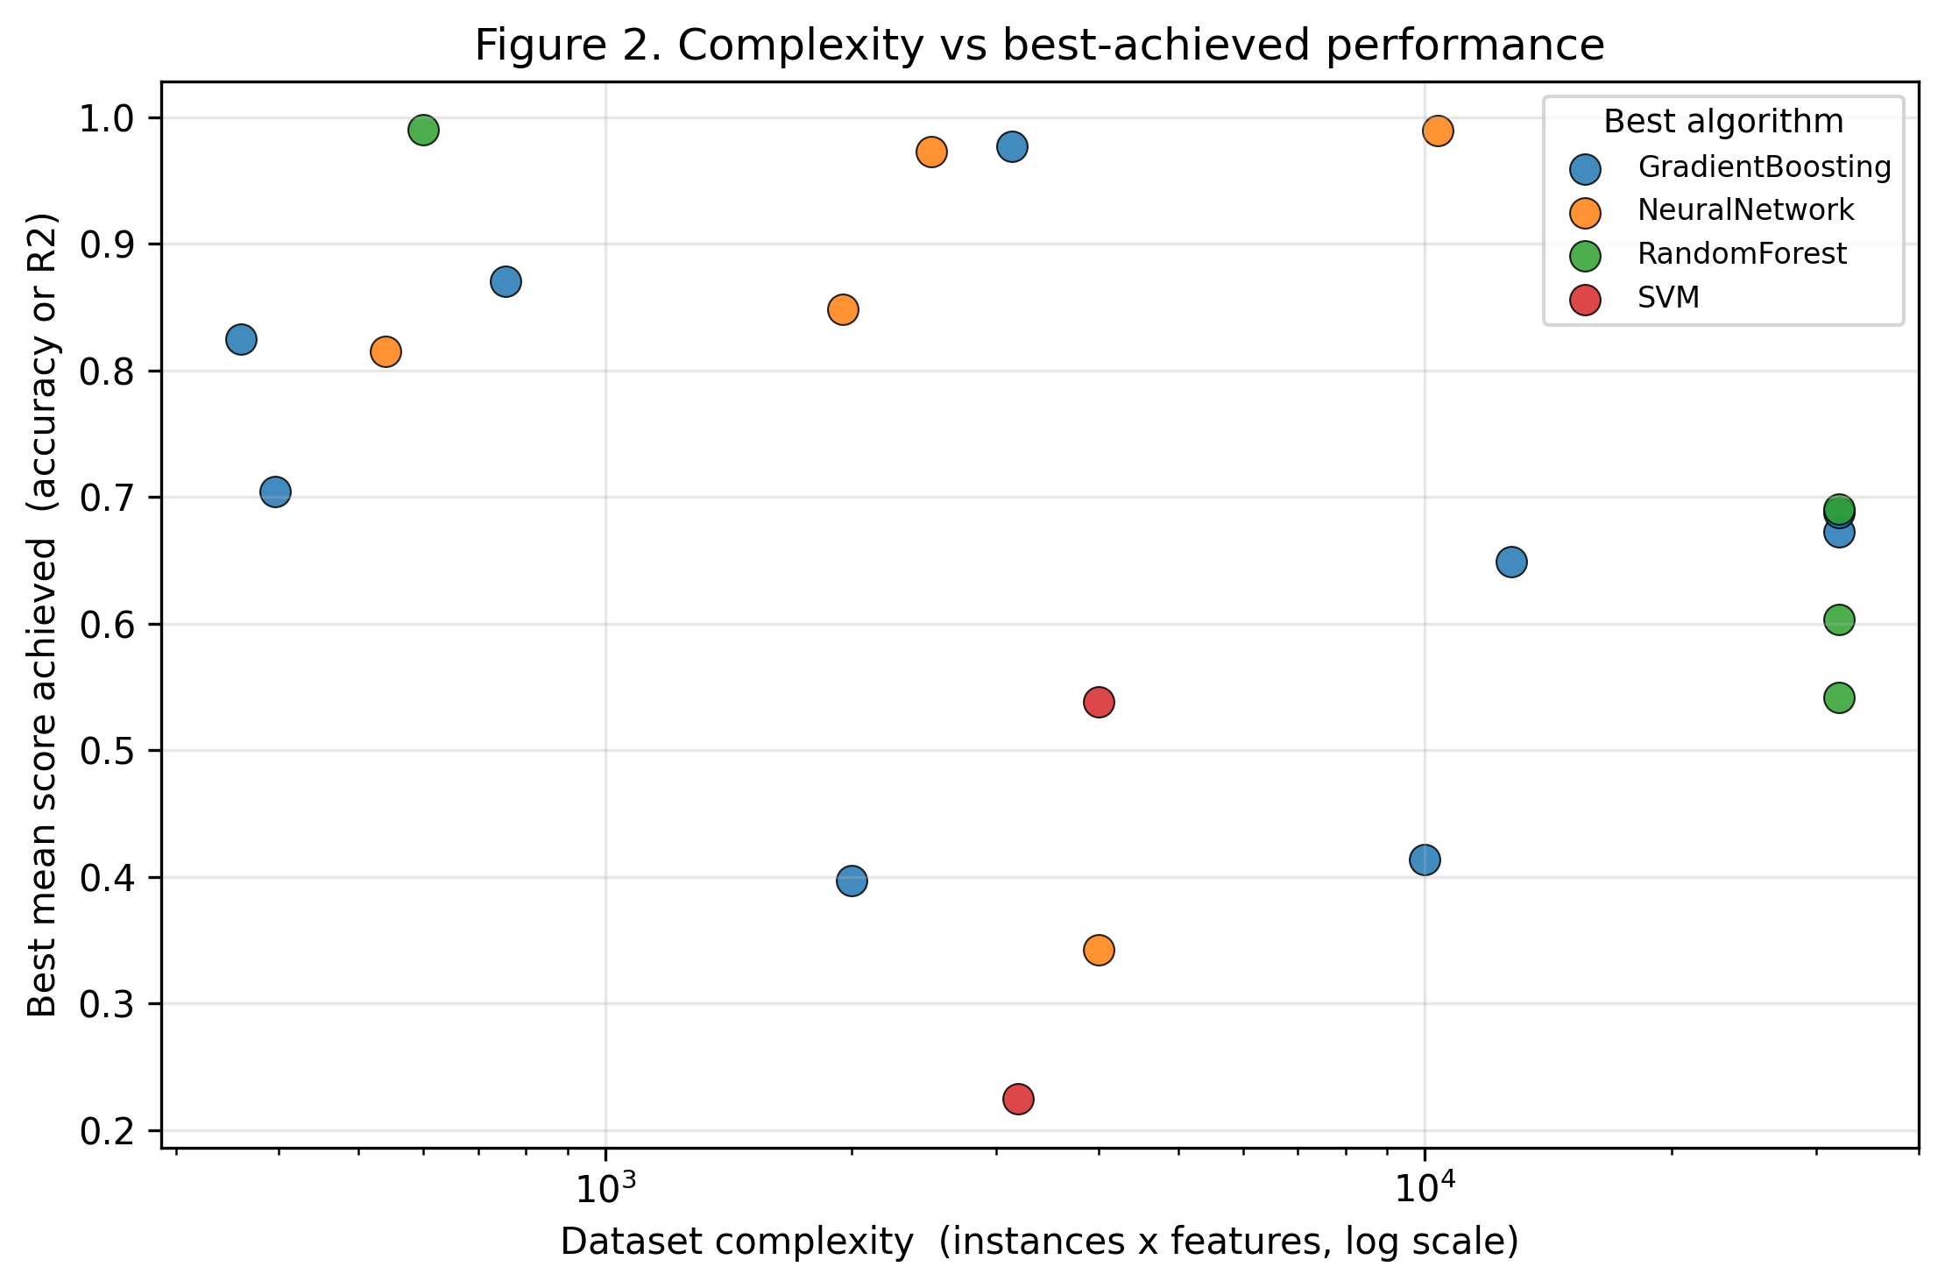
Step 6: What Predicts the Best Algorithm?
This answers the second half of our research question: which dataset features were most useful for the Meta-Learner's predictions?
Top predictive meta-features
Mean coefficient of variation (0.126) — how spread out feature values are, relative to their average
Mean skewness (0.122) — how lopsided the data's distribution is
Feature-to-instance ratio (0.110) — number of columns compared to number of rows
Source (GitHub): meta-learning-algorithm-selection/figures/table2_meta_feature_importance.csv
Source (GitHub): meta-learning-algorithm-selection/figures/figure2_complexity_performance.png
Meta-Learning for Algorithm Selection · 09
Notes:
This slide answers the second half of our research question: which dataset features were most useful for the Meta-Learner's predictions? The chart on the left is taken directly from our repository file figures/figure2_complexity_performance.png, and shows how dataset complexity relates to algorithm performance. On the right, from our repository file figures/table2_meta_feature_importance.csv, are the three most useful Meta-Features. The top one is Mean coefficient of variation, which measures how spread out feature values are relative to their average. Second is Mean skewness, which measures how lopsided the data's distribution is. Third is Feature-to-instance ratio, meaning the number of columns compared to the number of rows in the dataset.

Slide 10
A Distinctive Layer: Modeling the Whole Experiment
Beyond the machine learning pipeline, our group also formally documented the entire experiment using structured, machine-checkable files.
1
2
3
4
Extensible Markup Language (XML)
XML Schema Definition (XSD)
XML Path Language (XPath)
XML Query Language (XQuery)
A standard, structured way to write down data so that both people and computers can read it clearly.
A formal rulebook that defines exactly what a valid version of our experiment's data must look like.
A tool used to point to, and pull out, one exact piece of information from inside a large XML file.
A tool used to search through and ask more complex questions of our XML data, and check that it is correct.
Meta-Learning for Algorithm Selection · 10
Notes:
Beyond the machine learning pipeline, our group also formally documented the entire experiment using structured, machine-checkable files. This is a distinctive part of our project that most similar studies do not include. We used Extensible Markup Language, shortened to XML, a standard, structured way to write down data so that both people and computers can read it clearly. We defined an XML Schema Definition, shortened to XSD, which is a formal rulebook stating exactly what a valid version of our experiment's data must look like. We used XML Path Language, shortened to XPath, to point to and pull out one exact piece of information from inside a large XML file. And we used XML Query Language, shortened to XQuery, to search through and ask more complex questions of our XML data, and to check that it is correct. Together, these tools give our experiment a formal, verifiable record — not just code and notebooks.

Slide 11
Conclusion
Gradient Boosting was our strongest overall algorithm, and dataset meta-features — especially how spread out and lopsided the data is — reliably predicted which algorithm would win, backed by formal statistical proof, not guesswork.
What we did
Limitations & next steps
Curated twenty varied datasets from a trusted source
Tested five algorithms fairly, using the same method each time
Trained a Meta-Learner to predict the best algorithm in advance
Proved our findings with formal statistical tests
Documented the whole study in structured, checkable files
Our results are limited to the twenty datasets we studied
More datasets would make the Meta-Learner's predictions even stronger
Future work could test more algorithms and more meta-features
Meta-Learning for Algorithm Selection · 11
Notes:
To conclude: we set out to answer whether dataset meta-features can predict which machine learning algorithm will perform best. Our findings support that they can. Gradient Boosting came out as our strongest overall algorithm, with the best average rank, and features describing how spread out and lopsided a dataset's values are turned out to be the strongest predictors — backed by formal statistical proof, not guesswork. In summary, our group curated twenty varied datasets from a trusted source, tested five algorithms fairly using the same method every time, trained a Meta-Learner to predict the best algorithm in advance, proved our findings with formal statistical tests, and documented the whole study in structured, checkable files. Of course, our results are limited to the twenty datasets we studied, and future work could test more algorithms and more meta-features to make the Meta-Learner even stronger.

Slide 12
Thank You
Meet the team behind the research
Akindipe Ireoluwawolemi Jeremiah
Ajibola
Akinmoju
Machine Learning Engineer — full pipeline & Meta-Learner
Data Curator & Metadata Specialist
Extensible Markup Language / XML Schema Definition (XSD) Architect
Akinwola
Akinyele
Akinyemi
XML Path Language (XPath) & XML Query Language (XQuery) Developer
Visualisation & Statistical Reporting
Manuscript Lead
Asamu Caleb Ayomide
Presentation & Peer-Review Coordinator
Meta-Learning for Algorithm Selection · 12
Notes:
Thank you for watching. This research was carried out by our full group: Akindipe Ireoluwawolemi Jeremiah as Machine Learning Engineer, Ajibola as Data Curator and Metadata Specialist, Akinmoju as Extensible Markup Language and XML Schema Definition Architect, Akinwola as XML Path Language and XML Query Language Developer, Akinyele on Visualisation and Statistical Reporting, Akinyemi as Manuscript Lead, and myself, Asamu Caleb Ayomide, as Presentation and Peer-Review Coordinator. Thank you for your attention.

