Slide 1

Disclosing Latent Mockery Sense of Sentences : Sarcasm Detection Using Natural Language Processing
Mr. Devender Kumar
Project Supervisor
Division of Information Technology,
Netaji Subhas Institute of Technology, University of Delhi, India
By :
Aditi Kumar (706/IT/14)
Arushi Bhatt (718/IT/14)

Slide 2
AIM
To study the significance of social or cognitive traits intrinsic to users of sarcasm for detecting sarcastic tweets and to analyze this process in detail with the help of various features list.
To scrutinize the feature list using supervised learning classification models.
Analyze the results using Data Visualization Techniques.

Slide 3
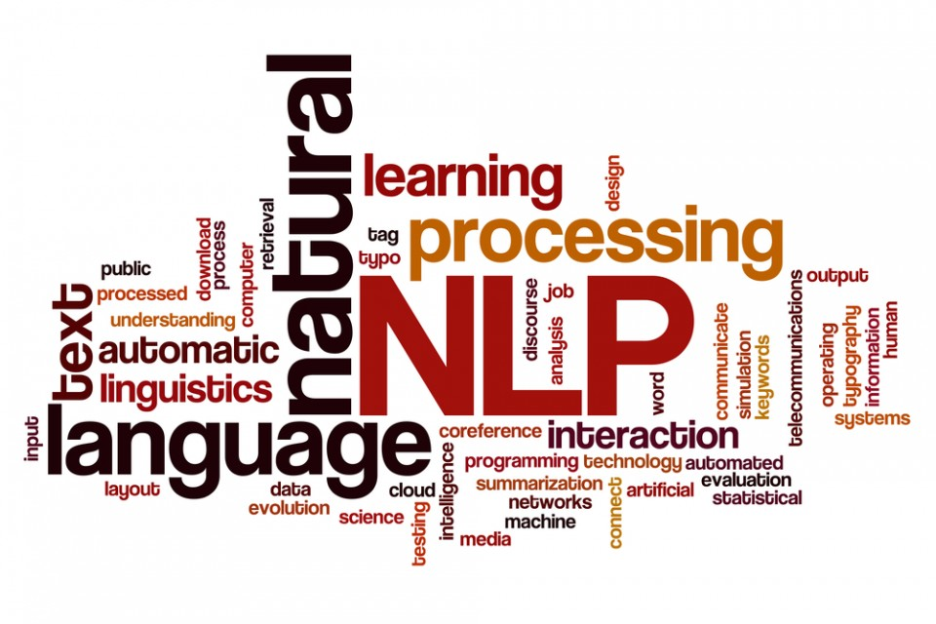

Slide 4
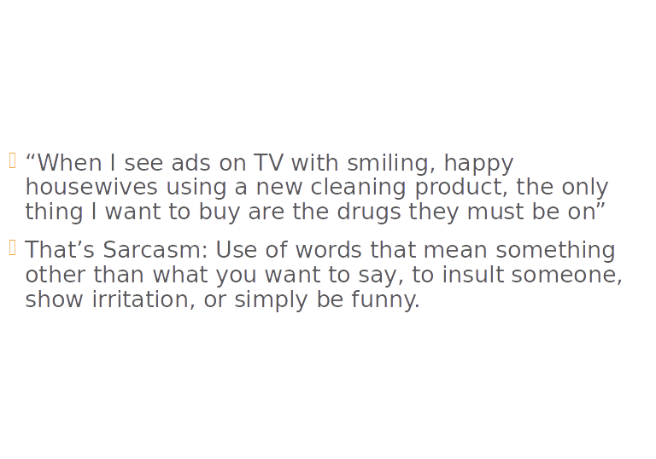
What is Sarcasm?

Slide 5


Current Problem :
Most large companies have a dedicated social media team working on marketing, after-sales service, and consumer assistance.
Tools like Hoot Suite work well for basic tasks ; lack ability to detect nuanced form of languages.
Thers’s a lot of ambiguity.

Slide 6
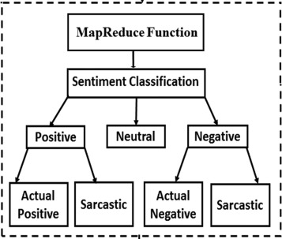
Sarcasm detection as a subtask of NLP

Slide 7
Fascinating points about Sarcasm Detection …!!!!
For the past 20 years, researchers from linguists to psychologists to neurologists have been studying our ability to perceive snarky remarks and gaining new insights into how the mind works.
An inability to understand sarcasm may be an early warning sign of brain disease.
In sentiment analysis, for example, sarcasm can flip the polarity of an “apparently positive” sentence and, hence, negatively affect polarity detection performance.
To date, most approaches to sarcasm detection have treated the task primarily as a text categorization problem.

Slide 8
Sarcasm seems to exercise the brain more than sincere statements do.
Sarcasm, however, can be expressed in very subtle ways and requires a deeper understanding of natural language that standard text categorization techniques cannot grasp.
Although there has been much work in the theory of humor by many linguists, philosophers and mathematicians (Paulos, 2008), the definition of humor is still a debated topic of research

Slide 9
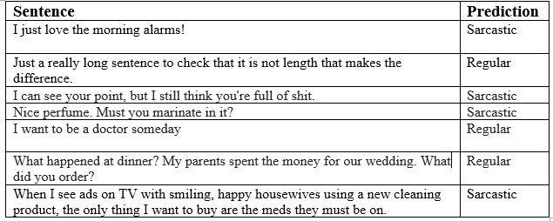

Slide 10
Research Papers ..!!!
Identifying Sarcasm in Twitter: A Closer Look by : Roberto González-Ibáñez Smaranda Muresan Nina Wacholder Proceedings of the 49th Annual Meeting of the Association for Computational Linguistics:shortpapers, pages 581–586, Portland, Oregon, June 19-24, 2011. ⃝c 2011 Association for Computational Linguistics
A Deeper Look into Sarcastic Tweets Using Deep Convolutional Neural Networks by : Soujanya Poria, Erik Cambria, Devamanyu Hazarika, Prateek Vij
Identifying Humor in Reviews using Background Text Sources by Alex Morales and ChengXiang Zhai Department of Computer Science University of Illinois, Urbana-Champaign.
Automatic Sarcasm Detection: A Survey By ADITYA JOSHI, IITB-Monash Research Academy PUSHPAK BHATTACHARYYA, Indian Institute of Technology Bombay MARK J CARMAN, Monash University
Are Word Embedding-based Features Useful for Sarcasm Detection? https://www.cse.iitb.ac.in/~pb/papers/emnlp16-sarcasm.pdf

Slide 11
Identifying Sarcasm in Twitter: A Closer Look
By: Roberto González-Ibáñez
Smaranda Muresan
Nina Wacholder
Empirical study on the use of lexical and pragmatic factors to distinguish sarcasm from positive and negative sentiments expressed in Twitter messages.
We therefore argue that using the tweets labeled by their authors using hashtag produces a better quality gold standard. We used a Twitter API to collect tweets that include hashtags that express sarcasm (#sarcasm, #sarcastic), direct positive sentiment (e.g., #happy, #joy, #lucky), and direct negative sentiment (e.g., #sadness, #angry, #frustrated), respectively
Features Used :
Lexical Factors. - unigrams and dictionary-based
- WordNet Affect
- Interjections
- Punctuations
2. Pragmatic Features - Emojis
- Mentions

Slide 12
Automatic Sarcasm Detection: A Survey
by
ADITYA JOSHI, IITB-Monash Research Academy
PUSHPAK BHATTACHARYYA, Indian Institute of Technology Bombay
MARK J CARMAN, Monash University
Automatic sarcasm detection refers to computational approaches that predict if a given text is sarcastic.
Types of Sarcasm : Propositional
Embedded
Like- Prefixed
Illocutionary
Tuple-representation of sarcasm: <S, H, C, u, p, p’>
APPROACHES
` Rule Based : hashtag and emoticons
Statistical Approaches : Bag of Words, Classifiers
Deep Learning : Similarity between word embeddings as a feature, Combination of CNN, LSTM followed by DNN

Slide 13
Are Word Embedding-based Features Useful for Sarcasm Detection?
by
Aditya Joshi1,2,3 Vaibhav Tripathi1 Kevin Patel1Pushpak Bhattacharyya1 Mark Carman2
1Indian Institute of Technology Bombay, India2Monash University, Australia3IITB-Monash Research Academy, India
Use of word embeddings is used to capture context incongruity in the absence of sentiment words.
Since existing feature sets rely on sentiment-based features to capture context incongruity, it is imperative that the two be combined for sarcasm detection.
We wish to capture the most similar and most dissimilar word pairs in the sentence, and use their scores as features for sarcasm detection.
The similarity score is the cosine similarity between vectors of two words.

Slide 14
A Deeper Look into Sarcastic Tweets Using Deep Convolutional Neural Networks
by : Soujanya Poria, Erik Cambria, Devamanyu Hazarika, Prateek Vij
(2017)
Major Contribution
  In this work, models based on a pre-trained convolutional neural network for extracting sentiment, emotion and personality features for sarcasm detection are used.
  Such features, along with the network’s baseline features, allow the proposed models to outperform the state of the art on benchmark datasets.
  The often ignored generalizability issue of classifying data that have not been seen by the models at learning phase is also addressed.

Slide 15
Identifying Humor in Reviews using Background Text Sources
by Alex Morales and ChengXiang Zhai Department of Computer Science University of Illinois, Urbana-Champaign.
HIGHLIGHTS:
  A generative language model, based on the theory of incongruity, to model humorous text
  Achieved almost 86% accuracy.
  These humorous review predictions can also supply good indicators for identifying helpful reviews.
Other than tweets, In this paper, we study the problem of automatically identifying humorous text from a new kind of text data, i.e., online reviews i.e Yelp Review Data.
Referential Humor and Incongruity
Language Models as a Proxy for Incongruity
The background language model

Slide 16
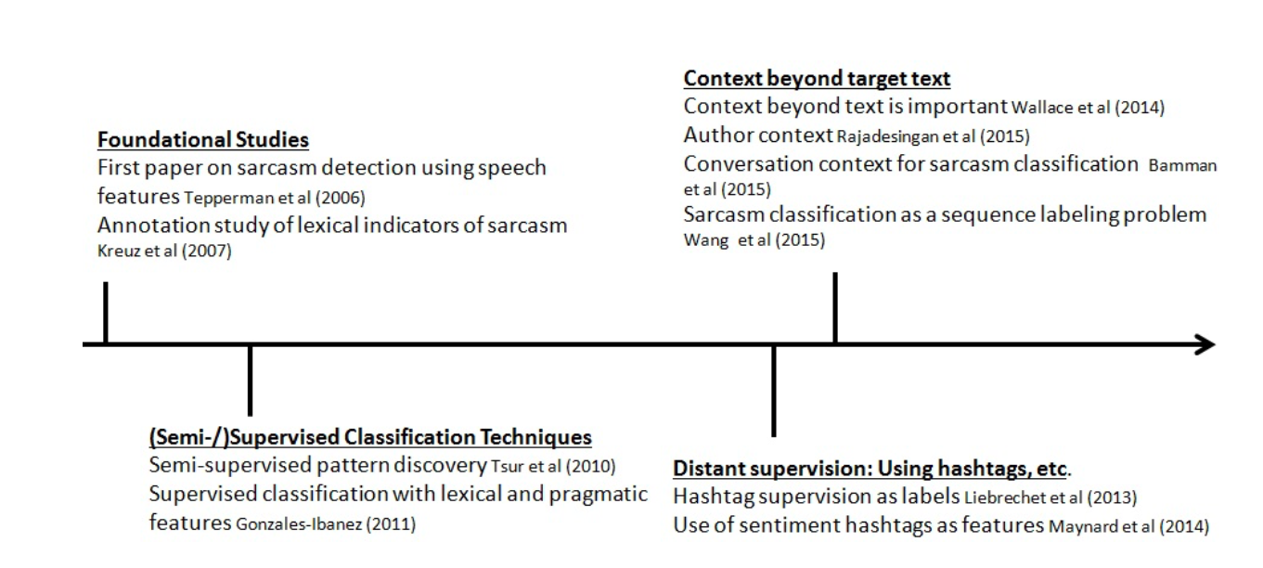
Trends in Sarcasm Detection...

Slide 17
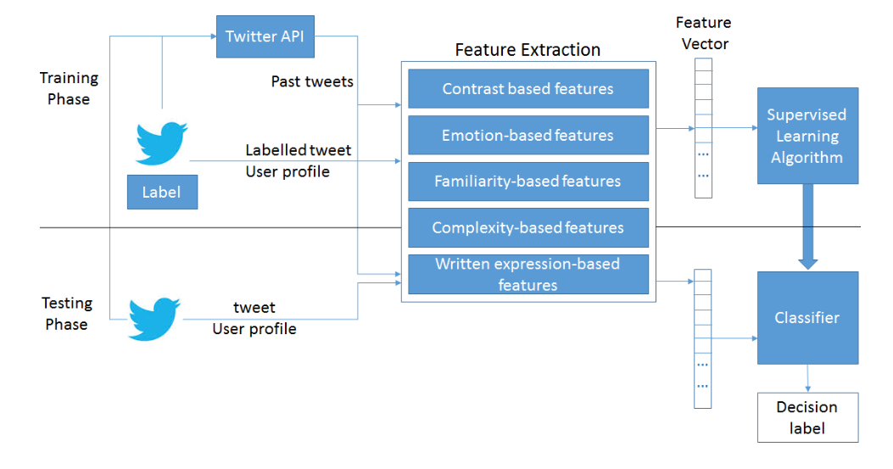
Proposed Methodology

Slide 18
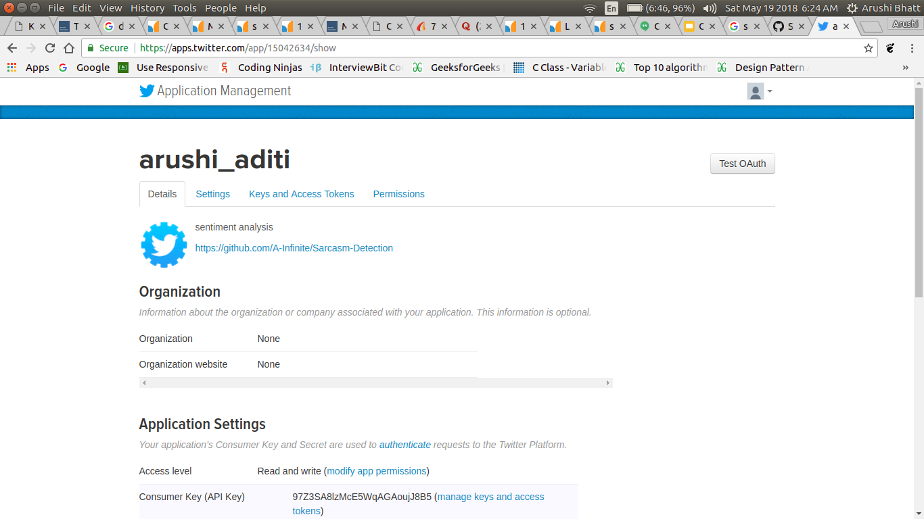
Account on Twitter for using its APIs

Slide 19
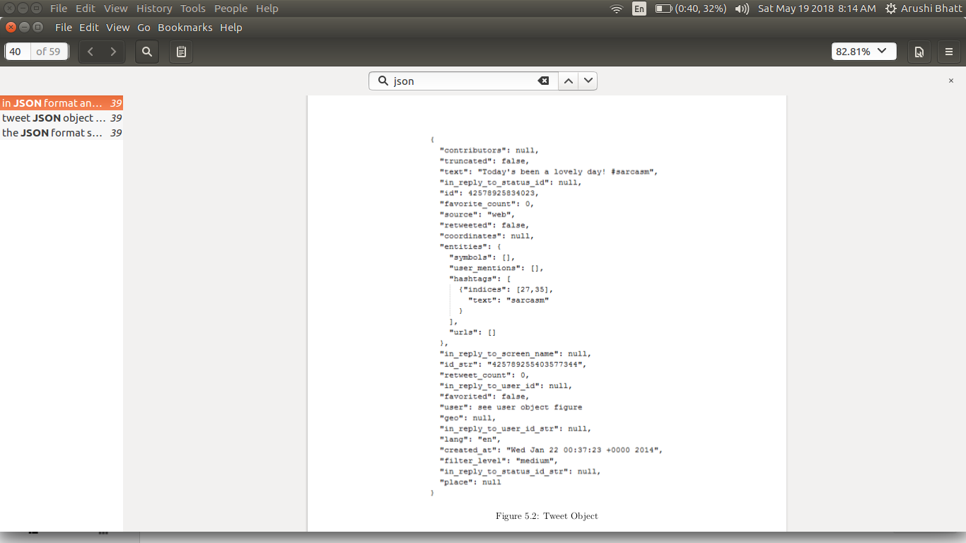
Tweet Object

Slide 20
Tools to be used...
Programming Language : Python
Scikit Learn Library
Google Cloud Computing
NLTK (Natural Language Tool Kit)
Twitter APIs

Slide 21
Dataset...
We have extracted approximately 6074 tweets and their past 30 tweets for every user by using the twitter API in Java.
Each file contains one current tweet followed by 30 past tweets.
Tweets were extracted by finding keywords like ‘#sarcasm’ , ‘#sarcastic’, ‘#not’.
Normal tweets | 2855 users
Sarcastic tweets | 3219 users

Slide 22
Pre-Processing
After this data is preprocessed in the following ways :
Mentions and URLs were removed : @ , http, www, etc
Lemmatization :Lemmatization usually refers to doing things properly with the use of a vocabulary and morphological analysis of words, normally aiming to remove inflectional endings only and to return the base or dictionary form of a word, which is known as the lemma .
Stemming : stemming is the process of reducing inflected (or sometimes derived) words to their word stem, base or root form—generally a written word form. The stem need not be identical to the morphological root of the word; it is usually sufficient that related words map to the same stem, even if this stem is not in itself a valid root.
Stop word were removed : Ex. a, the, an, is, etc.
Punctuations were also removed : . ,’ ,” ,; , : etc.

Slide 23
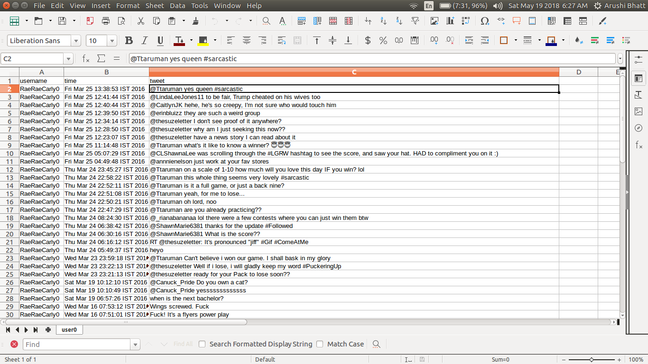
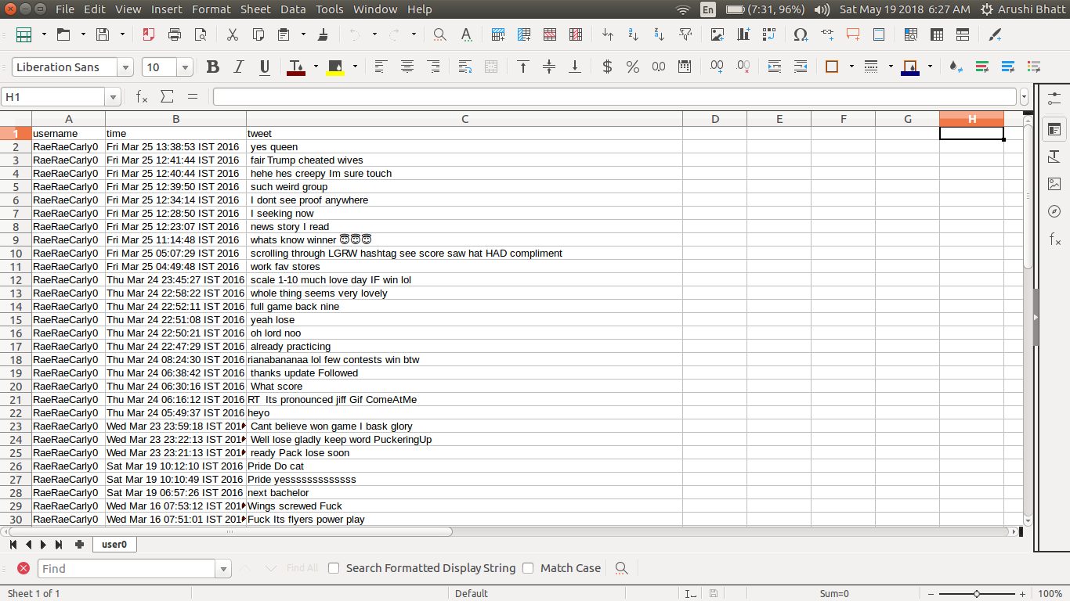

Slide 24
Features Extraction ...

Slide 25
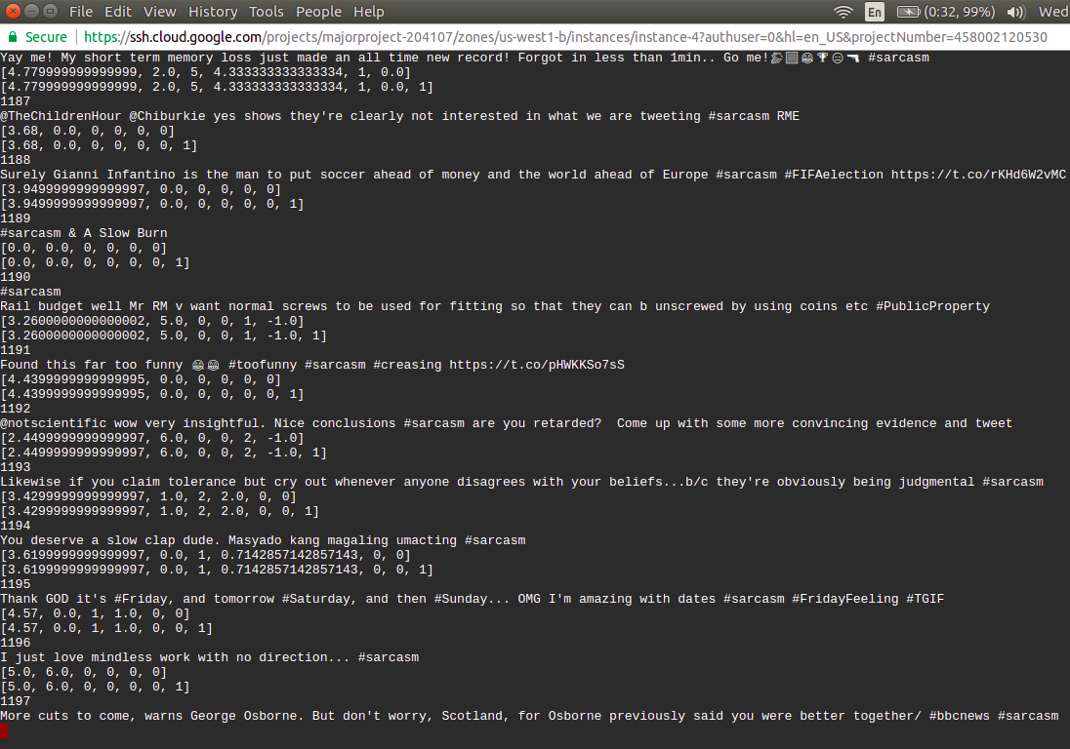

Slide 26
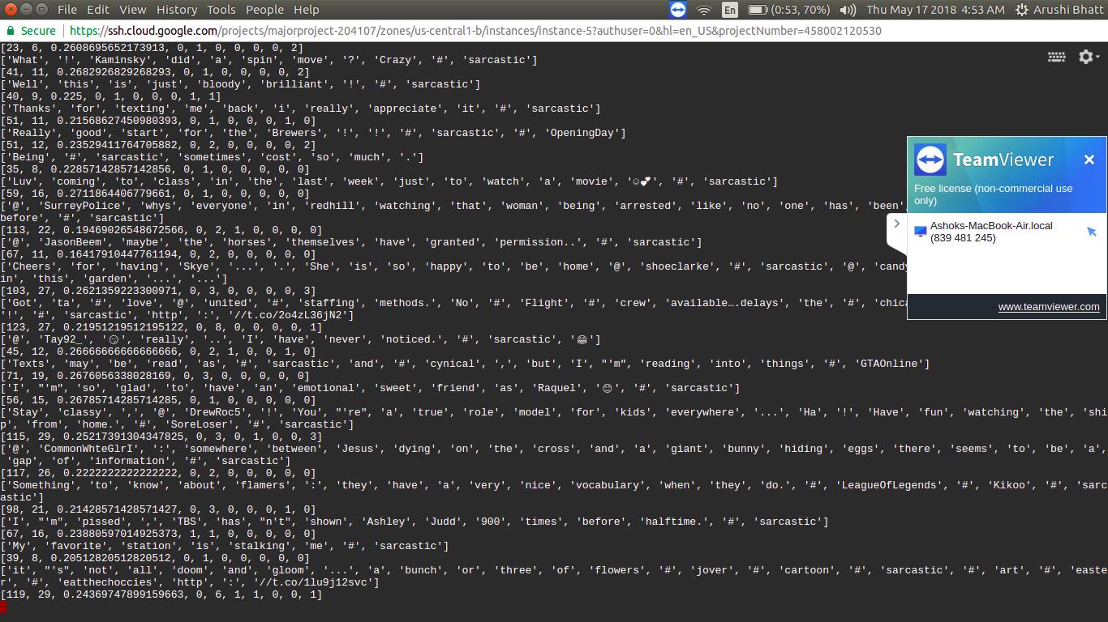

Slide 27
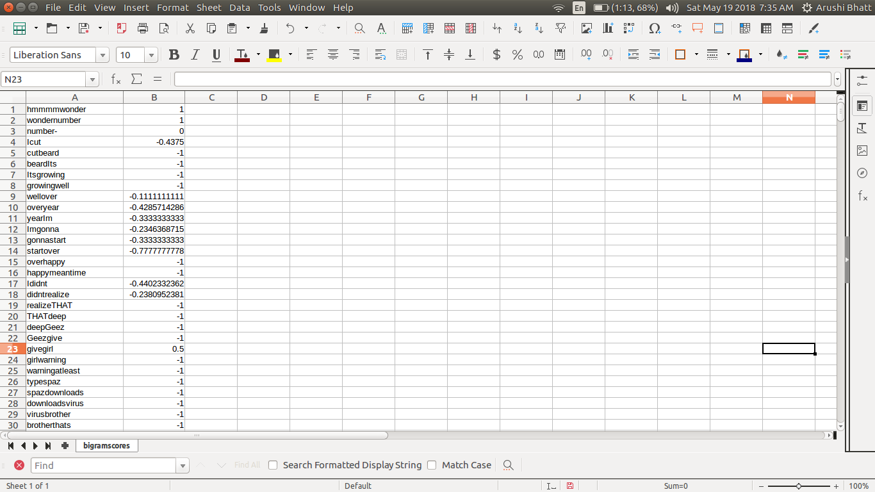
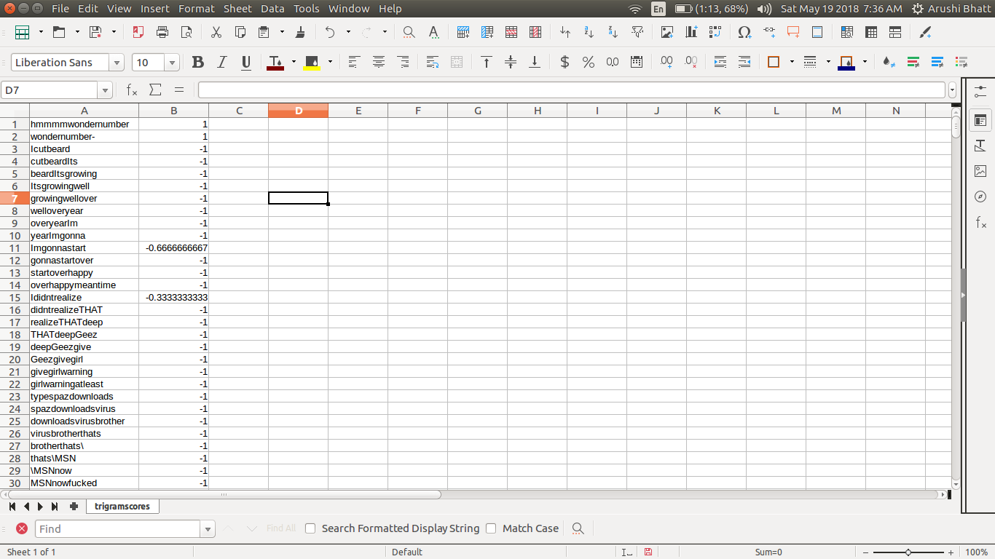
(i) Feature 1 : Contrasting Connotation
No. of Features: 6
Using Bigrams and Trigrams of already labeled data, bigrams scores and trigram scores were generated. Now using these affect scores were calculated, along with sentiment strength.
A = {affect(w)|w ε t}
S = { sentimentw) | w ε t}
∆affect = max(A) − min(A)
∆sentiment = max(S) − min(S)
Sb = POS(b) − NEG(b)
POS(b)+NEG(b)

Slide 28
(ii) Feature 2 : Transition Probability
No. of Features : 10
This feature checks the relation of transition of sentiment with respect to past tweets posted by the user.

Slide 29
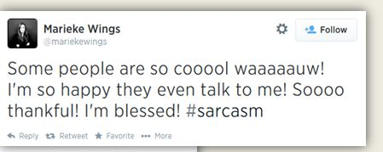
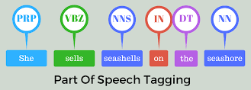
(iii) Feature 3 : Prosodic Variation
No. of Features : 2
This checks for the repeated characters along with the sentiments.
(iv) Feature 4 : Structural Variation
No. of Features : 5
This feature extracts lexical density, hereby looking at the complexity issue of the sentences

Slide 30
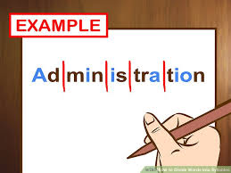
(v) Feature 5 : Probability
No. of Features : 5
This calculates the probability by the ratio of length of letters and total letters.
(vi) Feature 6 : Word Length Distribution
No. of Features : 12
This includes calculation of word length distribution with the help of polysyllables and syllables. Using these, median, mode, standard deviation were calculated for word length distribution.
Word length distribution L = {li} i=1 to 19
< E[lw], med[lw], mode[lw], σ[lw], min(lw) , max (lw) >
W ∈ t

Slide 31
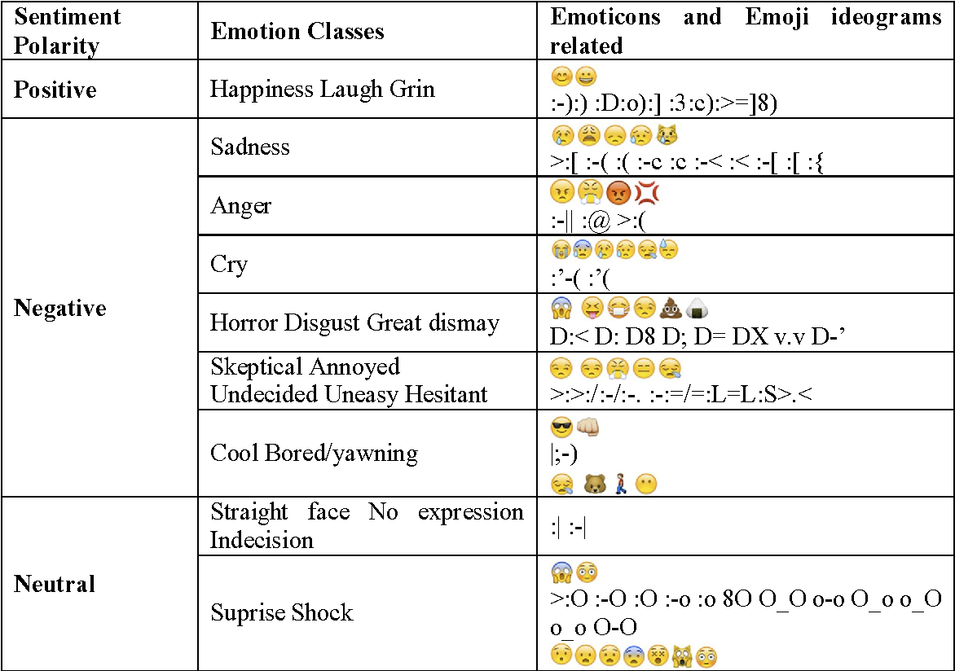
(vii) Feature 7 : Emoji
No. of Features : 16
This feature calculates the sentiments presented by emoticons, using emoji dictionary (values ranging from -5 to 5)

Slide 32
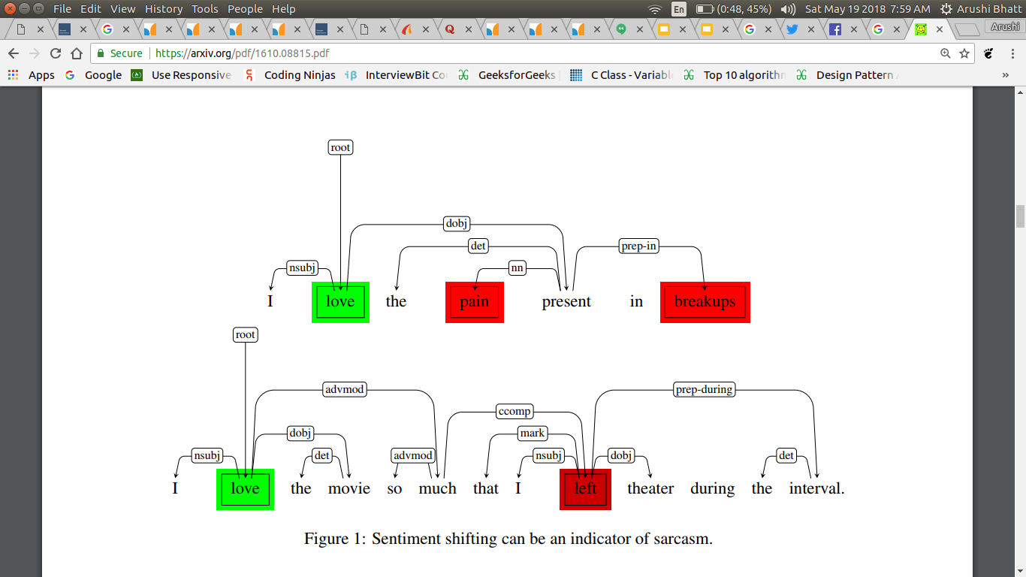
(viii) Feature 8 : Polarity
No. of Features : 23
This pertains to incongruity of feature by dividing the sentences into different parts(1-4). Polarity and subjectivity of every part is calculated.

Slide 33
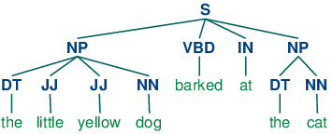
Punctuations : ‘…’ , ‘?’, ‘!!!’
Intensifiers : ”so” ,”very” , “amazingly", "astoundingly", "awful",
interjections : "oh", "hey", "wow", "aha", "aham", "aw"
affirmatives : "yes", "yeah", "always", "all"
negations : "no", "not", "never"
(ix) Feature 9 : Pragmatic Features
No. of Features : 10
This includes capitalized words, interjections, intensifiers, negations and affirmations.
(x) Feature 10: Parse Trees
No. of Features : 1
This includes sarcasm detection by checking the occurrence of certain parse trees in the sentence.

Slide 34
Classification
After this 13 classifiers were fed with the features extracted. Scores were generated on Google cloud as we needed more computation power which were out of the limitation of our personal machines.
Gaussian Naive Bayes
Stochastic Gradient Descent
Decision Tree
Random Forest
Adaboost
L1 regularised Logistic Regression
L2 regularised Logistic Regression
Gradient Boosting
Bagging Model
SVM (rbf kernel)
Extra trees
SVM (polynomial kernel)
MultiLayer Perceptron

Slide 35
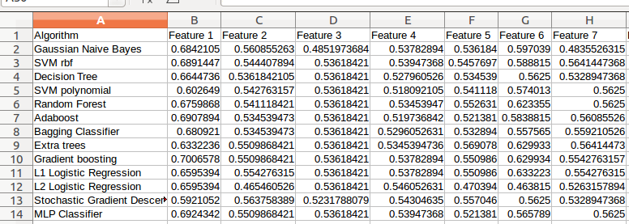
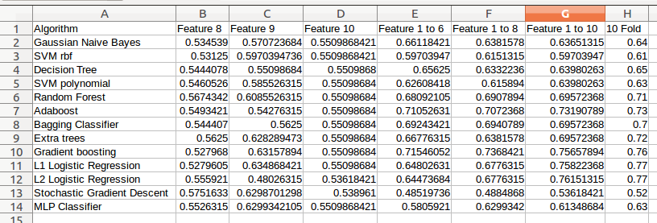

Slide 36
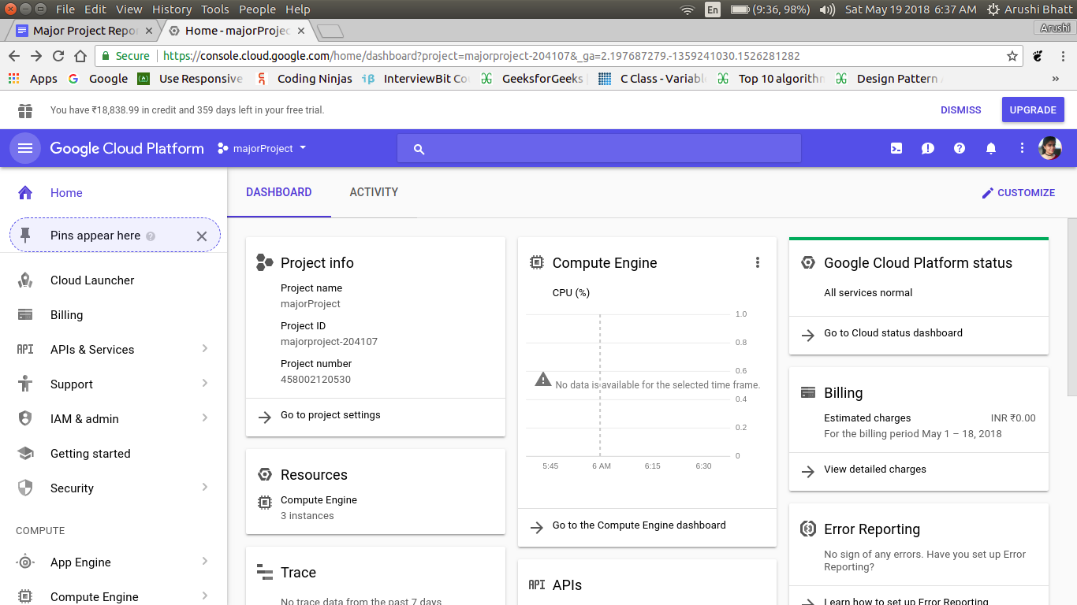
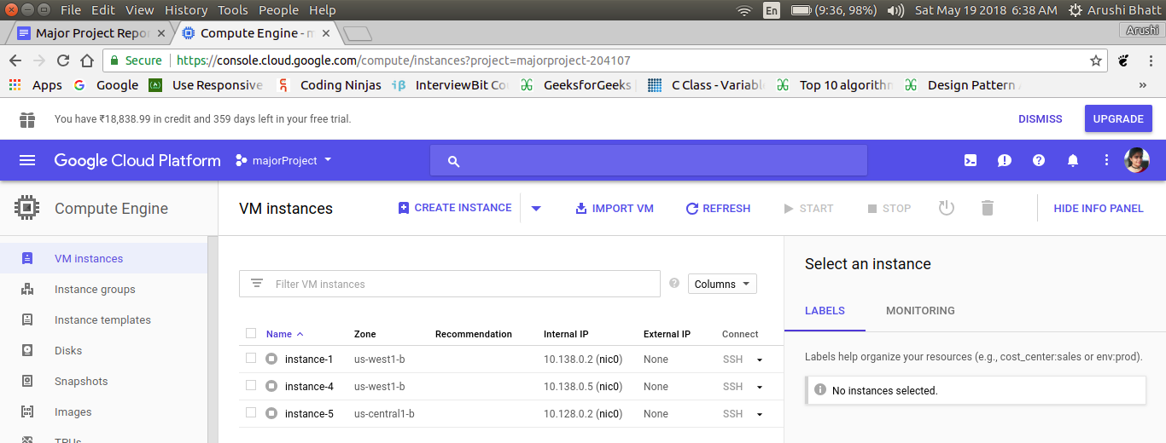

Slide 37
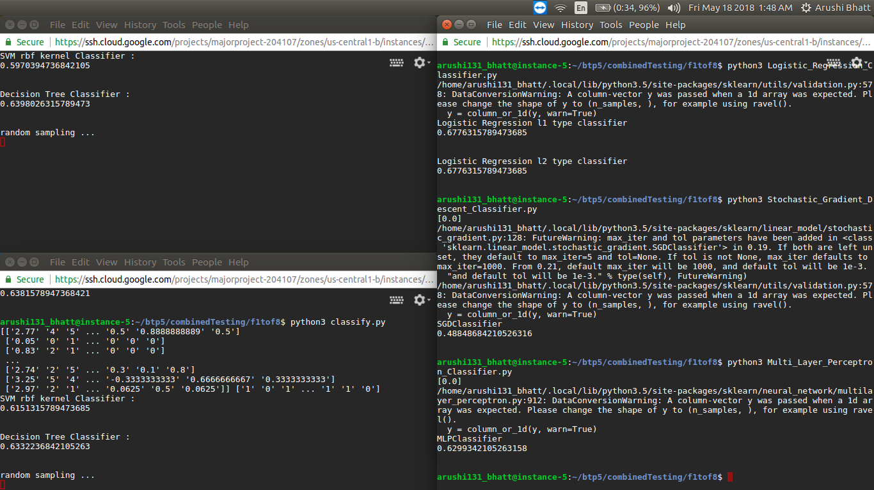

Slide 38
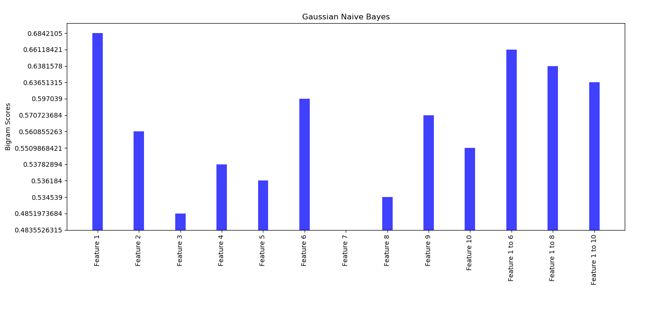
Results and Analysis ...

Slide 39
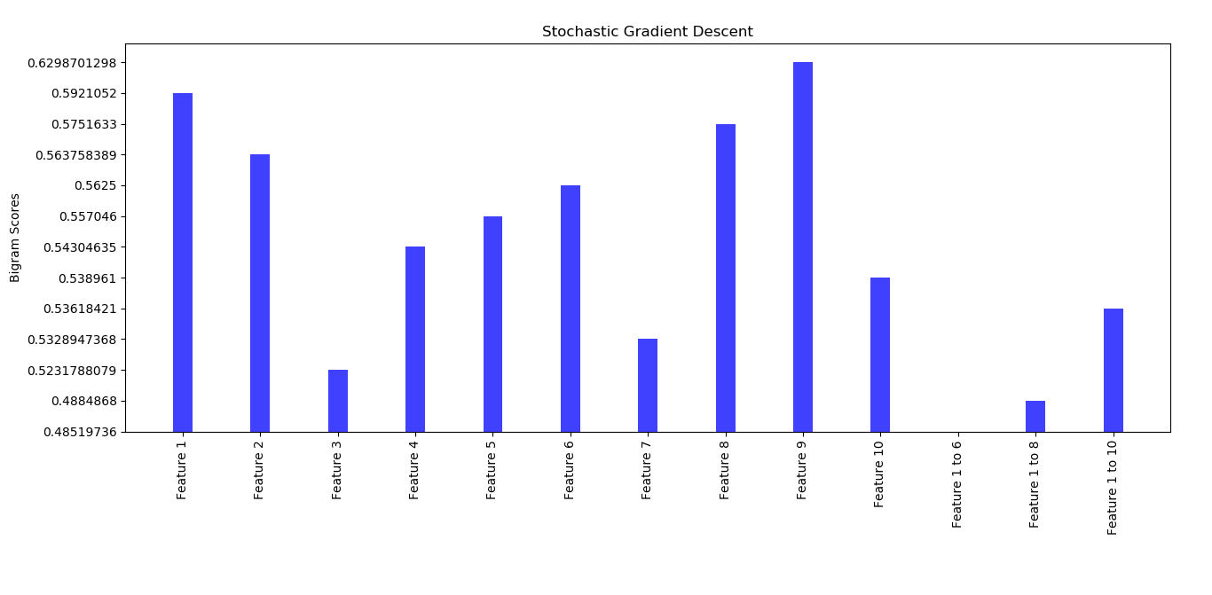
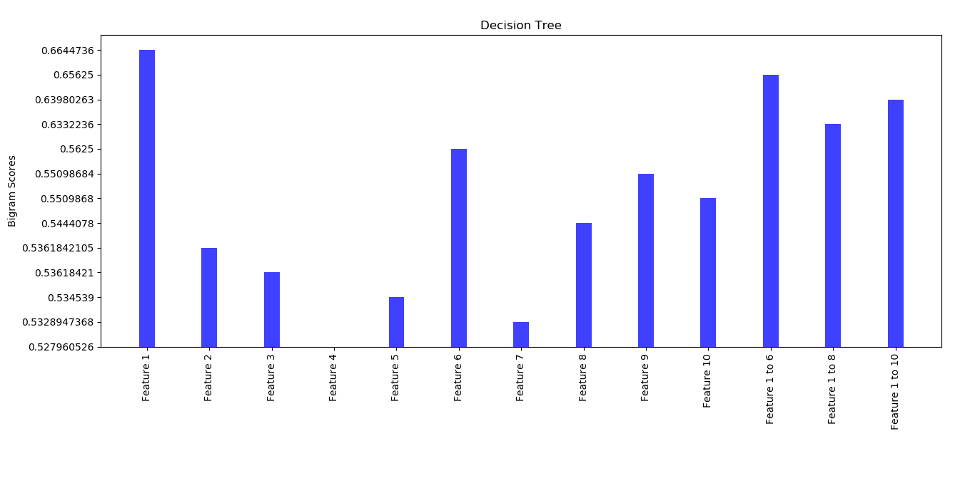

Slide 40
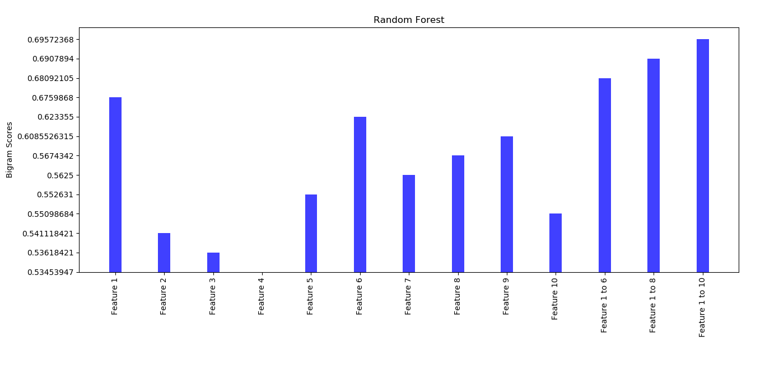
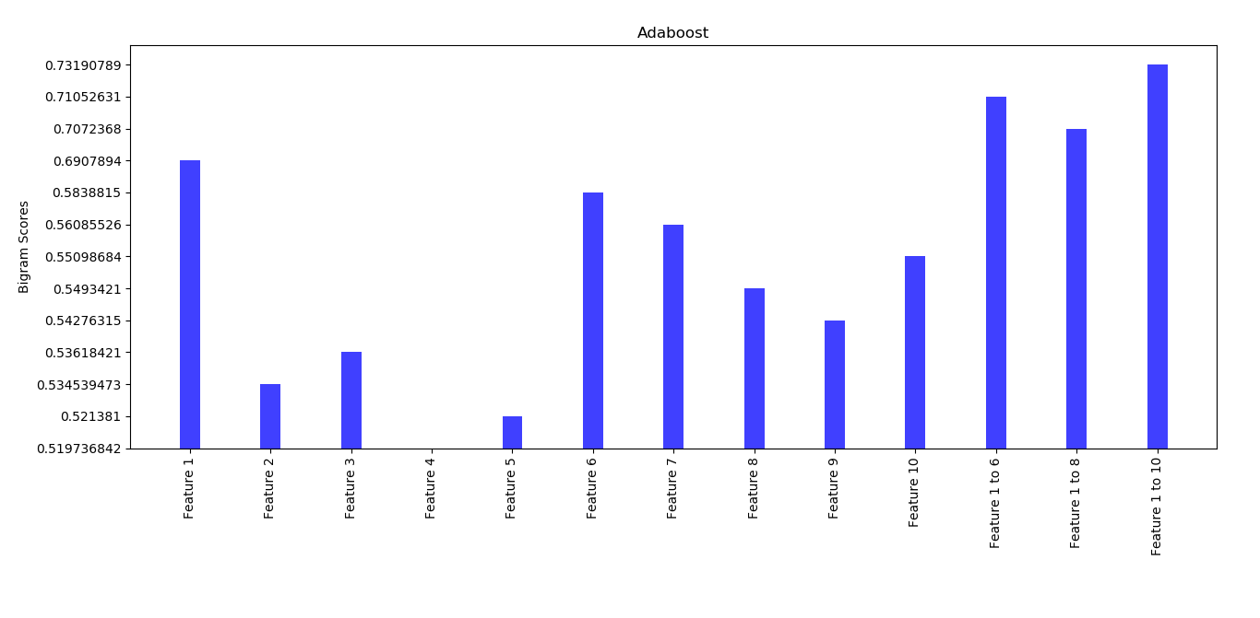

Slide 41
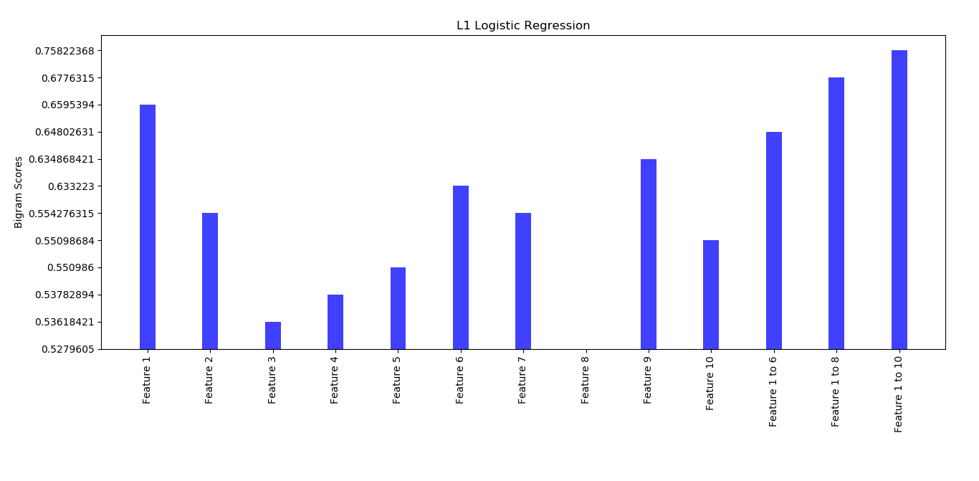
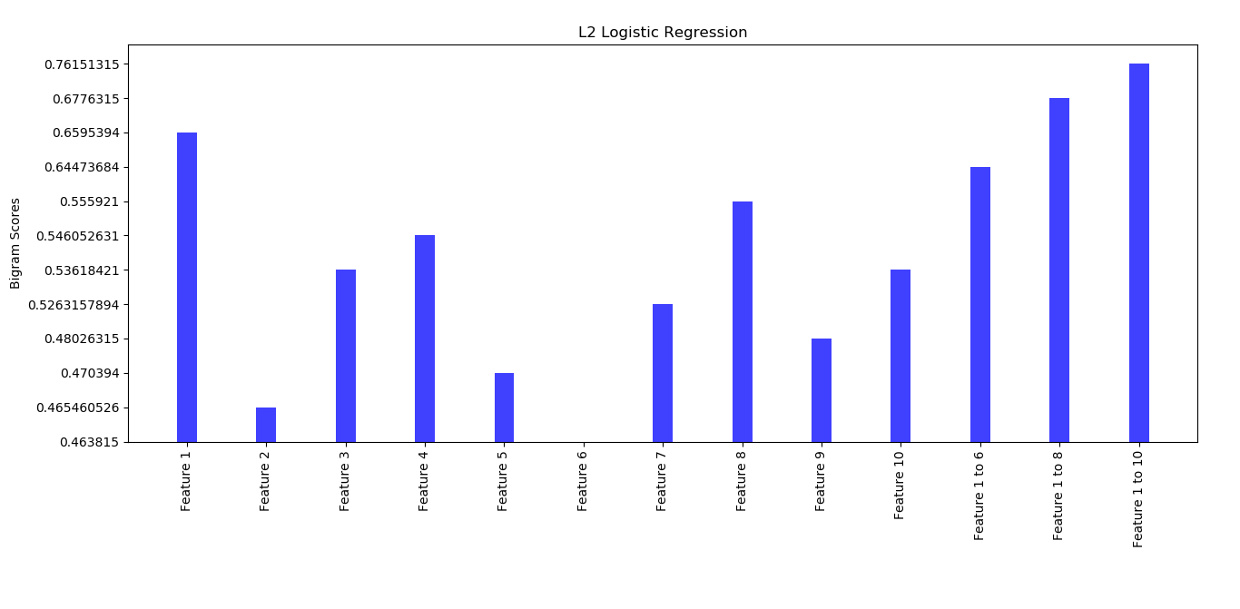

Slide 42
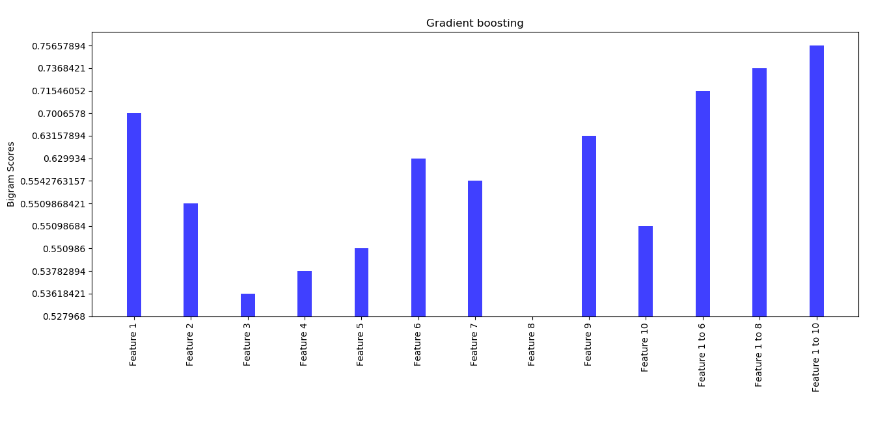
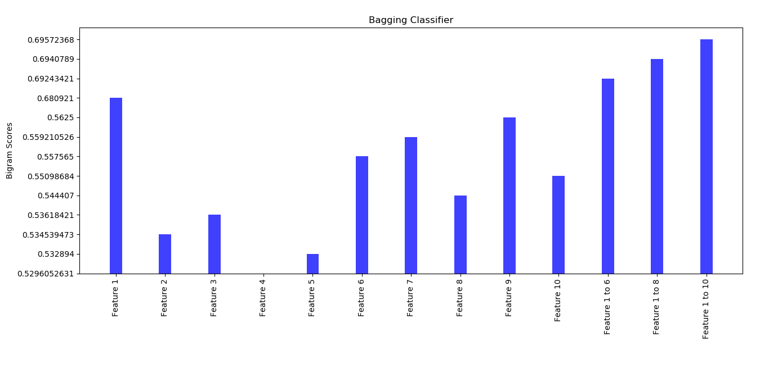

Slide 43
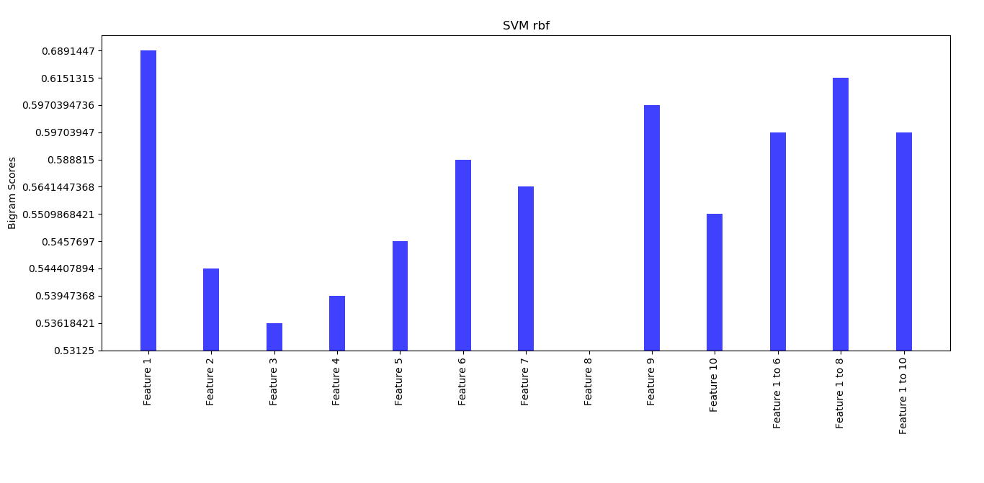
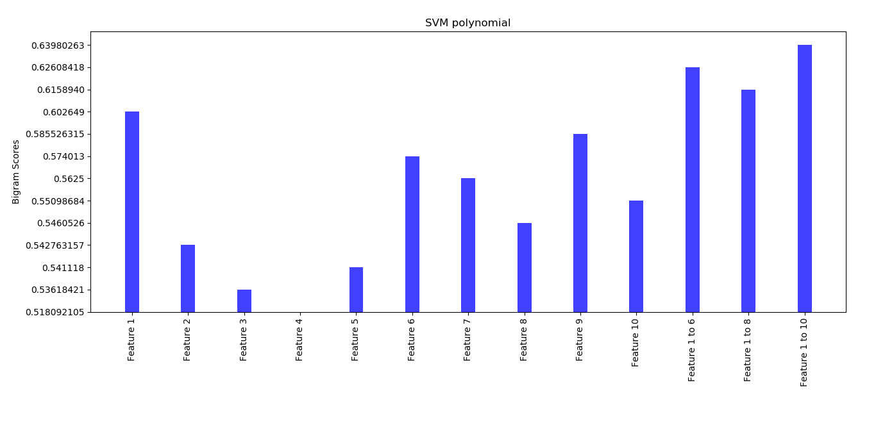

Slide 44
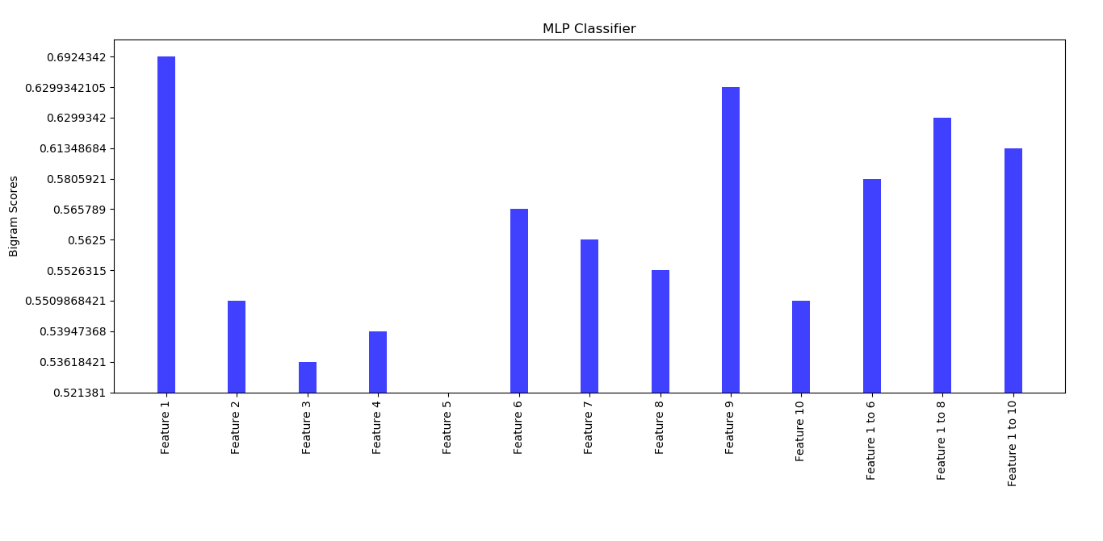
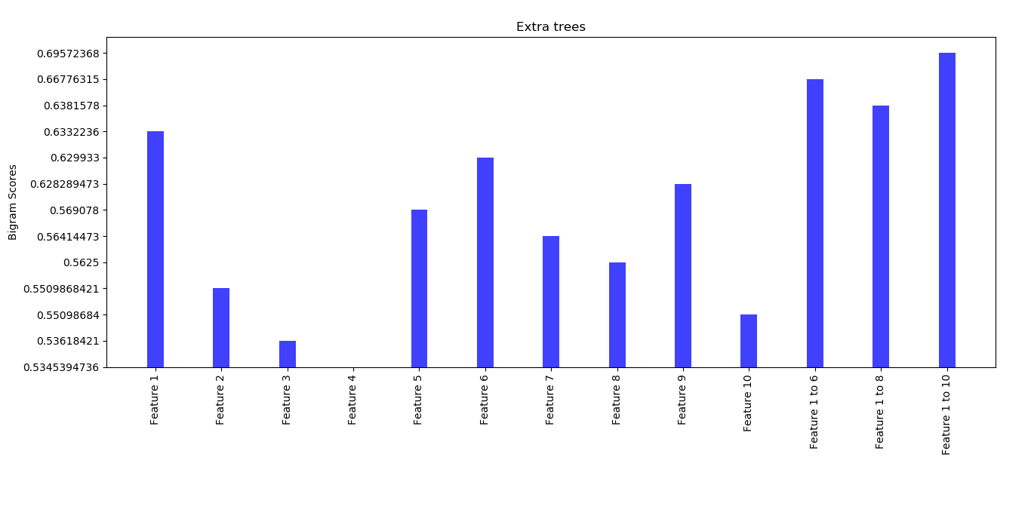

Slide 45
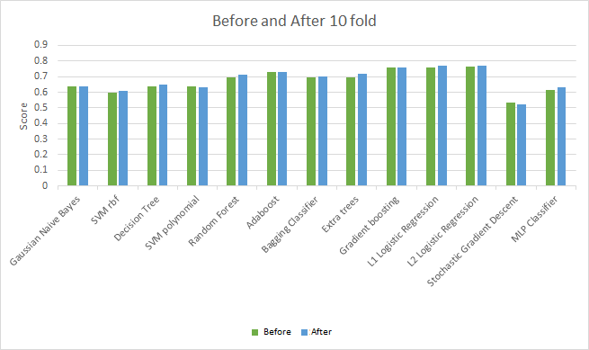
Comparison ...

Slide 46
Conclusion..
Including social traits for sarcasm detection framework gives pretty robust results.
Indicates that incorporating features that describe the psychological and behavioral aspects of the user goes a long way.
We can easily see the what type of feature outperformed and underperformed using Data Visualization Techniques.
Optimization done through 10-fold cross validation improvised the scores of most of the algorithms.

Slide 47
Application Area and Scope..
Quality of sarcasm annotation : sarcasm is closely related to language/culture-specific traits.
Extraction of implicit sentiment in patterns : it is well-established that sarcasm is closely linked to sentiment incongruity
Analysis based on types of sarcasm: A dataset which labels sarcastic sentences into one of the four types, and then studies the performance of various systems on each of these types will be helpful
Sarcasm versus irony classification : Sarcasm and irony are closely related and most work so far considers them to be the same.

Slide 48
Linguistic basis for sarcasm detection
Coverage of different forms of sarcasm
Extraction of Contextual Information using Deep learning-based architectures
Online Reviews
Understanding brain functioning

Slide 49
Future Work...
We can do intrusion of Deep Learning in this model.
More Features can be analyzed.
Features can be picked up for the particular classifier according to the performance and then they can be passed through softmax gating.
We have also thought of using this model for identifying the topic of sarcasm for finding out social problems and automating the process of complaints on change.org

Slide 50
REFERENCES
González-Ibánez, Roberto, Smaranda Muresan, and Nina Wacholder. "Identifying sarcasm in Twitter: a closer look." Proceedings of the 49th Annual Meeting of the Association for Computational Linguistics: Human Language Technologies: Short Papers-Volume 2.
Soujanya Poria, Erik Cambria, Devamanyu Hazarika, Prateek Vij A Deeper Look into Sarcastic Tweets Using Deep Convolutional Neural Networks : Published in COLING 2016 Computation and Language (cs.CL) http://arxiv.org/abs/1610.08815
Alex Morales and ChengXiang Zhai.”Identifying Humor in Reviews using Background Text Sources “ Proceedings of the 2017 Conference on Empirical Methods in Natural Language Processing, pages 492–501 Copenhagen, Denmark, September 7–11, 2017c 2017 Association for Computational Linguistics
Aditya Joshi, Pushpak Bhattacharyya, Mark James Carman Automatic Sarcasm Detection: A Survey ACM Computing Surveys, Vol. 0, No. 0, Article 1000. Publication date: 2017
Aditya Joshi Vaibhav Tripathi, Kevin Patel,Pushpak Bhattacharyya Mark Carman Are Word Embedding-based Features Useful for Sarcasm Detection? https://www.cse.iitb.ac.in/~pb/papers/emnlp16-sarcasm.pdf

Slide 51



