Slide 1
Fake News Detection
Using Machine Learning for Misinformation Prevention
Members : M S AJAYNATH
ABHIJITH J
VISAL KRISHNA K
SANIA VARMA
College Name & Department: Govt. Victoria College, Palakkad - B.Sc. Computer Science
Guide/Teacher’s Name: DR.SHWETA,JEEVA JOY
Date: 09-03-2025

Slide 2
Contents
Introduction
Methodology
Datasets used
Frontend and Backend Overview
Data Preprocessing
Models
Future Enhancement

Slide 3
Introduction
Fake news spreads rapidly through social media and online platforms.
It can mislead people, create confusion, and cause harm.
Machine learning helps detect and filter misinformation.
Fake news detection involves analyzing how it spreads and its impact.
Key models used: Logistic Regression, Decision Tree, Random Forest, and Gradient Boosting.
These models help reduce misinformation effectively

Slide 4
Objective of the Project
Develop a machine learning model to classify fake and real news.
Use multiple ML algorithms and compare their accuracy.
Evaluate model performance using precision, recall, F1-score, and confusion matrices.

Slide 5
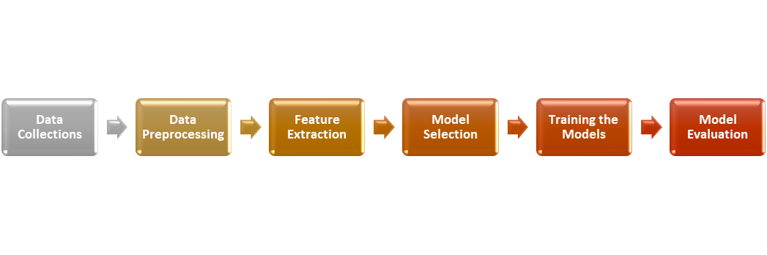
Methodology

Slide 6
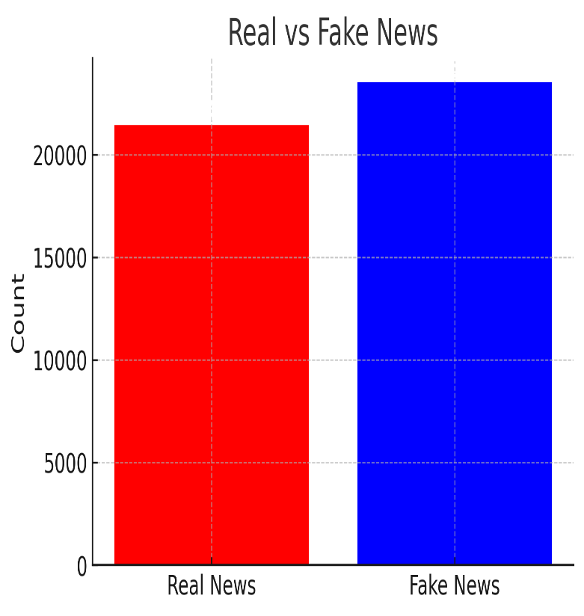
Dataset Used
23502
The research uses a public dataset from Kaggle called the "ISOT Fake News Dataset.
The dataset contains: - 23,481 fake news articles - 21,417 real news articles.
All articles focus on political topics.
Each article includes details like: - Title,Text, Subject,Publication,date.
For classification: - Fake news is labeled as 0 Real news is labeled as 1.
Dataset-used
21417

Slide 7
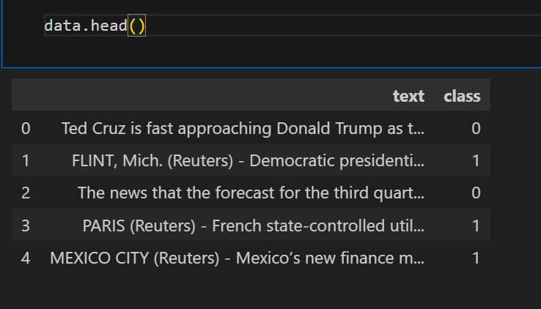
In this image, class 0 indicates fake news, while class 1 denotes true news.

Slide 8
Frontend & Backend Overview
Frontend (User Interface)
Technology Used: HTML, CSS, JavaScript
Features:
Simple interface for users to enter news text.
Send button to classify news as "Fake" or "Real“.
Displays results instantly with confidence scores.
Framework: Flask (to connect the ML model with the UI).

Slide 9
Backend (Machine Learning Model & API)
Technology Used: Python (Flask), Scikit-learn
Process:
User enters text → Sent to backend API → ML model predicts → Result displayed

Slide 10


Slide 11
Python Libraries Used
NumPy: For numerical operations and array manipulation.
Pandas: For data analysis and manipulation, including data frames.
Seaborn: For data visualization and statistical graphics.
Re :provides support for working with regular expressions.
String : A collection of constants and utility functions for working with and manipulating strings, such as ASCII letters, digits, and punctuation.
Matplotlib: For creating plots and charts.
scikit-learn (sklearn): For machine learning algorithms and model evaluation metrics

Slide 12
Data preprocessing
Elimination of variables: Title, subject, and publishing dates are removed to ensure consistency and focus on the actual text content.
Text normalization: Text is converted to lowercase
Character filtering: Using regular expressions, non-alphanumeric characters (excluding underscores) are replaced with spaces, and special characters, punctuation marks, HTML tags and URLs are removed to refine the text. Words containing numerical digits are removed to maintain focus on textual information.

Slide 13
TF-IDF Vectorizer
The TF-IDF Vectorizer in sci-kit-learn transforms text documents into a numerical format suitable for machine learning.
It operates in two steps:
Term Frequency (TF): Computes the frequency of each word in a document.
Inverse Document Frequency (IDF): Evaluates the uniqueness of each word across all documents.
By multiplying TF and IDF, it generates TF-IDF scores, which indicate the importance of each word in a document. This process allows machine learning models to understand the significance of words in text data.

Slide 14
Data Splitting – Train-Test Split
Before training, we split our dataset to evaluate model performance.
A common split ratio is 80:20 or 70:30.
Training set: Used to train the model.
Testing set: Used to evaluate performance.
Equation for Train-Test Split:
D = D_{train​} ∪ D_{test}​ , D_{train}​ ∩ D_{test​} = ∅

Slide 15
Algorithms Used for Fake News Detection
Logistic Regression
Decision Tree Classifier
Random Forest Classifier
Gradient Boosting
Each algorithm is tested to compare accuracy and performance.

Slide 16
1. Logistic Regression
Logistic Regression is a supervised machine learning algorithm used for binary classification problems, such as predicting whether a news article is fake (1) or real (0). Instead of directly predicting a label, Logistic Regression predicts the probability that an input belongs to a certain class.
Why Use Logistic Regression for Fake News Detection?
✔ Fast & Efficient: Works well with large text datasets. ✔ Interpretable: Provides probability scores, making it easy to understand. ✔ Good for Linearly Separable Data: If fake and real news have distinct patterns, Logistic Regression performs well.

Slide 17
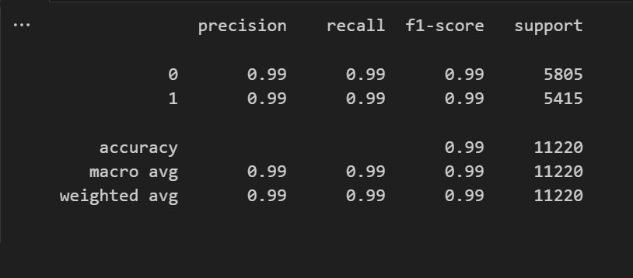
Performance Metrics

Slide 18
2. Decision Tree
A Decision Tree is a machine learning algorithm that helps us classify news articles as real or fake by making a series of simple yes/no decisions. It works like a flowchart, where each decision is based on specific words or patterns in the text.
Why Use Decision Tree for Fake News Detection?
✓ Easy to Understand: The tree structure is intuitive and interpretable, making it easy to visualize and explain.
✓ Handles Non-Linear Data: Unlike Logistic Regression, Decision Trees can capture non-linear relationships between features.
✓ Feature Importance: Provides insights into which features are most important for classification.
✓ No Need for Feature Scaling: Decision Trees do not require normalization or scaling of input data.

Slide 19
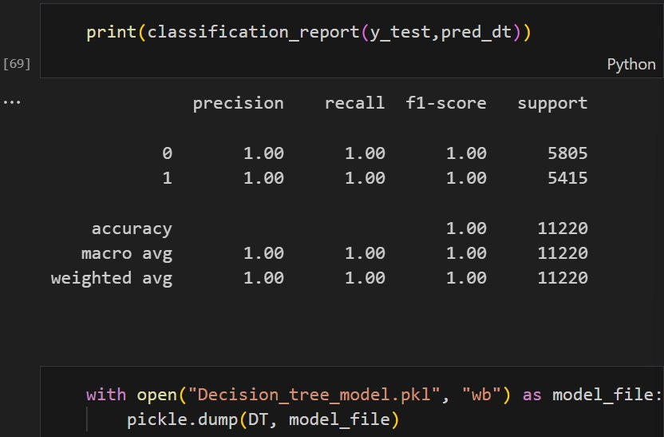
Performance Metrics

Slide 20
3.RANDOM FOREST 🌳
Random Forest is an ensemble machine learning algorithm that uses multiple Decision Trees to make predictions. The idea is simple: instead of relying on a single decision tree, it creates multiple decision trees and combines their results to improve accuracy and reduce errors.
It's called a "forest" because it consists of many decision trees.

Slide 21
Performance Metrics

Slide 22
4.GRADIENT BOOSTER
Gradient Boosting is an ensemble machine learning algorithm that builds multiple weak models (usually Decision Trees) in a sequential manner, each correcting the mistakes of the previous one.The final model is a strong predictor that combines all these weak models.
It is called Boosting because it boosts the performance of weak models by learning from their mistakes.
Why Use Gradient Boosting for Fake News Detection?
✓ High Predictive Power: Gradient Boosting often achieves state-of-the-art performance on many datasets.
✓ Flexibility: Can optimize different loss functions, making it adaptable to various types of data and problems.
✓ Feature Importance: Provides insights into feature importance, similar to Decision Trees and Random Forests

Slide 23
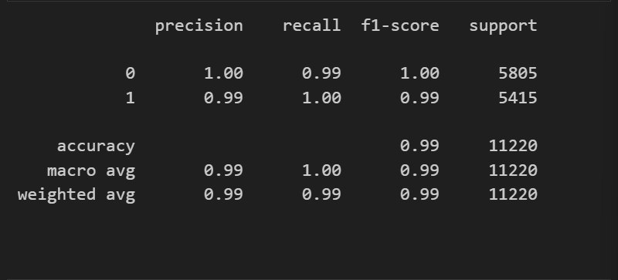
Performance Metrics

Slide 24
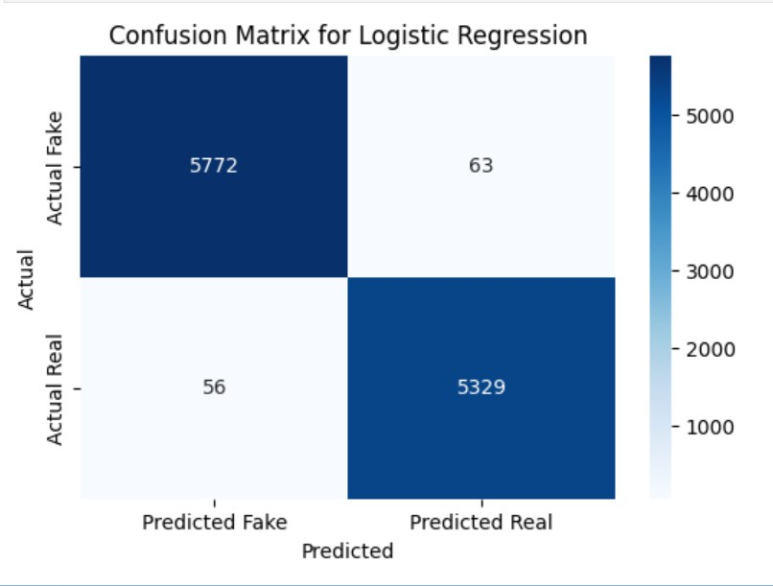
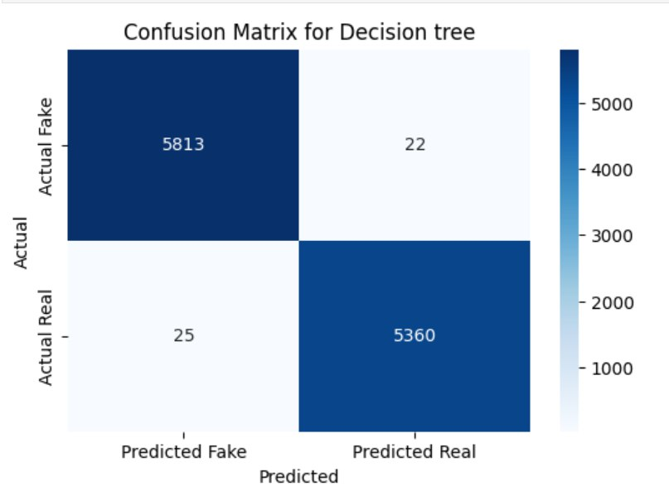
CONFUSION MATRIX

Slide 25
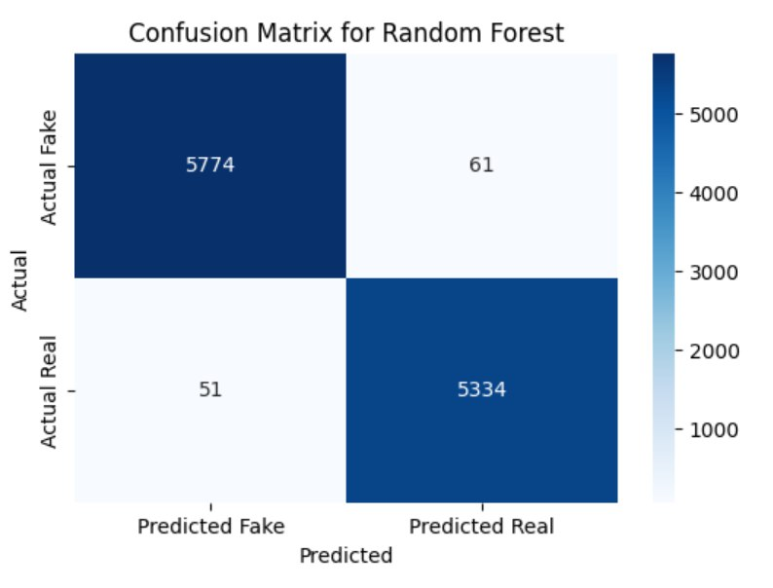


Slide 26
Future Enhancements
Integration with a real-time news API.
Adding more sophisticated deep learning models.
Improving UI with interactive elements.

Slide 27
THANK YOU

