Slide 1
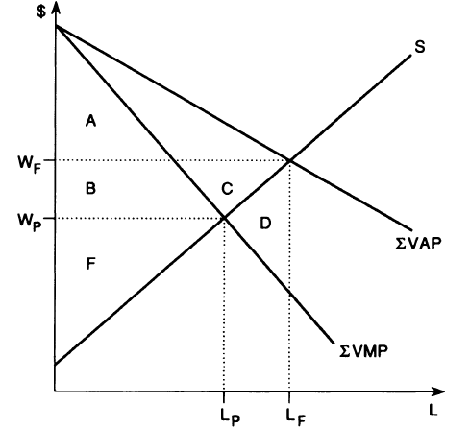







$$D_{1}$$
$$D_{2}$$
$$G_{1}$$
$$G_{2}$$
$$W_{I}$$
$$H_{1}$$
$$H_{2}$$

Slide 2
Open Access
Ag workers earnings
$$D_{1}$$
$$D_{2}$$
$$G_{1}$$
$$G_{2}$$
$$W_{I}$$
$$H_{1}$$
$$H_{2}$$

Slide 3
Low community wage
Rent from use rights
$$D_{1}$$
$$D_{2}$$
$$G_{1}$$
$$G_{2}$$
$$W_{I}$$
$$H_{1}$$
$$H_{2}$$
Implies A = C + D

Slide 4
Open Access
Ag workers earnings
$$D_{1}$$
$$D_{2}$$
$$G_{1}$$
$$G_{2}$$
$$W_{I}$$
$$H_{1}$$
$$H_{2}$$

Slide 5
Enclosure by owner-claimants
Ag wages
Rents to new owner-claimants
$$D_{1}$$
$$D_{2}$$
$$G_{1}$$
$$G_{2}$$
$$W_{I}$$
Enclosure:
lowers effective wage from wF to WP
Workers do get H2+G2+D2 as manuf wages
But lose A + B
$$H_{1}$$
$$H_{2}$$

