Slide 1

Nearest Elementary, Middle, and Highschool in PgAdmin/QGIS
Timothy Elvira
CS540

Slide 2
Appending to Volusia.Parcels
ALTER TABLE volusia.parcel
add column nearest_Elem_School VARCHAR,
add column distance_To_Elem_School double precision,
add column nearest_Middle_School VARCHAR,
add column distance_To_Middle_School double precision,
add column nearest_High_School VARCHAR,
add column distance_To_High_School double precision;
This is for the columns to add the data in.

Slide 3
Its important to use get_gis_schools. Bat file in order to grab the shape files and use them in PGAdmin.

Slide 4
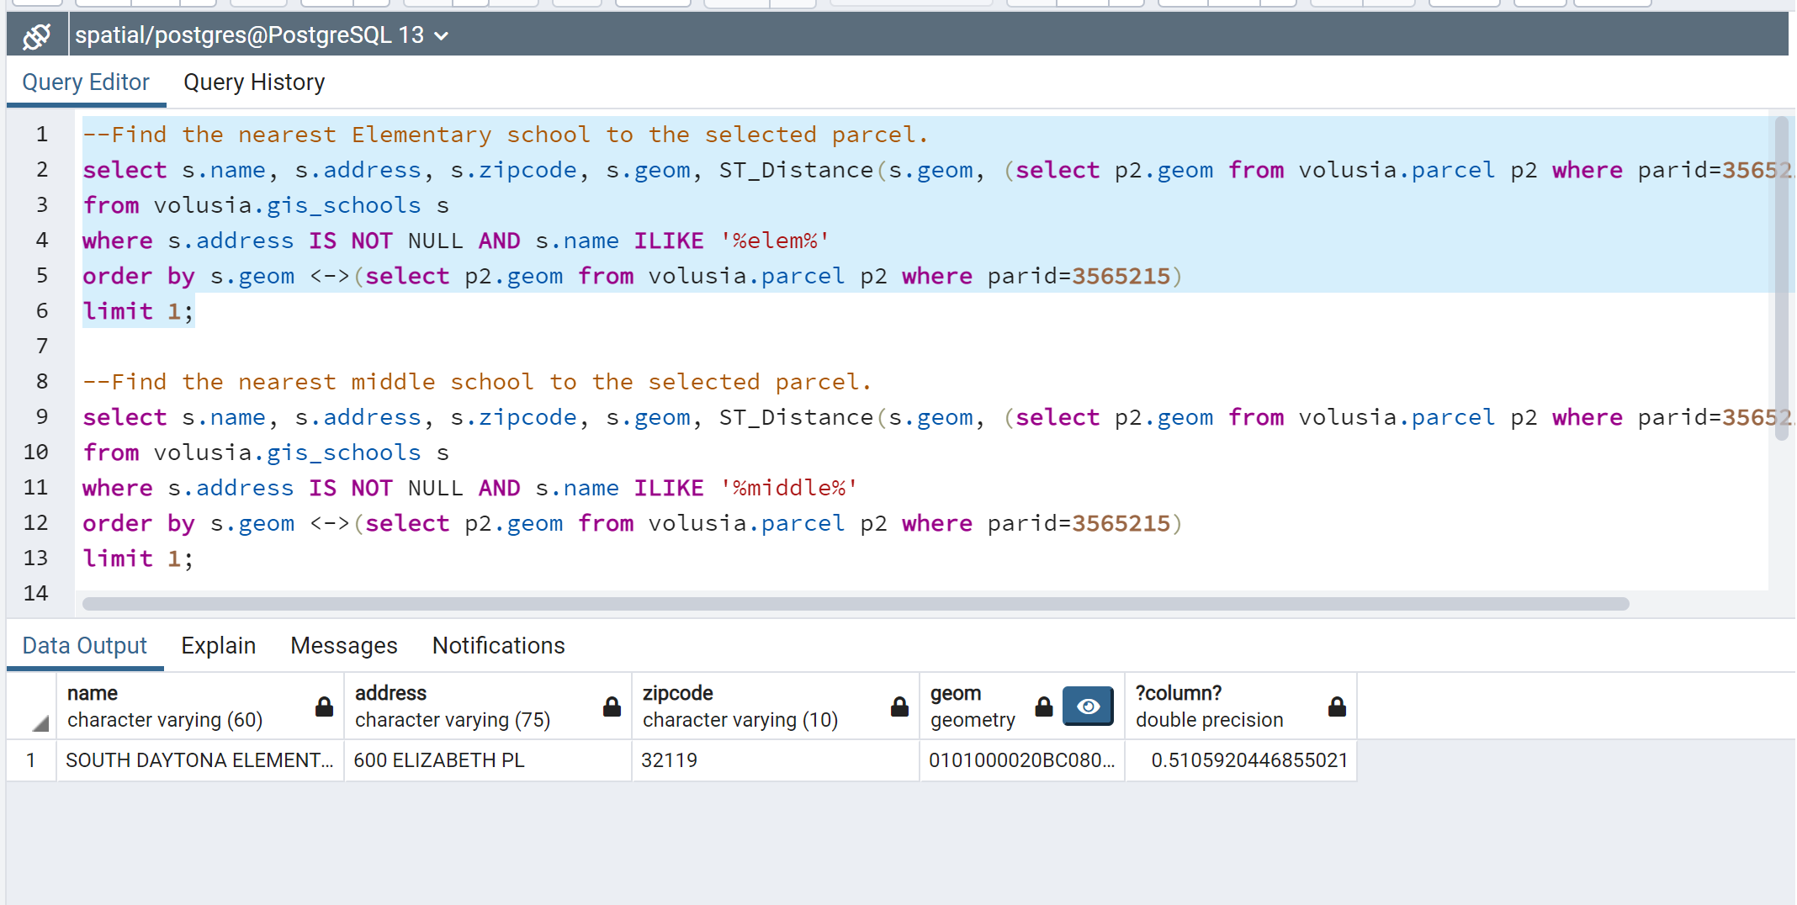
Example queries to get the knn of the closes elementary school. I grab the name, address, zipcode, geoms, and distance between the school and the parcel 356215.

Slide 5
--Find the nearest Elementary school to the selected parcel.
select s.name, s.address, s.zipcode, s.geom, ST_Distance(s.geom, (select p2.geom from volusia.parcel p2 where parid=3565215))/5280
from volusia.gis_schools s
where s.address IS NOT NULL AND s.name ILIKE '%elem%'
order by s.geom <->(select p2.geom from volusia.parcel p2 where parid=3565215)
limit 1;
--Find the nearest middle school to the selected parcel.
select s.name, s.address, s.zipcode, s.geom, ST_Distance(s.geom, (select p2.geom from volusia.parcel p2 where parid=3565215))/5280
from volusia.gis_schools s
where s.address IS NOT NULL AND s.name ILIKE '%middle%'
order by s.geom <->(select p2.geom from volusia.parcel p2 where parid=3565215)
limit 1;
--find the nearest high school to the selected parcel.
select s.name, s.address, s.zipcode, s.geom, ST_Distance(s.geom, (select p2.geom from volusia.parcel p2 where parid=3565215))/5280
from volusia.gis_schools s
where s.address IS NOT NULL AND s.name ILIKE '%high%'
order by s.geom <->(select p2.geom from volusia.parcel p2 where parid=3565215)
limit 1;

Slide 6
The hard part… Looping in PGAdmin
First step:
Ensure that the columns are Null Using:
Update volusia.parcelset nearest_elem_school = null, distance_To_Elem_School = null;
This is because we’re going to use the fact that they are Null to loop through them.
I provided the SQL files to do all these loops: elem, middle, and highschool and they each take about 10 minutes to run.

Slide 7
Declaration
DO
LANGUAGE plpgsql
$$
DECLARE
g1 geometry;
rec RECORD;
es VARCHAR(45);
distanceFromES float;
This section just declares the variables within the loop. IN the case of Rec, that’s just each individual parcel within the volusia.parcels. Es and distanceFromES are placeholder variables that we’re going to use to update the volusia.parcels columns.

Slide 8
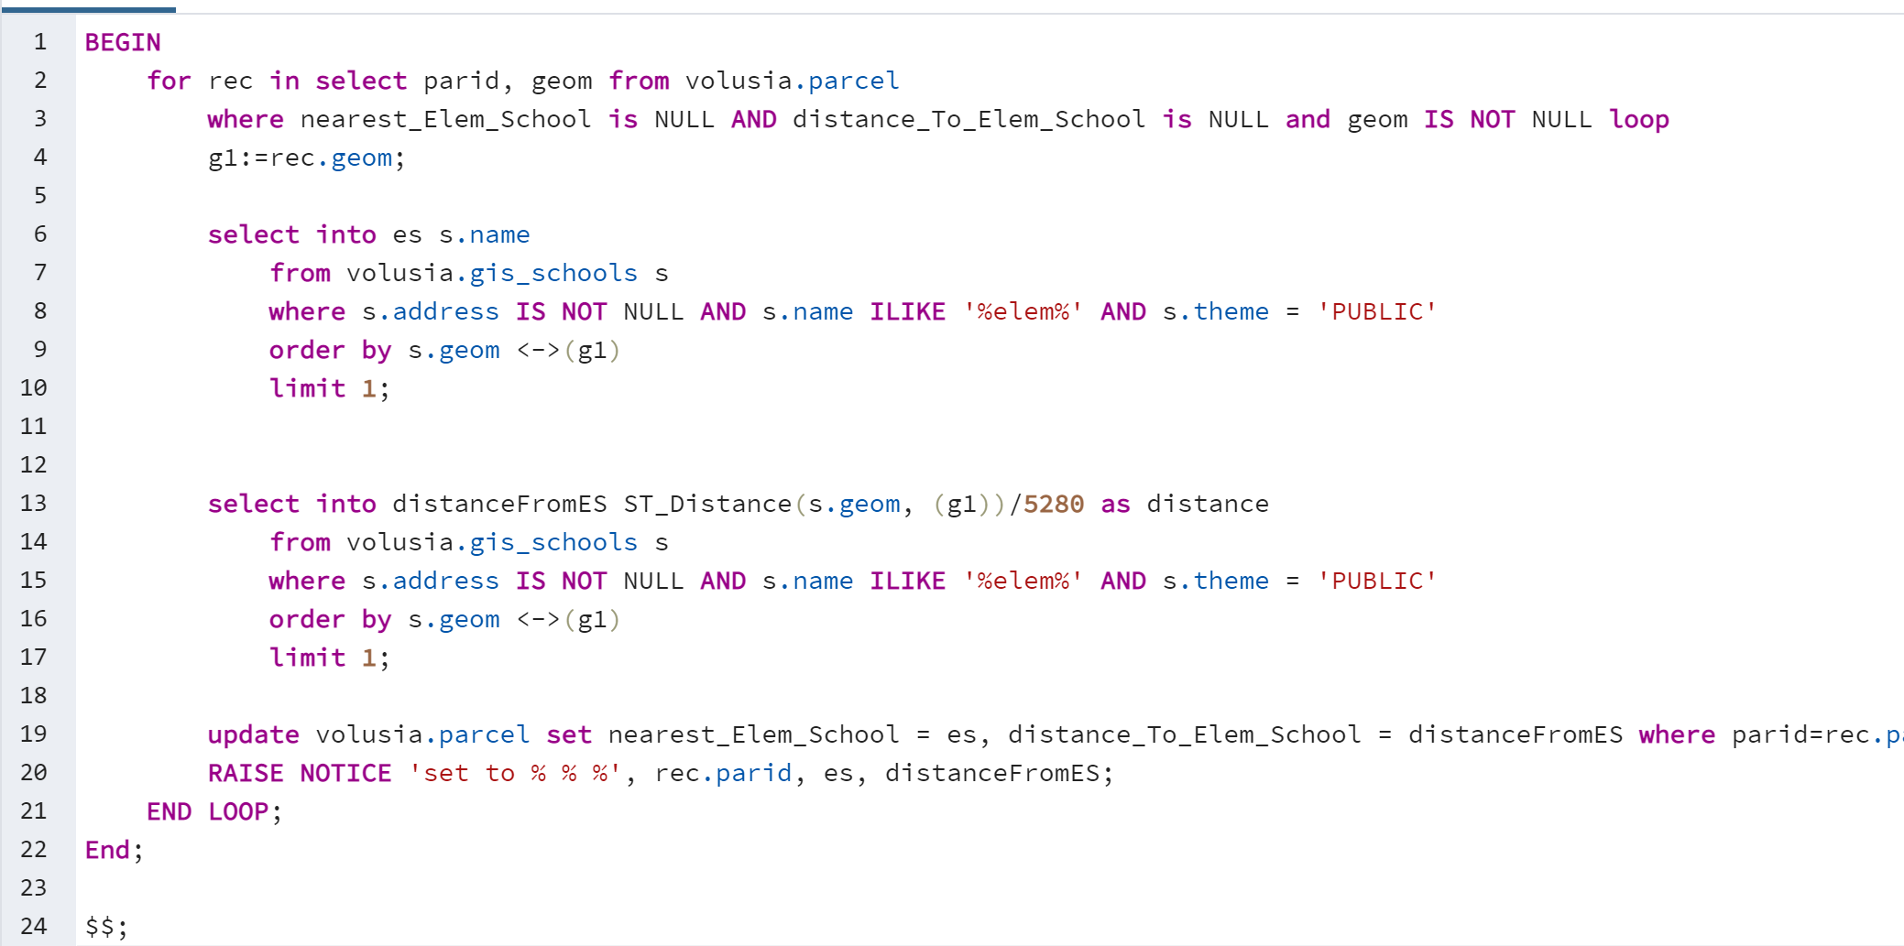

Slide 9
The loop
The previous slide is the loop query. The for statement loops through each parcel (rec) that has null values for the elem name and distance and also has valid geoms. G1 is set to be the current rec’s geoms.
Then the s.name is selected to be the es variable using the closest school near g1.
Distance is selected to be inputted into the distanceFromES using the closest elementary school near g1.

Slide 10
The loop, the update
We update the volusia.parcels columns using:
update volusia.parcel set nearest_Elem_School = es, distance_To_Elem_School = distanceFromES where parid=rec.parid ; RAISE NOTICE 'set to % % %', rec.parid, es, distanceFromES;
The raise notice is not necessarily needed because you’re updating 300k parcels but you can show them if you want. Not recommended but it also didn’t slow me down.

Slide 11
Verification
Repeat for the Middle School and Highschool SQL files in your PGAdmin
Once that is done, query your volusia.parcels with:
select geom, parid, nearest_elem_school, distance_to_elem_school, nearest_middle_school, distance_to_middle_school, nearest_high_school, distance_to_high_school from volusia.parcel
where nearest_elem_school IS NOT NULL AND nearest_middle_school IS NOT NULL AND nearest_high_school IS NOT NULL
limit 50;

Slide 12
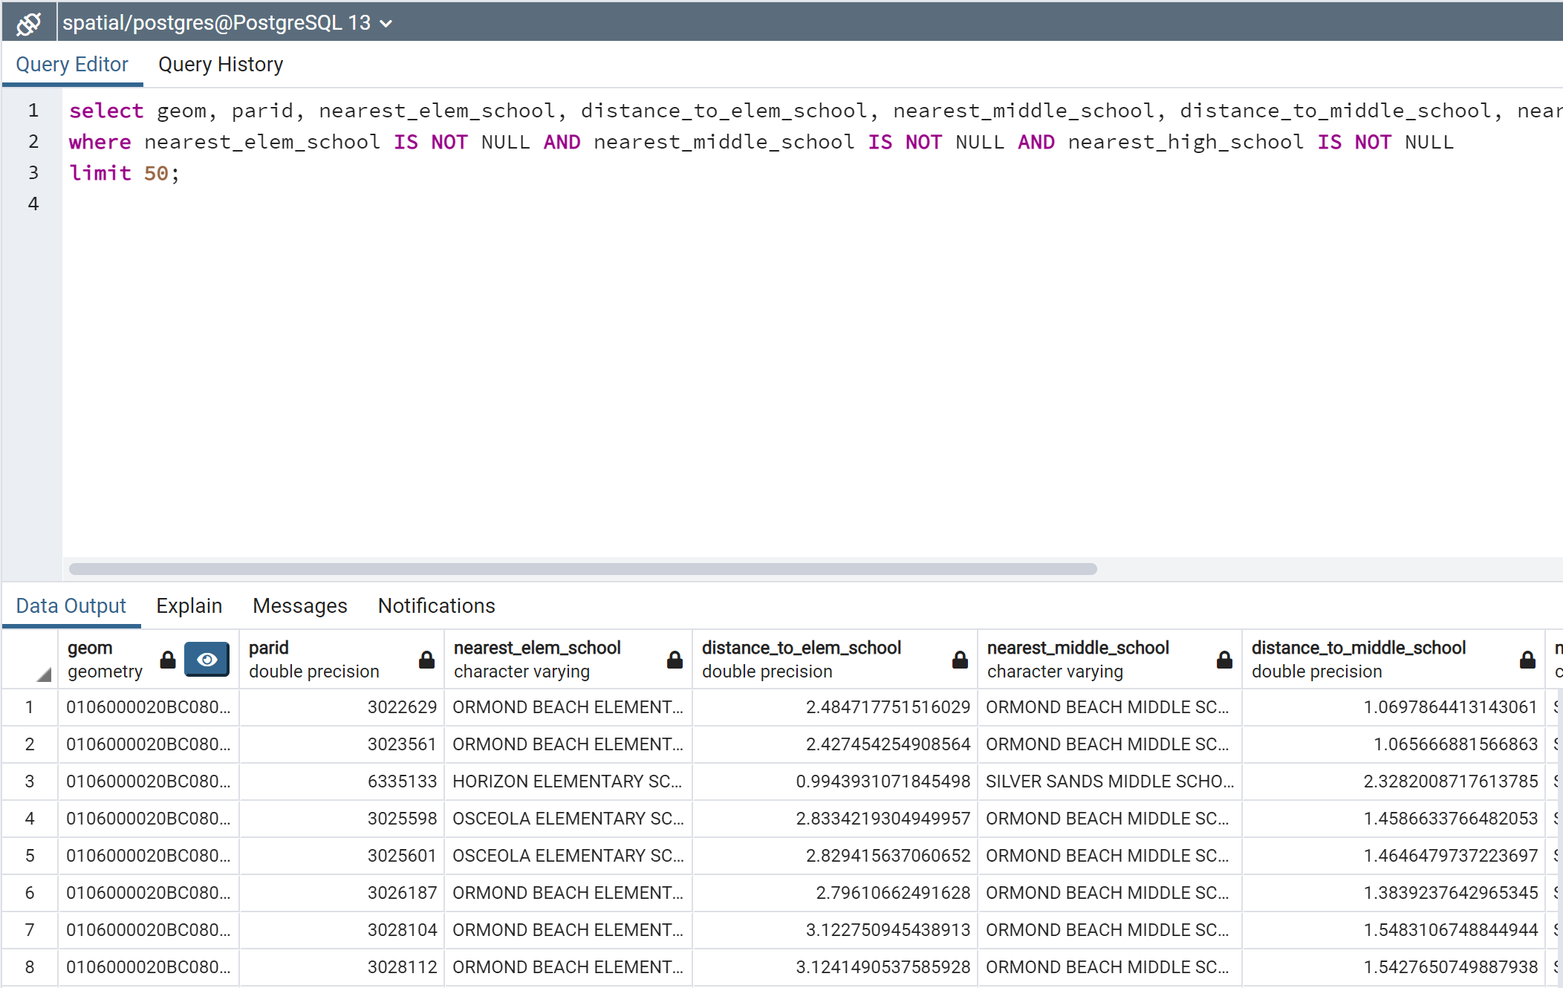
Query and
Select the
Columns to
View the data.

Slide 13
PostGis Layer
In QGIS, add a postgis layer and select the volusia.parcels table.
Go to Symbology and select nearest_elem/middle/high_school and click classify, this should classify each parcel with their respective nearest school.

Slide 14
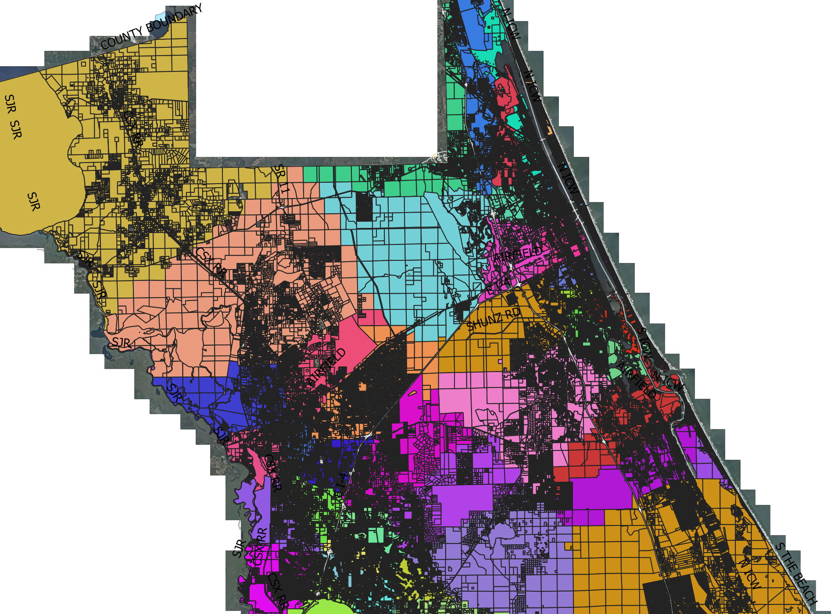
View on QGIS
Bit of a mess but those parcels are match with those highschools. Add the appropriate categorization in QGIS to see elementary and middle respectively. I just used the categorization button and all the school names were used.

