Slide 1
KEYLOGGER
CAPSTONE PROJECT
Presented By:
A.JASMIN - Jeppiaar Institute of Technology – B.TECH/ IT

Slide 2
OUTLINE
Problem Statement
Proposed System/Solution
System Development Approach
Algorithm & Deployment
Result
Conclusion
Future Scope
References

Slide 3
PROBLEM STATEMENT
With the increasing sophistication of cyber threats, keyloggers pose a significant risk to individuals and organizations by surreptitiously recording keystrokes and compromising sensitive information. Detecting and mitigating these threats effectively remains a challenge, requiring robust monitoring and prevention mechanisms.

Slide 4
PROPOSED SOLUTION
To address the threat posed by keyloggers, a Python-based keylogger detection and prevention system is proposed. This system leverages the pynput library for keyboard monitoring and tkinter for the graphical user interface (GUI), enabling real-time monitoring and response to keylogger activity.

Slide 5
SYSTEM APPROACH
Technology Used:
Python: For programming the keylogger functionality.
Tkinter: For building the graphical user interface (GUI).
pynput: For keyboard Monitoring.
JSON: For data serialization.

Slide 6
ALGORITHM & DEPLOYMENT
.
Initialization:
The program initializes the necessary components, including the Tkinter GUI, global variables, and callback functions for keyboard events.
Event Handling:
The on_press and on_release functions handle keyboard events using the pynput library.
Logging:
generate_text_log writes the keystroke data to a text file named 'key_log.txt' in a human-readable format.
generate_json_file converts the keys_used list into JSON format and writes it to a file named 'key_log.json’.
Keylogger Control:
The start_keylogger function initiates the keyboard listener using the keyboard.Listener class from the pynput library

Slide 7
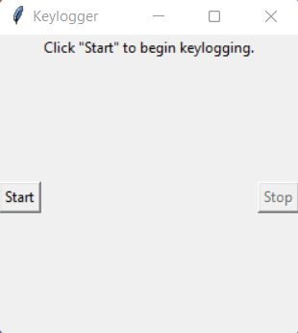
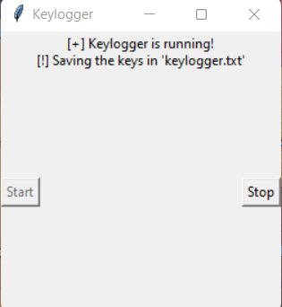
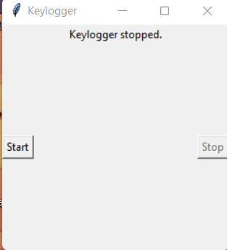
RESULT
Evaluation of the system demonstrates its effectiveness in detecting and mitigating keylogger threats, reducing the risk of sensitive information compromise. Real-world deployment enhances cybersecurity posture, bolstering defenses against evolving cyber threats.

Slide 8
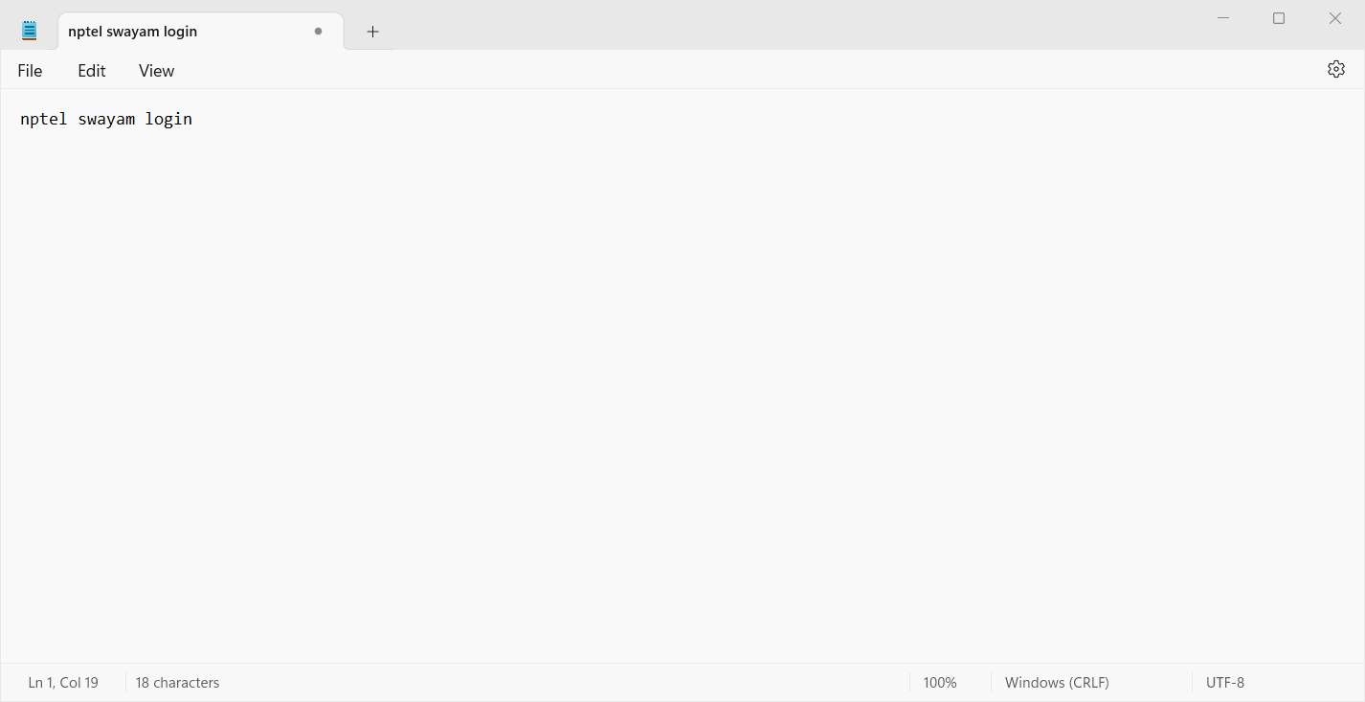
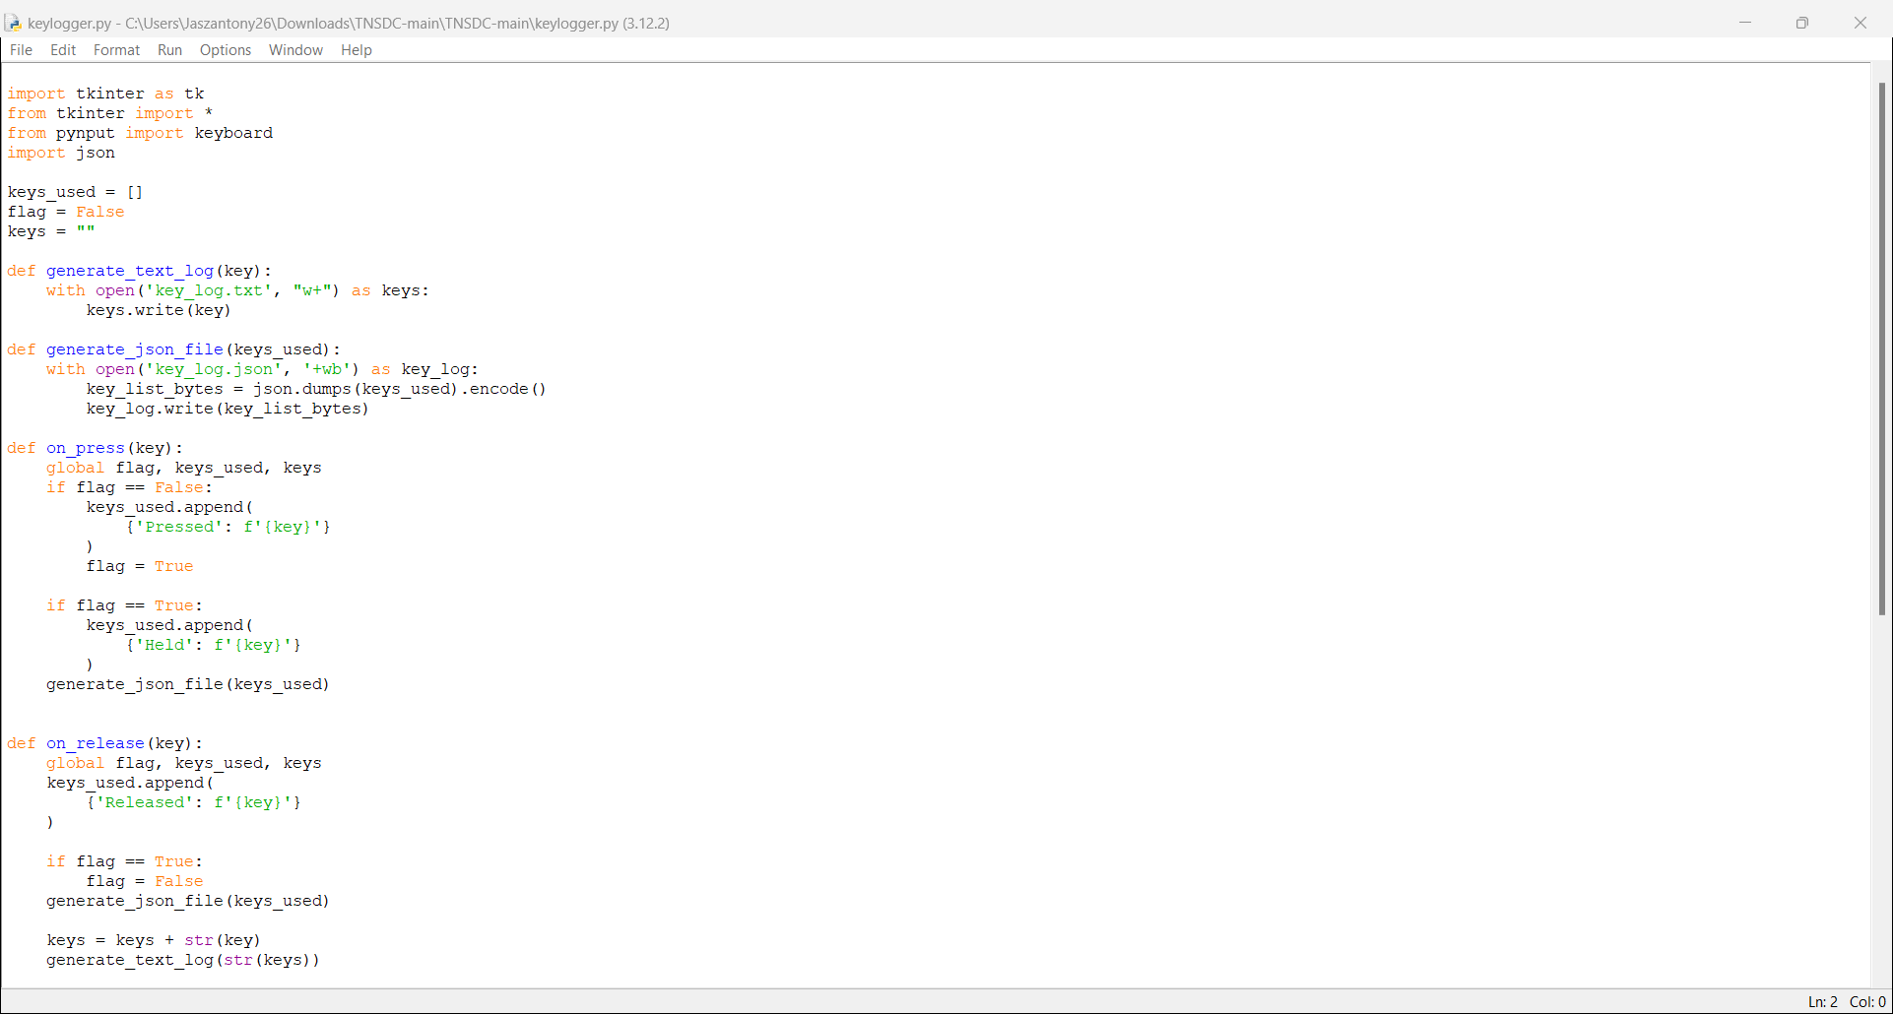
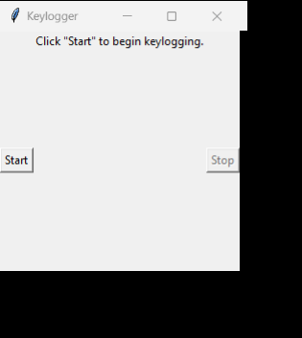

OUTPUT

Slide 9
CONCLUSION
The developed keylogger detection and prevention system offers a proactive approach to cybersecurity, safeguarding against the pervasive threat posed by keyloggers. By leveraging advanced algorithms and real-time monitoring, the system enhances the security posture of individuals and organizations.

Slide 10
FUTURE SCOPE
Future enhancements may include incorporating machine learning algorithms for improved threat detection, implementing dynamic response mechanisms to mitigate detected threats, and expanding compatibility with diverse operating environments.

Slide 11
REFERENCES
1.Python Documentation: https://docs.python.org/3/
2.pynput Documentation: https://pynput.readthedocs.io/en/latest/
3.tkinter Documentation: https://docs.python.org/3/library/tkinter.html
4.Stack Overflow for community insights: https://stackoverflow.com/User

Slide 12
THANK YOU

