Slide 1
Linux Native Development
with Visual Studio
Jun 2017
Notes:
Good/Bad news
No .NET today
But VS is still here
Two sides of development
IDE
Debugger

Slide 2
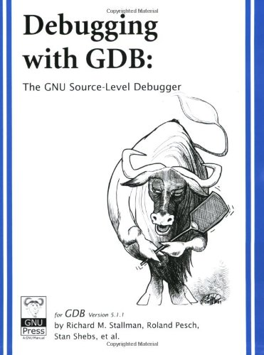
What is GDB?

Slide 3

What is GDB?
GDB is..
GNU Debugger
Command like application
Supports for Ada, C, C++, Objective-C, Pascal,..
Mac OS X uses modified version of GDB
Fetures
Supports for various architectures (ARM, MIPS, i386, etc.)
Supports for instructions; SSE, AVX, AVX2 MPX, etc
Including all the functionalities of GUI debuggers

Slide 4
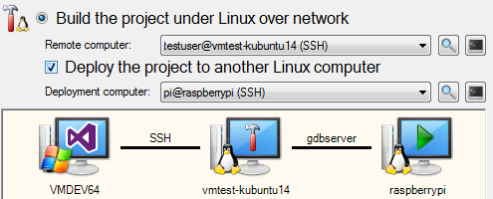
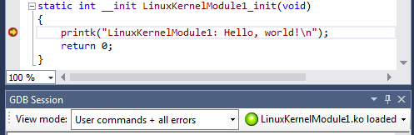
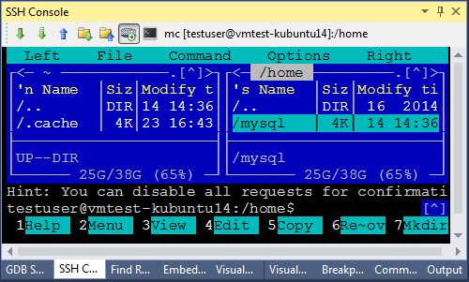
VisualGDB

Slide 5

VisualGDB

Slide 6
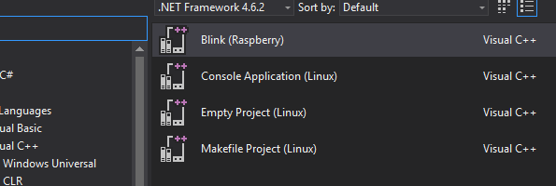
Visual C++ for IoT Development
VC++ for Linux Development Tools
VS GDB Debugger extension
Project templates
Notes:
https://marketplace.visualstudio.com/items?itemName=MarcGoodner-MSFT.VisualCforIoTDevelopment
https://blogs.msdn.microsoft.com/vcblog/2016/03/30/visual-c-for-linux-development/
https://blogs.msdn.microsoft.com/vcblog/2017/04/11/linux-development-with-c-in-visual-studio/

Slide 7
Remote machine
sudo apt-get install openssh-server g++ gdb gdbserver

Slide 8
Remote machine
sudo apt-get install openssh-server g++ gdb gdbserver

Slide 9

Demo
Notes:
Verbose build output
We’ve gotten a lot of questions about what exactly are the arguments being passed to GCC. Our build output doesn’t make this obvious, but you can enable it. There are two ways to get to the same place to change this setting. In the quick input window search for “verbosity”, or under
Tools, Options go to Projects and Solutions, Build and Run.
Now for the option of MSBuild Project output verbosity change it to diagnostic to see everything in your output window when you build. This can really help you find what exactly was passed to GCC to build your program if you are having issues.

Slide 10
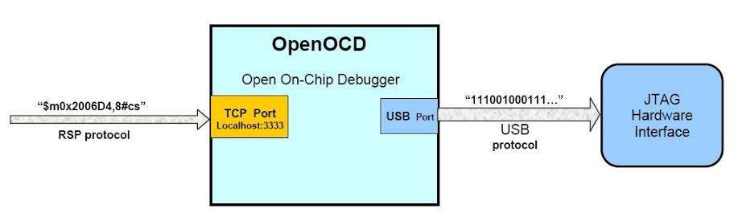
On-Chip Debugging (OCD)

Slide 11
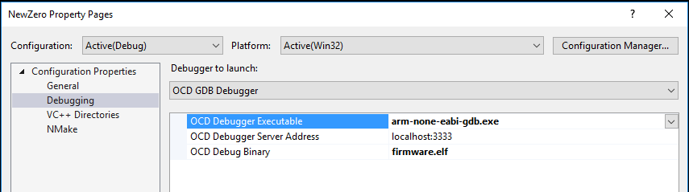
OCD GDB Visual Studio

Slide 12
Remote machine

