Slide 1

Brazilian E-Commerce Data Analysis (Olist Dataset)
A Collaborative Data Analysis Project
Presented by the Cross-Functional Data Team: SQL, Python, Power BI, and Streamlit Experts

Slide 2

Chapter 1
Project Introduction: The Olist Dataset
Olist is a major Brazilian marketplace connecting small businesses to customers across the country. Our analysis focuses on understanding the dynamics of this rapidly growing e-commerce environment.
Dataset Source
Data Scope
Kaggle Public Dataset
100,000+ orders
Time Frame 2016 to 2018
Project Goal: Explore e-commerce insights, customer behavior, and key operational metrics (payments, delivery, satisfaction) to drive strategic decision-making.

Slide 3




Our Collaborative Workflow
This project leveraged four specialized data tools, each playing a crucial role in the data pipeline from ingestion to deployment.
Data Foundation (SQL)
Deep Dive (Python)
Structured data for reliability.
Exploratory Data Analysis (EDA).
Business Visualization (Power BI)
Deployment (Streamlit)
Interactive reporting for stakeholders.
Interactive web application for user exploration.

Slide 4



Tool Focus
SQL: Data Extraction and Preparation
The initial phase involved standardizing the raw data from various tables to create a clean, unified dataset ready for deeper analysis.
Data Cleaning
Handling null values and standardizing date formats.
Output Ready
Cleaned tables serving as the single source of truth.
Example Queries: Calculating total order volume and identifying delivery delay frequencies.

Slide 5

Tool Focus
Python: Exploratory Data Analysis (EDA)
Using Pandas for manipulation and Matplotlib/Seaborn for visualization, we uncovered crucial temporal trends and operational correlations.
Data cleaning & Preprocessing
1
Aggregations
2
Visualizations
3

Slide 6
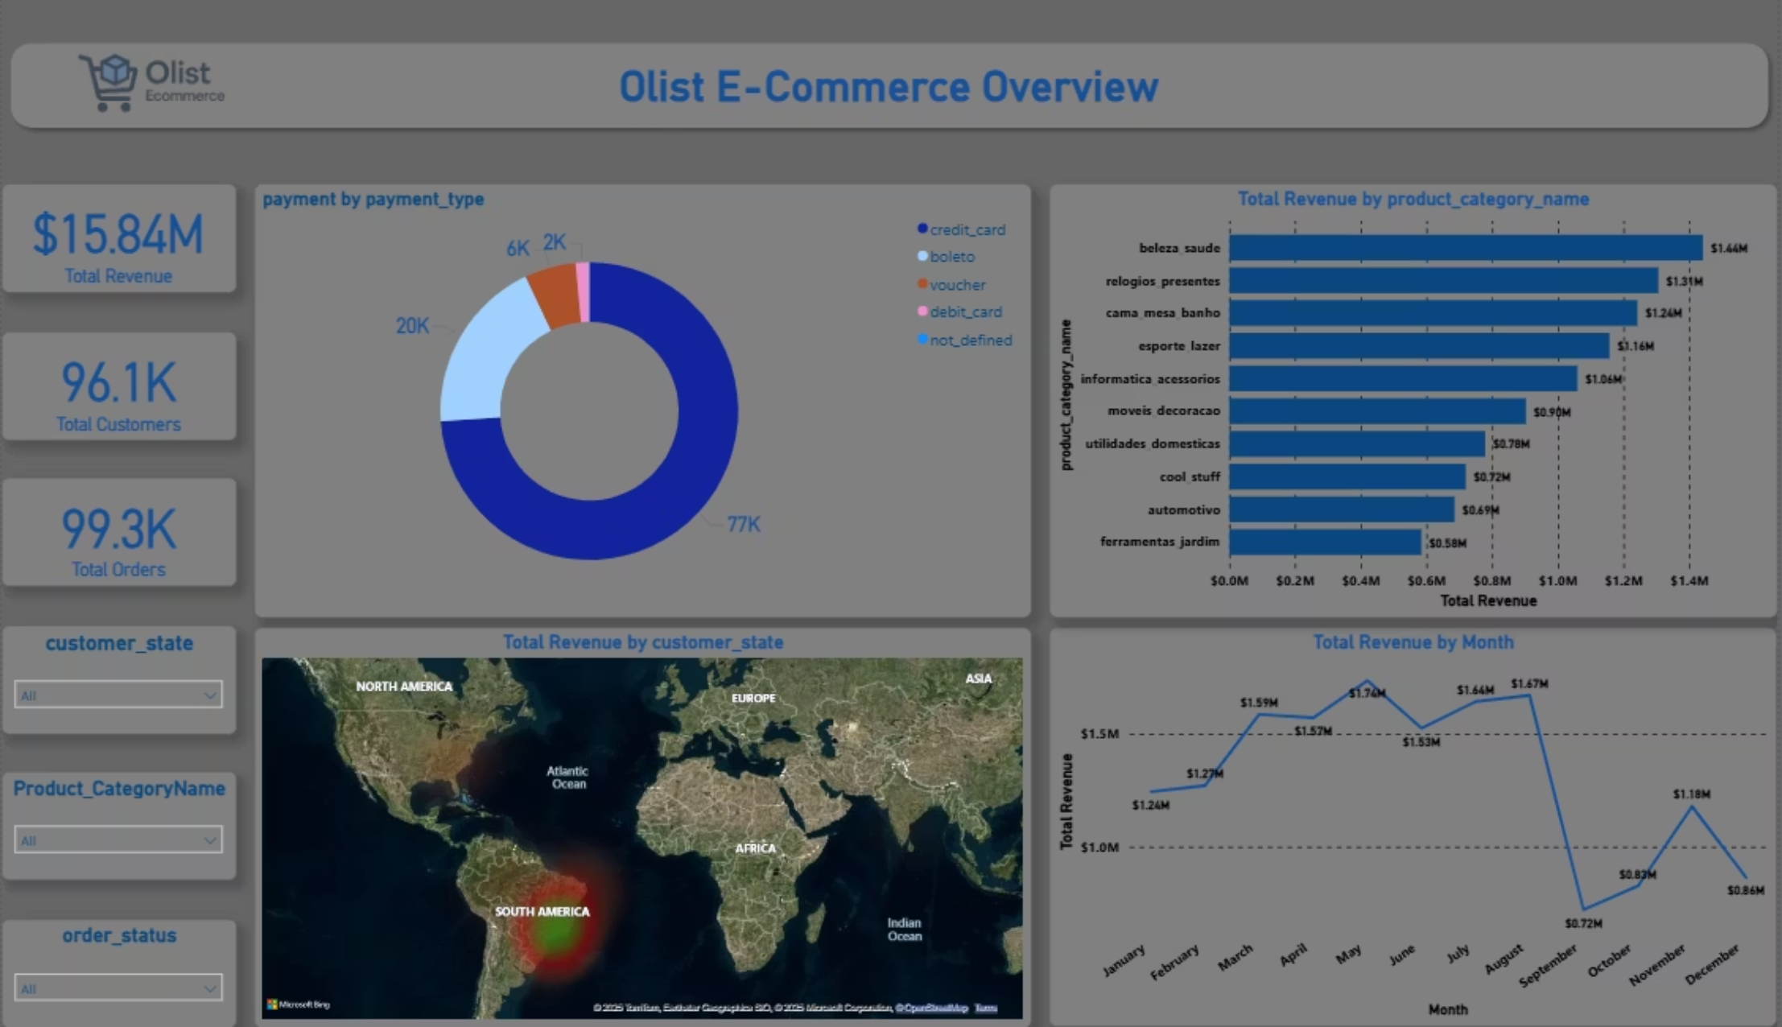



Tool Focus
Power BI: Stakeholder Dashboard
We developed an interactive, visual dashboard to provide business stakeholders with accessible and actionable insights.
Sales Overview
Payment Analysis
Monthly and categorical sales performance.
Distribution and volume across various payment methods.
Value Add: The dashboard features KPIs and customizable filters for real-time insight generation.

Slide 7
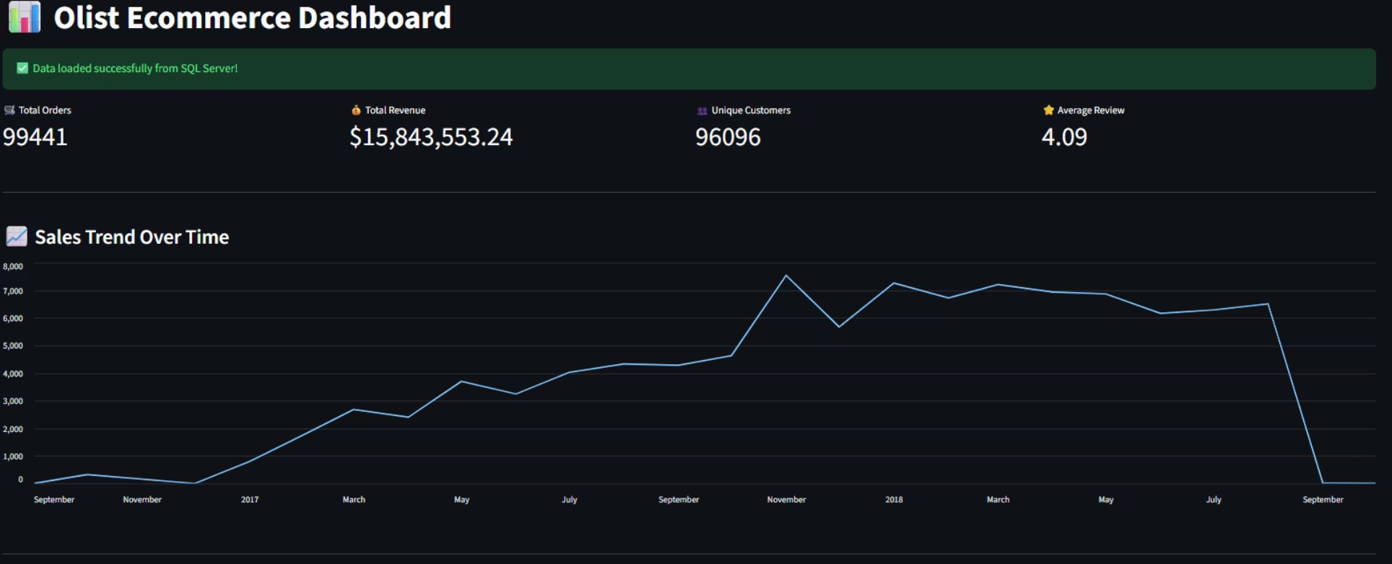
Tool Focus
Streamlit: Interactive App Deployment
To democratize access to the data, we created a lightweight web application using Streamlit, allowing non-technical users to dynamically explore the findings.
Display of core KPIs (Key Performance Indicators).
Dynamic filtering by date range and product category.
Interactive charts for sales and customer review scores.

Slide 8









Methodology
Integrated Data Workflow
Our success was dependent on a smooth, sequential flow of data, ensuring integrity and consistency at every stage of the analysis.
Kaggle Data
Raw source files.
SQL Cleanup
Data modeling & joins.
Python EDA
Statistical analysis.
Power BI
Stakeholder reporting.
Streamlit
Interactive deployment.

Slide 9




Summary
Conclusion and Future Outlook
The Olist dataset offered a robust platform to analyze the evolving landscape of Brazilian e-commerce, demonstrating clear pathways for operational improvement and growth.
Key Takeaway
Next Steps
The project successfully merged multiple analytical tools to derive actionable insights, highlighting the power of cross-tool data workflow.
Predictive Modeling
Develop models to forecast delivery delays.
Satisfaction Score Modeling
Identify variables that most influence customer ratings.
Recommendation Systems
Build personalized product suggestion engines.
Thank You.

