Slide 1
OOPs Concepts

Slide 2
Object Oriented Programming
The word object-oriented is the combination of two words i.e object and oriented. The dictionary meaning of the object is an entity that exists in the real world.
The meaning of oriented is interested in a particular kind of thing or entity.
In layman's terms, it is a programming pattern that rounds around an object or entity are called object-oriented programming.

Slide 3
POINTS TO REMEMBER
Everything is an object
Every object is an instance of a class.
The class contains the attribute and behavior associated with an object.

Slide 4
Pillars of oops
Abstraction
Encapsulation
Inheritance
Polymorphism

Slide 5
Object
An object is a real-world entity that has attributes, behavior, and properties.
It is referred to as an instance of the class. It contains member functions, variables that we have defined in the class.
It occupies space in the memory.

Slide 6
Class
A class is a blueprint or template of an object.
It is a user-defined data type.
Inside a class, we define variables, constants, member functions, and other functionality. it binds data and functions together in a single unit.
It does not consume memory at run time.
It is a logical entity. It is the best example of data binding.

Slide 7
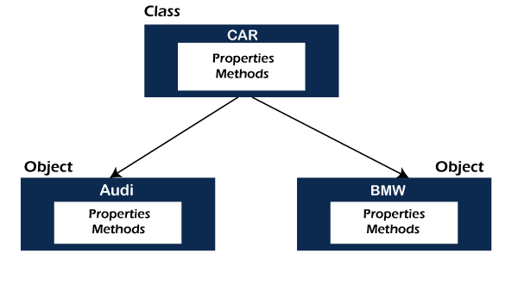

Slide 8
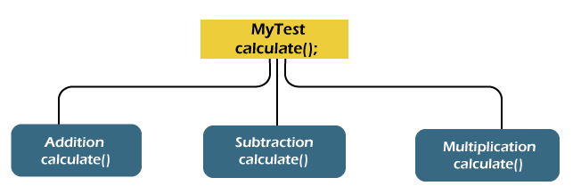
Abstraction
The concept allows us to hide the implementation from the user but shows only essential information to the user.

Slide 9
Advantages
It reduces complexity.
Eases the burden of maintenance
Increase security and confidentially.

Slide 10
Encapsulation
It is a mechanism that allows us to bind data and functions of a class into an entity.
It protects data and functions from outside interference and misuse. Therefore, it also provides security.

Slide 11
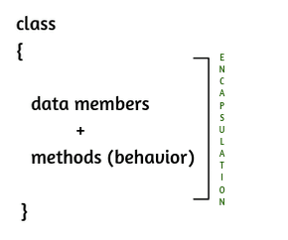

Slide 12
Inheritance
The concept allows us to inherit or acquire the properties of an existing class (parent class) into a newly created class (child class
It provides code reusability.

Slide 13
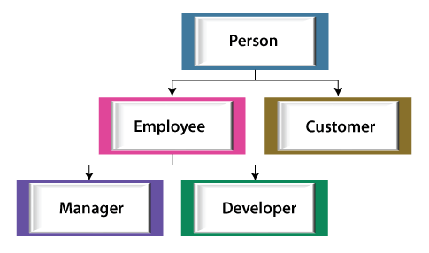

Slide 14
Polymorphism
The word polymorphism is derived from the two words i.e ploy and morphs. Poly means many and morphs means forms.
It allows us to create methods with the same name but different method signatures.
It allows the developer to create clean, sensible, readable, and resilient code.

Slide 15
