Slide 1

A Comparison Between Time Series Forecasting Models
By Ariel Leston
Notes:
Good afternoon everyone, my name is Ariel Leston and for my capstone I did a comparison between some popular Time Series Forecasting models.

Slide 2
Motivation
To learn forecasting principles
To see which model would preform best on difficult data
To see if any insights could be made from the data during the process
Notes:
My motivation for this project came from multiple places. I was very interested in forecasting and I wanted to learn how it was done. I also wanted to see if deep learning models were necessary or if less complex models could preform similarly. Finally I chose to work with covid data too see if there were any other insights I could make that would be relevant or useful. Also using covid data would ensure I was using data that is realistic and hard to predict.
Although the models currently being used by Governments are much more complex than what I did, There was still a possibility That something I come across in the results or process may be relevant to our global pandemic.

Slide 3
Data Used
https://github.com/owid/covid-19-data/blob/master/public/data/owid-covid-data.csv
Covid-19 daily cases and daily deaths separated by country
Notes:
This brings me to the data. I used the Owid repository of conglomerated covid-19 statistics that I found on github.
The data itself is a huge excel sheet with many columns of different features. I chose to focus on daily new deaths and daily new cases as I felt they were most relevant in assessing the impact of covid.

Slide 4
Pre-Processing
Load data from file
Isolate column for daily deaths or daily cases
Isolate rows for a specific country
Impute blank spots
Organize data by date and down-sample to weekly data so every point becomes the average value for that week
Notes:
Alright, now to begin forecasting on data, I first had to process it into a format that I can work with. This is mostly enabled by importing the pandas Library. Which I used to load a file, isolate specific columns and filter by location.
But after doing this there is still issues with the data, you need to look for blank spots. And there definitely are blank spots in this data, most likely due to inconsistent reporting of covid information from hospitals around the world. This can be fixed with imputation, which is just the process of filling in blank spots with an educated guess. I used simple imputation which fills any blank spots with the mean value of that features data.
The last step is to down-sample the data. Originally its daily data, but as I mentioned before, reporting is inconsistent, and tends to fluctuate on a weekly basis almost as if some hospitals always report on Fridays while others only report on Mondays, or some variation of that. Either way, This creates noise in the data and makes it confusing for the models.
So to smooth it out and make it easier for models to forecast, I clump the data into weekly data. This makes every point become the average value for each week. This also reduces the overall point count making the models run faster as nice added bonus.

Slide 5
Chosen Models
Holt-Winters Simple Exponential Smoothing
Auto Regressive Integrated Moving Average (ARIMA)
Recurrent Neural Network with Long Short-Term Memory nodes (RNN LSTM )
Notes:
Once the data is prepared, I was ready to start considering the models. The models I chose to use were these three. Holt-winters, ARIMA, and LSTM. I chose these based on a sliding complexity scale.

Slide 6
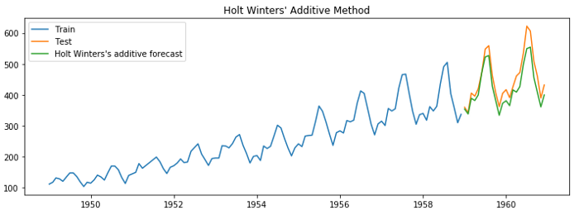
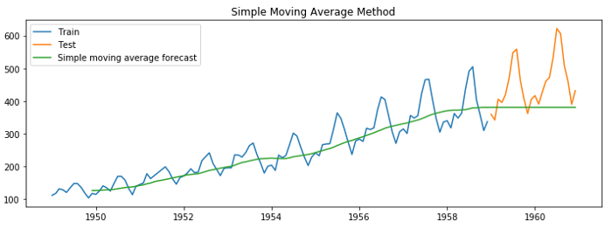
Holt-Winter’s
An extension of exponential smoothing to allow for a seasonal approach
Assigns exponentially decreasing weights over time
Figures from https://towardsdev.com/the-ultimate-guide-to-time-series-forecasting-part-2
Notes:
First I will talk about the simplest model, Holt-Winters
The Holt Winters model is an extension of exponential smoothing to allow for a seasonal approach in forecasting. It works by encoding many past values with an exponential smoothing function to use when predicting a typical following value. The Exponential smoothing function is a standard method for smoothing time series data with a window which will assign exponentially decreasing weights over time to the past observations so they aren’t all weighted equally.
For comparison, A super basic model is a just simple moving average, which would only use the average of its past observations to predict following points. The issue with this approach is that it would weigh all past values equally, when in most cases, recent data is much more valuable then old data. This weighting difference emphasizes the purpose for using Holt Winters method.

Slide 7
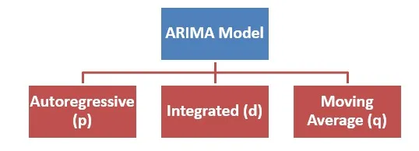
ARIMA
Combination of functions that work together for powerful forecasting.
  Auto-regressive calculation
  Moving Average Calculation
  Integration Calculation
Figure from https://www.projectguru.in/introduction-to-the-autoregressive-integrated-moving-average-arima-model/
Notes:
Then there’s the medium complexity model, ARIMA
which is a combination of functions that work together for powerful forecasting. Although they don’t all need to be used, as its very dynamic.
First is the Auto Regressive calculation, which attempts to find a correlation between the full data and some number of past values.
Then the Moving Average calculation attempts to find a correlation between the full data and the residual error in the moving average on the past observations.
Now for integration we need to understand stationarity. A stationary series is a series where the data appears roughly the same at any point. This happens when the overall trend is flat. It implies that the data is cyclic and repeating in some way so it is predictable. ARIMA expects its given data to be stationary, but will still work on non-stationary data by utilizing differencing.
Integration, or differencing, in this context, is a process that can force stationarity, this is done by computing the differences between consecutive observations and using those as the new data points. The transformation is reversible and the data will still represent the changes in the value over time but will now be stabilized. Sometimes a single differencing isn't enough to make the data completely stationary, that's where higher order differencing comes in, which is essentially just differencing multiple times.

Slide 8
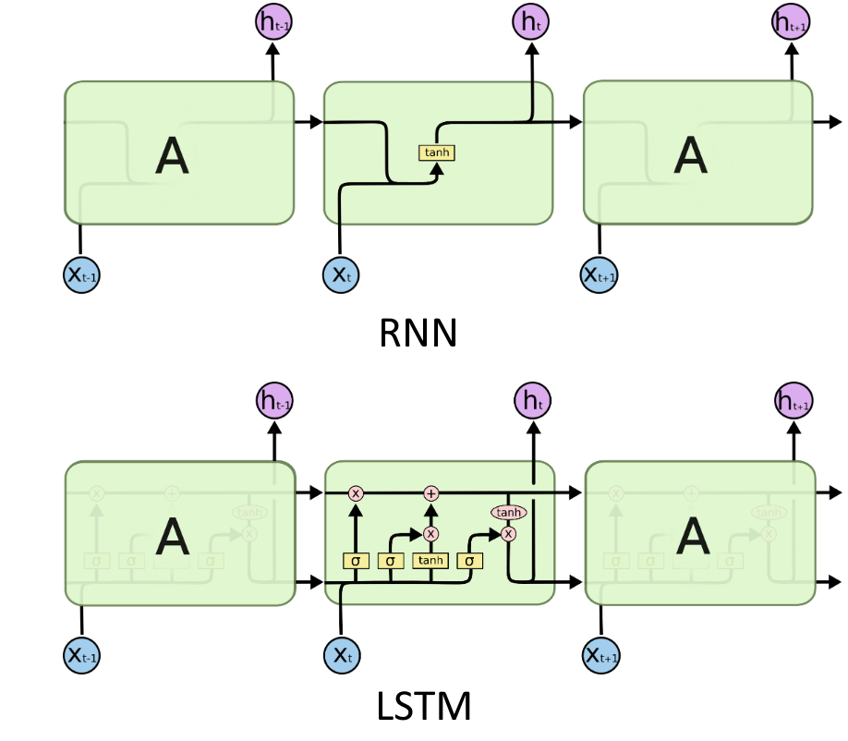
LSTM
Recurrent Neural Network using Long Short-term Memory nodes
Hidden state Values act as memory
Figure from https://mett29.github.io/posts/2019/12/intro_to_rnn_and_lstm/
Notes:
And finally there is the most complex model the RNN LSTM
an RNN is a class of neural network that is specifically made for modeling sequential data such as time series or natural language.
And a standard RNN node uses a for loop to iterate over a sequence, while maintaining an internal hidden state that encodes information about the data it has seen so far. The main issue with this kind of node however, is that the gap between relevant past data and when that data is next needed cant be too large. It's kind of like the model having very short-term memory for learning.
But, Long Short-Term Memory Nodes, or LSTM's, are a special kind of RNN node, capable of learning long-term patterns due to each node being specially modified to pass its hidden state values along to the next node for consideration instead of each node just calculating it's own hidden state independently.

Slide 9
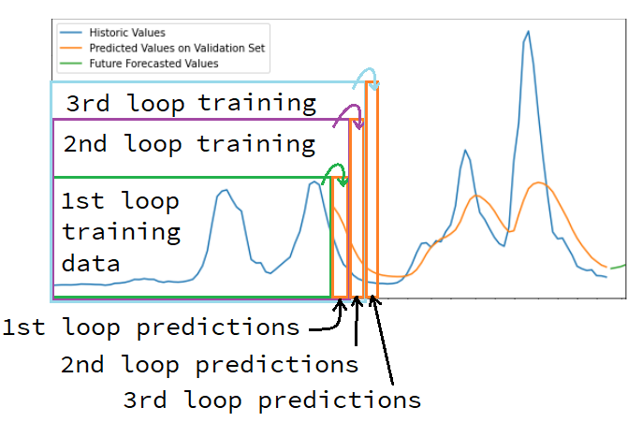
Methodology - Rolling Predictions
Forecasting Models all predict into the future which would not be verifiable data
Unless you pretend your at a past date by limiting the data given
So, set up a rolling prediction function to loop across all the data and create predictions
Notes:
next I had to setup a way to evaluate these models forecasts. However its not as simple as other problems. Since all forecasting models predict into the future, the predictions cant be verified as we don’t know the future yet. However It is possible to pretend your in the past by giving the model less data, then verify its prediction against the data you didn’t give it.
So I setup a rolling prediction function that starts at the smallest possible training set, trains the model, gets a prediction, saves it and then repeats the whole process but with a slightly larger training set over and over until there is a prediction for every point. Notice that the predictions for the second loop start exactly were the predictions for the first loop ended. When it finishes looping through, there is a prediction set with a matching validation set, so error metrics can actually be calculated. However I still cant evaluate the actual accuracy of the future predictions. Only the accuracy of the model while it was predicting on dates that are known. but Its as close of an estimate as possible.

Slide 10
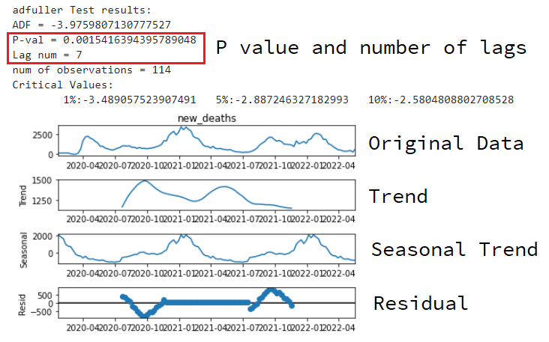
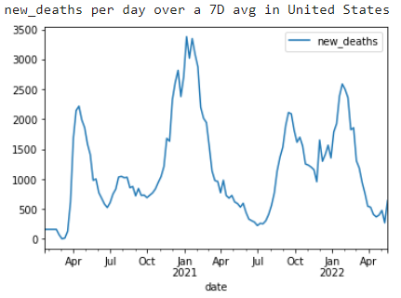
Methodology - Decomposition
Analyze input data to help select proper parameters for each model
Generally looking for any patterns or trends
Notes:
With the rolling prediction function made for each model, I now need proper parameters to use it well.
In order to select to proper parameters for each model, I need to analyze the data so I can tailor the models to it. The main way of doing this is an ad-fuller test and a data decomposition. The ad-fuller test tells me how predictable the data is based on the P-value, lower is better. It also tells me it noticed some kind of trend happening roughly every 7 points as the lag is 7. So in this case, 7 would actually be my starting guess for any type of seasonal period size parameter. Then the decomposition splits the data into its parts. the regular trend, the seasonal trend and the residual which is whatever is left over. This is useful for seeing if there is a trend, is it ongoing or seasonal, what kind of trend is it, and there are lot of other things you can deduce from it. Its a very helpful process.
However, it is important to note that there is no exact method for selecting some of these parameters, there is a lot of tweaking involved but this analysis would give you a good place to start.

Slide 11
Methodology – Parameters
Parameters that all the models have
  Steps
  Sliding
  Slide Size
Notes:
As far as the parameters, Each of the models have different input parameters, however they all have steps, sliding and slide size built in from the rolling prediction function for each model. Steps is how many points to predict each iteration. for fair comparison I chose to predict the next 4 weekly points and kept this static for all the models.
If sliding is true, then the rolling loop function will limit the train window to some set size instead of using all previous available data. The size is dictated by slide size. This can ensure every prediction is only training with the last 6 months, or the last year of data.

Slide 12
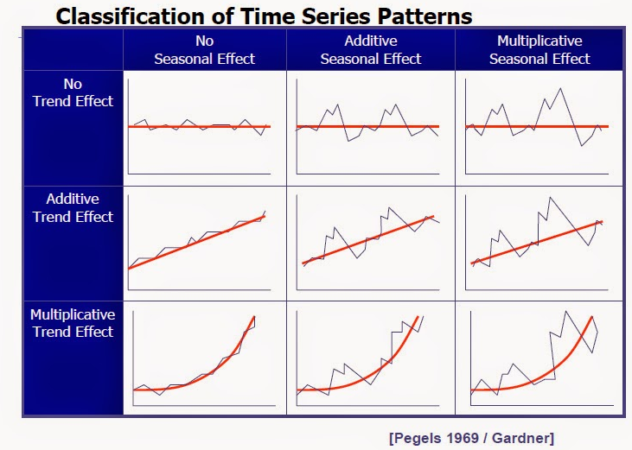
Methodology – Holt Parameters
Trend
Seasonal Trend
Seasonal Period Size
Dampening
Figure from http://forecastingtech.blogspot.com/2015/03/patterns-components-and-classification.html
Notes:
For the specific parameters in Holt-Winters:
There are 3 main parameters. The trend type, the seasonal trend type, and the seasonal cycle size. The trend and seasonal trend can be set to Additive if the trend appears linear, Multiplicative if the trend appears exponential, or None if there is no apparent trend. Also important to keep in mind that although deducing the trend and seasonal trend follow the same procedures, the type of trend is not necessarily the same. You need to use the decomposition of the original data to visualize the trend portion, seasonal portion and the left over residual that isn't following a pattern.
There is also the dampening option, which if enabled will attempt to smooth the input slightly to reduce noise and create a smoother prediction

Slide 13
Methodology – ARIMA Parameters
Order contains p, d and q
  p = number of points for auto-regression
  d = order of differencing to use
  q = size of moving average window
Seasonal Order contains P, D, Q and s.
  P , D, and Q same as order but for seasonal component
  s = seasonal cycle size
Notes:
Then the specific parameters for ARIMA:
the main parameters are kept inside an order variable. p, d and q. The P refers to the number of past points to use in the auto regression, this is the AR in ARIMA. The d refers to the order of differencing to use that should make the data stationary, this is the integrating part or I in the ARIMA. Then the q refers to the size of the Moving Average window being used, this is the MA in the ARIMA. ARIMA also has an additional seasonal feature for when there is seasonal trends in the data. This turns it into a SARIMA model. The parameters for the SARIMA model include all the regular ARIMA parameters and an additional set of P, D, Q to explain the extra seasonality and an extra variable s which refers to the size of a seasonal cycle. The seasonal parameters go inside a separate seasonal order variable.

Slide 14
Methodology – LSTM Parameters
Train split
Epochs
Layer setup
  How many
  What kind
  What order
Notes:
For the specific parameters in LSTM:
An LSTM model is more dynamic than the other models used so far. It can be trained and fit on one set, then given another set to predict off the end of. The others before this could only predict off the end of the data they trained and fit on. This meant they required a new model that is refitted for each step in the rolling prediction. Since LSTM doesn’t need to do this, it can be trained just once using many slices of the train set with a corresponding validation set for each slice. Then to get future predictions it can back-feed its own forecasts into itself without refitting to keep predicting further into unknown data. With this in mind the parameters it will use are some percentage train split for the input data and training phase, some number of epochs to control how long it trains, and the layer setup which could have many variations. The layer setup includes how many layers, how many nodes on each layer, what types of layers, and what sequence of layer types.

Slide 15
Methodology - Evaluation
Compare the resulting prediction set to the true set using:
  Mean Percent Error
  Median Percent Error
  Normalized Root Mean Squared Error
  Correlation check
Notes:
Up to this point I now have each model making predictions on a validation set, so now I need to setup the evaluation functions. This is crucial as any model is useless without knowing how accurate it is in some way, and that was the whole reason for using the rolling loop function to create a prediction set with a validation set.
So, I chose to use Mean average percent, Median average percent, normalized root mean squared error and a correlation check. However while testing I noticed that MAPE punishes overestimates far more than underestimates, whereas I found NRMSE to be a more consistent metric. So I started to compare the models to each other mainly by their NRMSE score while taking the others into consideration. But generally all the scores get better or worse at the same time, or move in unison.

Slide 16
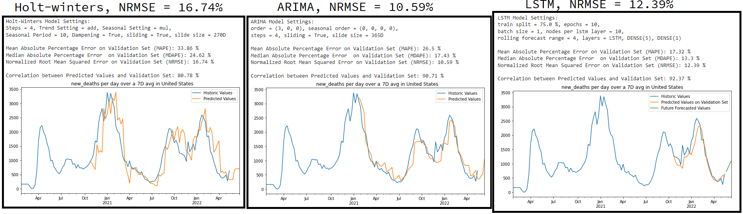
Results - Single set
Each models’ best result for United States daily deaths data set
Notes:
As for the results, here is an example from using united states daily deaths as the input data.
even from just this, the differences between the models can be seen. On the left, there is Holt-winters, which is generally a more rough fit, jagged but still decently accurate. Whereas on the right, there is LSTM, which is a much smoother prediction, that underestimated abit, but is more accurate than the Holt-Winters model. Then in the middle is ARIMA, which had the lowest error score of the three for this data, and its sort of a middle ground between a rough fit and a smooth fit.
In this Case ARIMA preformed the best based on
NRMSE, with LSTM being a close second on the other scores.

Slide 17
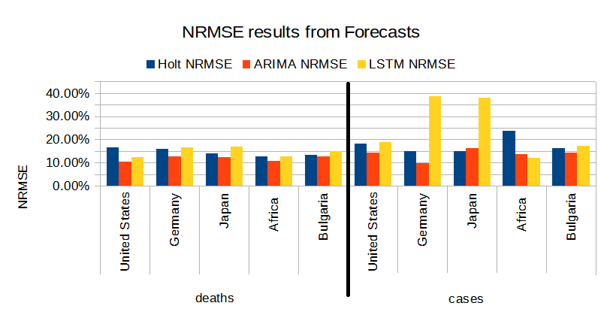
Results - Overall
Normalized Root Mean Squared Error for each tested data set and each model
Notes:
I repeated this process multiple times with datasets pulled from the covid data. So the first set of bars on the left, is the data from the previous slide, daily deaths in united states. And the value these bars are representing is the NRMSE that each model got on that dataset. Alongside united States, I re-tested daily deaths with Germany, Japan, Africa, and Bulgaria. Then all over again using new cases instead of new deaths.
From this its clear that ARIMA is often the best model as it the lowest bar in in 8 of the 10 sets, meaning it generally had the least error or highest accuracy. Whats also apparent is that something weird happened with LSTM on new cases in Germany and Japan as it got very high error in both those cases. This was a result of LSTM being unable to compensate for an extreme and sudden rise in cases that happened around the time of the omicron wave. Surprisingly the other models were able to compensate anyway. But It would be expected for a model to fail on prediction due to unforeseen radical changes in data.

Slide 18
Conclusion and Challenges
ARIMA was the best overall
Parameter selection is a challenge
Could improve performance:
  Cleaner Data
  Better imputation strategy
  Re-scale values for all models
  Using multiple variables instead of one
Notes:
In Conclusion, its clear ARIMA is a very powerful forecasting model as it was always able to get less than 15% error whereas the same cant be said for the others.
However, the biggest challenge I dealt with during this process, was properly tuning these models. The quality of any forecasts are heavily dependent on the parameter selection and as I said before, there is no sure way to select a lot of these parameters. There are ways to get a decent guess for some of them, but even that still requires tweaking and testing. As a result, I spent a large portion of my time on this project doing just the parameter tweaking to make the models preform the best they could.
And while ARIMA did produce the best results overall. this could be due to a variety of factors, its possible performance of the other models could be enhanced with better data, like data that doesn’t need blanks filled in. or using a smarter process to fill in blanks, like using the mean from the preceding week to fill a blank instead of using the whole mean. Or re-scaling the input data to between 0 and 1, this is already done for LSTM as its necessary to not break the activation function, but it may improve the accuracy of the other models. Lastly using multi-variate models may produce far better results as they could correlate trends between values such as seeing a pattern between number of cases to number of deaths instead of only guessing based on one feature.

Slide 19
Sources
https://www.youtube.com/playlist?list=PLoK4oIB1jeK0LHLbZW3DTT05e4srDYxFq (Business Analytics Using Forecasting channel)
https://www.youtube.com/watch?v=v5ijNXvlC5A&ab_channel=Enthought (Modern Time Series Analysis | SciPy 2019)
https://github.com/john-science/scipy_con_2019/tree/main/modern_time_series_analysis
https://pandas.pydata.org/docs/reference/api/pandas.DataFrame.html
https://scikit-learn.org/stable/modules/generated/sklearn.impute.SimpleImputer.html
https://www.tensorflow.org/tutorials/structured_data/time_series
https://www.statsmodels.org/dev/generated/statsmodels.tsa.holtwinters.Holt.html
https://www.statsmodels.org/dev/generated/statsmodels.tsa.holtwinters.ExponentialSmoothing.html
https://otexts.com/fpp2/ses.html (chapter 7 - Exponential Smoothing)
https://otexts.com/fpp2/seasonal-arima.html
https://medium.com/swlh/temperature-forecasting-with-arima-model-in-python-427b2d3bcb53
https://towardsdatascience.com/machine-learning-part-19-time-series-and-autoregressive-integrated-moving-average-model-arima-c1005347b0d7
https://www.statsmodels.org/v0.12.0/generated/statsmodels.tsa.arima_model.ARIMA.html
https://medium.com/analytics-vidhya/understanding-arima-forecasting-140dc5ceda06
https://github.com/https-deeplearning-ai/tensorflow-1-public/blob/main/C4/W3/assignment/C4W3_Assignment.ipynb (coursera course code)
https://www.relataly.com/multi-step-time-series-forecasting-a-step-by-step-guide/275/
https://github.com/nachi-hebbar/Time-Series-Forecasting-LSTM
https://www.pythonfixing.com/2022/01/fixed-forecast-future-values-with-lstm.html
https://www.tensorflow.org/guide/keras/rnn
https://www.tensorflow.org/api_docs/python/tf/keras/layers/LSTM
https://machinelearningmastery.com/how-to-develop-lstm-models-for-time-series-forecasting/
Notes:
and here are all the sources I used during this project.
Thank you for your time, any questions?

