Slide 1
Objects and Classes
Object-Oriented Programming · Alba Meca

Slide 2
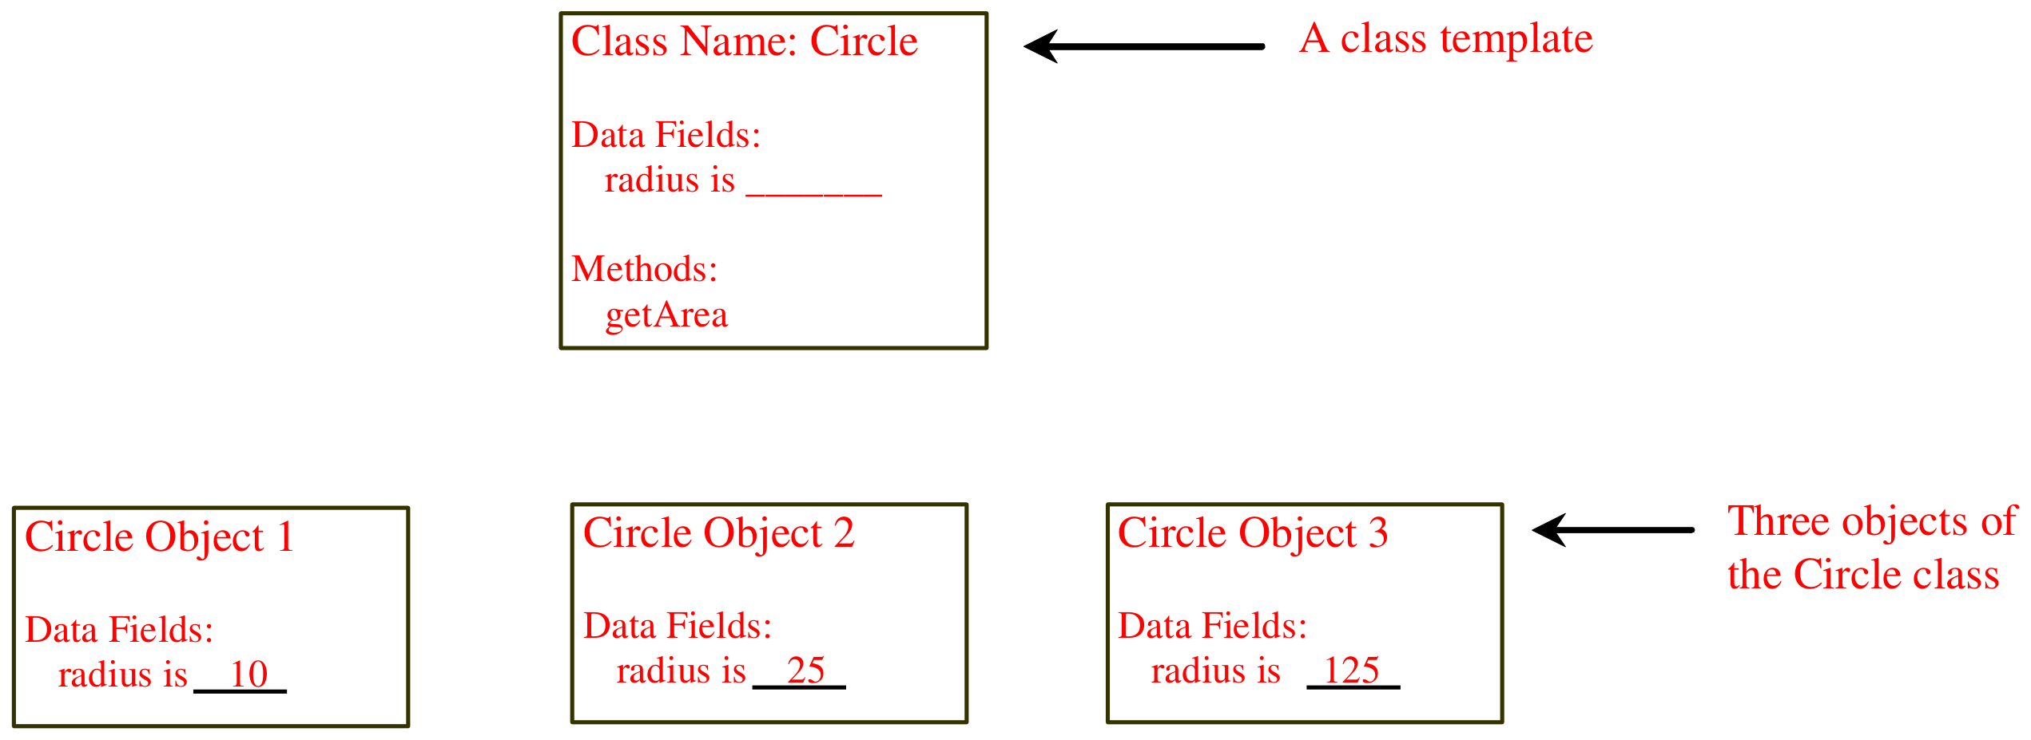
Objects
An object has both a state and behavior. The state defines the object, and the behavior defines what the object does.
OOP · Objects and Classes · 2

Slide 3
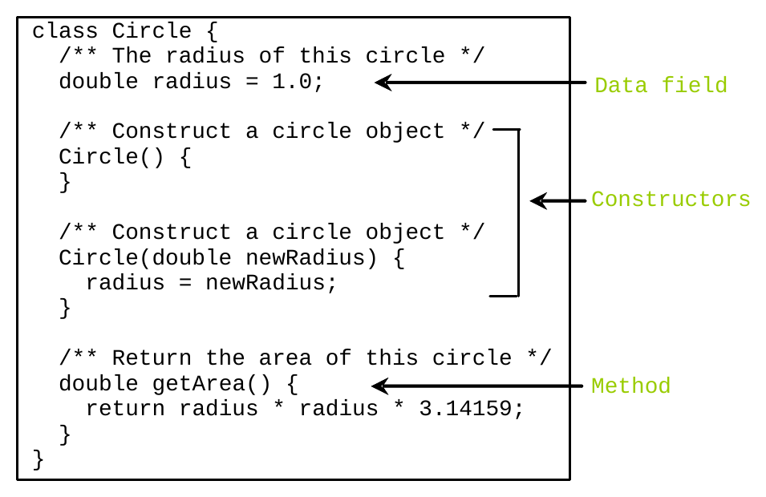
Classes
OOP · Objects and Classes · 3
Notes:
Classes are constructs that define objects of the same type. A class uses variables to define data fields and methods to define behaviors. Additionally, a class provides a special type of methods, known as constructors, which are invoked to construct objects from the class.

Slide 4
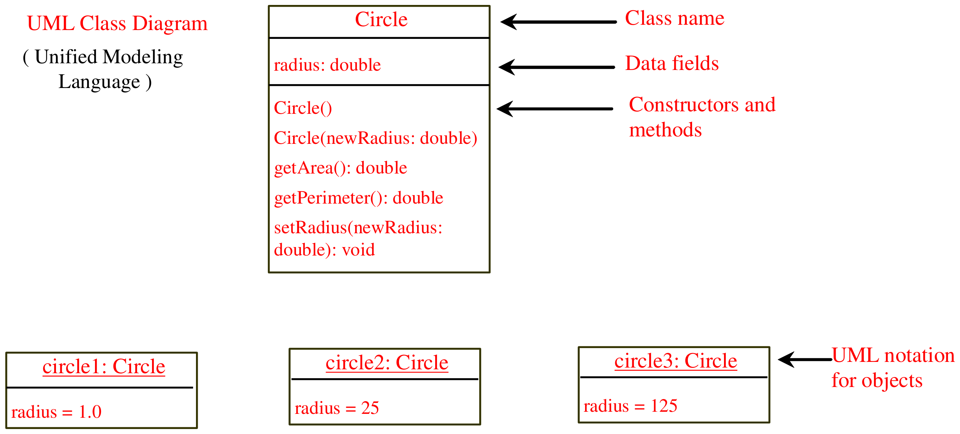
UML Class Diagram
OOP · Objects and Classes · 4

Slide 5
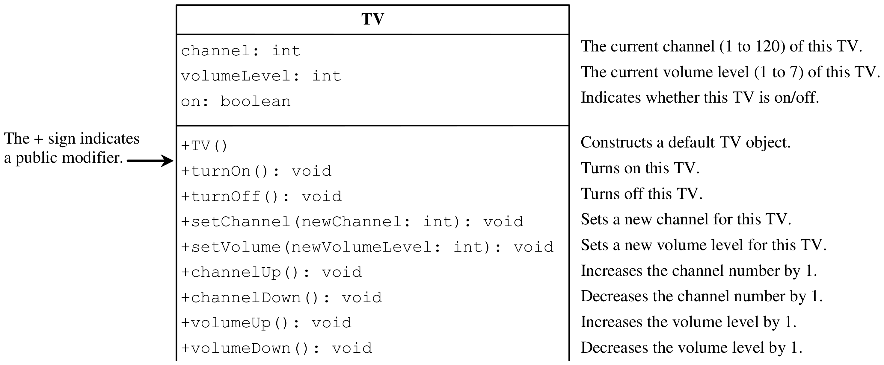
Example: Defining Classes and Creating Objects
OOP · Objects and Classes · 5

Slide 6
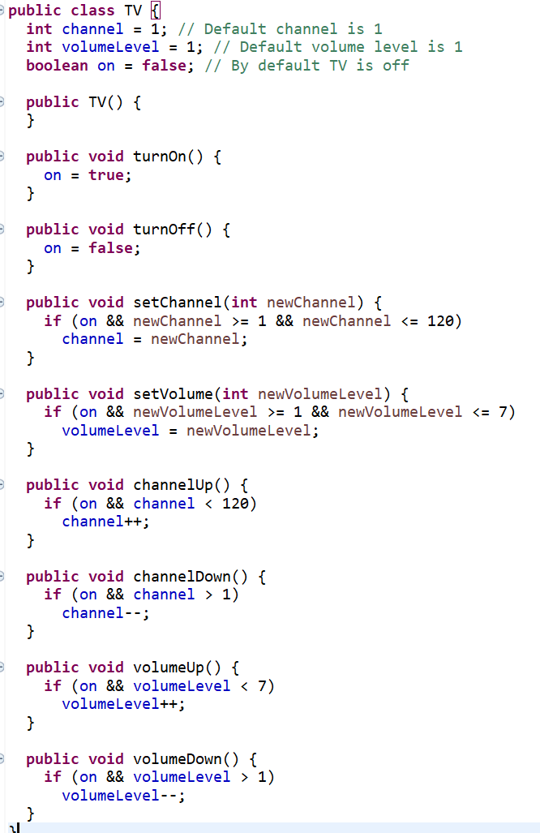
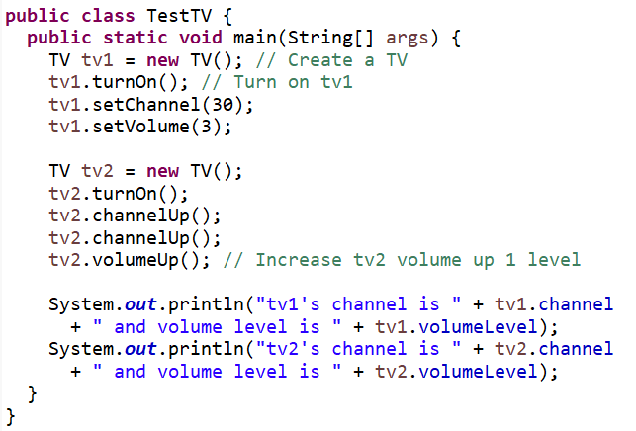
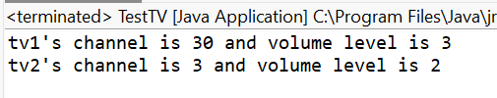
Example: Defining Classes and Creating Objects
OOP · Objects and Classes · 6

Slide 7
Class – definition
public class Car {
String color;
String brand;
boolean turnedOn;
void turnOn() {
turnedOn = true;
}
void paint (String newCol) {
color = newCol;
}
void printState () {
System.out.println("Car " + brand + " " + color);
System.out.println("the engine is"
+(turnedOn?"on":"off"));
}
}
Name
Car
color
brand
turnedOn
Attributes
turnOn
paint
printState
Methods
OOP · Objects and Classes · 7

Slide 8
Constructors
Circle() {
}
Circle(double newRadius) {
radius = newRadius;
}
Constructors are a special kind of methods that are invoked to construct objects.
A constructor with no parameters is referred to as a no-arg constructor.
▫ Constructors must have the same name as the class itself.
▫ Constructors do not have a return type - not even void.
▫ Attributes are always initialized (with default values if not specified)
▫ Constructors are invoked using the new operator when an object is created.
OOP · Objects and Classes · 8

Slide 9
The keyword new
▫ Creates a new instance of the specific class
▫ Allocates the required memory
▫ Calls the constructor of the object
▫ Returns a reference to the new object
▫ Constructor may have parameters
OOP · Objects and Classes · 9

Slide 10
Declaring/Creating Objects in a Single Step
ClassName objectRefVar = new ClassName();
Assign object reference
Create an object
Example:
Circle myCircle = new Circle();
OOP · Objects and Classes · 10

Slide 11
Accessing Objects
▫ Referencing the object’s data:
objectRefVar.data
e.g., myCircle.radius
▫ Invoking the object’s method:
objectRefVar.methodName(arguments)
e.g., myCircle.getArea()
OOP · Objects and Classes · 11

Slide 12
Access to Attributes of the Same Object
▫ Methods accessing attributes of the same object do not need to use the object reference
class Car {
String color;
…
void paint(){
color = "green";
// color refers to current obj
}
}
OOP · Objects and Classes · 12

Slide 13
Trace Code
myCircle
no value
Circle myCircle = new Circle(5.0);
Circle yourCircle = new Circle();
yourCircle.radius = 100;
Declare myCircle
OOP · Objects and Classes · 13

Slide 14
Trace Code
myCircle
no value
Circle myCircle = new Circle(5.0);
Circle yourCircle = new Circle();
yourCircle.radius = 100;
: Circle
radius: 5.0
Create a circle
OOP · Objects and Classes · 14

Slide 15
Trace Code
myCircle
reference value
Circle myCircle = new Circle(5.0);
Circle yourCircle = new Circle();
yourCircle.radius = 100;
: Circle
radius: 5.0
Assign object reference
to myCircle
OOP · Objects and Classes · 15

Slide 16
Trace Code
myCircle
reference value
Circle myCircle = new Circle(5.0);
Circle yourCircle = new Circle();
yourCircle.radius = 100;
: Circle
radius: 5.0
yourCircle
no value
Declare yourCircle
OOP · Objects and Classes · 16

Slide 17
Trace Code
myCircle
reference value
Circle myCircle = new Circle(5.0);
Circle yourCircle = new Circle();
yourCircle.radius = 100;
: Circle
radius: 5.0
yourCircle
no value
: Circle
radius: 1.0
Create a new
Circle object
OOP · Objects and Classes · 17

Slide 18
Trace Code
myCircle
reference value
Circle myCircle = new Circle(5.0);
Circle yourCircle = new Circle();
yourCircle.radius = 100;
: Circle
radius: 5.0
yourCircle
reference value
: Circle
radius: 1.0
Assign object reference
to yourCircle
OOP · Objects and Classes · 18

Slide 19
Trace Code
myCircle
reference value
Circle myCircle = new Circle(5.0);
Circle yourCircle = new Circle();
yourCircle.radius = 100;
: Circle
radius: 5.0
yourCircle
reference value
: Circle
radius: 100.0
Change radius in
yourCircle
OOP · Objects and Classes · 19

Slide 20
Objects and References
▫ An object can be accessed through a reference
– Any object can be pointed to by one or more references
– Aliasing
OOP · Objects and Classes · 20

Slide 21
Objects and References
Car a1, a2;
a1 = new Car();
a1.paint("yellow");
a2 = a1;
a1 = null;
a2 = null;
Two uninitialized references
are created, they can’t be
used in any way.
A reference is not an object
a1
?
a2
?
OOP · Objects and Classes · 21

Slide 22
Objects and References
Car a1, a2;
a1 = new Car();
a1.paint("yellow");
a2 = a1;
a1 = null;
a2 = null;
a1 : Car
An object is created
and the “pointer” stored into
the reference a1
a1
a2
?
OOP · Objects and Classes · 22

Slide 23
Objects and References
Car a1, a2;
a1 = new Car();
a1.paint("yellow");
a2 = a1;
a1 = null;
a2 = null;
a1 : Car
Method paint() is invoked on
the object through the
reference a1
a1
a2
?
OOP · Objects and Classes · 23

Slide 24
Objects and References
Car a1, a2;
a1 = new Car();
a1.paint("yellow");
a2 = a1;
a1 = null;
a2 = null;
a1 : Car
Two references point
to the same object.
This is aliasing
a1
a2
OOP · Objects and Classes · 24

Slide 25
Objects and References
Car a1, a2;
a1 = new Car();
a1.paint("yellow");
a2 = a1;
a1 = null;
a2 = null;
a1 : Car
Only one reference
points to the object
a1
null
X
a2
OOP · Objects and Classes · 25

Slide 26
Objects and References
Car a1, a2;
a1 = new Car();
a1.paint("yellow");
a2 = a1;
a1 = null;
a2 = null;
a1 : Car
No reference pointing to
the object, which is
unreachable and may be
disposed of by the
garbage collector
a1
null
a2
null
X
OOP · Objects and Classes · 26

Slide 27
Operations on References
▫ Only the comparison operators == and != are defined
– The equality condition is evaluated on the values of the references and NOT on the objects themselves!
– The relational operators tells whether the references points to the same object in memory
▫ There is NO pointer arithmetic
OOP · Objects and Classes · 27

Slide 28
Default Value for a Data Field
The default value of a data field is null for a reference type, 0 for a numeric type, false for a boolean type, and '\u0000' for a char type.
public class Test {
public static void main(String[] args) {
Student student = new Student();
System.out.println("name? " + student.name);
System.out.println("age? " + student.age);
System.out.println("isScienceMajor? " + student.isScienceMajor);
System.out.println("gender? " + student.gender);
}
}
OOP · Objects and Classes · 28

Slide 29
However, Java assigns no default value to a local variable inside a method.
public class Test {
public static void main(String[] args) {
int x; // x has no default value
String y; // y has no default value
System.out.println("x is " + x);
System.out.println("y is " + y);
}
}
Compile error: variable not initialized
OOP · Objects and Classes · 29

Slide 30
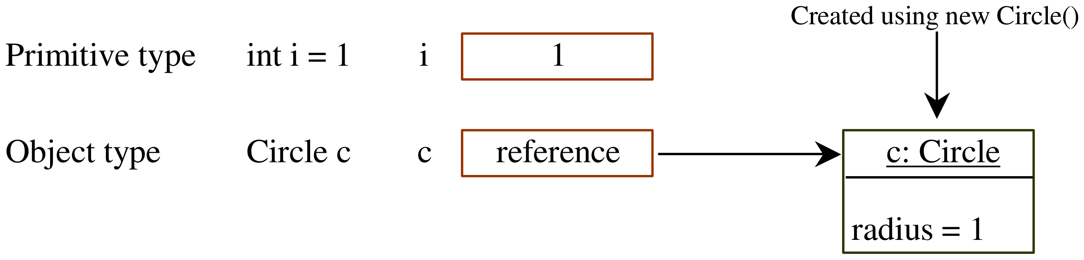
Differences between Variables of Primitive Data Types and Object Types
OOP · Objects and Classes · 30

Slide 31
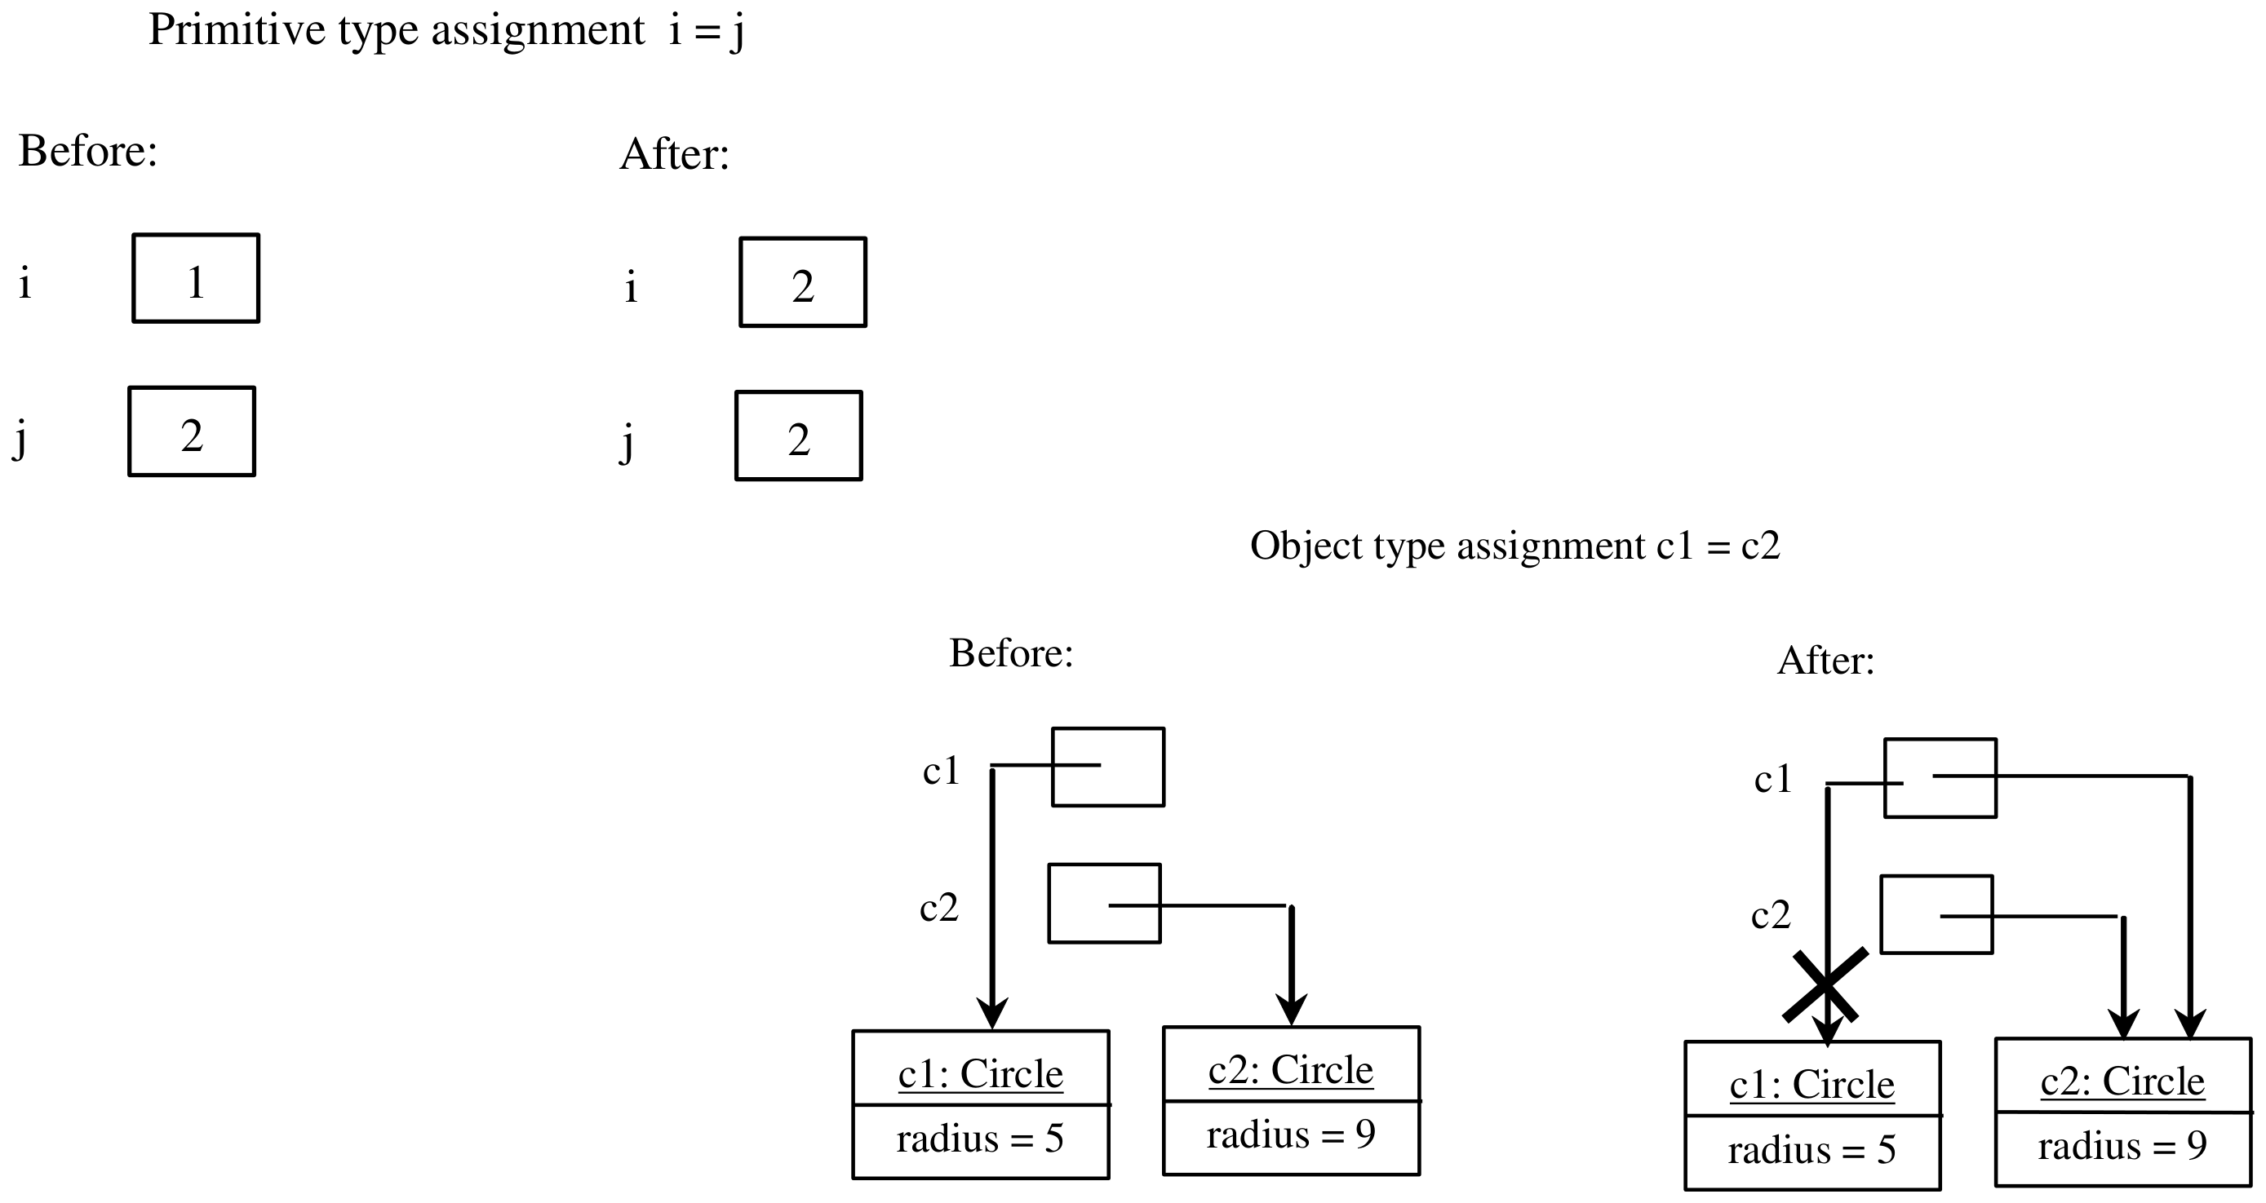
Copying Variables of Primitive Data Types and Object Types
OOP · Objects and Classes · 31

Slide 32
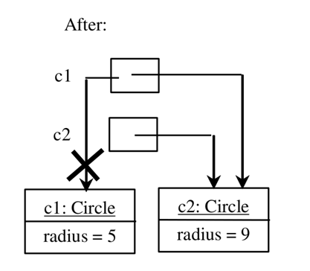
Garbage Collection
As shown in the figure, after the assignment statement c1 = c2, c1 points to the same object referenced by c2. The object previously referenced by c1 is no longer referenced. This object is known as garbage. Garbage is automatically collected by JVM. Memory release, in Java, is not a programmer’s concern
TIP: If you know that an object is no longer needed, you can explicitly assign null to a reference variable for the object. The JVM will automatically collect the space if the object is not referenced by any variable.
OOP · Objects and Classes · 32

Slide 33
Static Variables, Constants, and Methods
Static variables are shared by all the instances of the class.
Static methods are not tied to a specific object.
Static constants are final variables shared by all the instances of the class.
To declare static variables, constants, and methods, use the static modifier.
static int numberOfObjects = 0;
OOP · Objects and Classes · 33

Slide 34
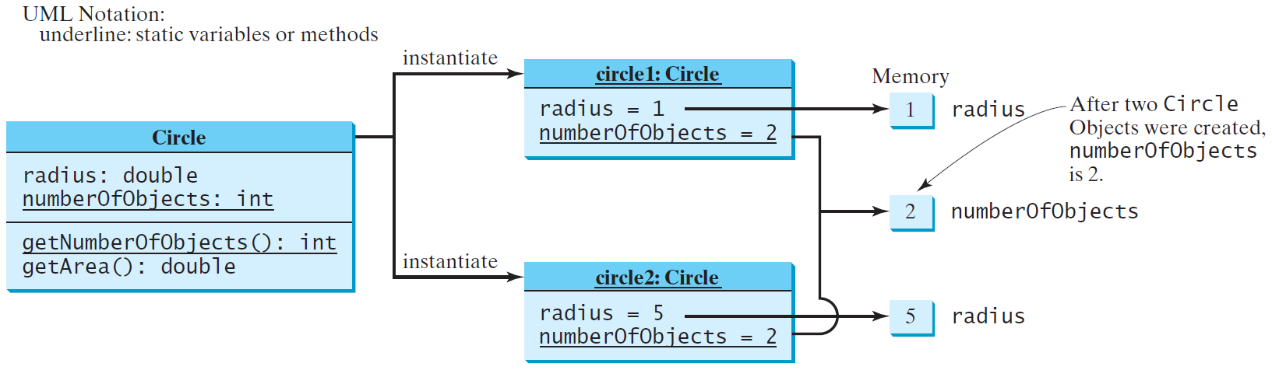
Static Variables, Constants, and Methods, cont.
OOP · Objects and Classes · 34

Slide 35
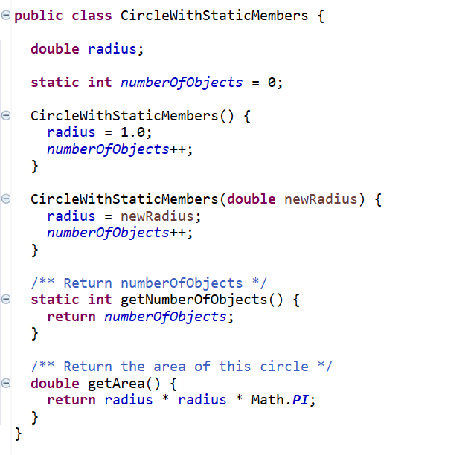
Example of Static Variable and Method
OOP · Objects and Classes · 35

Slide 36
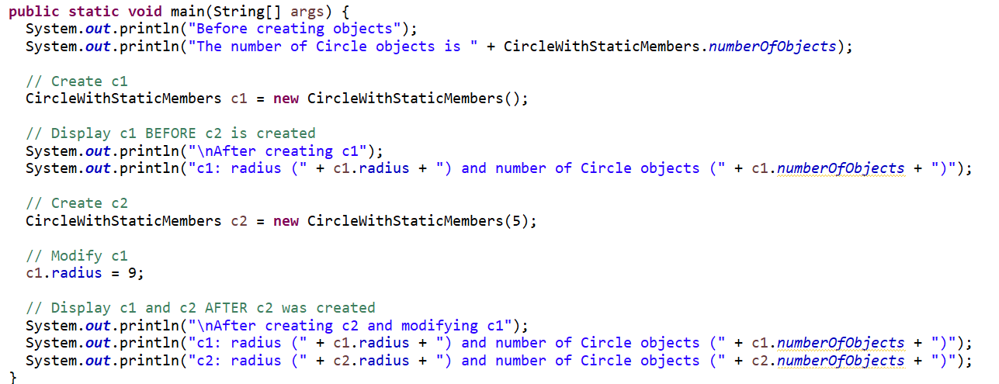
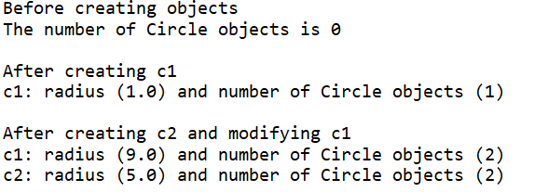
Example of Static Variable and Method cont.
OOP · Objects and Classes · 36

Slide 37
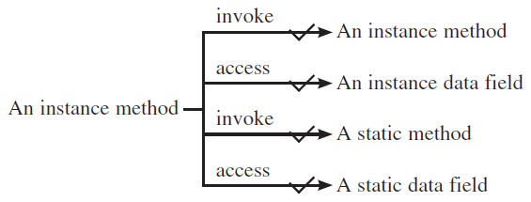
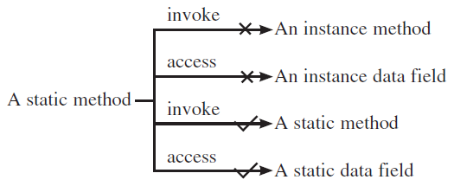
An instance method vs A static method
OOP · Objects and Classes · 37

Slide 38
An instance method vs A static method
For example, the following code is wrong.
public class A {
int i = 5;
static int k = 2;
public static void main(String[] args) {
int j = i; // Wrong because i is an instance variable
m1(); // Wrong because m1() is an instance method
}
public void m1() {
// Correct since instance and static variables and methods can be used in an instance method
i = i + k + m2(i, k);
}
public static int m2(int i, int j) {
return (int)(Math.pow(i, j));
}
}
OOP · Objects and Classes · 38

Slide 39
An instance method vs A static method
If you replace the preceding code with the following new code, the program would be fine,
public class A {
int i = 5;
static int k = 2;
public static void main(String[] args) {
A a = new A();
int j = a.i; // OK, a.i accesses the object's instance variable
a.m1(); // OK. a.m1() invokes the object's instance method
}
public void m1() {
i = i + k + m2(i, k);
}
public static int m2(int i, int j) {
return (int)(Math.pow(i, j));
}
}
OOP · Objects and Classes · 39

Slide 40
Static Attributes
▫ Sometimes called class attributes as opposed to instance attributes
▫ Static attributes exists before any object is created
▫ A change performed by any object is visible to all instances at once
▫ Used to keep a shared property
class Car {
static int countBuiltCars = 0;
public Car(){
countBuiltCars++;
}
}
Static Methods: why
▫ Used to implement functions
– Avoid creating an object just to invoke the method (see e.g., main())
public class Utility {
public static int inverse(double n){
return 1 / n;
}
}
OOP · Objects and Classes · 40

Slide 41
Final Attributes
▫ An attribute declared as final:
– cannot be changed after object construction
– can be initialized inline or by the constructor
class Student {
final int years=3;
final String id;
public Student(String id){
this.id = id;
}
}
OOP · Objects and Classes · 41

Slide 42
Visibility Modifiers and Accessor/Mutator Methods
By default, the class, variable or method can be accessed by any class in the same package.
▫ public
The class, data, or method is visible to any class in any package.
▫ private
The data or methods can be accessed only by the declaring class.
The get and set methods are used to read and modify private properties.
OOP · Objects and Classes · 42

Slide 43
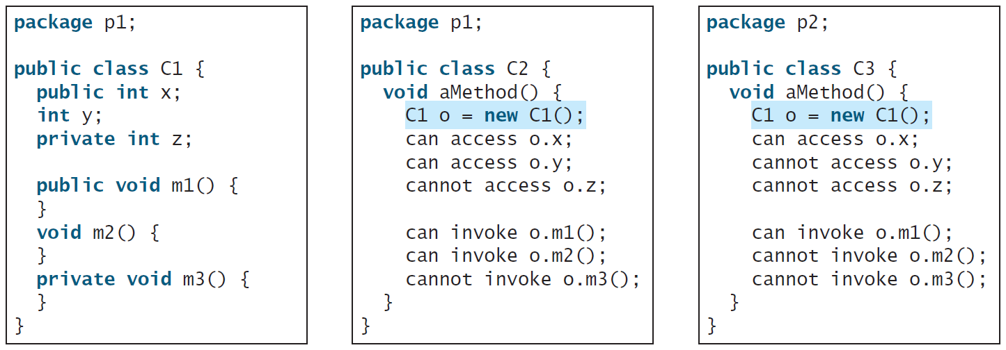
Visibility Modifiers and Accessor/Mutator Methods
The private modifier restricts access to within a class, the default modifier restricts access to within a package, and the public modifier enables unrestricted access.
OOP · Objects and Classes · 43

Slide 44
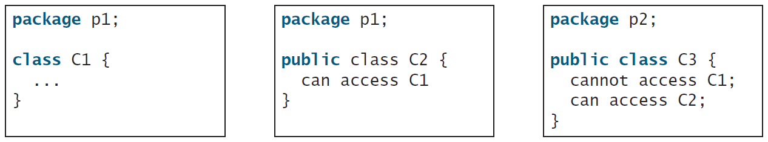
Visibility Modifiers and Accessor/Mutator Methods
OOP · Objects and Classes · 44
Notes:
The default modifier on a class restricts access to within a package, and the public modifier enables unrestricted access.

Slide 45
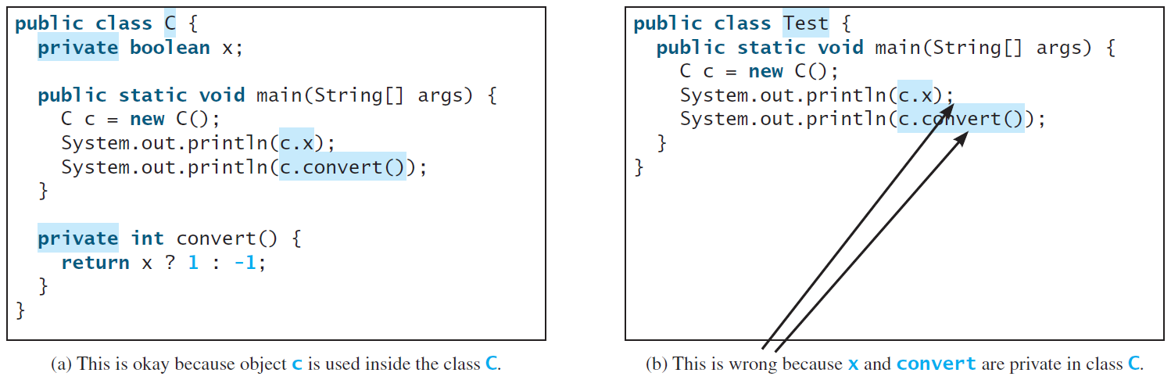
NOTE
An object cannot access its private members, as shown in (b). It is OK, however, if the object is declared in its own class, as shown in (a).
OOP · Objects and Classes · 45

Slide 46
Package
▫ For the purpose of code organization and structuring Java provides the package feature
▫ A package is a logic set of class definitions
▫ These classes consist of several files, all stored in the same folder
▫ Each package defines a new scope. It is therefore possible to use same class names in different package without name-conflicts
▫ Declaration:
– Package statement at the beginning of each class file
package packageName;
▫ Usage:
– Import statement at the beginning of class file (where needed)
import packageName.className;
OOP · Objects and Classes · 46

Slide 47
Visibility with Multiple Packages
▫ public class A { }
– Class and public members of A are visible from outside the package
▫ class B { } (package visibility)
– Class and any members of B are not visible from outside the package
▫ private class A { }
– Illegal: why?
The class and its members would be visible to themselves only
OOP · Objects and Classes · 47

Slide 48
Why Data Fields Should Be private?
To protect data.
To make code easy to maintain.
Encapsulation is one of the four fundamental OOP concepts.
Encapsulation in Java is a mechanism of wrapping the data (variables) and code acting on the data (methods) together as a single unit. In encapsulation, the variables of a class will be hidden from other classes and can be accessed only through the methods of their current class.
OOP · Objects and Classes · 48

Slide 49
Data Field Encapsulation
To achieve encapsulation in Java:
▫ Declare the variables of a class as private.
– A private data field cannot be accessed by an object from outside the class
▫ Provide public setter and getter methods to modify and view the variables values
– To make a private data field accessible
▫ A getter method has the following signature:
– public returnType getPropertyName()
public double getRadius();
▫ A setter method has the following signature:
– public void setPropertyName(dataType propertyValue)
public void setRadius(double newRadius);
OOP · Objects and Classes · 49
Notes:
Setters allow performing checks before modifying the attribute (e.g. validity of values, authorization)

Slide 50
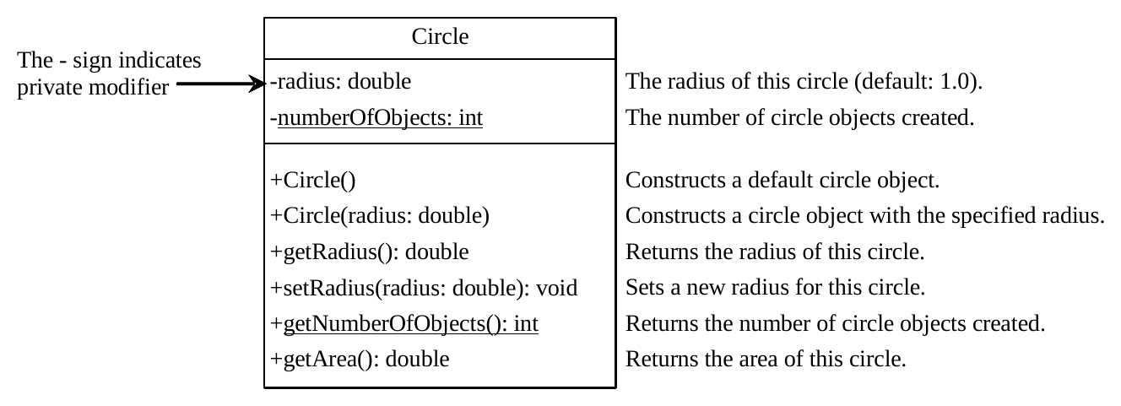
Example of Data Field Encapsulation
OOP · Objects and Classes · 50

Slide 51
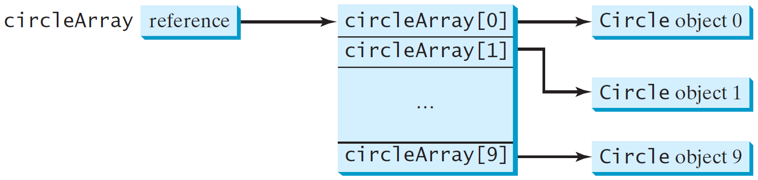
Array of Objects
Syntax:
Class obj[]= new Class[array_length]
Ex:
Circle[] circleArray = new Circle[10];
An array of objects is actually an array of reference variables.
OOP · Objects and Classes · 51

Slide 52
Arrays are Objects
▫ An array can contain both primitive types or object references (but no object values)
▫ In Java an array is an Object
▫ Array declaration allocates memory space for a reference, whose default value is null
▫ Elements are selected with brackets [ ] (C-like)
▫ An array reference is not a pointer to the first element of the array, it is a pointer to the array object
OOP · Objects and Classes · 52

Slide 53
Arrays of Arrays
Since rows are not stored in adjacent positions in memory they can be easily exchanged
double[][] balance = new double[5][6];
...
double[] temp = balance[i];
balance[i] = balance[j];
balance[j] = temp;
Rows can be created one at a time:
int[][] triangle = new int[3][]
for (int i=0; i< triangle.length; i++)
triangle[i] = new int[i+1];
OOP · Objects and Classes · 53

Slide 54
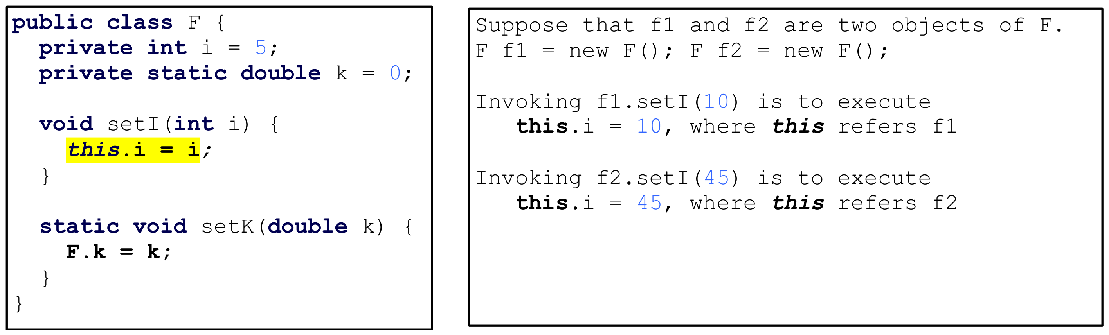
The this Keyword
▫ The this keyword is the name of a reference that refers to an object itself. One common use of the this keyword is reference a class’s hidden data fields.
▫ this makes no sense within methods that have not been invoked on an object, e.g. the main method
OOP · Objects and Classes · 54

Slide 55
Immutable Objects and Classes
If the contents of an object cannot be changed once the object is created, the object is called an immutable object and its class is called an immutable class.
A class with all private data fields and without setters is not necessarily immutable. For example, the following class Student is mutable.
OOP · Objects and Classes · 55

Slide 56
Example
public class Student {
private int id;
private BirthDate birthDate;
public Student(int ssn,
int year, int month, int day) {
id = ssn;
birthDate = new BirthDate(year, month, day);
}
public int getId() {
return id;
}
public BirthDate getBirthDate() {
return birthDate;
}
}
public class BirthDate {
private int year;
private int month;
private int day;
public BirthDate(int newYear,
int newMonth, int newDay) {
year = newYear;
month = newMonth;
day = newDay;
}
public void setYear(int newYear) {
year = newYear;
}
}
OOP · Objects and Classes · 56

Slide 57
Example, cont.
public class Test {
public static void main(String[] args) {
Student student = new Student(111223333, 1970, 5, 3);
BirthDate date = student.getBirthDate();
date.setYear(2010); // Now the student birth year is changed!
}
}
OOP · Objects and Classes · 57

Slide 58
What Class is Immutable?
For a class to be immutable, it must mark all data fields private and provide no setters and no getters that would return a reference to a mutable data field object.
OOP · Objects and Classes · 58

