Slide 1
Chapter 3
Cascading Style Sheet
CSS

Slide 2
3.1 Introduction
stands for Cascading Style Sheet
CSS1 specification was developed in 1996
CSSs provide the means to control and change presentation of HTML documents
CSS is not technically HTML, but can be embedded in HTML documents
A style sheet is a syntactic mechanism for specifying style information (like word processor)
Style sheets allow you to impose (force) a standard style on a whole document, or even a whole collection of documents
Style is specified for a tag by the values of its properties (e.g., using the id or class attributes)

Slide 3
3.2 Levels of Style Sheets
- There are three levels of style sheets
  Inline style sheets
    Apply to content of a single HTML element
    Specified for a specific occurrence of a tag and apply only to that tag
  2. Document-level style sheets
    Apply to the whole body of a document in which they appear
  3. External style sheets
    Can be applied to any number of documents

Slide 4
3.2 Levels of Style Sheets
Precedence:
Highest------------------ > Lowest
Inline → Document level → External
When more than one style sheet applies to a specific tag in a document, the lowest level style sheet has precedence
  The browser searches for a style property spec, starting with inline, until it finds one.
  If none is specified then the browser default property is used.
  In case with tag and tag attributes, if the browser not capable of using the property values specified in a style sheet (e.g. font size can not displayed), browser will ignore the requirement and use its default value (default font size)

Slide 5
Internal Style Sheets
Inline style sheets appear in the opening tag and applied to that tag (element) itself
- Inline style disadvantage:
Defeat imposing uniform style
Result style info that expressed in a language distinct/different from HTML
Recommendation: keep style sheet separate from HTML markup → use external style sheet

Slide 6
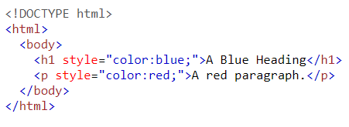
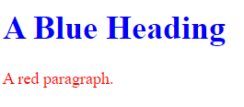
3.2. CSS TYPES – INLINE CSS
The style is written in the opening tag of the desired elements
The attribute style is used to include the style
The value of the style attribute is given in pairs of property and value using:
  property: “value”;
You can include as many styles as you want; must be separated by semi-colon (;)
Disadvantage:
Defeat imposing uniform style
Result style info that expressed in a language different from HTML

Slide 7
3.2. CSS TYPES – INTERNAL CSS
The style is written in the head-section of the document, therefore, the style can apply to the whole document
  Can apply the style across the entire document, but not the website
The <style> is used to include the styles; and it contains a set of rules, which comes in the following format:
  Selector { property: “value”; …;}
  selector: HTML element effected by the rule
  List of property-values pairs(similar to inline)
    Each property/value pair has the form: property: value
    Pairs are separated by semicolons
The <style> element must also has the type=“text/css” attribute
You can include as many styles as you want for any selector
CSS comments use Java style: /* ….. */

Slide 8
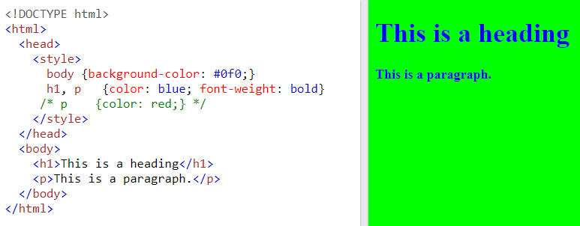
3.2. CSS TYPES – INTERNAL CSS (EXAMPLE)
CSS Comment

Slide 9
5. CSS TYPES – EXTERNAL CSS
Similar layout like Internal CSS, but uses separate file (with .css extension) to include all styles
    Can apply (link) the style (file) across many documents
    Easy to change the site’s entire look-and-feel design
The CSS file(s) are used to include the styles; and it contains a set of rules, which comes in the following format:
  Selector { property: “value”; …;}
The CSS file must be linked to HTML document(s) in the <head>:
  <link rel="stylesheet" href="styles.css">
An alternative way to reference an external style sheet:
  @import url(“filename”); //OR @import “filename”;
You can link (to a single HTML document) as many files as you want
CSS comments use Java style: /* ….. */

Slide 10
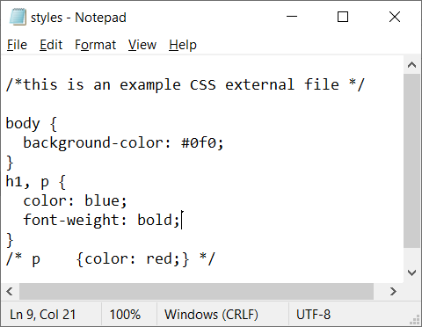
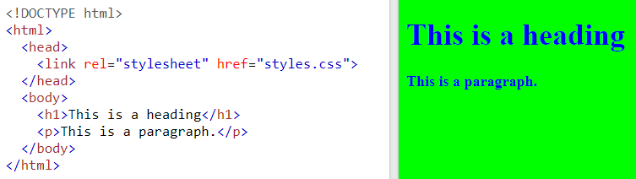
3.2. CSS TYPES – EXTERNAL CSS (EXAMPLE)

Slide 11
HTML <link> media Attribute
This attribute is mostly used with CSS style sheets to specify different styles for different media types.
Example: Two different style sheets for two different media types (screen and print):
  <head>
  <link rel="stylesheet" type="text/css"
  href="theme.css">
  <link rel="stylesheet" type="text/css"
  href="print.css" media="print">
  </head>
all | Default. Used for all media type devices
print | Used for Print preview mode/printed pages
screen | Used for computer screens, tablets, smart-phones etc.
speech | Used for screen readers that "reads" the page out loud
aural | Speech synthesizers
braille | Braille feedback devices
handheld | Handheld devices (small screen, limited bandwidth)
projection | Projectors
tty | Teletypes and similar media using a fixed-pitch character grid
tv | Television type devices (low resolution, limited scroll ability)

Slide 12
3.4. CSS SELECTORS – OVERVIEW
Selectors are used to specify the HTML content, which will receive the styles effects
There are 7 different selectors:
  Simple
  Class
  Generic
  id-linked
  Universal
  Contextual
  Pseudo Classes

Slide 13
1. Simple Selector Forms
The selector is a tag name or a list of tag names, separated by commas
- Examples: h1 {property-value list}
h2, h3 {property-value list}
h1 {
color: blue; font-size: 12px;
}
h2, p {
color: red;
}
…
<h1>Book Title: Java Programming</h1>
<h1 >
Chapter1: Introduction
</h1>
<p> … </p>
<p> … </p>
<p> … </p>
…

Slide 14
2- Class Selectors
Used to allow different occurrences of the same tag to use different style specifications
  A style class has a name, which is attached to a tag name
  For example, p.normal {property/value list}
  p.worning {property/value list}
The class you want on a particular occurrence of a tag is specified with the class attribute of the tag
<p class = “normal”>Your paragraph </p>
h1.chapters {
color: blue; font-size: 12px;
}
p.mainPara {
color: red;
}
…
<h1>Book Title: Java Programming</h1>
<h1 class=“chapters”>
Chapter1: Introduction
</h1>
<p class=“mainPara”> … </p>
<p class=“normalPara”> … </p>
<p> … </p>
…

Slide 15
3. Generic Selectors
  - A generic class can be defined if you want a style to apply to more than one kind of tag
  - A generic class must be named, and the name must begin with a period
- Example, .sale { … }
- Use it as if it were a normal style class
<h1 class = "sale"> Weekend Sale </h1>
...
<p class = "sale"> … </p>
.chapters {
color: blue; font-size: 12px;
}
.mainPara {
color: red;
}
…
<h1>Book Title: Java Programming</h1>
<h1 class=“chapters”>
Chapter1: Introduction
</h1>
<p class=“mainPara”> … </p>
<p class=“mainPara”> … </p>
…

Slide 16
4. id Selectors
An id selector allows the application of a style to one specific element
- General form:
#specific-id {property-value list}
- Example:
#section14 {...}
<h2 id = “section14” > Header title </h2>
…
<h1>Book Title: Java Programming</h1>
<h1 id=“ch1”>
Chapter1: Introduction
</h1>
<p id=“para1”> … </p>
<p id=“para2”> … </p>
<p> … </p>
…
#ch1{
color: blue; font-size: 12px;
}
#para1, #para2 {
color: red;
}

Slide 17
5. Universal Selectors
Denoted by (*)
Applies to all elements in the document
  i.e. wants every element in a document to have a particular properties, then include
  * {property-value list}
Example:
* {
color: blue; font-size: 12px;
}
…
<h1>Book Title: Java Programming</h1>
<h1> Chapter1: Introduction </h1>
<p > … </p>
<p > … </p>
…

Slide 18
6- Contextual Selector
Applies to particular nested elements in the document (without separating them with commas)
Syntax: tag1 tag2 … {property-value list}
Question: what is the difference between rules that have tag names with/out comma?
div p {………}
div ,p{………}
…
<h1>Book Title: JavaScript Programming</h1>
<h1>
Chapter1: Introduction
</h1>
<p > … </p>
<p > … </p>
<p> This <span>chapter</span> … </p>
…
p span {
color: red;
}

Slide 19
7. Pseudo Classes
Pseudo classes are styles that apply when something happens, rather than because the target element simply exists
Pseudo Classes names begin with colons
e.g. h2:hover {property-value list}
Two pseudo classes for styling links:
  link : link not being selected yet
  visited: link that previously selected
- hover classes apply when the mouse cursor is over the element
  - active classes apply when an element is currently selected
- focus classes apply when an element has focus
(e.g. right click mouse button over the link)
e.g. a:focus {property-value list}

Slide 20
Example
<!DOCTYPE html>
<html><head>
<style>
a:link { color: green; } /* unvisited link */
a:visited { color: blue; } /* visited link */
a:hover { color: red; } /* mouse over link */
a:active { color: yellow;} /* selected link */
</style>
</head>
<body>
<p>Mouse over and click the link:
<a href="https://www.w3schools.com">w3schools.com</a>
</p>
</body></html>

Slide 21
7. Pseudo Classes
Example
<!-- pseudo.html -->
<html xmlns = "http://www.w3.org/1999/xhtml">
<head> <title> Checkboxes </title>
<style type = "text/css">
input:hover {background: pink;
color: red;}
input:focus {background: lightblue;
color: blue;}
</style>
</head>
<body>
<form action = "">
<p> Your name: <input type = "text" /> </p>
</form>
</body>
</html>

Slide 22
3.5 CSS PROPERTIES – OVERVIEW
REMEMBER: CSS properties are used by CSS styles to control the appearance of items that are selected by CSS selectors (e.g., h1 {color: red;})
There are more than 60 different properties grouped into 7 categories:
  Fonts
  Lists
  Alignment
  Color
  Background
  Margin
  Border
The following slides will explain each category with examples

Slide 23
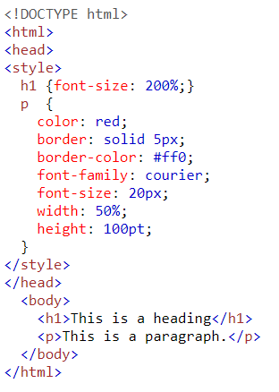

3.5 CSS PROPERTIES – MEASUREMENTS AND UNITS
When assigning a value to a property, the number can be specified in ay of the following units:
  px - pixels
  in - inches
  cm - centimeters
  mm - millimeters
  pt - points
  pc - picas (12 points)
  em - 1em is equal to the current font size.
  ex - height of the letter ‘x’
The default text size in browsers is 16px.

Slide 24
3.6. CSS PROPERTIES – FONTS
font-family: the font name such as Arial, Serif, …etc.
font-size: the size of the text; it can be measured by units shown in previous slide
font-style: the style of the text; e.g., italic, normal
font-weight: the weight (thickness) of the text;
e.g., bold, bolder, lighter, normal, ….., etc.
font: use short-cut in specifying the properties:
  E.g., font: italic bolder 14pt Arial, Serif;
text-decoration:
can be line-through, overline, underline, none
letter-spacing:
specify the distance between letters;

Slide 25
3.6 Font Properties
- font-family
- Value is a list of font names - browser uses the first in the list it
has
- font-family: Arial, Helvetica, Futura
- Generic fonts: serif, sans-serif, cursive,
fantasy, and monospace (defined in CSS)
Browser has a specific font for each
If a font name has more than one word, it should be single-quoted
    e.g. font-family: ‘Times New Roman’
- More examples, see page 107

Slide 26
3.6 Font Properties (continued)
- font-size property:
- two categories:
  Absolute:
    length value in point, picas, pixels
    Keyword: small, xx-large
  Relative: 1.2em or 120%
Font size does not display the same size in different computers/browsers
Recommended usage of em or precentage

Slide 27
3.6 Font Properties (continued)
- Font variants
- Default is normal, but can be set to small-caps
- font-style (italic)
- italic, oblique (useless), normal
- font-weight - degrees of boldness
- bolder, lighter, bold, normal
  - Could specify as a multiple of 100 (100 – 900)
  - most browsers uses normal or bold
- font shorthand
- For specifying a list of font properties
font: bolder 14pt Arial Helvetica
- Order must be: style, weight, size, name(s)
→ SHOW fonts.html and display
→ SHOW fonts2.html and styles.css and display
For more examples, See pages110 -112

Slide 28
3.6 Font Properties (continued)
Text Decoration / text spacing:
- text-decoration property
- line-through, overline, underline, none
→ See page 112 decoration.html
- letter-spacing:
- space between letters in a word
– value is any length property value
  - positive values increase spaces
  - negative values decrease spaces
Example: see pages 114-115

Slide 29
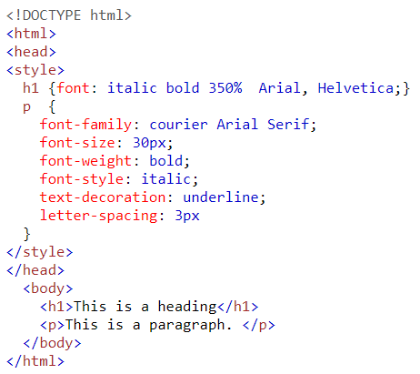
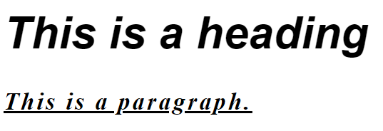
3.6. CSS PROPERTIES – FONTS
EXAMPLE

Slide 30
3.7. CSS PROPERTIES – LISTS
list-style-type:
  In <ul>, <li>: will determine the used bullets shape: disc, square, circle.
  In <ol>, <li>: will determine numbering scheme:
    decimal Arabic numerals 1, 2, 3, 4
    upper-alpha Uc letters A, B, C, D
    lower-alpha Lc letters a, b, c, d
    upper-roman Uc Roman I, II, III, IV
    lower-roman Lc Roman i, ii, iii, iv
You can also use images in <li> elements:
  <li style=“list-style-image: url(smile_face.jpg)” >

Slide 31
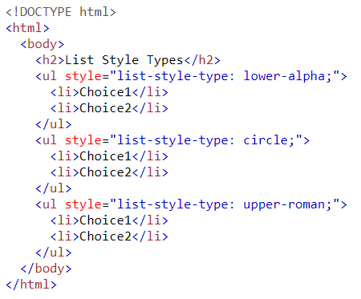
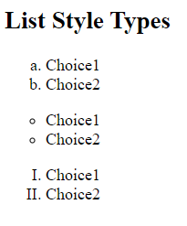
3.7. CSS PROPERTIES – LISTS (EXAMPLE)

Slide 32
3.8 Alignment of Text
- The text-indent property allows indentation
- Indent the first line of a paragraph
- Takes either a length value or a % value
- The text-align property has the possible values:
left (the default), center, right, or justify
- The float property:
  We want text to flow around another element
  The float property has the possible values, left, right, and none (the default)
Example: If we have an element (e.g., <p>) we want on the right, with text flowing on its left, we use the
  text-align value (left) for the text and the left value for float
  p {text-align:left;width:30%;float:left;}

Slide 33

3.8 Alignment of Text
<img src = "c210.jpg" style = "float: right" />
-- Some text with the default alignment - left

Slide 34
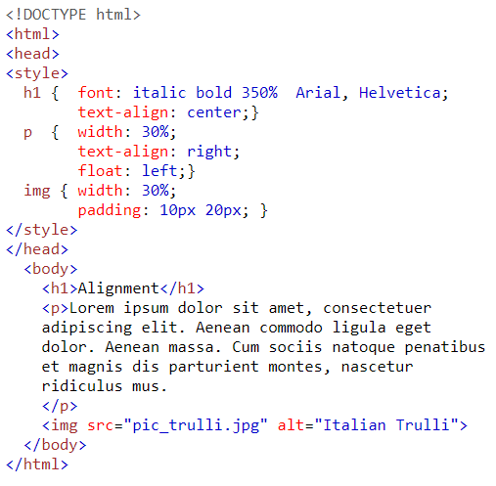
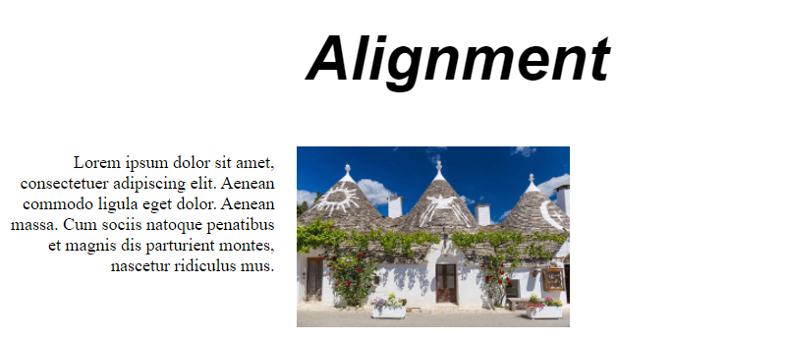
3.8. CSS PROPERTIES – ALIGNMENT

Slide 35
3.9 Colors
Colors are used in different situation in HTML
  Background (also filling)
  Foreground (e.g., text colors)
  Borders
- There are three color collections
1. There is a set of original 17 colors that are guaranteed to be displayable by all graphical browsers on all color monitors
black 000000 purple 800080
navy 000080 olive 808000
blue 0000FF gray 808080
green 008000 silver C0C0C0
teal 008080 red FF0000
lime 00FF00 fuchia FF00FF
aqua 00FFFF yellow FFFF00
maroon 800000 white FFFFFF
orange FFA500
2- There are 147 named colors widely supported by browsers
see Appx. B in your textbook
3. There is a much larger set, the Web Palette
- 216 colors (ones were only supported colors)
- Use hex color values of 00, 33, 66, 99, CC, and FF

Slide 36

3.9 Colors (continued)
- The color property specifies the foreground color of HTML elements
<style type = "text/css" >
th.red {color: red}
th.orange {color: orange}
</style>
…
<table border = "5">
<tr>
<th class = "red"> Apple </th>
<th class = "orange"> Orange </th>
<th class = "orange"> Screwdriver </th>
</tr>
</table>

Slide 37
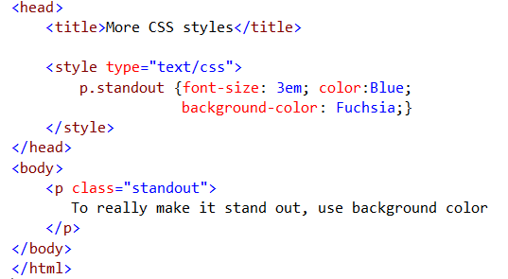
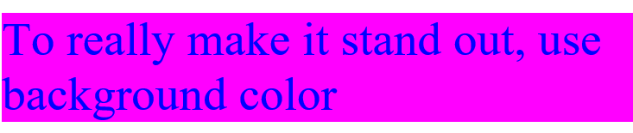
3.9 Colors (continued)
-
- The background-color property specifies the
background color of HTML elements

Slide 38
3.9. CSS PROPERTIES – COLORS
The color value can take the one of the following forms
    rgb(X, X, X); where X can range from 0 to 255; and rgb stands for RED-GREEN-BLUE
    rgba(X, X, X, Y); similar to rgb(…), where Y can range from 0 to 1 and it indicates the transparency
    hsl(X,Y%,Z%); where X ranges from 0 to 360, Y and Z from 0 to 100%; and hsl stands for hue, saturation, and lightness
    hsla(X,Y%,Z%,W); similar to hsl(…), where W can range from 0 to 1 and it indicates the transparency
    #RRGGBB; where RR, GG, BB are hexa-decimal numbers range from 00 to ff

Slide 39
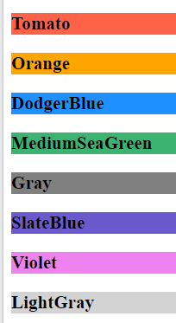
3.9. CSS PROPERTIES – COLORS (EXAMPLE1)
<!DOCTYPE html>
<html>
<body>
<h1 style="background-color:Tomato;">Tomato</h1>
<h1 style="background-color:Orange;">Orange</h1>
<h1 style="background-color:DodgerBlue;">DodgerBlue</h1>
<h1 style="background-color:MediumSeaGreen;">MediumSeaGreen</h1>
<h1 style="background-color:Gray;">Gray</h1>
<h1 style="background-color:SlateBlue;">SlateBlue</h1>
<h1 style="background-color:Violet;">Violet</h1>
<h1 style="background-color:LightGray;">LightGray</h1>
</body>
</html>

Slide 40
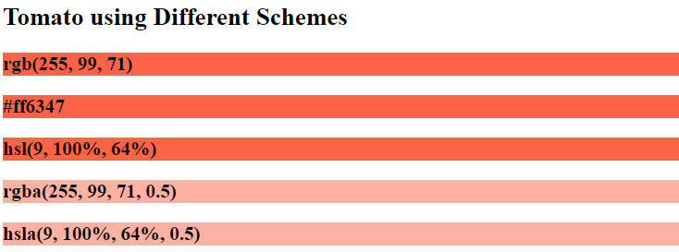
3.9. CSS PROPERTIES – COLORS (EXAMPLE2)
<!DOCTYPE html>
<html>
<body>
<p>Same as color name "Tomato":</p>
<h1 style="background-color:rgb(255, 99, 71);">rgb(255, 99, 71)</h1>
<h1 style="background-color:#ff6347;">#ff6347</h1>
<h1 style="background-color:hsl(9, 100%, 64%);">hsl(9, 100%, 64%)</h1>
<p>Same as color name "Tomato", but 50% transparent:</p>
<h1 style="background-color:rgba(255, 99, 71, 0.5);">rgba(255, 99, 71, 0.5)</h1>
<h1 style="background-color:hsla(9, 100%, 64%, 0.5);">hsla(9, 100%, 64%, 0.5)</h1>
<p>In addition to the predefined color names, colors can be specified using RGB, HEX, HSL, or even transparent colors using RGBA or HSLA color values.</p>
</body>
</html>

Slide 41
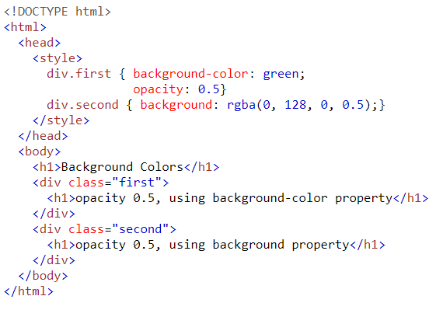
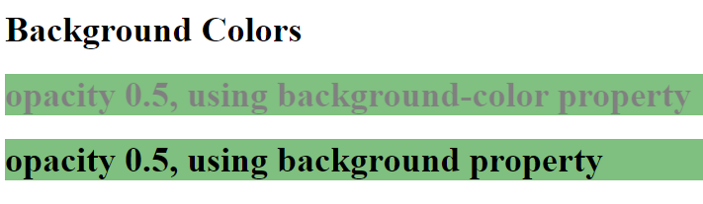
3.9. CSS PROPERTIES – BACKGROUND (EXAMPLE1)

Slide 42
3.9. CSS PROPERTIES – BACKGROUND
Background (applicable to some HTML elements) can be formatted by different properties including:
  background-color: you can assign any color scheme that are discussed before
  opacity: determine the percentage of the background opacity (opposite of transparency)
  Using rgba(…) or hsla(…) with background property is same as using the combination of background-color and opacity
  background-image is used to fill the background with an image selected by url(…)
  background-repeat is used to repeat or prevent repeating the image: repeat, no-repeat, repeat-x, repeat-y
  background-position is used to specify the position of the image-background: top, right, left, bottom
  background-attachment is used to fix or scroll the background image: scroll, fixed

Slide 43
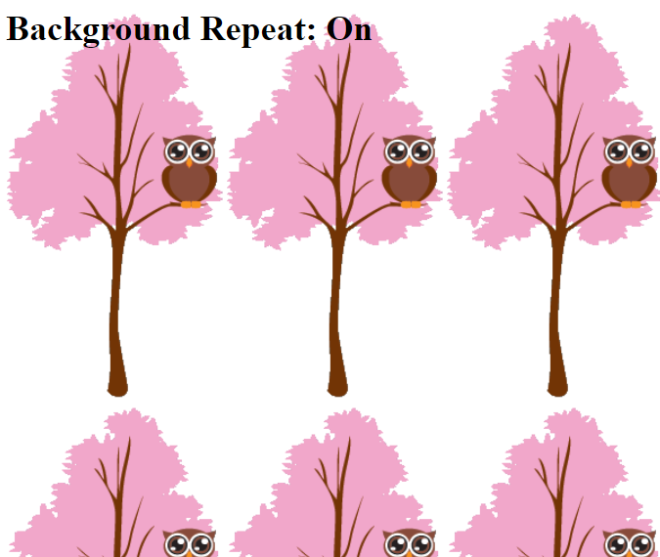
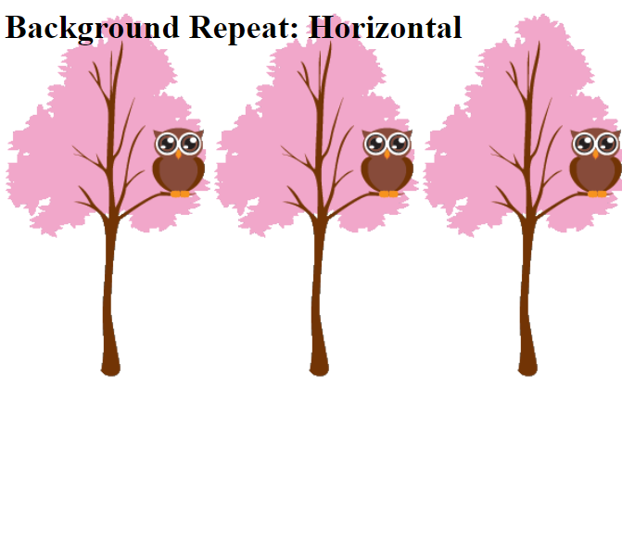
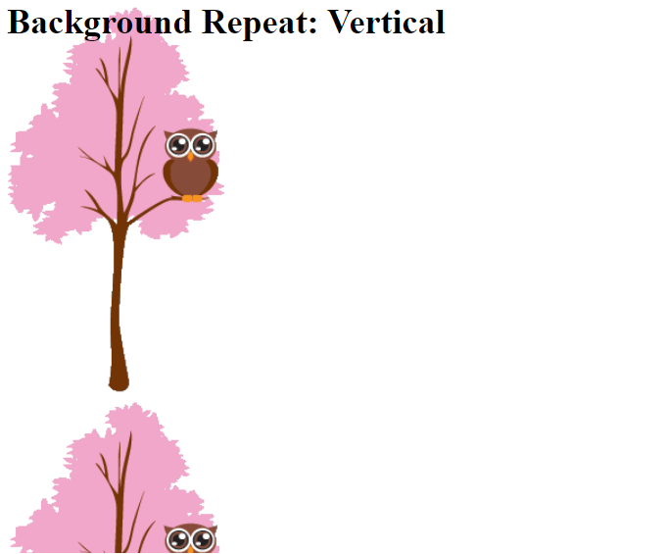
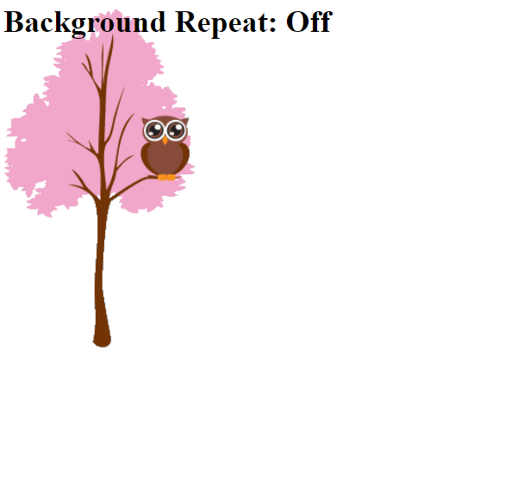
3.9. CSS PROPERTIES – BACKGROUND (EXAMPLE2)
<!DOCTYPE html>
<html>
<head>
<style>
body{
background-image:url("download.jpg");
background-repeat:repeat; /*repeat-x, repeat-y,no-repeat*/
}
</style>
</head>
<body>
<h1>Hello World!</h1>
<p>This text is not easy to read on this background image.</p>
</body>
</html>

Slide 44
3.10. CSS PROPERTIES – MARGINS
A HTML element has 4-margins (top, right, bottom, left), which can be specified using the following properties:
  margin-top: determine the top space-distance between the content and its top-border
  margin-right: determine the top space-distance between the content and its right-border
  margin-bottom: determine the top space-distance between the content and its bottom-border
  margin-left: determine the top space-distance between the element and its left-border
  margin: determines the four margins in the following order: top, right, bottom, left
  When only 1 value is given to the margin property, it applies to all margins
  When 2 values are given to the margin property, the 1st value applies to top and bottom, the 2nd value applies to the right and left

Slide 45
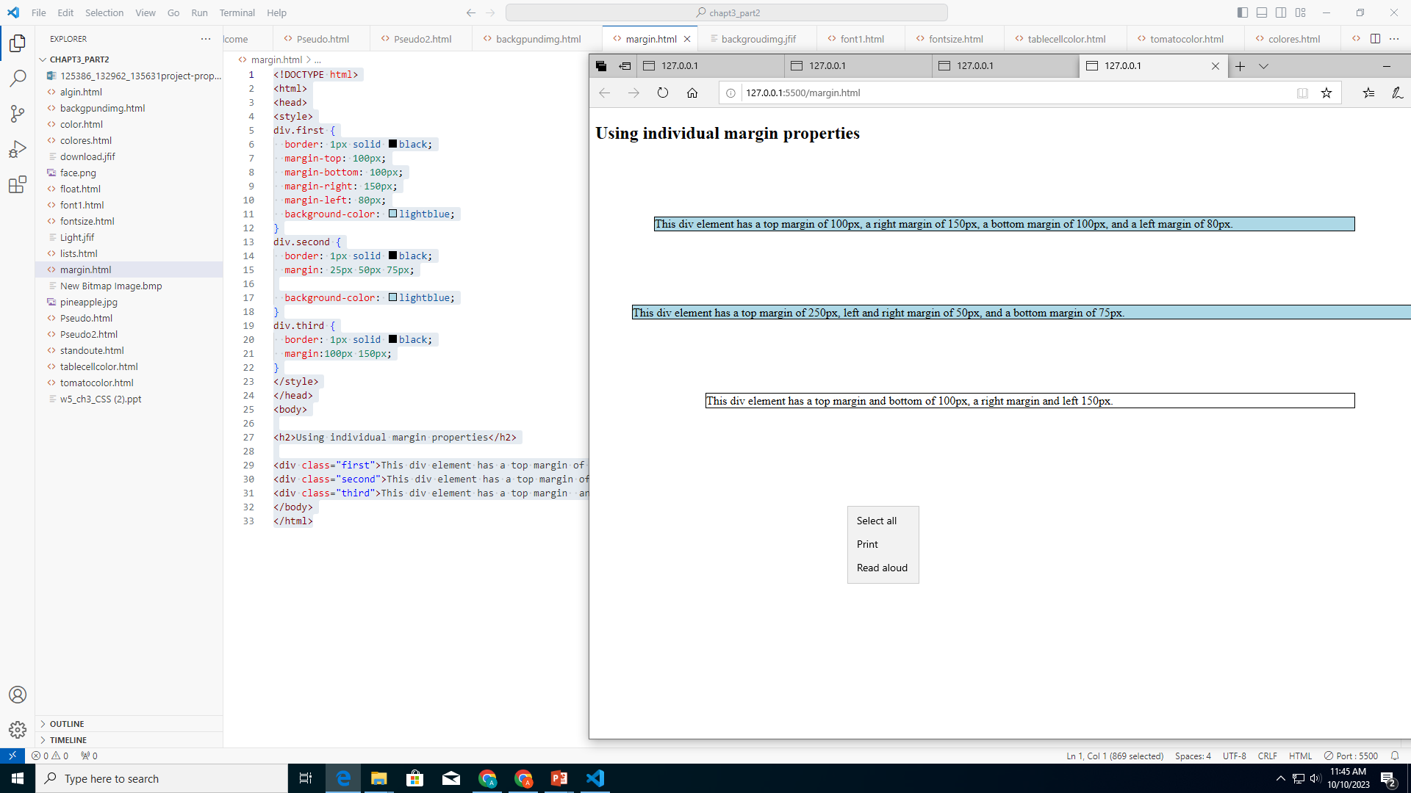
3.10. CSS PROPERTIES – MARGINS (EXAMPLE)
<html>
<head>
<style>
div.first {
border: 1px solid black;
margin-top: 100px;
margin-bottom: 100px;
margin-right: 150px;
margin-left: 80px;
background-color: lightblue;}
div.second {
border: 1px solid black;
margin: 25px 50px 75px;
background-color: lightblue;}
div.third {
border: 1px solid black;
margin:100px 150px;}
</style>
</head>
<body>
<div class="first">This div element has a top margin of 100px, a right margin of 150px, a bottom margin of 100px, and a left margin of 80px.</div>
<div class="second">This div element has a top margin of 250px, left and right margin of 50px, and a bottom margin of 75px.</div>
<div class="third">This div element has a top margin and bottom of 100px, a right margin and left 150px.</div>
</body>
</html>

Slide 46
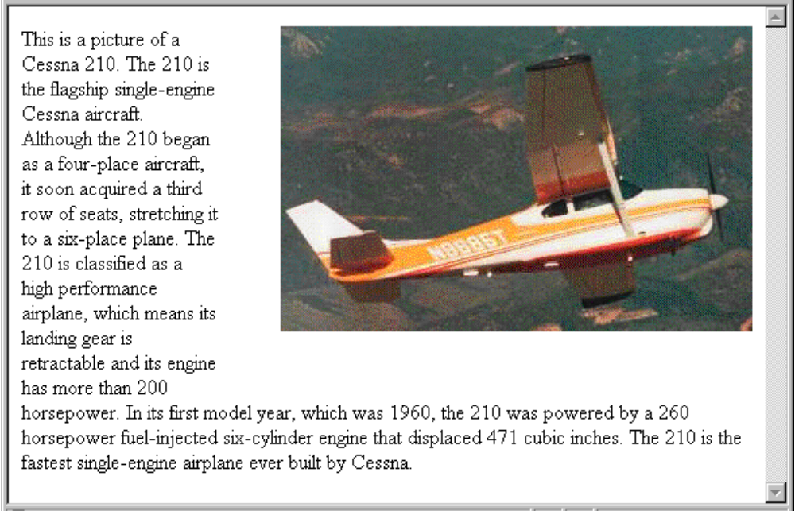
3.10 The Box Model (continued)
- Margin – the space between the border of an element and its neighbor element
- The margins around an element can be set with margin-left, etc.
- just assign them a length value
<img src = "c210.jpg " style = "float: right;
margin-left: 0.35in;
margin-bottom: 0.35in" />

Slide 47
3.10. CSS PROPERTIES – BORDERS
The following properties can be used to control the element’s borders in CSS:
  border-style: determine the style (e.g., dotted, double, solid) of the 4 borders; it takes 1, 2 or 4 values:
    If 1 value: it applies to all borders
    If 2 values: the 1st applies to top and bottom, the 2nd applies to right and left
    If 4 values: they apply one-to-one in the following order: top, right, bottom, left
  border-width: determine the thickness of the border(s) using the same way as for border-style
  border-color: determine the color of the border(s) using the same way as for border-style
  border: determine the width, style and color; all at once
  border-XXXX: same as border property; where XXXX can be top, right, bottom, or left
  border-radius: create rounded border; looks like buttons

Slide 48
3.10 The Box Model
- Borders – every element has a border-style property
- Controls whether the element has a border and
if so, the style of the border
- border-style values: none, dotted, dashed, and double
- border-width: thin, medium (default), thick, or a length value in pixels
- Border width can be specified for any of the four borders
(e.g., border-top-width)
- border-color – any color
- Border color can be specified for any of the four borders
(e.g., border-top-color)
→ SHOW borders.html see page 124 - 125

Slide 49
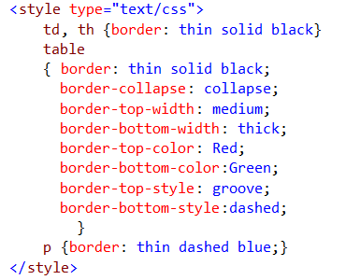
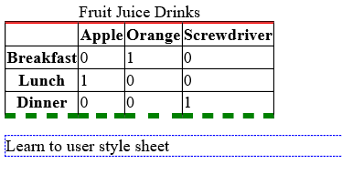
3.10 The Box Model

Slide 50
3.10 The Box Model
required
Shorthand
{Border: width, style, color;}

Slide 51
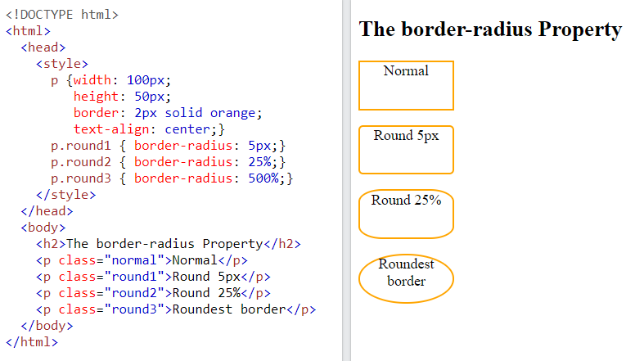
3.10. CSS PROPERTIES – BORDERS (EXAMPLE)

Slide 52
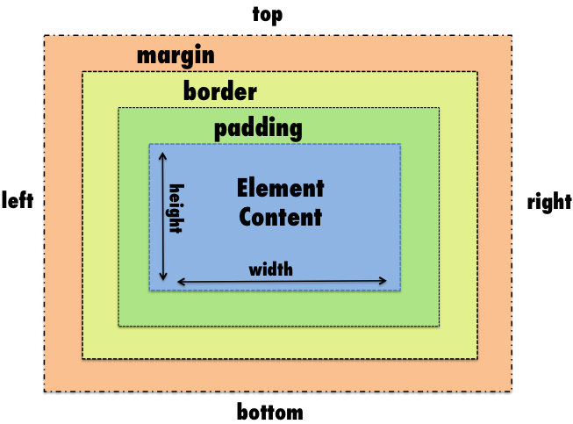
3.10 The Box Model (continued)
- Padding – the distance between the content of an
element and its border
- Controlled by padding, padding-left, etc.
→ SHOW marpads.html page 126-128

Slide 53
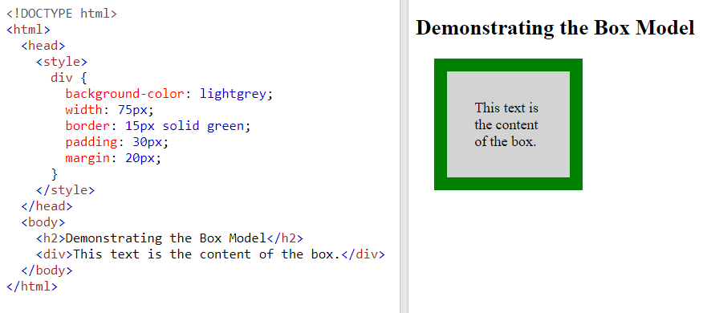
3.10. CSS BOX MODEL – DEMONSTRATING EXAMPLE
When setting-up the width and height properties of an HTML element, we actually specify the content’s area width and height; the thickness of the other areas will be added to the element’s total width and height

Slide 54
3.12 The <span> and <div> tags
- One problem with the font properties is that they apply to whole elements, which are often too large
- Solution: a new tag to define an element in the content of a larger element - <span>
- The default meaning of <span> is to leave the content as it is
<p>Now is the <span> best time </span> ever!</p>
- Use <span> to apply a document style sheet to its content
<style type = "text/css">
.bigred {font-size: 24pt;font-family: Ariel; color: red}
</style>
..
<p> Now is the <span class = "bigred"> best time </span> ever! </p>

Slide 55
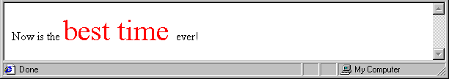
3.12 The <span> and <div> tags (continued)
- The <span> tag is similar to other HTML tags, they can be nested and they have id and class attributes
- Another tag that is useful for style specifications:
<div>
- Used to create document sections (or divisions) for which style can be specified
- e.g., A section of five paragraphs for which you want some particular style
Try it!
https://www.w3schools.com/tags/tryit.asp?filename=tryhtml_div_test

Slide 56
3.12 The <span> and <div> tags (continued)
-CSS border:
+ Try rounded borders
  https://www.w3schools.com/css/tryit.asp?filename=trycss_border_round
-CSS background special affects
+ CSS Gradients
  https://www.w3schools.com/css/css3_gradients.asp
example:
background: linear-gradient(to right, orange,Fuchsia);

Slide 57
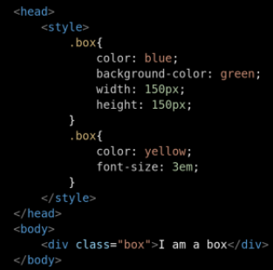
3.12 Conflict Resolution
- A conflict occurs when there are two or more values for the same property on the same element
- Sources of conflict:
1. Conflicting values between levels of style sheets
2. Within one style sheet
3. Inheritance can cause conflicts
4. Property values can come from style sheets written by the document author, the browser user, and the browser defaults

Slide 58
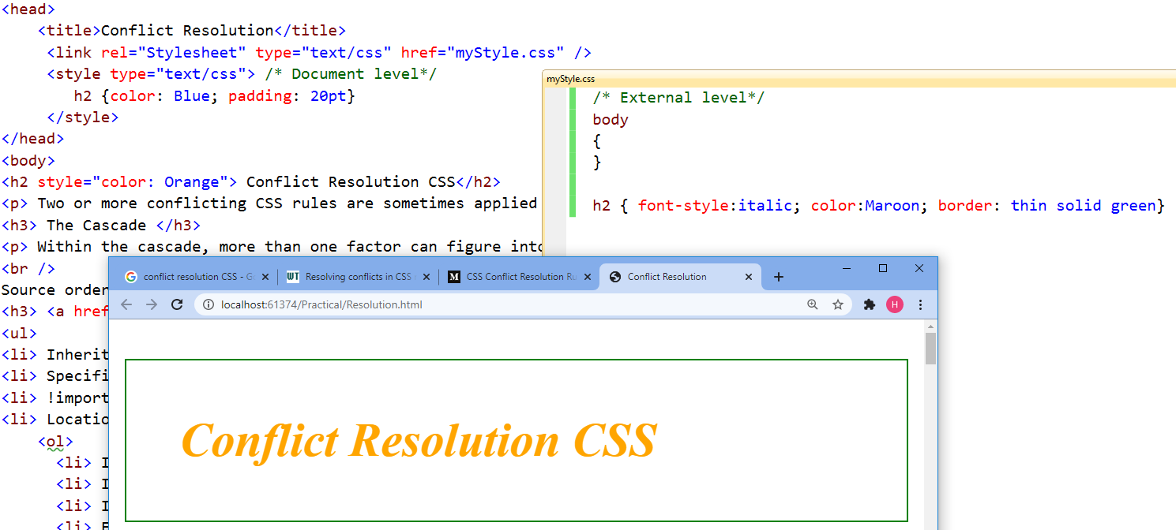
3.12 Conflict Resolution
- Sources of conflict:
1. Conflicting values between levels of style
sheets

Slide 59
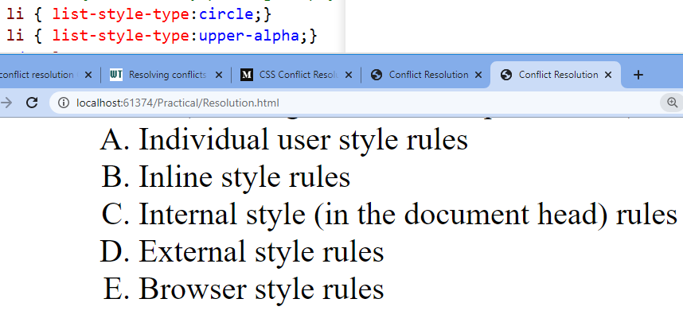
3.12 Conflict Resolution
- Sources of conflict:
2. Within one style sheet

Slide 60
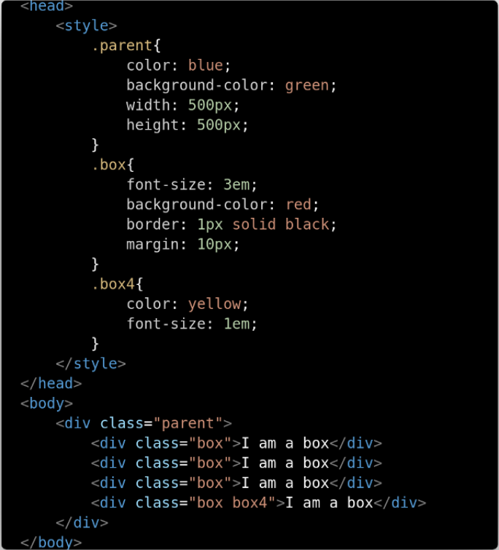
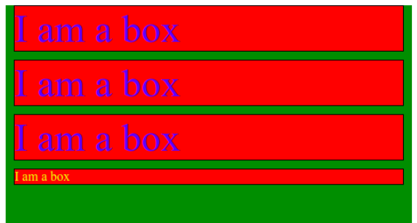
3.12 Conflict Resolution
- Sources of conflict:
3. Inheritance can cause conflicts

Slide 61
3.12 Conflict Resolution
- Sources of conflict:
4. Property values can come from style sheets written by the document author, the browser user, and the browser defaults
Assume:
Browser user (has vision problem) → set browser font to be White with black background
Author: some content important in red
Browser default: White background with black font

Slide 62
3.12 Conflict Resolution
- Resolution mechanisms:
1. Precedence rules for the different levels of
style sheets
2. Source of the property value
3. The specificity of the selector used to set the
property value
4. Property value specifications can be marked
to indicate their weight (importance)
Conflict resolution
https://medium.com/web-for-you/css-conflict-resolution-rules-explained-9ab90de18aef

Slide 63
3.12 Conflict Resolution (continued)
- Weight is assigned to a property value by attaching !important to the value
- Conflict resolution is a multistage process, called the cascade:
1. Gather all of the style specs from the different levels of style sheets
2. All available specs, from all sources, are sorted by origin and weight, using the following rules, which are given in precedence order:
a. Important declarations with user origin
b. Important declarations with author origin
c. Normal declarations with author origin
d. Normal declarations with user origin
e. Any declarations with browser (or other user agent) origin
NOTE: highest precedence: user-origin specification because of some capability of the user (e.g. Visual weakening) – must be marked important

Slide 64
3.12 Conflict Resolution (continued)
3. If any conflicts remain, sort them by specificity:
a. id selectors
b. Class and pseudo-class selectors then simple selector
c. Contextual selectors
d. Universal selectors
4. If there are still conflicts, resolve them by precedence to the most recently seen specification; i.e. the value used will be the last:
p {font-size: 1em;}
p {font-size: 0.9em;} → this will be used
More about conflict Resolution
https://developer.mozilla.org/en-US/docs/Learn/CSS/Building_blocks/Cascade_and_inheritance

