Slide 1
ADO.NET
(ActiveX Data Objects)

Slide 2
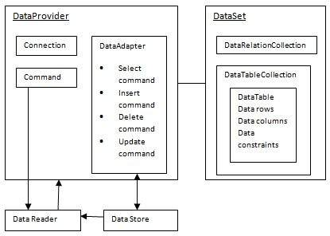
ADO.NET is a set of classes (a framework) to interact with data sources such as databases and XML files.
ADO is the acronym for ActiveX Data Objects. It allows us to connect to underlying data or databases.
It has classes and methods to retrieve and manipulate data.
The following figure shows the ADO.NET objects at a glance:

Slide 3
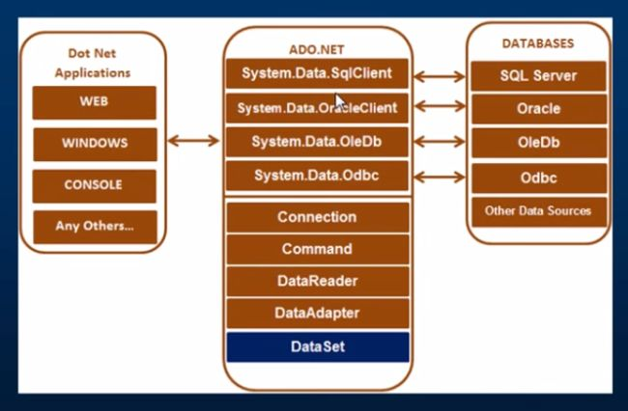
Various Connection Architectures
There are the following two types of connection architectures:
Connected architecture: the application remains connected with the database throughout the processing.
Disconnected architecture: the application automatically connects/disconnects during the processing. The application uses temporary data on the application side called a DataSet.

Slide 4
Important Classes in ADO.NET
1. Connection Class
In ADO.NET, we use these connection classes to connect to the database. These connection classes also manage transactions and connection pooling. To learn more about connection classes, start here: Connection in ADO.NET.
2. Command Class
The Command class provides methods for storing and executing SQL statements and Stored Procedures. The following are the various commands that are executed by the Command Class.
ExecuteReader: Returns data to the client as rows. This would typically be an SQL select statement or a Stored Procedure that contains one or more select statements. This method returns a DataReader object that can be used to fill a DataTable object or used directly for printing reports and so forth.
ExecuteNonQuery: Executes a command that changes the data in the database, such as an update, delete, or insert statement, or a Stored Procedure that contains one or more of these statements. This method returns an integer that is the number of rows affected by the query.
ExecuteScalar: This method only returns a single value. This kind of query returns a count of rows or a calculated value.
ExecuteXMLReader: (SqlClient classes only) Obtains data from an SQL Server 2000 database using an XML stream. Returns an XML Reader object.

Slide 5
3. DataReader Class
The DataReader is used to retrieve data. It is used in conjunction with the Command class to execute an SQL Select statement and then access the returned rows. Learn more here: Data Reader in C#.
4. DataAdapter Class
The DataAdapter is used to connect DataSets to databases. The DataAdapter is most useful when using data-bound controls in Windows Forms, but it can also be used to provide an easy way to manage the connection between your application and the underlying database tables, views and Stored Procedures. Learn more here: Data Adapter in ADO.NET.
5. DataSet Class
The dataset represents a subset of the database.
It does not have a continuous connection to the database.
To update the database a reconnection is required.
The DataSet contains DataTable objects and DataRelation objects.
In turn each object contains a collection of DataColumn and DataRow objects.
The DataRelation objects represent the relationship between two tables.

Slide 6
DataSet Properties
Properties | Description
CaseSensitive | Indicates whether string comparisons within the data tables are case-sensitive.
Container | Gets the container for the component.
DataSetName | Gets or sets the name of the current data set.
DefaultViewManager | Returns a view of data in the data set.
DesignMode | Indicates whether the component is currently in design mode.
EnforceConstraints | Indicates whether constraint rules are followed when attempting any update operation.
Events | Gets the list of event handlers that are attached to this component.
ExtendedProperties | Gets the collection of customized user information associated with the DataSet.
HasErrors | Indicates if there are any errors.
IsInitialized | Indicates whether the DataSet is initialized.
Locale | Gets or sets the locale information used to compare strings within the table.
Namespace | Gets or sets the namespace of the DataSet.
Prefix | Gets or sets an XML prefix that aliases the namespace of the DataSet.
Relations | Returns the collection of DataRelation objects.
Tables | Returns the collection of DataTable objects.

Slide 7
Methods | Description
AcceptChanges | Accepts all changes made since the DataSet was loaded or this method was called.
BeginInit | Begins the initialization of the DataSet. The initialization occurs at run time.
Clear | Clears data.
Clone | Copies the structure of the DataSet, including all DataTable schemas, relations, and constraints. Does not copy any data.
Copy | Copies both structure and data.
CreateDataReader() | Returns a DataTableReader with one result set per DataTable, in the same sequence as the tables appear in the Tables collection.
CreateDataReader(DataTable[]) | Returns a DataTableReader with one result set per DataTable.

Slide 8
Methods | Description
EndInit | Ends the initialization of the data set.
Equals(Object) | Determines whether the specified Object is equal to the current Object.
Finalize | Free resources and perform other cleanups.
GetChanges | Returns a copy of the DataSet with all changes made since it was loaded or the AcceptChanges method was called.
GetChanges(DataRowState) | Gets a copy of DataSet with all changes made since it was loaded or the AcceptChanges method was called, filtered by DataRowState.
GetDataSetSchema | Gets a copy of XmlSchemaSet for the DataSet.
GetObjectData | Populates a serialization information object with the data needed to serialize the DataSet.

Slide 9
Methods | Description
GetType | Gets the type of the current instance.
GetXML | Returns the XML representation of the data.
GetXMLSchema | Returns the XSD schema for the XML representation of the data.
HasChanges() | Gets a value indicating whether the DataSet has changes, including new, deleted, or modified rows.
HasChanges(DataRowState) | Gets a value indicating whether the DataSet has changes, including new, deleted, or modified rows, filtered by DataRowState.
IsBinarySerialized | Inspects the format of the serialized representation of the DataSet.
Load(IDataReader, LoadOption, DataTable[]) | Fills a DataSet with values from a data source using the supplied IDataReader, using an array of DataTable instances to supply the schema and namespace information.
Load(IDataReader, LoadOption, String[]) | Fills a DataSet with values from a data source using the supplied IDataReader, using an array of strings to supply the names for the tables within the DataSet.

Slide 10
Methods | Description
GetType | Gets the type of the current instance.
Merge() | Merges the data with data from another DataSet. This method has different overloaded forms.
ReadXML() | Reads an XML schema and data into the DataSet. This method has different overloaded forms.
ReadXMLSchema(0) | Reads an XML schema into the DataSet. This method has different overloaded forms.
RejectChanges | Rolls back all changes made since the last call to AcceptChanges.
WriteXML() | Writes an XML schema and data from the DataSet. This method has different overloaded forms.
WriteXMLSchema() | Writes the structure of the DataSet as an XML schema. This method has different overloaded forms.

Slide 11
The DataTable Class
Methods | Description
AcceptChanges | Commits all changes since the last AcceptChanges.
Clear | Clears all data from the table.
GetChanges | Returns a copy of the DataTable with all changes made since the AcceptChanges method was called.
GetErrors | Returns an array of rows with errors.
ImportRows | Copies a new row into the table.
LoadDataRow | Finds and updates a specific row, or creates a new one, if not found any.
Merge | Merges the table with another DataTable.
NewRow | Creates a new DataRow.
RejectChanges | Rolls back all changes made since the last call to AcceptChanges.
Reset | Resets the table to its original state.
Select | Returns an array of DataRow objects.

Slide 12
The DataRow Class
Properties | Description
HasErrors | Indicates if there are any errors.
Items | Gets or sets the data stored in a specific column.
ItemArrays | Gets or sets all the values for the row.
Table | Returns the parent table.
Methods | Description
AcceptChanges | Accepts all changes made since this method was called.
BeginEdit | Begins edit operation.
CancelEdit | Cancels edit operation.
Delete | Deletes the DataRow.
EndEdit | Ends the edit operation.
GetChildRows | Gets the child rows of this row.
GetParentRow | Gets the parent row.
GetParentRows | Gets parent rows of DataRow object.
RejectChanges | Rolls back all changes made since the last call to AcceptChanges.

Slide 13
Move to code samples

Slide 14
create proc data_ins( @name varchar(100),@age int) as
insert into emp values( @name, @age)

Slide 15
//Take input from the controls
string name = TextBox1.Text;
int age = Convert.ToInt32(TextBox2.Text);
//Create connection and open it.
SqlConnection con = new SqlConnection("connection string of your system");
con.Open();
//create command object to pass the connection and other information
SqlCommand cmd = new SqlCommand();
cmd.Connection = con;
//set command type as stored procedure
cmd.CommandType = CommandType.StoredProcedure;
//pass the stored procedure name
cmd.CommandText = "data_ins";
//pass the parameter to stored procedure
cmd.Parameters.Add(new SqlParameter("@name",SqlDbType.VarChar)).Value=name;
cmd.Parameters.Add(new SqlParameter("@age",SqlDbType.Int)).Value=age;

Slide 16
//Execute the query
int res = cmd.ExecuteNonQuery();
con.Close();
if (res > 0)
{
Response.Write("Data Inserted Successfully");
}
else
{
Response.Write("Data Not Inserted!!!! Try Again");
}

Slide 17
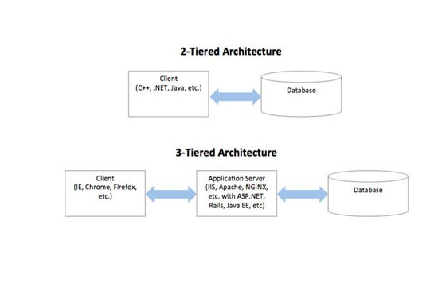

Slide 18
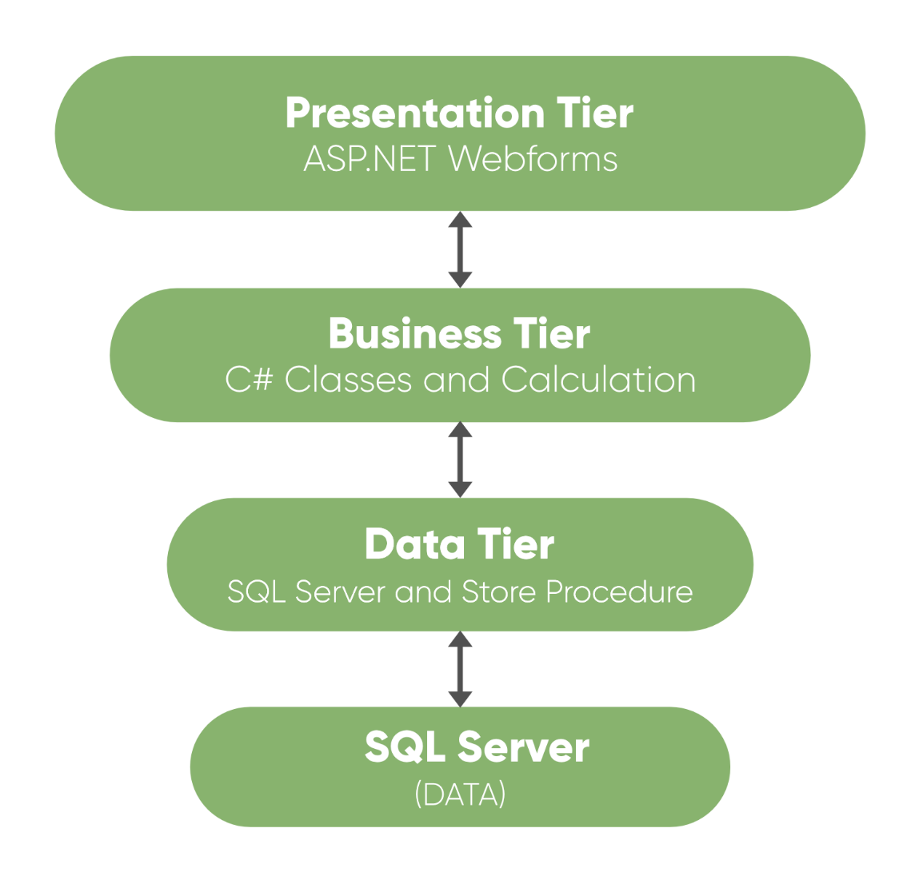
Presentation Layer
This is the top layer of architecture. The topmost level of application is the user interface.
It is related to the user interface that is what the user sees.
The main function of this layer is to translate tasks and results in something which the user can understand.
It contains pages like web forms, windows form where data is presented to the user and use to take input from the user.
The presentation layer is the most important layer because it is the one that the user sees and good UI attracts the user and this layer should be designed properly.

Slide 19
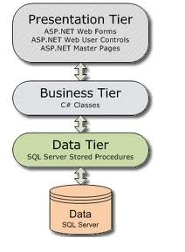
2. Business Layer
This is the middle layer of architecture. This layer involves C# classes and logical calculations and operations are performed under this layer.
It processes the command, makes logical decisions and perform calculations.
It also acts as a middleware between two surrounded layers that is presentation and data layer.
It processes data between these two layers. This layer implements business logic and calculations.
This layer also validates the input conditions before calling a method from the data layer.
This ensures the data input is correct before proceeding, and can often ensure that the outputs are correct as well. This validation of input is called business rules.

Slide 20
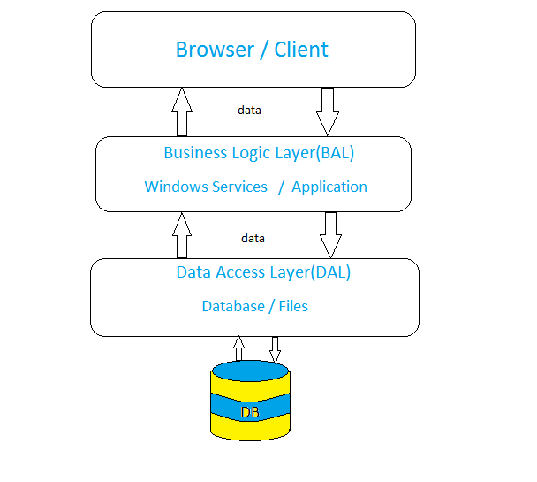
3. Data Layer
This layer is used to connect the business layer to the database or data source.
It contains methods which are used to perform operations on database like insert, delete, update, etc.
This layer contains stored procedures which are used to query database.
Hence this layer establishes a connection with the database and performs functions on the database.

Slide 21
Advantages:
Updation to new graphical environments is easier and faster.
Easy to maintain large and complex projects.
It provides logical separation between presentation layer, business layer and data layer.
By introducing application layer between data and presentation layer, it provides more security to database layer hence data will be more secure.
You can hide unnecessary methods from the business layer in the presentation layer.
Data provider queries can be easily updated and OOP’s concept can be easily applied on project.
Disadvantages:
It is more complex than simple client-server architecture.
It is difficult to build and time consuming.
User should have good knowledge of object-oriented concepts.

Slide 22
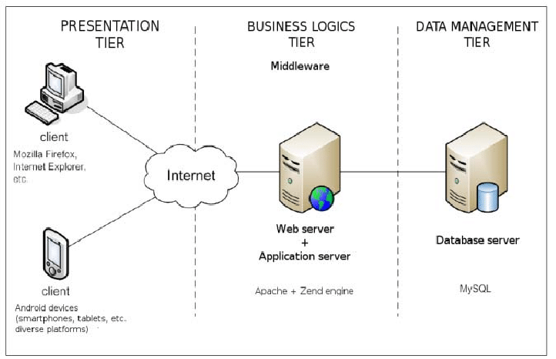

Slide 23
C# ADO.NET Connection String
Connection String is a normal String representation which contains Database connection information to establish the connection between Database and the Application.
The Connection String includes parameters such as the name of the driver, Server name and Database name , as well as security information such as user name and password.
Microsoft SQL Server Connection String
connetionString="Data Source=ServerName; Initial Catalog=Databasename;
User ID=UserName; Password=Password"
OLEDB Data Provider Connection String
connetionString="Provider=Microsoft.Jet.OLEDB.4.0;
Data Source=yourdatabasename.mdb;"
ODBC Connection String
connetionString="Driver={Microsoft Access Driver (*.mdb)};
DBQ=yourdatabasename.mdb;"

Slide 24
Reference Url
https://www.connectionstrings.com

