Slide 1
C# Programming
Starting Date : 01-09-2020
Krishna P.

Slide 2
Visual Studio Release History
Product name | Release date | Version number | Latest Update Date | Supported .NET Framework (no add-on) | Supported .NET Core (no add-on)
Visual Studio 2019 | 2019-04-02 | 16.0 | 2020-07-14 | 3.5 - 4.8 | 2.1, 2.2, 3.0, 3.1
Visual Studio 2017 | 2017-03-07 | 15.0 | 2020-07-14 | 3.5 - 4.7.2 | 1.0-1.1, 2.0, 2.1
Visual Studio 2015 | 2015-07-20 | 14.0 | 2016-06-27 | 2.0 - 4.6.1 | 1.0
Visual Studio 2013 | 2013-10-17 | 12.0 | 2015-07-20 | 2.0 - 4.5.1 | N/A
Visual Studio 2012 | 2012-09-12 | 11.0 | 2015-08-24 | 2.0 - 4.5 | N/A
Visual Studio 2010 | 2010-04-12 | 10.0 | 2011-03-10 | 2.0 - 4.0 | N/A
Visual Studio 2008 | 2007-11-19 | 9.0 | 2008-08-11 | 2.0, 3.0, 3.5 | N/A
Visual Studio 2005 | 2005-11-07 | 8.0 | 2006-12-15 | 2.0 | N/A
Visual Studio .NET 2003 | 2003-04-24 | 7.1 | 2006-08-15 | 1.1 | N/A
Visual Studio .NET (2002) | 2002-02-13 | 7.0 | 2005-03-08 | 1.0 | N/A
Visual Studio 6.0 | 1998-09-02 | 6.0 | 2004-03-29 | N/A | N/A
Visual Studio 97 | 1997-03-19 | 5.0 | 1997-12-04 | N/A | N/A

Slide 3
Introduction
Microsoft Visual Studio is an integrated development environment (IDE) from Microsoft.
It is used to develop computer programs, as well as
Console Application
Websites,
Web apps,
Web services
Mobile apps.
Visual Studio supports 36 different programming languages and allows the code editor and debugger to support (to varying degrees) nearly any programming language, provided a language-specific service exists. Built-in languages include
C++, Visual Basic .NET, C#, F#, JavaScript, Type Script, XML, XSLT, HTML, and CSS. Support for other languages such as Python,Ruby, Node.js.
Note: Community edition is "Free, fully-featured IDE for students, open-source and individual developers

Slide 4
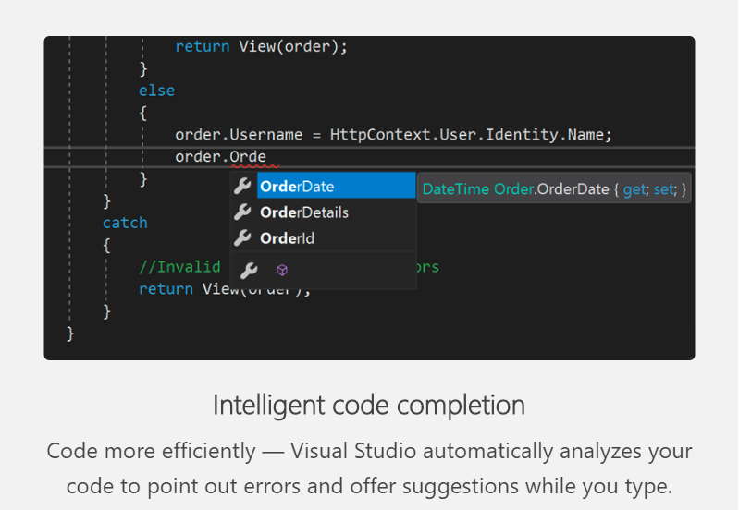
.NET high level features

Slide 5
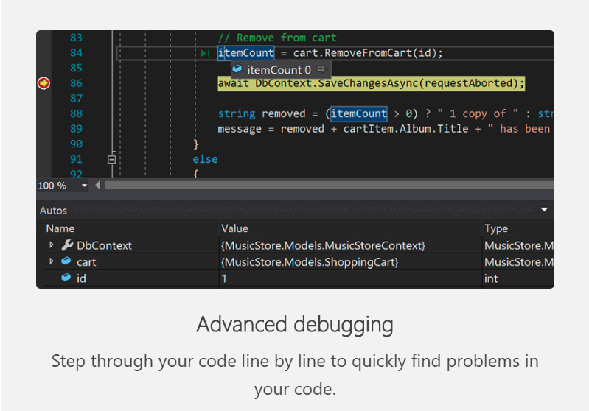

Slide 6
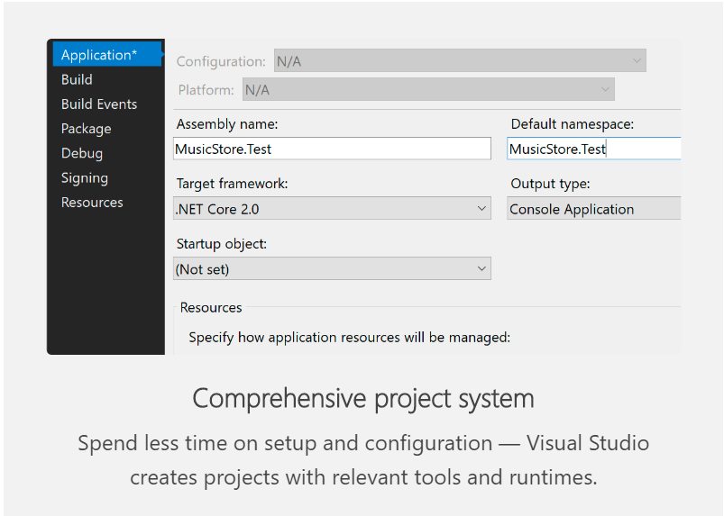

Slide 7
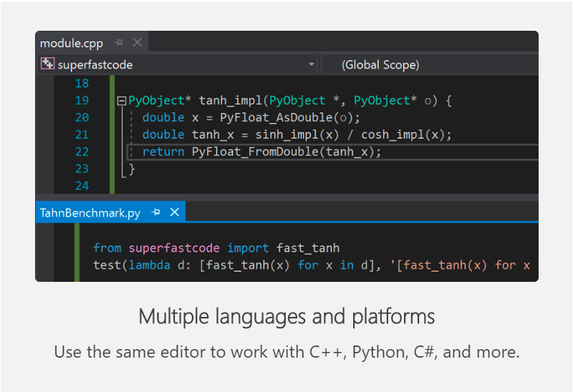

Slide 8
C# Language
C# syntax is highly expressive, yet it is also simple and easy to learn. The curly brace syntax of C# will be instantly recognizable to anyone familiar with C, C++, or Java.
Developers who know any of these languages are typically able to begin to work productively in C# within a short time. C# syntax simplifies many of the complexities of C++ and provides powerful features such as null able types, enumerations, delegates, lambda expressions, and direct memory access.
C# supports generic methods and types, which provide increased type safety and performance, and iterators, which enable implementers of collection classes to define custom iteration behaviors that are simple to use by client code. Language-Integrated Query (LINQ) expressions make the strongly typed query a first-class language construct.
As an object-oriented language, C# supports the concepts of encapsulation, inheritance, and polymorphism. All variables and methods, including the Main method, the application's entry point, are encapsulated within class definitions.

Slide 9
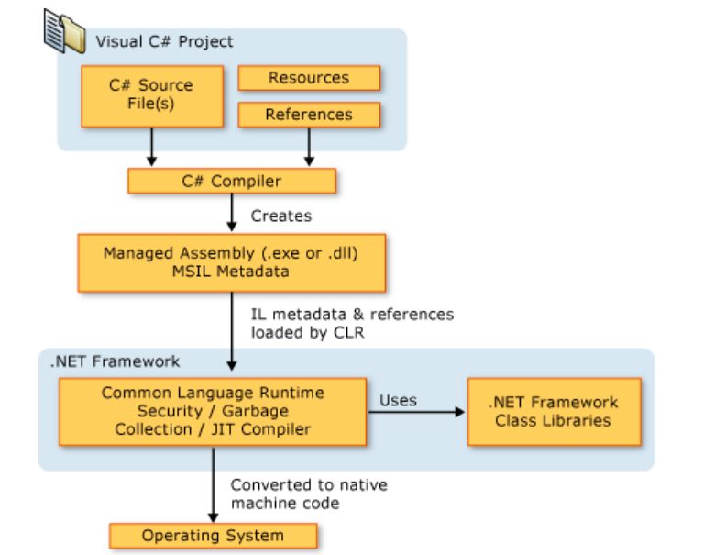
.NET Framework Platform Architecture

Slide 10
C#.NET Syntax
<data-type> <variable_list>;
C# is case sensitive.
All statements and expression must end with a semicolon (;).
The program execution starts at the Main method.
Unlike Java, program file name could be different from the class name.
string stringVar = "Hello World!!";
int intVar = 100;
float floatVar = 10.2f;
char charVar = 'A';
bool boolVar = true;
Variable : A name given to storage location
Constant : An immutable value

Slide 11
Type | Description | Range | Suffix
byte | 8-bit unsigned integer | 0 to 255
sbyte | 8-bit signed integer | -128 to 127
short | 16-bit signed integer | -32,768 to 32,767
ushort | 16-bit unsigned integer | 0 to 65,535
int | 32-bit signed integer | -2,147,483,648 to 2,147,483,647
uint | 32-bit unsigned integer | 0 to 4,294,967,295 | u
long | 64-bit signed integer | -9,223,372,036,854,775,808 to 9,223,372,036,854,775,807 | l
ulong | 64-bit unsigned integer | 0 to 18,446,744,073,709,551,615 | ul
float | 32-bit Single-precision floating point type | -3.402823e38 to 3.402823e38 | f
double | 64-bit double-precision floating point type | -1.79769313486232e308 to 1.79769313486232e308 | d
decimal | 128-bit decimal type for financial and monetary calculations | (+ or -)1.0 x 10e-28 to 7.9 x 10e28 | m
char | 16-bit single Unicode character | Any valid character, e.g. a,*, \x0058 (hex), or\u0058 (Unicode)
bool | 8-bit logical true/false value | True or False
object | Base type of all other types.
string | A sequence of Unicode characters
DateTime | Represents date and time | 0:00:00am 1/1/01 to 11:59:59pm 12/31/9999

Slide 12
A C# program consists of the following parts −
Namespace declaration
A class
Class methods
Class attributes
A Main method
Statements and Expressions
Comments
Sample Program:
using System;
namespace SampleApplication {
class TestClass {
static void Main(string[] args) {
/* my first program in C# */
Console.WriteLine("Hi everyone, Good morning");
Console.ReadKey();
}
}
}
Naming Conventions:
Camel case : firstName
For local variable-> int number;
Pascal Case : FirstName
For constants -> const double PiValue=3.14;

Slide 13
Let us look at the various parts of the given program −
The first line of the program using System; - the using keyword is used to include the System namespace in the program. A program generally has multiple using statements.
The next line has the namespace declaration. A namespace is a collection of classes. The SampleProgram namespace contains the class TestClass.
The next line has a class declaration, the class TestClass contains the data and method definitions that your program uses. Classes generally contain multiple methods. Methods define the behavior of the class. However, the TestClass class has only one method Main.
The next line defines the Main method, which is the entry point for all C# programs. The Main method states what the class does when executed.
The next line /*...*/ is ignored by the compiler and it is put to add comments in the program.
The Main method specifies its behavior with the statement Console.WriteLine("Hi Everyone, Good morning");
WriteLine is a method of the Console class defined in the System namespace. This statement causes the message "Hello, World!" to be displayed on the screen.
The last line Console.ReadKey(); is for the VS.NET Users. This makes the program wait for a key press and it prevents the screen from running and closing quickly when the program is launched from Visual Studio .NET.

Slide 14
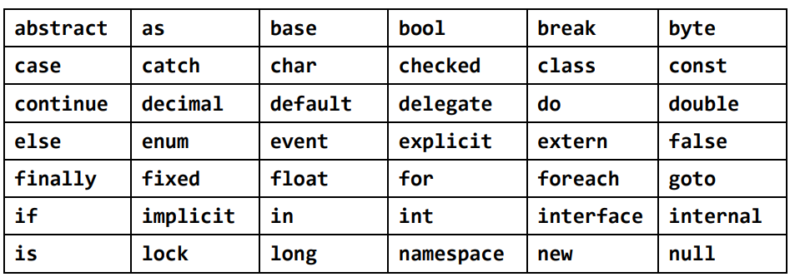
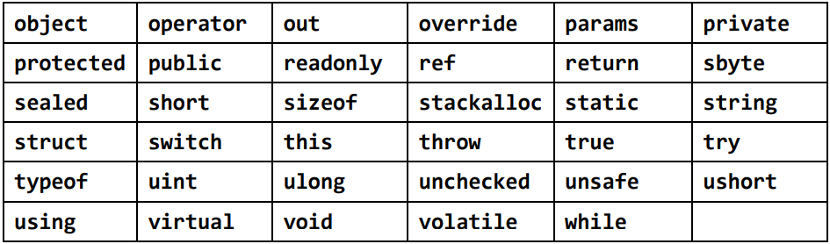
Keywords

Slide 15
Implicitly Typed Local Variables – var
Implicitly typed variables are those variables which are declared without specifying the .NET type explicitly.
In implicitly typed variable, the type of the variable identify automatically at compile time by the compiler from the value used to initialize the variable.
The implicitly typed variable concept is introduced in C# 3.0.
The implicitly typed variable is not designed to replace the normal variable declaration, it is designed to handle some special-case situation like LINQ(Language-Integrated Query).
Note: It is not allowed to use var as a parameter value or return type in the method or defining it at class level etc. because the scope of the implicitly typed variable is local.

Slide 16
Important Points:
Implicitly typed variables are generally declared using var keyword as shown below:
var num = 10;
In implicitly typed variables, you are not allowed to declare multiple var in a single statement
var ivalue = 20, a = 30; // invalid
In C#, one cannot declare implicitly typed variable without any initialization like:
var ivalue; // invalid
It is not allowed to use a null value in implicitly typed variable like:
var value = null; // invalid
The initializer cannot contain any object or collection, it may contain a new expression that includes an object or collection initializer like:
// Not allowed
var data = { 23, 24, 10};
// Allowed
var data = new int [] {23, 34, 455, 65};
It is not allowed to initialize implicitly typed variable with different types more than one type like:
It will give error because the type of the value is different
one is of string type and another one is of int type
var value = "sd" ;
value = new int[]{1, 2, };

Slide 17
Arithmetic Operators
Following table shows all the arithmetic operators supported by C#.
Operator | Description | Example
+ | Adds two operands | A + B = 30
- | Subtracts second operand from the first | A - B = -10
* | Multiplies both operands | A * B = 200
/ | Divides numerator by de-numerator | B / A = 2
% | Modulus Operator and remainder of after an integer division | B % A = 0
++ | Increment operator increases integer value by one | A++ = 11
-- | Decrement operator decreases integer value by one | A-- = 9

Slide 18
Relational Operators
Following table shows all the relational operators supported by C#.
Operator | Description | Example
== | Checks if the values of two operands are equal or not, if yes then condition becomes true. | (A == B)
!= | Checks if the values of two operands are equal or not, if values are not equal then condition becomes true. | (A != B)
> | Checks if the value of left operand is greater than the value of right operand, if yes then condition becomes true. | (A > B)
< | Checks if the value of left operand is less than the value of right operand, if yes then condition becomes true. | (A < B)
>= | Checks if the value of left operand is greater than or equal to the value of right operand, if yes then condition becomes true. | (A >= B)
<= | Checks if the value of left operand is less than or equal to the value of right operand, if yes then condition becomes true. | (A <= B)

Slide 19
Logical Operators
Following table shows all the logical operators supported by C#.
Operator | Description | Example
&& | Called Logical AND operator. If both the operands are non zero then condition becomes true. | (A && B)
|| | Called Logical OR Operator. If any of the two operands is non zero then condition becomes true. | (A || B)
! | Called Logical NOT Operator. Use to reverses the logical state of its operand. If a condition is true then Logical NOT operator will make false. | !(A && B)

Slide 20
Assignment Operators
There are following assignment operators supported by C#
Operator | Description | Example
= | Simple assignment operator, Assigns values from right side operands to left side operand | C = A + B assigns value of A + B into C
+= | Add AND assignment operator, It adds right operand to the left operand and assign the result to left operand | C += A is equivalent to C = C + A
-= | Subtract AND assignment operator, It subtracts right operand from the left operand and assign the result to left operand | C -= A is equivalent to C = C - A
*= | Multiply AND assignment operator, It multiplies right operand with the left operand and assign the result to left operand | C *= A is equivalent to C = C * A
/= | Divide AND assignment operator, It divides left operand with the right operand and assign the result to left operand | C /= A is equivalent to C = C / A
%= | Modulus AND assignment operator, It takes modulus using two operands and assign the result to left operand | C %= A is equivalent to C = C % A
<<= | Left shift AND assignment operator | C <<= 2 is same as C = C << 2
>>= | Right shift AND assignment operator | C >>= 2 is same as C = C >> 2
&= | Bitwise AND assignment operator | C &= 2 is same as C = C & 2
^= | bitwise exclusive OR and assignment operator | C ^= 2 is same as C = C ^ 2
|= | bitwise inclusive OR and assignment operator | C |= 2 is same as C = C | 2

Slide 21
Miscellaneous Operators
There are few other important operators including sizeof, typeof and ? : supported by C#
Operator | Description | Example
sizeof() | Returns the size of a data type. | sizeof(int), returns 4.
typeof() | Returns the type of a class. | typeof(StreamReader);
& | Returns the address of an variable. | &a; returns actual address of the variable.
* | Pointer to a variable. | *a; creates pointer named 'a' to a variable.
? : | Conditional Expression | If Condition is true ? Then value X : Otherwise value Y
is | Determines whether an object is of a certain type. | If( Ford is Car) // checks if Ford is an object of the Car class.
as | Cast without raising an exception if the cast fails. | Object obj = new StringReader("Hello"); StringReader r = obj as StringReader;

Slide 22
Methods
A method is a group of statements that together perform a task. Every C# program has at least one class with a method named Main.
Defining Methods in C#
When you define a method, you basically declare the elements of its structure. The syntax for defining a method in C#
<Access Specifier> <Return Type> <Method Name>(Parameter List)
{
Method Body
}
Access Specifier − This determines the visibility of a variable or a method from another class.
Return type − A method may return a value. The return type is the data type of the value the method returns. If the method is not returning any values, then the return type is void.
Method name − Method name is a unique identifier and it is case sensitive. It cannot be same as any other identifier declared in the class.
Parameter list − Enclosed between parentheses, the parameters are used to pass and receive data from a method. The parameter list refers to the type, order, and number of the parameters of a method. Parameters are optional; that is, a method may contain no parameters.
Method body − This contains the set of instructions needed to complete the required activity.

Slide 23
Calling Methods in C#
You can call a method using the name of the method
<Method Name>(Parameter List)
using System;
namespace CalculatorApplication {
public int FindMax(int num1, int num2) {
/* local variable declaration */
int result;
if (num1 > num2)
result = num1;
else
result = num2;
return result;
}
}//class end
}//namespace end
class NumberManipulator {
static void Main(string[] args) {
/* local variable definition */
int a = 100;
int b = 200;
int ret;
NumberManipulator n = new NumberManipulator();
//calling the FindMax method
ret = n.FindMax(a, b);
Console.WriteLine("Max value is : {0}", ret );
Console.ReadLine();
}

Slide 24
Recursive Method Call
A method can call itself. This is known as recursion
Passing Parameters to a Method
When method with parameters is called, you need to pass the parameters to the method
Sr.No. | Mechanism & Description
1 | Value parameters This method copies the actual value of an argument into the formal parameter of the function. In this case, changes made to the parameter inside the function have no effect on the argument.
2 | Reference parameters This method copies the reference to the memory location of an argument into the formal parameter. This means that changes made to the parameter affect the argument.
3 | Output parameters This method helps in returning more than one value.

Slide 25
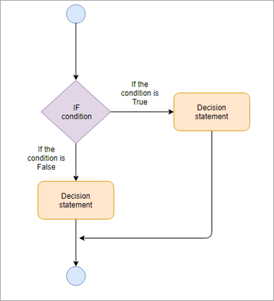
Conditional Statements
C# conditional statements are used when we want to execute a certain action depending upon an available condition.
Decision-making statements require a few conditions that can be evaluated by the program and set of statements that can be executed if the condition evaluates as true or another statement that can be executed when the condition values as false.

Slide 26
(if) ? then : else
Conditional Statements
If Statements
C# supports the usual logical conditions from mathematics:
Less than: a < b
Less than or equal to: a <= b
Greater than: a > b
Greater than or equal to: a >= b
Equal to a == b
Not Equal to: a != b
You can use these conditions to perform different actions for different decisions.
Use if to specify a block of code to be executed, if a specified condition is true
Use else to specify a block of code to be executed, if the same condition is false
Use else if to specify a new condition to test, if the first condition is false
Syntax
If(condition)
{
// block of code to be execute if the condition is true
}
Else
{
// block of code to be execute if the condition is true
}
Note: we can echieve if else by single line statement (Condition) ? then : else

Slide 27
Conditional Statements
Switch Statement
Use the switch statement to select one of many code blocks to be executed.
Syntax :
switch(expression)
{
case x:
// code block
break;
case y:
// code block
break;
default:
// code block
break;
}
The switch expression is evaluated once
The value of the expression is compared with the values of each case
If there is a match, the associated block of code is executed
The break will helps to exit the block
The default block will execute when no condition is satisfied.

Slide 28
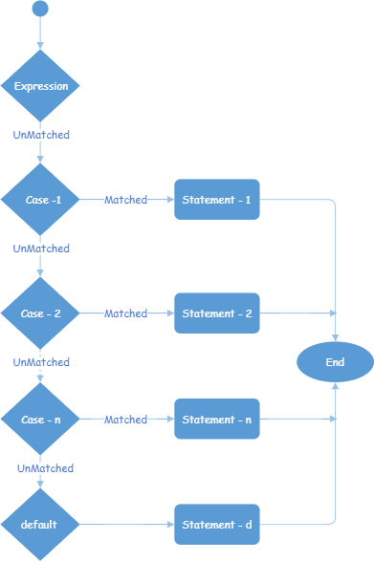
using System;
namespace Tutlane
{
class Program
{
static void Main(string[] args)
{
int x = 20;
switch (x)
{
case 10:
Console.WriteLine("x value is 10");
break;
case 15:
Console.WriteLine("x value is 15");
break;
default:
Console.WriteLine("Not Known");
break;
}
Console.WriteLine("Press Enter Key to Exit..");
Console.ReadLine();
}
}
}

Slide 29
While /Do While Loop
The while loop loops through a block of code as long as a specified condition is True
Syntax:
while (condition)
{
// code block to be executed
}
int i = 0;
while (i < 50)
{
Console.WriteLine(i);
i++;
}
This loop will execute the code block once, before checking if the condition is true, then it will repeat the loop as long as the condition is true.
int i = 0;
do
{
Console.WriteLine(i);
i++;
}
while (i < 50);
Syntax:
do
{
// code block to be executed
}
while (condition);

Slide 30
For Loop
When you know exactly how many times you want to loop through a block of code, use the for loop instead of a while loop
Syntax:
for (statement 1; statement 2; statement 3)
{
// code block to be executed
}
Statement 1 is executed (one time) before the execution of the code block.
Statement 2 defines the condition for executing the code block.
Statement 3 is executed (every time) after the code block has been executed.
for (int i = 0; i < 50; i++)
{
Console.WriteLine(i);
}

Slide 31
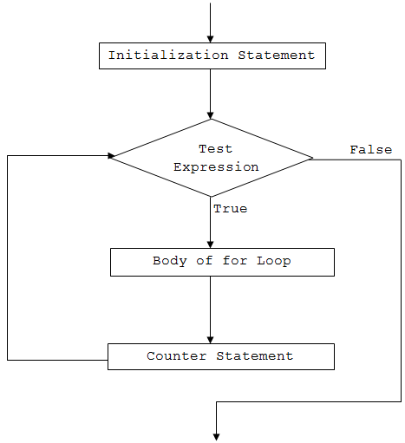
using System;
namespace Loop
{
class ForLoop
{
public static void Main(string[] args)
{
for (int i=1; i<=50; i++)
{
Console.WriteLine("C# For Loop: Iteration {0}", i);
}
}
}
}.

Slide 32
foreach Loop
The foreach loop in C# executes a block of code on each element in an array or a collection of items.
The foreach loop is useful for traversing each items in an array or a collection of items and displayed one by one
Syntax:
foreach (<datatype> variable in collection variable)
{
// code block to be executed
}

Slide 33
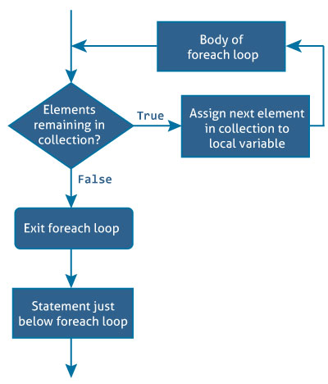
using System;
using System.Collections.Generic;
namespace Loop
{
class ForEachLoop
{
public static void Main(string[] args)
{
var numbers = new List() {5,-8,3,14,9,17,0,4};
int sum = 0;
foreach(int number in numbers)
{
sum += number;
}
Console.WriteLine("Sum = {0}", sum);
}
}
}

Slide 34
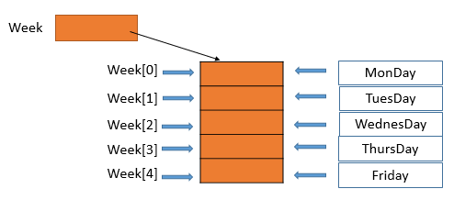
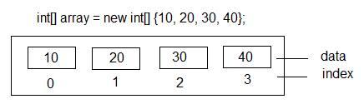
C# Collections
string[] week = new string[7];
week[0] = "Sunday";
week[1] = "Monday";
week[2] = "Tuesday";
week[3] = "Wednesday";
week[4] = "Thursday";
week[5] = "Friday";
week[6] = "Saturday";
for (int i = 0; i < = week.Length-1; i++)
{
MessageBox.Show(week[i]);
}
Arrays
Arrays are using for store similar data types grouping as a single unit.
We can access Array elements by its numeric index.
The array indexes start at zero. The default value of numeric array elements are set to zero, and reference elements are set to null
datatype arrayname= new datatype[numofelement];
Integer Array
String Array

Slide 35
Methods | Description | Example
Clear(Array, Int32, Int32) | Sets a range of elements in the Array to zero to max index. | string[] coursesArray = { “C", “C#", “CPP", "J#" }; Array.Clear(coursesArray,1,2)
Clone() | Creates a shallow copy of the Array. | string[] languages=coursesArray.Clone()
Copy(Array, Array, Int32) | Copies elements from one array to another. The length is specified as a 32-bit integer. | String[] languages=new string[4]; Array.copy(coursesArray,languages,3)
IndexOf(Array, Object) | Searches for the specified object and returns the index of its first occurrence in a one-dimensional array. | Int a=Array.IndexOf(coursesArray,”C#”)
Reverse(Array) | Reverses the sequence of the elements in the entire one-dimensional Array. | Array.Reverse(courseArray)
SetValue(Object, Int32) | Sets a value to the element at the specified position in the one-dimensional Array. The index is specified as a 32-bit integer. | courseArray.SetValue(“Java”,3)
Sort(Array) | Sorts the elements in an entire one-dimensional Array using the IComparable implementation of each element of the Array. | Array.Sort(coursesArray)

Slide 36
Difference between System.Array.CopyTo and System.Array.Clone()
The System.Array.CopyTo method copies the elements into another pre-existing array starting from a given index.
In this case the destination array need to already exist. More over, the target Object needs to be sufficient to hold all the elements in the source array from the index you specify as the destination. When perform CopyTo() method both arrays must be single dimensional.
The System.Array.Clone() method returns a new array object, which means that the destination array need not exist yet since a new one is created from scratch with containing all the elements in the original array. The Clone() method works on both single and multi-dimensional arrays.
Performance wise System.Array.CopyTo is faster than Clone when copying to array of same type.
Using Clone Methods
var source = new[] { "c language", "Cpp", "Java" };
var target = (string[])source.Clone();
Using Copyto method
var target = new string[4];
source.CopyTo(target, 1);
foreach (var item in target)
{
Console.WriteLine(item);
}
()

Slide 37
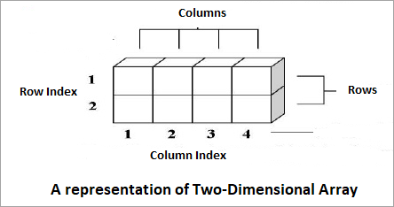
2-Dimensional Arrays
The simplest form of multidimensional array is a two-dimensional array. A two-dimensional array can be formed by stacking several one-dimensional arrays together. The following figure will help in understanding the concept better

Slide 38
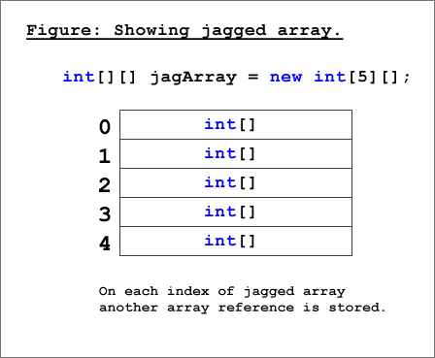
Jagged Array
A jagged array in C# is an array whose elements are arrays. The elements of a jagged array can be of different dimensions and sizes. A jagged array is sometimes called an "array of arrays." A special type of array is introduced in C#. A Jagged Array is an array of an array in which the length of each array index can differ.
// Declare the array of four elements:
int[][] jaggedArray = new int[4][];
// Initialize the elements:
jaggedArray[0] = new int[2] { 7, 9 };
jaggedArray[1] = new int[4] { 12, 42, 26, 38 };
jaggedArray[2] = new int[6] { 3, 5, 7, 9, 11, 13 };
jaggedArray[3] = new int[3] { 4, 6, 8 };

Slide 39
ArrayList
ArrayList is one of the most flexible data structure from CSharp Collections. ArrayList contains a simple list of values. ArrayList implements the IList interface using an array and very easily we can add , insert , delete , view etc. It is very flexible because we can add without any size information , that is it will grow dynamically and also shrink.
Add an Item in an ArrayList
Insert an Item in a specified position in an ArrayList
Remove an Item from ArrayList
Remove an item from a specified position
Remove a range of elements from the ArrayList

Slide 40
C# List
Following examples show how to create and manipulate with .NET strongly typed list List<T>.
List is a generic type, so you can create list of any type (it can be reference type such as Customer or value type such as int)
var list1 = new List<object>();
var list2 = new List<Customer>();
var list3 = new List<int>();
All the following examples use list of integer values List<int>.
Creates an empty list (of integer values).
var list = new List<int>(); list: (empty)
Creates a list and initializes it with some items (integer values).
var list = new List<int>() { 8, 3, 2 }; list: 8 3 2
Creates a list and initializes it with items of another list (or array or anything which implements IEnumerable interface).
var listA = new List<int>() { 8, 3, 2 };
var listB = new List<int>(listA); listB: 8 3 2
Creates a list with specified capacity.
var list = new List<int>(16); list.Count:0 list.Capacity:16

Slide 41
List[index]
Gets an item at the specified zero-based index.
list: 8 3 2
int item = list[1]; item: 3
Sets the item at the specified zero-based index.
list[1] = 4;
list: 8 4 2
List.Add
Adds an item to the end of the list.
list.Add(5);
list: 8 4 2 5
List.AddRange
Adds items of another list (or an IEnumerable collection) to the end of the list.
listA: 8 3 2
listB: 5 7
listA.AddRange(listB);
listA: 8 3 2 5 7

Slide 42
Sr.No. | Class & Description and Useage
1 | ArrayList It represents ordered collection of an object that can be indexed individually. It is basically an alternative to an array. However, unlike array you can add and remove items from a list at a specified position using an index and the array resizes itself automatically. It also allows dynamic memory allocation, adding, searching and sorting items in the list.
2 | Hashtable It uses a key to access the elements in the collection. A hash table is used when you need to access elements by using key, and you can identify a useful key value. Each item in the hash table has a key/value pair. The key is used to access the items in the collection.
3 | SortedList It uses a key as well as an index to access the items in a list. A sorted list is a combination of an array and a hash table. It contains a list of items that can be accessed using a key or an index. If you access items using an index, it is an ArrayList, and if you access items using a key , it is a Hashtable. The collection of items is always sorted by the key value.

Slide 43
Hashtable is a collection of the Key-Value pairs, which are organized on the hash code of their respective keys. When you add an element, it gets added to the hashtable and its corresponding hash code is generated automatically. Here, we are using the keys to access those hashcodes. Hashtable optimizes lookup with the help of the keys
Hashtable ht=new Hashtable();
ht.Add(“1”,”Value”);
Advantage of Hashtable Hashtable allows the execution time for the lookup, retrieves and sets the operation to remain nearly constant, even for the large sets.
In the large data sets, Hashtable is an ability to locate the item quickly.
No need to scan through the entire data sets to find the items.
The difference between them is that, in the SortedList, the key/value pairs are sorted by key and, since they have a definite order, you can access them by index as well as by key. In the HashTable, the key/value pairs are not sorted and you can only access them by key. This means that random insertions for the SortedList are relatively slow because it needs to be resorted after each insertion. On the other hand, in some applications it is useful to be able to iterate through the keys in sorted order.

Slide 44
Hashtable | Dictionary
Hashtable is included in the System.Collections namespace. | Dictionary is included in the System.Collections.Generic namespace.
Hashtable is a loosely typed (non-generic) collection, this means it stores key-value pairs of any data types. | Dictionary is a generic collection. So it can store key-value pairs of specific data types.
Hashtable is thread safe. | Only public static members are thread safe in Dictionary.
Hashtable returns null if we try to find a key which does not exist. | Dictionary throws an exception if we try to find a key which does not exist.
Data retrieval is slower than dictionary because of boxing-unboxing. | Data retrieval is faster than Hashtable.

Slide 45
SortedList is a collection of key/value pairs which are sorted according to keys. By default, this collection sort the key/value pairs in ascending order. It is of both generic and non-generic type of collection. The generic SortedList is defined in System.Collections.Generic namespace whereas non-generic SortedList is defined under System.Collections namespace, here we will discuss non-generic type SortedList.
Important Points:
The SortedList class implements the IEnumerable, ICollection, IDictionary and ICloneable interfaces.
In SortedList, an element can be accessed by its key or by its index.
A SortedList object internally maintains two arrays to store the elements of the list, i.e, one array for the keys and another array for the associated values.
Here, a key cannot be null, but a value can be.
The capacity of a SortedList object is the number of key/value pairs it can hold.
In SortedList, duplicate keys are not allowed.
In SortedList, you can store values of the same type and of the different types due to the non-generic collection. If you use a generic SortedList in your program, then it is necessary that the type of the values should be the same.
In SortedList you cannot store keys of different data types in the same SortedList because the compiler will throw an exception. So, always add the key in your SortedList of the same type.
You can also cast key/value pair of SortedList into DictionaryEntry.

Slide 46


