Slide 1

Remote CARI (rCARI) Validation Study
IRAQ (IRQ) Pilot Study
RAM-N – rCARI Team | JANUARY 2025

Slide 2

Background
Why The need for this study?
Notes:
rCARI is based on the following modules
Food consumption score
Consumption-based coping strategy (rCSI)
Livelihood coping strategy (usually a shorter version of the original)
Income sources
Changes in income

Slide 3
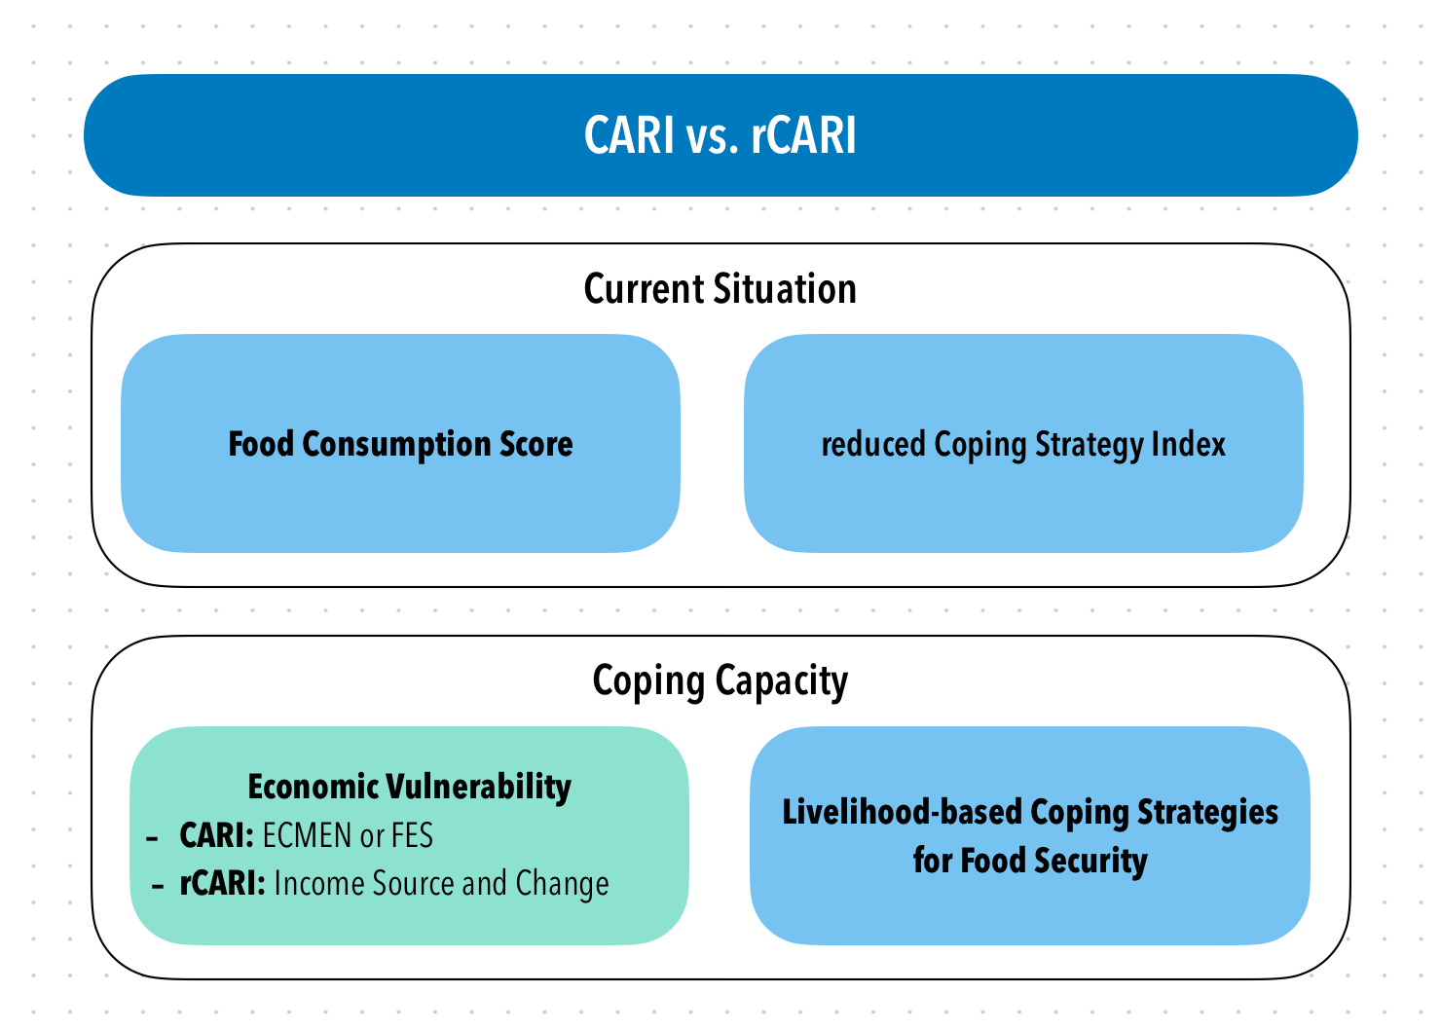
Background
CARI and rCARI (remote CARI) aggregate indicators in a similar way and the only difference is in the Economic Vulnerability
To date, rCARI is not validated
Notes:
Consolidate Approach for Reporting food Insecurity (CARI)
rCARI useful in emergencies where F2F survey is not feasible
rCARI though easily available, results are not globally accepted because methodology is not been empirically validated against other standard methods- CARI
rCARI is based on the following modules
Food consumption score
Consumption-based coping strategy (rCSI)
Livelihood coping strategy (usually a shorter version of the original)
Income sources & income changes

Slide 4
Objective
Validate the remote Consolidated Approach for Reporting Indicators of Food Insecurity (rCARI) – Using a survey experiment with stratified sample
Validate income choice and income change indicator
Test and validate different expenditure modules (shorter versions)
Notes:
rCARI useful in emergencies where F2F survey is not feasible
The Challenge with rCARI numbers & methodology is that not it is been validated against CARI or IPC
Though is easily available, results are not globally accepted
rCARI is based on the following modules
Food consumption score
Consumption-based coping strategy (rCSI)
Livelihood coping strategy (usually a shorter version of the original)
Income sources
Changes in income

Slide 5
Pilot countries
West Africa [RBD]
Burkina Faso
Central African Republic
Panama [RBP]
Ecuador
Guatemala
Middle East [RBC]
Iraq
Southeast Asia [RBB]
Myanmar
Notes:
rCARI useful in emergencies where F2F survey is not feasible
The Challenge with rCARI numbers & methodology is that not it is been validated against CARI or IPC
Though is easily available, results are not globally accepted
rCARI is based on the following modules
Food consumption score
Consumption-based coping strategy (rCSI)
Livelihood coping strategy (usually a shorter version of the original)
Income sources
Changes in income

Slide 6
Inclusion criteria [ADMIN level selection]
Mobile phone penetration
Mobile phone network
Accessibility
Heterogenous in terms AFI
Rural & urban
CARI groups of AFI
These factors informed the final ADMIN selection

Slide 7
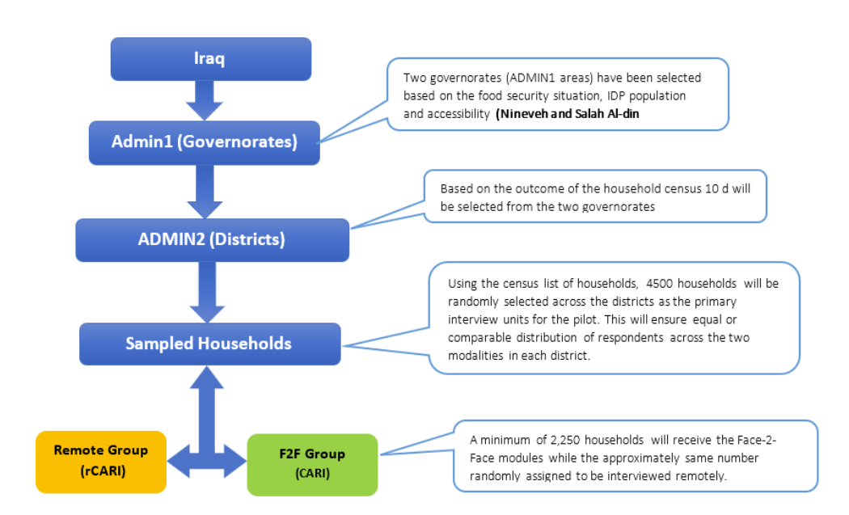
Implementation

Slide 8
Implementation
The study will be implemented in an experimental setup
Survey Experiment with Stratified Sample
Two statistically comparable samples
F2F
Remote
Simultaneous interviews

Slide 9
Selection of Households
Using a confidence level 95%
5% margin of error
Min. sample (2 sample mean test) = 2000hh (completed sample at least 1000 hh per modality)
Final sample size = 2000HH (1000 hh per modality)
$$Sample Size= \frac{{\left(Z−score\right)}^{2} ×StdDev ×\left(1−StdDev\right)}{{\left(confidence interval\right)}^{2}}$$

Slide 10
Selection of Respondents
Sampling frame = All RETURNEES in selected ADMIN1 areas
Conduct census of all RETURNEES
(Trained and conscientious enumerators)
Standardized listing instrument to be used
Collect basic demographic and other HH observable characteristics
Final sampling frame = HHs that have consented to participate during the listing

Slide 11
Randomization
Randomization of respondents will be done using observable HH characteristics such as:
Phone ownership
Gender of HH head
Livelihood source
Education

Slide 12
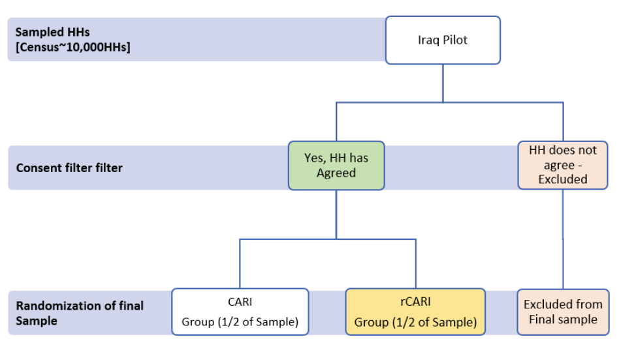
Randomization

Slide 13
Limitations & suggested mitigation strategies
Geographical variation in the distribution of respondents
Study areas will be purposively selected to cater to geographic variations
Enumerator effects (gender, training and motivation)
Consciously hire more females for the remote
At least two enumerators per village
Enumerator assignment will be random (F2F)
High attrition particularly in the remote cohort
Follow strict call protocol

Slide 14
Survey protocols to enhance response rate
Enhanced community engagement & collaboration through local authorities, stakeholders, and opinion leaders at ADMIN5 level
Build trust, support and cooperation
Sensitization during the census/listing phase
Choose their timing of convenience to be interviewed
A comprehensive training on the calling protocol for remote cohort
Introduction
Consent
Questioning techniques
Ethical considerations

Slide 15
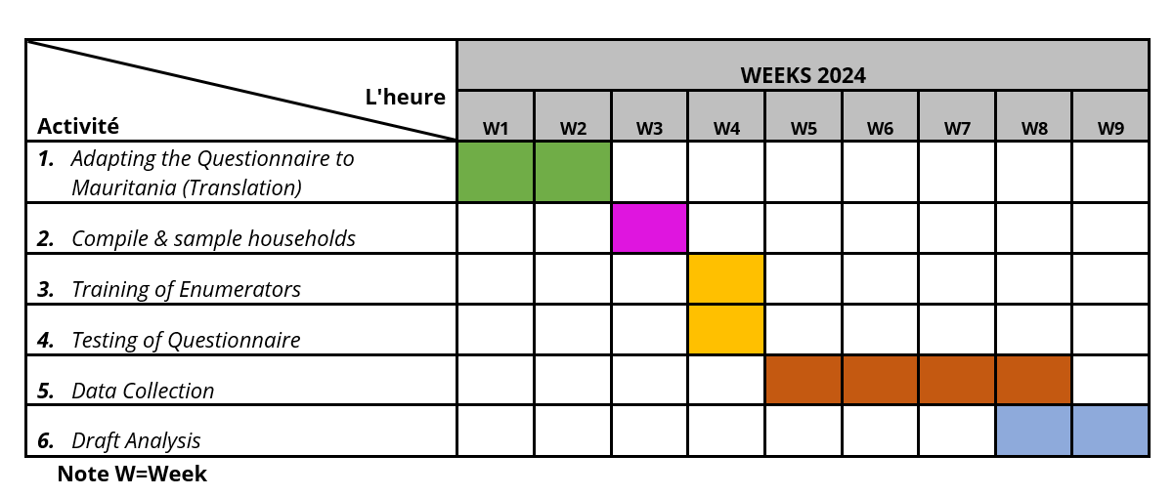
Tentative timelines…

Slide 16
Questions & Comments

Slide 17
Tentative timelines…

