Slide 1

Remote CARI (rCARI) Validation Study
Preliminary Results from CAR, Myanmar & Ecuador
RAM-N – rCARI Team | Oct 2023

Slide 2
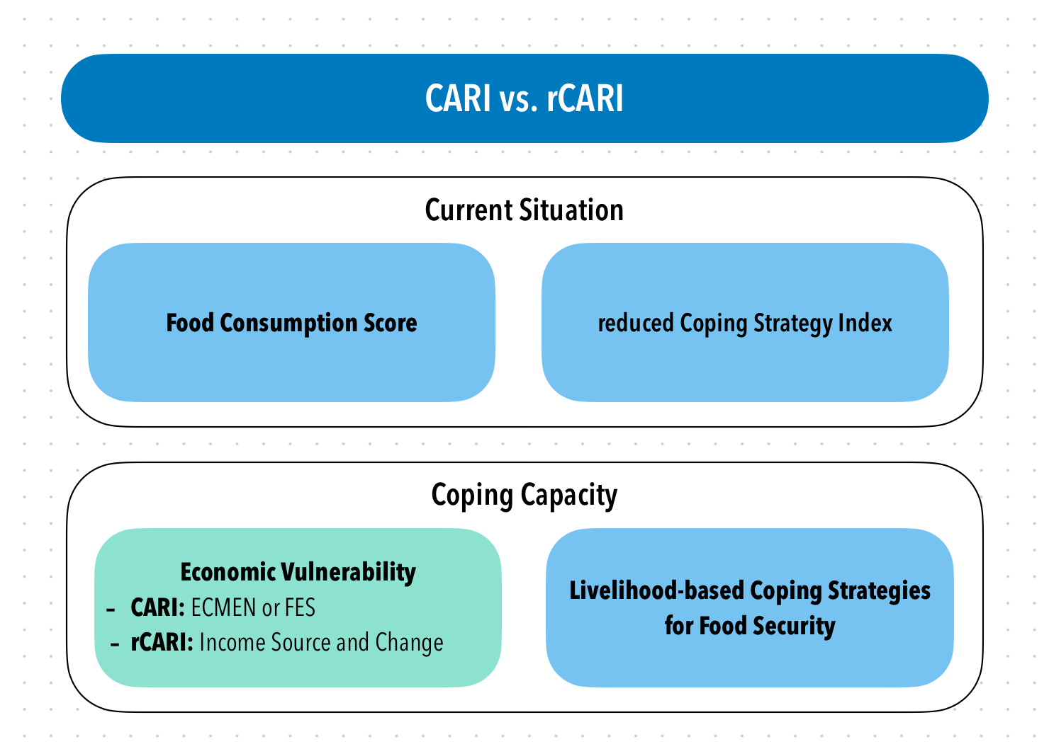
Background
CARI and rCARI aggregate indicators in a similar way and the only difference is in the Economic Vulnerability
To date, rCARI is not validated against the conventional CARI
Notes:
rCARI useful in emergencies where F2F survey is not feasible
The Challenge with rCARI numbers & methodology is that not it is been validated against CARI or IPC
Though is easily available, results are not globally accepted
rCARI is based on the following modules
Food consumption score
Consumption-based coping strategy (rCSI)
Livelihood coping strategy (usually a shorter version of the original)
Income sources
Changes in income

Slide 3
Main Research Objective
Validate and calibrate rCARI with the standard CARI methodology
Specific objectives:
Compare the results produced by rCARI and CARI
Compare food security indicators collected remotely (FCS, rCSI, LCS, FES, income sources and income change) against the F2F modality

Slide 4
Overall sampling framework
Study-Country
Simple random sampling to select at least 2 regions /livelihood zones based on the food security situation.
Livelihood Zones/Admin1 Area
Based on the number of regions selected, draw a list of districts from the selected regions and select minimum of 4 districts. Equally distributed in the Admin1
Admin2 Districts
In the same manner, list all the smallest administrative units within the Admin2 (e.g., villages) and randomly select 20 ADMIN3 Units as sampling clusters.
Admin3 Villages/Communities
From each PSU, 100 households will be randomly selected. Final sampled households (2000) will be randomized into two groups, i.e., Control Group and Treated Group (1000 households per group). The interviews will be conducted simultaneous to avoid significant changes that may affect the food security between the groups.
Sampled Households
Group Treated
(F2F)
Group Control
(Remote)
Control Group will receive the Face-2-Face modules while Treated Group will receive the Remote modules simultaneously.

Slide 5
Experimental Design
Listing of HHs
Contact details & baseline demographics collected
1200 Sampled Households
(+ ~20% for non-response)
1st Random Assignment
F2F
Remote
300 HH Long-modules
300 HH Long-modules
2nd Random Assignment
300 HH Short Modules
300 HH Short Modules

Slide 6
Aggregation methods to be tested
 | Aggregation Methodology
Indicator | CARI | rCARI (FES) | rCARI (Income) | rCARI (F2F)
FCS | Yes | Yes | Yes | Yes
FES | Yes | Yes | No | No
LCS | Yes | Yes | Yes | Yes
rCSI | Yes | Yes | Yes | Yes
Income source & income change | No | No | Yes | Yes

Slide 7
Study Design Caveats
Mobile phone penetration
Mobile phone network
Response rate of mobile surveys
Corrected statistically through weighting

Slide 8
Study Design Caveats
Current study insulated from these effects
Nationally representative sample
✓ Test remote collection of F2F indicators using same population

Slide 9
Tentative Workplan 2023
Time Countries | Jan - Apr | May | Jun | Jul | Aug | Sep | Status
Overall Design & Planning | ✓
Myanmar |  | Planning | Data Collection |  |  |  | Completed
Ecuador |  |  | Planning | Data Collection |  |  | Completed
CAR |  |  |  | Planning | Data Collection |  | Completed
Burkina Faso |  |  |  |  | Planning Ready | Listing Ready | On-hold
Lebanon |  |  |  |  |  |  | To Be Confirmed
Mauritania |  |  |  |  |  |  | To Be Confirmed
Guatemala |  |  |  |  |  |  | To Be Confirmed
Data Cleaning & Analysis |  | Pilot | Myanmar | Ecuador | CAR | Comparison | Ongoing
Report Writing |  |  |  |  |  |  | Ongoing
Notes:
Country selection based on 3-key indicators
Global representation
Relevance of rCARI
Mobile network penetration
We will give (dumb) phones with credit to identified HH who don't have phones (50%) for the remote surveys (CAR)

Slide 10
Sample Completion
 | Country
 | Myanmar | Ecuador | CAR | Total
N | 1,665 (27.2%) | 2,372 (38.8%) | 2,080 (34.0%) | 6,117 (100.0%)
Survey Progress
Not Completed | 572 (34.4%) | 956 (40.3%) | 835 (40.1%) | 2,363 (38.6%)
Completed | 1,093 (65.6%) | 1,416 (59.7%) | 1,245 (59.9%) | 3,754 (61.4%)
Survey Modality
Face-to-Face | 610 (55.8%) | 760 (53.7%) | 969 (77.8%) | 2,339 (62.3%)
Remote | 483 (44.2%) | 656 (46.3%) | 276 (22.2%) | 1,415 (37.7%)
Source: rCARI survey 2023

Slide 11
CAR Results

Slide 12
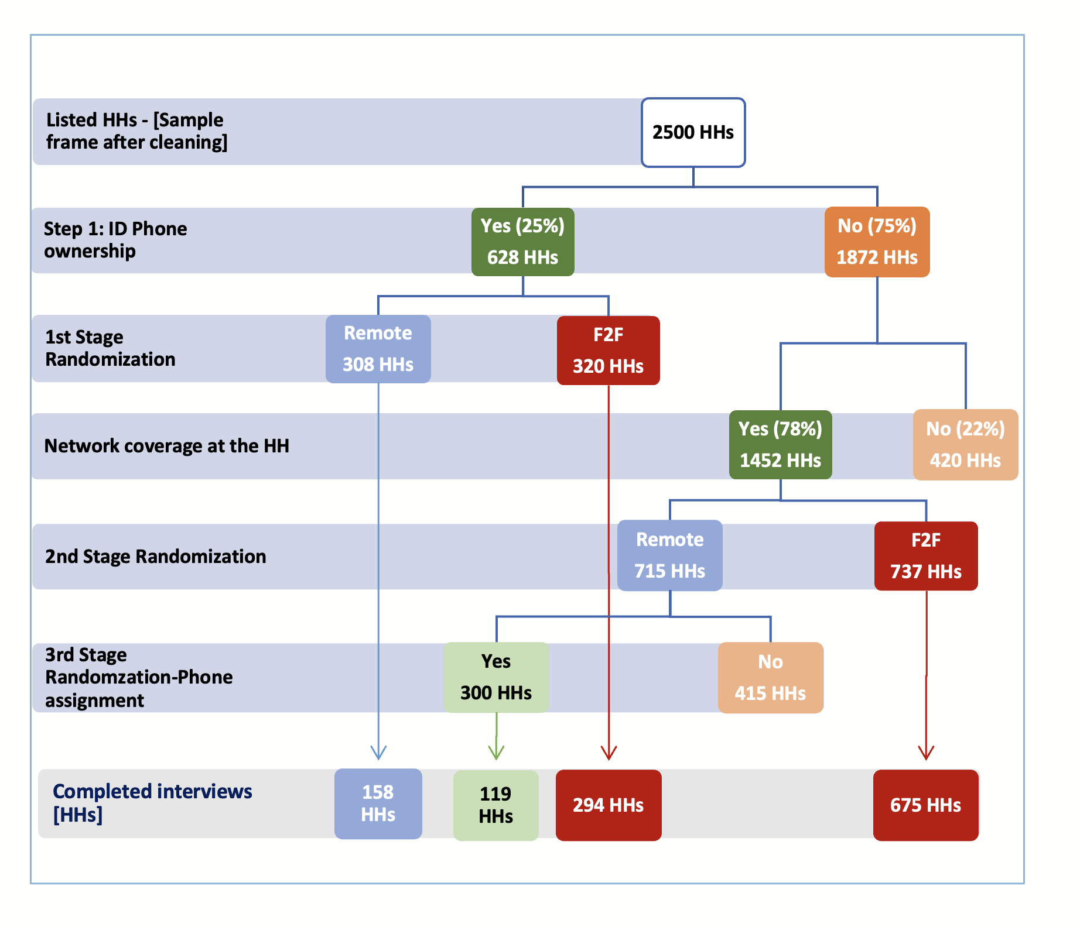
Sampling & completion
2500 HHs
Yes (25%)
628 HHs
Remote
308 HHs
F2F
320 HHs
No (75%)
1872 HHs
Yes (78%)
1452 HHs
Listed HHs - [Sample frame after cleaning]
Step 1: ID Phone ownership
1st Stage Randomization
Remote
715 HHs
No (22%)
420 HHs
F2F
737 HHs
Network coverage at the HH
2nd Stage Randomization
Yes
300 HHs
No
415 HHs
3rd Stage Randomzation-Phone assignment
Completed interviews [HHs]
158 HHs
119 HHs
294 HHs
675 HHs

Slide 13
Sample Completion
 | Not Completed Count | Percent | Completed Count | Percent | Total Count | Percent
Face2Face | 88 | 9.3 | 969 | 91.7 | 1057 | 100
Remote | 331 | 54.4 | 277 | 46.6 | 608 | 100
Total | 419 | 25.2 | 1246 | 74.8 | 1665 | 100
Source: rCARI survey 2023
Note: Significance * p<0.10, ** p<0.05, *** p<0.01

Slide 14
Balance tests for full sample
 | (1) | (2) | (1)-(2)
 | F2F | Remote | Pairwise t-test
Variable | Mean/(SE) | Mean/(SE) | Mean difference
List respondent age | 38.50 | 39.34 | -0.84
 | (0.43) | (0.79)
Household head is the respondent | 0.77 | 0.80 | -0.03
 | (0.01) | (0.02)
Female Household Head | 0.26 | 0.28 | -0.02
 | (0.01) | (0.03)
Married Household Head | 0.18 | 0.22 | -0.04
 | (0.01) | (0.02)
Household head years of education | 4.66 | 6.03 | -1.37***
 | (0.13) | (0.28)
Displaced household | 0.05 | 0.10 | -0.05***
 | (0.01) | (0.02)
Household size | 6.57 | 7.36 | -0.78***
 | (0.10) | (0.21)
Number of household member younger than 15 | 3.48 | 3.80 | -0.32**
 | (0.07) | (0.13)
Number of household member older than 60 | 0.19 | 0.18 | 0.01
 | (0.01) | (0.03)
Has household member with disability/chronic disease | 0.19 | 0.24 | -0.05
 | (0.01) | (0.03)
Number of rooms | 2.26 | 2.62 | -0.36***
 | (0.04) | (0.08)
Household Crowding Index | 3.60 | 3.30 | 0.30
 | (0.08) | (0.11)
Household has impoverished roof | 0.80 | 0.73 | 0.07**
 | (0.01) | (0.03)
Household has impoverished floor | 0.94 | 0.94 | 0.00
 | (0.01) | (0.01)
N | 969 | 276 | 1245

Slide 15
Balance tests for - Phone owner group
 | (1) | (2) | (1)-(2)
 | F2F | Remote | Pairwise t-test
Variable | Mean/(SE) | Mean/(SE) | Mean difference
List respondent age | 36.27 | 39.03 | -2.76**
 | (0.73) | (0.99)
Household head is the respondent | 0.72 | 0.78 | -0.05
 | (0.03) | (0.03)
Female Household Head | 0.19 | 0.25 | -0.06
 | (0.02) | (0.03)
Married Household Head | 0.27 | 0.27 | -0.01
 | (0.03) | (0.04)
Household head years of education | 7.55 | 7.92 | -0.38
 | (0.24) | (0.37)
Displaced household | 0.09 | 0.15 | -0.06
 | (0.02) | (0.03)
Household size | 7.72 | 8.39 | -0.67**
 | (0.20) | (0.27)
Number of household member younger than 15 | 4.04 | 4.31 | -0.27
 | (0.13) | (0.16)
Number of household member older than 60 | 0.21 | 0.21 | 0.00
 | (0.03) | (0.04)
Has household member with disability/chronic disease | 0.30 | 0.31 | -0.01
 | (0.03) | (0.04)
Number of rooms | 2.89 | 3.13 | -0.24**
 | (0.07) | (0.10)
Household Crowding Index | 3.01 | 2.97 | 0.04
 | (0.09) | (0.10)
Household has impoverished roof | 0.68 | 0.63 | 0.05
 | (0.03) | (0.04)
Household has impoverished floor | 0.90 | 0.92 | -0.02
 | (0.02) | (0.02)
Number of observations | 294 | 157 | 451

Slide 16
CARI vs. rCARI Disaggregation
Food security category | FES |  | Income | F2F | Pairwise t-test
 | (1) CARI Mean/(SE) | (2) rCARI Mean/(SE) | (3) rCARI Mean/(SE) | (4) rCARI Mean/(SE) | (5) (1) - (2) Mean diff. | (6) (1) - (3) Mean diff. | (7) (1) - (4) Mean diff.
Food Secure | 0.00 (0.00) | 0.01 (0.01) | 0.01 (0.01) | 0.01 (0.00) | -0.01 | -0.01** | -0.01*
Marginally Food Secure | 0.14 (0.01) | 0.23 (0.03) | 0.36 (0.03) | 0.32 (0.02) | -0.09*** | -0.22** | -0.18***
Moderately Food Insecure | 0.70 (0.01) | 0.57 (0.03) | 0.56 (0.03) | 0.64 (0.02) | 0.12*** | 0.14*** | 0.06**
Severely Food Insecure | 0.16 (0.01) | 0.18 (0.02) | 0.07 (0.02) | 0.03 (0.02) | -0.02 | 0.09*** | 0.13***
Vulnerable Households (M + S-FI) | 0.86 (0.01) | 0.76 (0.03) | 0.63 (0.03) | 0.67 (0.02) | 0.10*** | 0.23*** | 0.19***
N | 969 | 277 | 277 | 969 | 1246 | 1246 | 969
Source: rCARI survey 2023
Note: Significance * p<0.10, ** p<0.05, *** p<0.01

Slide 17
Other Food Security Outcome Indicators
Indicator | (1) F2F Mean/(SE) | (2) Remote Mean/(SE) | (1)-(2) Pairwise t-test Mean difference
Food Consumption Score-FCS | 29.19 (0.51) | 39.31 (1.09) | -10.12***
Reduced Coping Strategies Index-rCSI | 13.52 (0.34) | 17.04 (0.56) | -3.51***
Livelihood coping: None | 0.33 (0.02) | 0.12 (0.02) | 0.21***
Livelihood coping: Stress level | 0.48 (0.02) | 0.41 (0.03) | 0.07**
Livelihood coping: Crisis level | 0.13 (0.01) | 0.24 (0.03) | -0.11***
Livelihood coping: Emergency level | 0.05 (0.01) | 0.23 (0.03) | -0.17***
Food Expenditure Share: FES | 0.71 (0.01) | 0.67 (0.02) | 0.04***
N | 969 | 277 | 1246
Source: rCARI survey 2023
Note: Significance * p<0.10, ** p<0.05, *** p<0.01

Slide 18
 | Poor/Border line - FCG |  | Acceptable - FCG |  | Pairwise t-test Mean difference
 | (1) | (2) | (3) | (4) | (1)-(2) | (3)-(4)
Indicator | F2F Mean/(SE) | Remote Mean/(SE) | F2F Mean/(SE) | Remote Mean/(SE)
rCSI | 13.31 (0.39) | 16.66 (0.72) | 14.35 (0.65) | 17.68 (0.88) | -3.33** | -3.33***
Livelihood Coping: None | 0.36 (0.02) | 0.13 (0.03) | 0.21 (0.03) | 0.12 (0.03) | 0.24*** | 0.10**
Livelihood Coping: Stress level | 0.44 (0.02) | 0.40 (0.04) | 0.66 (0.03) | 0.43 (0.05) | 0.04 | 0.23***
Livelihood Coping: Crisis level | 0.14 (0.01) | 0.21 (0.03) | 0.10 (0.02) | 0.29 (0.04) | -0.07** | -0.19***
Livelihood Coping: Emergency level | 0.06 (0.01) | 0.26 (0.03) | 0.03 (0.01) | 0.17 (0.04) | -0.21*** | -0.14***
Food Expenditure Share: FES | 0.72 (0.01) | 0.69 (0.02) | 0.70 (0.01) | 0.65 (0.03) | 0.03* | 0.04
N | 781 | 174 | 188 | 103 | 955 | 291
Source: rCARI survey 2023
Note: Significance * p<0.10, ** p<0.05, *** p<0.01

Slide 19
FG consumption by modality
FCS Indicator disaggregated over the Last 7days | (1) F2F Mean/(SE) | (2) Remote Mean/(SE) | (1)-(2) Pairwise t-test Mean difference
Cereals and Tubers | 5.32 (0.07) | 5.65 (0.11) | -0.33**
Pulses | 2.54 (0.07) | 2.99 (0.13) | -0.45***
Dairy products | 0.20 (0.03) | 0.82 (0.11) | -0.62***
Protein rich foods | 0.88 (0.05) | 1.45 (0.10) | -0.58***
Vegetables | 3.99 (0.09) | 5.61 (0.10) | -1.62***
Fruits | 0.38 (0.04) | 0.67 (0.08) | -0.29***
Oils | 2.87 (0.09) | 4.49 (0.15) | -1.62***
Sugar | 1.62 (0.09) | 2.82 (0.16) | -1.20***
N | 969 | 277 | 1246
Source: rCARI survey 2023
Note: Significance * p<0.10, ** p<0.05, *** p<0.01

Slide 20
FCG by modality
FCG | (1) F2F Mean/(SE) | (2) Remote Mean/(SE) | (1)-(2) Pairwise t-test Mean difference
Acceptable | 0.19 (0.01) | 0.37 (0.03) | -0.18***
Borderline | 0.27 (0.01) | 0.33 (0.03) | -0.06*
Poor | 0.53 (0.02) | 0.30 (0.03) | 0.23***
N | 969 | 276 | 1245
Source: rCARI survey 2023
Note: Significance * p<0.10, ** p<0.05, *** p<0.01

Slide 21
FCG + rCSI by modality
FCG | (1) F2F Mean/(SE) | (2) Remote Mean/(SE) | (1)-(2) Pairwise t-test Mean difference
Acceptable | 0.01 (0.00) | 0.02 (0.01) | -0.01
Acceptable with reduced coping | 0.18 (0.01) | 0.35 (0.03) | -0.16***
Borderline | 0.27 (0.01) | 0.33 (0.03) | -0.06*
Poor | 0.53 (0.02) | 0.30 (0.03) | 0.23***
N | 969 | 276 | 1245
Source: rCARI survey 2023
Note: Significance * p<0.10, ** p<0.05, *** p<0.01

Slide 22
Income Sources vs. FES
Indicator | (1) F2F Mean/(SE) | (2) Remote Mean/(SE) | (1)-(2) Pairwise t-test Mean difference
Income
Regular and unchanged/increasing | 0.44 (0.02) | 0.25 (0.03) | 0.19**
Regular and reduced or irregular and Unchanged/increasing | 0.45 (0.02) | 0.49 (0.03) | -0.04
Irregular and reduced | 0.09 (0.01) | 0.24 (0.03) | -0.15***
No income sources | 0.02 (0.00) | 0.01 (0.01) | 0.01
FES
< 50% of HH Expenditure | 0.13 (0.01) | 0.23 (0.03) | -0.10***
50 – 65% of HH Expenditure | 0.18 (0.01) | 0.17 (0.020 | 0.01
65 – 75% of HH Expenditure | 0.16 (0.01) | 0.12 (0.02) | 0.04
>= 75% of HH Expenditure | 0.53 (0.02) | 0.48 (0.03) | 0.05
N | 969 | 277 | 1246
Source: rCARI survey 2023
Note: Significance * p<0.10, ** p<0.05, *** p<0.01

Slide 23
LCS strategy adoption by modality
LCS Category | F2F Mean/(SE) | Remote Mean/(SE) | Pairwise t-test Mean diff.
Lcs_stress_DomAsset | 0.19 | 0.38 | -0.20***
 | (0.01) | (0.03)
Lcs_stress_HealthEdu | 0.19 | 0.42 | -0.22***
 | (0.01) | (0.03)
Lcs_stress_Saving | 0.30 | 0.42 | -0.12***
 | (0.01) | (0.03)
Lcs_stress_BorrowCash | 0.36 | 0.45 | -0.09***
 | (0.02) | (0.03)
Lcs_crisis_ProdAssets | 0.04 | 0.18 | -0.14***
 | (0.01) | (0.02)
Lcs_crisis_DomMigration | 0.09 | 0.18 | -0.09***
 | (0.01) | (0.02)
Lcs_crisis_OutSchool | 0.03 | 0.07 | -0.04***
 | (0.01) | (0.02)
Lcs_em_ResAsset | 0.02 | 0.17 | -0.15***
 | (0.00) | (0.02)
Lcs_em_Begged | 0.02 | 0.07 | -0.05***
 | (0.00) | (0.02)
Lcs_em_IllegalAct | 0.01 | 0.04 | -0.03***
 | (0.00) | (0.01)
N | 969 | 277 | 1246
Source: rCARI survey 2023
Note: Significance * p<0.10, ** p<0.05, *** p<0.01

Slide 24
CAR- Phone Owners Only
2500 HHs
Yes (25%)
628 HHs
Remote
308 HHs
F2F
320 HHs
No (75%)
1872 HHs
Yes (78%)
1452 HHs
Listed HHs - [Sample frame after cleaning]
Step 1: ID Phone ownership
1st Stage Randomization
Remote
715 HHs
No (22%)
420 HHs
F2F
737 HHs
Network coverage at the HH
2nd Stage Randomization
Yes
300 HHs
No
415 HHs
3rd Stage Randomzation-Phone assignment
Completed interviews [HHs]
158 HHs
294 HHs
675 HHs

Slide 25
CARI vs. rCARI Disaggregation
Food security category | F2F |  | REMOTE | REMOTE | Pairwise t-test | Pairwise t-test | Paired t-test
 | (1) CARI-FES Mean/(SE) | (2) CARI-Inc Mean/(SE) | (3) CARI-Inc Mean/(SE) | (4) CARI-FES Mean/(SE) | (5) (1)-(3) Mean diff. | (6) (1)-(4) Mean diff. | (7) (1)-(2) Mean diff. | (8) (3)-(4) Mean diff.
Food Secure | 0.01 | 0.02 | 0.01 | 0.01 | -0.00 | -0.00
 | (0.00) | (0.01) | (0.01) | (0.01)
Marginally Food Secure | 0.31 | 0.51 | 0.52 | 0.29 | 0.21*** | -0.02
 | (0.03) | (0.03) | (0.04) | (0.04)
Moderately Food Insecure | 0.60 | 0.45 | 0.45 | 0.58 | -0.15*** | -0.02
 | (0.03) | (0.03) | (0.04) | (0.04)
Severely Food Insecure | 0.08 | 0.02 | 0.02 | 0.13 | -0.06*** | 0.05
 | (0.02) | (0.01) | (0.01) | (0.03)
Vulnerable Group (M + S-FI) | 0.68 | 0.47 | 0.47 | 0.71 | -0.21*** | 0.02
 | (0.03) | (0.03) | (0.04) | (0.04)
N | 294 | 294 | 157 | 157 | 294 | 294 | 451 | 157
Source: rCARI survey 2023
Note: Significance * p<0.10, ** p<0.05, *** p<0.01

Slide 26
Other Food Security Outcome Indicators
Indicator | (1) F2F Mean/(SE) | (2) Remote Mean/(SE) | (1)-(2) Pairwise t-test Mean difference
Food Consumption Score | 39.76 | 47.63 | -7.87***
 | (1.03) | (1.39)
Reduced Consumption Strategies Index (rCSI) | 14.35 | 17.27 | -2.92***
 | (0.58) | (0.71)
Maximum Livelihood Coping: None | 0.20 | 0.11 | 0.09**
 | (0.02) | (0.03)
Maximum Livelihood Coping: Stress level | 0.61 | 0.43 | 0.19***
 | (0.03) | (0.04)
Maximum Livelihood Coping: Crisis level | 0.14 | 0.26 | -0.13***
 | (0.02) | (0.04)
Maximum Livelihood Coping: Emergency level | 0.05 | 0.20 | -0.15***
 | (0.01) | (0.03)
Food Expenditure Share | 0.67 | 0.73 | -0.06***
 | (0.01) | (0.02)
N | 294 | 157 | 451
Source: rCARI survey 2023
Note: Significance * p<0.10, ** p<0.05, *** p<0.01

Slide 27
LCS strategy adoption by modality (Phone-owners)
LCS Category | F2F Mean/(SE) | Remote Mean/(SE) | Pairwise t-test Mean diff.
Lcs_stress_DomAsset | 0.28 | 0.46 | -0.18***
 | (0.03) | (0.04)
Lcs_stress_HealthEdu | 0.23 | 0.43 | -0.20***
 | (0.02) | (0.04)
Lcs_stress_Saving | 0.47 | 0.50 | -0.03
 | (0.03) | (0.04)
Lcs_stress_BorrowCash | 0.46 | 0.53 | -0.07
 | (0.03) | (0.04)
Lcs_crisis_ProdAssets | 0.07 | 0.26 | -0.19***
 | (0.02) | (0.04)
Lcs_crisis_DomMigration | 0.05 | 0.14 | -0.09***
 | (0.01) | (0.03)
Lcs_crisis_OutSchool | 0.03 | 0.05 | -0.02
 | (0.01) | (0.02)
Lcs_em_ResAsset | 0.03 | 0.14 | -0.11***
 | (0.01) | (0.03)
Lcs_em_Begged | 0.01 | 0.07 | -0.06***
 | (0.01) | (0.02)
Lcs_em_IllegalAct | 0.01 | 0.03 | -0.02
 | (0.01) | (0.01)
N | 294 | 157 | 451
Source: rCARI survey 2023
Note: Significance * p<0.10, ** p<0.05, *** p<0.01

Slide 28
Income Sources vs. FES
Indicator | (1) F2F Mean/(SE) | (2) Remote Mean/(SE) | (1)-(2) Pairwise t-test Mean difference
Income
Regular and unchanged/increasing | 0.45 | 0.26 | 0.19***
 | (0.03) | (0.04)
Regular and reduced or irregular and Unchanged/increasing | 0.42 | 0.50 | -0.08
 | (0.03) | (0.04)
No income sources | 0.12 | 0.23 | -0.11***
 | (0.02) | (0.03)
Irregular and reduced | 0.01 | 0.01 | 0.00
 | (0.01) | (0.01)
FES
< 50% of HH Expenditure | 0.20 | 0.16 | 0.04
 | (0.02) | (0.03)
50 - 65% of HH Expenditure | 0.23 | 0.17 | 0.06
 | (0.02) | (0.03)
65 - 75% of HH Expenditure | 0.13 | 0.13 | 0.01
 | (0.02) | (0.03)
>= 75% of HH Expenditure | 0.44 | 0.54 | -0.10**
 | (0.03) | (0.04)
N | 294 | 157 | 451
Source: rCARI survey 2023
Note: Significance * p<0.10, ** p<0.05, *** p<0.01

Slide 29
Summary and Key Points
Compared to CARI, rCARI significantly underestimates the number of food insecurity between 10 and 23 percentage points depending on the indicator used
When FES is used, it rCARI underreports by 10%
Under reports by 23% if income and income change indicator is used
Income module implemented in F2F, 19% points
Results are largely driven by the FCS, rCSI and adoption of the emergency LCS strategies
Households in the remote arm have significantly higher and varied food consumption, and less vulnerable in terms of FES

Slide 30
Balancing test – attrition sample
 | (1) | (2) | (1)-(2)
 | Attrition | Completed | Pairwise t-test
Variable | Mean/(SE) | Mean/(SE) | Mean difference
List respondent age | 38.46 | 38.69 | -0.23
 | (0.49) | (0.38)
Household head is the respondent | 0.76 | 0.77 | -0.02
 | (0.01) | (0.01)
Female Household Head | 0.29 | 0.27 | 0.02
 | (0.02) | (0.01)
Married Household Head | 0.13 | 0.19 | -0.06***
 | (0.01) | (0.01)
Household head years of education | 4.05 | 4.97 | -0.92***
 | (0.13) | (0.12)
Displaced household | 0.05 | 0.06 | -0.01
 | (0.01) | (0.01)
Household size | 6.30 | 6.75 | -0.45***
 | (0.11) | (0.09)
Number of household member younger than 15 | 3.24 | 3.55 | -0.31***
 | (0.07) | (0.06)
Number of household member older than 60 | 0.20 | 0.18 | 0.01
 | (0.02) | (0.01)
Has household member with disability/chronic disease | 0.19 | 0.20 | -0.01
 | (0.01) | (0.01)
Number of rooms | 2.07 | 2.34 | -0.27***
 | (0.04) | (0.04)
Household Crowding Index | 3.92 | 3.58 | 0.34***
 | (0.10) | (0.07)
Household has impoverished roof | 0.81 | 0.78 | 0.03*
 | (0.01) | (0.01)
Household has impoverished floor | 0.94 | 0.94 | 0.00
 | (0.01) | (0.01)
Number of observations | 835 | 1245 | 2080

Slide 31
Myanmar Results

Slide 32
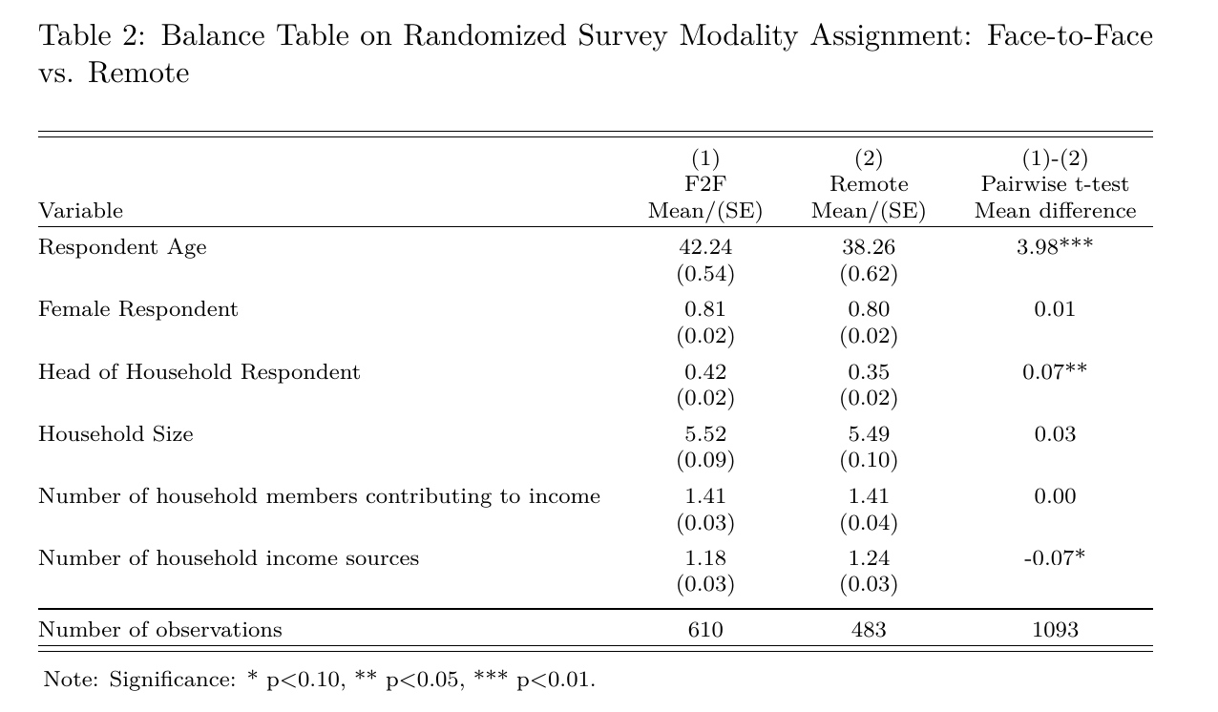
Balance Tests for Randomization

Slide 33
CARI vs. rCARI Disaggregation
Food security category | FES |  | Income | F2F | Pairwise t-test
 | (1) CARI Mean/(SE) | (2) rCARI Mean/(SE) | (3) rCARI Mean/(SE) | (4) rCARI Mean/(SE) | (5) (1) - (2) Mean diff. | (6) (1) - (3) Mean diff. | (7) (1)- (4) Mean diff.
Food Secure | 0.08 (0.01) | 0.04 (0.01) | 0.07 (0.01) | 0.16 (0.01) | 0.04*** | 0.02 | -0.08***
Marginally Food Secure | 0.44 (0.02) | 0.37 (0.02) | 0.40 (0.02) | 0.43 (0.02) | 0.08*** | 0.05 | 0.01
Moderately Food Insecure | 0.44 (0.02) | 0.54 (0.02) | 0.50 (0.02) | 0.39 (0.02) | -0.10*** | -0.06* | -0.05***
Severely Food Insecure | 0.03 (0.01) | 0.05 (0.01) | 0.04 (0.01) | 0.02 (0.01) | -0.02*** | -0.01 | 0.01
Vulnerable Households (M + S - FI) | 0.47 (0.02) | 0.59 (0.02) | 0.54 (0.02) | 0.41 (0.02) | -0.12*** | -0.07** | 0.06***
N | 610 | 483 | 483 | 610 | 1093 | 1093 | 610
Source: rCARI survey 2023
Note: Significance * p<0.10, ** p<0.05, *** p<0.01

Slide 34
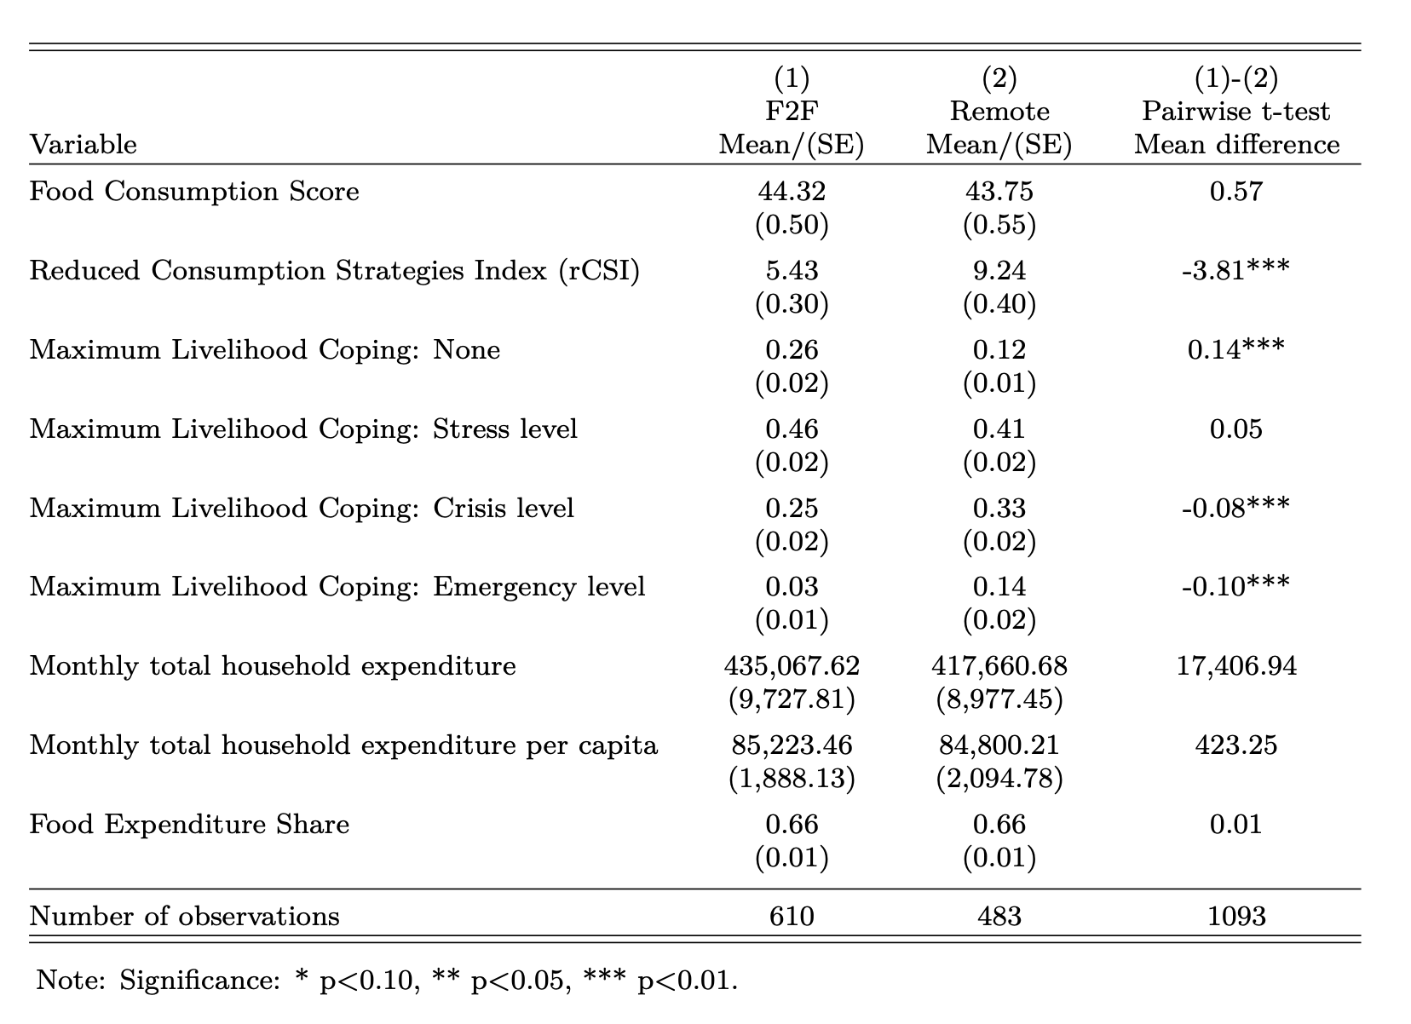
Other Food Security Outcome Indicators

Slide 35
 | Poor/Borderline - FCG |  | Acceptable - FCG |  | Pairwise t-test Mean difference
 | (1) | (2) | (3) | (4) | (1)-(2) | (3)-(4)
Indicator | F2F Mean/(SE) | Remote Mean/(SE) | F2F Mean/(SE) | Remote Mean/(SE)
rCSI | 8.03 (0.53) | 10.89 (0.55) | 3.18 (0.27) | 7.46 (0.57) | -2.86*** | -4.28***
Livelihood Coping: None | 0.19 (0.02) | 0.08 (0.02) | 0.31 (0.03) | 0.16 (0.02) | 0.11*** | 0.16***
Livelihood Coping: Stress level | 0.50 (0.03) | 0.33 (0.03) | 0.43 (0.02) | 0.50 (0.03) | 0.17*** | -0.07*
Livelihood Coping: Crisis level | 0.25 (0.03) | 0.42 (0.03) | 0.24 (0.02) | 0.24 (0.02) | -0.16*** | 0.00
Livelihood Coping: Emergency level | 0.05 (0.01) | 0.17 (0.02) | 0.02 (0.01) | 0.11 (0.02) | -0.11*** | -0.09***
Food Expenditure Share: FES | 0.67 (0.01) | 0.65 (0.01) | 0.66 (0.01) | 0.66 (0.01) | 0.02 | 0.00
N | 283 | 251 | 327 | 232 | 534 | 569
Source: rCARI survey 2023
Note: Significance * p<0.10, ** p<0.05, *** p<0.01

Slide 36
FCS Indicator disaggregated by food groups over the last 7 days | (1) F2F Mean/(SE) | (2) Remote Mean/(SE) | (1)-(2) Pairwise t-test Mean difference
Cereals and Tubers | 7.00 (0.00) | 7.00 (0.00) | -0.00
Pulses | 1.63 (0.06) | 1.82 (0.07) | -0.20**
Dairy products | 0.17 (0.03) | 0.18 (0.03) | -0.01
Protein rich foods | 3.22 (0.08) | 3.01 (0.09) | 0.21
Vegetables | 6.42 (0.06) | 6.48 (0.06) | -0.06
Fruits | 1.73 (0.08) | 1.43 (0.08) | 0.30***
Oils | 6.67 (0.05) | 6.37 (0.06) | 0.30***
Sugar | 0.82 (0.06) | 0.85 (0.07) | -0.03
N | 610 | 483 | 1093

Slide 37
LCS adoption by modality
LCS-Strategy | (1) F2F Mean/(SE) | (2) Remote Mean/(SE) | (1)-(2) Pairwise t-test Mean difference
Lcs_stress_DomAsset_yn | 0.19 | 0.38 | -0.20***
 | (0.01) | (0.03)
Lcs_stress_HealthEdu_yn | 0.19 | 0.42 | -0.22***
 | (0.01) | (0.03)
Lcs_stress_Saving_yn | 0.30 | 0.42 | -0.12***
 | (0.01) | (0.03)
Lcs_stress_BorrowCash_yn | 0.36 | 0.45 | -0.09***
 | (0.02) | (0.03)
Lcs_crisis_ProdAssets_yn | 0.04 | 0.18 | -0.14***
 | (0.01) | (0.02)
Lcs_crisis_DomMigration_yn | 0.09 | 0.18 | -0.09***
 | (0.01) | (0.02)
Lcs_crisis_OutSchool_yn | 0.03 | 0.07 | -0.04***
 | (0.01) | (0.02)
Lcs_em_ResAsset_yn | 0.02 | 0.17 | -0.15***
 | (0.00) | (0.02)
Lcs_em_Begged_yn | 0.02 | 0.07 | -0.05***
 | (0.00) | (0.02)
Lcs_em_IllegalAct_yn | 0.01 | 0.04 | -0.03***
 | (0.00) | (0.01)
N | 610 | 483 | 1093
Source: rCARI survey 2023
Note: Significance * p<0.10, ** p<0.05, *** p<0.01

Slide 38
FCS Group by Modality
FCS Group | (1) F2F Mean/(SE) | (2) Remote Mean/(SE) | (1)-(2) Pairwise t-test Mean difference
Acceptable | 0.54 (0.02) | 0.48 (0.02) | 0.06*
Borderline | 0.40 (0.02) | 0.45 (0.02) | -0.05*
Poor | 0.06 (0.01) | 0.07 (0.01) | -0.00
N | 610 | 483 | 1093
Source: rCARI survey 2023
Note: Significance * p<0.10, ** p<0.05, *** p<0.01

Slide 39
FCG + rCSI by Modality
FCS Group + rCSI | (1) F2F Mean/(SE) | (2) Remote Mean/(SE) | (1)-(2) Pairwise t-test Mean difference
Acceptable | 0.37 (0.02) | 0.22 (0.02) | 0.15***
Acceptable with reduced coping | 0.16 (0.01) | 0.26 (0.02) | -0.10***
Borderline | 0.40 (0.02) | 0.45 (0.02) | -0.05*
Poor | 0.06 (0.01) | 0.07 (0.01) | -0.01
N | 610 | 483 | 1093
Source: rCARI survey 2023
Note: Significance * p<0.10, ** p<0.05, *** p<0.01

Slide 40
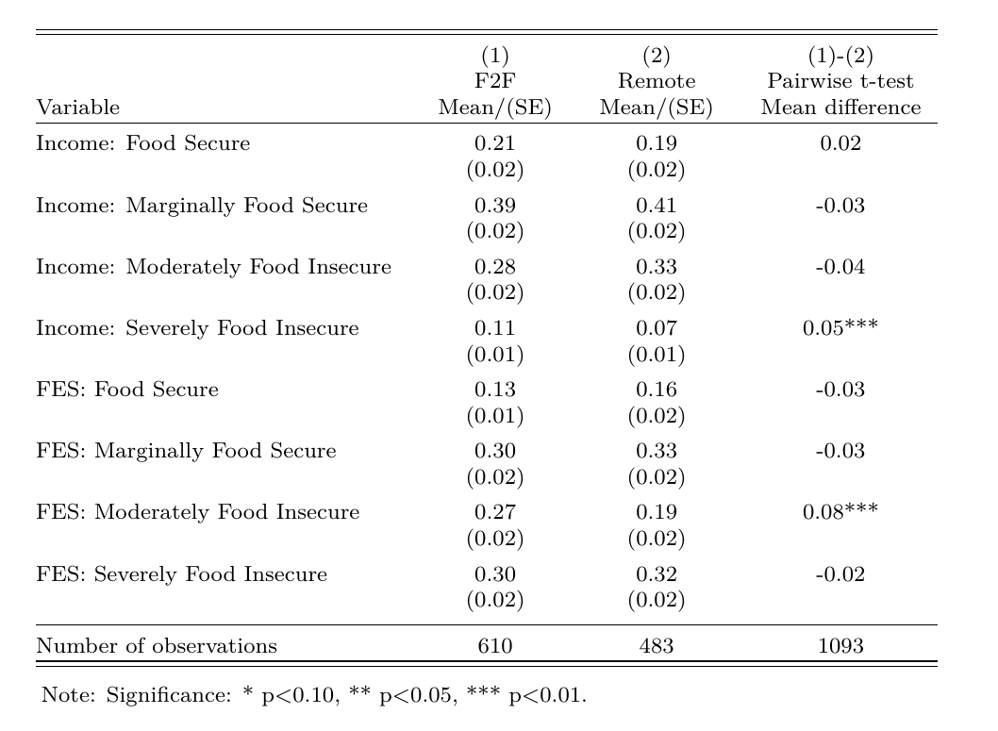
Income Sources vs. FES

Slide 41
Disaggregated rCSI Strategies by modality
rCSI Indicator disaggregated | (1) F2F Mean/(SE) | (2) Remote Mean/(SE) | (1)-(2) Pairwise t-test Mean difference
Relied on less preferred food | 1.92 (0.09) | 2.86 (0.10) | -0.94***
Borrowed food/relied on help from families and friends | 0.59 (0.05) | 0.56 (0.05) | 0.03
Reduced portion size of meals | 0.56 (0.05) | 0.74 (0.06) | -0.18**
Restrict consumption of adults for children to eat | 0.52 (0.06) | 1.23 (0.08) | -0.72***
Reduced the number of meals per day | 0.22 (0.04) | 0.82 (0.08) | -0.60***
N | 610 | 483 | 1093
Source: rCARI survey 2023
Note: Significance * p<0.10, ** p<0.05, *** p<0.01

Slide 42
Summary and key points
rCARI systematically overstate the number of food insecurity compared to CARI by between 7 and 17 percentage points
The magnitude depends on whether FES (17%) or income and income change (7%) indicator is used
Remote households reported better food consumption (FCS), exaggerate their vulnerability (rCSI & FES) and adopted more stress and emergency coping strategies (LCS)

Slide 43
Income Sources vs. FES
 | (1) | (2) | (1)-(2)
 | F2F | Remote | Pairwise t-test
Variable | Mean/(SE) | Mean/(SE) | Mean difference
Food Expenditure Share | 0.66 | 0.71 | -0.05***
 | (0.01) | (0.01)
FES: <50% | 0.13 | 0.08 | 0.06**
 | (0.01) | (0.02)
FES: 50-65% | 0.30 | 0.22 | 0.08**
 | (0.02) | (0.03)
FES: 65-75% | 0.27 | 0.26 | 0.01
 | (0.02) | (0.03)
FES: >= 75% | 0.30 | 0.45 | -0.15***
 | (0.02) | (0.03)
Number of observations | 610 | 232 | 842
Source: rCARI survey 2023
Note: Significance * p<0.10, ** p<0.05, *** p<0.01

Slide 44
Ecuador Results

Slide 45
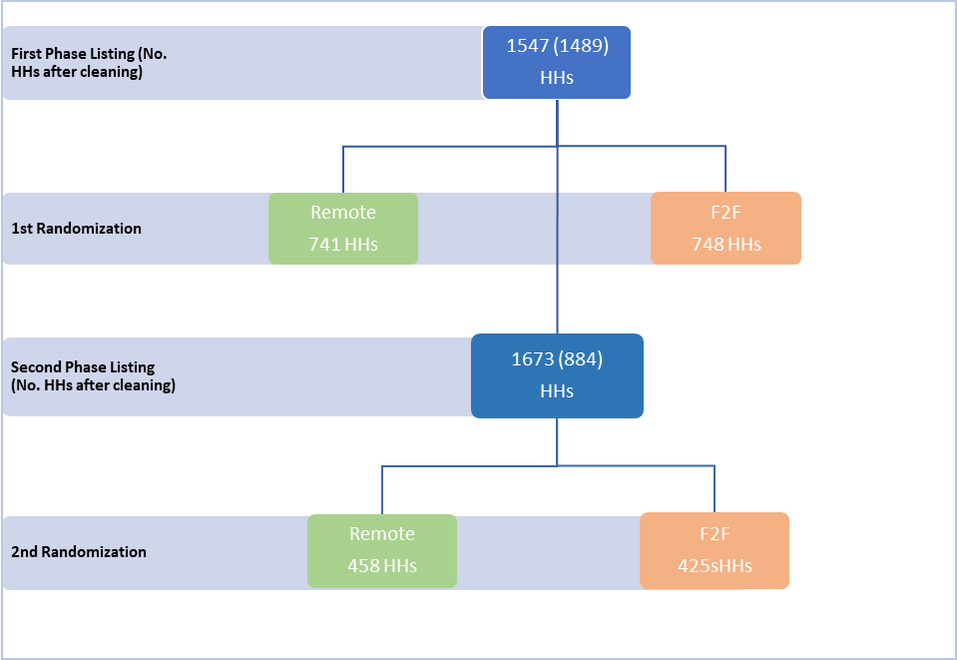
Sampling
Completed Remote
656 HH
Completed
F2F
760 HH
Final Completion

Slide 46
Balance Tests for Randomization
Variable | (1) F2F Mean/(SE) | (2) Remote Mean/(SE) | (1)-(2) Pairwise t-test Mean difference
Respondent Age | xxx | 43.00 | xxx
Female Respondent | 0.77 (0.02) | 0.76 (0.02) | 0.01
Head of Household Respondent | 0.60 (0.02) | 0.53 (0.02) | 0.07**
Household Size | 4.37 (0.08) | 4.57 (0.09) | -0.19
Number of household members contributing to income | 1.47 (0.03) | 1.45 (0.03) | 0.01
N | 760 | 656 | 1416
Source: rCARI survey 2023
Note: Significance * p<0.10, ** p<0.05, *** p<0.01

Slide 47
CARI vs. rCARI Disaggregation
Food security category | FES |  | Income | F2F | Pairwise t-test
 | (1) CARI Mean/(SE) | (2) rCARI Mean/(SE) | (3) rCARI Mean/(SE) | (4) rCARI Mean/(SE) | (5) (1) - (2) Mean diff. | (6) (1) - (3) Mean diff. | (7) (1)- (4) Mean diff.
Food Secure | 0.01 (0.00) | 0.00 (0.00) | 0.00 (0.00) | 0.03 (0.01) | 0.01** | 0.01* | -0.02**
Marginally Food Secure | 0.23 (0.02) | 0.07 (0.01) | 0.27 (0.02) | 0.33 (0.02) | 0.16*** | -0.03 | -0.10***
Moderately Food Insecure | 0.59 (0.02) | 0.69 (0.02) | 0.62 (0.02) | 0.53 (0.02) | -0.10*** | -0.03 | 0.06***
Severely Food Insecure | 0.16 (0.01) | 0.23 (0.02) | 0.11 (0.01) | 0.11 (0.01) | -0.07*** | 0.06*** | 0.06**
Vulnerable Households (M + S - FI) | 0.76 (0.02) | 0.92 (0.01) | 0.73 (0.02) | 0.64 (0.02) | -0.17*** | 0.03 | 0.12***
N | 760 | 656 | 656 | 760 | 1416 | 1416 | 760
Source: rCARI survey 2023
Note: Significance * p<0.10, ** p<0.05, *** p<0.01

Slide 48
Other Food Security Outcome Indicators
Indicator | (1) F2F Mean/(SE) | (2) Remote Mean/(SE) | (1)-(2) Pairwise t-test Mean difference
Food Consumption Score-FCS | 46.28 (0.78) | 52.54 (0.94) | -6.25***
Reduced Coping Strategies Index-rCSI | 19.86 (0.45) | 18.50 (0.46) | 1.36**
Livelihood coping: None | 0.09 (0.01) | 0.02 (0.01) | 0.07***
Livelihood coping: Stress level | 0.28 (0.02) | 0.08 (0.01) | 0.20***
Livelihood coping: Crisis level | 0.42 (0.02) | 0.19 0.02 | 0.23***
Livelihood coping: Emergency level | 0.21 (0.01) | 0.70 (0.02) | -0.50***
Food Expenditure Share: FES | 0.71 (0.01) | 0.79 (0.01) | -0.08***
N | 760 | 656 | 1416
Source: rCARI survey 2023
Note: Significance * p<0.10, ** p<0.05, *** p<0.01

Slide 49
 | Poor/Border line - FCG |  | Acceptable - FCG |  | Pairwise t-test Mean difference
 | (1) | (2) | (3) | (4) | (1)-(2) | (3)-(4)
Indicator | F2F Mean/(SE) | Remote Mean/(SE) | F2F Mean/(SE) | Remote Mean/(SE)
rCSI | 21.36 (0.65) | 17.57 (0.70) | 18.55 (0.62) | 19.07 (0.02) | 3.79*** | -0.52
Livelihood Coping: None | 0.07 (0.01) | 0.02 (0.01) | 0.11 (0.02) | 0.02 (0.01) | 0.06*** | 0.08***
Livelihood Coping: Stress level | 0.21 (0.02) | 0.08 (0.02) | 0.34 (0.02) | 0.09 (0.01) | 0.13*** | 0.26***
Livelihood Coping: Crisis level | 0.46 (0.03) | 0.20 (0.03) | 0.39 (0.02) | 0.19 (0.02) | 0.26*** | 0.20***
Livelihood Coping: Emergency level | 0.26 (0.02) | 0.71 (0.03) | 0.16 (0.02) | 0.70 (0.02) | -0.45*** | -0.54***
Food Expenditure Share: FES | 0.70 (0.01) | 0.78 (0.01) | 0.72 (0.01) | 0.80 (0.01) | -0.08*** | -0.08***
N | 353 | 248 | 407 | 408 | 601 | 815
Source: rCARI survey 2023
Note: Significance * p<0.10, ** p<0.05, *** p<0.01

Slide 50
FG consumption by modality
FCS Indicator disaggregated over the Last 7days | (1) F2F Mean/(SE) | (2) Remote Mean/(SE) | (1)-(2) Pairwise t-test Mean difference
Cereals and Tubers | 5.38 (0.08) | 4.93 (0.09) | 0.45***
Pulses | 2.00 (0.07) | 2.50 (0.09) | -0.50***
Dairy products | 1.38 (0.07) | 2.03 (0.09) | -0.65***
Protein rich foods | 3.03 (0.09) | 3.48 (0.09) | -0.44***
Vegetables | 3.93 (0.10) | 4.75 (0.10) | -0.82***
Fruits | 2.58 (0.09) | 2.90 (0.10) | -0.32**
Oils | 5.38 (0.09) | 5.40 (0.09) | -0.02
Sugar | 5.39 (0.09) | 5.64 (0.09) | -0.25*
N | 760 | 656 | 1416
Source: rCARI survey 2023
Note: Significance * p<0.10, ** p<0.05, *** p<0.01

Slide 51
LC adoption by modality
LCS Category | F2F Mean/(SE) | Remote Mean/(SE) | Pairwise t-test Mean diff.
Lcs_stress_DomAsset | 0.10 | 0.15 | -0.05***
 | (0.01) | (0.01)
Lcs_stress_HealthEdu | 0.39 | 0.31 | 0.08***
 | (0.02) | (0.02)
Lcs_stress_Saving | 0.62 | 0.65 | -0.03
 | (0.02) | (0.02)
Lcs_stress_BorrowCash | 0.64 | 0.64 | -0.01
 | (0.02) | (0.02)
Lcs_crisis_ProdAssets | 0.05 | 0.08 | -0.03*
 | (0.01) | (0.01)
Lcs_crisis_DomMigration | 0.57 | 0.61 | -0.04
 | (0.02) | (0.02)
Lcs_crisis_OutSchool | 0.08 | 0.11 | -0.03*
 | (0.01) | (0.01)
Lcs_em_ResAsset | 0.08 | 0.09 | -0.01
 | (0.01) | (0.01)
Lcs_em_Begged | 0.10 | 0.23 | -0.13***
 | (0.01) | (0.02)
Lcs_em_IllegalAct | 0.09 | 0.58 | -0.49***
 | (0.01) | (0.02)
N | 760 | 656 | 1416
Source: rCARI survey 2023
Note: Significance * p<0.10, ** p<0.05, *** p<0.01

Slide 52
FCG by modality
FCG | (1) F2F Mean/(SE) | (2) Remote Mean/(SE) | (1)-(2) Pairwise t-test Mean difference
Acceptable | 0.54 (0.02) | 0.62 (0.02) | -0.09***
Borderline | 0.24 (0.02) | 0.22 (0.02) | 0.02
Poor | 0.22 (0.02) | 0.16 (0.01) | 0.07***
N | 760 | 656 | 1416
Source: rCARI survey 2023
Note: Significance * p<0.10, ** p<0.05, *** p<0.01

Slide 53
FCG + rCSI by modality
FCG | (1) F2F Mean/(SE) | (2) Remote Mean/(SE) | (1)-(2) Pairwise t-test Mean difference
Acceptable | 0.06 (0.01) | 0.04 (0.01) | 0.02
Acceptable with reduced coping | 0.48 (0.02) | 0.58 (0.02) | -0.10***
Borderline | 0.24 (0.02) | 0.22 (0.02) | 0.02
Poor | 0.22 (0.02) | 0.16 (0.01) | 0.07***
N | 760 | 656 | 1416
Source: rCARI survey 2023
Note: Significance * p<0.10, ** p<0.05, *** p<0.01

Slide 54
Income Sources vs. FES
Indicator | (1) F2F Mean/(SE) | (2) Remote Mean/(SE) | (1)-(2) Pairwise t-test Mean difference
Income
Regular and unchanged/increasing | 0.19 (0.01) | 0.25 (0.02) | -0.06***
Regular and reduced or irregular and Unchanged/increasing | 0.38 (0.02) | 0.41 (0.02) | -0.03
Irregular and reduced | 0.26 (0.02) | 0.24 (0.02) | 0.01
No income sources | 0.17 (0.01) | 0.09 (0.01) | 0.08***
FES
< 50% of HH Expenditure | 0.15 (0.01) | 0.05 (0.01) | 0.10***
50 – 65% of HH Expenditure | 0.17 (0.01) | 0.09 (0.01) | 0.08***
65 – 75% of HH Expenditure | 0.19 (0.01) | 0.18 (0.01) | 0.01
>= 75% of HH Expenditure | 0.49 (0.02) | 0.68 (0.02) | -0.19***
N | 760 | 656 | 1416
Source: rCARI survey 2023
Note: Significance * p<0.10, ** p<0.05, *** p<0.01

Slide 55
Summary and key points
Compared to CARI, the rCARI results are dependent on the indicator combination
Significantly overstate the food insecurity/vulnerability if FES (17%) is used
When FES is replaced by income and income change, the difference is not significantly different
Food consumption is higher and varied for remote respondents compared to F2F
Results are driven by LCS (crisis and emergency), rCSI and FES.
Significantly more remote households vulnerable in terms of FES, and are also adopting more emergency LCS

Slide 56
Thank you

