Slide 1

Income Source & Income Change Indicator
RAM-N – rCARI Team

Slide 2
Background
In the circles of Humanitarian sector
There are several methods to report on acute food insecurity (AFI)
IPC (36 countries)
CH (Used in WA)
CARI (used to report AFI in absence of IPC & CH, available in >80 Countries)
rCARI a remote version of the CARI

Slide 3
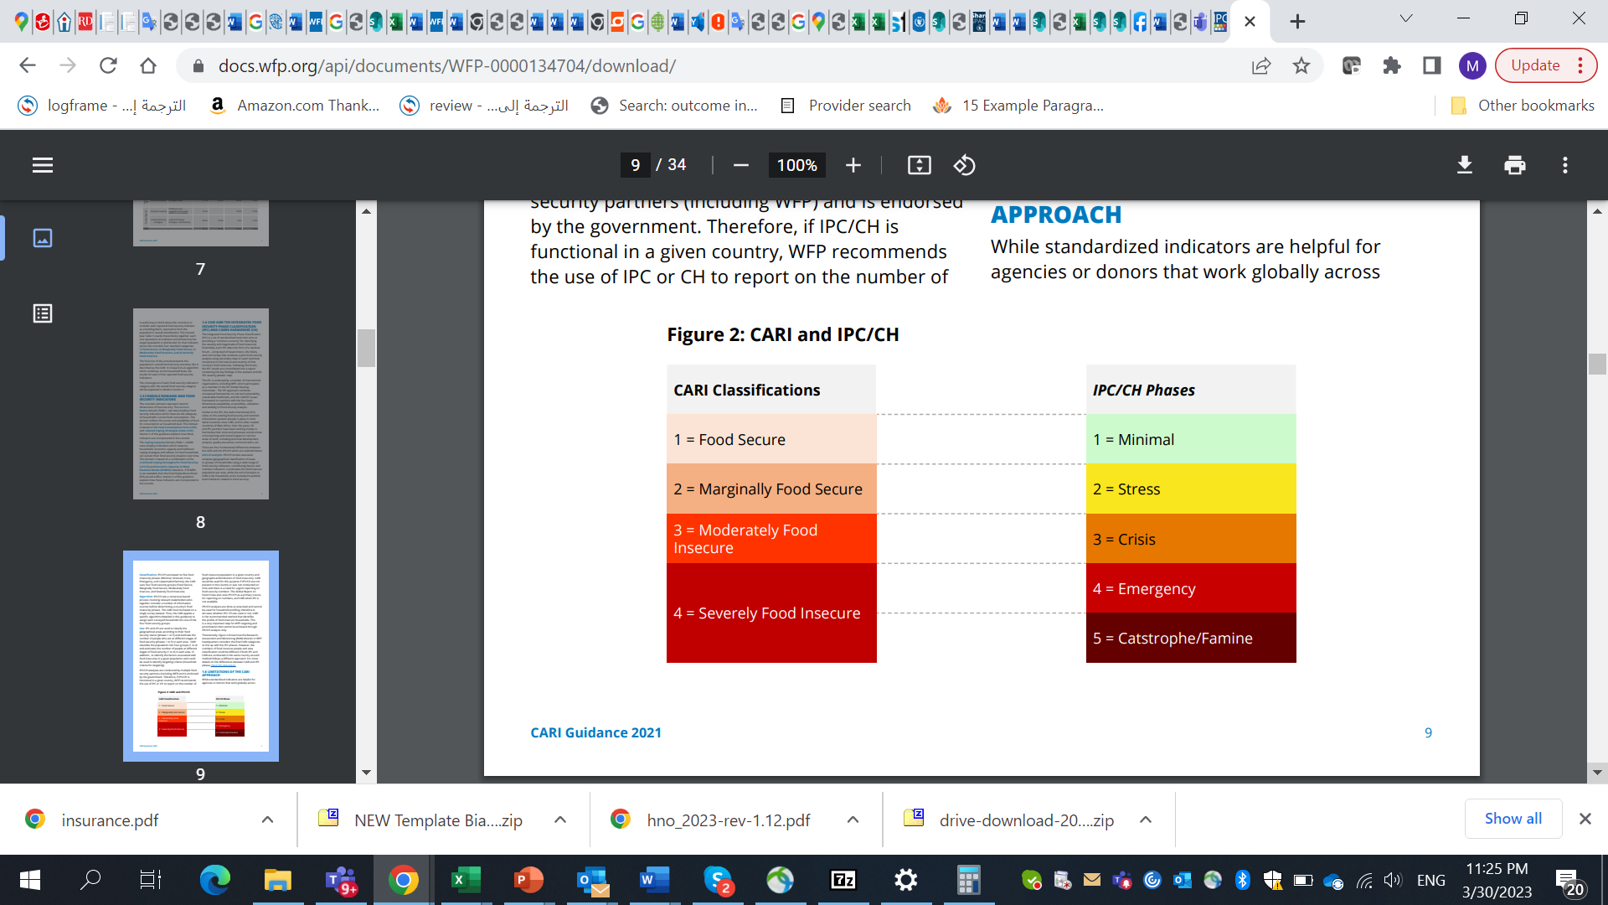
Background
How these methods empirically compare is to each other is not well researched
CARI mostly rejected when discussing acute global food insecurity
E.g. How comparable are the IPC/CH with CARI?
Are they compatible?
If they are different what/where and how different are these methods?

Slide 4
Background
rCARI useful in emergencies where F2F survey is not feasible
Relies on call centers or Computerized Assisted Telephone Interviews (CATI)
Uses simple & easy to understand acute food insecurity questions
Anchored on two livelihood dimensions
Current food consumption status &
Current coping capacity to meet future food security needs
rCARI numbers & methodology is not empirically validated
Though is easily available, results are not globally accepted
Notes:
rCARI is based on the following modules
Food consumption score
Consumption-based coping strategy (rCSI)
Livelihood coping strategy (usually a shorter version of the original)
Income sources
Changes in income

Slide 5
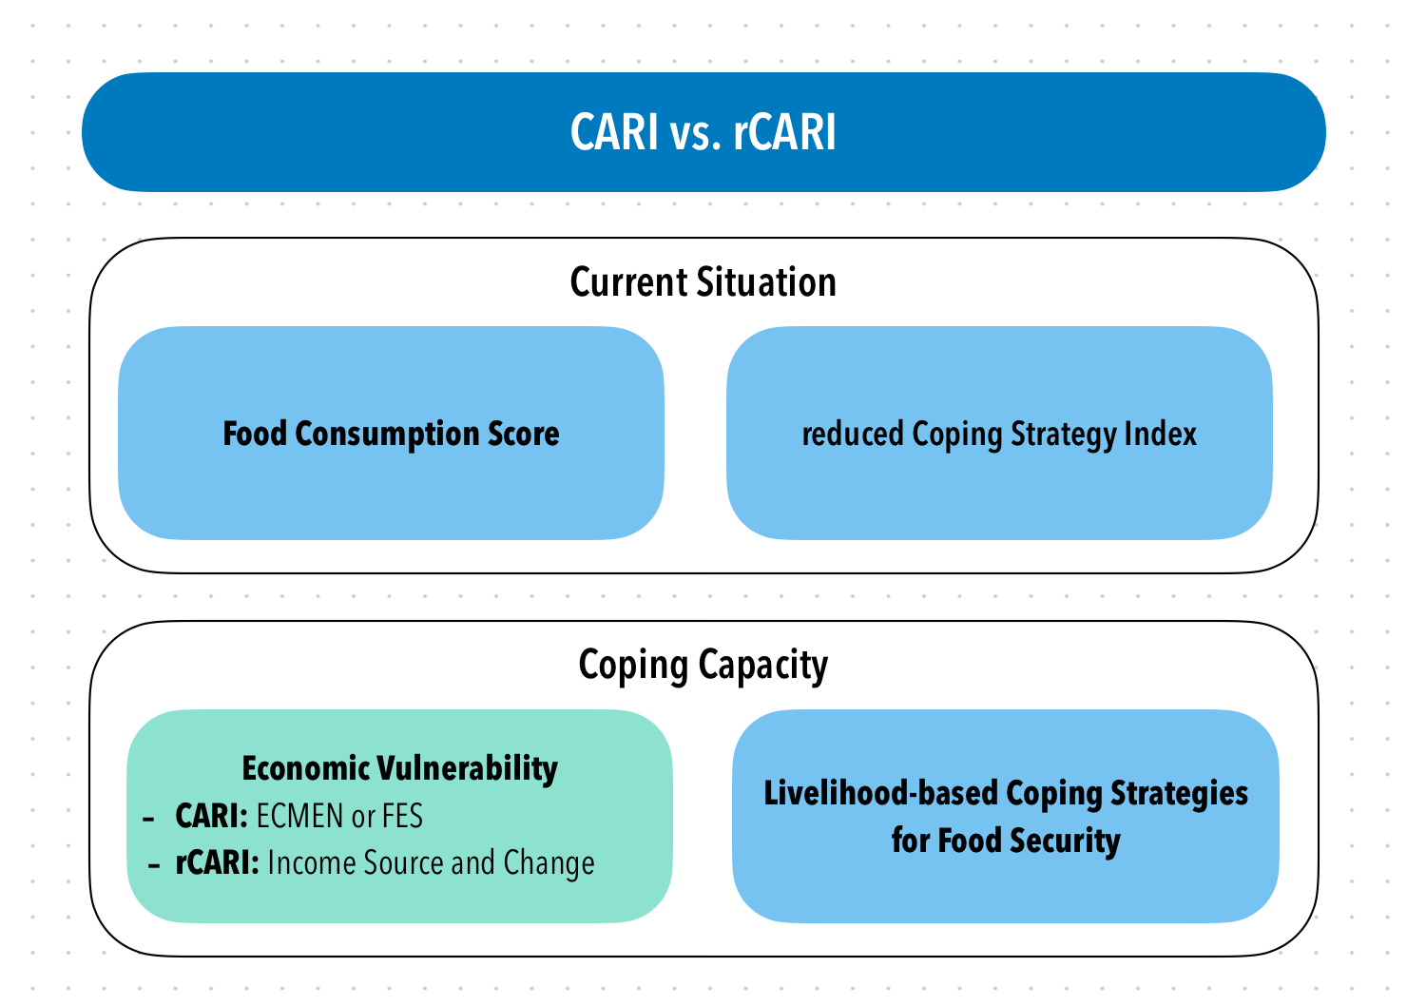
Background
CARI and rCARI (remote CARI) aggregate indicators in a similar way and the only difference is in the Economic Vulnerability
To date, rCARI is not validated
Notes:
Consolidate Approach for Reporting food Insecurity (CARI)
rCARI useful in emergencies where F2F survey is not feasible
rCARI though easily available, results are not globally accepted because methodology is not been empirically validated against other standard methods- CARI
rCARI is based on the following modules
Food consumption score
Consumption-based coping strategy (rCSI)
Livelihood coping strategy (usually a shorter version of the original)
Income sources & income changes

Slide 6
Current Proposal
The current study is a BHA funded project – 5/12/2022 – /12/2023
720BHA23IO00001
Value $ 947, 850
Two components
First component – rCARI validation
Second Component – IPC/CARI comparability
Coverage
IPC/CARI – Global (all countries with available data)
rCARI validation – 6 countries

Slide 7
The Technical Advisory Board
The Technical Advisory Board is made of 5 Professionals Across Academia, IPC, FSIN, BHA, and WFP
Prof. Maxwell Daniel (Tufts University, USA)
Prof. Sebastian Vollmer (University of Gottingen, Germany)
Korpi Kaija (IPC)
Sara Mchattie (FSIN)
Michael Schenkmann (BHA)
Naouar Labidi (RAM-N, WFP)** to be replaced by Sid

Slide 8
Project Work Assignment
First Component:
a. APP-FA started this component
Data preparation
Initial analysis and presentation
Data aggregation
b. Transferred to an independent consultant - Prof. Diego Rose (Tulane University, U.S.A)
Supported by the APP-FA Team
Second Component:
a. Fully led & implemented by APP-FA

Slide 9
The Remote CARI (rCARI) Component
RAM-N – rCARI Team

Slide 10
Objective
Primary:
Validate the remote Consolidated Approach for Reporting Indicators of Food Insecurity (rCARI) – Using a survey experiment with stratified sample
Secondary
Validate income choice and income change indicator
Test and validate different expenditure modules (shorter versions)
Notes:
rCARI useful in emergencies where F2F survey is not feasible
The Challenge with rCARI numbers & methodology is that not it is been validated against CARI or IPC
Though is easily available, results are not globally accepted
rCARI is based on the following modules
Food consumption score
Consumption-based coping strategy (rCSI)
Livelihood coping strategy (usually a shorter version of the original)
Income sources
Changes in income

Slide 11
Pilot Countries
Global representation (In at least 4 RBx)
Relevance of rCARI
Mobile network penetration
West Africa [RBD] Burkina Faso & Central African Republic
Panama [RBP] Ecuador & Guatemala
Middle East [RBC] Iraq?? (Access is only limited to camps (refugees and IDPs))
Southeast Asia [RBB] Myanmar

Slide 12
Inclusion criteria [ADMIN level selection]
Mobile phone penetration
Mobile phone network
Accessibility
Heterogenous in terms AFI
Rural & urban
CARI groups of AFI
These factors informed the final ADMIN selection

Slide 13
Methodology
Initially approved methodology – Cross over design
Sample size of 1200 HHs per study country [600 CARI & 600 rCARI]
At least 2 ADMIN1 areas and 20 ADMIN5 areas
Methodology & survey instrumented piloted in Iraq 2022
Notes:
rCARI useful in emergencies where F2F survey is not feasible
The Challenge with rCARI numbers & methodology is that not it is been validated against CARI or IPC
Though is easily available, results are not globally accepted
rCARI is based on the following modules
Food consumption score
Consumption-based coping strategy (rCSI)
Livelihood coping strategy (usually a shorter version of the original)
Income sources
Changes in income

Slide 14
Study Setup - The Crossover Design
Involves two comparable groups
Randomly selected households
Randomly assigned to the two groups-Group A and B
Interviews will run concurrently for both groups
Each group taking either F2F or Remote
Each respondent interviewed twice
First either face-to-face/remote depending on the group
The reverse module is administered during the second contact depending the first

Slide 15
Study Setup- Primary objective - [rCARI vs CARI]
1st Interview
Group A (Phone)
375 HH
Sampled HH
(600 + 25% iteration)
Group B
(F2F)
375 HH

Slide 16
Study Setup- Primary objective - [rCARI vs CARI]
1st Interview
Follow-up interview
Group A (Phone)
375 HH
Max 48 Hrs
Group A
(F2F)
300 HH
Sampled HH
(600 + 25% iteration)
Group B
(F2F)
375 HH
Max 48 Hrs
Group B (Phone)
300 HH

Slide 17
Study Setup- Secondary objective no.1 – [validate diff. modules]
1st Interview
Follow-up interview
Group A (Phone)
375 HH
Group A (F2F) 300
Max 48 Hrs
150 HH Long-modules
Sampled HH
(600 + 25% iteration)
150 HH Short Modules
Group B (F2F) 375
188 HH Long-modules
Max 48 Hrs
Group B (Phone)
300 HH
187 HH Short Modules

Slide 18
Study Setup- Secondary objective no.2 - [rCARI/CARI vs IPC]
1st Interview
Follow-up interview
Qualitative
Group A (Phone)
375 HH
Group A (F2F) 300
Max 48 Hrs
Qualitative approach – Case Identification to classify HH into the IPC Phases
150 HH Long-modules
Sampled HH
(600 + 25% iteration)
150 HH Short Modules
Group B (F2F) 375
188 HH Long-modules
Group B (Phone)
300 HH
Max 48 Hrs
187 HH Short Modules

Slide 19
Data collection
Modules collected
Food consumption score
Consumption-based coping strategy
Livelihood coping strategy
Food expenditure share
Economic capacity to meet essential needs
Income sources & income change

Slide 20
Analysis plan
Primary Objective
F2F A
Remote A
vs
Remote B
vs
F2F B
vs
vs
Quantitative tools
Sensitivity, specificity, NPV, PPV

Slide 21
Analysis plan
Primary Objective
2ndry Objective No. 1
F2F A
Remote A
All (F2F) sample
vs
HH Long-modules
vs
vs
Remote B
vs
F2F B
HH Short Modules
Quantitative tools
Sensitivity, specificity, NPV, PPV
Paired t-test
Quantitative tools
Pearson correlation
Test of significance

Slide 22
Analysis plan
2ndry Objective No. 2
Primary Objective
2ndry Objective No. 1
Qualitative approach – Case Identification to classify HH into the IPC Phases
F2F A
Remote A
All (F2F) sample
CARI
vs
vs
HH Long-modules
vs
vs
rCARI
vs
Remote B
vs
F2F B
HH Short Modules
Quantitative tools
Sensitivity, specificity, NPV, PPV
Quantitative tools
Pearson correlation
Pair t-test, etc
Quantitative tools
Pearson correlation, t-test
Simple regression analysis
Test of specificity and sensitivity

Slide 23
Study organogram…
APP-FA
rCARI Team
Head of VAM RBx
Facilitates communication with COs & supporting training
Head VAM
COs
Supports in identifying the study areas together with the APP-FA team
Supports with admin work for training
Budgeting and logistics
Provides technical support for COs
Leads in field work (implementation)
Data analysis and report writing
Designs the study methodology

Slide 24
Work done…
Conducted two training of trainers’ (ToT) workshops in for RBP & RBD
3 pilots completed so far
Myanmar
Ecuador
CAR –Two separate analysis produced
BKF – yet to be analysed
3 Reports produced and presented to BHA (Draft reports)
4 Advisory meetings held

Slide 25
Work completed and Workplan
Status Activity | Completed | Completed | Completed | Completed | In-progress | In preparation phases
Pilot testing
Myanmar
Ecuador
CAR
Burkina Faso
Iraq
Guatemala
Mauritania
Data Analysis |  |  |  |  |  | On going
Report writing |  |  |  |  |  | On going

Slide 26
Key Changes to the Project
Change of the study methodology name
Crossover design →RCT→ Survey Experiment with Stratified Sample
Increase of the coverage at the ADMIN5 level
20 →35-40ADMIN5s
Pilot Country composition
Increase of the sample
1,200HHs to 4,000HHS
Replace HH listing with full census
All HHs in ADMIN5s included in the study
All pilot countries should have FEWS NET presence
Replacing Peru for Guatemala
Consideration of Mauritania

Slide 27
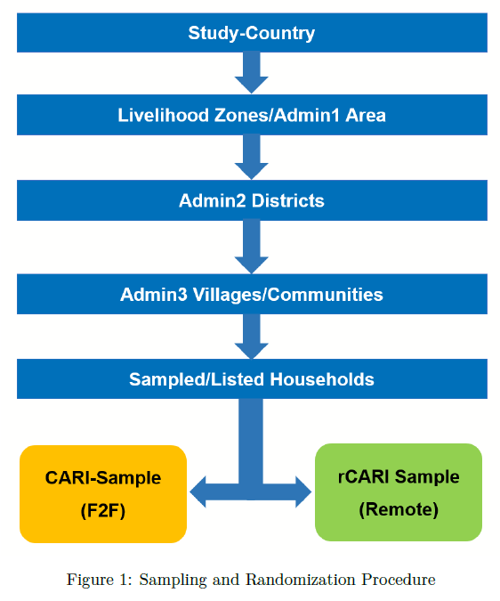
The survey experiment…

Slide 28
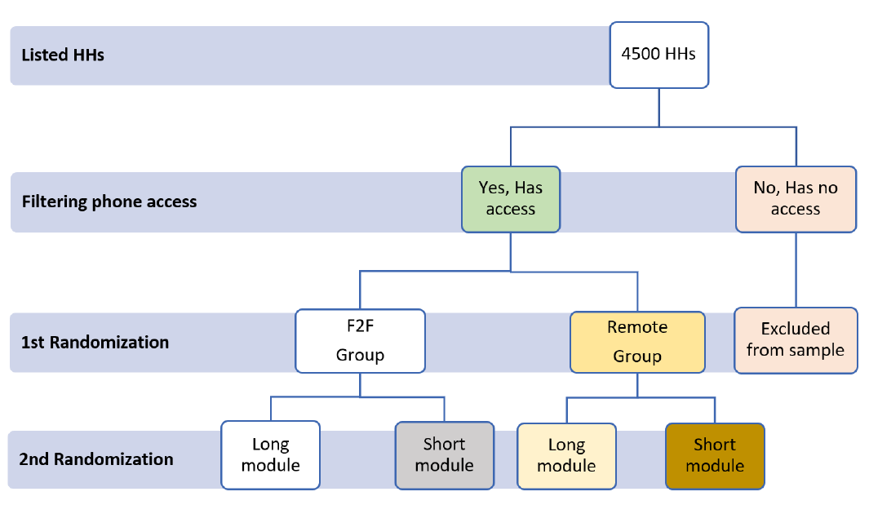
Randomization

Slide 29
Where we stand…
Discussion with Guatemala currently stalled
VAM officer on BIS
The OIC has not responded to my last emails
Follow up in the coming days
At the budgeting study area selection stage for Mauritania
A meeting to be arranged in coming days to discuss & finalize the budget
Iraq discussion far advance, waiting to receive the list of potential study areas from CO
To target returnee IDPs and refugees

Slide 30
Going forward…
APP-FA must submit a methodology document for each pilot country to BHA through the TAB for approval before data collection
Include study area selection
Sampling ( sample size, sample selection, challenges and mitigations strategies)
A WAE consultant hired to advise on statistical analysis (Prof. Michelle Lacey, University of Tulane, U.S.A)
A NCE has been submitted to BHA through WAS (this has been informally approved awaiting formal communication)
To be extended until end of August 2025

Slide 31
Tentative work for remaining pilot
Time Countries | Nov 2024 | Dec 2024 | Jan 2025 | Feb 2025 | Mar 2025 | Apr 2025 | May 2025 | Jun 2025 | Jul-Aug 2025
(1) Iraq | Planning | Data collection
(2) Mauritania |  |  | Planning | Data Collection
(3) Guatemala |  |  |  | Planning | Data Collection
(4) Burkina Faso | Data Analysis Ongoing
Data Analysis
Report writing
Note: There would be intermittent presentation to the TAB and BHA after each pilot country

Slide 32
Thank you

