Slide 1
Health-related Stigma, Stereotype and Discrimination.
Shiyi Li

Slide 2

Self-introduction
Education background
Ph.D. student in Journalism and Media Studies, The University of Hong Kong
M.A. in Journalism and Communication, Tsinghua University
B.A. in Journalism and Communication, Tsinghua University
Research interests
Health communication
Health-related stigma
Media Psychology

Slide 3
Warm up！！
Quick Association Challenge
Words will appear on the screen one at a time.
Classify each word using the categories shown at the top.
Raise your left or right hand to indicate your choice, or simply decide in your mind.
Respond as quickly and accurately as possible.
The category pairings will change in the second round.
No right or wrong feelings — just follow the classification rules!

Slide 4
Origin and History of Stigma
PIE root · *steig- — “to stick; pointed”
Greek · stigma — “mark of a pointed instrument, puncture, tattoo-mark, brand,”
Latin · stigma

Slide 5
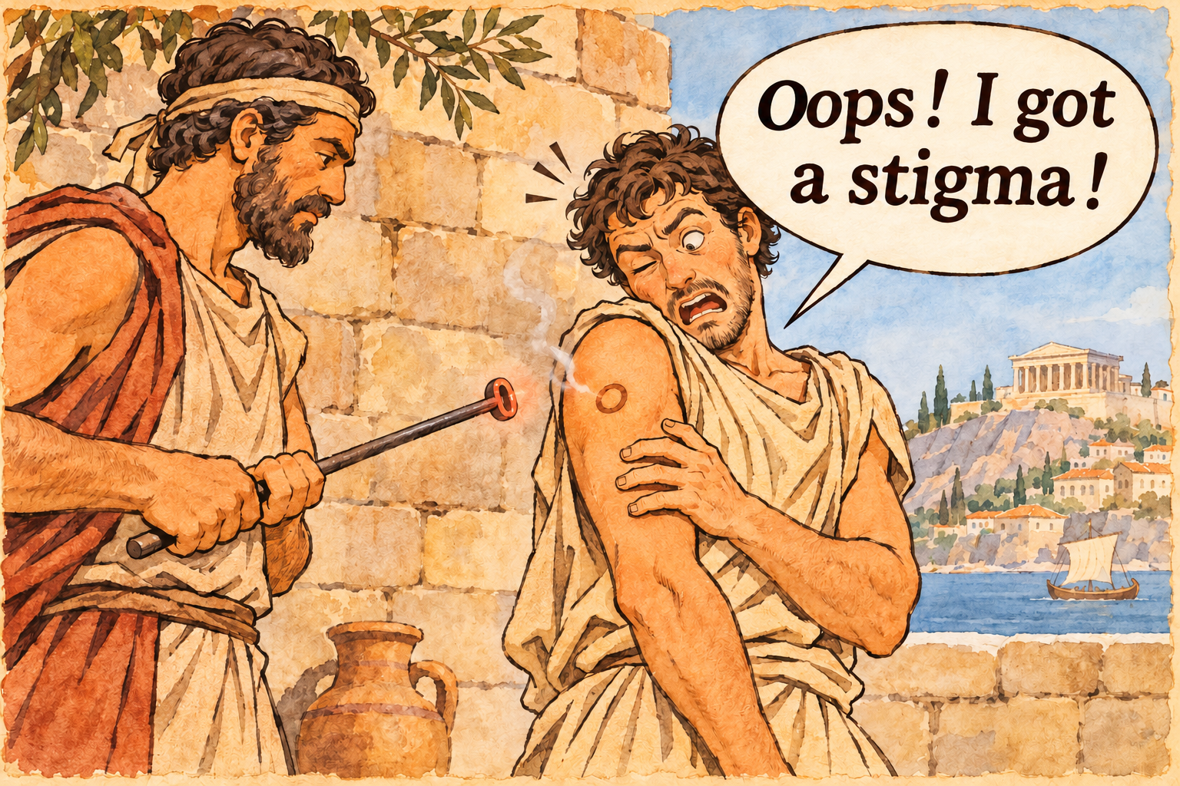
English · stigma
1590s
“mark made on skin by burning with a hot iron”
1610s
“mark of disgrace or infamy which attaches to a person on account of evil conduct”

Slide 6
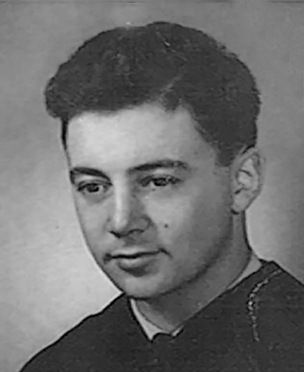
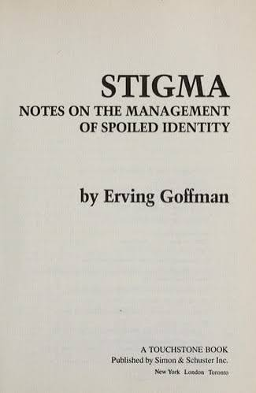
Erving Goffman and His Classic Work
Classic Works
His best-known contribution is his study of symbolic interaction and his 1956 book:
1956 · The Presentation of Self in Everyday Life
1963 · Stigma: Notes on the Management of Spoiled Identity
Erving Goffman
1922–1982
A Canadian-born American sociologist, social psychologist, and writer, considered by some “the most influential American sociologist of the twentieth century”.

Slide 7
Definition
“Society establishes the means of categorizing persons and the complement of attributes felt to be ordinary and natural for members of each of these categories……When a stranger comes into our presence, then, first appearances are likely to enable us to anticipate his category and attributes, his”social identity”……We lean on these anticipations that we have, transforming them into normative expectations……his possessing an attribute that makes him different from others in the category…… a person who is quite thoroughly bad, or dangerous, or weak. He is thus reduced in our minds from a whole and usual person to a tainted, discounted one.”
— Goffman, 1963

Slide 8
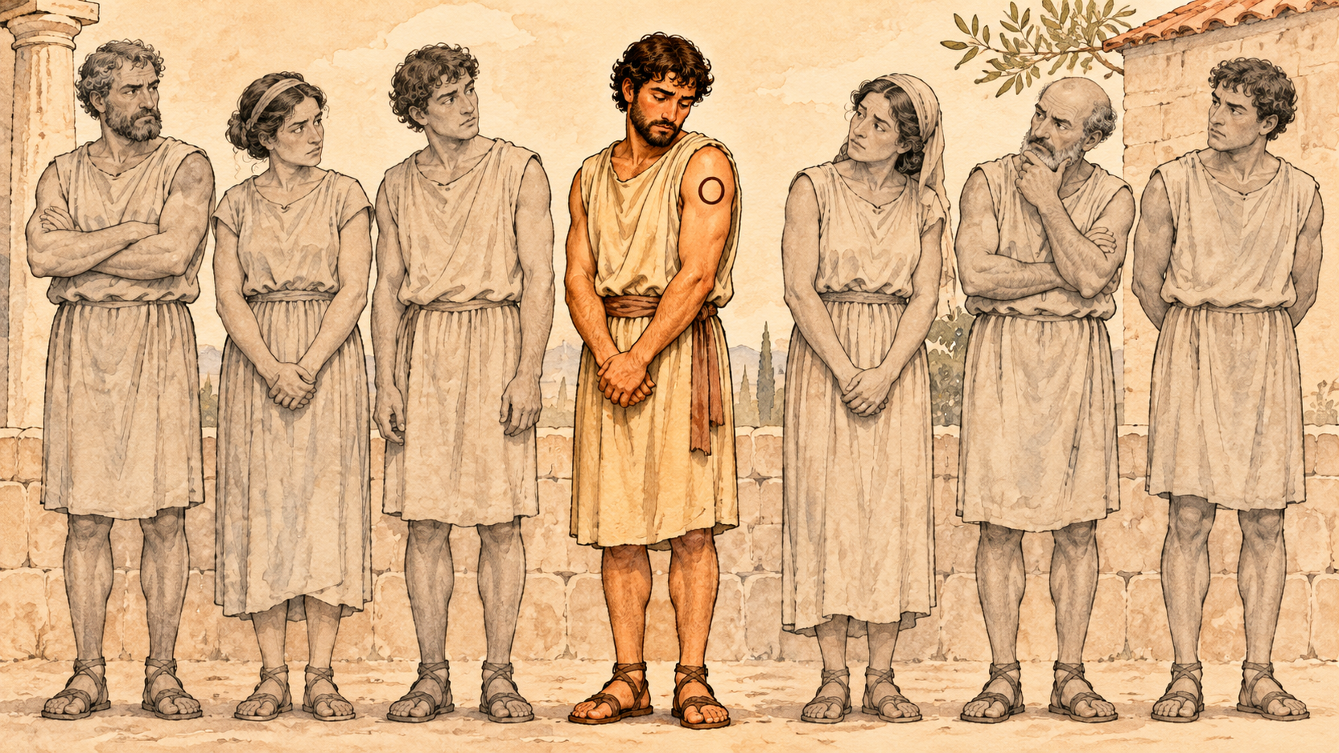
Definition
Keyword:
social categorization
social identity
attribute
relationship
expectation violation

Slide 9
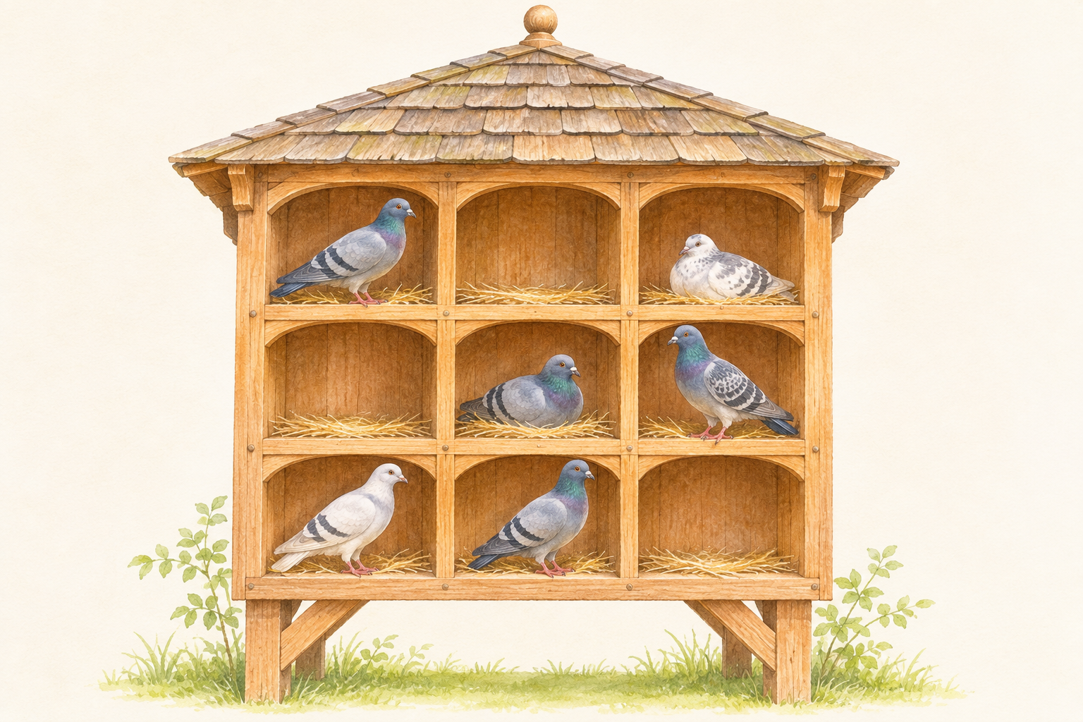
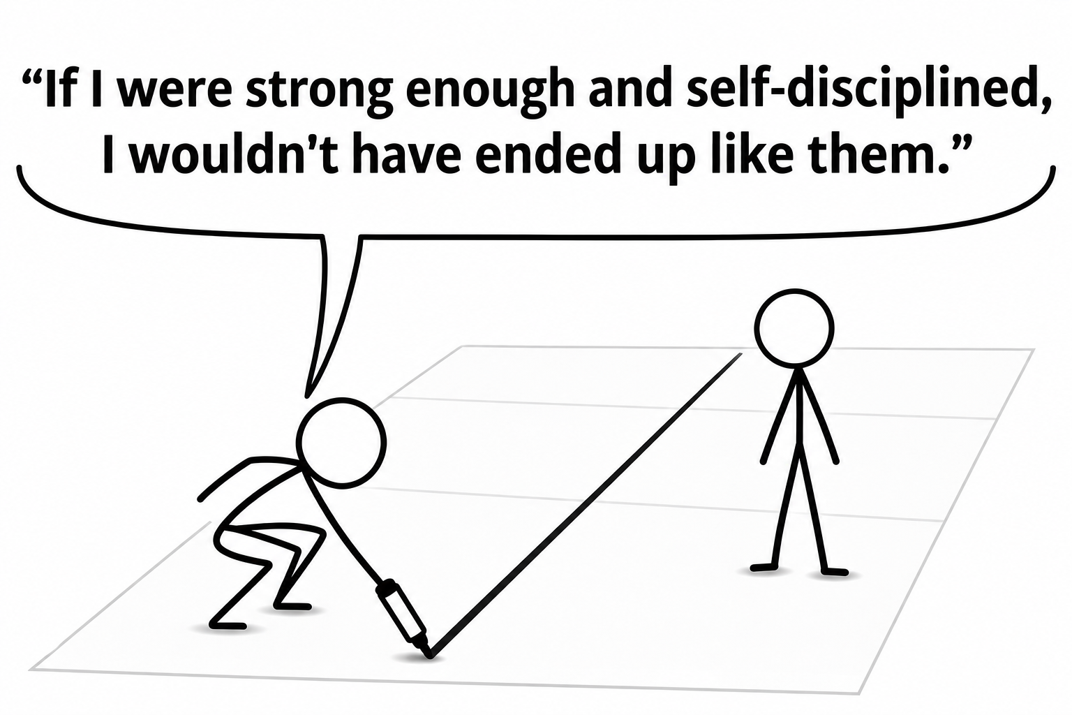
Why Is Stigma So Hard to Remove? A Sociological Perspective
Cognitive categorization
We habitually categorize people, simplifying complex individuals into familiar social labels.
Maintaining boundaries
Seeing others as “abnormal” reinforces our sense of being “normal.”

Slide 10
Why Are Anti-Stigma Campaigns So Challenging?
Common misconceptions
“You have too much time on your hands.”
“Just be more positive.”
A biomedical response
“Depression is an illness—not a personal failing.”
“You cannot simply ‘cheer up’ and recover.”
But does emphasizing biology always reduce stigma?

Slide 11
Why Are Anti-Stigma Campaigns So Challenging?
Biological explanations: less blame, greater difference?
Potential benefit: less blame
“It’s beyond their control.”
Biological explanations may reduce personal blame.
Potential risk: essentialism
“They are fundamentally different.”
Biological explanations may reinforce an “us vs. them” divide.

Slide 12
Why Are Anti-Stigma Campaigns So Challenging?
Us vs. Them—Promoting Continuum Beliefs as a Campaign

Slide 13
Would a Smile Change Your First Impression?
One profile describing depression. Four photo versions.
Each participant saw one version at random, then rated the person and their own reactions.
Your prediction

Slide 14
What Did We Find?
Expressions mattered
Positive expressions prompted warmer, more capable impressions. Color tone showed no clear effect on these impressions.
Perceived capability changed the pattern
Warmth’s link to less discrimination was stronger when the person seemed less capable.

Slide 15
Acceptance Can Come with Conditions
A possible reading of the findings
“We accept your depression… if you still look positive.”
Pity can coexist with stigma
Feeling sorry for someone may still mean seeing them as less capable.
The campaign dilemma
Smiling images may invite acceptance, yet leave less room for visible sadness.

