Slide 1
Privacy-preserving Machine Learning as a Service (pp-MLaaS) in a many-to-many scenario
Students: Federica GERMINARIO, Alessandro PISANI

Slide 2
Table of Contents
01
02
03
04
Protocol
Improvements
This part contains a quick overview of the protocol
Improvements we applied to the MK-TFHE library
Demo
Final results
In this section we will see a “running” example
In this section we analyze the obtained results in terms of time.

Slide 3
01
Protocol
This part contains a quick overview of the protocol

Slide 4
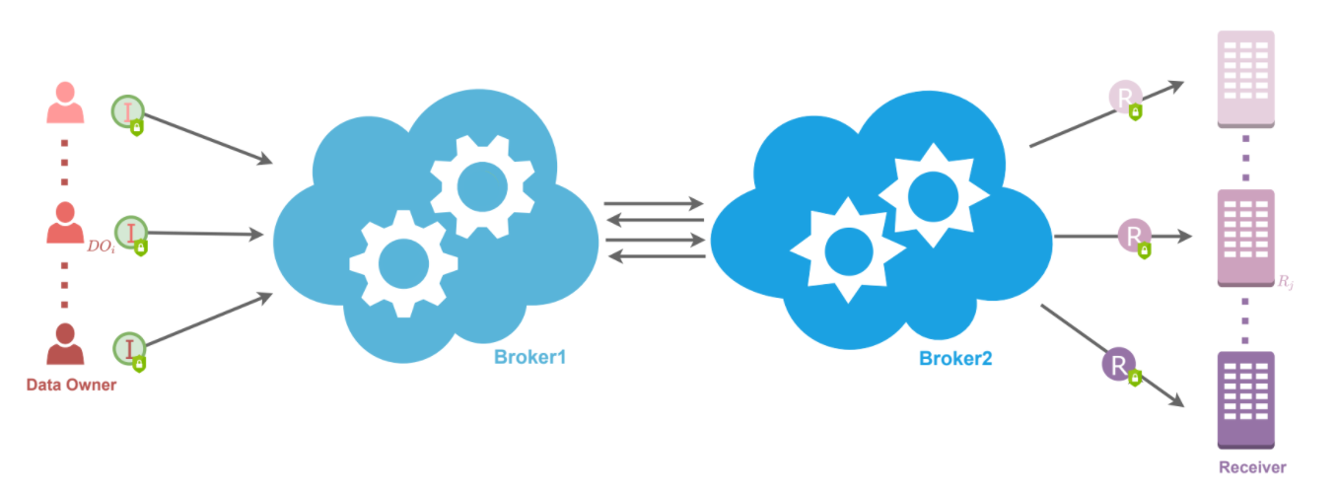
The Scenario - Phase 0
Each Data Owner
Generation of a symmetric shared key of DOi with Broker1 and one with with Broker2.
Each Receiver
Generation of its Receiver key Rj.
Each Broker
Broker1 and Broker2 specific keys.

Slide 5
The Scenario - Phase 1
Each Data Owner
Generates secret shares of its Choice Vector ci consisting choices of 0 or 1 for Receivers.
0 if the receiver is not Authorized
1 if the receiver is authorized
Sends ci1 to Broker1 and ci2 to Broker2.

Slide 6
The Scenario - Phase 1
Each Broker
After receiving shares of the Choice Vectors, adds these shares without any interaction with the other Broker.
This partial sum is sent to the other Broker.
Both Brokers bring together the partial sums to observe whether Receiver Rj is authorised:
If the total sum is bigger or equal to Threshold, Brokers operate the data aggregation over the private data for that Receiver.
Otherwise, the two Brokers stop processing for that Receiver.

Slide 7
The Scenario - Phase 2
Each Data Owner
Generates secret shares of its private Data Vector di for Receivers.
Each component of shared data vectors is encrypted with the keys of Rj and the keys of DOi with the two Brokers.
To be used for Beaver’s triplets, DO generates secret shares of random numbers αi and βi where γi = αi ∗ βi.
sends the shares of [di], ci, γi, αi, and βi to Broker1 and Broker2.
Notes:
(αi = αi1 + αi2 and βi = βi1 + βi2)

Slide 8
The Scenario - Phase 2
Each Broker
Unmask the known secret keys of DOik and Aggk to change the part of [dik] related to the DOik’s secret key to the Aggk’s secret key.
Agg1 and Agg2 end up with samples encrypted with the keys of Rj, Agg1, Agg2.
Adds all multiplication result vectors to find the data aggregation results for Receivers.
Finally, it has the data aggregation vector [sj ] which is equal to the summation (for i which goes from 1 to n) of [di] ∗ ci
Notes:
(αi = αi1 + αi2 and βi = βi1 + βi2)

Slide 9
The Scenario - Phase 3
Broker2
Sends the data aggregation vector to Broker1. Then he partially decrypts it for the authorised Receivers.
Broker1
Broker1 partially decrypts the data aggregation vector for the authorised Receivers and sends it to Broker 2.
Broker2
Sends the partially decrypted data aggregation vectors to authorised Receiver.
Authorised receivers
He will partially decrypt its part, merge all partial decryptions to get the data aggregation result.

Slide 10
02
Improvements
Improvements we applied to the MK-TFHE library

Slide 11
Improvements to MK-TFHE
We have done Four main improvements to the existing library:
PRELIMINARY. We have implemented some useful gates:
All basic gates present in TFHE library
Complex ones like Subtractor, XOR3, 2OF3, Shift_Left, ...
FULL ADDER. We have implemented a full_adder_v2 using the gates XOR3 and 2OF3
MULTIPLICATION. We have implemented a multiplier_v2 using shift left operations and additions
MK STRUCTURE. Improved the masking and unmasking operation to use data structures of maximum three keys.

Slide 12
FULL_ADDER_v2
We improve the full_adder by going from 5 Bootstrapping gates to only 2 which leads to an improvement from 45 sec to 18 sec for each addition
SUM = (A XOR B) XOR Cin
CARRY-OUT = A AND B OR Cin(A XOR B)
SUM = XOR3( A, B, Cin )
CARRY-OUT = 2OF3( A, B, Cin )
5 BOOTSTRAPPING GATES
ONLY 2 BOOTSTRAPPING GATES

Slide 13
MULTIPLICATOR_v2
MKLweSample *mulTimesPlain_v2(MKLweSample *total, int32_t val, …){ ... while (val > 0){ // check for set bit and left shift total, count times if (val % 2 == 1){ for (int i = 0; i < count; i++){ shift_reg(temp, total, … ); full_adder_v2(sumTemp, sum, …); … } } count++; val /= 2; } return sum; }

Slide 14
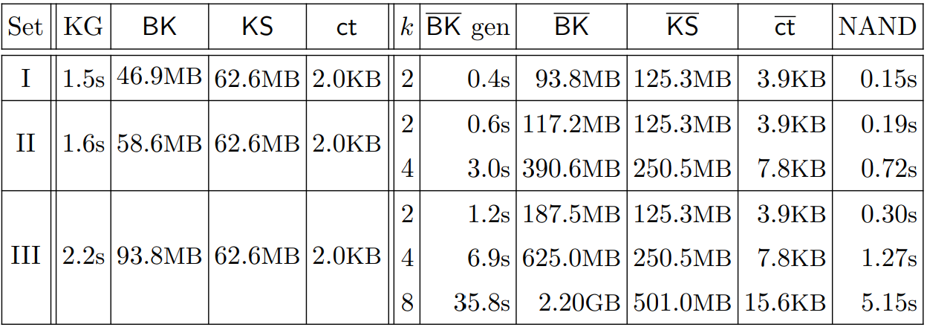
MK Structure Improvements
The final improvement is aimed at reducing as maximum as possible the number of keys:
Each Broker needs to store 4 keys 1 for each DO and 1 which will be replacing the others
Each data will need (at most) 3 layers of encryption only

Slide 15
Partial Masking/ Unmasking
To complete the protocol the library has been extended:
MKlweFirstPartyEncrypt
at p-th block of mask, generate a random mask and add to the masked message
at other blocks of mask, fill zeros
MKlweNthPartyEncrypt
Add p-th party mask
MKlweNthPartyUnmask
remove p-th party mask
MKlweLastPartyDecrypt
decrypt by removing the last party's mask

Slide 16
03
Demo
In this section we will see a “running” example

Slide 17
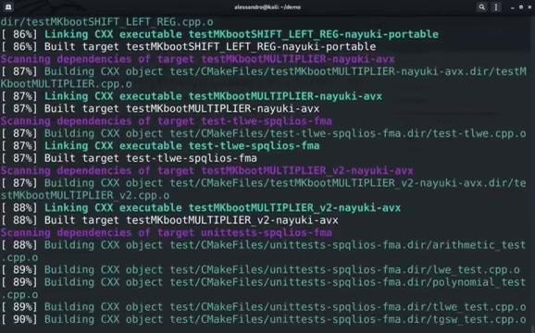
Cloning the working directory
Command ran:
Git clone -b only_three_keys https://github.com/federicagerminario31/MK-TFHE/
cd MK-TFHE
git submodule init
git submodule update
mkdir build
cd build
cmake ../src -DENABLE_TESTS=on -DENABLE_FFTW=off -DENABLE_NAYUKI_PORTABLE=on -DENABLE_NAYUKI_AVX=on -DCMAKE_BUILD_TYPE=debug
make

Slide 18
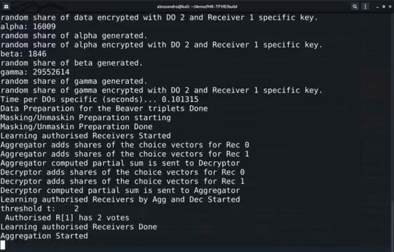
Key generation and Beaver’s Triplets
Command ran:
./test/PPanalytics-spqlios-fma
DO[0] has not authorized any receiver.
DO[1] has authorized
R[1] but not R[0]
DO[2] has authorized
R[0] and R[1]

Slide 19
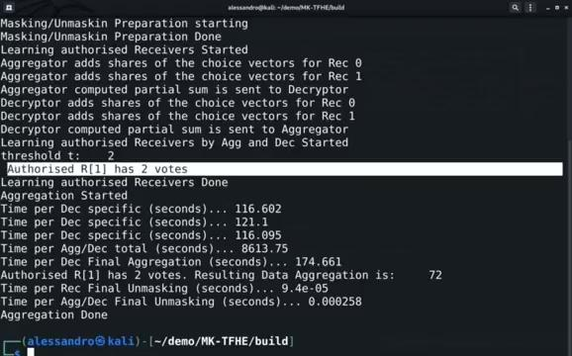
Final aggregation result
Once the Aggregation is done:
Receiver R[0] is not Authorized
Received R[1] is
authorized with 2 votes, one from DO1 and one from DO2
aggregated value received is 72.

Slide 20
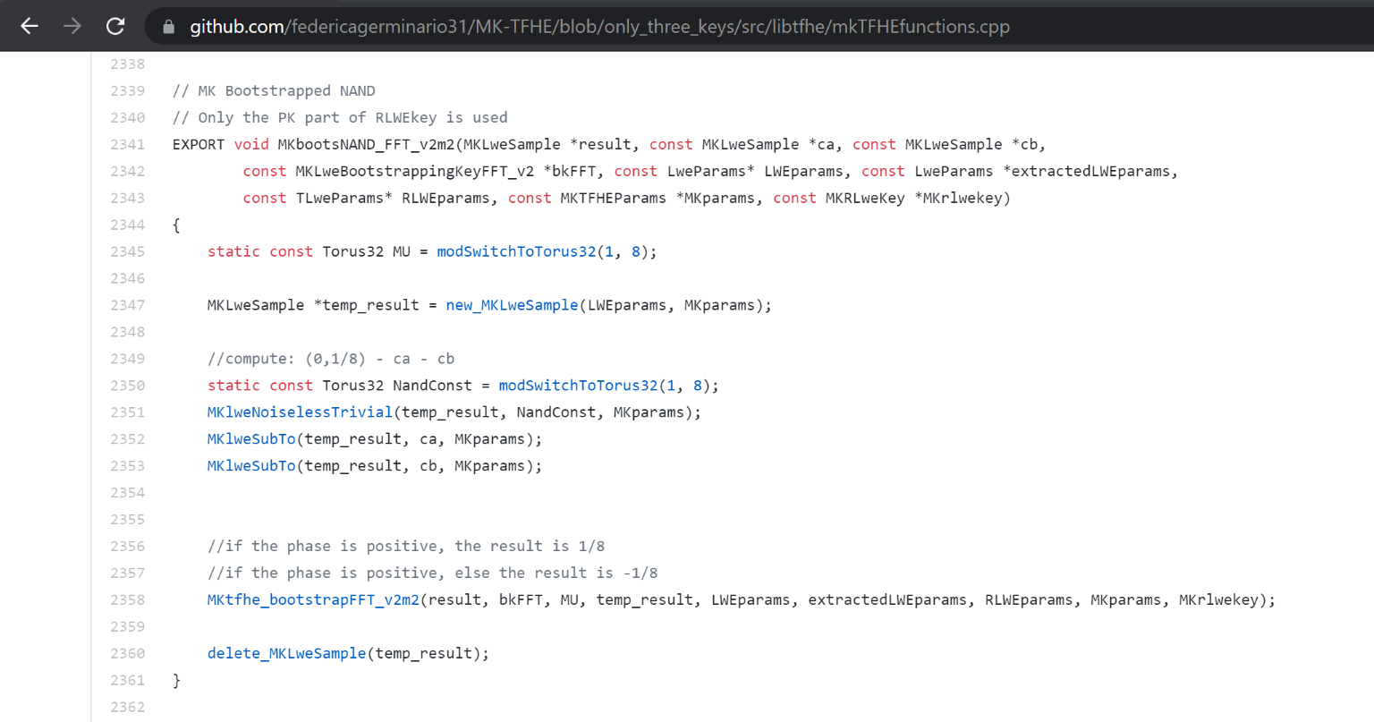
NAND
Only gate implemented from the beginning!
..But we need others!

Slide 21
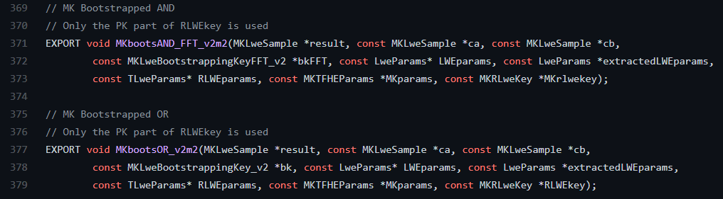
Gates we implemented...
Prototype of AND Gate
Prototype of OR Gate

Slide 22
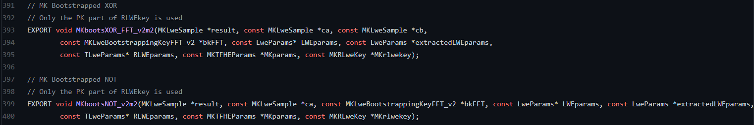
Gates we implemented...
Prototype of XOR Gate
Prototype of NOT Gate
Prototype of COPY Gate
Prototype of CONSTANT Gate

Slide 23
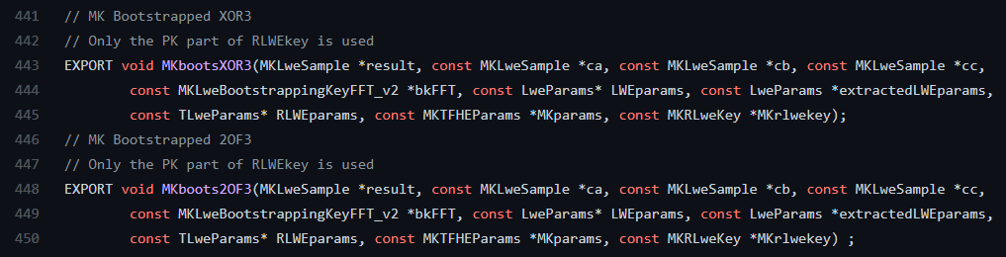
Gates we implemented...
Prototype of XOR3 Gate
Prototype of 2OF3 Gate
These new gates have been used to improve the Full Adder function...

Slide 24
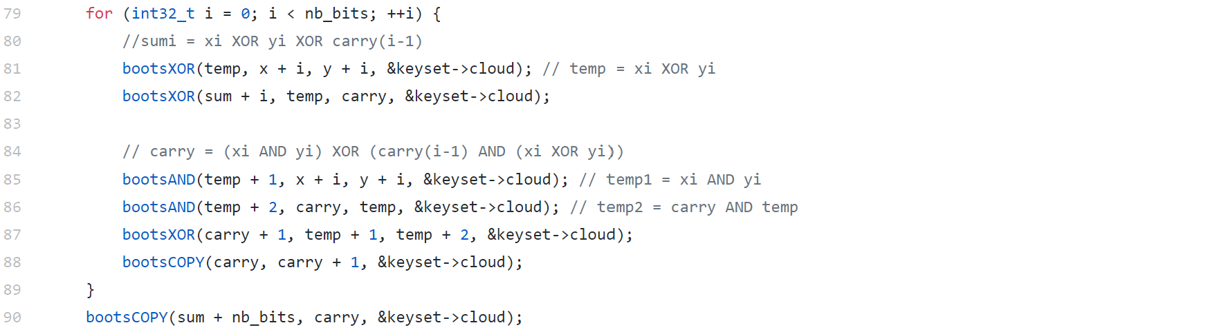
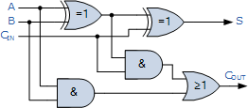
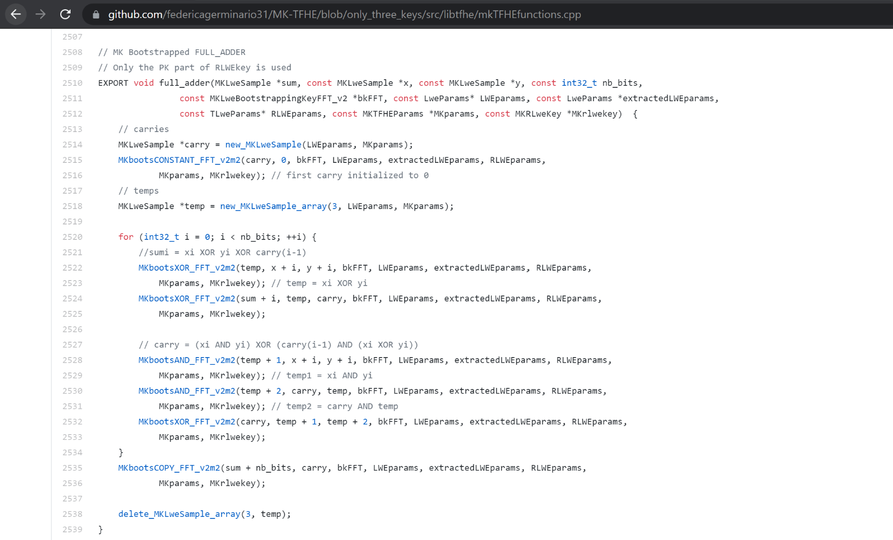
Full Adder
Total of 5 Gates needed, not efficient !!!
2 gates needed to calculate the sum
3 gates needed to calculate the carry

Slide 25
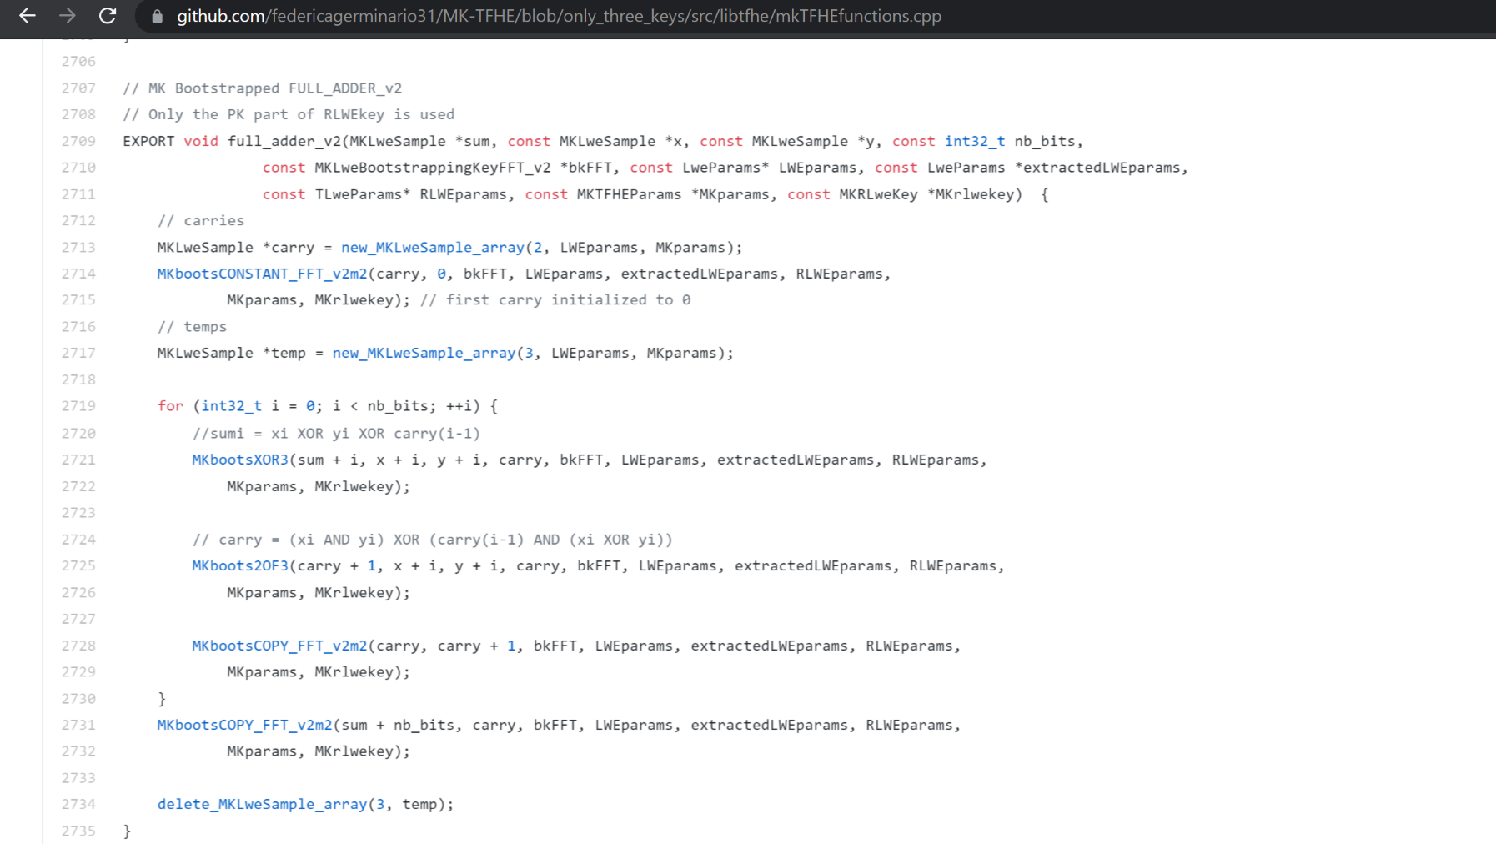
Full Adder (Improved version)
Total of 2 Gates needed, faster solution !!!
1 gate needed to calculate the sum
1 gate needed to calculate the carry

Slide 26
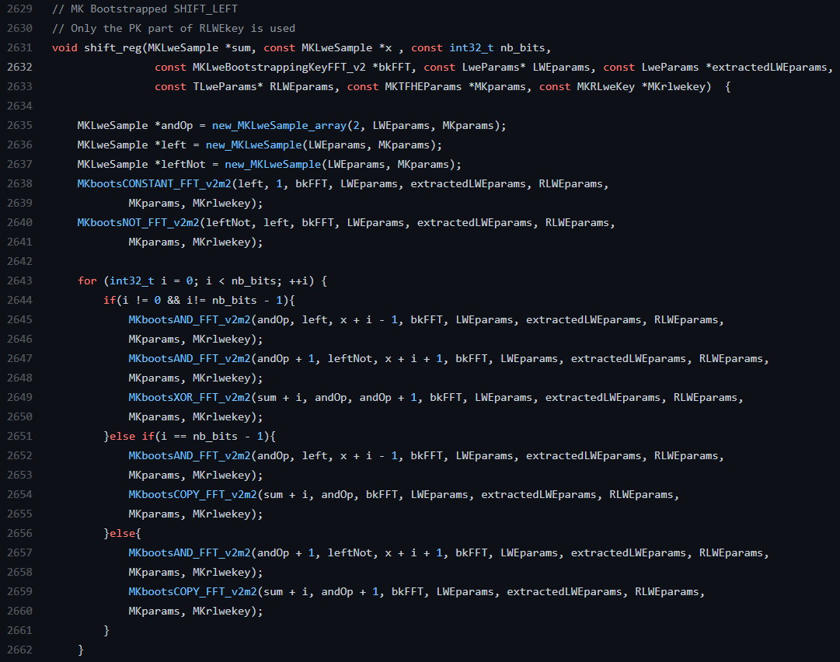
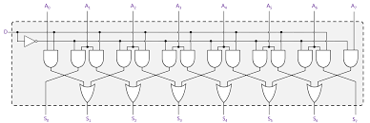
Functions we implemented...
This new function has been used to improve the Multiplier function...

Slide 27
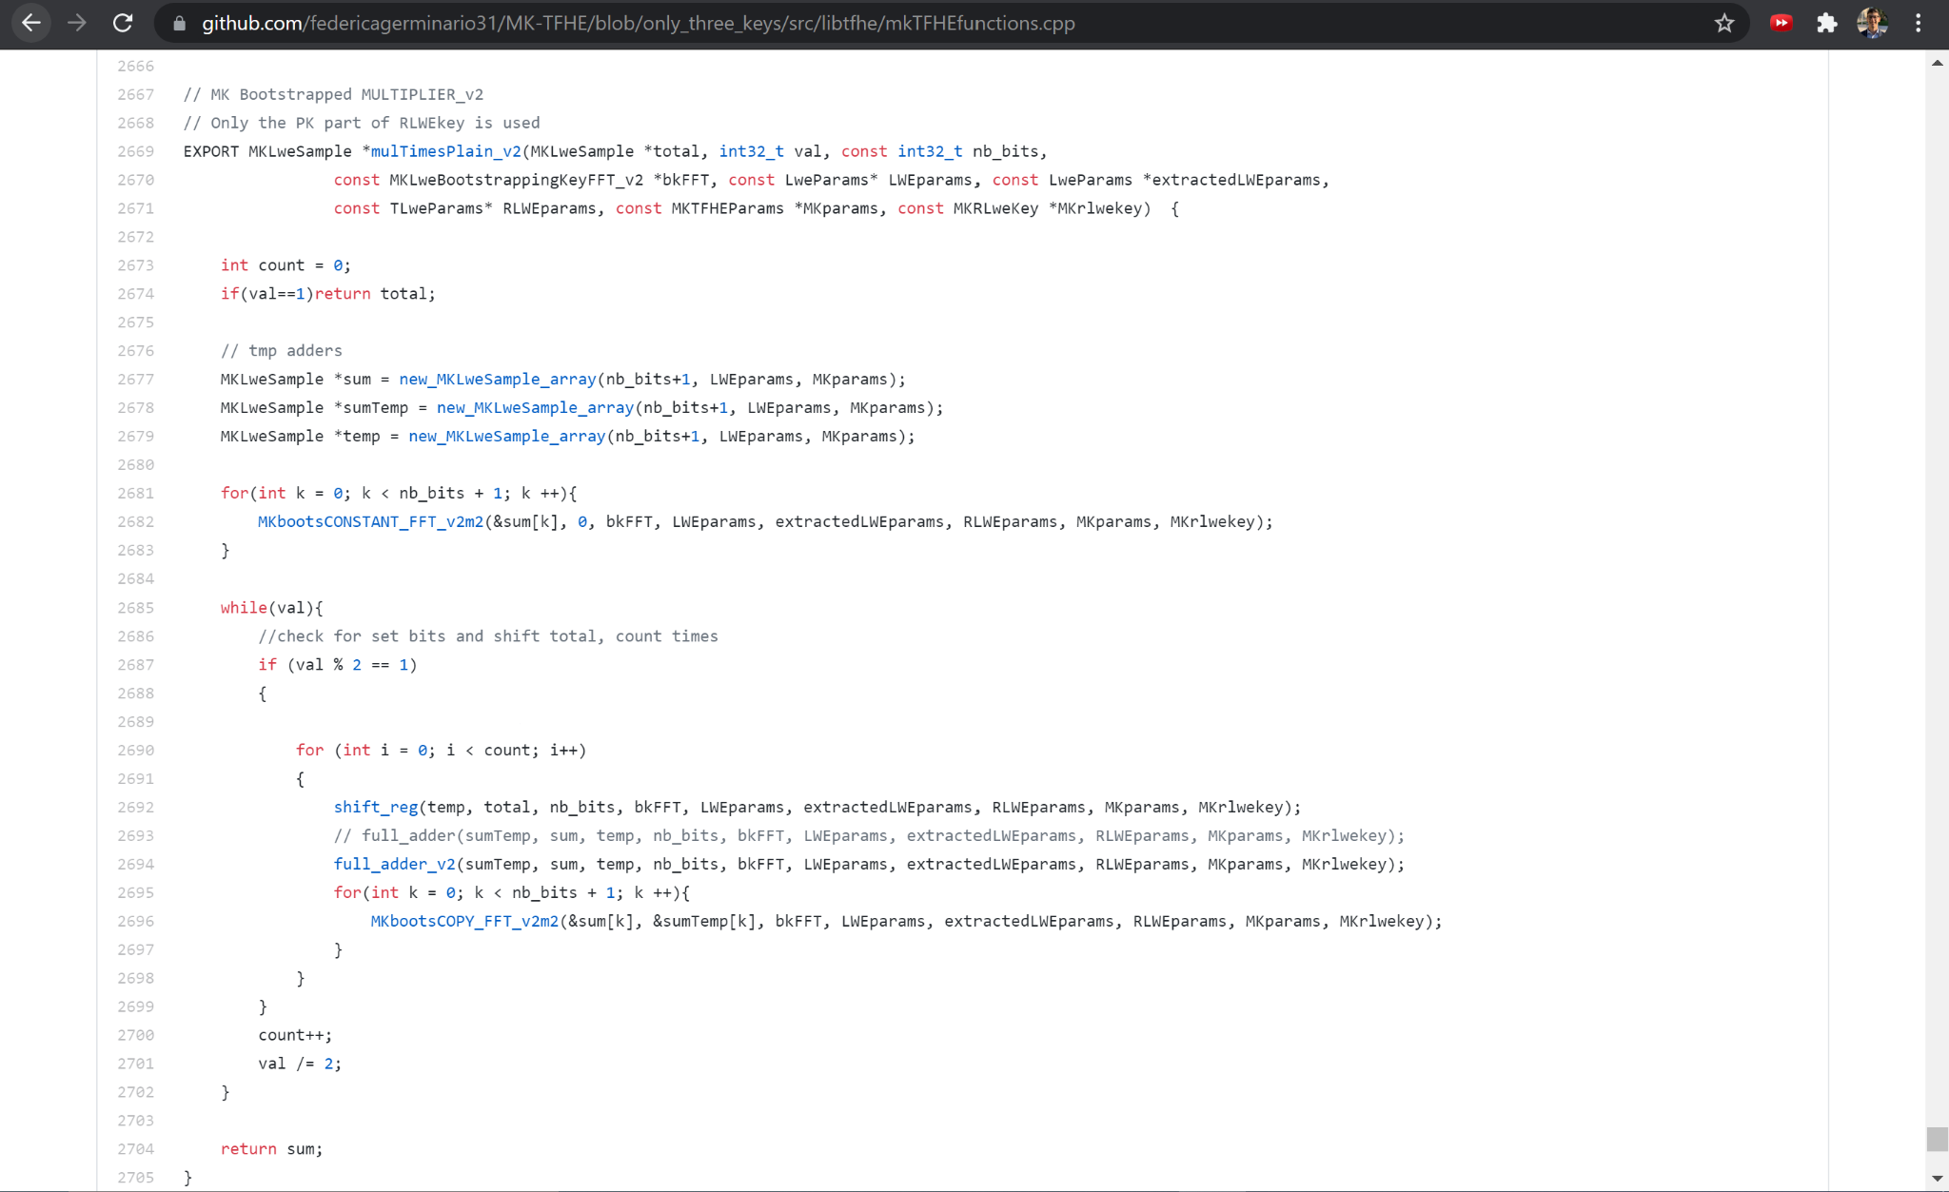
Multiplier (Improved version)
Solution based on the idea:
Left Shift = x2 Multiplication

Slide 28
04
Final results
In this section we analyze the obtained results in terms of time.

Slide 29
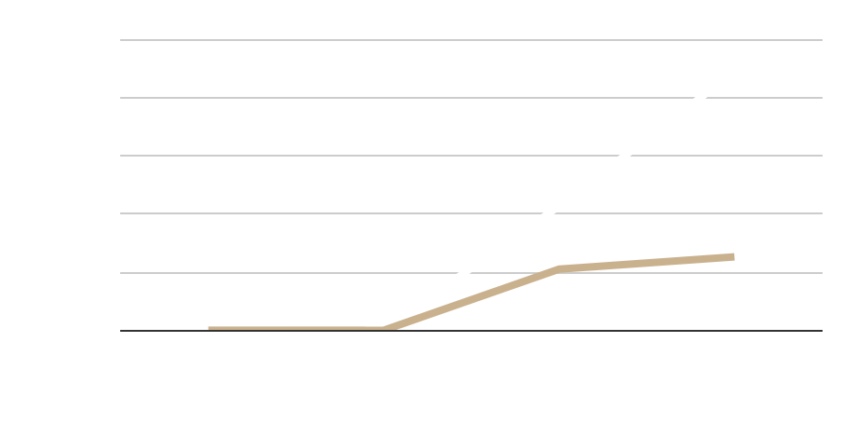
CONCLUSIONS
Results before modifications
Results after modifications
Modifications applied:
We used 4 keys instead of 9
The full_adder has been implemented using XOR3 and 2OF3 gates (going from 5 to only 2 bootstrapping gates required)
We improved multiplication as a function of shift left and additions
Reduction in time of more than 50%

Slide 30
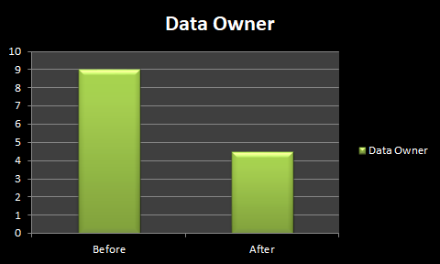
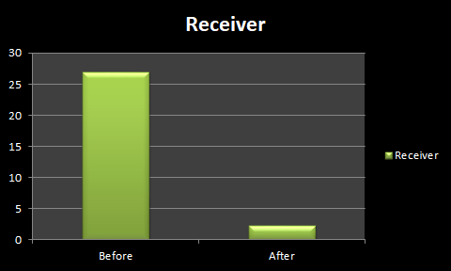

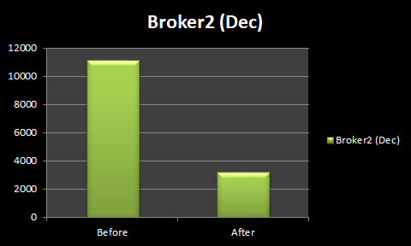
… In particular

Slide 31
References
[1] https://github.com/fakub/mk-tfhe/
[2] https://yongsoosong.github.io/files/papers/MKTFHE.pdf
[3] https://github.com/federicagerminario31/MK-TFHE
[4] Beaver, D.: Efficient multiparty protocols using circuit randomization. In: CRYPTO (1991)
[5] https://tfhe.github.io/tfhe/

Slide 32

Thank You
Do you have any questions?

