Slide 1

Calculating SEAP from measurements fully automatically
By Andre Potthoff

Slide 2
Why R?
Easy, reliable
Just drag the script to the folder where you have your data
Just open and run
Works offline
People are used to work in excel anyway
Easy to modify/adapt
fast

Slide 3
What we implemented
And how our script looks like

Slide 4
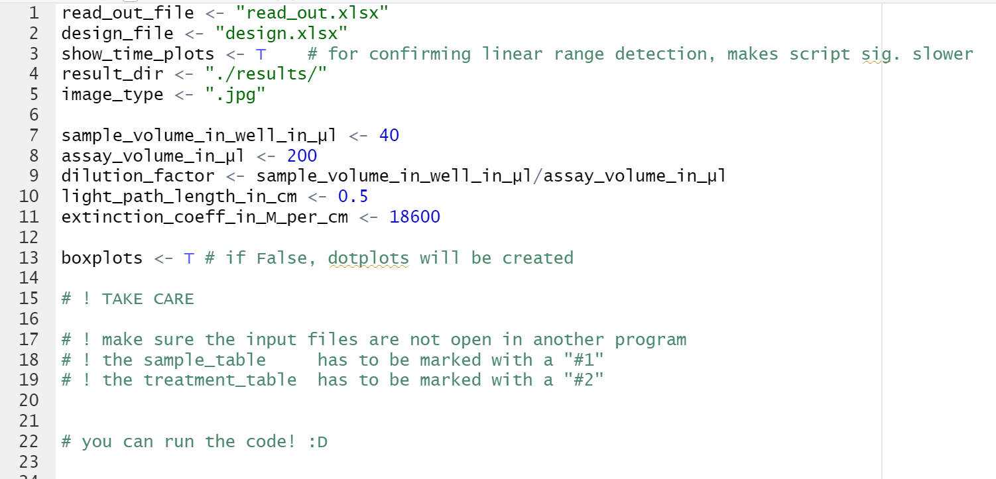
prerequisites

Slide 5
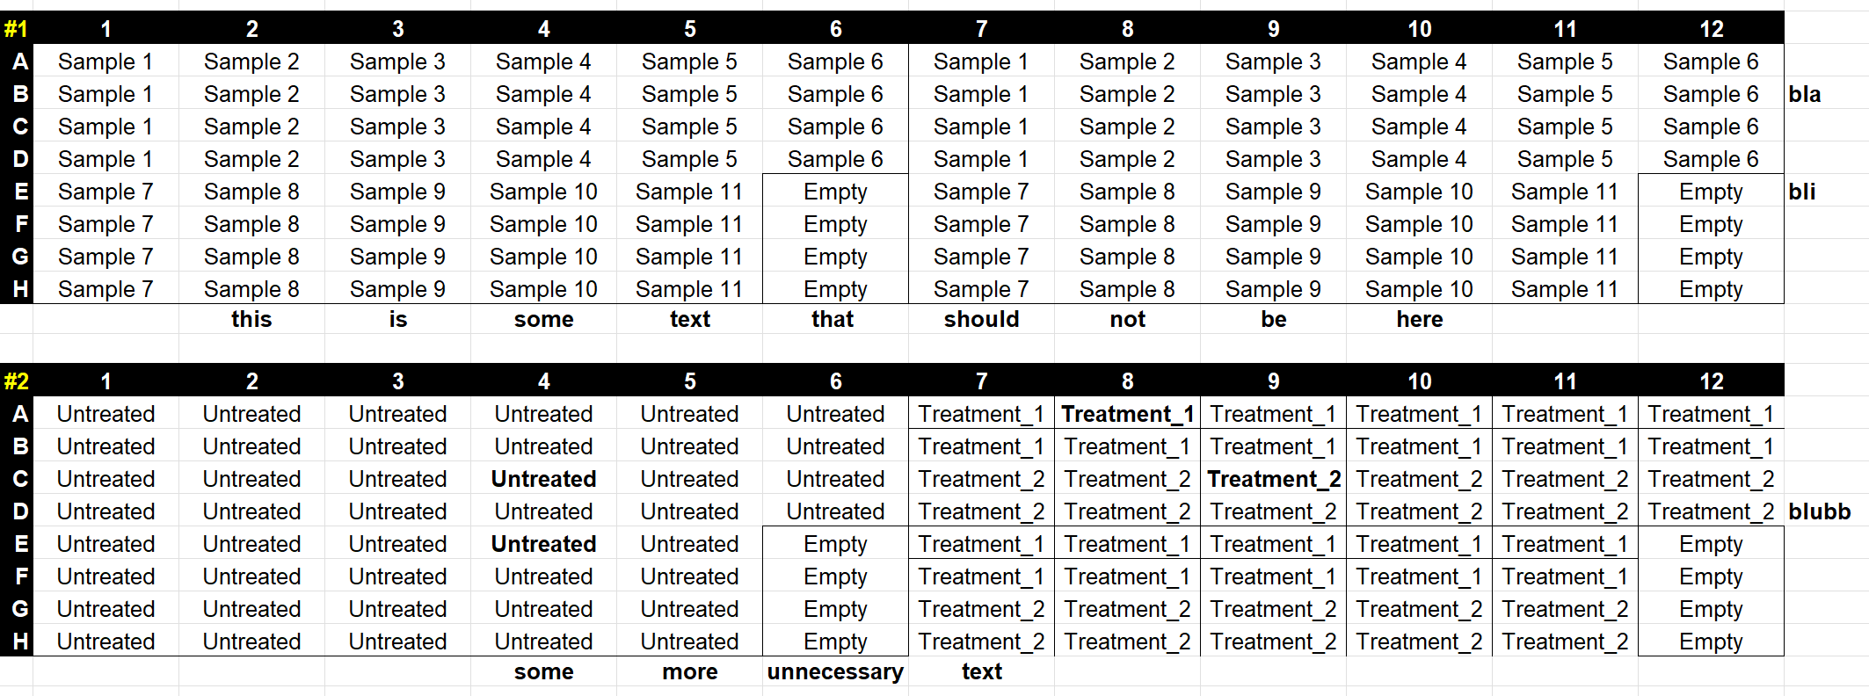
Prerequisites for the files

Slide 6
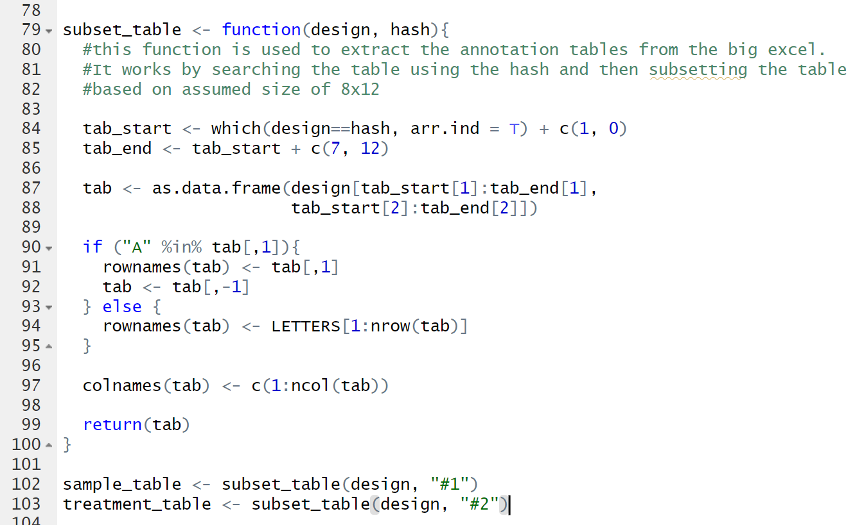

Slide 7
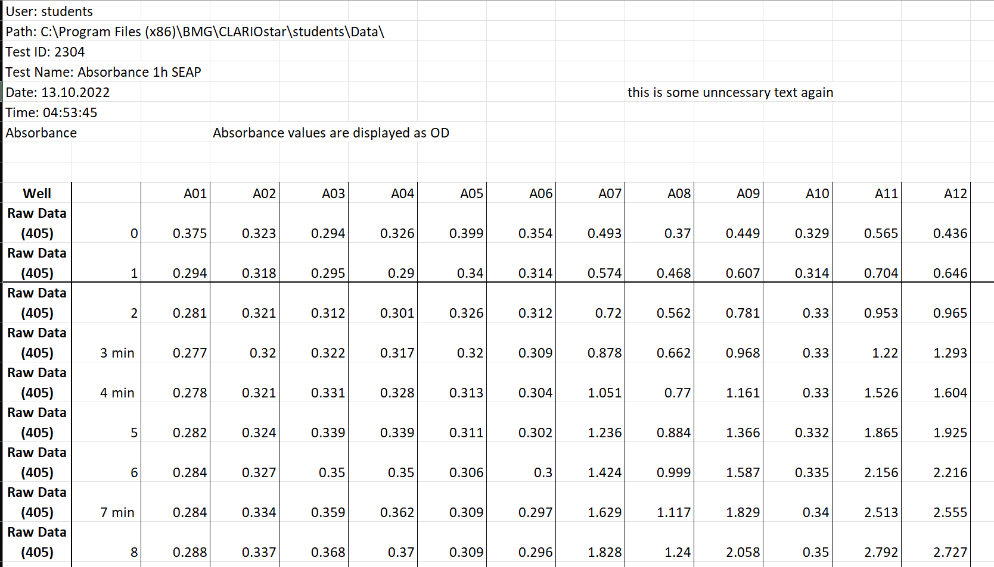
Prerequisites for the files

Slide 8
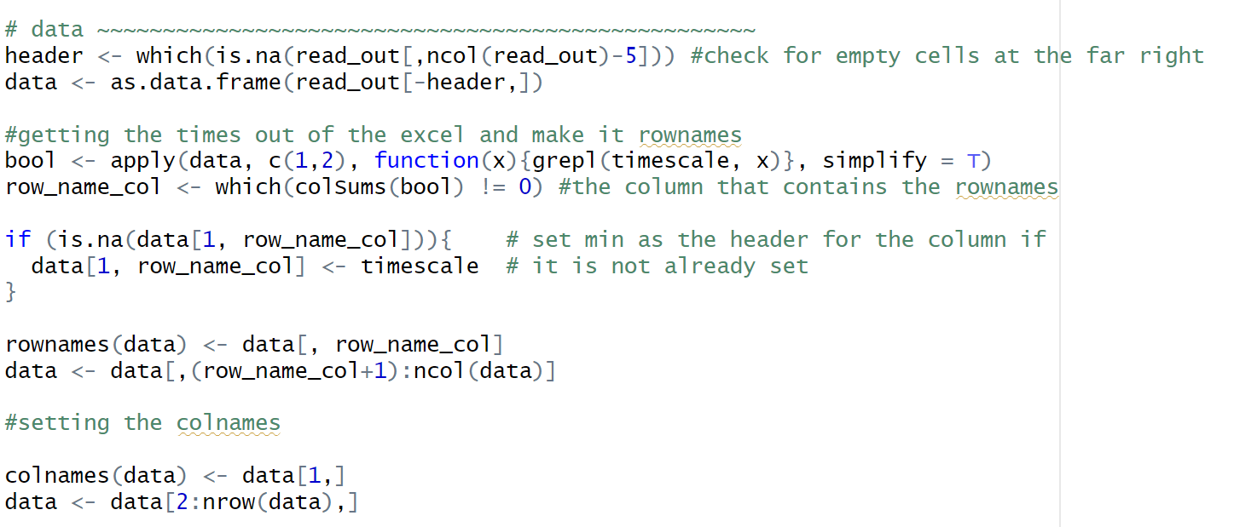

Slide 9
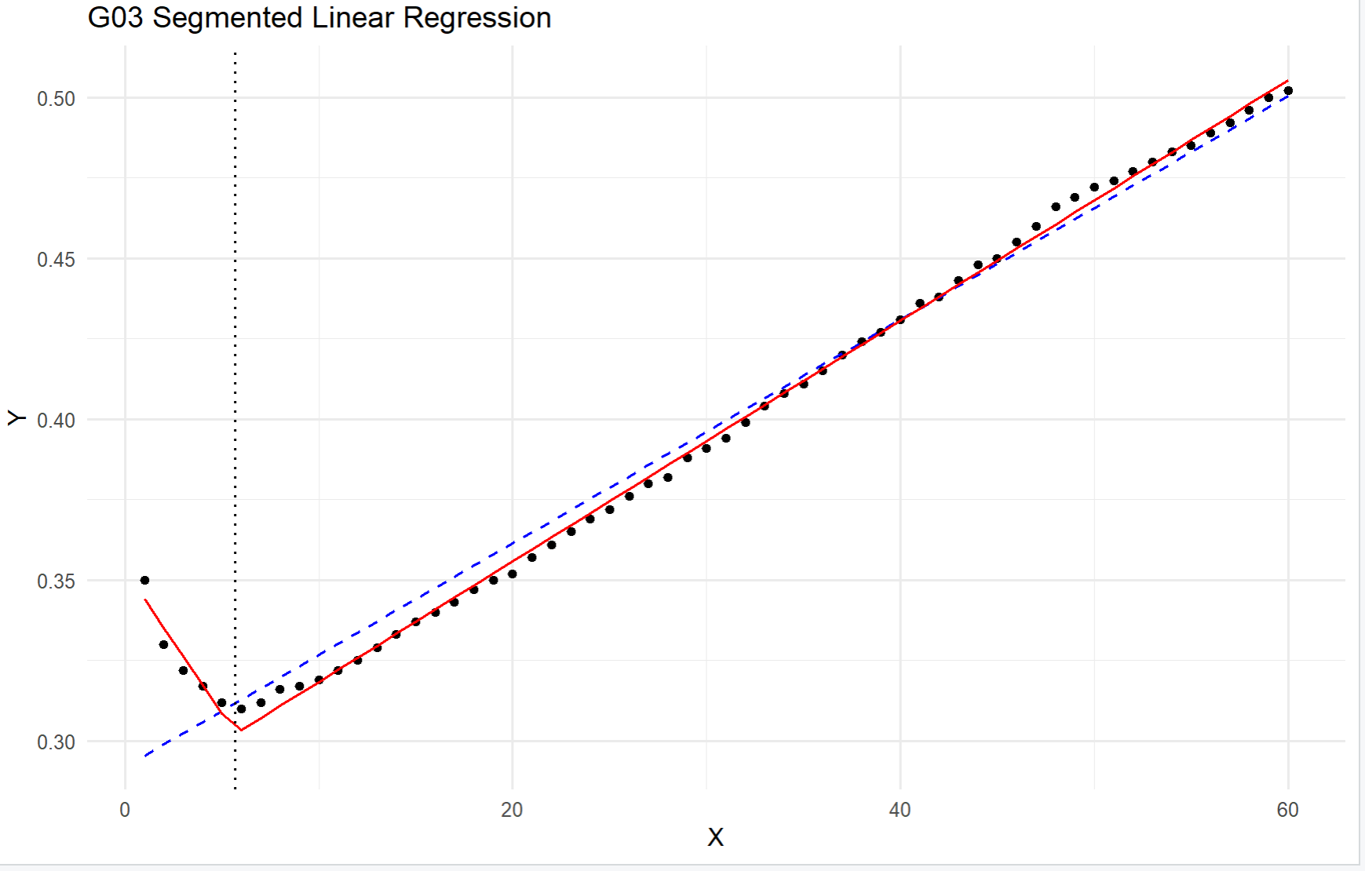
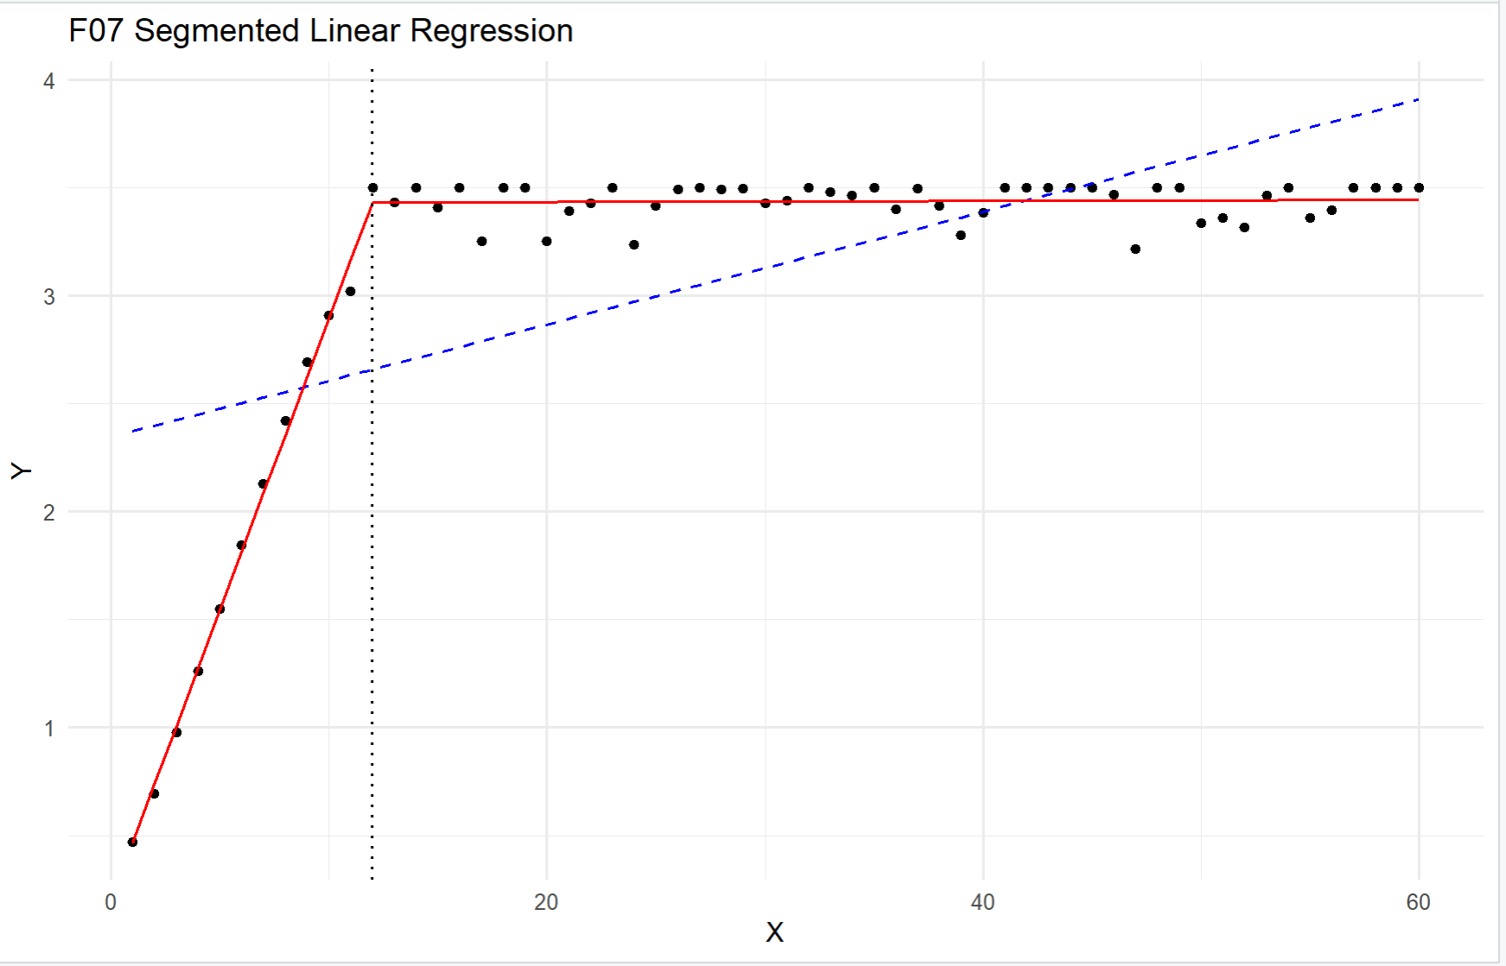
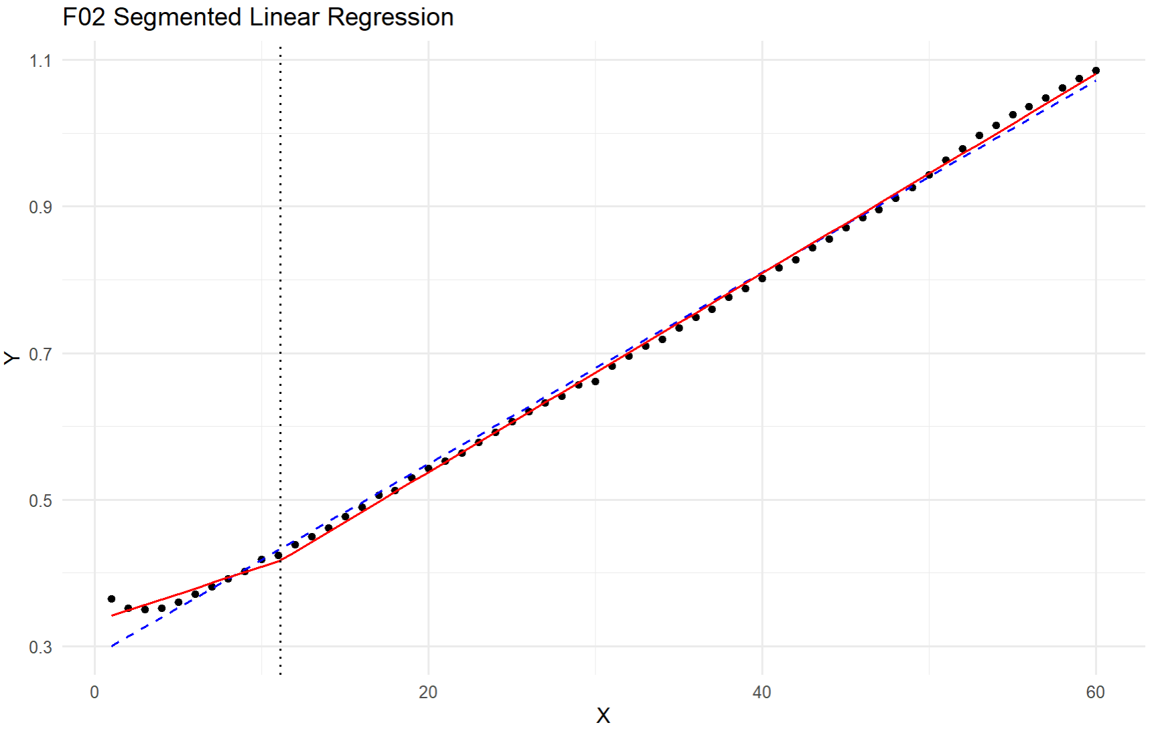
Linear range detection

Slide 10
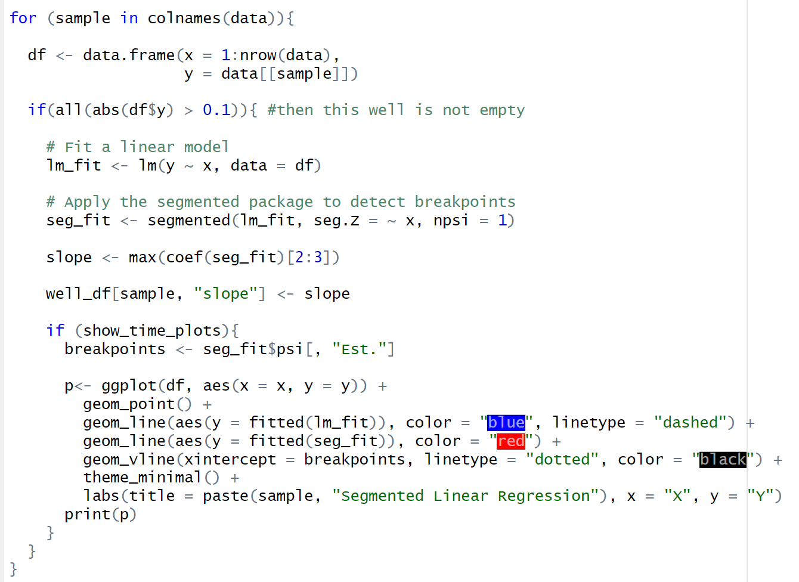

Slide 11
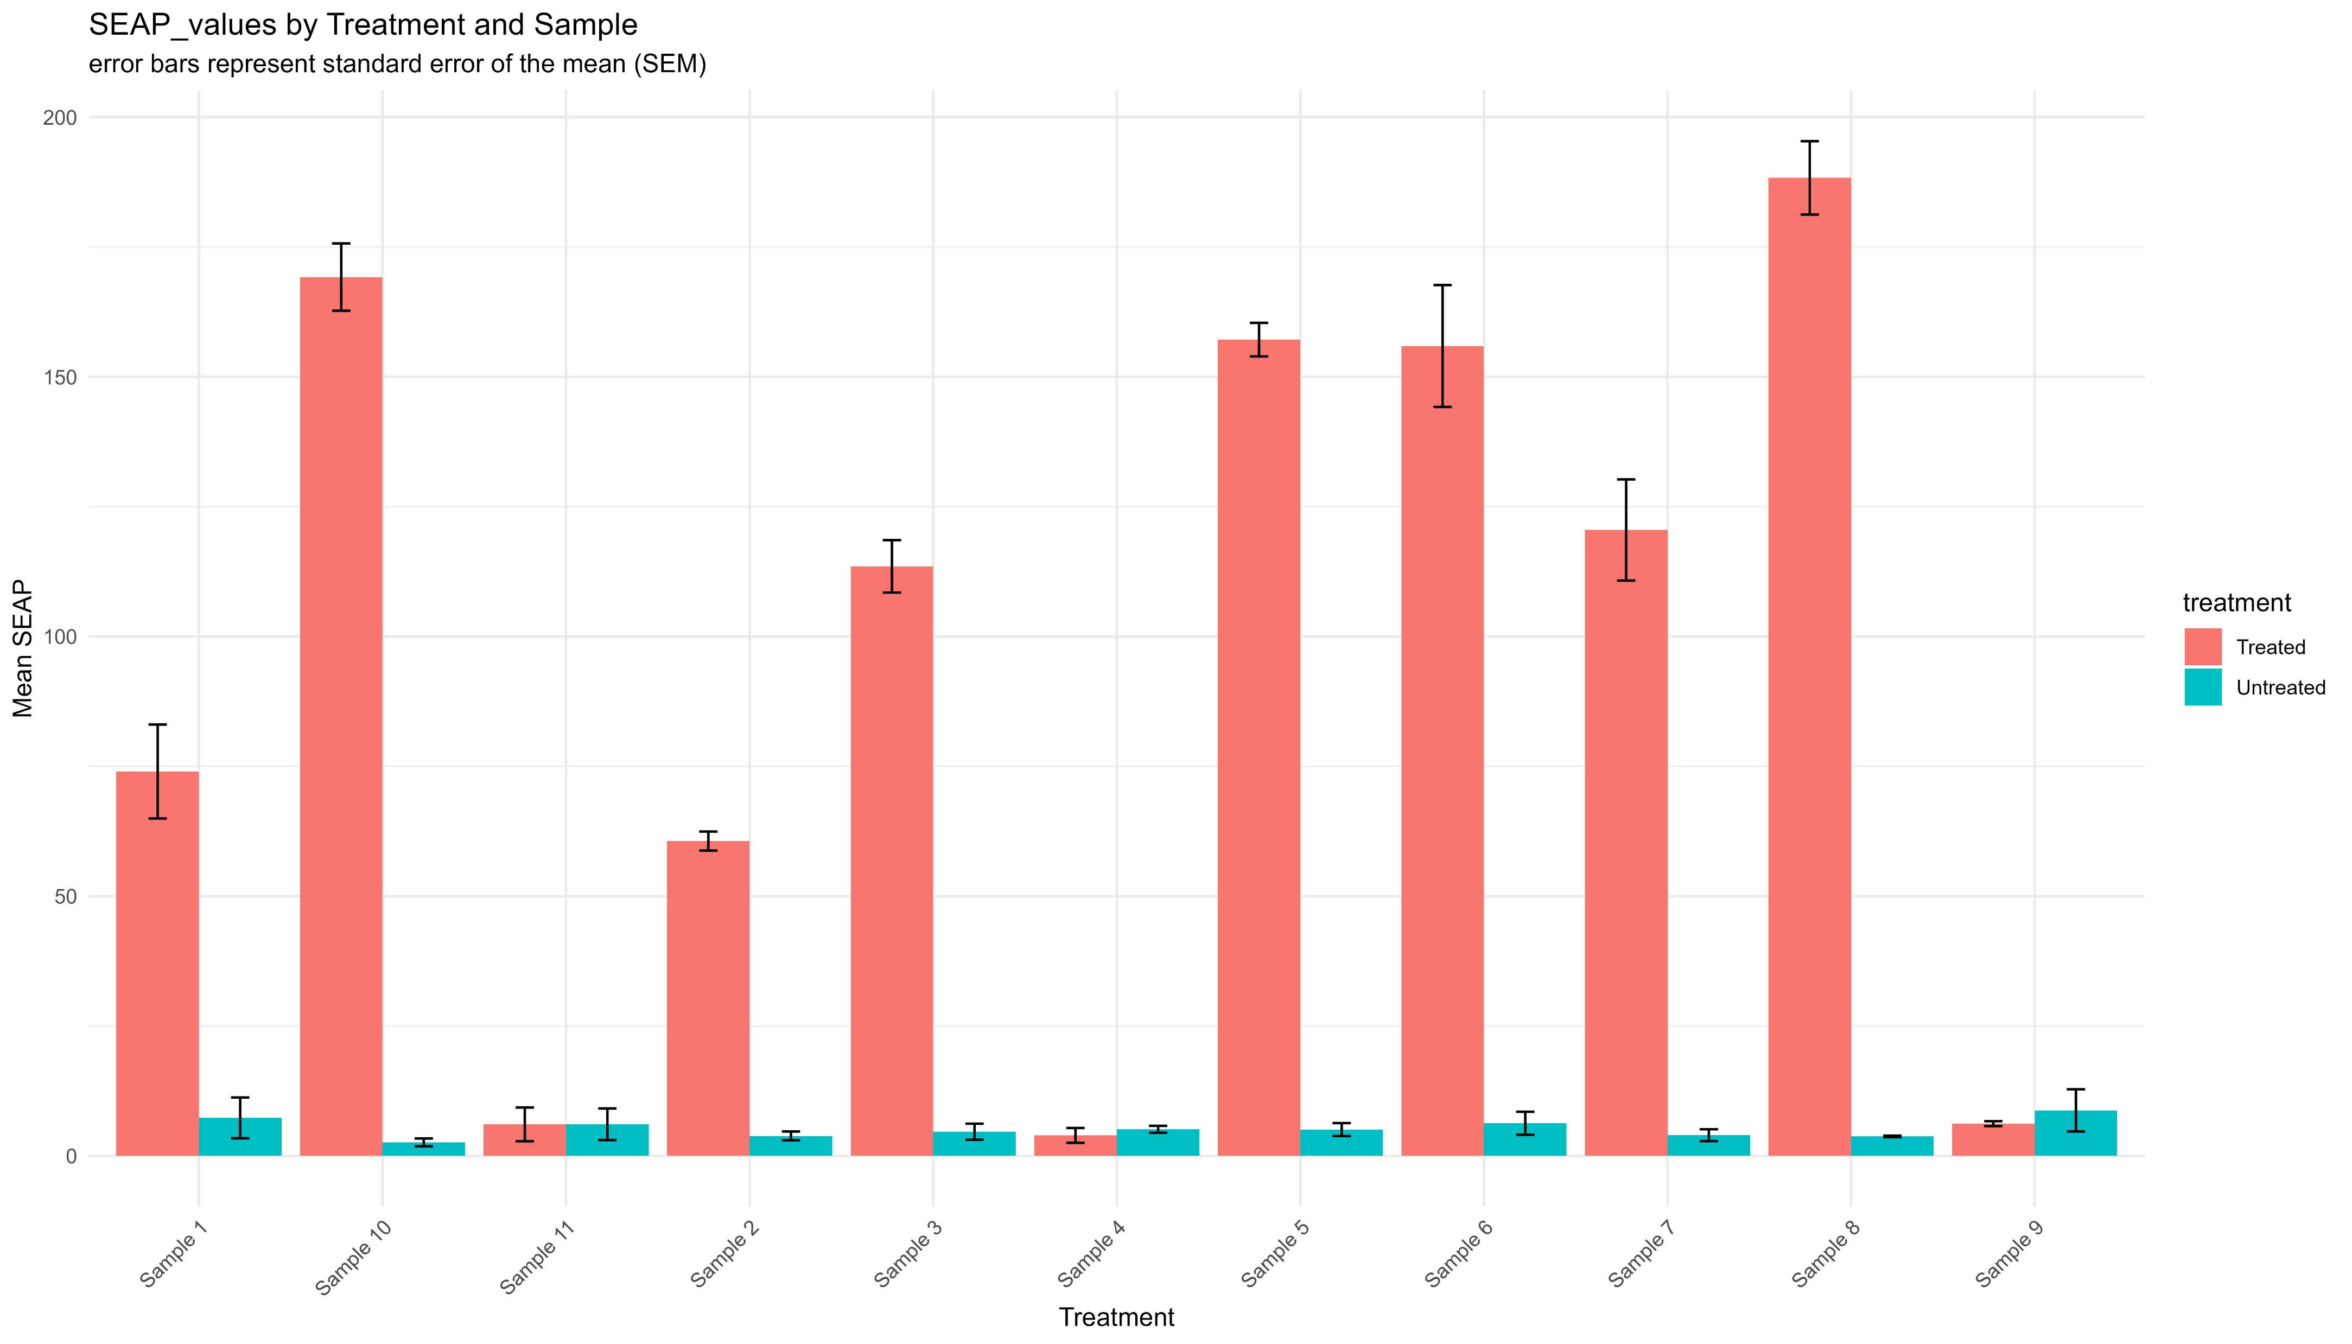
Output

Slide 12
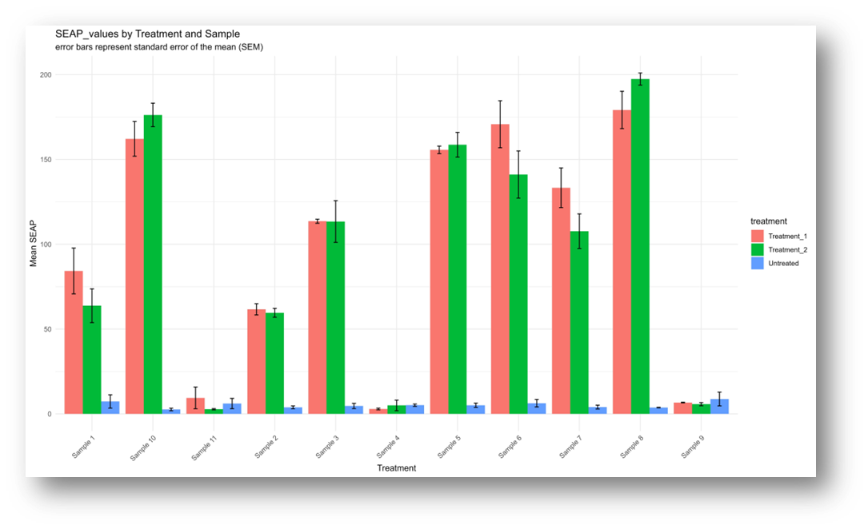
Output

Slide 13
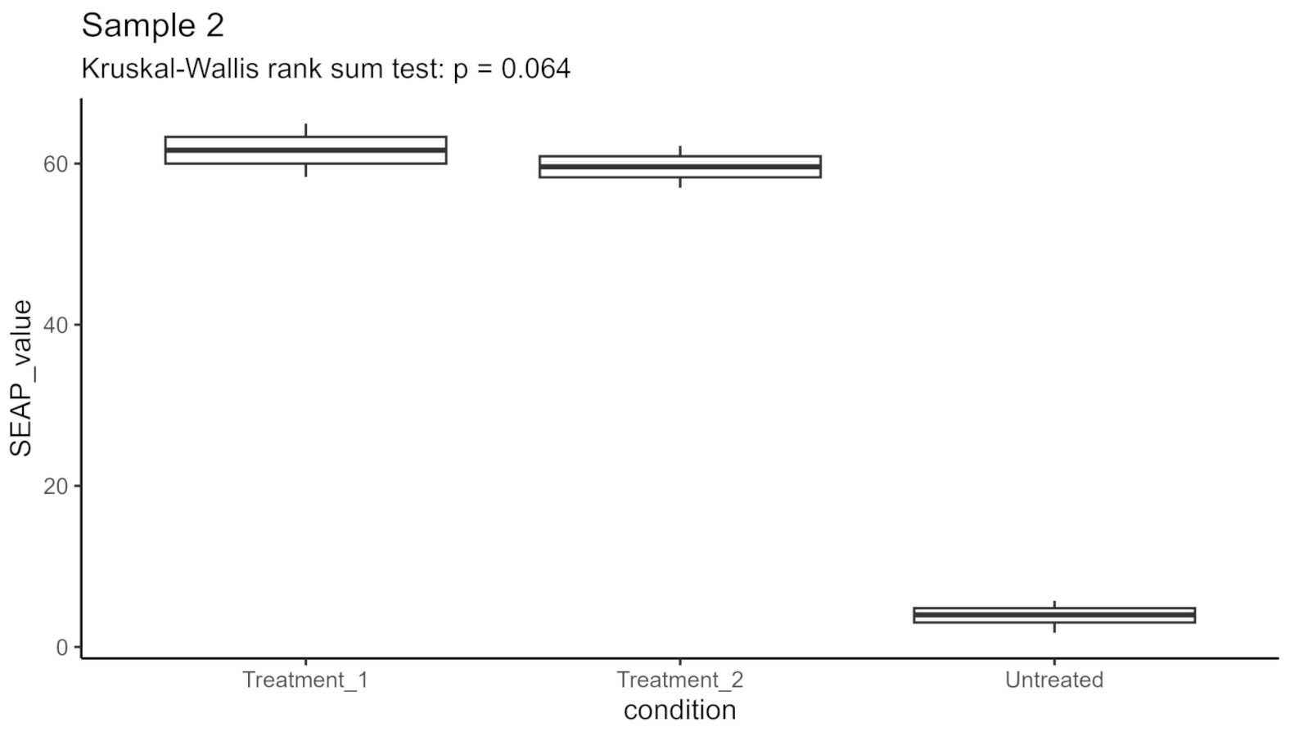
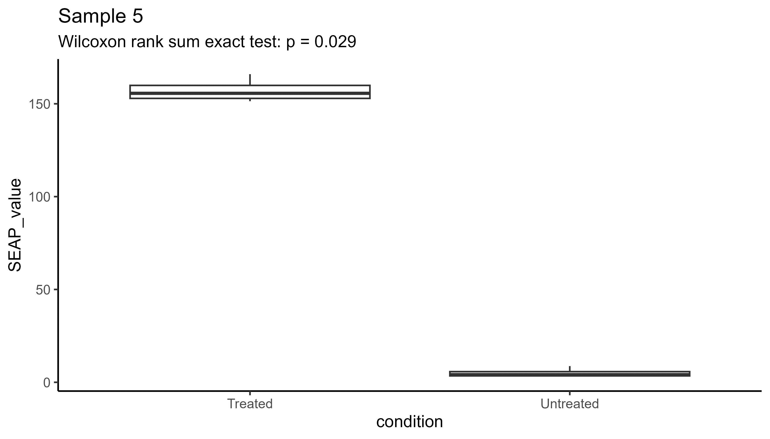
Output

Slide 14
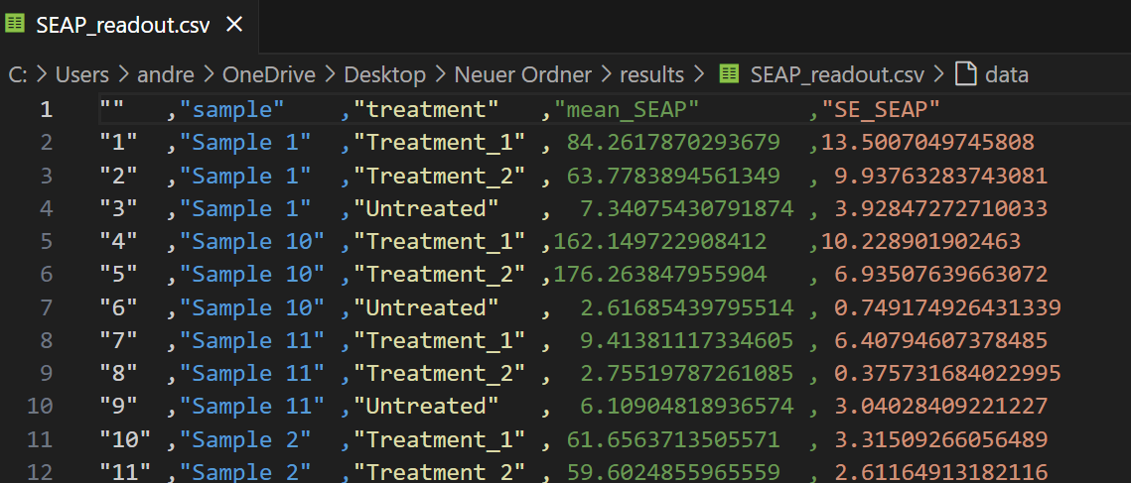
OUtput

Slide 15
Benefits of our script
Automatically detects headers of different sizes in read_out file
Is flexible wrt the order of samples and treatments and their replicate number
Can handle >2 groups (automatically chooses appropriate statistical test)
Automatically excludes empty wells
Returns and automatically saves a diversity of outputs (both graphical and machine readable)
Quite fast

Slide 16
Live demo

