Slide 1
PROJECT PRESENTATION
Cloud-Based Road Damage Reporting and Monitoring System
Turning citizen reports into faster, data-driven road repairs
Presented by [Name] · [Institution / Course] · [Date]

Slide 2
Why we need it
FOUR GOALS FOR THE PLATFORM
THE PROBLEM
Manual reporting
1
2
Phone, letter or walk-in complaints with no exact location or photo.
Easy reporting
One cloud platform
Log damage with a photo and GPS in a few taps.
Store every report in a single scalable system.
Scattered records
Each department keeps its own data, so duplicates go unnoticed.
No feedback loop
3
4
Citizens rarely learn if a pothole was scheduled or repaired.
Smart prioritisation
Transparent tracking
Rank repairs by severity, traffic and repeat reports.
Show live status from submission to completed repair.
Result: damaged roads stay open longer, raising accident risk.

Slide 3
How the system works
1
2
3
4
5
Report
Validate
Prioritise
Assign
Resolve
A citizen uploads a photo; the app adds GPS and time.
The cloud checks the image and merges duplicate reports.
Severity and traffic level decide the repair queue.
An officer dispatches a repair crew from the dashboard.
The crew uploads an after-repair photo and the citizen is notified.
Report status lifecycle
Submitted
→
Verified
→
Assigned
→
In progress
→
Resolved

Slide 4
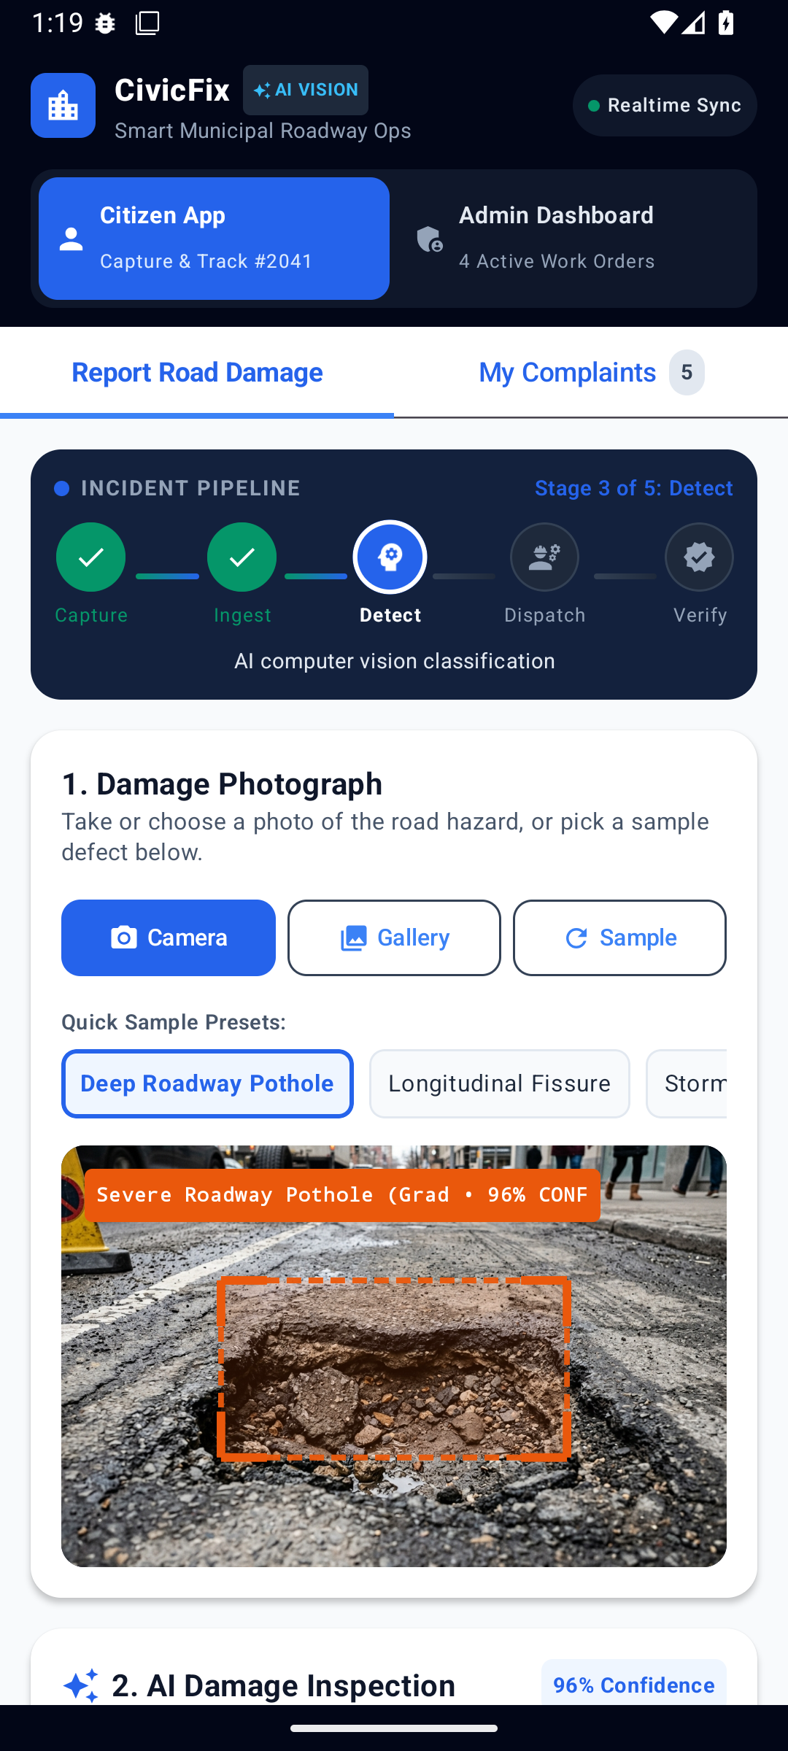
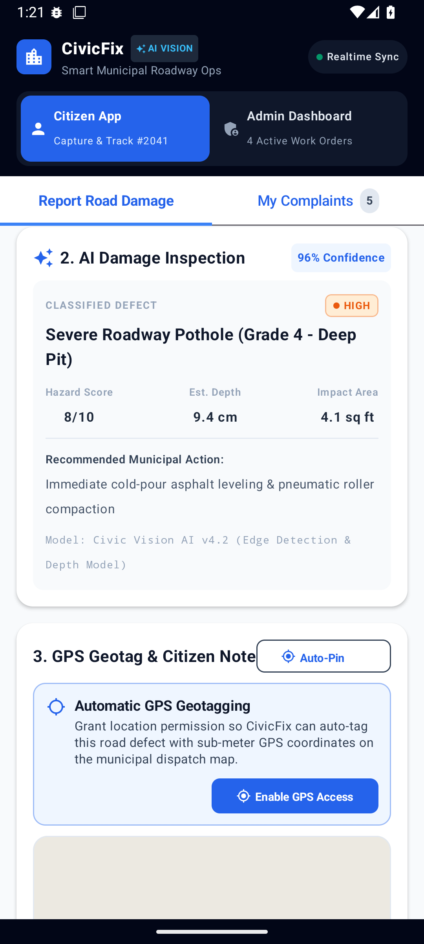
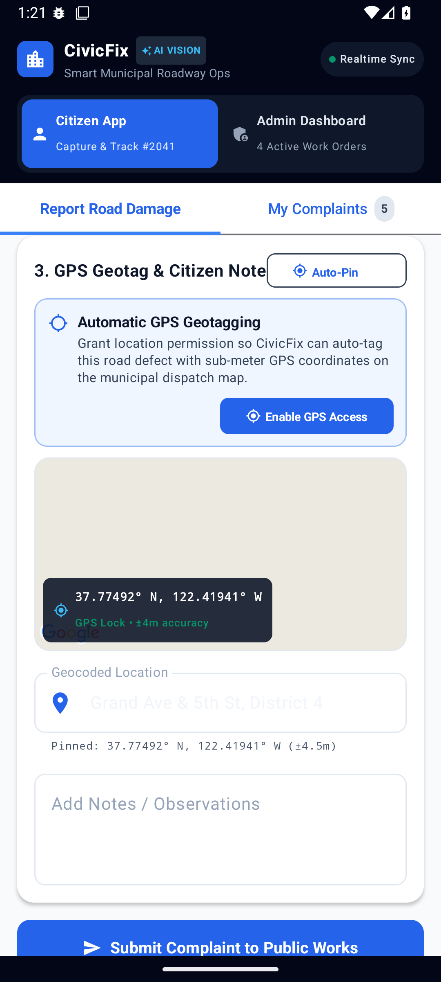
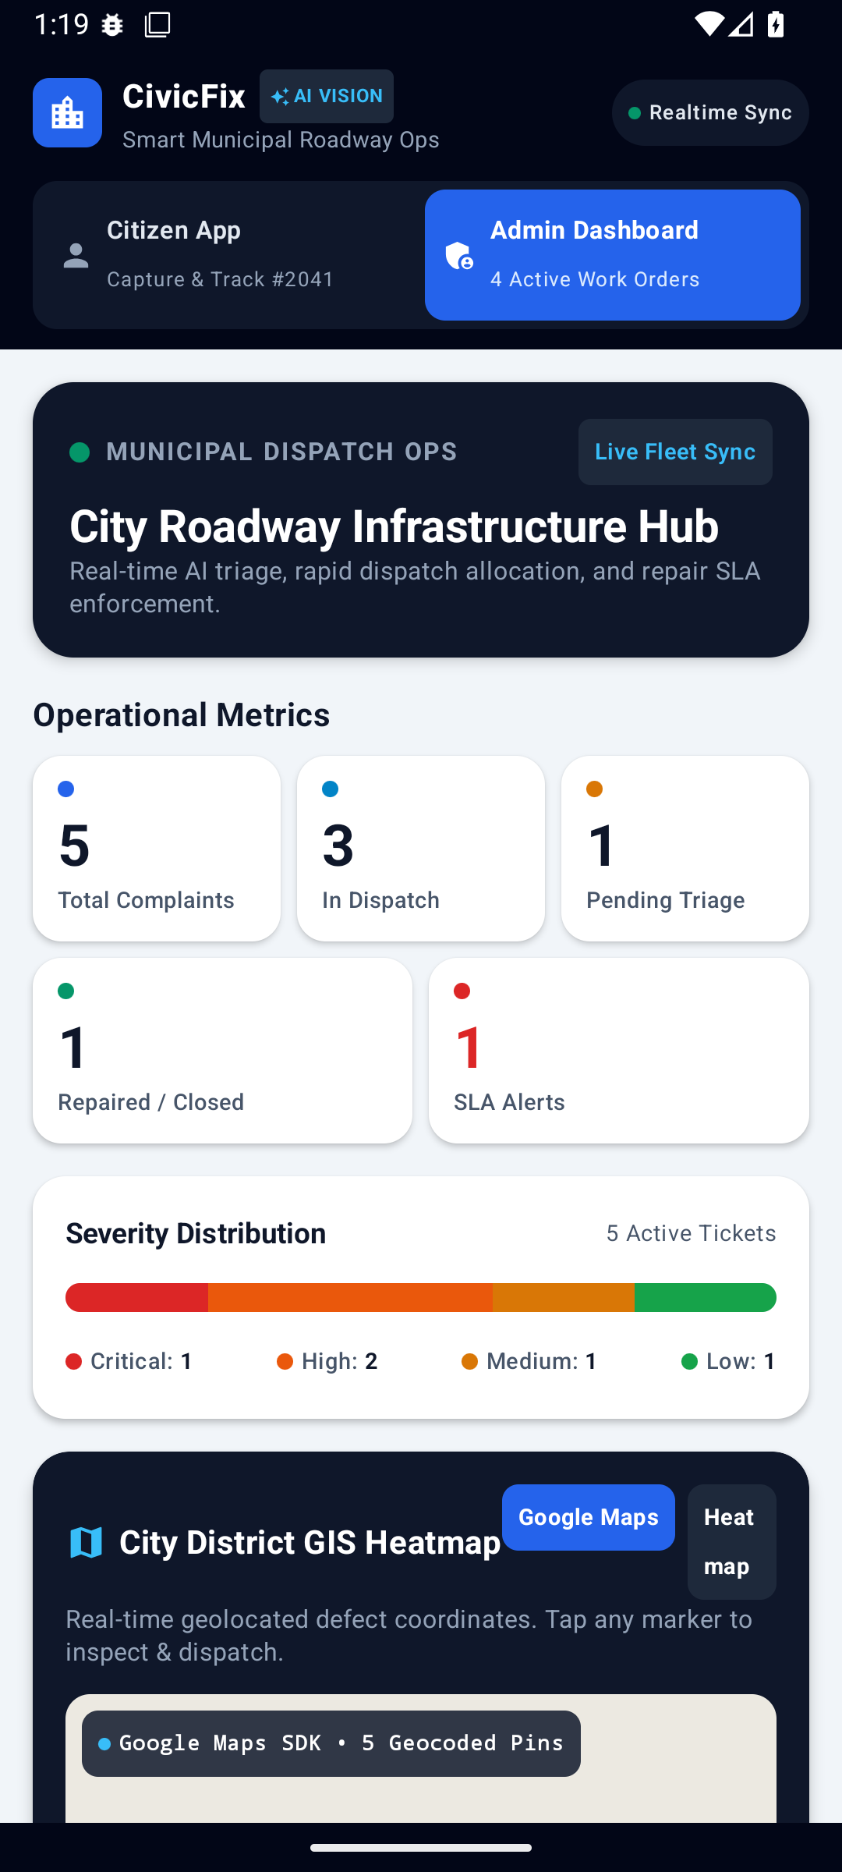
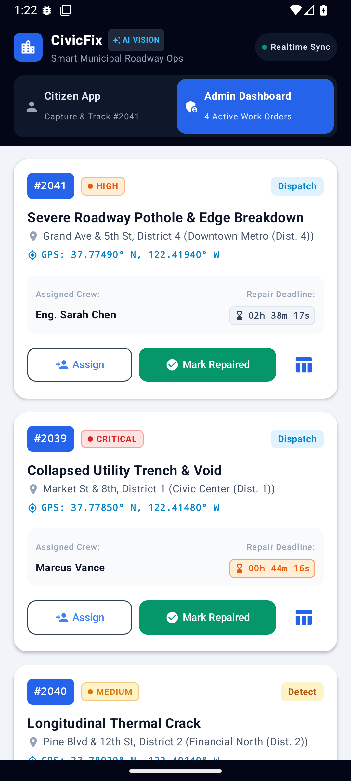
How the app works
1. Capture
AI detects the damage
2. Inspect
Severity, depth, action
3. Geotag
GPS pin and notes
4. Triage
Admin metrics and map
5. Dispatch
Assign crews, track SLA

Slide 5
Four cloud layers, one tech stack
LAYER 1
LAYER 2
LAYER 3
LAYER 4
Client
Access
Processing
Storage
Citizen app, web portal, authority dashboard, field-crew app
API gateway, authentication, load balancer, push alerts
Report service, AI detection, duplicate and priority engine
Image storage, geospatial database, cache, logs and backups
PROPOSED TECH STACK
Mobile app
Web dashboard
Backend API
Flutter or React Native
React + map library
FastAPI or Node.js
AI model
Database
Cloud services
CNN / YOLO detection
PostgreSQL + PostGIS
AWS S3, Lambda, Cognito

Slide 6
What the platform offers
1
Photo and GPS reports
2
AI damage detection
3
Duplicate merging
Location and time captured automatically.
Spots potholes and cracks and rates severity.
Nearby reports of one defect become one case.
4
Priority scoring
5
Live status alerts
6
Analytics dashboard
Severity, road type and traffic set the priority.
Citizens are notified at every repair stage.
Maps and charts reveal hotspots and repair times.
One dashboard for every road
Live severity map · Filters by area, type, status and date · Crew assignment and progress tracking · Trend charts

Slide 7
Benefits, risks and mitigations
Citizens
Challenge | Mitigation
Fake or blurry reports | AI validation, GPS and time checks
Weak roadside internet | Offline capture, upload later
Privacy of location data | Encryption and role-based access
Cost as reports grow | Serverless auto-scaling, storage rules
Low citizen participation | Simple app and status alerts
Report in a few taps, follow status live, get notified when fixed.
Authorities
One clear view of damage, data-based priorities, fewer duplicate inspections.
Society
Safer roads, lower vehicle repair costs, more trust through open tracking.

Slide 8
Where the system can grow
1
Detection from vehicle dashcams and sensors
Thank You
2
Drone and satellite imagery for road surveys
3
Predictive maintenance before roads fail
One cloud platform connecting citizens, crews and planners to fix roads faster.
4
Smart-city and municipal integration
Questions and discussion
5
Multilingual and voice-based reporting
[Name] · [Email]

