Slide 1

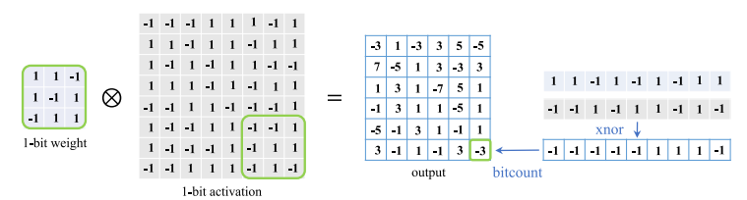
Binary Neural Networks (BNN)
32 bit Weights => 1 bit Weights
Naive BNN and Optimization based BNN
Forward Propagation:
Backward Propagation:

Slide 2
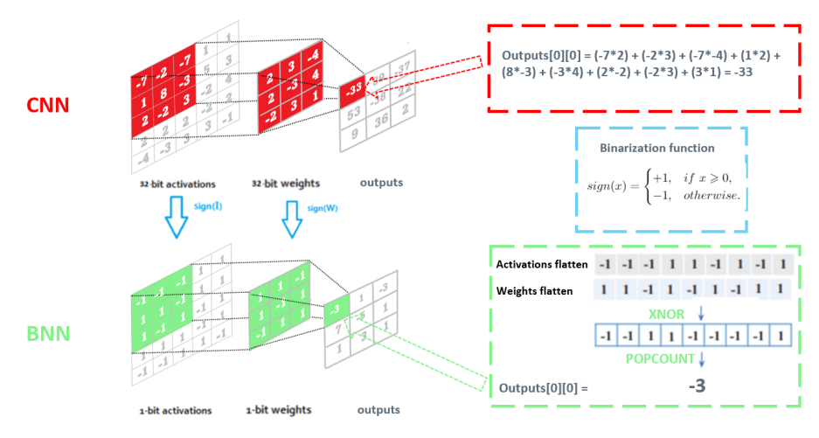

Slide 3



Types of Binarization
Deterministic:
Stochastic:

Slide 4
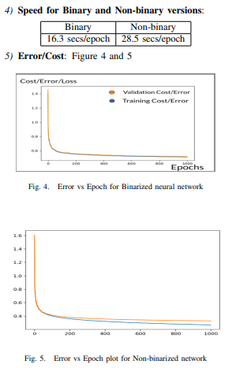
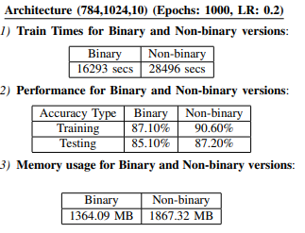
Binary vs Non-Binary
MNIST dataset
60000 training images and 10000 testing images
Dimensions 28*28 with 10 classes
Further split the 60000 training images into 50000 training images and 10000 validation images
Batches size 5000

