Slide 1
Previous Models for Compression and Acceleration of DNN
Approach | Description | Application | Compatibility
Parameter pruning and quantization | Reducing redundant parameter which do not affect performance much | Both Convolutional and Fully connected | Training from scratch and Pre-trained
Low rank Factorization | Use matrix decomposition to estimate important parameters | Both Convolutional and Fully connected | Training from scratch and Pre-trained
Transfer/Compact Convolutional Filters | Structural convolutional filters | Only Convolutional | Pre-trained
Knowledge Distillation | Training compact neural network with distilled knowledge of huge model | Both Convolutional and Fully connected | Pre-trained

Slide 2

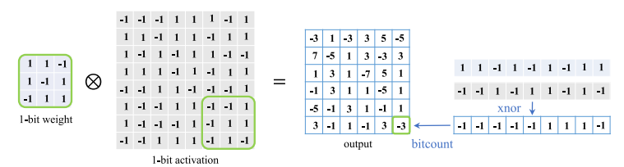
New Approach (Binary Networks)
32 bit Weights => 1 bit Weights
Naive BNN and Optimization based BNN
Optimization:
1. Minimize Quantization Error
2. Improve Network Loss Function
3. Reduce Gradient Error
Forward Propagation:
Backward Propagation:

Slide 3
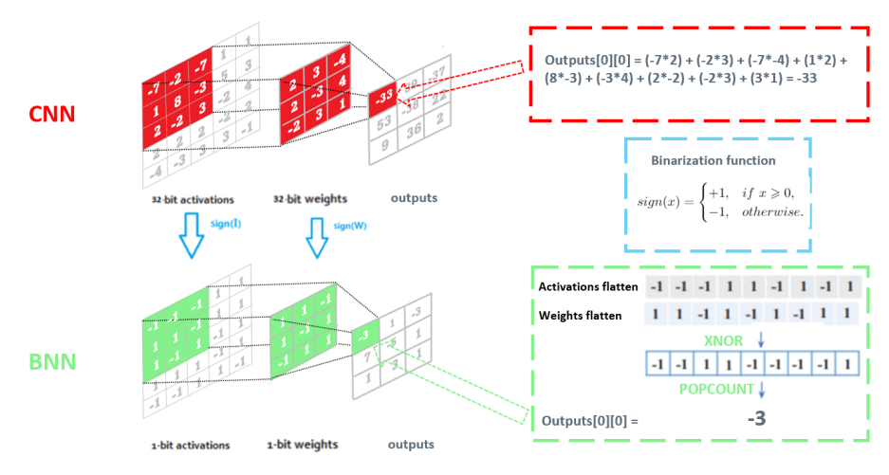
Next POA: Resources for Binary Netowork
Study differnet Optimazation based BNN’s available.
Select few best among them.

