Slide 1




Types of Binarization
32 bit Weights => 1 bit Weights
Naive BNN and Optimization based BNN
Optimization:
1. Minimize Quantization Error
2. Improve Network Loss Function
3. Reduce Gradient Error
Deterministic:
Stochastic:

Slide 2

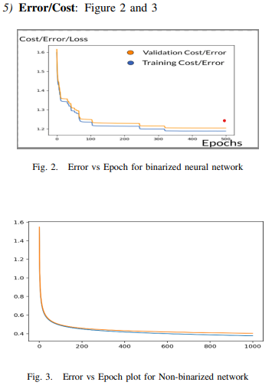
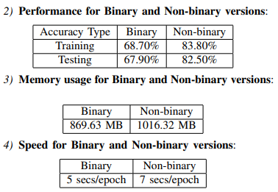
Experiments on BNN (Arizona Research Paper)
MNIST dataset
60000 training images and 10000 testing images
Dimensions 28*28 with 10 classes
Further split the 60000 training images into 50000 training images and 10000 validation images
Batches size 5000

