Slide 1
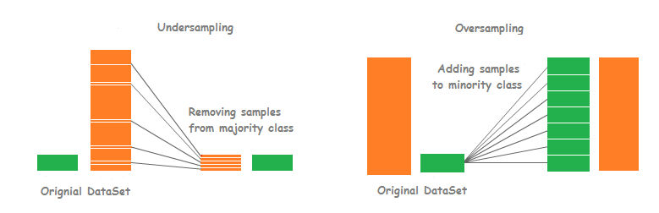

Data Distribution Analysis and Visualization
Dataset consists of images.
5 Labels:
We can observe that the dataset is skew fashioned.
Undersampling/Oversampling can be used to balance the count.

Slide 2
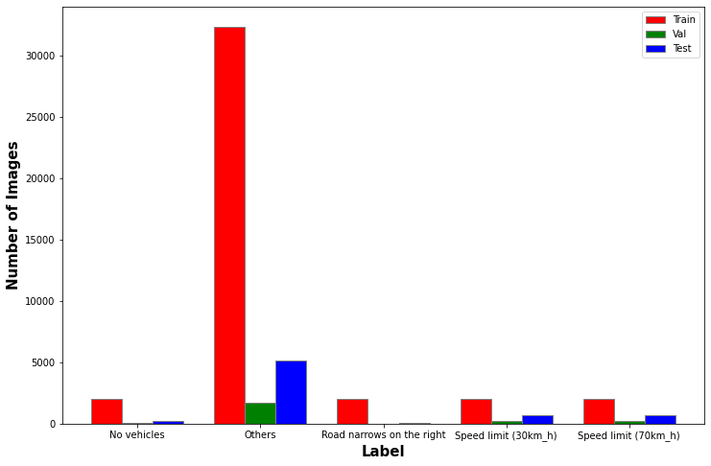
Others label dataset is much larger than the remaining labels.

Slide 3
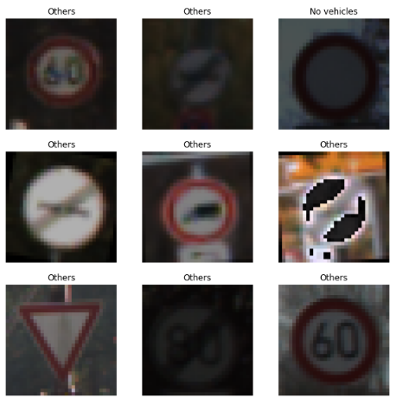

Required features are in the center => Padding doesn’t matter much.

Slide 4
Parameters to be checked and optimised
Conv2D Layers (Features, Kernel size, Activation)
Dense Layers (Features, Activation)
Optimizer and Loss (sparsecategoricalclassentropy)
Epochs
Confusion Matrix and Classification Report

Slide 5
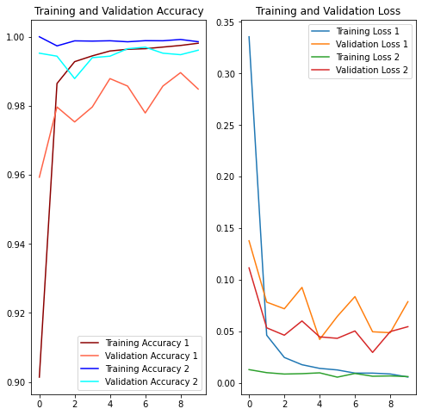
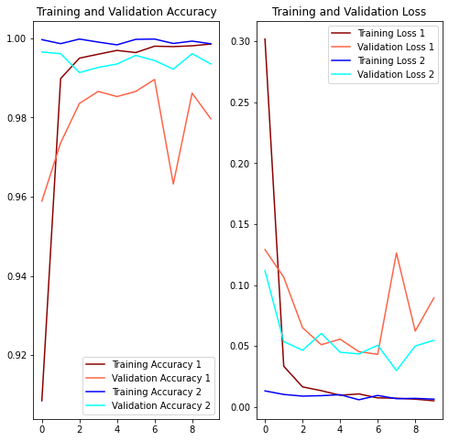
Features in Layers
How to increase
1: Decreasing
2: Increasing
1: 10 25 50 100
2: 16 32 64 128

Slide 6
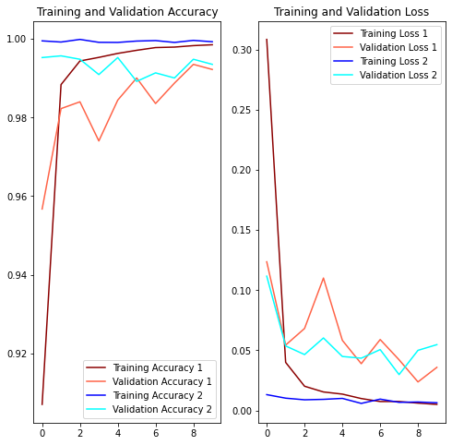
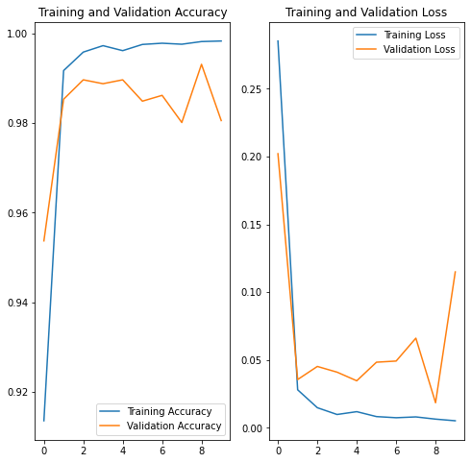
Padding
*Activation
1: Without
2: With
1: All ReLu
2: ReLu + tanh

Slide 7
Optimizer
Epochs
1: adam
2:
1: 5
2: 10
3: 20
4: 30

Slide 8
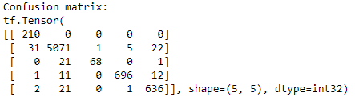
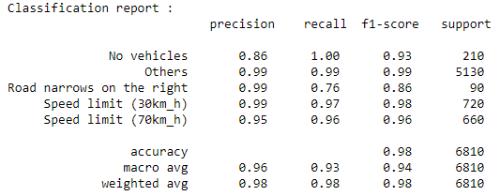
Model:

Slide 9
Next Plan of Action
Try augment the dataset.
Try to minimize the datasize.
Try to infer more from the confusion matrix.

