Slide 1
Parameters to be checked and optimised
Conv2D Layers (Features, Kernel size, Activation)
Dense Layers (Features, Activation)
Optimizer and Loss (sparsecategoricalclassentropy)
Epochs
Confusion Matrix and Classification Report

Slide 2
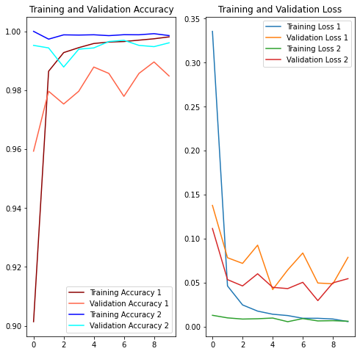
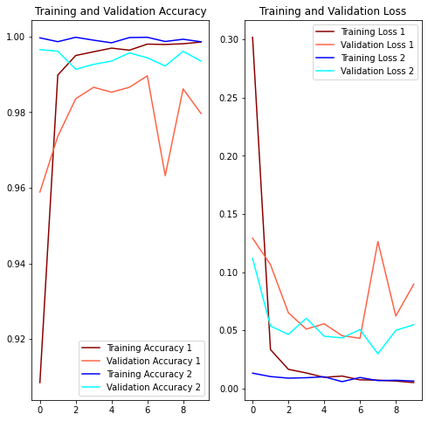
Features in Layers
How to increase
1: Decreasing
2: Increasing
1: 10 25 50 100
2: 16 32 64 128

Slide 3
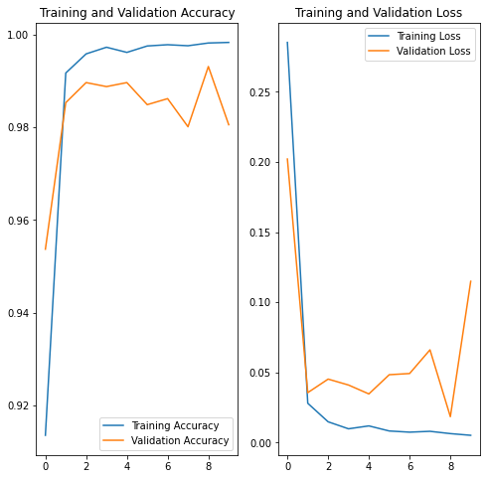


Padding
1: Without
2: With

Slide 4
Next Plan of Action
Try different optimizers available.
Try to minimize the model size.
Try to infer more from the confusion matrix.

