Slide 1
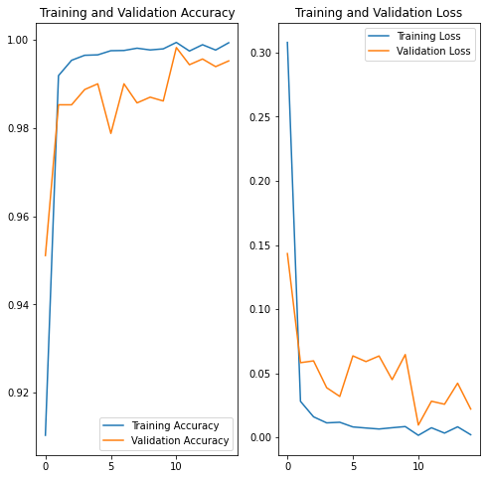
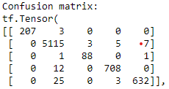
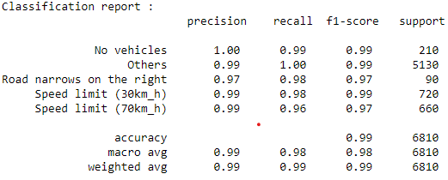
model = Sequential([
layers.Rescaling(1./255, input_shape=(img_size[0], img_size[1], 3)),
layers.Conv2D(16, 3, padding='same', activation='relu'),
layers.MaxPooling2D(),
layers.Conv2D(32, 3, padding='same', activation='relu'),
layers.MaxPooling2D(),
layers.Conv2D(64, 3, padding='same', activation='relu'),
layers.MaxPooling2D(),
layers.Conv2D(128, 3, padding='same', activation='relu'),
layers.MaxPooling2D(),
layers.Flatten(),
layers.Dense(256, activation='relu'),
layers.Dense(num_classes)
])
model.summary()
model.compile(optimizer='adam', loss=tf.keras.losses.SparseCategoricalCrossentropy(from_logits=True), metrics=['accuracy'])
[0.07003779709339142, 0.9911894202232361]

Slide 2
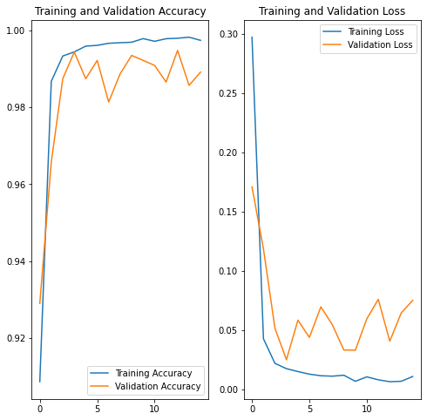
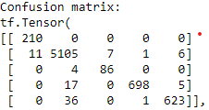
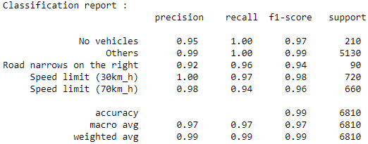
model = Sequential([
layers.Rescaling(1./255, input_shape=(img_size[0], img_size[1], 3)),
layers.Conv2D(16, 3, padding='same', activation='relu'),
layers.MaxPooling2D(),
layers.Conv2D(32, 3, padding='same', activation='relu'),
layers.MaxPooling2D(),
layers.Conv2D(64, 3, padding='same', activation='relu'),
layers.MaxPooling2D(),
layers.Conv2D(128, 3, padding='same', activation='relu'),
layers.MaxPooling2D(),
layers.Dropout(0.5),
layers.Flatten(),
layers.Dense(256, activation='relu'),
layers.Dense(num_classes)
])
model.summary()
model.compile(optimizer='adam', loss=tf.keras.losses.SparseCategoricalCrossentropy(from_logits=True), metrics=['accuracy'])
[0.09562737494707108, 0.9870778322219849]

Slide 3
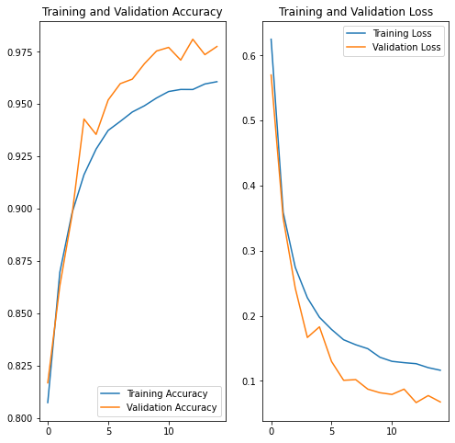
model = Sequential([
layers.Rescaling(1./255, input_shape=(img_size[0], img_size[1], 3)),
layers.Conv2D(16, 3, padding='same', activation='relu'),
layers.MaxPooling2D(),
layers.Dropout(0.5),
layers.Conv2D(32, 3, padding='same', activation='relu'),
layers.MaxPooling2D(),
layers.Dropout(0.5),
layers.Conv2D(64, 3, padding='same', activation='relu'),
layers.MaxPooling2D(),
layers.Dropout(0.5),
layers.Conv2D(128, 3, padding='same', activation='relu'),
layers.MaxPooling2D(),
layers.Dropout(0.5),
layers.Flatten(),
layers.Dense(256, activation='relu'),
layers.Dense(num_classes)
])
model.summary()
model.compile(optimizer='adam', loss=tf.keras.losses.SparseCategoricalCrossentropy(from_logits=True), metrics=['accuracy'])
[0.06649414449930191, 0.9759177565574646]

Slide 4
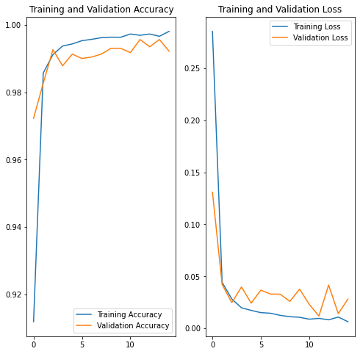
model = Sequential([
layers.Rescaling(1./255, input_shape=(img_size[0], img_size[1], 3)),
layers.Conv2D(16, 3, padding='same', activation='relu'),
layers.MaxPooling2D(),
layers.Dropout(0.1),
layers.Conv2D(32, 3, padding='same', activation='relu'),
layers.MaxPooling2D(),
layers.Dropout(0.1),
layers.Conv2D(64, 3, padding='same', activation='relu'),
layers.MaxPooling2D(),
layers.Dropout(0.1),
layers.Conv2D(128, 3, padding='same', activation='relu'),
layers.MaxPooling2D(),
layers.Dropout(0.1),
layers.Flatten(),
layers.Dense(128, activation='relu'),
layers.Dense(num_classes)
])
model.summary()
model.compile(optimizer='adam', loss=tf.keras.losses.SparseCategoricalCrossentropy(from_logits=True), metrics=['accuracy'])
[0.08015342801809311, 0.9885462522506714]

Slide 5
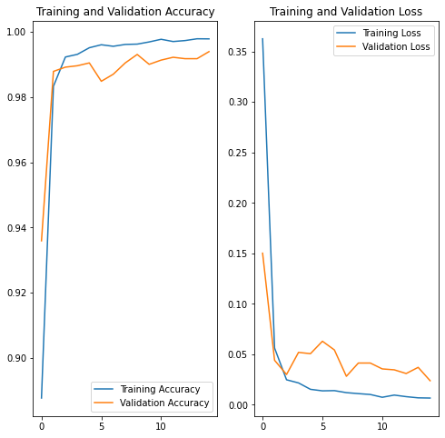
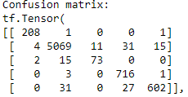
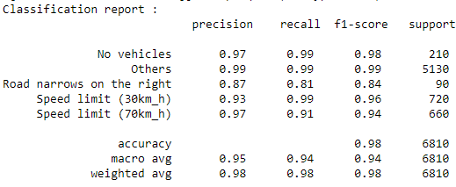
model = Sequential([
layers.Rescaling(1./255, input_shape=(img_size[0], img_size[1], 3)),
layers.Conv2D(16, 3, padding='same', activation='relu'),
layers.MaxPooling2D(),
layers.Dropout(0.05),
layers.Conv2D(32, 3, padding='same', activation='relu'),
layers.MaxPooling2D(),
layers.Dropout(0.05),
layers.Conv2D(64, 3, padding='same', activation='relu'),
layers.MaxPooling2D(),
layers.Dropout(0.05),
layers.Conv2D(128, 3, padding='same', activation='relu'),
layers.MaxPooling2D(),
layers.Dropout(0.05),
layers.Flatten(),
layers.Dense(128, activation='relu'),
layers.Dense(num_classes)
])
model.summary()
model.compile(optimizer='adam', loss=tf.keras.losses.SparseCategoricalCrossentropy(from_logits=True), metrics=['accuracy'])
[0.0889609307050705, 0.9911483283042908]

