Slide 1
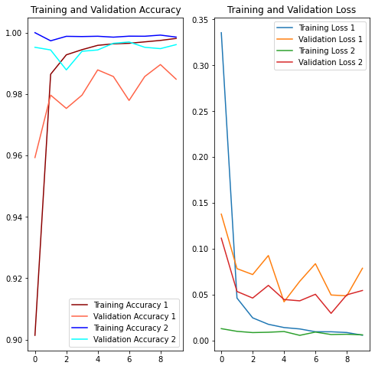
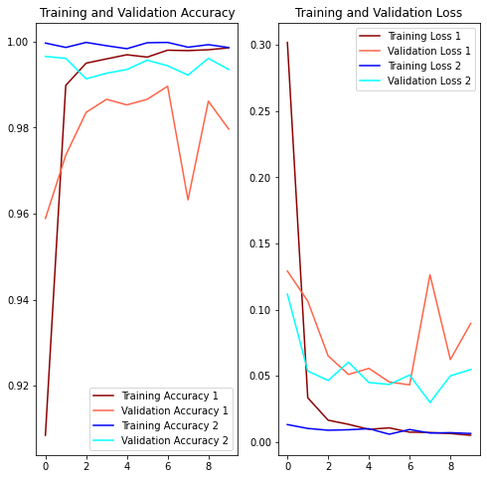


Features in Layers
How to increase
Padding
1: Decreasing
2: Increasing
1: 10 25 50 100
2: 16 32 64 128
1: Without
2: With

Slide 2
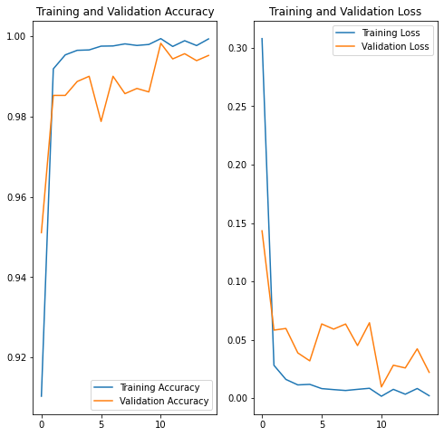
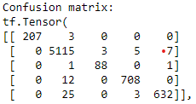
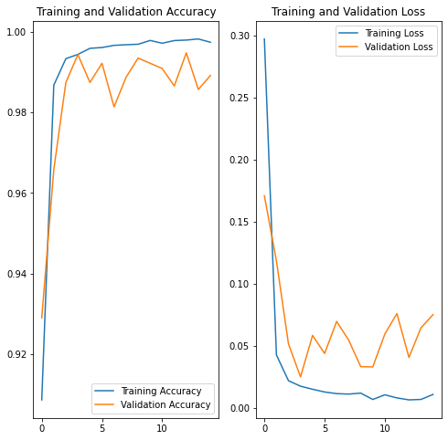
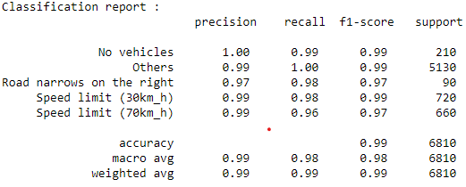
4 Conv2D Layers (16, 32, 64, 128)
1 Dropout(0.5) after 4th layer
2 Dense Layers (128, 5)
4 Conv2D Layers (16, 32, 64, 128)
2 Dense Layers (128, 5)
[Test Loss: 0.09562737494707108, Test Acc: 0.9870778322219849]
[Test Loss: 0.07003779709339142, Test Acc: 0.9911894202232361]

Slide 3
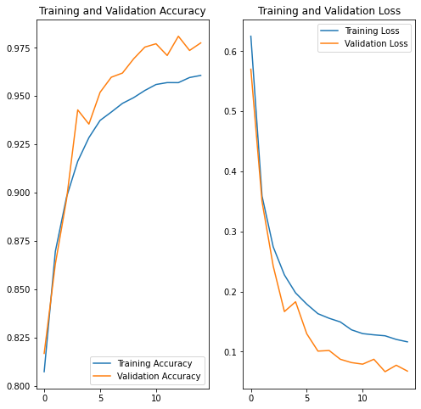
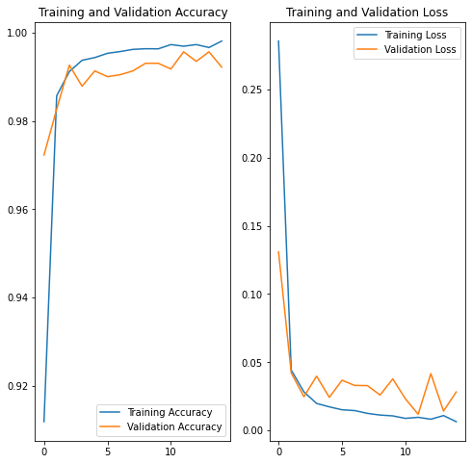
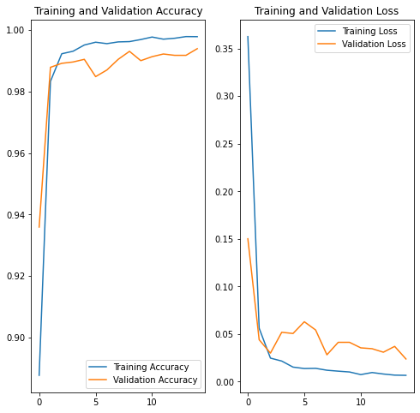
4 Conv2D Layers (16, 32, 64, 128)
4 Dropout(0.5) after all 4 layers
2 Dense Layers (128, 5)
4 Conv2D Layers (16, 32, 64, 128)
4 Dropout(0.1) after all 4 layers
2 Dense Layers (128, 5)
4 Conv2D Layers (16, 32, 64, 128)
4 Dropout(0.05) after all 4 layers
2 Dense Layers (128, 5)
[Test Loss: 0.06649414449930191, Test Acc: 0.9759177565574646]
[Test Loss: 0.08015342801809311,
Test Acc: 0.9885462522506714]
[Test Loss: 0.0889609307050705, Test Acc: 0.9911483283042908]

Slide 4
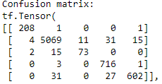
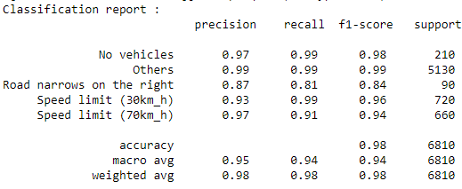
Next Plan of Action:
Try sampling the dataset
Try different optimizers and activation functions available.
Try to minimize the model size.
Try to infer more from the confusion matrix.

