Slide 1
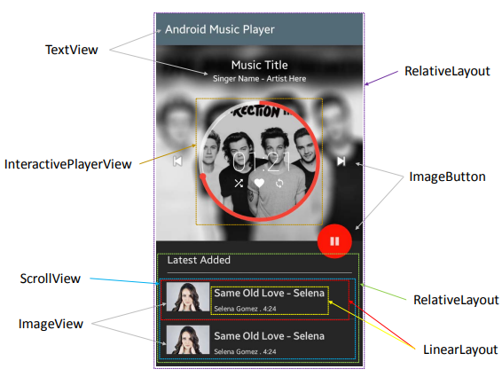
UI Design Image to GUI Skeleton
Neural Machine Translator to Bootstrap Mobile GUI Implementation
Problem:
Translating a UI design image into a GUI skeleton.
To obtain GUI skeleton from a UI design image, developers have to visually understand UI elements and their spatial layout in the image.
Translate this understanding into proper use of GUI components and their compositions.
Challenges:
Diversity of UI designs and the complexity of GUI skeletons to generate.
Existing tools are rigid as they depend on heuristically-designed visual understanding and GUI generation rules.

Slide 2
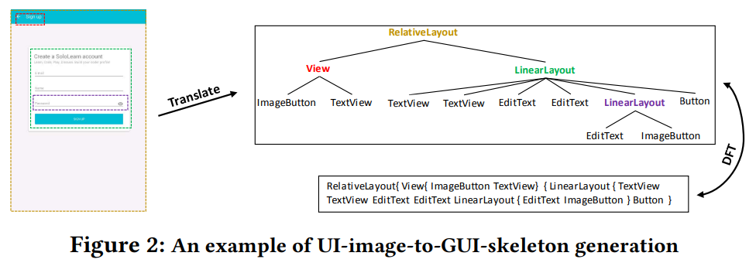
What do we require?
Translate
Layout Tree
Draft
UI Design Image
XML Code

Slide 3
Neural Machine Translator to Bootstrap Mobile GUI Implementation
Paper Link: https://chunyang-chen.github.io/publication/ui2code.pdf
The paper presents a neural machine translator that combines recent advances in computer vision and machine translation for translating a UI design image into a GUI skeleton.
The translator learns to extract visual features in UI images, encode these features' spatial layout, and generate GUI skeletons in a unified neural network framework, without requiring manual rule development.
For training the translator, an automated GUI exploration method to automatically collect large-scale UI data from real-words applications is developed.

Slide 4
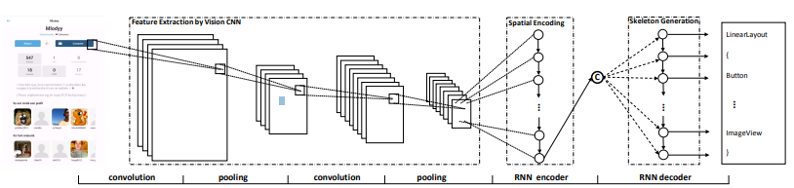
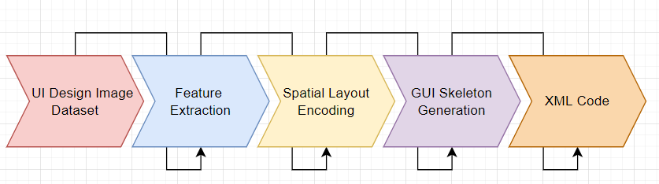
Architecture of the Translator
Vision CNN
RNN Encoder

Slide 5
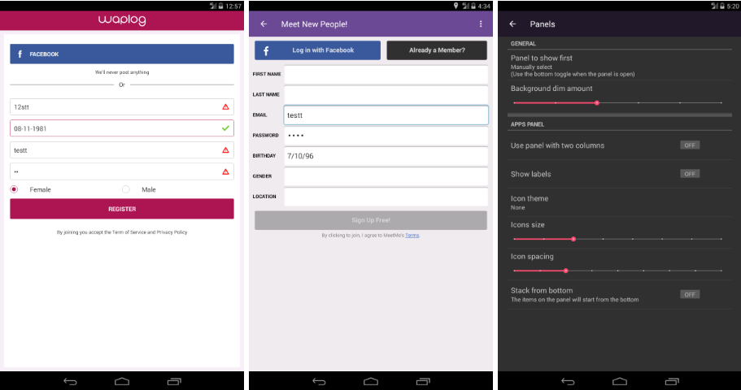
UI Design Image Examples:

Slide 6
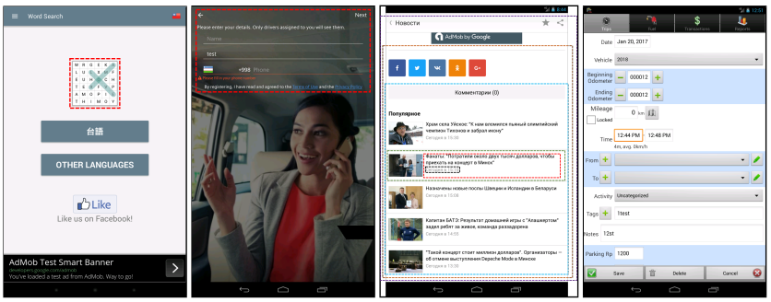
Examples of different cases of Visual Understanding and Generation Capability:
Text Like Image
UI Elements on Background Image
Deep Component Heirarchy
Complex Spatial Layout

Slide 7
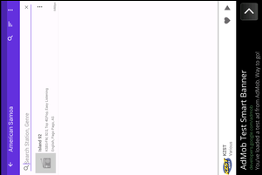
Example of raw XML Code generated by the model:
android.support.v4.widget.DrawerLayout { android.widget.LinearLayout { android.view.View_horizontal { android.widget.ImageButton android.widget.ImageView android.widget.RelativeLayout_horizontal { android.widget.TextView android.widget.TextView } } android.widget.LinearLayout { android.widget.TextView android.widget.SeekBar android.widget.ImageView android.widget.ImageView } android.widget.FrameLayout { android.widget.LinearLayout { android.widget.Button android.widget.Button android.widget.Button android.widget.TextView } android.widget.LinearLayout { android.widget.Button android.widget.TextView android.widget.TextView android.widget.ScrollView { android.widget.TextView android.widget.ImageView android.widget.TextView android.widget.ImageView android.widget.TextView android.widget.TextView android.widget.ImageView android.widget.TextView android.widget.ImageView android.widget.Button android.widget.Button } } } android.webkit.WebView } }

