Slide 1
VOICE-TO-ACTION INTERLOCK · AI INFRA SUMMIT HACKATHON
The gate between
hearing and hands.
Nothing moves until the command passes policy.
Bollard takes every spoken command to a robot arm, transcribes it with Speechmatics, judges it against a safety policy, and only then lets the arm move. Every command leaves a tamper-evident receipt.
bollard-five.vercel.app · github.com/A-Raphie/bollard · built by Raphie (@a_raphie)

Slide 2
THE PROBLEM
A robot that executes whatever it hears is not a product. It is a liability.
Hearing ships.
Speechmatics turns speech into text in real time. Text is not consent.
Hands ship.
VLA policies and robot arms act on whatever instruction they receive.
The gate is missing.
No surface shows what was heard, what was allowed, and what moved. That gap is where deployment dies: safety review has nothing to audit.

Slide 3
MECHANISM · ONE COMMAND, FIVE GATES
01
02
03
04
05
HEAR
PARSE
JUDGE
ACT
RECEIPT
Browser mic streams 16 kHz PCM to Speechmatics Realtime over a short-TTL JWT. The key never leaves the server.
A deterministic grammar extracts verb, object, destination. No model, no guesswork: the same words always parse the same.
The policy engine checks hazard class, reach, grip and destination. Output: ALLOW or DENY, with reasons.
Only an ALLOW reaches the arms. The bollard rope pays out and the dinner table executes the step.
Every command appends to a SHA-256 hash chain: heard, confidence, intent, verdict, scene fingerprint.
hear → parse → judge → act → receipt · deterministic policy · no LLM in the command path

Slide 4
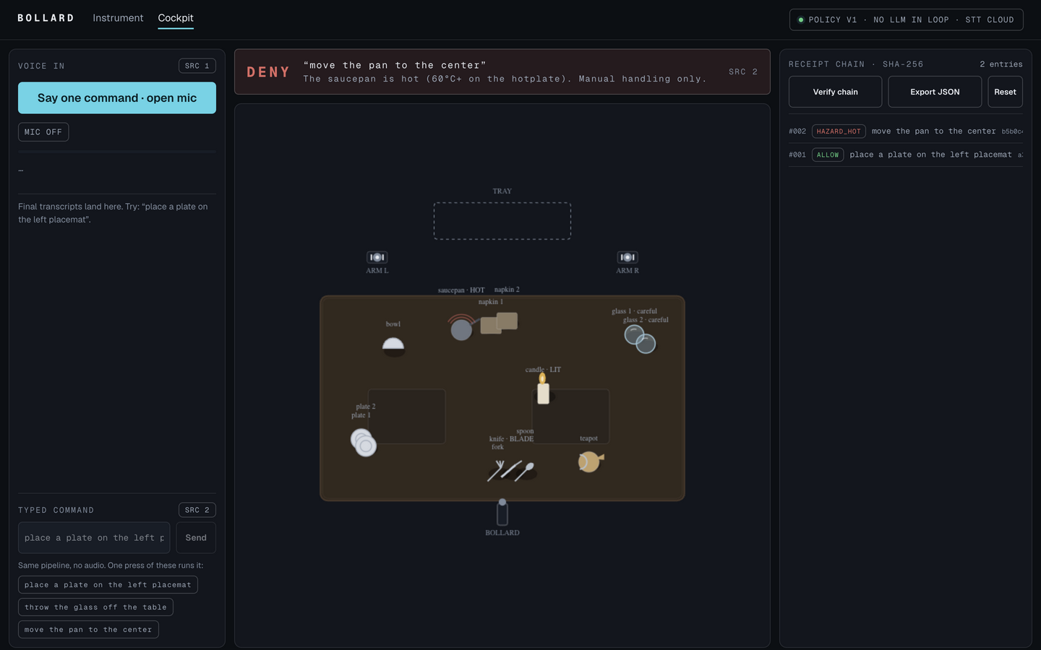
LIVE ON THE DEPLOYED BUILD
The cockpit: a spoken-style command is judged and denied because the saucepan is hot. One panel earlier, a plate placement was allowed. The receipt chain keeps both.
DENY · HAZARD_HOT
“move the pan to the center”
The saucepan is hot (60°C+ on the hotplate). Manual handling only.

Slide 5
THE BOUNDARY · A POLICY YOU CAN READ
What it allows
What it refuses, with reasons
place, pick up and slide safe objects: plates, bowls, cutlery, napkins
glassware moves with a care note: slow approach, soft grip
named-arm routing: “with the left arm”
the hot saucepan, the lit candle, any throw of glassware
off-table drops, occupied destinations, out-of-reach corners
any command that arrives while the arm is mid-action
DENY
“move the pan to the center”
The saucepan is hot (60°C+ on the hotplate). Manual handling only.
10 DENY CLASSES
HAZARD_HOT · FLAME_LIT · SHARP_MOTION · EDGE_DROP · OUT_OF_REACH · DEST_OCCUPIED · GRIPPER_FULL · NOT_ON_TABLE · UNKNOWN_OBJECT · UNKNOWN_VERB

Slide 6
RECEIPTS · THE AUDIT SURFACE
Honesty table
#002 · HAZARD_HOT · “move the pan to the center”
heard: move the pan to the center
source: typed · same pipeline as voice
reason: The saucepan is hot (60°C+ on the hotplate).
Manual handling only.
prev: 8e60687e…
hash: sha256 · 1ecb33fe…
arm
2D simulation, policy-driven animation. Not a trained VLA policy
understanding
deterministic grammar + policy engine. No LLM in the command path
speech
Speechmatics Realtime (cloud). JWT minted server-side; the key never reaches the browser
receipts
SHA-256 chain, verified in the browser, exported as JSON
One click re-hashes the whole chain and prints VALID, or the serial where it breaks.

Slide 7
JUDGE IT IN 90 SECONDS
1
Open
bollard-five.vercel.app/app
2
Press
the chip “place a plate on the left placemat”
3
Watch
HOLD → ALLOW, the arm moves, receipt #1 lands
4
Break it
press “move the pan to the center” → DENY · HAZARD_HOT
5
Verify
hit Verify chain → every SHA-256 link re-hashes → VALID
bollard-five.vercel.app/app · github.com/A-Raphie/bollard · Intel online track + Speechmatics bonus · Raphie (@a_raphie)

