Slide 1
CSE623 - Machine Learning Theory and Practice
Project Name - Identifying Hard Stop and Momentary Stop Using Vehicle Trajectory Dataset
Group Name - 405 Found
Aarsha Shah – AU2240163 Parshwa Shah – AU2240249
Hetav Shah - AU2240253
Ved Savalia – AU2240242
Dev Gorakhiya – AU2240087

Slide 2
Problem Statement
Goal - Distinguish between Hard Stop and Momentary Stop using DBSCAN
Hard Stop - Occur when a vehicle abruptly halts and remains stationary for a prolonged period.
Momentary Stop - These involve brief pauses in movement.
Challenges
Defining appropriate threshold for velocity and stop duration.
Handling noisy data and missing data in trajectory records.

Slide 3
Literature Survey
Paper Title | Authors | Published on | Methodology | Findings | Contributions
1. DBSCAN Clustering algorithm based on density | Dingsheng Den | 25th February 2021 | The paper analyzes the DBSCAN algorithm with respect to its potential for clustering non-uniform density datasets with parameters Eps and MinPts. Experiments are performed on synthetic (D31, R15) and actual (credit card user) datasets in Python, with results being compared using metrics such as standard deviation and community difference. | DBSCAN works well on non-uniform density data but is very sensitive to the Eps parameter. Low values of Eps result in fewer clusters, whereas high values enhance clustering for high-value data but have difficulty with low-value data, particularly in real-world data such as credit card user data. | The paper gives a performance evaluation of DBSCAN based on how sensitive it is to Eps and its possible real-life applications such as customer segmentation. It also points out problems with broad-based datasets and provides avenues for future work on enhancing clustering algorithms for big data.
2. ST-DBSCAN: An algorithm for clustering spatial–temporal data | Derya Birant, Alp | 13th March 2006 | The work generalizes the DBSCAN algorithm for processing spatial-temporal data by adding parameters Eps1 (space distance) and Eps2 (non-space attributes), with a density factor and threshold (Δε) to enhance clustering. The algorithm was experimented with on environmental data (e.g., sea surface temperature) with missing value preprocessing. | ST-DBSCAN clustered spatial-temporal data effectively and detected regions of similar properties (e.g., temperature, wave height) and performed better in noise detection, particularly for datasets with diverse cluster densities. Uses in environmental monitoring showed apparent spatial patterns and clusters. | The paper introduces ST-DBSCAN, which improves noise detection, handles adjacent clusters better, and extends DBSCAN's capabilities for spatial-temporal data

Slide 4
Literature Survey
Paper Title | Authors | Published on | Methodology | Findings | Contributions
1.DBSCAN Clustering Algorithm Based on Density. (2020, September 1). IEEE Conference Publication | IEEE Xplore. https://ieeexplore.ieee.org/abstract/document/9356727?casa_token=bE-GpoKD4UYAAAAA:MWfySFyC8222IMJ2ghlPFd7P2z6MMkdreLU_k6Zcylzf8msJu8nXTHoyF25vetmheHvKEbxbKQWG | Dingsheng Den | 25th February 2021 | The paper analyzes the DBSCAN algorithm with respect to its potential for clustering non-uniform density datasets with parameters Eps and MinPts. Experiments are performed on synthetic (D31, R15) and actual (credit card user) datasets in Python, with results being compared using metrics such as standard deviation and community difference. | DBSCAN works well on non-uniform density data but is very sensitive to the Eps parameter. Low values of Eps result in fewer clusters, whereas high values enhance clustering for high-value data but have difficulty with low-value data, particularly in real-world data such as credit card user data. | The paper gives a performance evaluation of DBSCAN based on how sensitive it is to Eps and its possible real-life applications such as customer segmentation. It also points out problems with broad-based datasets and provides avenues for future work on enhancing clustering algorithms for big data.
2.Derya Birant, A. K. (2007). ST-DBSCAN: An algorithm for clustering spatial–temporal data. ScienceDirect, 13. Retrieved from https://www.sciencedirect.com/science/article/pii/S0169023X06000218 | Derya Birant, Alp Kut | 13th March 2006 | The work generalizes the DBSCAN algorithm for processing spatial-temporal data by adding parameters Eps1 (space distance) and Eps2 (non-space attributes), with a density factor and threshold (Δε) to enhance clustering. The algorithm was experimented with on environmental data (e.g., sea surface temperature) with missing value preprocessing. | ST-DBSCAN clustered spatial-temporal data effectively and detected regions of similar properties (e.g., temperature, wave height) and performed better in noise detection, particularly for datasets with diverse cluster densities. Uses in environmental monitoring showed apparent spatial patterns and clusters. | The paper introduces ST-DBSCAN, which improves noise detection, handles adjacent clusters better, and extends DBSCAN's capabilities for spatial-temporal data.
3. Clustering of vehicle trajectories. (2010, September 1). IEEE Journals & Magazine | IEEE Xplore. https://ieeexplore.ieee.org/abstract/document/5462900 | Stefan Atev, Grant Miller, Nikolaos P. Papanikolopoulos | 10th May 2010 | The research uses distance metrics (MHD, DTW, and LCSS) to calculate trajectory similarity and clustering algorithms (Spectral and Agglomerative Clustering) to cluster similar trajectories. MHD captures spatial proximity, DTW accommodates speed differences, and LCSS detects shared segments, while clustering algorithms derive movement pattern. | MHD is efficient in capturing spatial similarity, but DTW is more appropriate for speed changes, and LCSS is appropriate for missing data handling. Spectral clustering is efficient in detecting natural movement patterns, while Agglomerative clustering offers hierarchical traffic behavior insights. | The research provides a comparative framework for trajectory similarity measures and clustering methods, helping applications in traffic analysis, movement behavior recognition, and intelligent transportation systems.

Slide 5
Dataset Discussion
Dataset includes:
Timestamp (Frame No.) , Track id, Left, Right , Width, Height (Provided)
Features extraction:
CenterX = Left + (Width/2)
CenterY = Top + (Height/2)
Instantaneous Velocity = Distance covered from last frame given/ No. of frames travelled
Average Velocity = Total Distance covered / Total frames travelled
Vehicle trajectory dataset includes data of each vehicle in different sheet.

Slide 6
Dataset Discussion
Center Coordinate Extraction
Missing Data Interpolation
Applied linear interpolation to fill gaps in frame sequences for smoother tracking.
Velocity Calculation
Instantaneous Velocity: Derived using center coordinates over time.
Average Velocity: Computed as displacement over total time per vehicle.
Dataset Filtering
Removed trackIDs with < 100 frames to ensure meaningful trajectory insights.
Stop Classification & Clustering
Identified hard stops & momentary stops using velocity changes with DBSCAN.

Slide 7
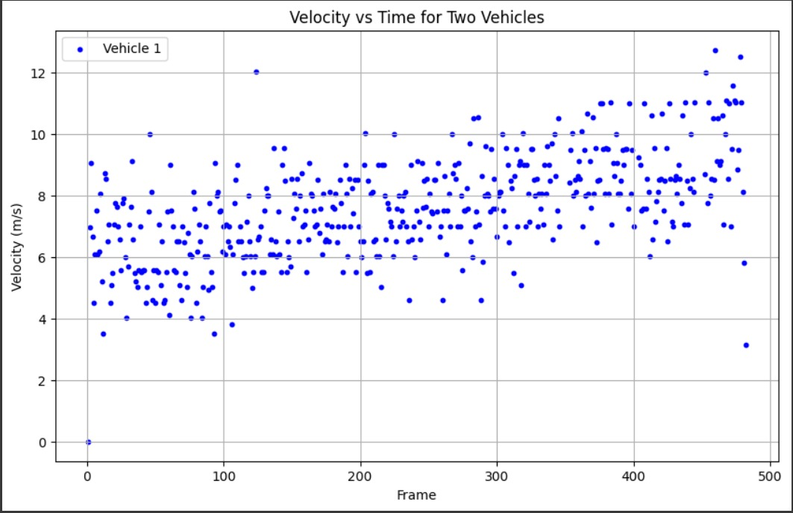
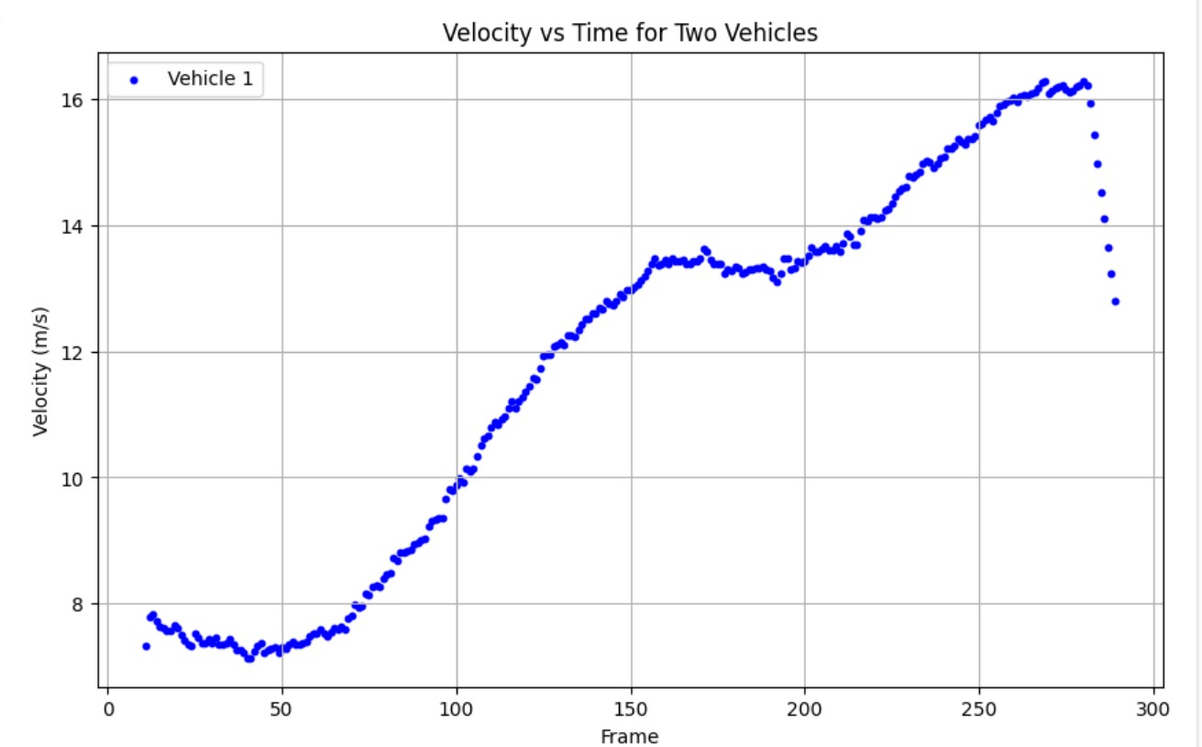
Scattered Plotting

Slide 8
Approach and Future Work
Here our approach is to find type of stop using instantaneous velocity.
Thereafter using DBSCAN unsupervised learning algorithm, we cluster the data points according to instantaneous velocity value.
Incorporating more unsupervised clustering algorithms such as kmeans.
Making our own optimization model.
Superimposition of those classifications on the video file.

Slide 9
References
[1] DBSCAN Clustering Algorithm Based on Density. (2020, September 1). IEEE Conference Publication | IEEE Xplore. https://ieeexplore.ieee.org/abstract/document/9356727?casa_token=bE-GpoKD4UYAAAAA:MWfySFyC8222IMJ2ghlPFd7P2z6MMkdreLU_k6Zcylzf8msJu8nXTHoyF25vetmheHvKEbxbKQWG
[2] Clustering of vehicle trajectories. (2010, September 1). IEEE Journals & Magazine | IEEE Xplore. https://ieeexplore.ieee.org/abstract/document/5462900
[3] Unsupervised K-Means clustering algorithm. (2020). IEEE Journals & Magazine | IEEE Xplore. https://ieeexplore.ieee.org/abstract/document/9072123
[4] Stats Wire. (2021, July 16). DBSCAN Clustering | Python | Clustering [Video]. YouTube. https://www.youtube.com/watch?v=2eDFjw456AM
[5] StatQuest with Josh Starmer. (2022, January 10). Clustering with DBSCAN, Clearly Explained!!! [Video]. YouTube. https://www.youtube.com/watch?v=RDZUdRSDOok

