Slide 1
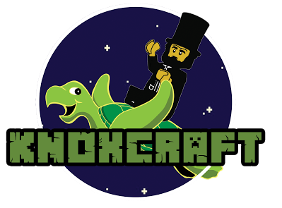
Teaching Introductory Programming with Minecraft
Emily Hastings and Michael Gerten
Advisor: Jaime Spacco

Slide 2
Motivation for Project
Lack of CS students in general
By 2020, only 30% of 1.4 million US computing jobs will be filled by US CS grads
Lack of inclusivity
2010: 57% of grads female/14% CS grads female
2011: 25% of computing workforce female; of this, 3% African-American, 4% Asian, 1% Hispanic

Slide 3
Motivation for Project
Need to reach and retain younger students without alienating underrepresented groups
Visual applications
Allows for more creativity
Media Computation- Guzdial, Georgia Tech

Slide 4
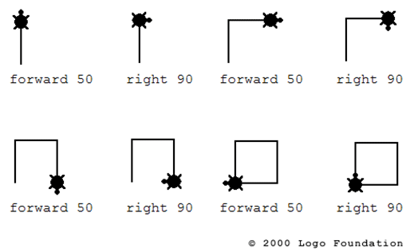
Turtle Graphics
Logo
Educational programming language developed in 1967
Made use of “turtle graphics”
CS 141 currently uses Java Turtles

Slide 5
Knoxcraft
3D Turtles in Minecraft
Students write Turtle code in Java or Python
Upload to special Minecraft server
Invoke in-game to build things

Slide 6
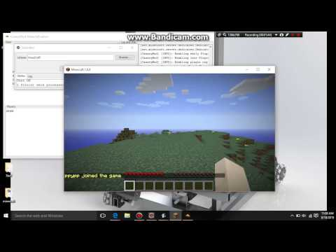

Slide 7
Future Work
Finish documentation, fixing bugs
Submit to Nifty Assignments at SIGCSE
Will use in CS 141 in the fall

Slide 8
Acknowledgements
Prof. Spacco
ASSET and Baker-Velde
All of you!

Slide 9
Image Sources
Knoxcraft logo by Angel Zuaznabal
http://blog.core-ed.org/files/2014/08/logo_turtle-21.png

