Slide 1

Structure or Nurture?
The Effects of Team-Building Activities and Team Composition on Team Outcomes
Emily M. Hastings, Farnaz Jahanbakhsh,
Karrie Karahalios, Darko Marinov, Brian P. Bailey
Notes:
Farnaz hi, Emily hi.
Many of you have worked on a team project before. For the instructors, many of you have probably done team-based activities in your courses, and you may have even used algorithmic team formation tools to help make this process more efficient or easier.
Provide more insight on how you should be using algorithmic team formation tools in your courses-- what to expect or not expect from them. How to focus your time
Need to add alt text everywhere

Slide 2
How should instructors promote positive team outcomes?

Slide 3




Team Composition
Criteria-based team formation: strategically select team members to achieve certain compositions
Skill diversity (e.g., Brickell et al. 1994, Horwitz and Horwitz 2007)
Balanced personality types (e.g., Lykourentzou et al. 2016)
Balanced genders (e.g., Jehn, Northcraft, and Neale 1999)
Many more
Notes:
First one is composition. Criteria-based team formation. Careful with wording-- Woolley will be there
Algorithmic team formation tools help implement this approach

Slide 4
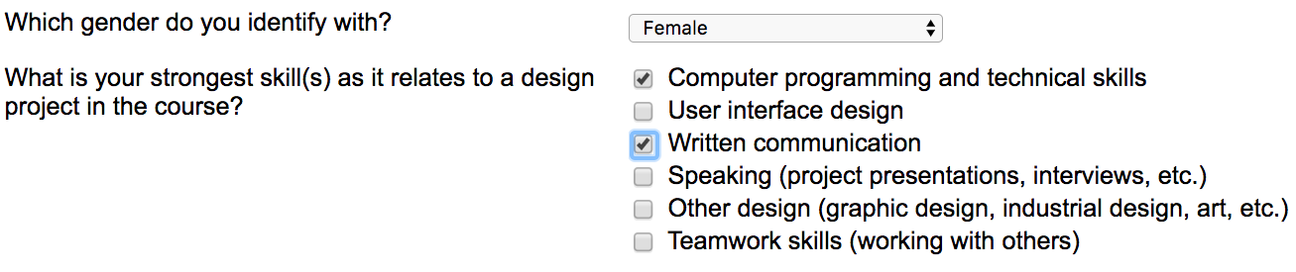
Algorithmic Team Formation Tools

Slide 5

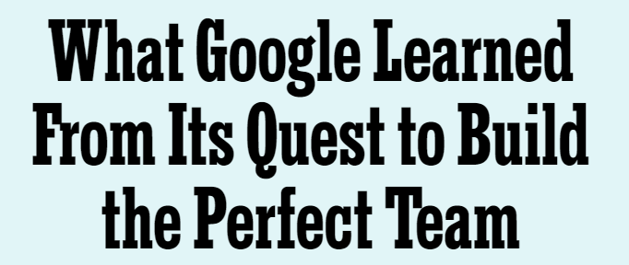
Team-Building
Nurture teamwork after the team is formed
Psychological safety: shared belief that the team is safe for interpersonal risk-taking (Edmondson 1999)
Recent article (Duhigg 2016) suggested that psychological safety contributes more to industry teams’ success than team composition does
Notes:
2nd approach focuses on nurturing team after has been formed. One attribute that can supported is PS…
An open question is do the results generalize to educational context? How best to allocate time/effort?

Slide 6
Research Questions
RQ1: How do composition strategies and team-building affect student team performance and team experience?
RQ2: To what degree do team-building and team composition strategies influence psychological safety for student teams?
RQ3: What is the relationship between psychological safety and team performance and experience?
Notes:
In this work, we combine these strands of research
Compare effects on outcomes, give better idea of how to allocate time
We measure performance using team project grades, and team experience using surveys capturing perceived performance, satisfaction with team assignment, peer evaluations, cohesiveness, and conflict.
WHY?

Slide 7

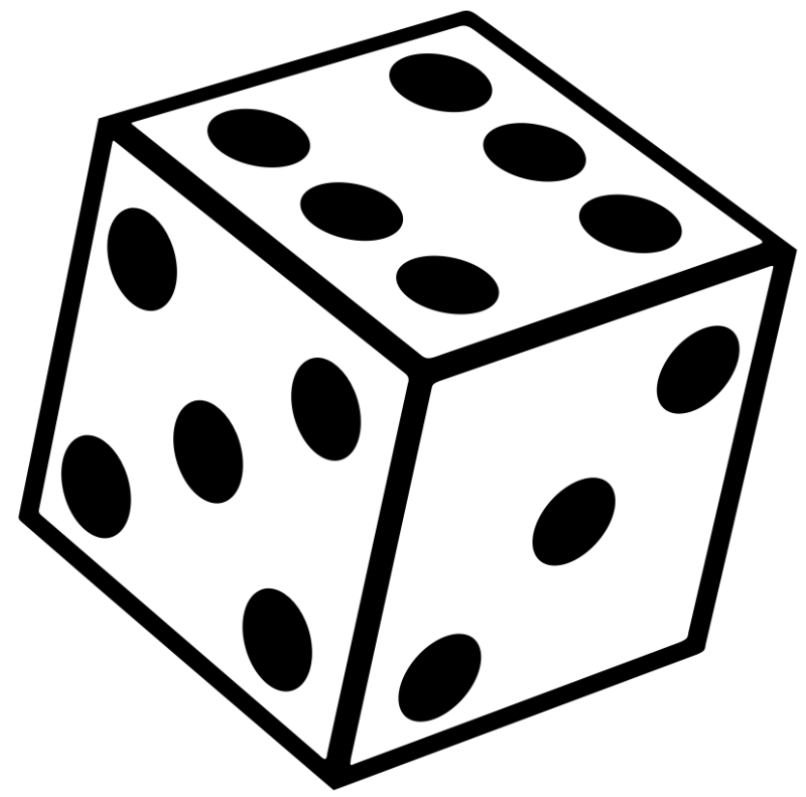


Team Formation Strategy
Criteria-based
Random
Task-focus
Activity Focus
Team-focus
Notes:
2x2 factorial design in two courses. Two factors were formation approach and activity focus. Will describe these in more detail in the next slides.
Repeated in 2 courses (UI Design and Software Engineering), n=304 students in total that incorporated semester long projects and had project deliverables throughout the course of the semester

Slide 8
Team Formation Strategy
Condition 1: Criteria-based
Condition 2: Random
Notes:
Some criteria used were gender, gpa, course skills.
For complete list, see paper
In order to keep students blind to condition, …
https://encrypted-tbn0.gstatic.com/images?q=tbn:ANd9GcRCsrgW3HWEdsyKcPXAKERUSdGJUTj8ry61tV7WB-tHsuVW4flj

Slide 9
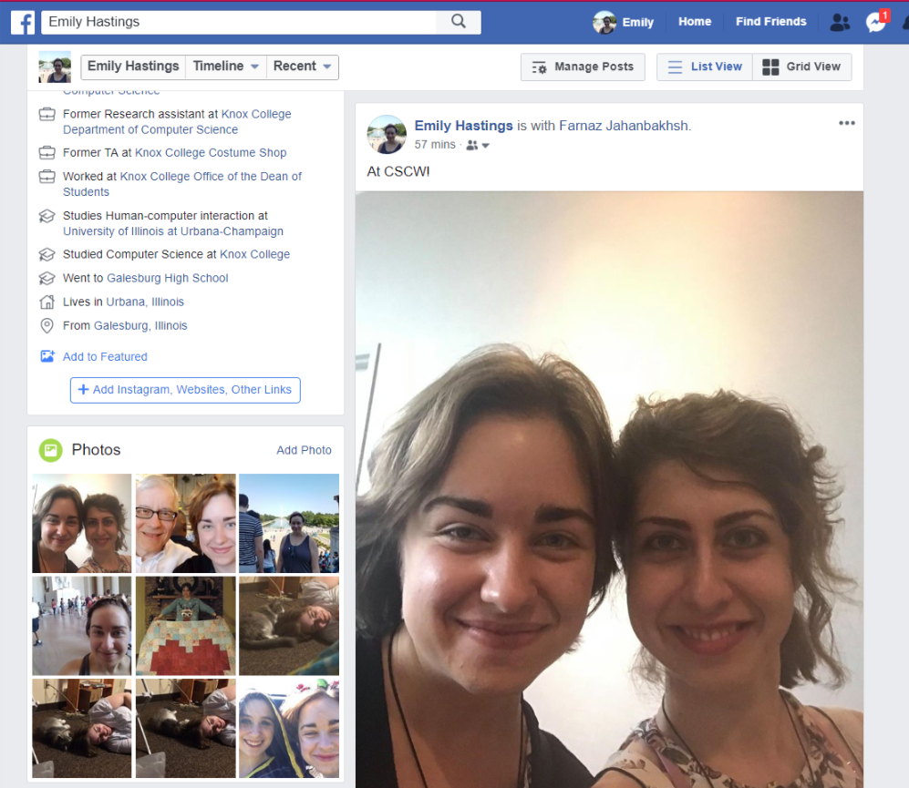

Team Focus Activities
Aimed at nurturing psychological safety within teams
Initial Activity
Midpoint Activity
Notes:
Replace image!!
Activity I (beginning of teamwork): Sharing “About Me” page on social media and three recently posted photos with teammates
The purpose of this activity was to nurture interpersonal relationships, as improved relations have been shown to correlate with feelings of psychological safety within teams. By fostering an initial knowing of teammates and directing one’s focus towards others, we also wanted team members to begin to differentiate their respective behaviors, cognitions, and emotions and build connections with each other
Activity II (midpoint of project): Individual essay describing a few strengths of each of their teammates and a few of their own weaknesses
The purpose was to further nurture interpersonal relations and to foster respectful engagement. This activity is similar to the teamwork intervention in [45], in which teams were asked to discuss how to work well together.
https://www.clipartmax.com/middle/m2i8K9b1G6K9Z5Z5_why-social-media-is-important-for-your-business-social-media-marketing-clip/
http://clipart-library.com/clipart/488681.htm

Slide 10
Task Focus Activities
Emphasized producing an outcome, rather than team relationships
Fellowship of the Designers
4 + 2 = 7
Will Code For Money
Initial Activity
Midpoint Activity
Notes:
Activity I (beginning of teamwork): Brainstorming team names following principles of brainstorming
Activity II (midpoint of project): Individual essay describing how the project could be improved
The task-focused activities were designed to evoke mechanics of collaboration and communication (e.g., generating ideas, defining group processes, and reaching consensus), and emphasized producing an outcome (e.g., team name). In contrast, the team-focused activities were designed to evoke inter-personal communication between the members of a team rather than the mechanics of collaboration. For example, the kinds of interaction between members prompted by brainstorming a team name are much shallower and narrower than those experienced when sharing personal photos and mementos. These interactions are therefore likely to be less effective at building positive regard, and consequently psychological safety [9, 38]
https://mbtskoudsalg.com/images/whiteboard-clipart-4.jpg

Slide 11
Measures
Objective
Subjective
Project Grades
Perceived Performance
Satisfaction with Team Assignment
Psychological Safety (Edmondson 1999)
Conflict (Jehn, Northcraft, & Neale 1999)
Cohesiveness (Carless & De Paola 2000)
Notes:
We had a number of dependent variables….
Wanted to measure effects on these variables/outcomes
Validated instruments incorporated into CATME’s peer evaluation that students were required to fill out
Clarify team vs individual measures

Slide 12
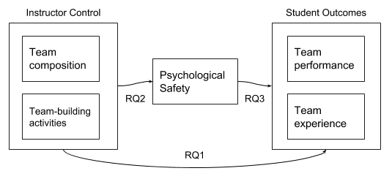
Results
Notes:
Now I’m going to talk about the results. First, to remind you of the research questions, we examined...

Slide 13
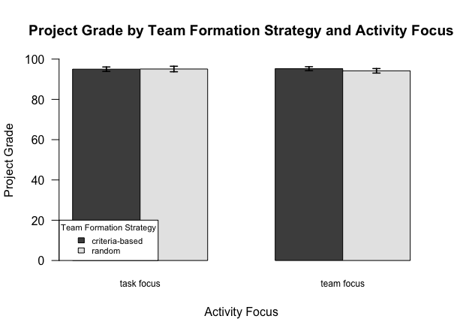
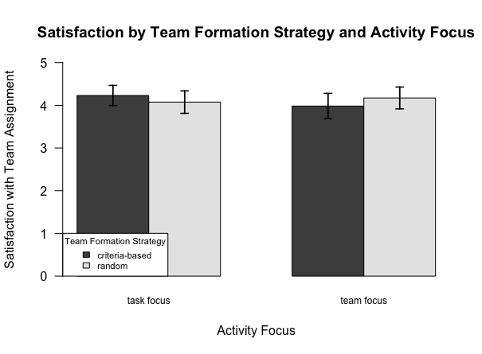
RQ1: Effects of Composition and Activity on Outcomes
Notes:
RQ1
Grades, satisfaction, and perceived performance were high
However, there were no differences by condition and no interaction effects
Which means random teams performed as well as criteria-based teams, which is “not supposed to happen”
New graph showing selection of measures for each condition

Slide 14
Potential Explanations
Expectation Effect
Prior work may not be generalizable to our study context
Using multiple criteria does not necessarily stack benefits
Notes:
5 min left
These are a few of the explanations that we offer for the results. We provide additional explanations in the paper.
The way CATME was described by the instructors of the courses may have given rise to an expectation effect. All teams believed they had been formed with the tool. Therefore, even randomly assigned teams believed themselves to be as capable as those created using the tool. There were quotes from students that support this interpretation.
Another reason for why team composition does not affect outcomes in our study while it does in some prior studies, may have to do with the difference in context. many studies showing that teams with specific compositions outperform teams without those compositions have leveraged in-lab team exercises or simulated classrooms on micro-task platforms; whereas our work leveraged multi-week team projects in an authentic learning environment. For the prior work that has examined authentic courses, it may be the case that the different disciplines, project lengths, or teaching cultures prevent generalization.
It is possible that since some criteria were assigned higher weights (greater importance) in the tool, the algorithm may have satisfied certain criteria for a team at the expense of other criteria.

Slide 15
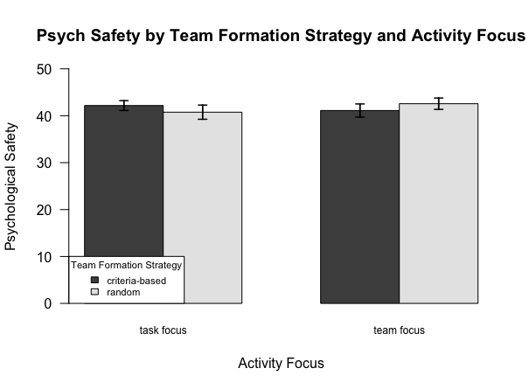
RQ2: Effects of Composition and Activity on Psych. Safety
Notes:
To answer the 2nd question about the effects of our interventions on psych safety
Similarly, it was high, but no differences…
New graph by condition

Slide 16
Potential Explanations
Nature of courses helped psychological safety develop organically
Both activities helped develop interpersonal relationships
Notes:
3 min left
The first explanation we offer for this lack of effect has to do with the nature of courses.
because students in both courses were unfamiliar with their project topics, they may have perceived their teammates as equally inexperienced as they were and felt more willing to ask for help without the fear of appearing incompetent. In addition, both courses required students to submit many team deliverables, which forced them to meet frequently with the course staff and with each other during the course.
Since psych safety was high across conditions both activities may have been equally effective. (Students mentioned that brainstorming activity may have revealed the introductory personal facts such as …???)

Slide 17
RQ3: Relation of Psychological Safety to Outcomes
Correlated with almost all subjective measures
No significant relation to project grades
Potential explanations:
Different context from prior literature (incentive structures, project length, etc.)
Potential for behaviors that negatively influence performance
Notes:
2 min left
RQ3
Almost all-- (satisfaction, perceived perf, cohesiveness, conflict) (not peer evals p=0.02, threshold .01 after correction)
But no relation to grades-- finding contradicts results from Google article
Say nobody did PS on grades?
This difference in results could be due to the difference in context.
Risks: the consequences of risk-taking in student teams are generally less grave than in work teams, where members could be demoted or dismissed if they are perceived as not possessing the required competencies
Negative Behaviors: psych safety may conceivably put team members at ease to display certain behaviors that negatively influence their performance. For instance, team members can choose to perform less than their share of work if they do not fear retribution from teammates.
Prior work has suggested psych safety has the potential to promote negative behaviors.
We identified multiple students who reported high psychological safety but received low peer evaluation scores from their teammates, who cited a lack of contribution and a disregard for the norms of the group.

Slide 18
Implications for Instructors
“Structure or Nurture” may be a false choice.
Should not use team formation tools as black box to increase performance, but for other benefits
Can incorporate activities to offset initial unfamiliarity
Building psychological safety is important for team experience but won’t automatically improve performance
Notes:
1 min
To return to the title question, our data suggests that “structure or nurture” may be a false choice. At least for educational contexts like ours, the answer is neither is really better (and both may have their strengths????)
Other benefits of team formation tools: efficient, fair, and consistent team formation experiences
Initial unfamiliarity esp when teams are formed algorithmically

Slide 19
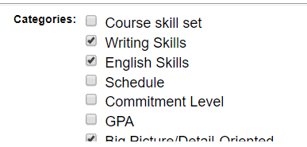

Implications for Tool Designers
Implement configuration templates that link directly with the literature
Searchable knowledge base
...
Notes:
Our results about the possible dangers of stacking criteria also suggest some implications for tool designers
Instructors could benefit from more support when configuring the tool so that they don’t for example they select so many criteria so that the benefits of some are overpowered by others. As shown in the screenshots, CATME makes it easy for instructors to select many criteria (from existing or add own)
This additional support could come in many forms e.g., templates or a knowledge base.

Slide 20
Contributions
Deeper empirical understanding of how algorithmic team formation, team building activities, and psychological safety impact team performance and satisfaction in authentic learning environments
Practical implications for the design and deployment of team formation tools
Contact info:
Emily Hastings (ehstngs2@illinois.edu)
Farnaz Jahanbakhsh (farnazj@mit.edu)
Notes:
In conclusion, this work contributed….

Slide 21
Extra Slides

Slide 22
Additional Analyses
Examining the “goodness” scores given by the tool to randomly assigned teams vs those formed by the tool
Criteria-based teams scored higher on gender (t(34.18)=3.14, p<0.01), commitment levels (t(34.89)=3.45, p<0.01), and skillsets (t(33.18)=4.96, p<0.01)
Random teams had higher variation
Hand examined skillsets

Slide 23
Statistical Analysis
Developing linear mixed effect models of the form: Outcome variable ~ composition * activity focus + (1| class) + (1| team)
Performing a Wald-Chi Square test on the fitted model

Slide 24
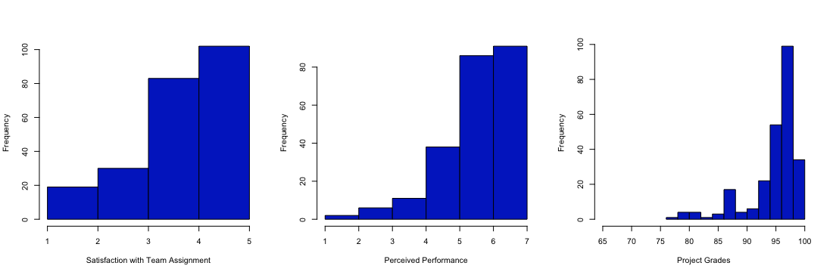
Distributions

Slide 25
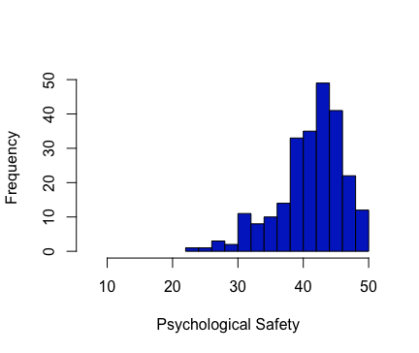
Distributions

