Slide 1

Data Architecture Use Cases
Using a LAMBDA ARCHITECTURE
Using a KAPPA Architecture
Rachael phillips

Slide 2
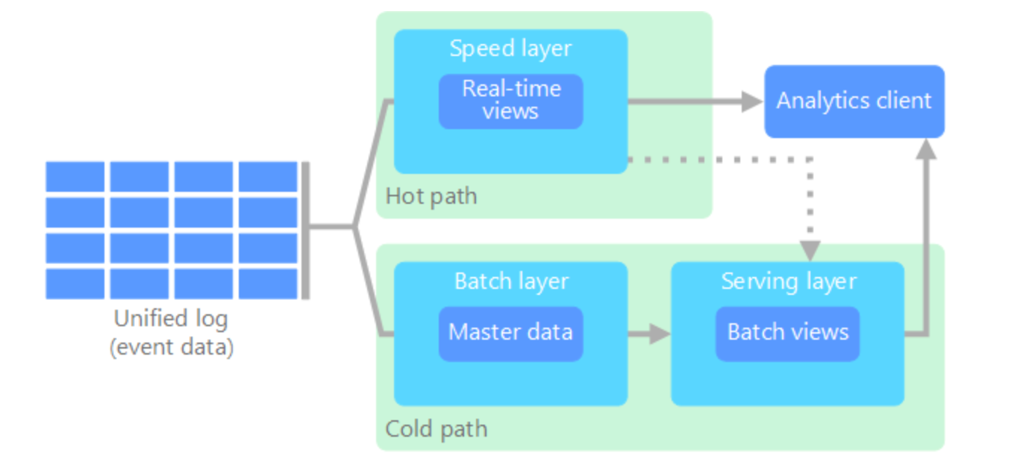
What is a Lambda Architecture?
A lambda architecture that was created by Nathan Marz in order to solve the issue of large data needed to be processed but having too much to process all in real-time. This process creates two paths for data flow, a batch layer and a speed layer.

Slide 3
Methodology of a Lambda Architecture
The batch layer stores the incoming data in its raw form and performs batch processing. It is stored as what is known as a batch view. This layer takes longer and has low latency but is accurate.
The speed layer analyzes real time data. It is designed for low latency, but with the possibility of inaccuracy.
The batch layer then feeds into what is called a serving layer which indexes the batch view. The speed layer updates the serving layer with incremental updates based on the most recent data.
The hot path is constrained by latency requirements imposed by the speed layer, so that it can be processed as quickly as possible, and the cold path does not subject to the same low latency requirements.
Eventually, the two paths converge at the analytics client application. The hot path has data for a relatively short window of time, after which the results can be updated with more accurate data from the cold path. The data in the batch layer is immutable. Incoming data is always appended to the existing data, and the previous data is never overwritten.

Slide 4
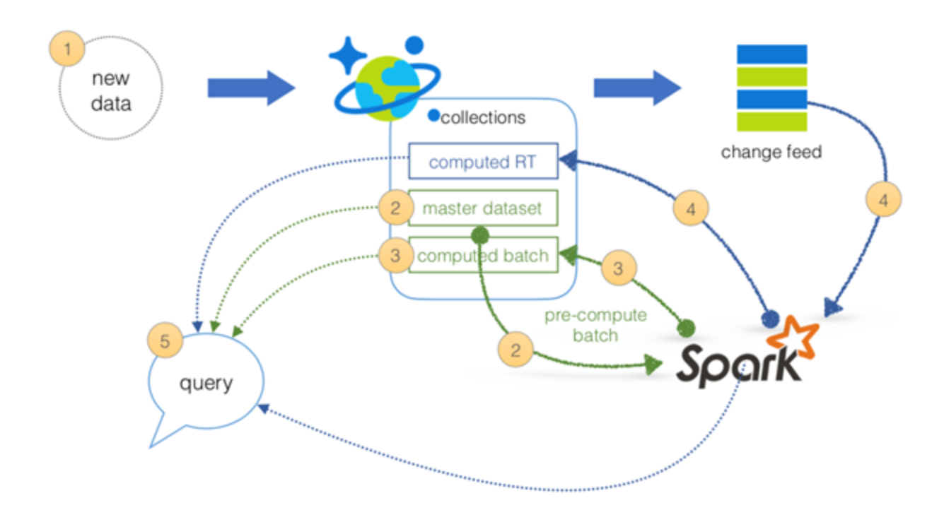
Creating a Lambda Architecture in Azure
The following resources are needed: Azure Cosmos DB, Azure Cosmos DB Change Feed Library, Apache Spark on HDInsight, and the native Spark Connector for Azure Cosmos DB.
Speed layer: Utilize the Azure Cosmos DB change feed support to keep the state for the batch layer while revealing the Azure Cosmos DB change log via the Change Feed API.
Batch and serving layers: Use Azure Cosmos DB for the master dataset (immutable, append-only set of raw data) and use the HDInsight (Apache Spark) to perform the pre-compute functions from the batch layer to the serving layer.
Here is a link to help get you started!

Slide 5
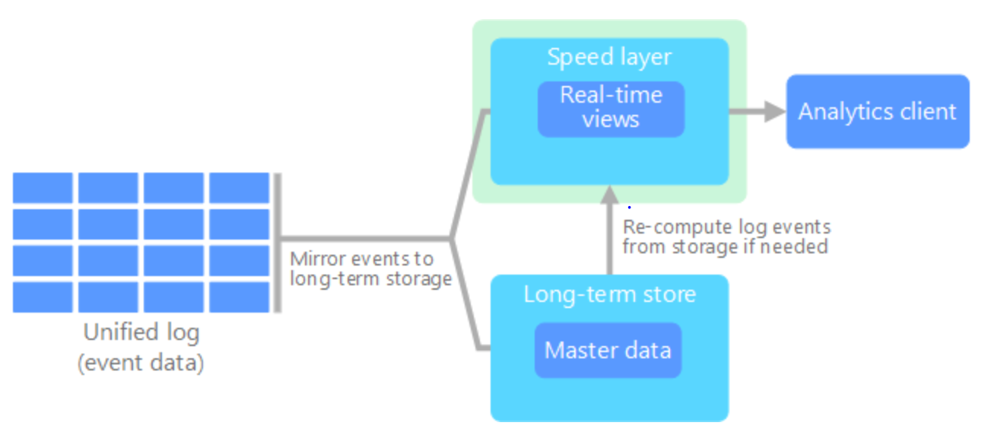
What is a Kappa Architecture?
A kappa architecture is less complex than a lambda architecture and was built as an alternative architecture by Jay Kreps. The main difference between the two is that all data flows in the kappa architecture in a single path, using a stream processing system.

Slide 6
Methodology of a Kappa Architecture
Event data is immutable and all of it is collected, instead of a subset. Data is ingested as a stream of events into a distributed and fault tolerant unified log. The events are ordered, and the current state of an event is changed only by a new event being appended. All event processing is performed on the input stream and persisted as a real-time view.
If a recompute is necessary for this architecture, you simply replay the stream, usually using parallelism to save on time.

