Slide 1



PS-12
Knowledge Representation and Insight Generation from Structured Dataset

Slide 2
UNIQUE IDEA
The UNIQUE IDEA™ was to create an app that would take a dataset as input and then ask the user some questions about the detected columns like the output columns and such.
The program would then apply a set of predefined calculations onto the dataset and generate a lot of graphs. These calculations would have been same for every dataset but with minor changes to suit each one.
Then the report would have been generated by redirecting the graphs onto Chat-GPT and taking the text along with the graphs to be put into placeholders of a sample report that I would make.
This ended up not working out mainly because of my lack of skills and motivation and slightly because I was busy with Summer Semester, Community Connect and a Certification Course.

Slide 3
01.
DATA CLEANING AND PREPROCESSING
02.
EXPLORATORY DATA ANALYSIS (EDA)
03.
FEATURE ENGINEERING
04.
MODEL TRAINING
05.
FEATURES OFFERED
REPORT GENERATION

Slide 4

PROCESS FLOW
Dataset
Code
Insights
Now I had to generate all the insights as code
I firstly generated the insight that i could in an excel workbook
Graphs
Report
Representation
SQL
Matplotlib and Seaborn were used to generate graphs
The thing i struggles the most is report generation. I still think that it is incomplete but I have no clue how to improve it further
I then represented some of the insights that i got in excel
SQL was also used to generate and execute more complex queries that were not possible in Excel

Slide 5
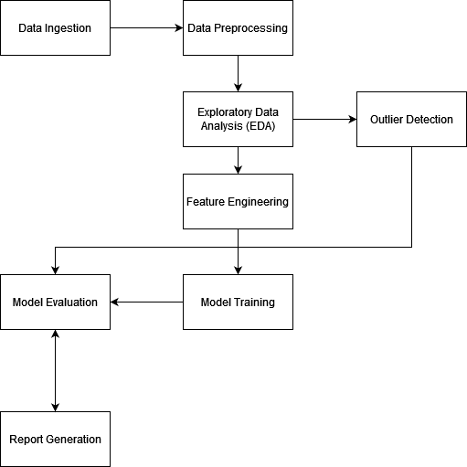
ARCHITECTURE DIAGRAM

Slide 6

TECHNOLOGIES USED:
Python: Core programming language.
pandas: Data manipulation and preprocessing.
zipfile and os: File extraction and management.
matplotlib and seaborn: Data visualization.
numpy: Numerical operations.
scikit-learn: Machine learning model training and evaluation.
Jupyter Notebook: Interactive coding

Slide 7
MEET OUR TEAM
Hi, Its just me here
Anshit Omveer Singh.
I did everything there was to be done. Probably could have done a better job but overall not a bad job for my first try at AI in my opinion.
Some of the text was generated by Chat-GPT (Version 4o)

Slide 8

CONCLUSION
This project provided a comprehensive workflow for handling the adult.data dataset, focusing on data ingestion, preprocessing, exploratory data analysis (EDA), feature engineering, model training, evaluation, and report generation.
This should work with any other dataset with similar information content but I have not tested it.

Slide 9
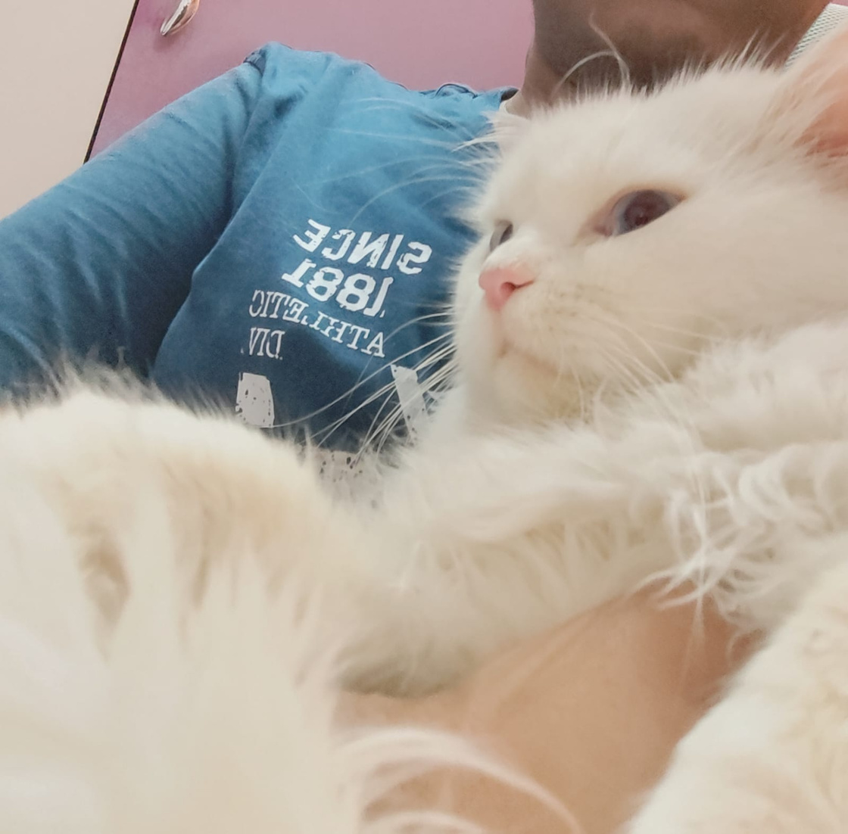
Goodbye and Thank You for your time

