Slide 1
QA IMS-Starter Project
A presentation by Andrew Slator

Slide 2
Contents
Brief
Entity Relationship Diagram
Risk Assessment
Methodology
Code Samples
Retrospective/Insights
Acknowledgements

Slide 3
Brief
We were tasked to create an inventory management system for a store that includes data for customers, items, and orders.
The system should exhibit CRUD (create, read, update, delete) functionality and be able to add items to orders.
We were given a start to the code that included implementation for customers, and had to extrapolate for the additional data from there.

Slide 4
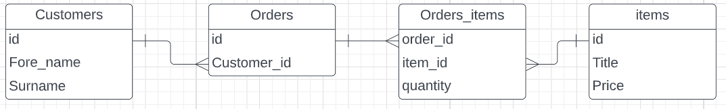
Entity Relationship Diagram
This was the initial draft for the ERD. Additional fields were added later for the orders_items table. This table in particular was added as an intermediary due to the database workbench not being able to process many-to-many relationships.

Slide 5
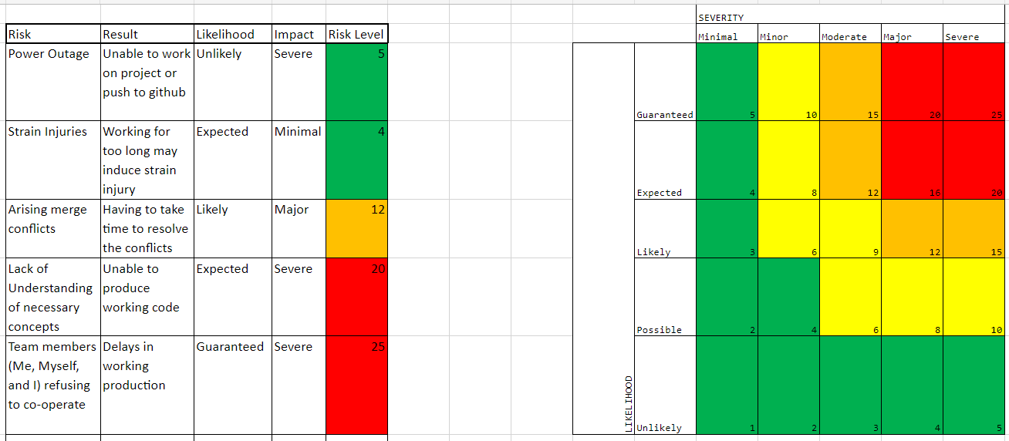
Risk Assessment

Slide 6
Methodology
I started by looking at the provided code and realised quite soon that implementing java code for the item table would be rather simple, as the data there was independent of any other data.
I was able to take inspiration from this to apply to the orders table. From here, to enable functionality with the orders_items table I required a much larger prepared statement with a nested join method.

Slide 7
Code Samples
The next few slides will include samples of code from various areas of the IMS

Slide 8
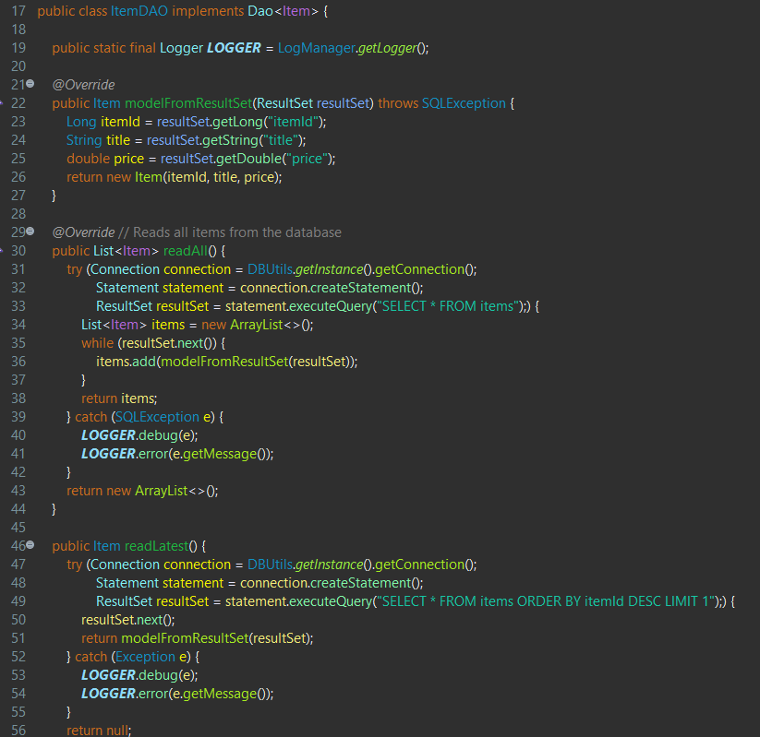
Item Data Access Object
This section of the code includes some of the methods used to interact with the database tables, specifically regarding reading from the items table

Slide 9
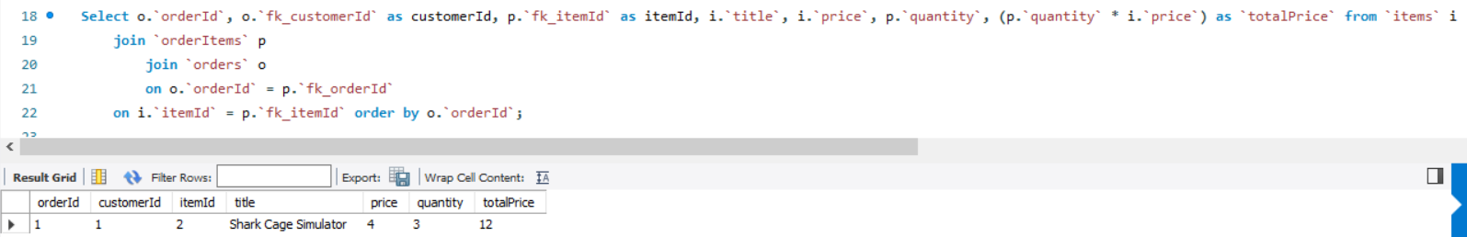
View Order Details
This is the aforementioned statement used to acquire order data from the database. As you can see below it gathers the customer Id, item Id, item title, item price, item quantity, and the total price of items of a particular order.
This statement is used as part of the OrderDAO class to try and print all of these details to the console, however the statement only prints the basic order details (order Id and customer Id). I believe the logic of this statement to be sound, with the issue lying in my java code and implementation there.

Slide 10
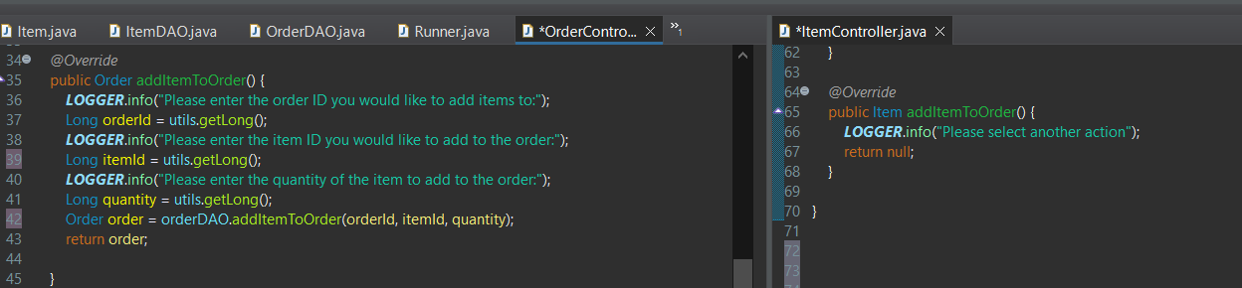
Add Items To Order
These are examples from the domain controller methods, which contain specific console outputs when particular methods from the DAO are selected. The below example demonstrates what happens when the user selects the "ADDITEMS" function. As you can see, there is a reason to add an item to an order, but one cannot add an item to an item, so the console would request the user to choose an alternative method for the item domain. This is an inelegant solution, as I would have preferred to implement specific options being shown for each domain, however this functionality was beyond my current capabilities as a programmer.

Slide 11
Retrospective/Insights
Looking back, I believe this to have been an interesting and fun, albeit frustrating, project. It allowed me to train coding "muscles" that I have not had a great deal using before. It has also allowed me to see some of my personal roadblocks when it comes to working with unfamiliar code, however I have been able to persevere and with assistance I have produced a product that was more complete than when I started.
From the start of the project, I attempted to follow a feature/dev branch model when it came to adjusting my code. Being quite new to this system of work, however, I did not realise my mistake until one of my colleagues pointed me the right way. Of course, attempting to follow the new (correct!) system that I did not previously understand caused me to have merge conflicts that slowed me down quite badly, however I have been able to rectify most of these conflicts to the best of my knowledge.
While the result of this project is far from perfect, I believe it represents a strong start in my coding journey, as I continue to train skills I am merely beginning to discover.

Slide 12
Acknowledgements
Ed Reynolds – Training in SQL, java testing, and the ever appropriately named Git.
Jordan Harrison – Training in java basics.
Jack [REDACTED] - A friend with some java experience who helped solidify concepts outside of training hours.
Dan Harrison – Fellow trainee who has assisted with advice and insight where available (although all the code produced was my own, promise!)

