Slide 1

Mini-Project
TCP Chat Application
Prepared By:
Ahmad Srour 5352
Ahmad Said 5613
Supervised by:
Dr. Mohamad Aoude

Slide 2
Table of content
Network Programming
01
Server-Client Model
Peer-to-Peer Model
02
Server Sockets
Creation / waiting / stream / send - receive
03
Client Socket
Establish a connection to the server
04
Simulation In Eclipse

Slide 3
Network Programming
Server-Client Model
Peer-to-Peer Model

Slide 4
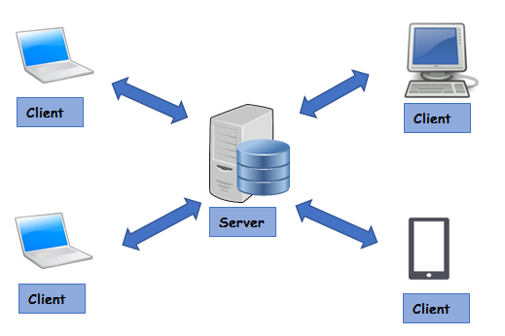
Client-Server Model
Server:
Always-on host
Permanent IP address
Data centers for scaling
Clients:
Communicate with server
May have dynamic ip address
Do not communicate with each other
Client-Server Model

Slide 5
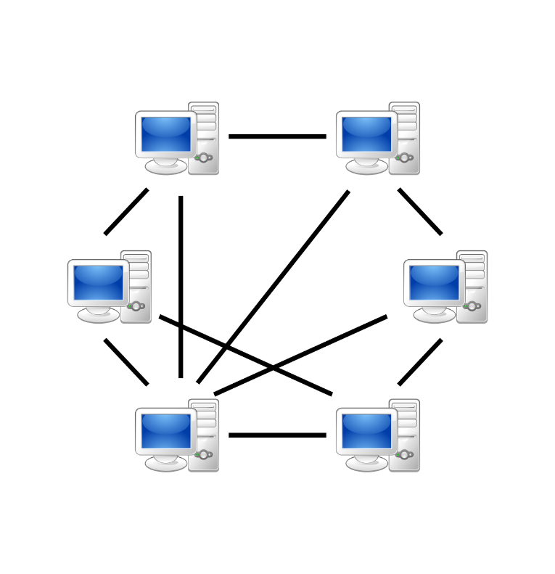
P2P Model
Characteristics of P2P model
no always-on server
arbitrary end sytem directly communicate
peers request service from other peers, provide service in return to other peer
Peer-to-peer model

Slide 6
Server Socket
Creation / waiting / stream / send - receive

Slide 7
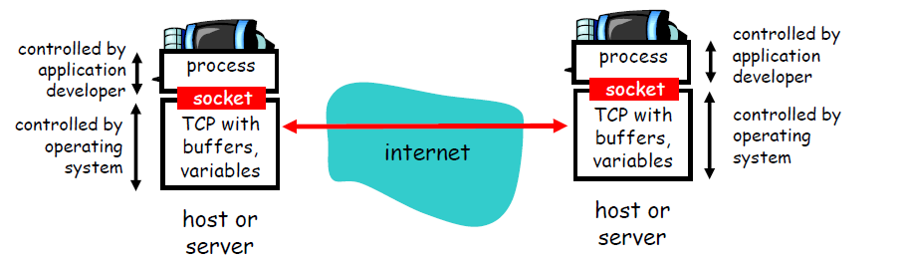
Network Socket
Process sends/receives messages to/from its socket
Socket analogous to door

Slide 8
Server Socket
Creation
ServerSocketserverSocket= new ServerSocket(1234);
Waiting State
Socket link = serverSock.accept();
Set up input/output stream
Scanner input= new Scanner(link.getlnputStream());
PrintWriter output = new PrintWriter(link.getOutputStream(),true);
Send and receive data
output.println("Awaiting data…");
String input = input.nextLine();

Slide 9
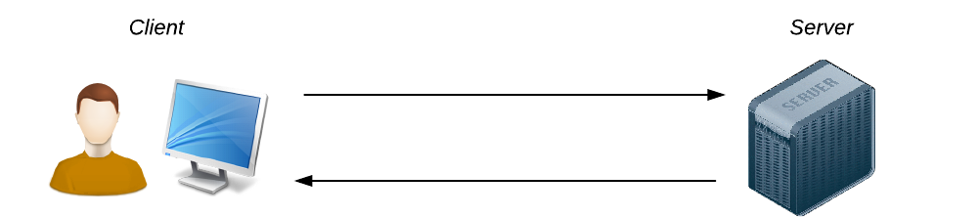
Client Socket
Establish a connection to the server
Socket link = new Socket(InetAddress.getLocalHost(),1234);
Set up input/output stream
Same as above
Send and receive data
Same as above

Slide 10
Simulation results
Run Java Project in Eclipse

Slide 11
THANK YOU

