Slide 1
Aspect Category Sentiment Analysis for Online Restaurant Review in Chinese
Group Name: 2023-Keith-4
Group members: Wong Ping Kuen (13031493)
Yeung Ho Yin Tommy (13024570)
Li Chi Fung (13031837)
Jon Rai (12749417)
Supervisor: Dr. Keith Lee

Slide 2
Introduction
Popular Restaurant review websites E.g. OpenRice, KeeTa
Provide review and rating
The users can share their experience in several aspects:
E.g. the food quality, service, price etc.
Feedback/Comments towards to restaurant
But reading the meaningful restaurant's comments always time-consuming.

Slide 3
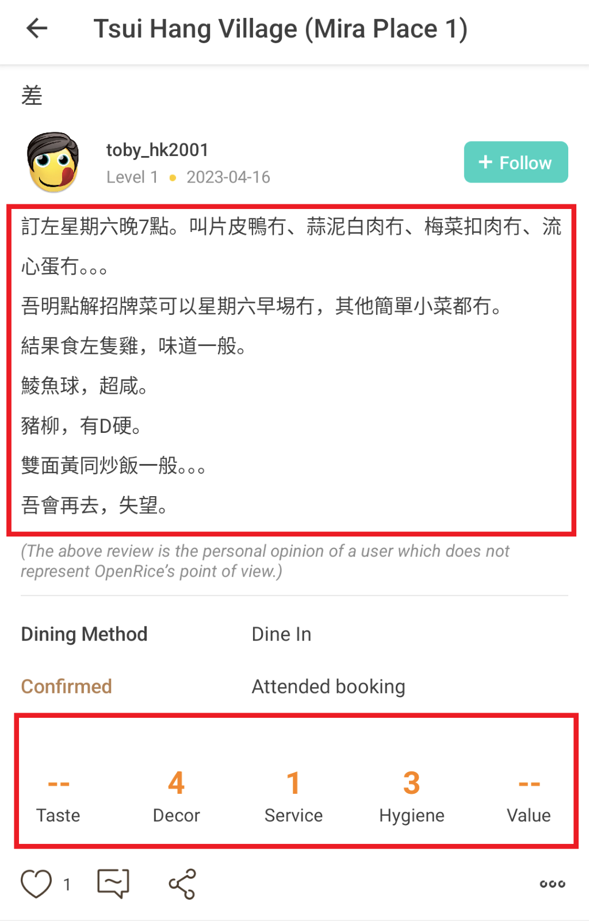
Introduction (Cont.)
These website provided rating function
Rate in each aspect
Some user only look at the restaurant score
Some rating are inaccurate
In Screenshot,
Customer commented the food quality (taste) was bad
But didn't not provide rating score for Taste
Only provides the score of Decor, Service, Hygiene.
Screenshot: Screen capture from OpenRice

Slide 4
Introduction (Cont.)
Aspect-Category Sentiment Analysis (ACSA)
Natural Language Processing (NLP)
In positive, negative, and neutral
ACSA research in Chinese
Lack of resources

Slide 5
Project Aims
Develop a tool Restaurant Review Analyzer for Chinese Language
Analyze the Chinese review for Hong Kong restaurant
Assign scores for each aspect
Two type of users:
Restaurant owners
Restaurant's Customers

Slide 6
Value Preposition
For restaurant owner's:
Business improvement
For restaurant's review website users:
Accurate score
Compared both score
For innovation:
contribute towards to ACSA research in Chinese

Slide 7
Project Objectives
Objective #1: Collect Chinese datasets from HK restaurant review website
Objective #2: Data Cleansing
Objective #3: Adapt existing models for English to handle Chinese dataset
Objective #4: Train models with collected dataset
Objective #5: Develop a prototype web dashboard for showing the about result
Objective #6: Evaluate the system by user satisfaction survey

Slide 8
Literature Review
Aspect-Category Sentiment Analysis (ACSA) | Aspect-Based Sentiment Analysis (ABSA)
Aspect category detection Aspect predefine by dataset Predict the aspects in coarse-grained E.g. food quality, service, environment | Aspect extraction Model define aspect Predict the aspects in fine-grained E.g. pasta, pizza, chicken wing
Both predict the sentiment polarity from text

Slide 9
Literature Review (Cont.)
Aspect-aware graph convolutional network (AAGCN)
Handle ACSA
GloVe and Bert
Limitation:
Not supported Chinese dataset
Syntactic and Semantic Enhanced Graph Convolutional Network (SSEGCN)
Handle ABSA
BiLSTM and Bert
Limitation:
Not supported Chinese dataset

Slide 10
Literature Review (Cont.) Existing Solution 1
Aspect-aware graph convolutional network (AAGCN)
Performance in Rest16 dataset: GloVe (Word embedding): Accuracy: 88.32 F1: 72.55 Bert (Pretrain): Accuracy: 92.83 F1: 80.77 | Performance in MAMS dataset: GloVe (Word embedding): Accuracy: 77.52 F1: 76.89 Bert (Pretrain): Accuracy: 81.93 F1: 81.36

Slide 11
Literature Review (Cont.) Existing Solution 2
Syntactic and Semantic Enhanced Graph Convolutional Network (SSEGCN)
Performance in Restaurant dataset: BiLSTM (Neural Network): Accuracy: 84.72 F1: 78.08 Bert (Pretrain): Accuracy: 87.31 F1: 81.09

Slide 12
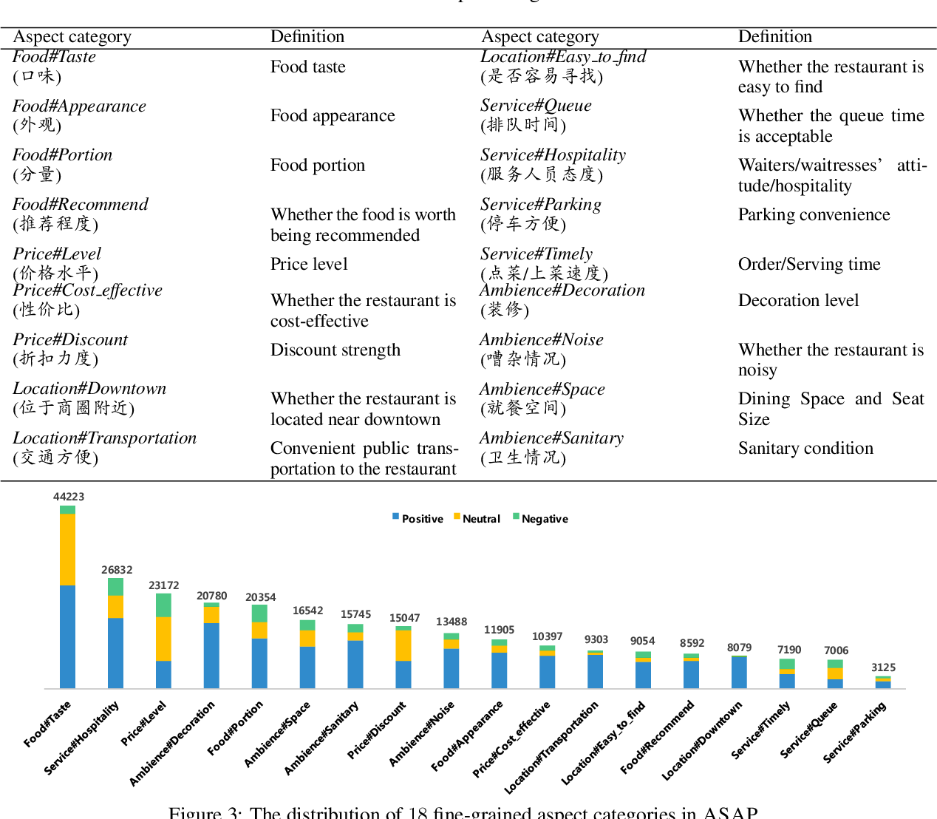
Literature Review (Cont.)
Existing Chinese datasets
Aspect category Sentiment Analysis and rating Prediction (ASAP)
A Large-scale Chinese Restaurant review dataset
For training ACSA model
Limitation:
Only support Simplified Chinese

Slide 13
Preliminary Methodology
Use the Python module BeautifulSoup to scrape the review data in HK restaurant review websites, E.g. OpenRice
Cleansing the data for construct Chinese datasets
Modify the AAGCN model for adapt the Chinese dataset
Train and evaluate the model accuracy and F1 score
Until satisfy the requirement e.g. accuracy 90 and F1 80

Slide 14
Preliminary Methodology
Construct a user interface (web dashboard) using python module Flask framework
Show analyzed results in pie charts, tables
Make a function to generate a statistic report
In csv file format
Use Google form to collect the users' opinions about the system
For latter improvement

Slide 15
Reference
Liang, B., Su, H., Yin, R., Gui, L., Yang, M., Zhao, Q., Yu, X., & Xu, R. (2022). Beta Distribution Guided Aspect-Aware Graph for Aspect Category Sentiment Analysis with Affective Knowledge. Proceedings of the 2021 Conference on Empirical Methods in Natural Language Processing, 4916–4925.
Zhang, Z., Zhou, Z., & Wang, Y. (2022). SSEGCN: Syntactic and Semantic Enhanced Graph Convolutional Network for Aspect-Based Sentiment Analysis. Proceedings of the 2022 Conference of the North American Chapter of the Association for Computational Linguistics: Human Language Technologies, 4916–4925.
Bu, J., Ren, L., Zheng, S., Yang, Y., Wang, J., Zhang, F., & Wu, W. (2021). ASAP: A Chinese Review Dataset Towards Aspect Category Sentiment Analysis and Rating Prediction. Proceedings of the 2021 Conference of the North American Chapter of the Association for Computational Linguistics: Human Language Technologies, 2069–2079.
Trisna, K. W., & Jie, H. J. (2022). Deep Learning Approach for Aspect-Based Sentiment Classification: A Comparative Review. Applied Artificial Intelligence, 36(1).
Zvornicanin, E. (2023, June 8). Differences Between Bidirectional and Unidirectional LSTM. Retrieved from Baeldung: https://www.baeldung.com/cs/bidirectional-vs-unidirectional-lstm#:~:text=Bidirectional%20LSTM%20(BiLSTM)%20is%20a,utilizing%20information%20from%20both%20sides.
Defferrard, M., Bresson, X., & Vandergheynst, P. (2016). Convolutional Neural Networks on Graphs with Fast Localized Spectral Filtering. Proceedings of the 2021 Conference on Empirical Methods in Natural Language Processing. ArXiv. /abs/1606.09375
Arya. (2018, October 22). 如何理解fine-grained和coarse-grained？. Retrieved from zhihu: https://www.zhihu.com/question/299171510/answer/515820188

Slide 16
Q&A

