Slide 1

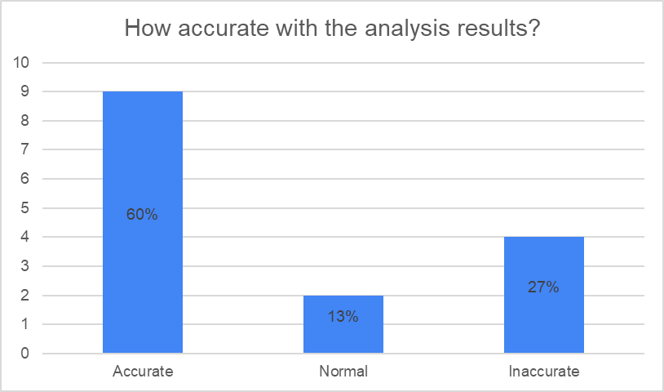
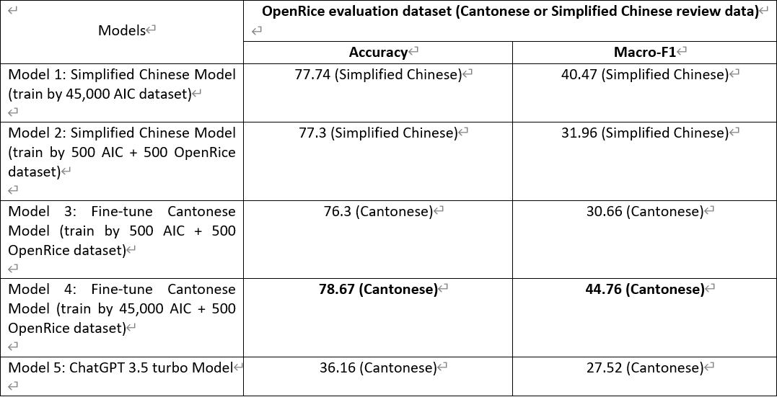
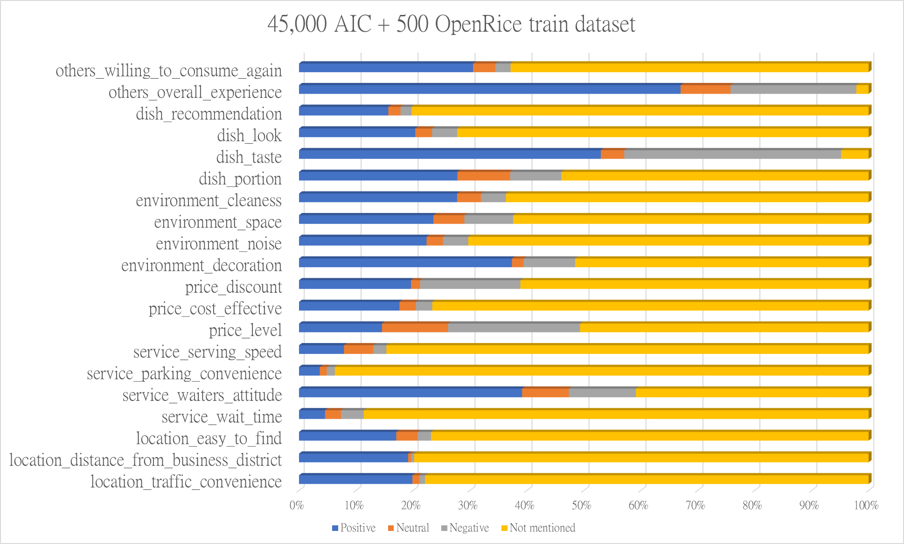
Aspect-Based Sentiment Analysis for Online Restaurant Review in Chinese
Yeung Ho Yin Tommy, Wong Ping Kuen, LI Chi Fung, Jon Rai
Abstract
Results
Aspect-Based Sentiment Analysis (ABSA) is one of the popular types of research in deep learning. It focuses on categorizing the aspects and predicting its sentiment polarity from the input. However, the ABSA research usually focused on English or Mandarin (Simplified Chinese). Further, we found that collecting opinions from restaurant review websites is time-consuming. In this report, we create a web application to analyze Chinese (Cantonese) restaurant reviews based on ABSA research. This application aims to save time collecting opinions from restaurant review websites, obtain more accurate analyzed review results, and also, to handle the lack of ABSA research in Cantonese. We labelled Cantonese restaurant review datasets for the model training and evaluation to create Cantonese Models. Also, we collected some Simplified Chinese datasets and applied the Microsoft Bing Translator to translate the Simplified Chinese datasets to Cantonese (Traditional Chinese). Then, we used the test dataset we created to evaluate the performance with 4 models and ChatGPT 3.5 turbo model for choose which model to be used to deploy the trained ABSA model for analyze the OpenRice Chinese restaurant review. Lastly, we designed the user satisfaction survey to obtain the opinions from 15 test users for web application improvement.
We compared 5 Models by the OpenRice evaluation dataset, as the result shown in Table 1. For model 4, it is the best model to handle the Cantonese restaurant review that its accuracy, and macro-F1 score of 78.67% and 44.76%. Therefore, we decided to deploy this model to our application to handle the problem of Aspect-Based Sentiment Analysis in Cantonese. According to the survey results, Figure 2 60% of respondents stated that our system provided accurate analysis results.
Figure 2. survey result
Table 1: The experimental results with our OpenRice evaluation dataset.
Introduction
As the internet is becoming more a part of our life, an increasing population are using the internet to collect and generate content, therefore various websites appeared that are close to our lives such as restaurant review websites (E.g. OpenRice). Many people appreciate sharing their experience in the restaurant in several aspects on these websites about the food quality, service, price etc. Therefore, restaurant customers could read the reviews and rating scores to look for suitable restaurants. Furthermore, restaurant owners could easily collect opinions from the clients for improving their restaurant. However, we found that most of the meaningful comments are always time-consuming to read. Moreover, we found that some of the review-mentioned aspects are not reflected in the rating. Furthermore, Aspect-Based Sentiment Analysis (ABSA) is popular research in natural language processing in Artificial Intelligence (AI), its aims to categorize the aspects from the given input and predicting its polarity in positive, negative, and neutral (Zhang et al., 2022). But we found that most of the ABSA research lacks of Chinese (Cantonese) resources. Therefore, a tool for summarizing the polarity of each aspect from the customer’s review text is especially important.
Figure 1. Statistic of training dataset
Discussion
Although model 4 has the highest performance in our experiment result, its performance is not ideal since the Macro-F1 score is lower than 50%, so it still needs to improve its performance in Cantonese reviews. According to our investigation, we found that some of the labels within the "45,000 AIC + 500 OpenRice dataset" are less. Moreover, in figure 1, most of the aspects’ provided very few neutral and negative labels. So this will significantly affect the multiplicity of the dataset, and that will affect the model performance. In Figure 2, 27% of the users think the web application is inaccurate. To solve the limitations, future work should mainly focus on enhancing the model’s performance. The extension for the training dataset may be a good direction to enhance the model’s performance in handling Cantonese reviews. Moreover, it may consider supporting the multi-models within an application to handle different language reviews such as English and Simplified Chinese.
Methods and Materials
By creating a web application, “Restaurant Review Analyzer for Chinese Language” (RRACL) is a web application that provides visualized output like statistic charts. Users can use RRACL to search for a restaurant's score that has been analyzed by using natural language processing technology, by using the controller to retrieve the review of the restaurant from the OpenRice platform, then the model will handle the retrieved review by analyzing the comments and generate overall polarities of restaurant’s overall performance and aspect. This web application deployed the AI Challenger model (JohanyCheung, 2018) that directly supports the Cantonese dataset. Furthermore, we have collected, cleansed, and labelled 1500 Cantonese restaurant reviews from OpenRice manually, also, collected the AI Challenger Sentiment Analysis Training set 2018 from the internet and we found 2 methods to translate the data from Simplified Chinese to Cantonese. To evaluate the model performance, we used the created Cantonese restaurant dataset to evaluate our model’s performance, also, applied the prompt technique to obtain the Cantonese restaurant dataset’s classified and labelled results from the ChatGPT 3.5 model, to evaluate its performance in handle ABSA task with a Cantonese restaurant review. Furthermore, we created a user satisfaction survey to obtain user feedback to improve the user experience of our web application.
Conclusions
In conclusion, this report presents an application, named “Restaurant Review Analyzer for Chinese Language (RRACL)” which aims to help restaurant owners to better collect opinions from customer(s), also, provide a way for the restaurant customers to see more accurate rating of the restaurant. The RRACL provided the functionality to analyze the Cantonese restaurant reviews that are obtained from OpenRice, it predicted result will show on the graphical user interface with the statistic charts. This tool deployed the Cantonese Aspect-Based Sentiment Analysis (ABSA) model that is used to predict the sentiments for restaurant reviews in each aspect. The objectives of this report have been achieved which are the Cantonese dataset creation, model adaptation, model training and evaluation, web application development and model deployment, and collect opinions by user satisfaction survey.
Contact
References
Name: Yeung Ho Yin Tommy, Wong Ping Kuen, LI Chi Fung, Jon Rai
Organization: Hong Kong Metropolitan University
Email: s1302457@live.hkmu.edu.hk, s1303149@live.hkmu.edu.hk, s1303183@live.hkmu.edu.hk, s 1274941@live.hkmu.edu.hk
Zhang, Z., Zhou, Z., & Wang, Y. (2022). SSEGCN: Syntactic and Semantic Enhanced Graph Convolutional Network for Aspect-based Sentiment Analysis. Proceedings of the 2022 Conference of the North American Chapter of the Association for Computational Linguistics: Human Language Technologies, 4916–4925. doi:http://dx.doi.org/10.18653/v1/2022.naacl-main.362
Czakon, J. (2023, September 5). F1 Score vs ROC AUC vs Accuracy vs PR AUC: Which Evaluation Metric Should You Choose? (Neptune Labs) Retrieved November 1, 2023, from neptune.ai: https://neptune.ai/blog/f1-score-accuracy-roc-auc-pr-auc
Defferrard, M., Bresson, X., & Vandergheynst, P. (2016). Convolutional Neural Networks on Graphs with Fast Localized Spectral Filtering. 30th Conference on Neural Information Processing Systems (NIPS 2016), 29, 3844-3852. Retrieved from https://proceedings.neurips.cc/paper_files/paper/2016/file/04df4d434d481c5bb723be1b6df1ee65-Paper.pdf
JohanyCheung. (2018, November 29). AI Challenger 细粒度用户评论情感分析. Retrieved from GitHub: https://github.com/JohanyCheung/fsauor/tree/master

