Slide 1


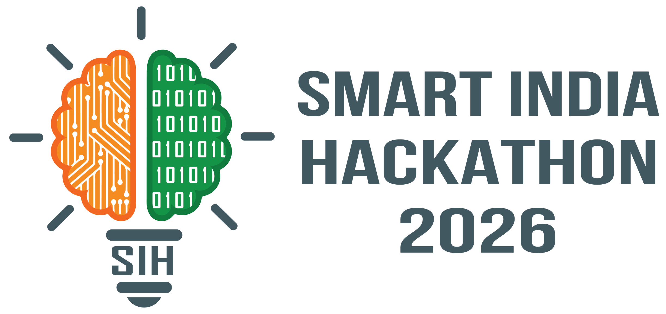

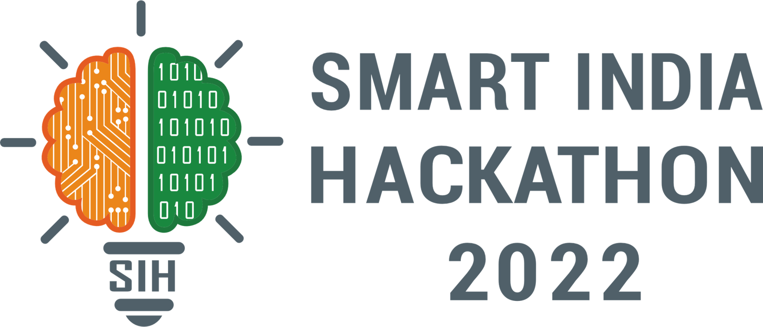
SMART INDIA HACKATHON 2026
AI-Driven Scheme Matching for Marginalized Entrepreneurs
Problem Statement ID – SIH26092
Problem Statement Title-
AI-Driven Scheme Matching for Marginalized Entrepreneurs
Theme- Smart Automation
PS Category- Software
Team ID-
Team Name (Registered on portal) DataDrift

Slide 2
IDEA TITLE
One Platform. One Personalized Financial Path.
PROPOSED SOLUTION
THE PROBLEM
Fragmented access: Beneficiaries must navigate multiple schemes, eligibility criteria and channel partners.
Poor decision support: It is difficult to determine the most suitable financial option and its affordability.
Application friction: Document requirements and partner selection can create delays, errors and repeated visits.
OUR SOLUTION
One personalized platform that matches beneficiaries with suitable loans, subsidies and scholarships.
Supports the journey from scheme selection → financial planning → document readiness → partner selection.
Connects beneficiaries with suitable SCAs / Banks / NBFC-MFIs for application.
WHY OUR SOLUTION IS BETTER
Beyond discovery: recommends the most suitable path, not just available schemes.
Decision before application: comparison, affordability and What-If analysis help users evaluate options first.
End-to-end guidance: Need → Scheme → Plan → Documents → Partner → Application.
Bottom USP.From finding a scheme to finding the right financial path.
@SIH Idea submission- Template
2
Notes:
2

Slide 3
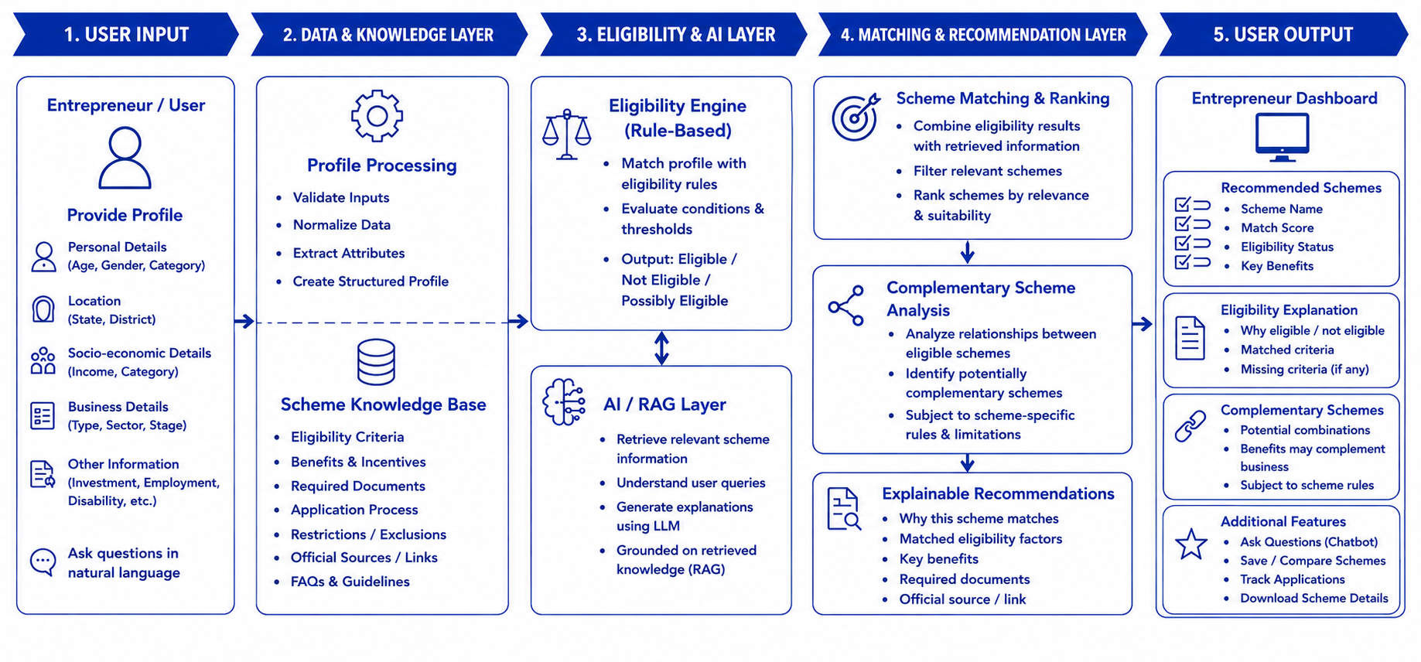
TECHNICAL APPROACH
@SIH Idea submission- Template
3
Notes:
3

Slide 4
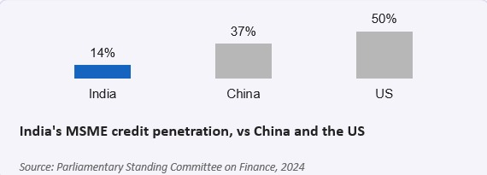
FEASIBILITY AND VIABILITY
Analysis of the feasibility of the idea
₹ 30 lakh crore
Income (less than 5L) and project cost decide the scheme- simple rule-based logic,not heavy AI.
Addressable MSME credit gap in India -24% of total credit demant unmet
The partner locator needs only a Maps API layered on the existing 100+ channel Partner directory.
35% vs 20%
Potential challenges and risk
Credit gap for women-led MSMEs vs male-led MSMEs - the widest demographic gap on record
Channel Partners dont publish live NPA or overdue status ,so a partner’s standing on file can go stale.
Micro,Term and Education schemes overlap in purpose-a wrong cost estimate misroutes applicants.
India’s MSME credit penetration ,vs China and the US
Strategies for overcoming these challenges
Sign monthly eligibility and NPA data-sharing agreements directly with SCAs ,PSBs,RRBs,and NBFC-MFIs.
35%
A one-screen confirmation of why a scheme fits - income,cost,purpose-catches errors early.
Micro-enterprices still unregistered/informal,citing low awarness of schemes as a key reason
@SIH Idea submission- Template
4
Notes:
4

Slide 5

IMPACT AND BENEFITS
WITH OUR SYSTEM
GOVERNANCE & POLICY INTELLIGENCE
Enter profile once, get matched everywhere
Automatic, plain-language eligibility analysis
Personalized, ranked scheme recommendations
Discover potentially complementary schemes
Strategic government value
Policy & governance insights
Government decision support
System-level governance benefits
Policy intelligence & oversight
EXPECTED IMPACT
Higher utilization of government schemes
Boost in entrepreneurship & MSME growth
Employment generation
Inclusive and sustainable economic growth
scalable support model across states, languages & sectors
@SIH Idea submission- Template
5
Notes:
5

Slide 6
RESEARCH AND REFERENCES
EXISTING GOVERNMENT ECOSYSTEM
Key Statistics & References
59.09 crore PMJDY beneficiaries/accounts, showing the huge potential user base for financial-service platforms.
₹3.17 lakh crore in PMJDY deposits, highlighting the scale of India's formal financial ecosystem.
11,556 education-loan subsidy claims in Andhra Pradesh, with about ₹31.85 crore in subsidy disbursement.
Key References
PM Jan-Dhan Yojana – Official Statistics
myScheme – Government Schemes Portal
National Scholarship Portal
PM-Vidyalaxmi
JanSamarth
RBI Statistics
These statistics demonstrate the large beneficiary base and significant financial support available, while existing portals show that scheme discovery and applications are fragmented—supporting the need for your proposed one-stop personalized platform.
myScheme
for discovering government schemes
DBT Bharat
Tracks implementation of Direct Benefit Transfer schemes
India.gov.in
Central portal providing government scheme information
data.gov.in
Government datasets and open data
https://nsfdc.nic.in/
https://nsfdc.nic.in/faqs
@SIH Idea submission- Template
6
Notes:
6

